Slide 1
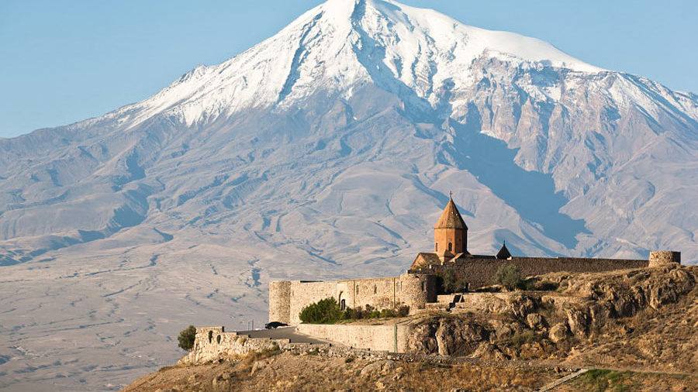
Bible Geography
February 23, 2023

Slide 2
Map showing area of recent Turkey/Syria earthquake
From United States Geological Survey

Slide 3
Turkey/Syrian area noted for earthquakes
https://www.newsweek.com/

Slide 4
https://abcnews.go.com/

Slide 5
Jacob’s well as noted in John 4
https://bibleatlas.org/

Slide 6
Another view of Sychar

Slide 7
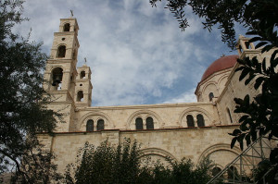
Jacob’s well is inside the St. Photina Basilica
https://www.seetheholyland.net/

Slide 8
Mesopotamia
https://www.thoughtco.com/

Slide 9
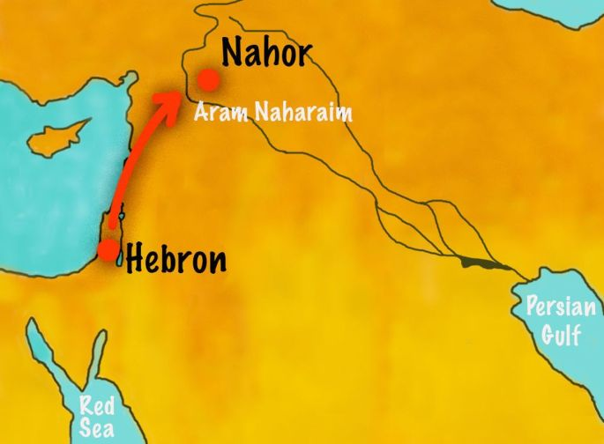
Mesopotamia- 8xs in Bible
Genesis 24:10
Deuteronomy 23:4
Judges 3:8,10
Acts 2:9
Acts 7:2
https://samuelashwood.wordpress.com/

Slide 10
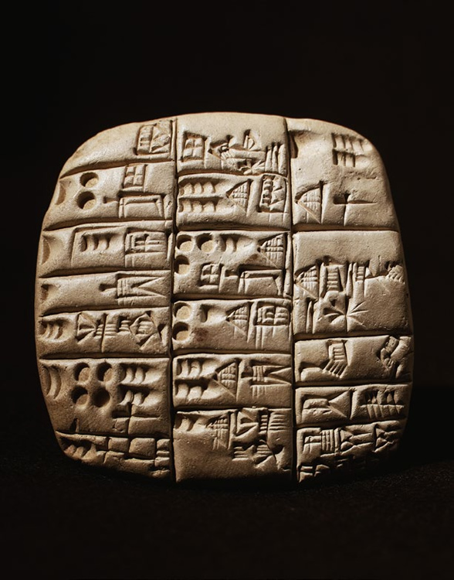
Mesopotamia
https://sciencing.com/
https://www.khanacademy.org/

Slide 11
Land of the Hittites
https://study.com/

Slide 12
Hieroglyphs discovered in tunnel at Hattusa, capital of the Hittites
https://arkeonews.net/

Slide 13
Hittites were warriors and had vast amount of chariots
https://www.nationalgeographic.co.uk/

Slide 14
More ancient reminders of the Hittites
https://www.ancientpages.com/

