Slide 1


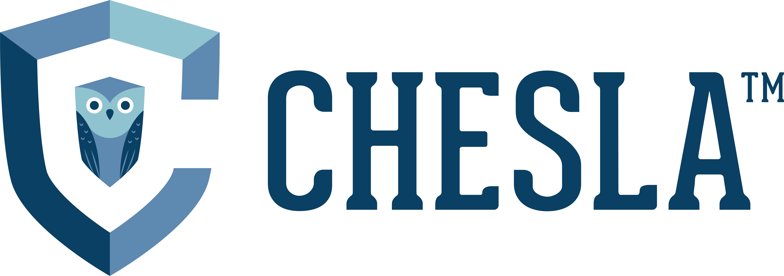
Latest Federal Student Loan Repayment Update
* See slide notes for page directions
Notes:
When listing all project collaborators, either use commas or bullets

Slide 2

Current and future student loan repayment plans
Notes:
Insert a map of your colony (draw it, ink it, or create it in PPT- be creative!)
Insert -> Pictures for photos
Draw for digital inking
Insert -> Shapes if you want to create it in PPT
All mountains, towns/villages, bodies of water/waterways, landmarks, etc. should be clearly labeled

Slide 3
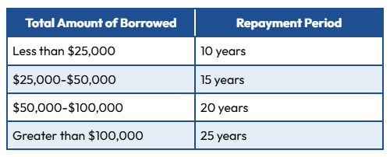
Standard, Income Contingent, PAYE, Income Based Repayment Plan – these repayment plans have qualifying payments for PSLF
Extended and Graduated Repayment Plans – payments in these plans do not qualify for PSLF
By July 1, 2028 or sooner the Department will phase out – PAYE, ICR, and SAVE
Loans disbursed before July 1, 2026 will be eligible for the Standard, Income Based, Graduated, Extended and Repayment Assistance Repayment Plans
Any loans disbursed after July 1, 2026 will only have the RAP (Repayment Assistance Plan) and the Standard Repayment Plan
RAP will not be operational until next year
RAP payments will qualify for PSLF

Slide 4
What you should be doing right now?
Are you currently enrolled in the SAVE Program?
How do I find a new student loan repayment plan?
Do you have a Federal Parent Plus Loan currently in repayment?
If you are, interest accrual will begin on August 1, 2025
You need to find a new repayment plan
You can stay in forbearance but by doing so, it will be costly as interest will be accruing
Tidbit: 7.7 million borrowers in the SAVE program
The best way to compare repayment plans is by using Loan Simulator. You can use this tool to estimate your monthly payments on different plans and compare plans side by side.
https://studentaid.gov/loan-simulator
Tidbit: SAVE was based on 5% and IBR is based on 10% or 15%
You want to visit https://studentaid.gov/loan-consolidation
Consolidate these loans into a Direct Consolidation Loan so you can qualify for an Income Based Repayment Plan
Hard deadline is July 1, 2026
Notes:
Think about the questions listed above and answer them.
Can you think of anything else in regards to economy and trade that you would like to add?

Slide 5
Better Alternatives to Forbearance
Definition: Forbearance is also a temporary suspension of loan payments, but interest continues to accrue on all types of loans during this period.
Eligibility: Forbearance can be granted for various reasons, including financial difficulties or medical expenses. Unlike deferment, you do not need to meet specific qualifying events to apply for forbearance.
Impact on Interest: Since interest accrues during forbearance, any unpaid interest may be capitalized (added to your principal balance) at the end of the forbearance period, increasing the total cost of your loan
It should only be used for short-term hardship, since repeated or extended forbearance can increase your loan balance.
Starting July 1, 2027, new federal borrowers will face stricter limits, capping forbearance at 9 months in any 24-month period.
If you need a more sustainable plan, explore these options:
・Income-Driven Repayment (IDR): Caps payments at 5–15% of your discretionary income, with forgiveness after 20–25 years. (PSLF Eligible Payment Plan)
・Refinancing: Can lower your interest rate and simplify multiple loans into one payment (best for borrowers with stable income and good credit that have private or alternative loans).

Slide 6



What you should know going forward…
PSLF payments
PSLF payments cont…
What is the RAP plan?
Borrowers pursuing Public Service Loan Forgiveness (PSLF) should note that while payments in a 10-year standard plan qualify for forgiveness, payments in standard plans with repayment periods longer than 10 years do not qualify.
As a result, borrowers that take on more than $25,000 in loans after July 1, 2026 will only be able to use the RAP plan to make qualifying payments towards PSLF.
Unlike the existing IDR plans, even the poorest student loan borrowers must make a minimum payment of at least $10 a month, regardless of whether or not they fall below the federal poverty line and regardless of their family size.
Notes:
Use the SmartArt to determine the flow of government/leadership:
Who leads the colony (executive)? What is that person/are those people’s duties?
Who makes the rules (legislature)?
Who ensures the rules are followed (judicial)?
Are there any other branches of government? If so, who are they and what is their job?
To add more shapes, click on the left shape first, then on SmartArt Tools -> Design -> Add Shape After
Do the same for the shape to the right
Feel free to rename the branches!

Slide 7
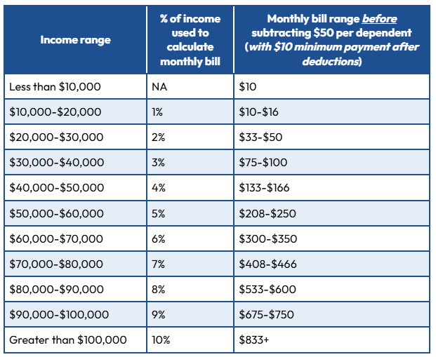
RAP – Repayment Assistance Program
Monthly payments will be calculated as a percentage of the borrower’s total income (using adjusted gross income, or AGI) minus $50 per month per dependent:
Notes:
What is the name of your colony song?
Write lyrics to the song and, if you are feeling creative, use a computer program or instruments to create the music that goes along with it!
To insert an audio file, click on Recording -> Audio -> Audio on My PC and choose your file

Slide 8
RAP Tidbits
Like the SAVE plan, the RAP plan will waive any interest not covered by the borrower’s monthly payment. Additionally, unlike SAVE or other existing plans, the RAP plan will reduce borrowers’ principal by up to $50 if the payment does not do so.
The RAP plan is significantly more expensive for borrowers than the SAVE plan, but will also be more expensive than the other existing IDR plans for low-income borrowers.
Unlike existing IDR plans that provide cancellation after 10-25 years, the RAP plan will only provide cancellation after 30 years of qualifying payments.
The Big Bill specifies that the RAP plan should be available to borrowers beginning on July 1, 2026.

Slide 9
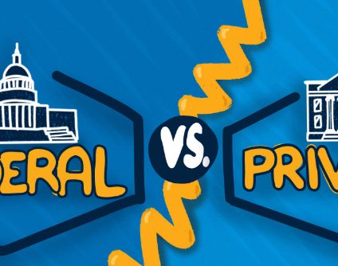
Private student loans
While CHESLA and RISLA are quasi-state entities, we are considered to be private lenders. Any lender that is not the federal government is a private lender.
Terms are set by the individual lender. Best to confirm the terms with your lender and current loan servicer.
Credit check and underwriting criteria to be approved for the loan.
Typical private student loan repayment terms are 5, 10, 15, or 20 years.
May offer deferment or forbearance in times of financial hardship. Some lenders, like CHESLA, offer additional forbearance during Major Natural Disaster Declarations.
Loan forgiveness is very rare and unlikely.
Less borrower benefits than the federal government.

Slide 10
Questions? Contact Information
Suzanne Hanlon - RISLA
401-468-1755
shanlon@risla.com
Apply for PSLF: www.studentaid.gov/pslf
Loan Simulator: www.studentaid.gov/loan-simulator
Student Loan WatchDog: https://thecollegeinvestor.com/newsletter
Josh Hurlock - CHESLA
860-761-8482
jhurlock@chesla.org

