Slide 1

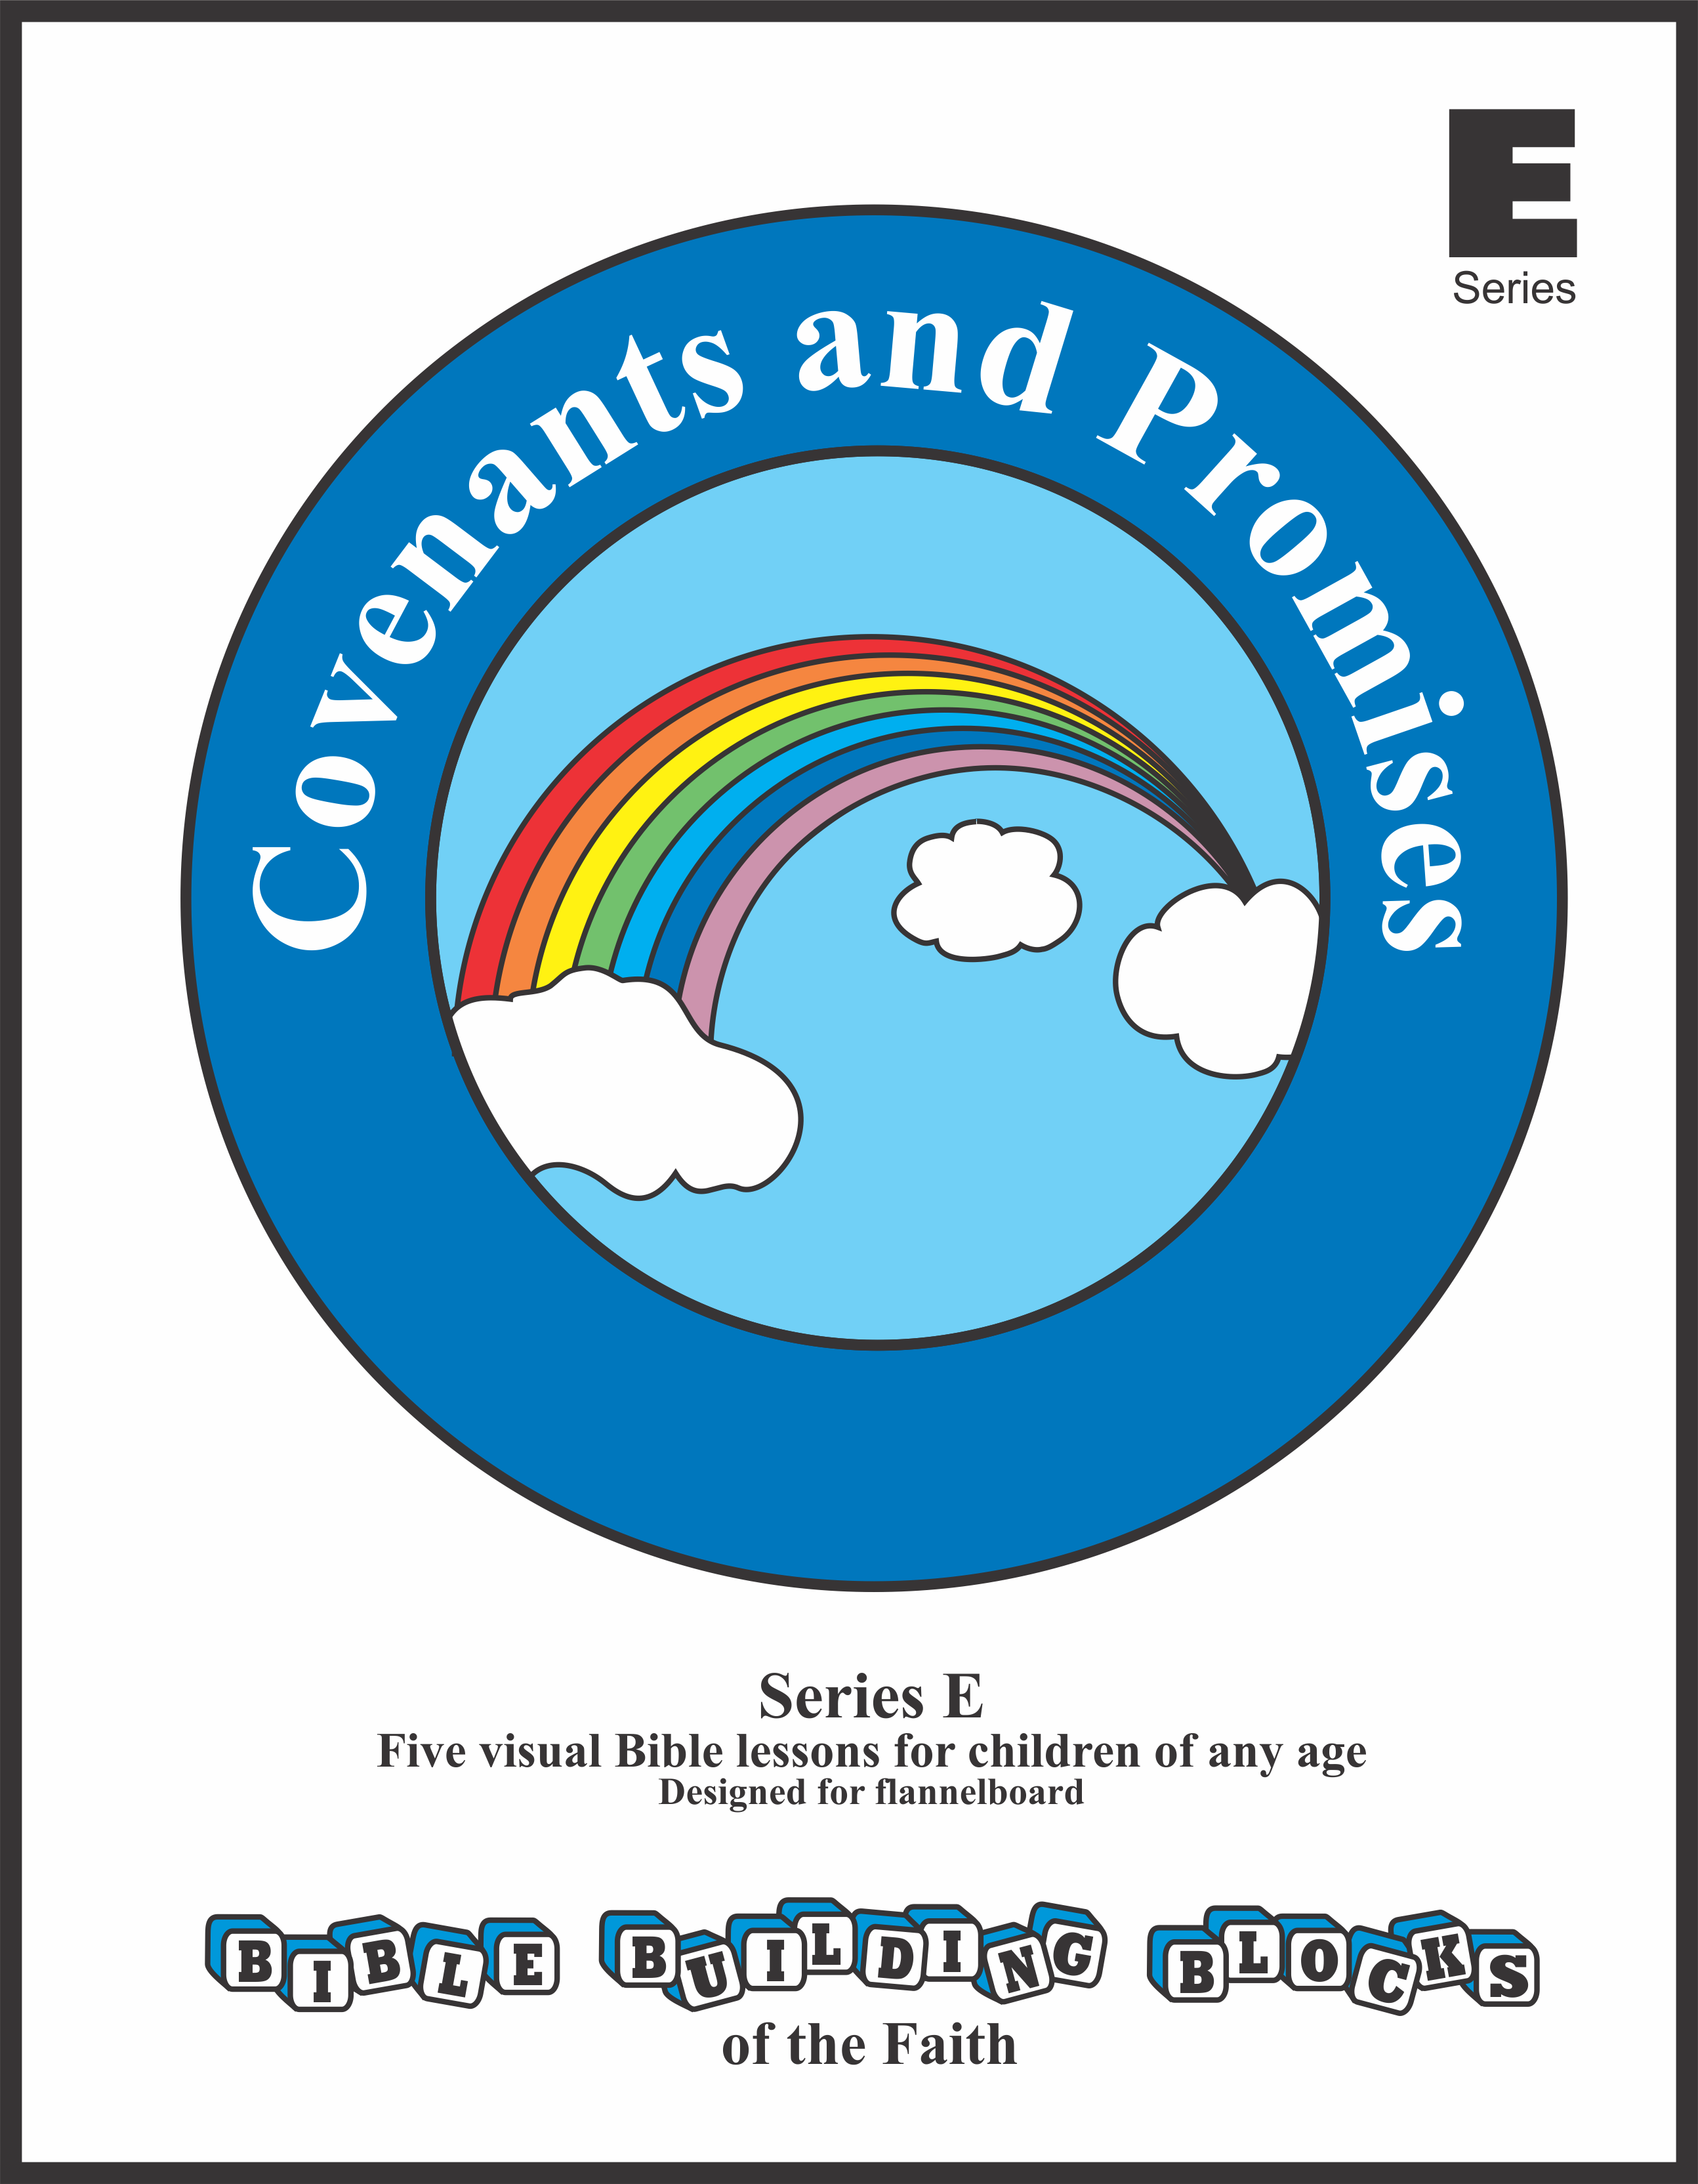

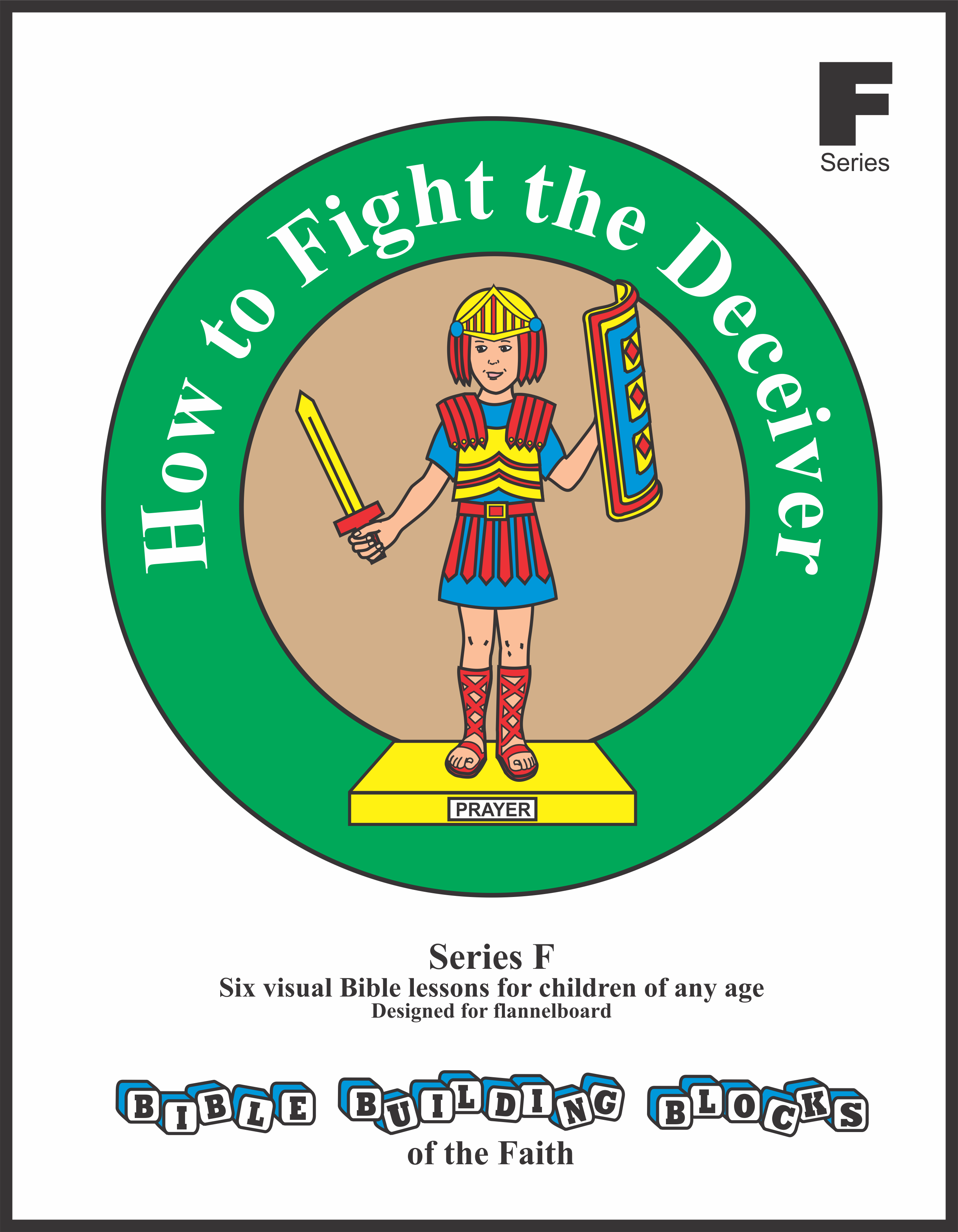
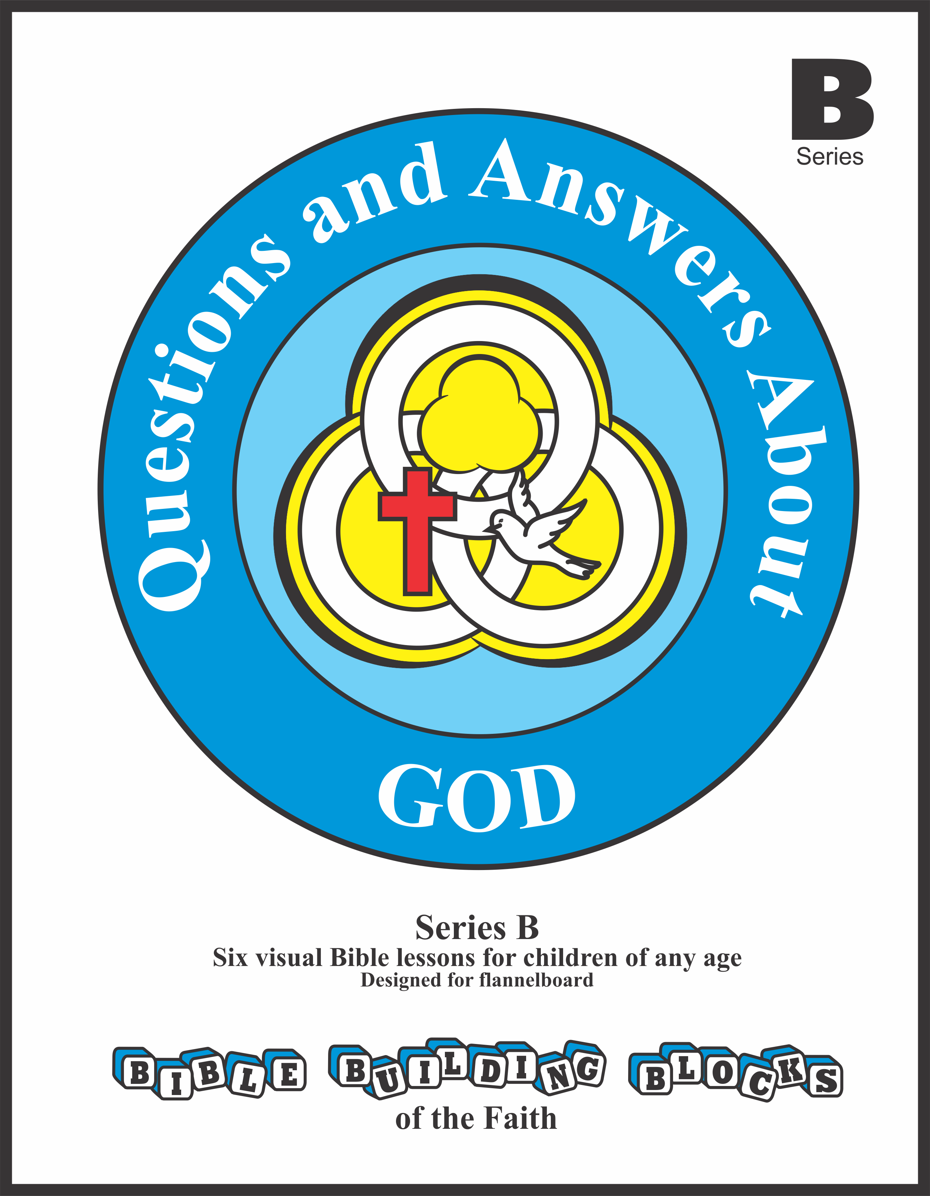



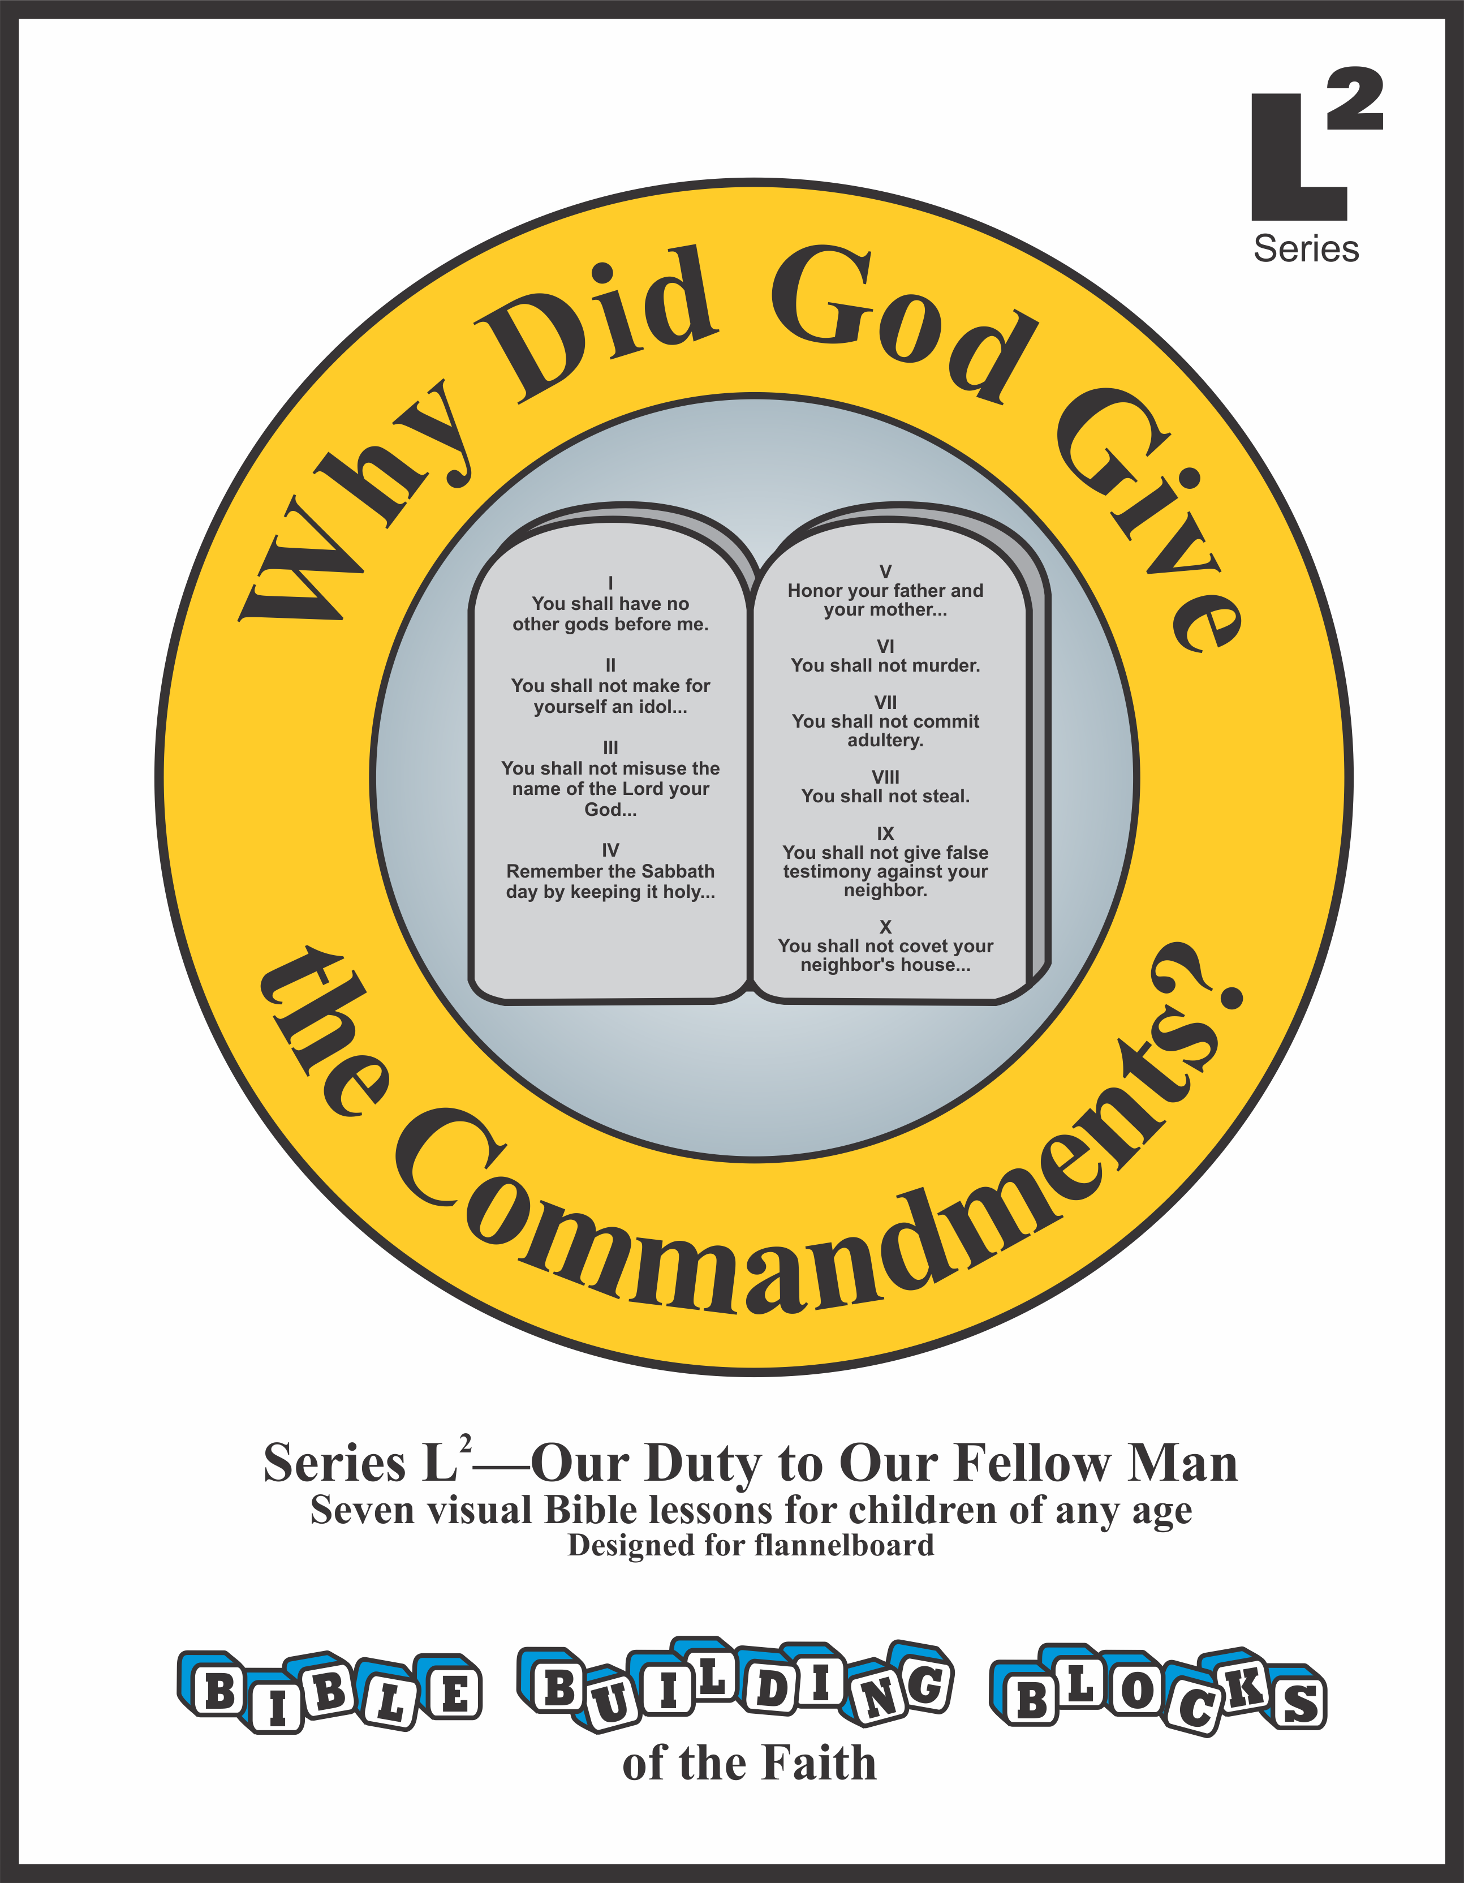
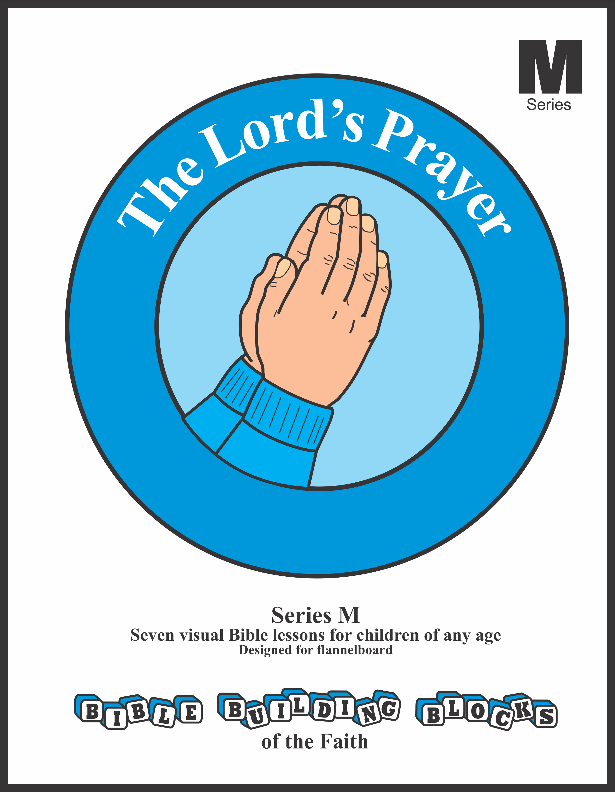
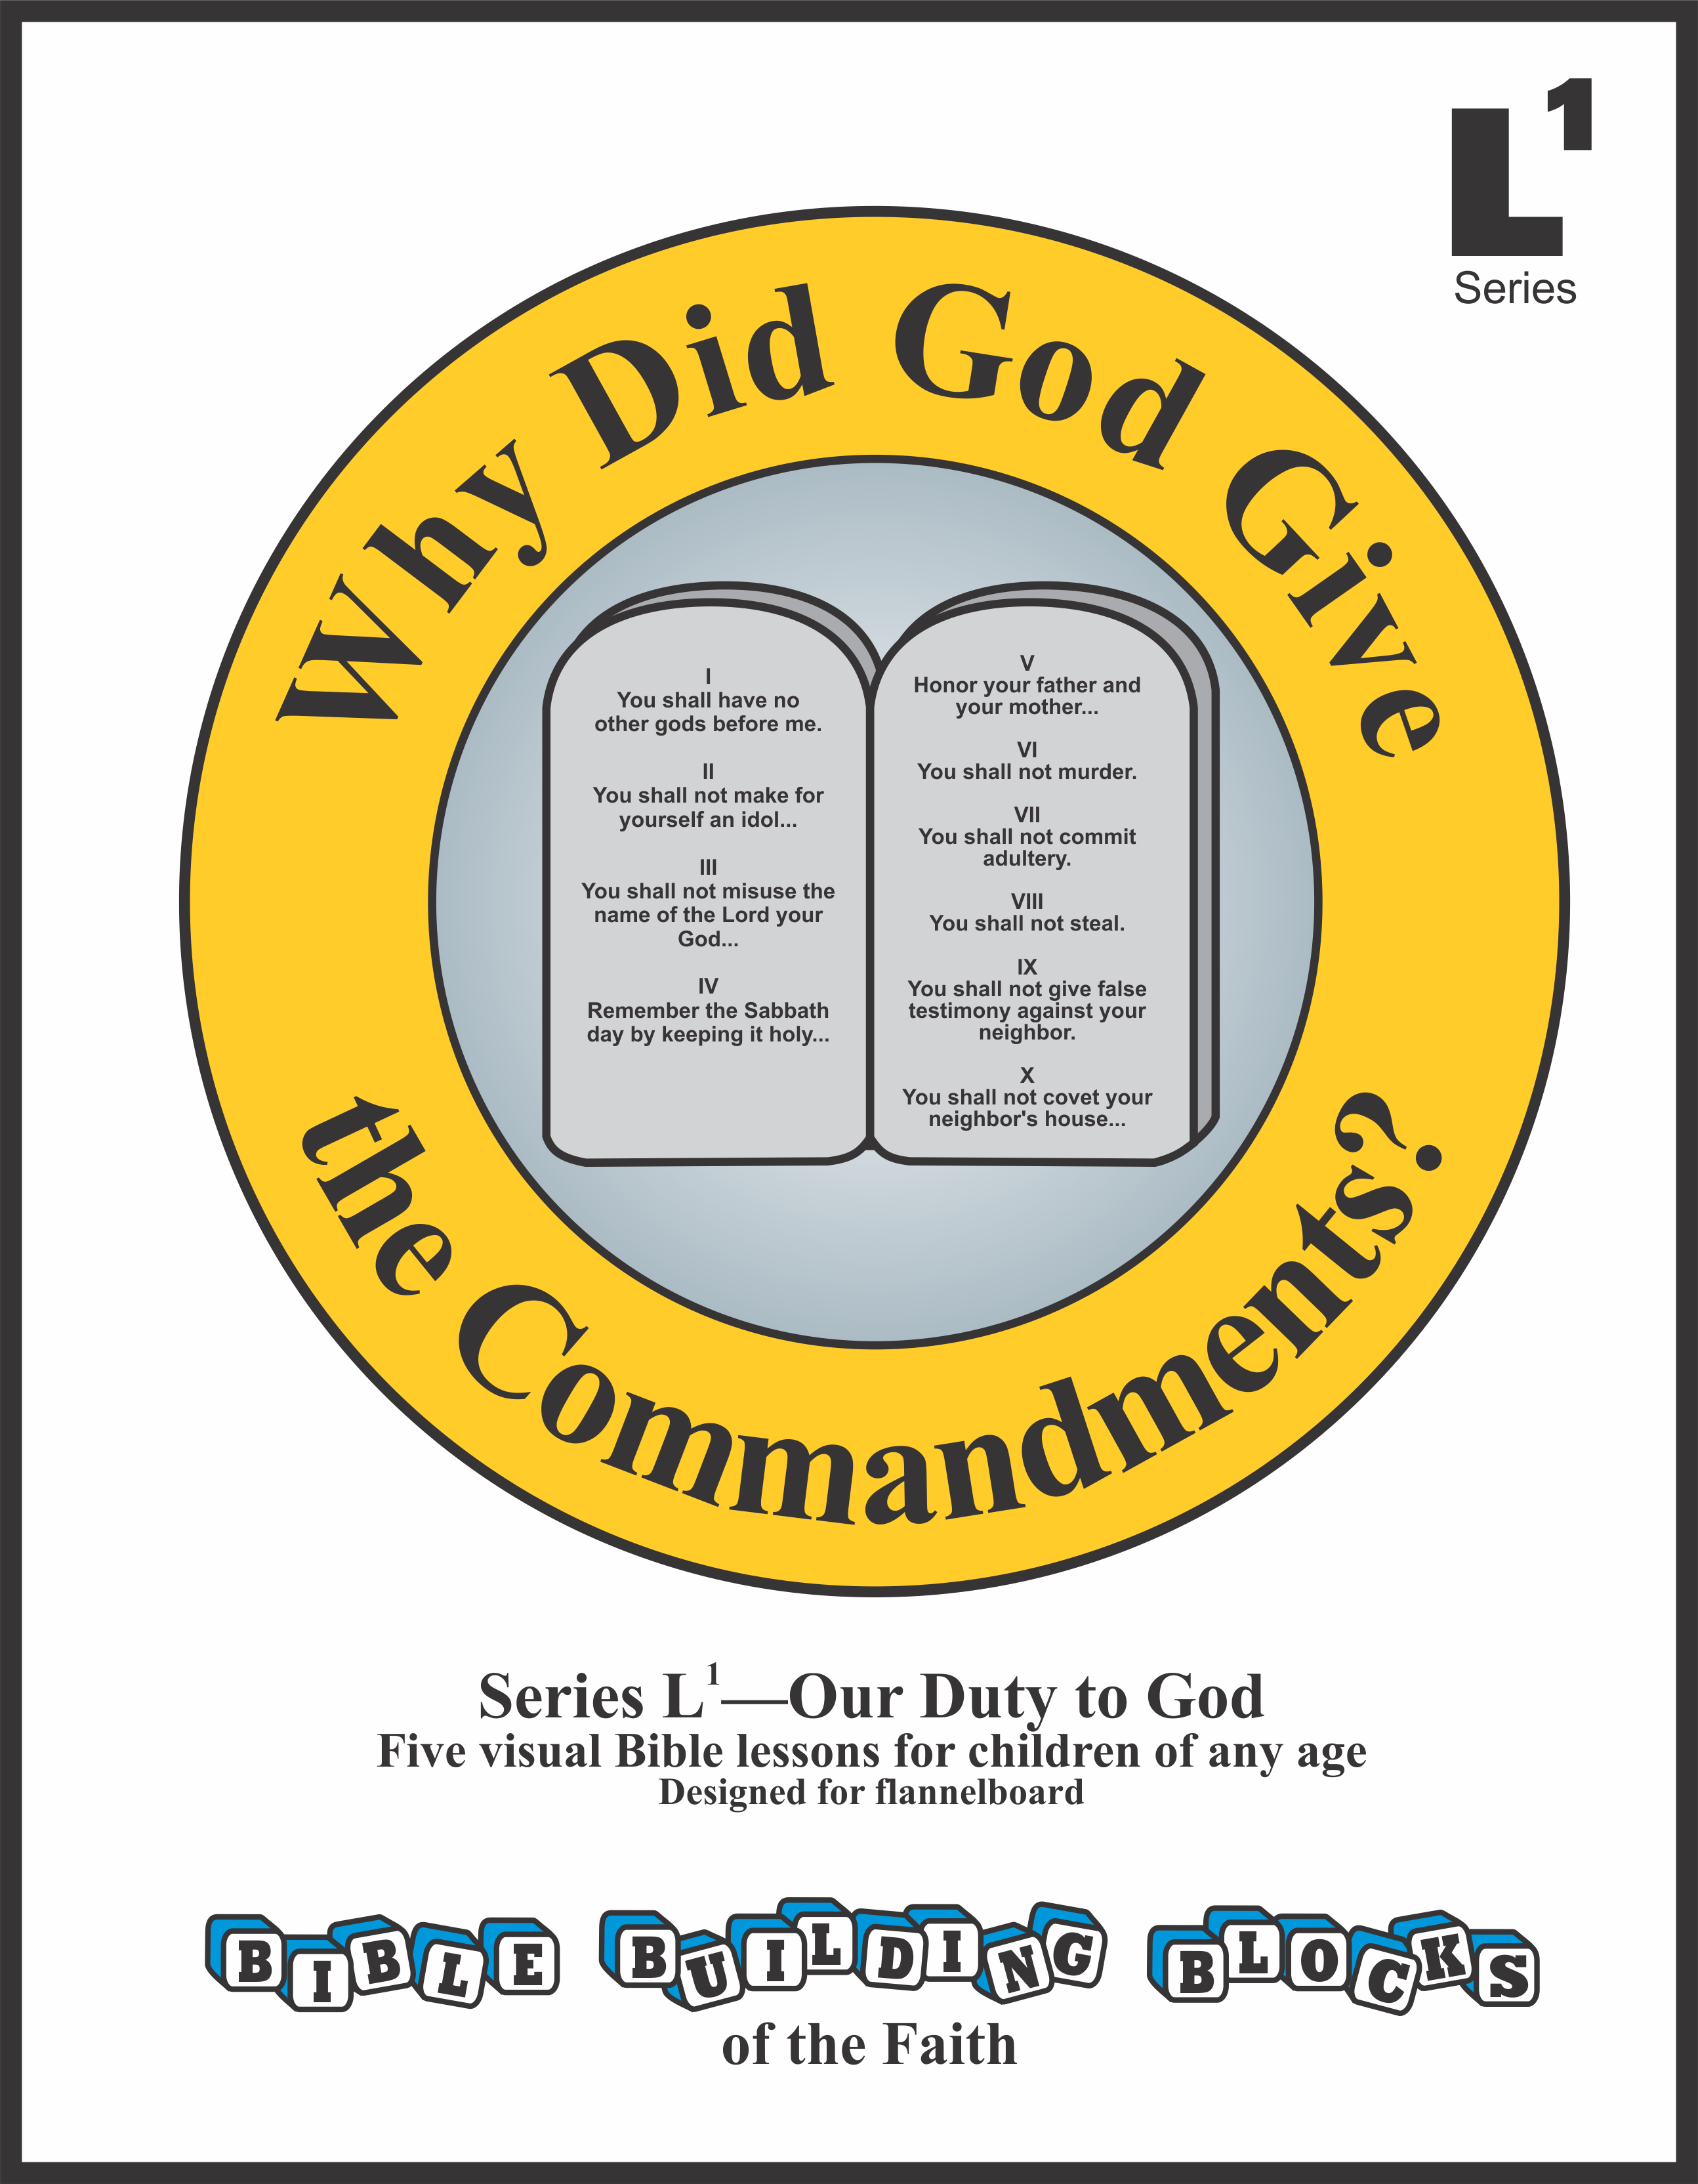


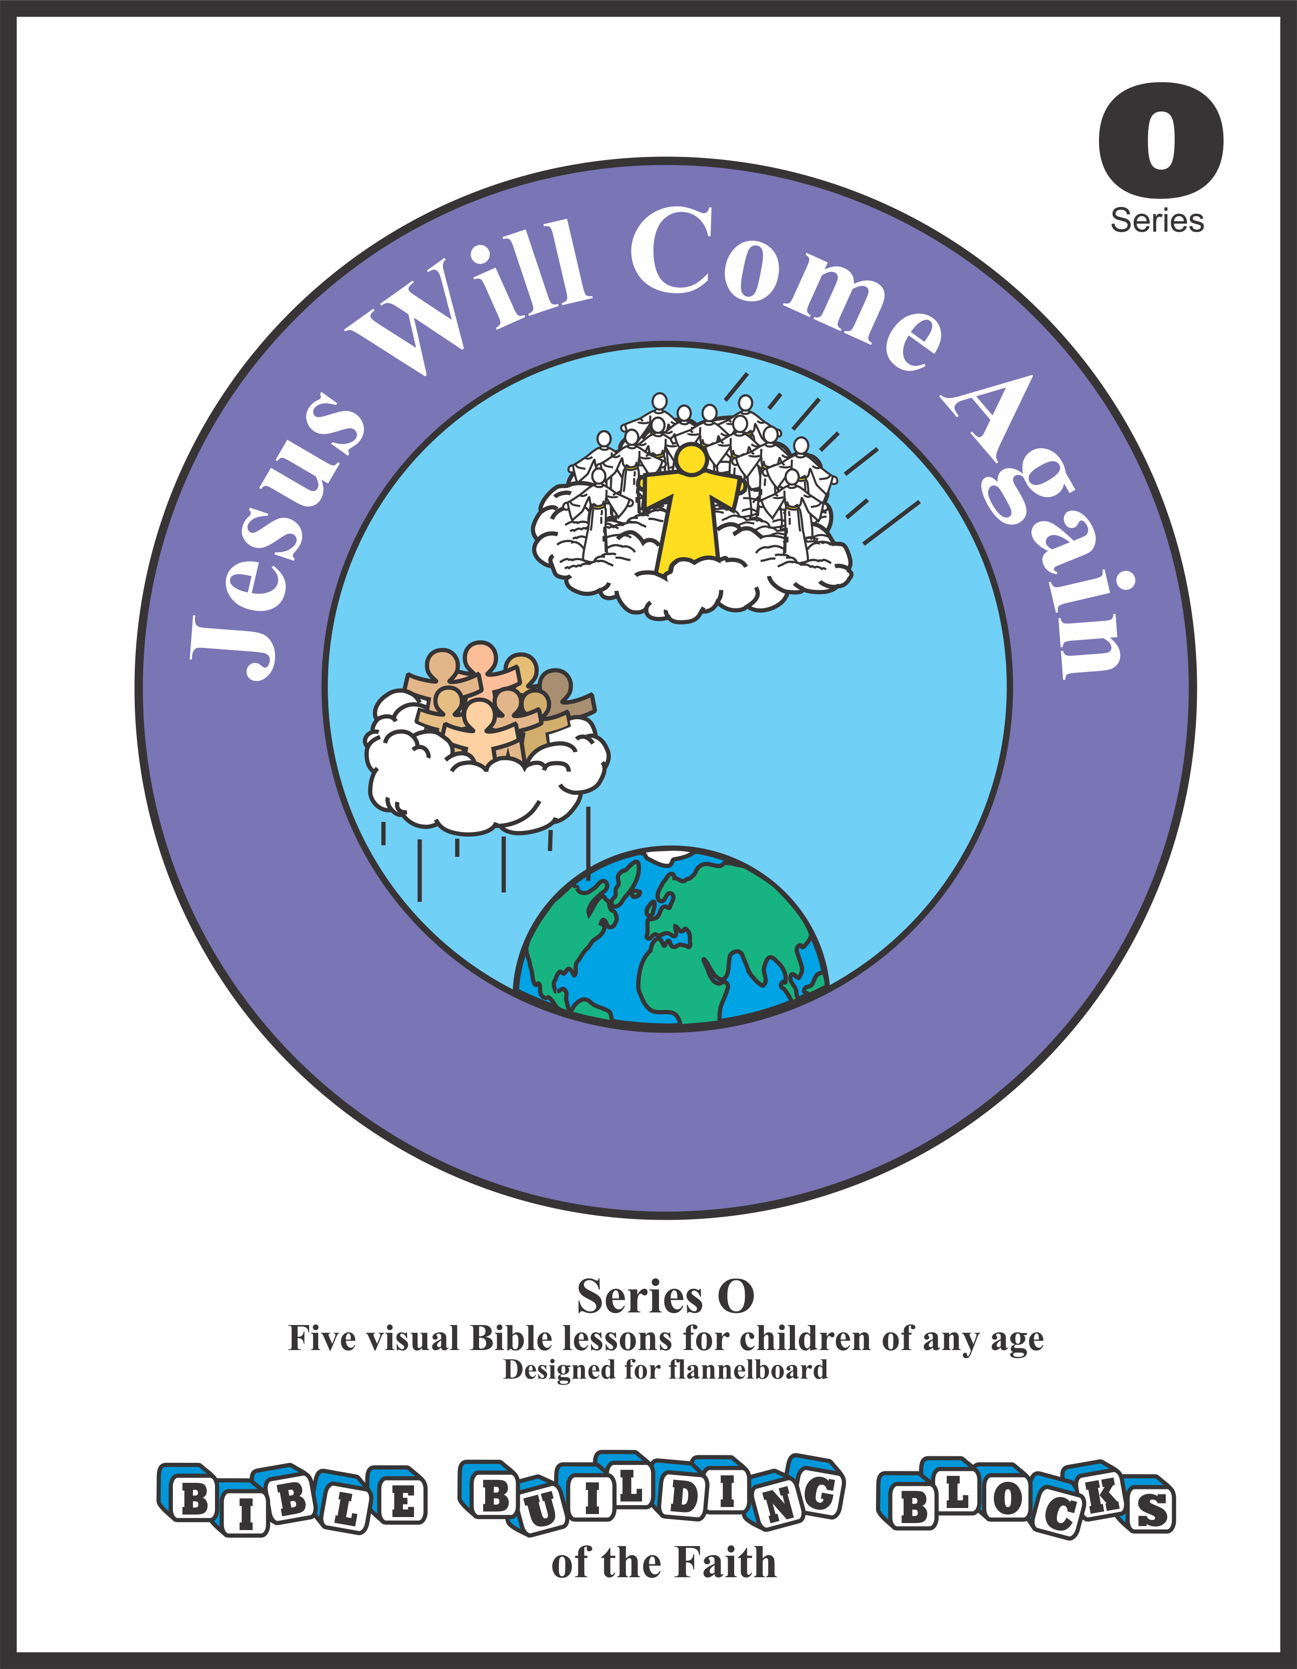

Bible Building Blocks of the Faith
Series E
Lesson 2

Slide 2
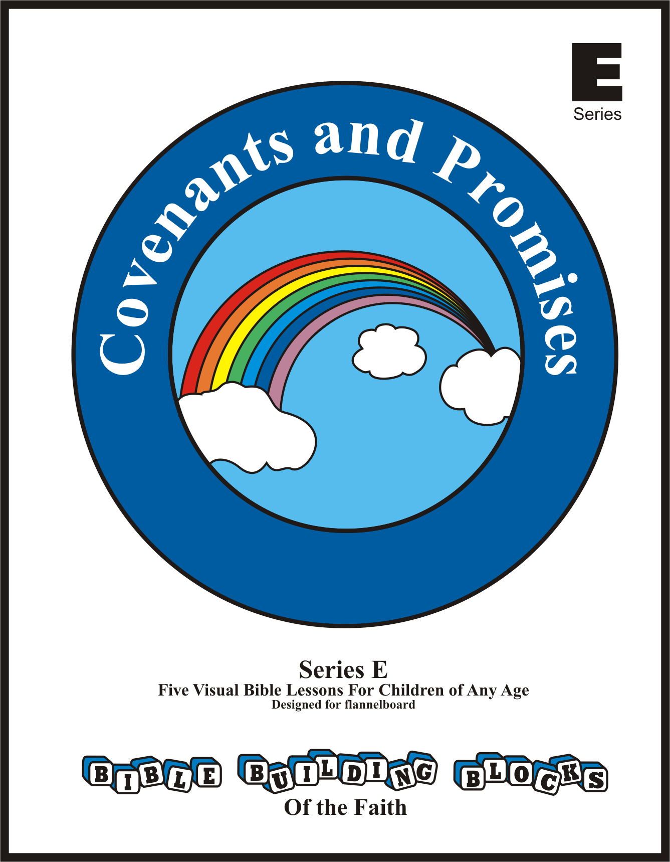

Bible Building Blocks of the Faith
Lessons in Series E
1 Covenants in the Bible
2 Reason for Covenants
3 Covenant of Works—Requirement
4 Covenant of Works—Blessing and Curse
5 Covenant of Grace

Slide 3


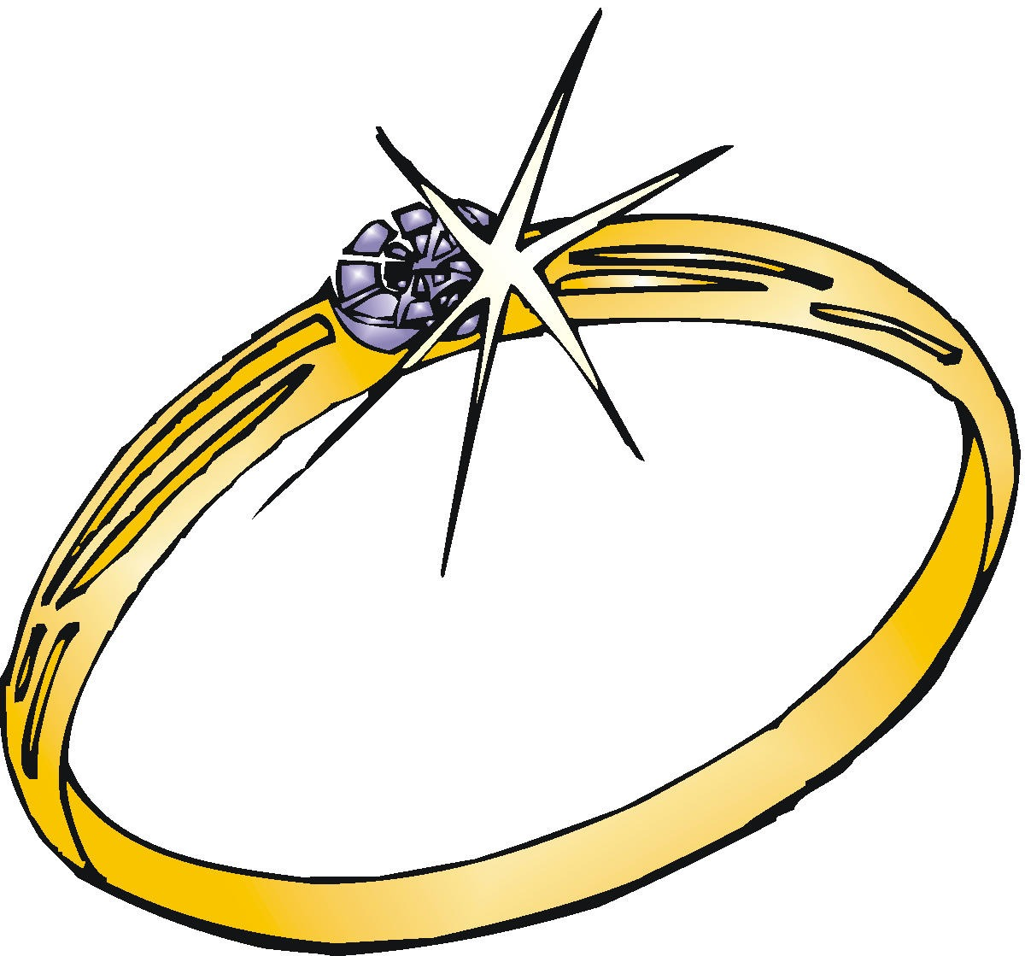
Stevie and Sarah
Lesson 2: Reason for Covenants
Engagement rings and rainbows—they’re both so pretty. My teacher said rainbows are a sign of God’s covenant. But, Stevie, an engagement ring is a sign that two people will marry. So, is the ring like a rainbow? Are they both signs?

Slide 4
Stevie and Sarah
Lesson 2: Reason for Covenants
Yes, engagement rings and rainbows are both signs of covenants. Remember, Karen explained how she and Terry promised to marry, and a ring is a sign of that promise.

Slide 5
Stevie and Sarah
Lesson 2: Reason for Covenants
Karen said the promise she and Terry made is forever and ever!

Slide 6
Stevie and Sarah
Lesson 2: Reason for Covenants
That’s right. Just like a ring goes around and around and around forever, so does their promise to each other.

Slide 7
Stevie and Sarah
Lesson 2: Reason for Covenants
Oh, I see. That’s why they use a ring. It’s a good picture of how long their promise will last.

Slide 8
Stevie and Sarah
Lesson 2: Reason for Covenants
Now you’re understanding. And when they marry, they’ll begin a new family and a new life together. They’ll live in the same house and have the same last name. In their new relationship, they’ll get to know each other better day by day.

Slide 9
Stevie and Sarah
Lesson 2: Reason for Covenants
Wow, no wonder marriage is a forever promise. I guess it takes a lifetime of “day-by-days” to get to know each other.

Slide 10
Stevie and Sarah
Lesson 2: Reason for Covenants
But, Sarah, tell me if you know this. What more important relationship is marriage like?

Slide 11
Stevie and Sarah
Lesson 2: Reason for Covenants
Oh, let me see. I know this answer, Stevie. I’ve heard it in Sunday school. Oh, oh, oh, wait a minute. I’m thinking. Um-m-m …. Oh, I can’t remember!

Slide 12
Stevie and Sarah
Lesson 2: Reason for Covenants
It’s our relationship with Jesus. It takes a lifetime of “day-by-days” to get to know Jesus better. That’s the best forever relationship.

Slide 13


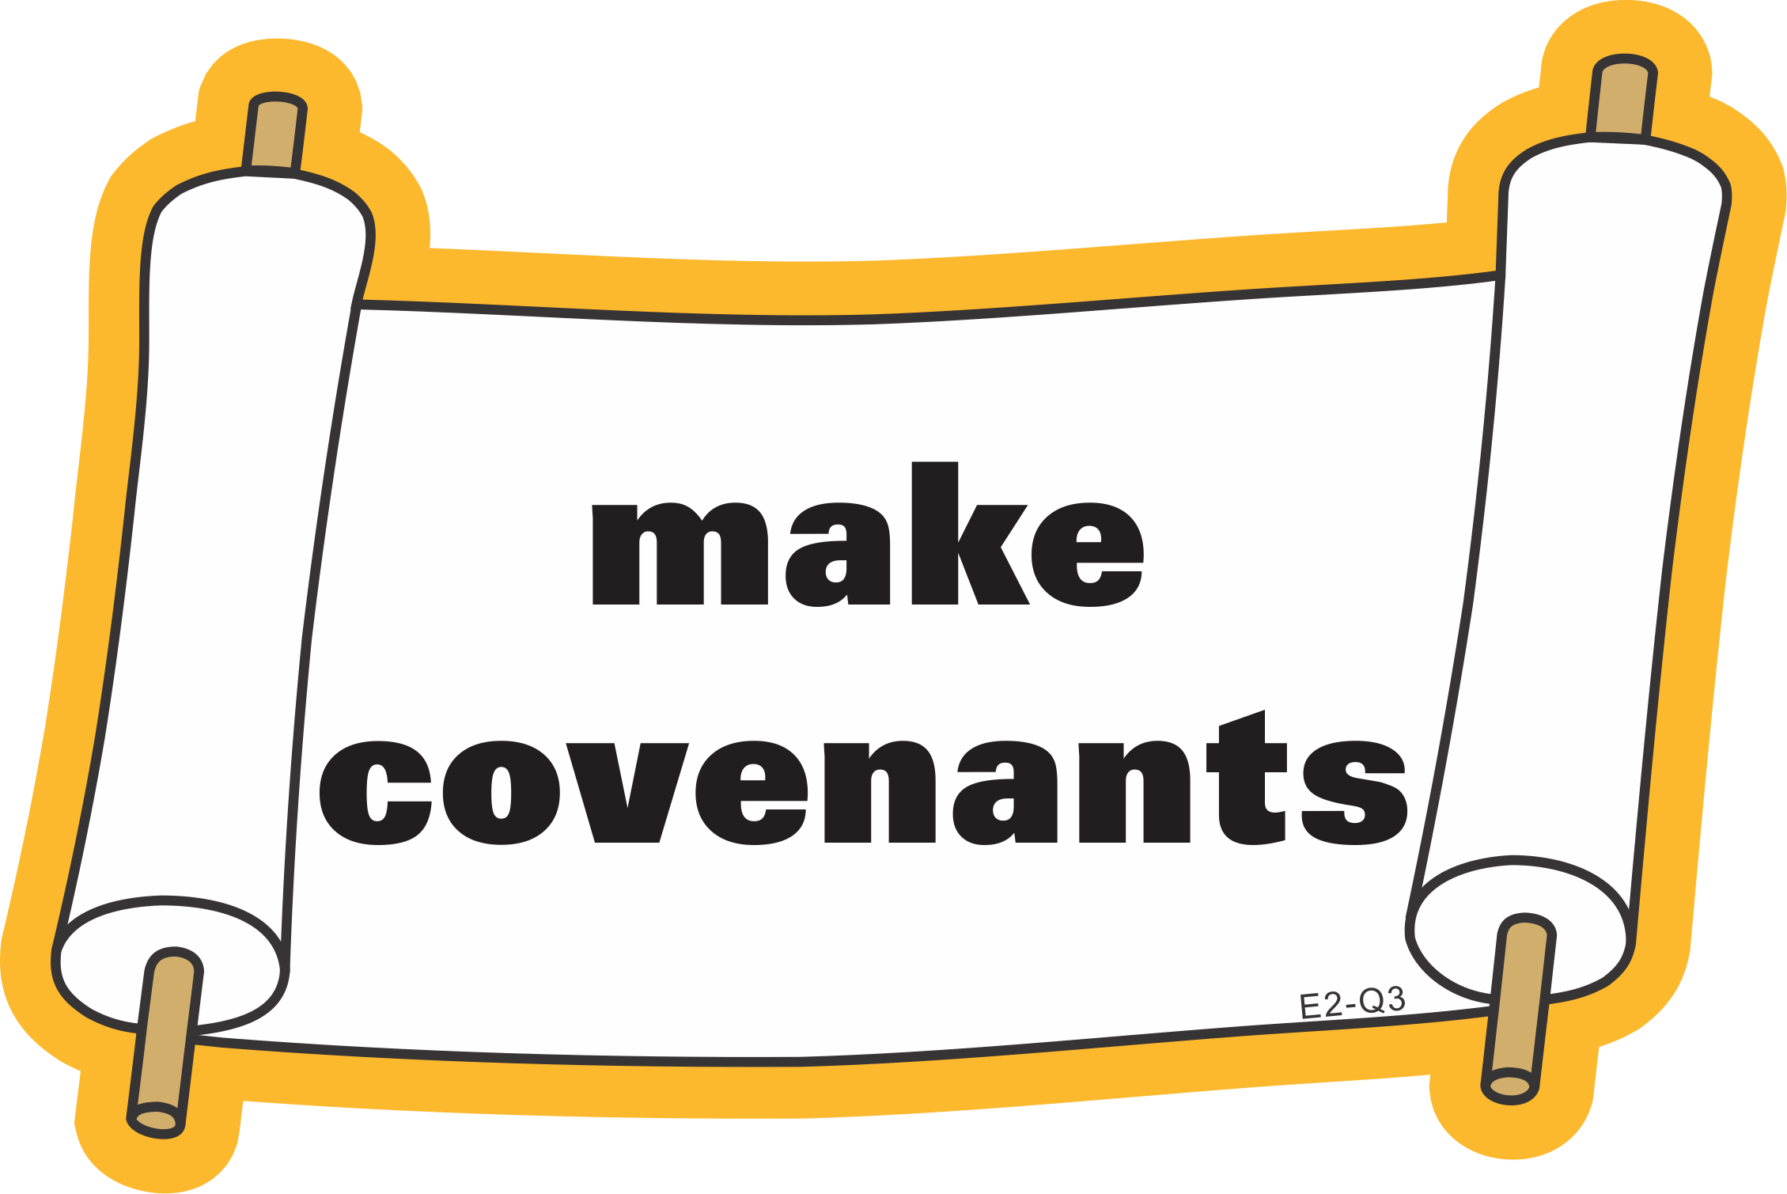
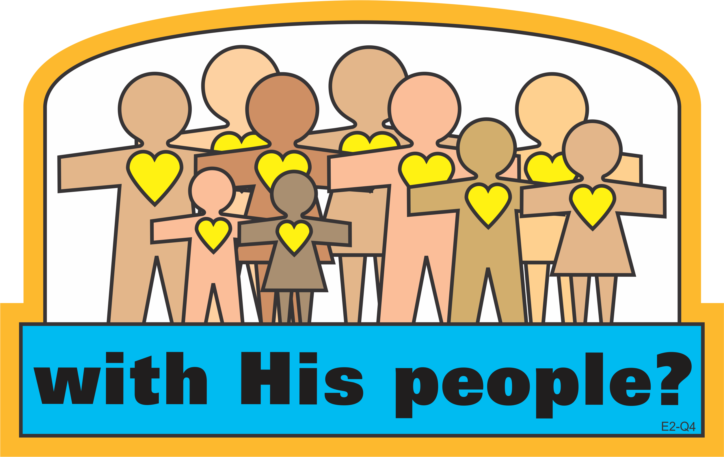


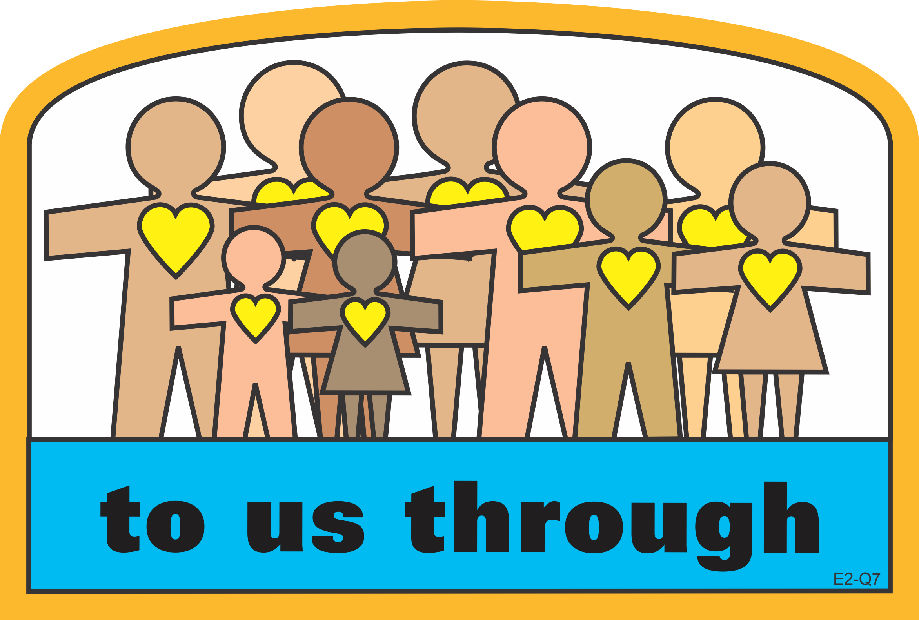
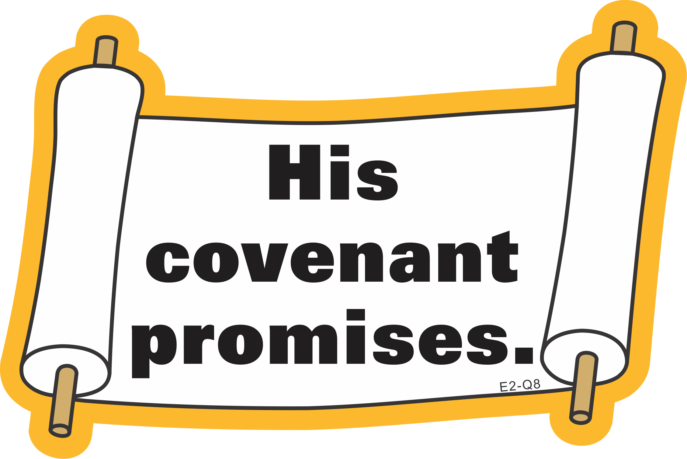
Question
Lesson 2: Reason for Covenants

Slide 14
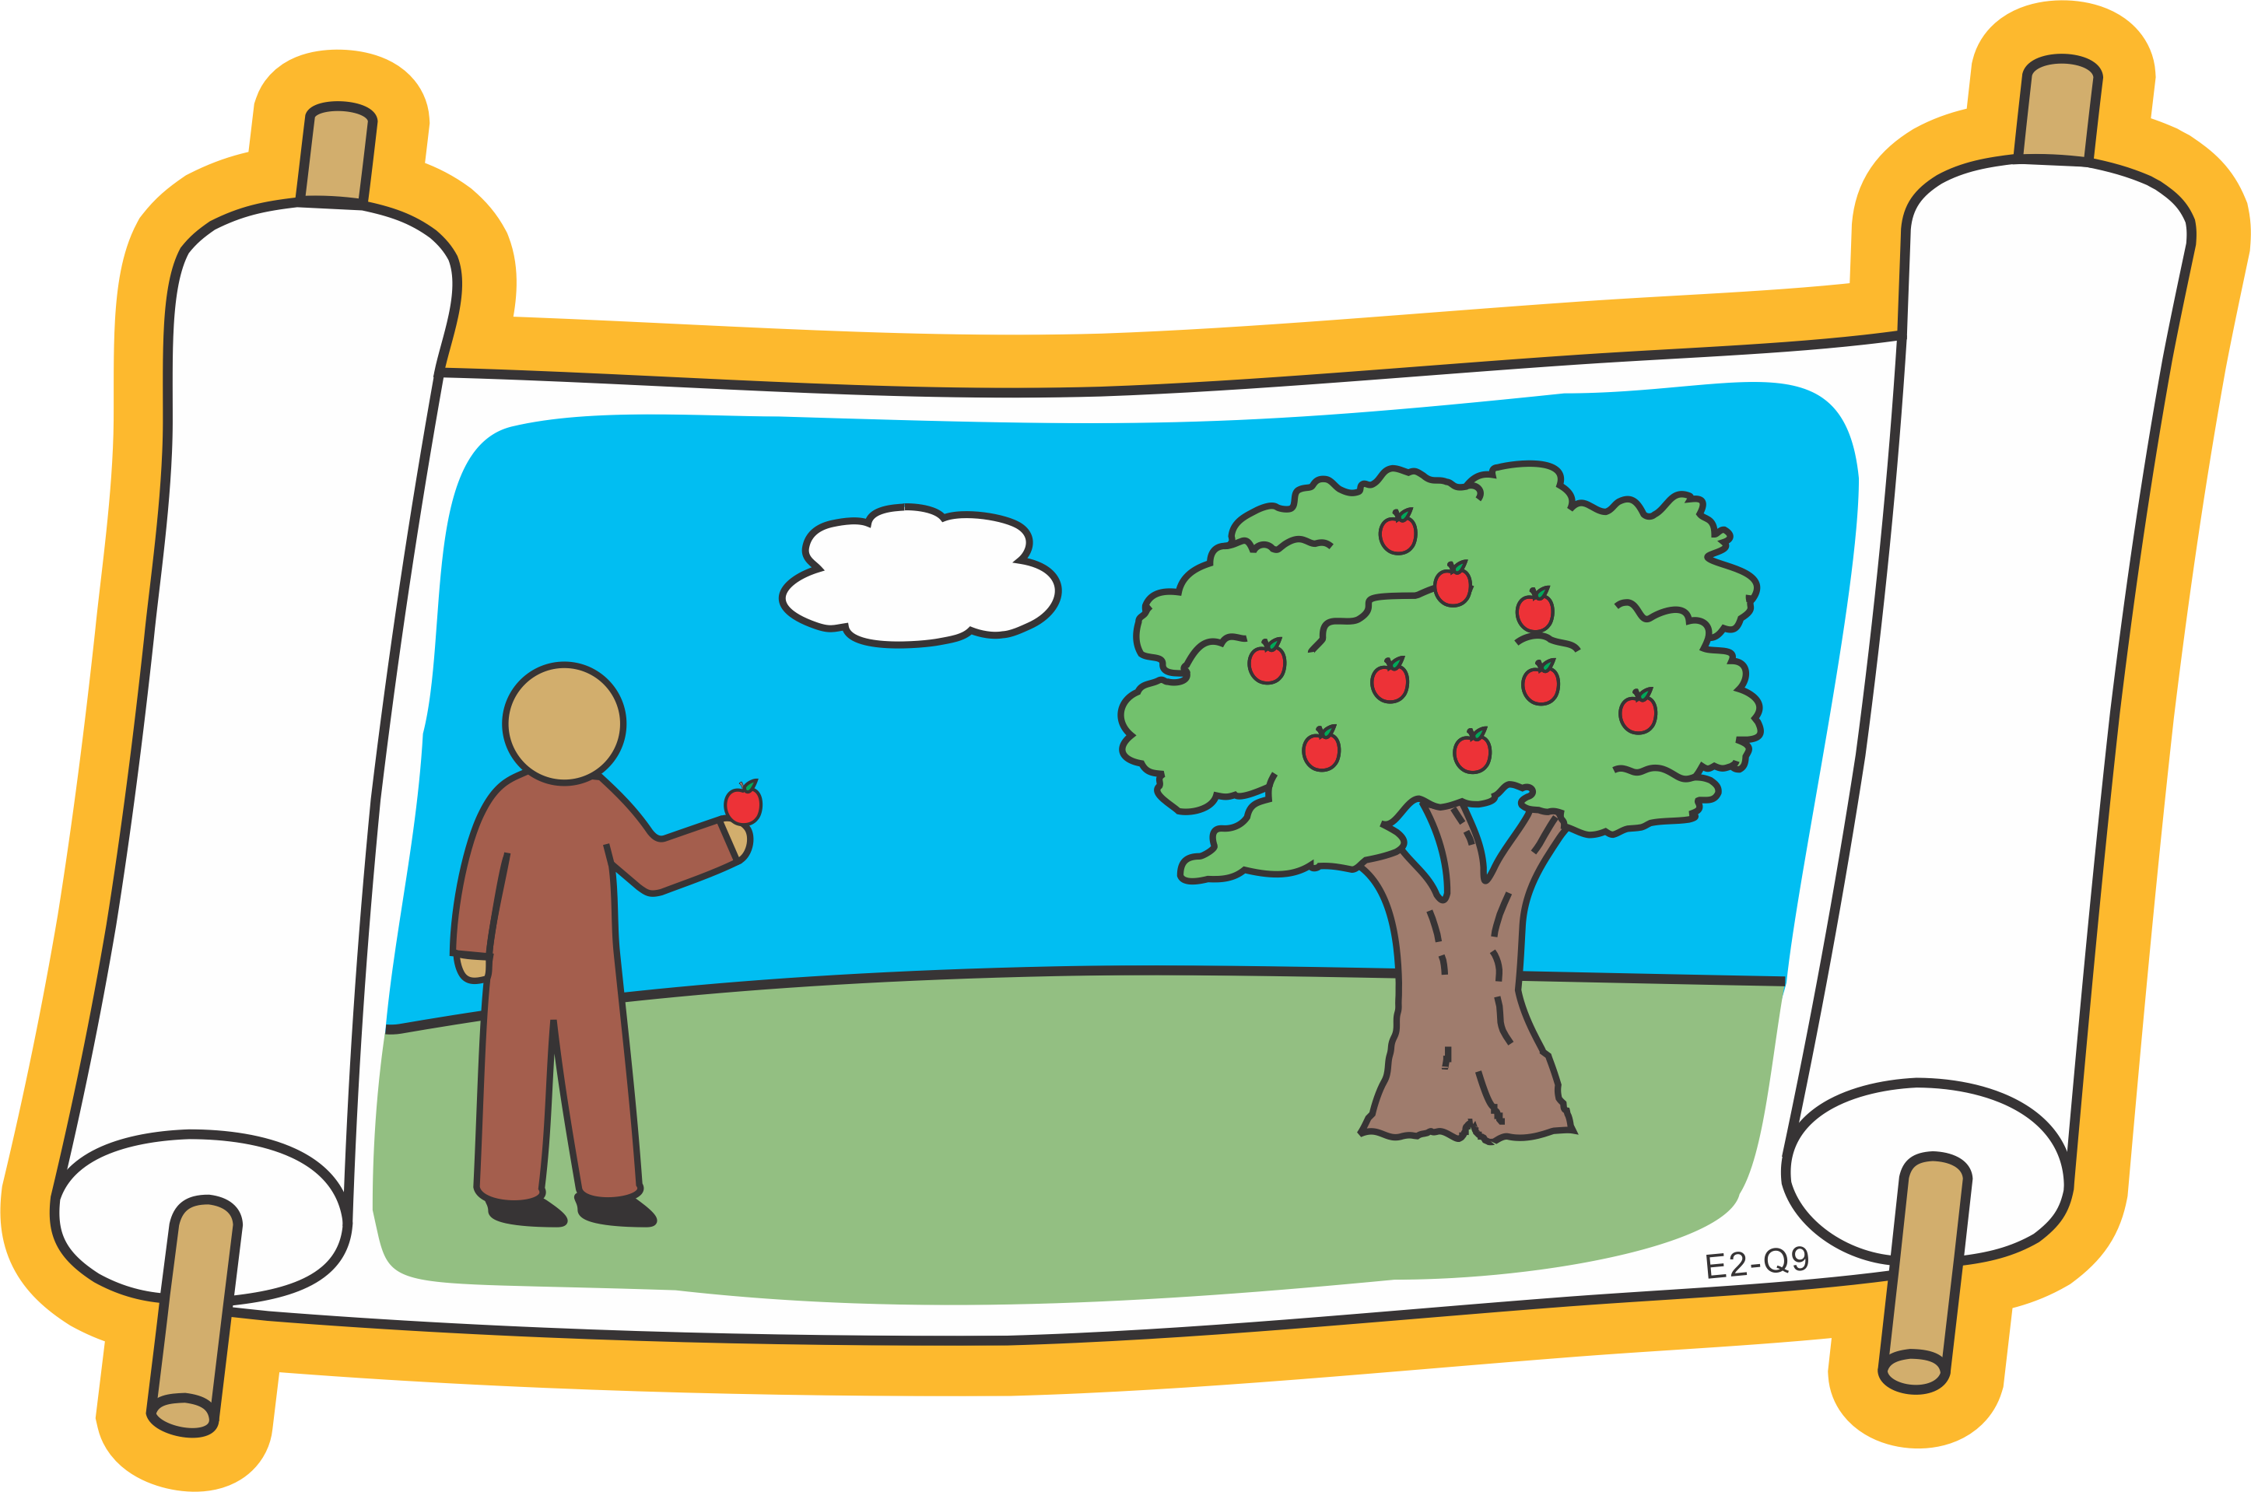
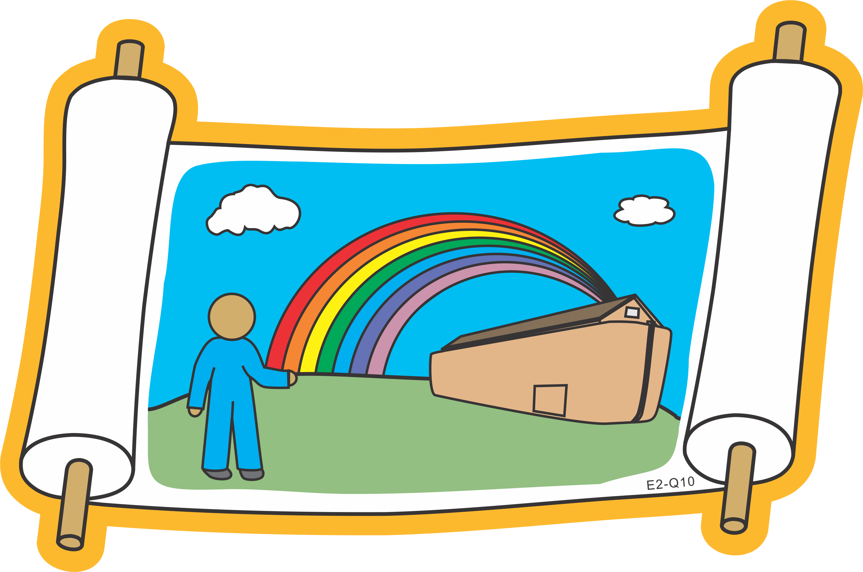
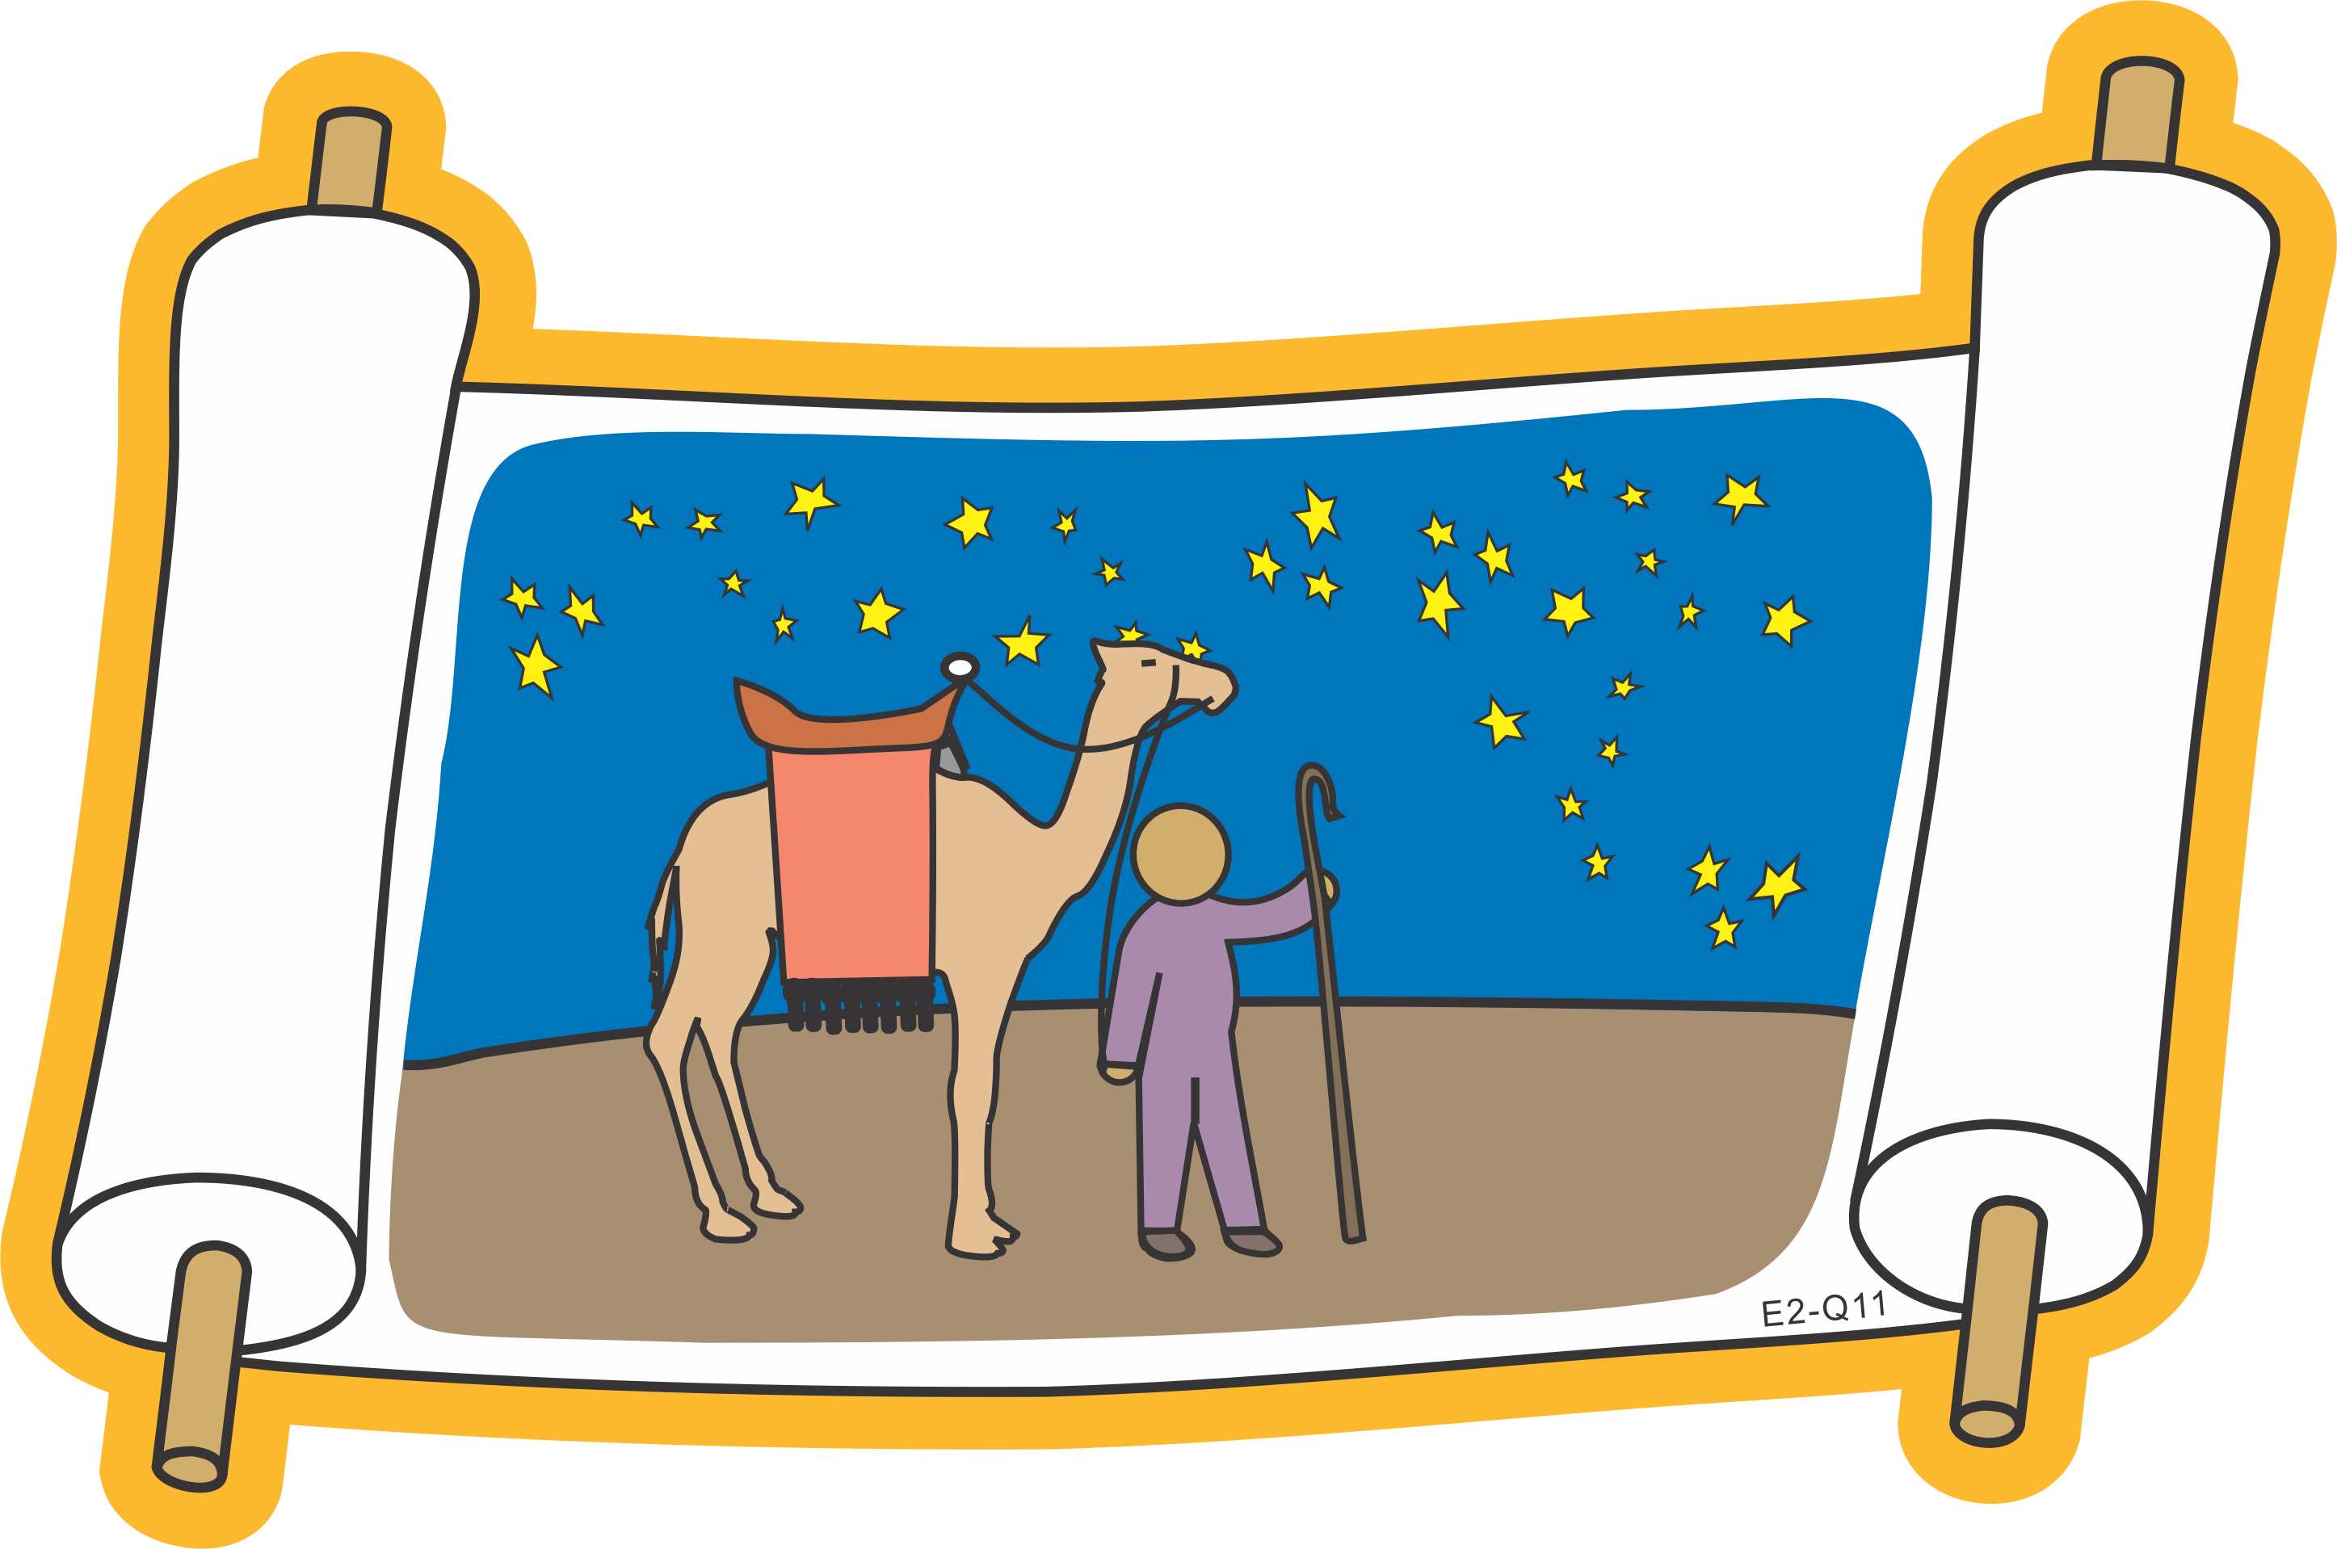
Question
Lesson 2: Reason for Covenants

Slide 15
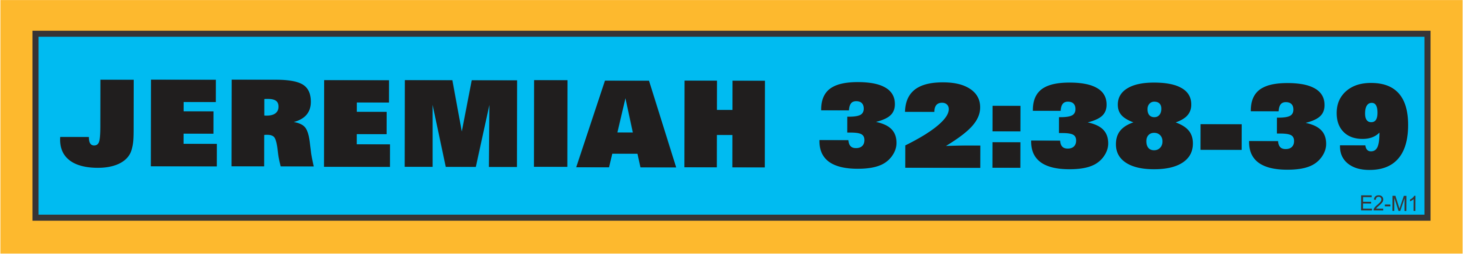

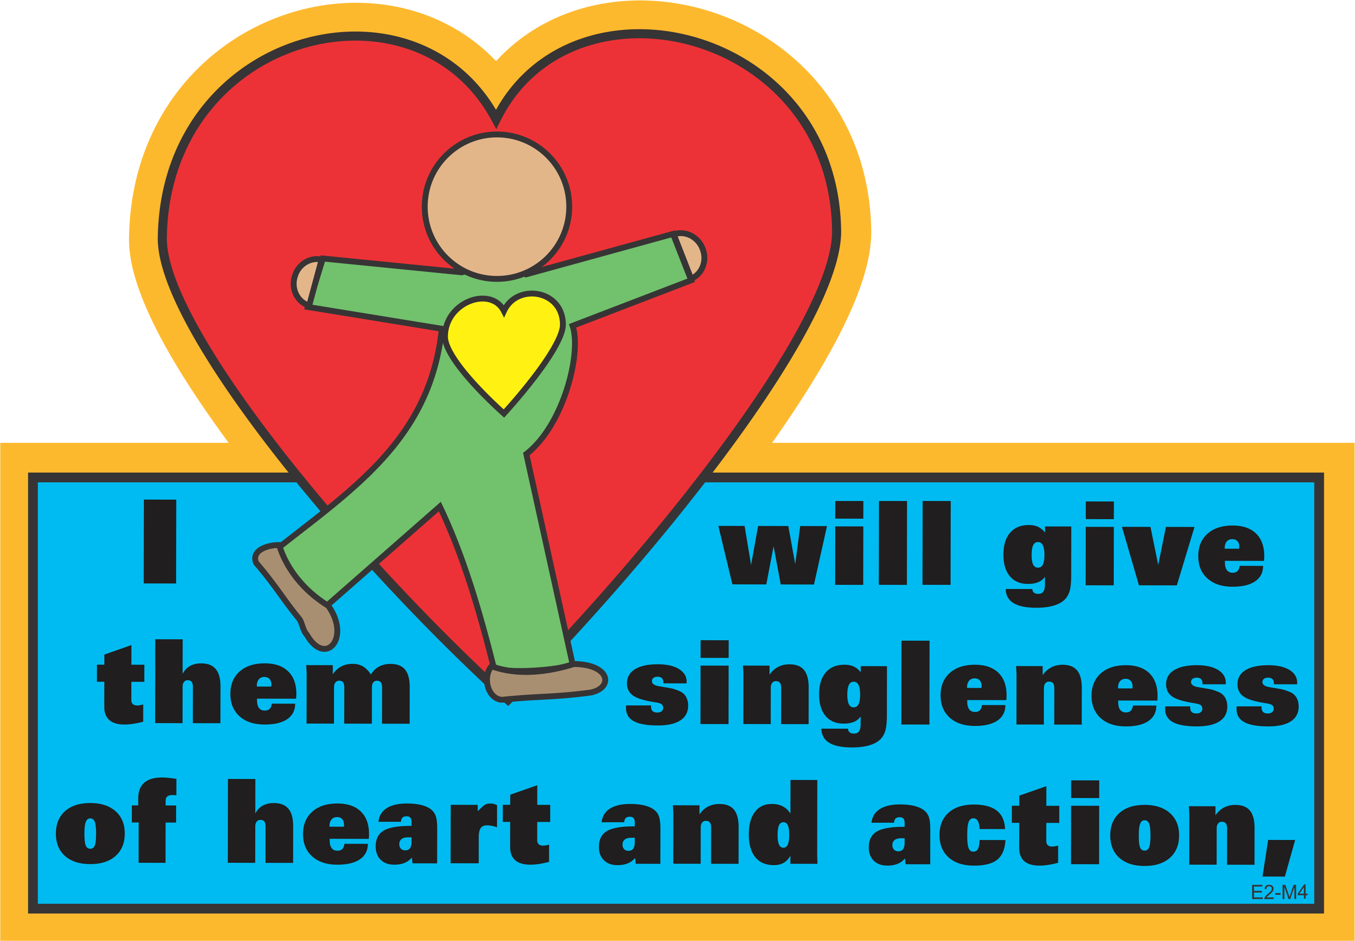
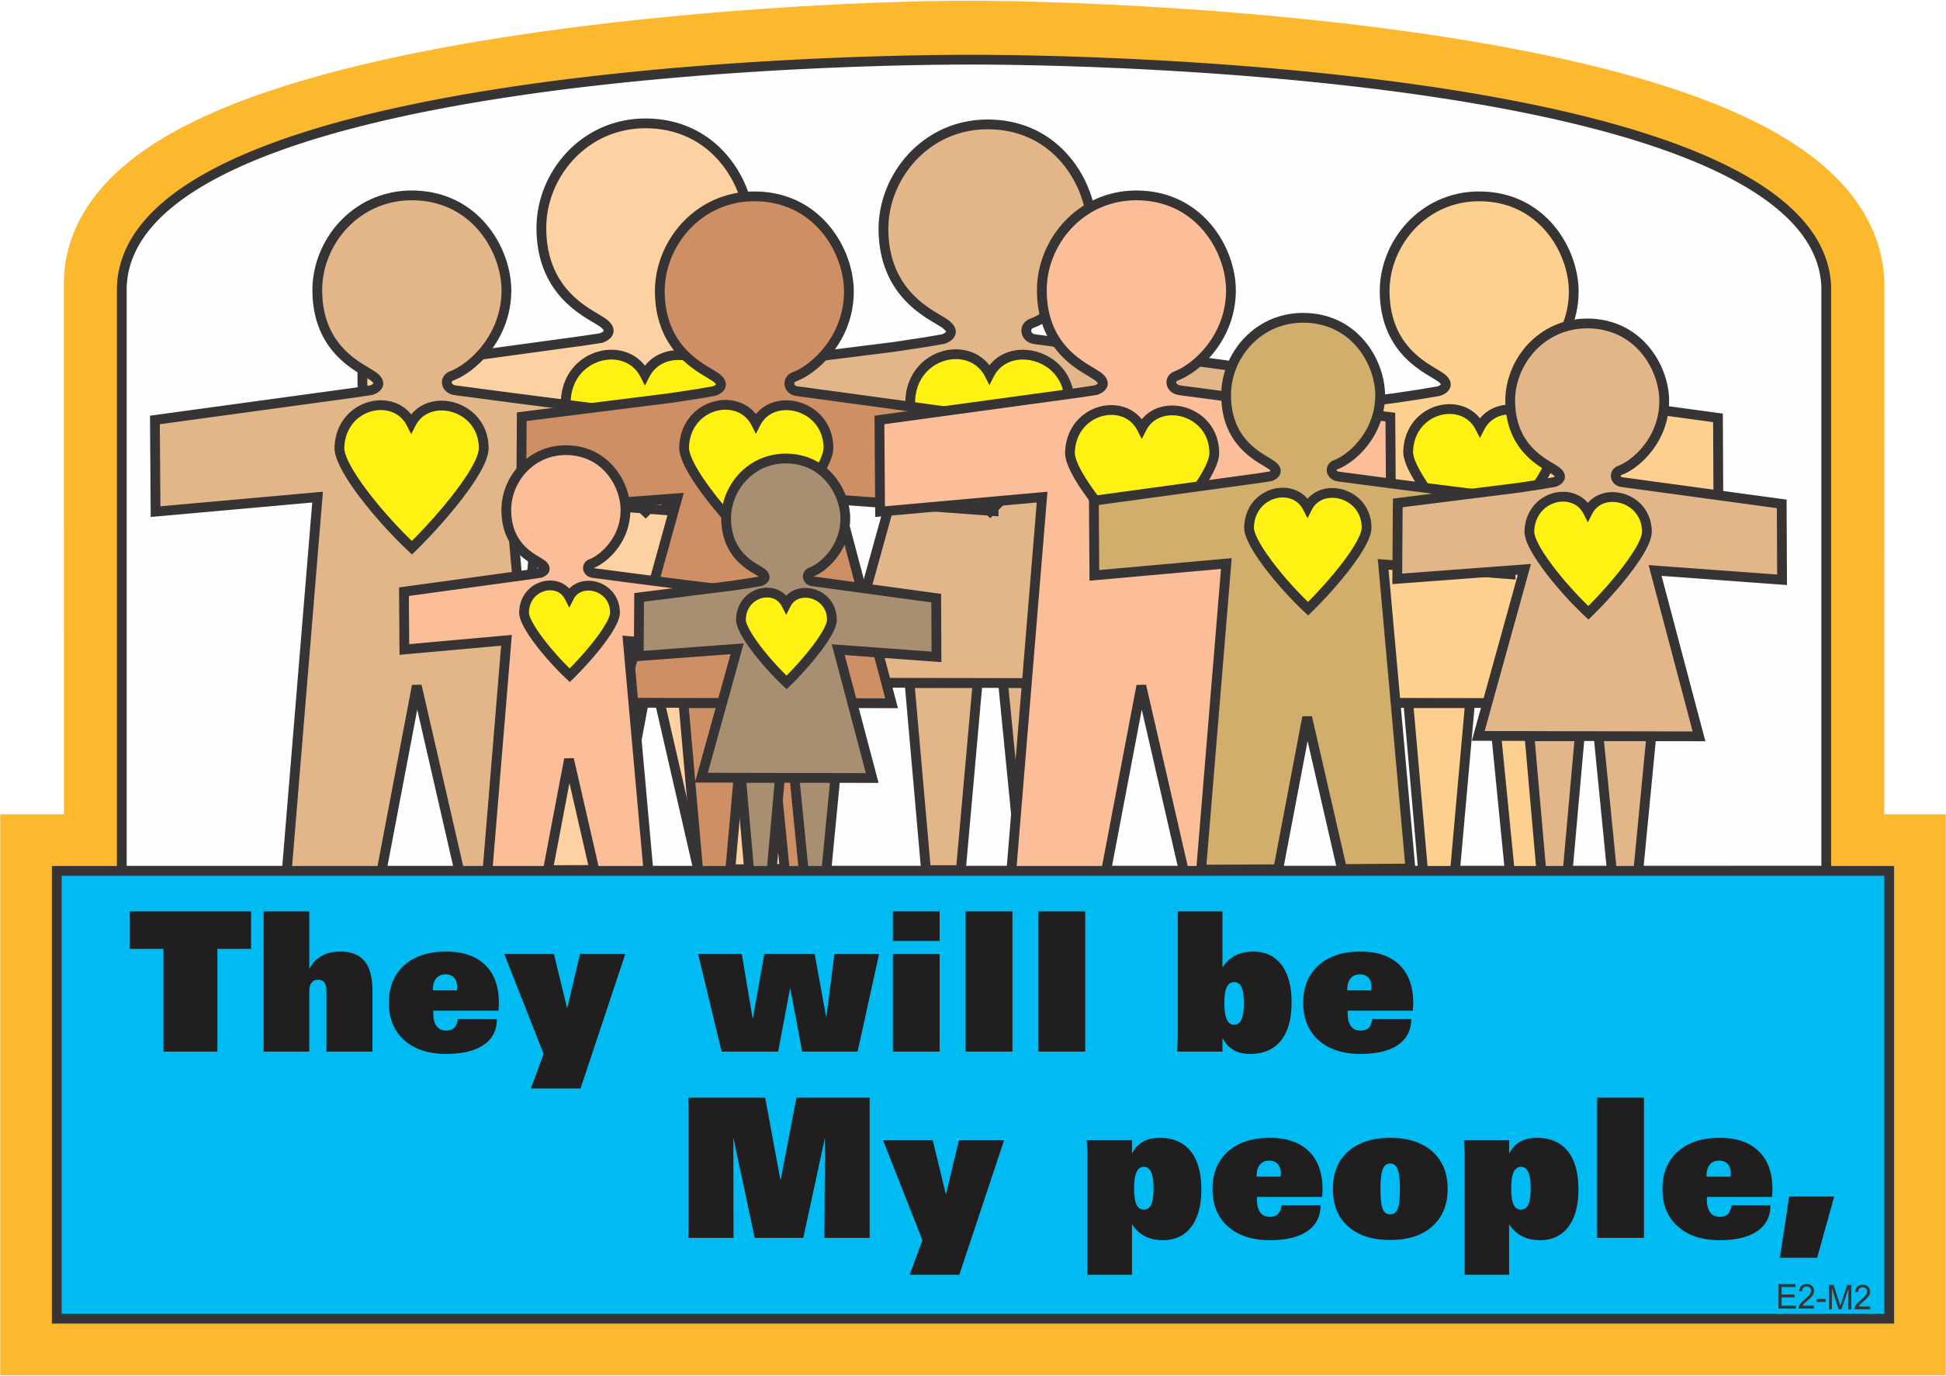
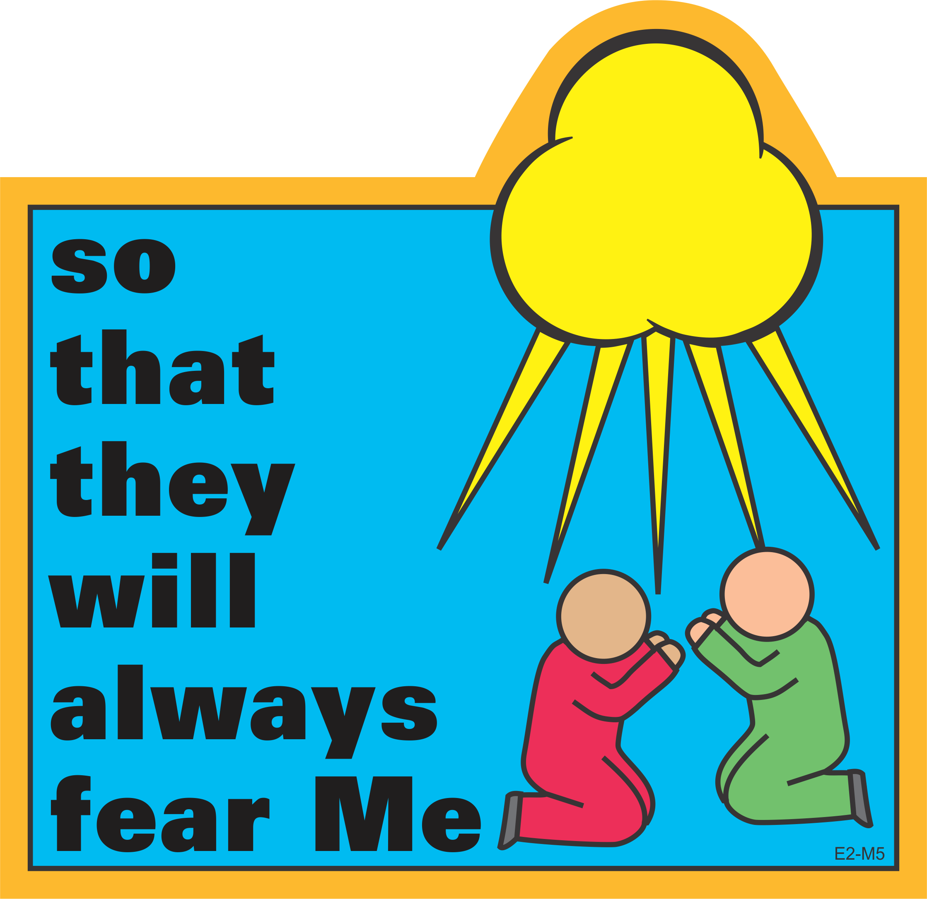
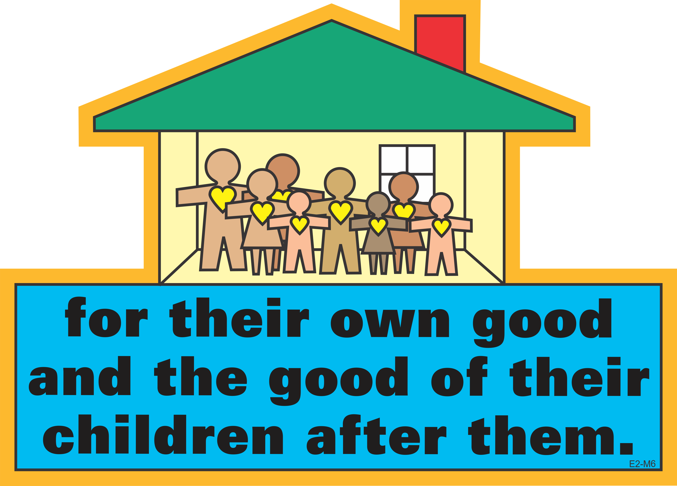
Memory Verse
Lesson 2: Reason for Covenants

Slide 16
Memory Verse
Lesson 2: Reason for Covenants
“For I know the plans I have for you,” declares the Lord, “plans to prosper you and not to harm you, plans to give you hope and a future” (Jeremiah 29:11).

Slide 17
Memory Verse
Lesson 2: Reason for Covenants
[Learn God’s law] so that you, your children and their children after them may fear the Lord your God as long as you live by keeping all His decrees and commands that I give you, and so that you may enjoy long life (Deuteronomy 6:2).

Slide 18
Memory Verse
Lesson 2: Reason for Covenants
Notes:
This game can be used in conjunction with the textbook procedure. On this first slide, one phrase is initially missing from the memory verse. Have the designated children (e.g., those who are wearing something blue) stand and say the entire verse, supplying the missing phrase. As they say the missing phrase, click to make it appear in the empty space. On the second slide, the procedure is identical except two phrases are missing, then three phrases will be missing on the third slide, etc.

Slide 19
Memory Verse Game
Lesson 2: Reason for Covenants

Slide 20
Memory Verse Game
Lesson 2: Reason for Covenants

Slide 21
Memory Verse Game
Lesson 2: Reason for Covenants

Slide 22
Memory Verse Game
Lesson 2: Reason for Covenants

Slide 23
Memory Verse Game
Lesson 2: Reason for Covenants

Slide 24
Memory Verse Game
Lesson 2: Reason for Covenants

Slide 25
✵ They Will Be My People 
Lesson 2: Reason for Covenants
They will be My people, and I will be their God.
They will be My people, and I will be their God.
I will give them singleness of heart and action,
so that they will always fear Me

Slide 26
✵ They Will Be My People 
Lesson 2: Reason for Covenants
for their own good and the good of their children after them,
for their own good and the good of their children after them.
They will be My people, and I will be their God.
They will be My people, and I will be their God.

Slide 27
✵ They Will Be My People 
Lesson 2: Reason for Covenants
I will give them singleness of heart and action,
so that they will always fear Me
for their own good and the good of their children after them,
for their own good and the good of their children after them.

Slide 28
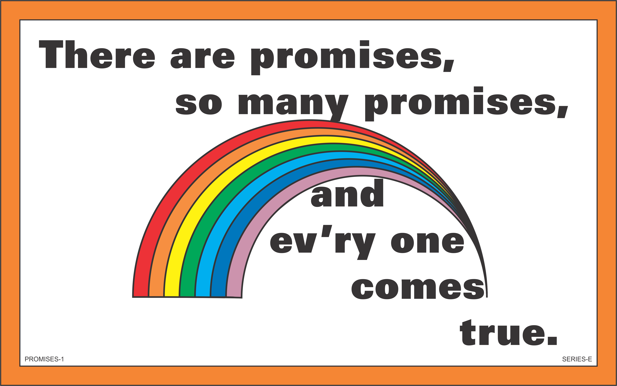
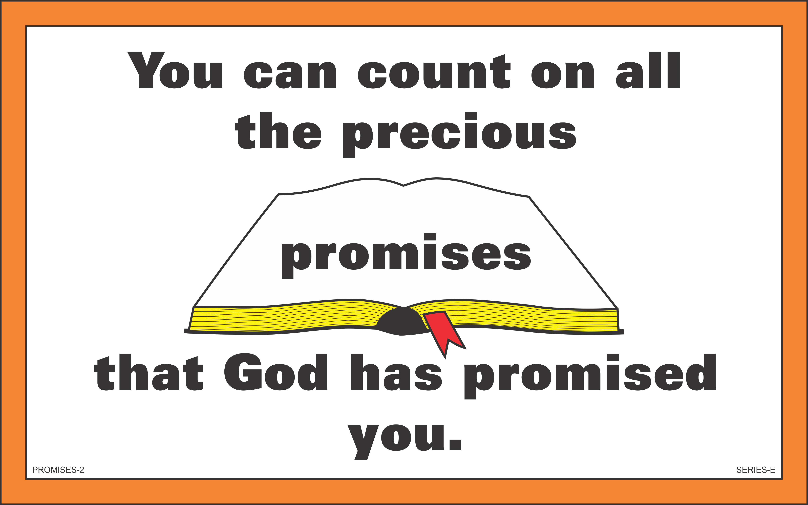
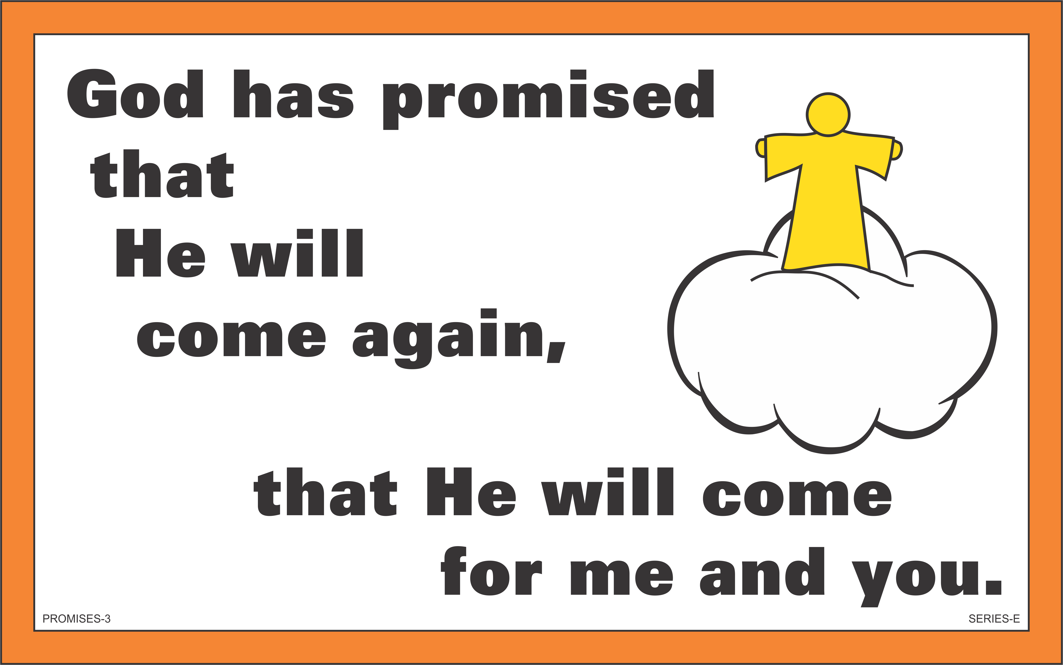
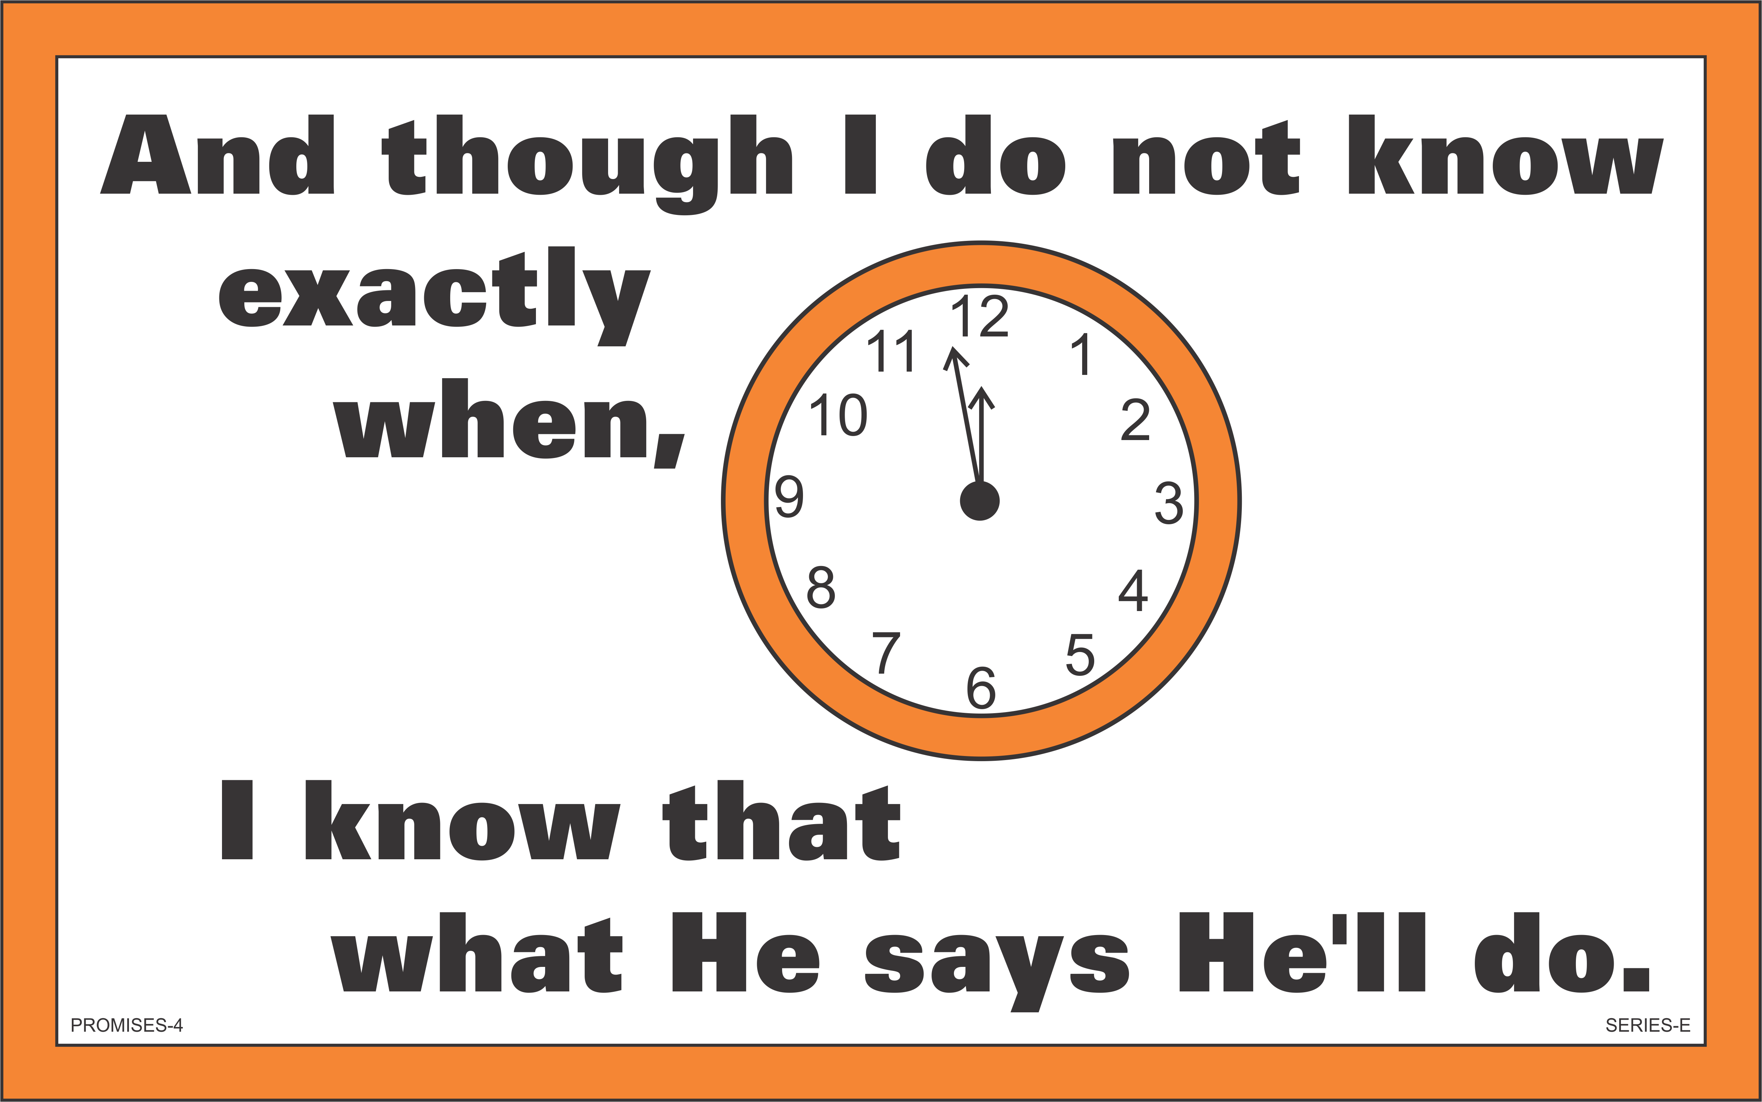


✵ Promises 
Lesson 2: Reason for Covenants

Slide 29
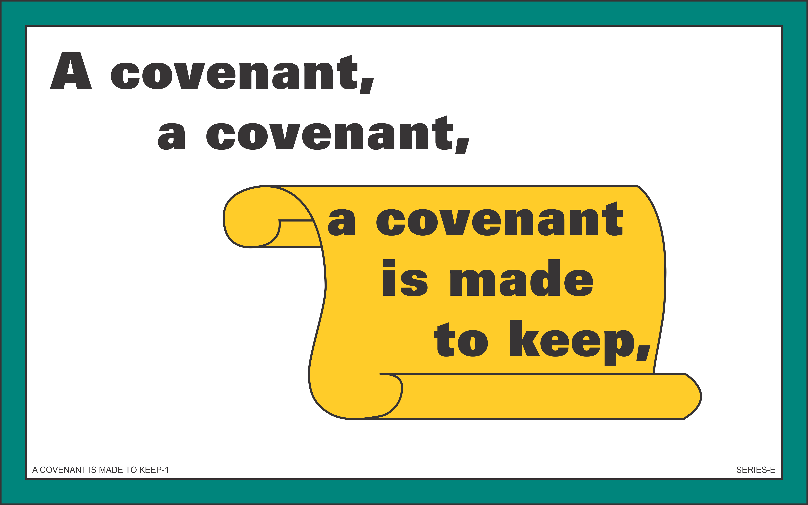
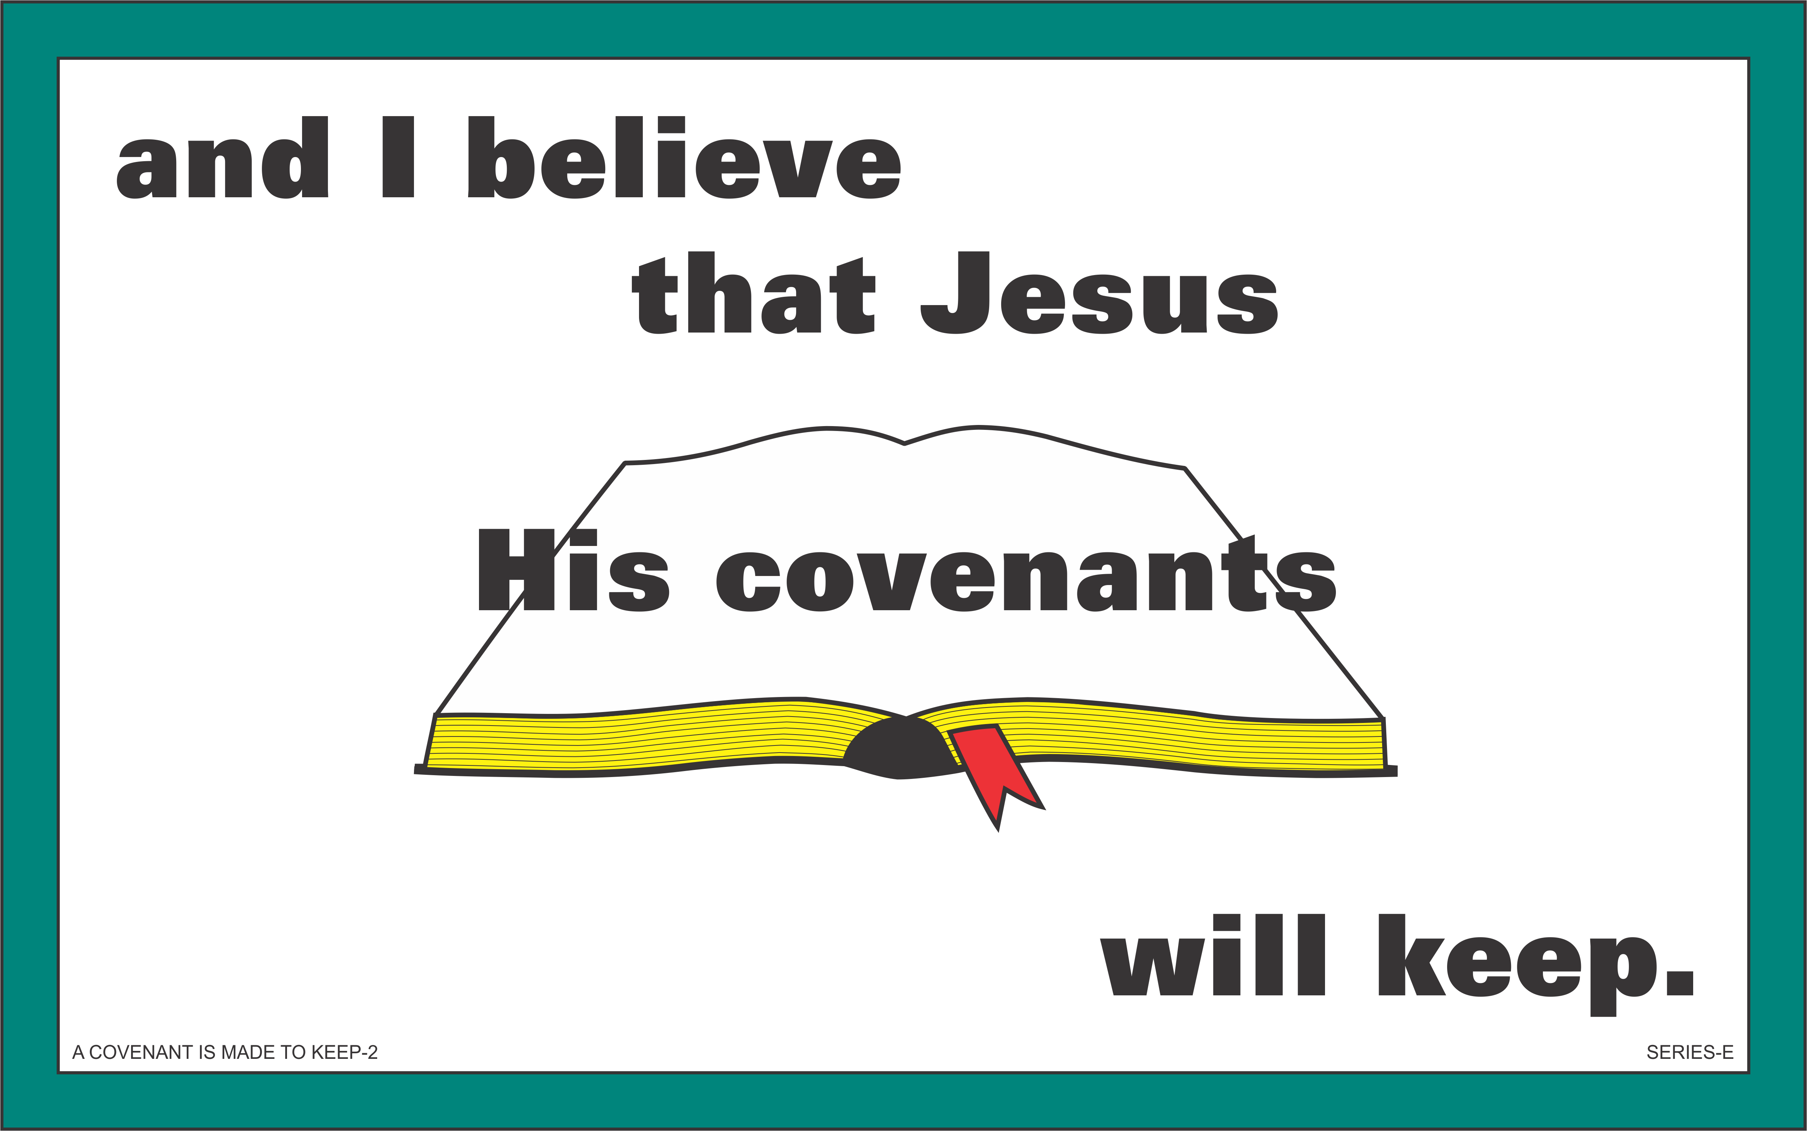
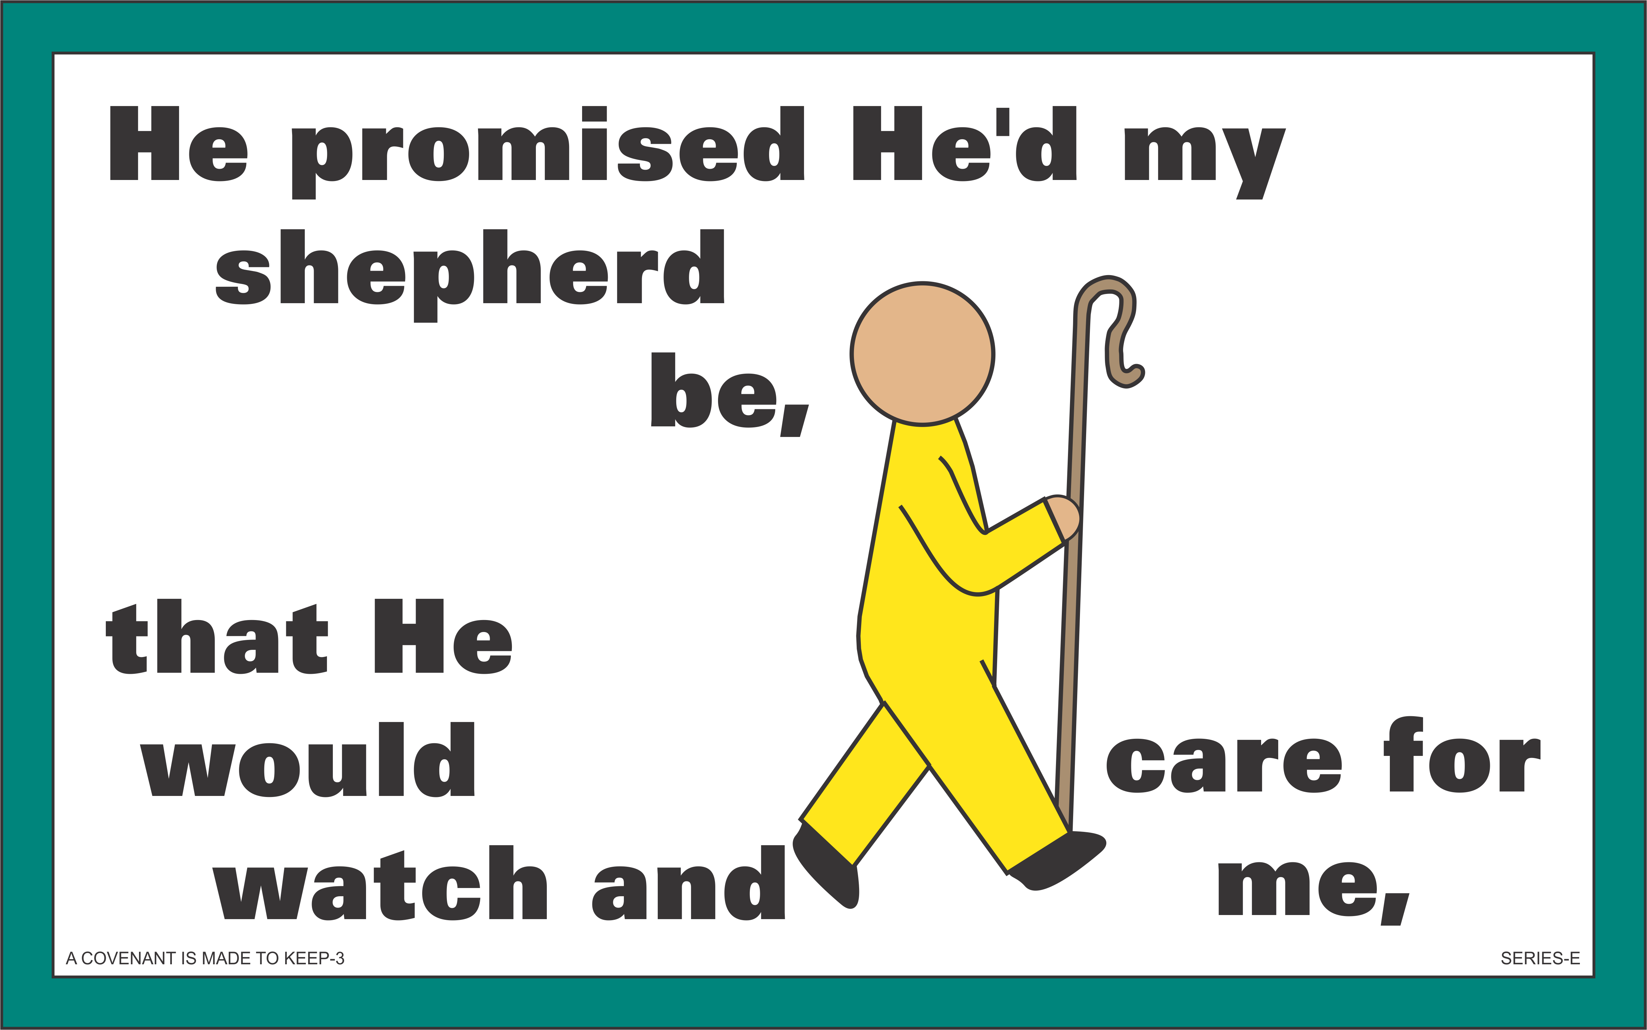



✵ A Covenant Is Made to Keep 
Lesson 2: Reason for Covenants
VERSE 1

Slide 30
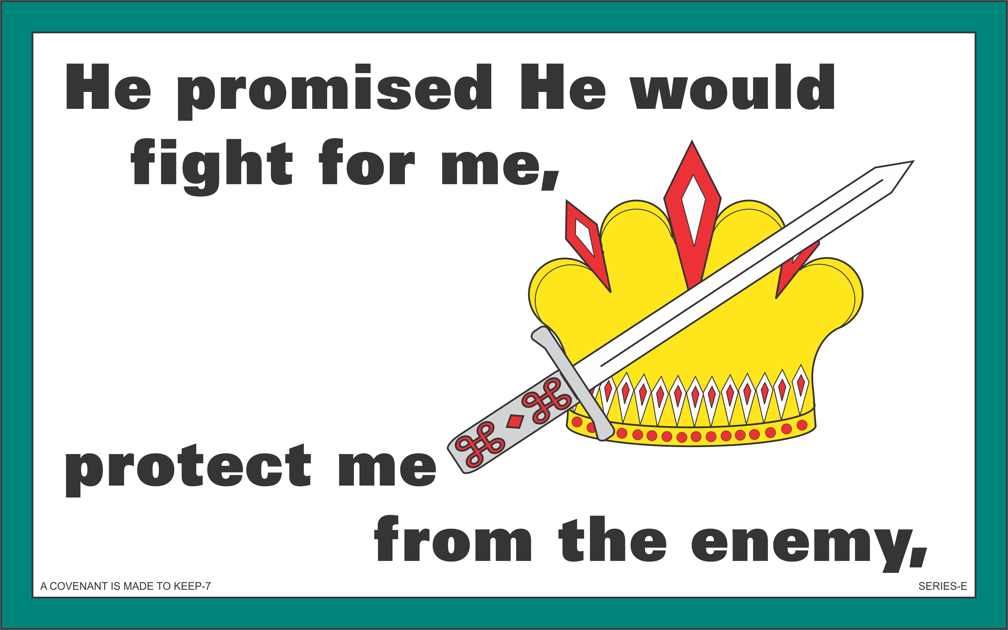



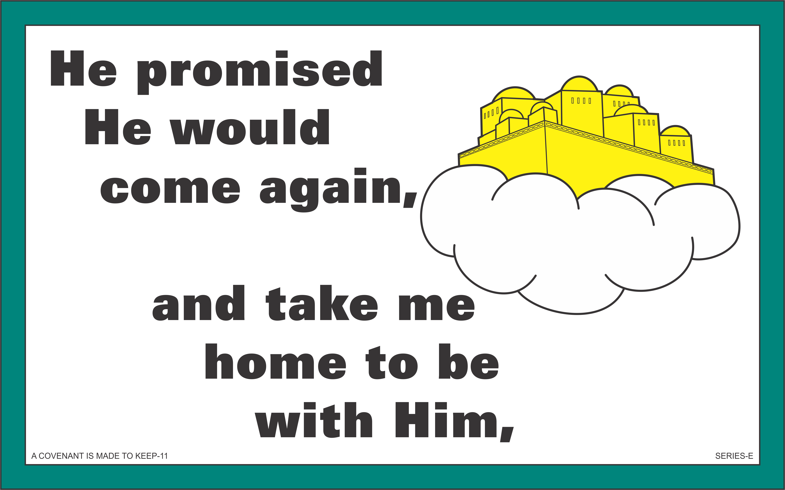

✵ A Covenant Is Made to Keep 
Lesson 2: Reason for Covenants
VERSES 2-3

Slide 31
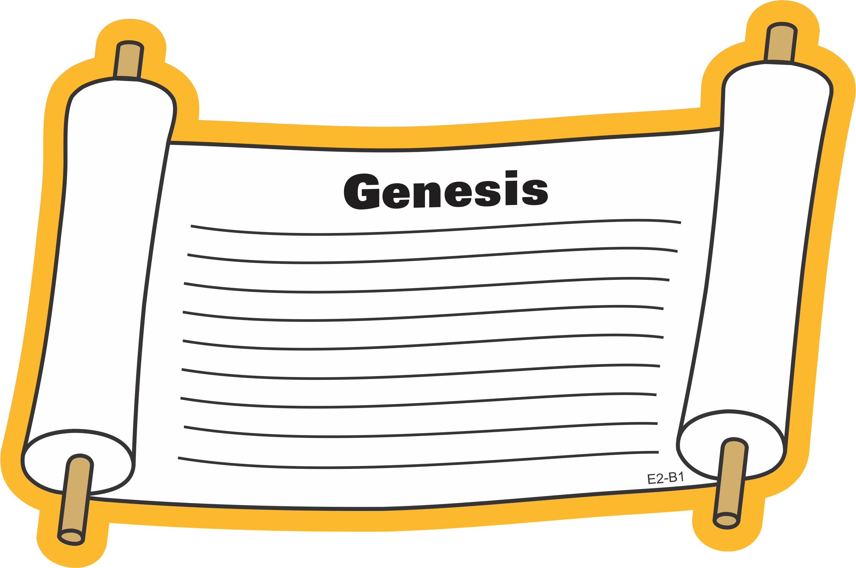
Bible Lesson
Lesson 2: Reason for Covenants

Slide 32
Bible Lesson
Lesson 2: Reason for Covenants
“All peoples on earth will be blessed through you” (Genesis 12:3).

Slide 33
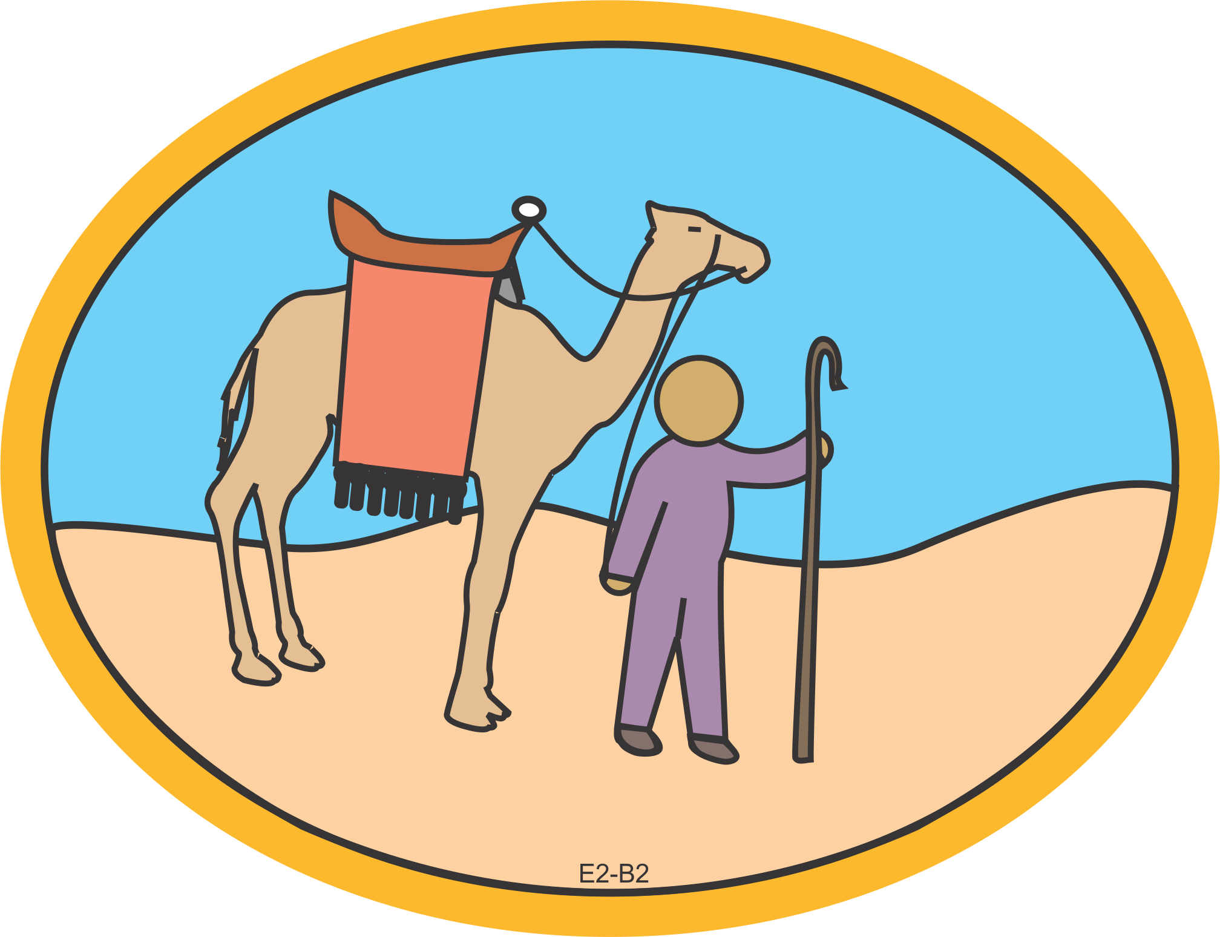
Bible Lesson
Lesson 2: Reason for Covenants

Slide 34
Bible Lesson
Lesson 2: Reason for Covenants
“Leave your country, your people and your father’s household and go to the land I will show you” (Genesis 12:1).
Promise #1: Land

Slide 35
Bible Lesson
Lesson 2: Reason for Covenants
“To your offspring I will give this
land” (Genesis 12:7).
Promise #2: Descendants

Slide 36
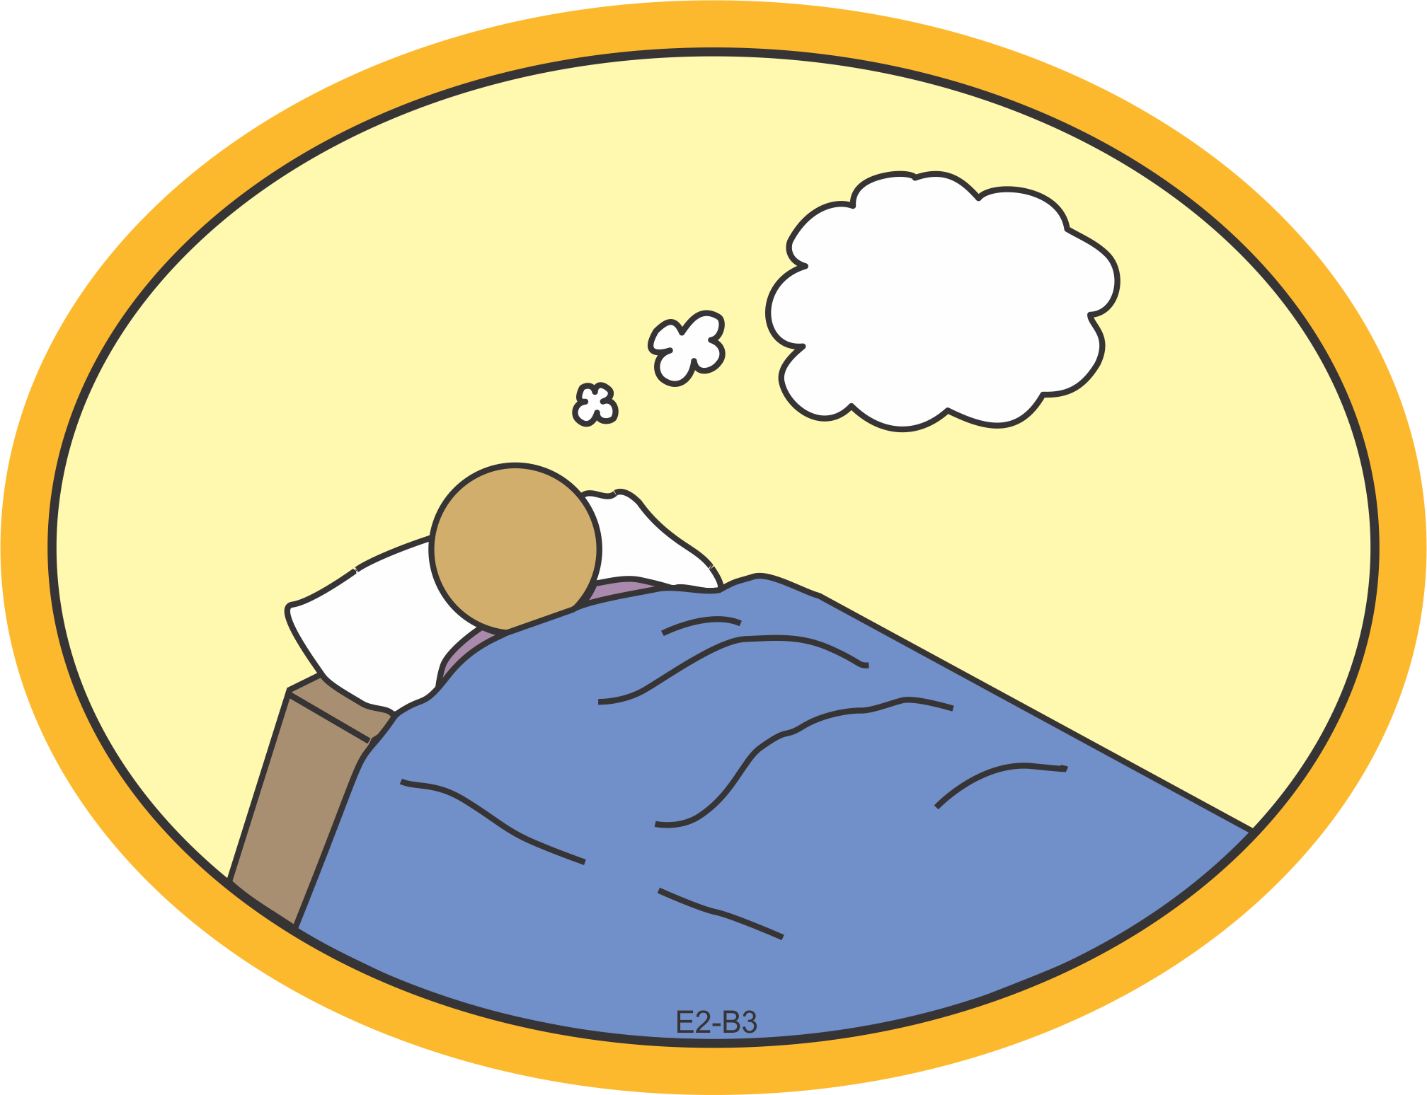
Bible Lesson
Lesson 2: Reason for Covenants

Slide 37
Bible Lesson
Lesson 2: Reason for Covenants
“Do not be afraid, Abram. I am your shield, your very great reward.” But Abram said, “O Sovereign Lord, what can You give me since I remain childless … . You have given me no children; so a servant in my household will be my heir” (Genesis 15:1-3).

Slide 38
Bible Lesson
Lesson 2: Reason for Covenants
“This man [your servant] will not be your heir, but a son coming from your own body will be your heir” (Genesis 15:4).
Promise #2: Descendants

Slide 39
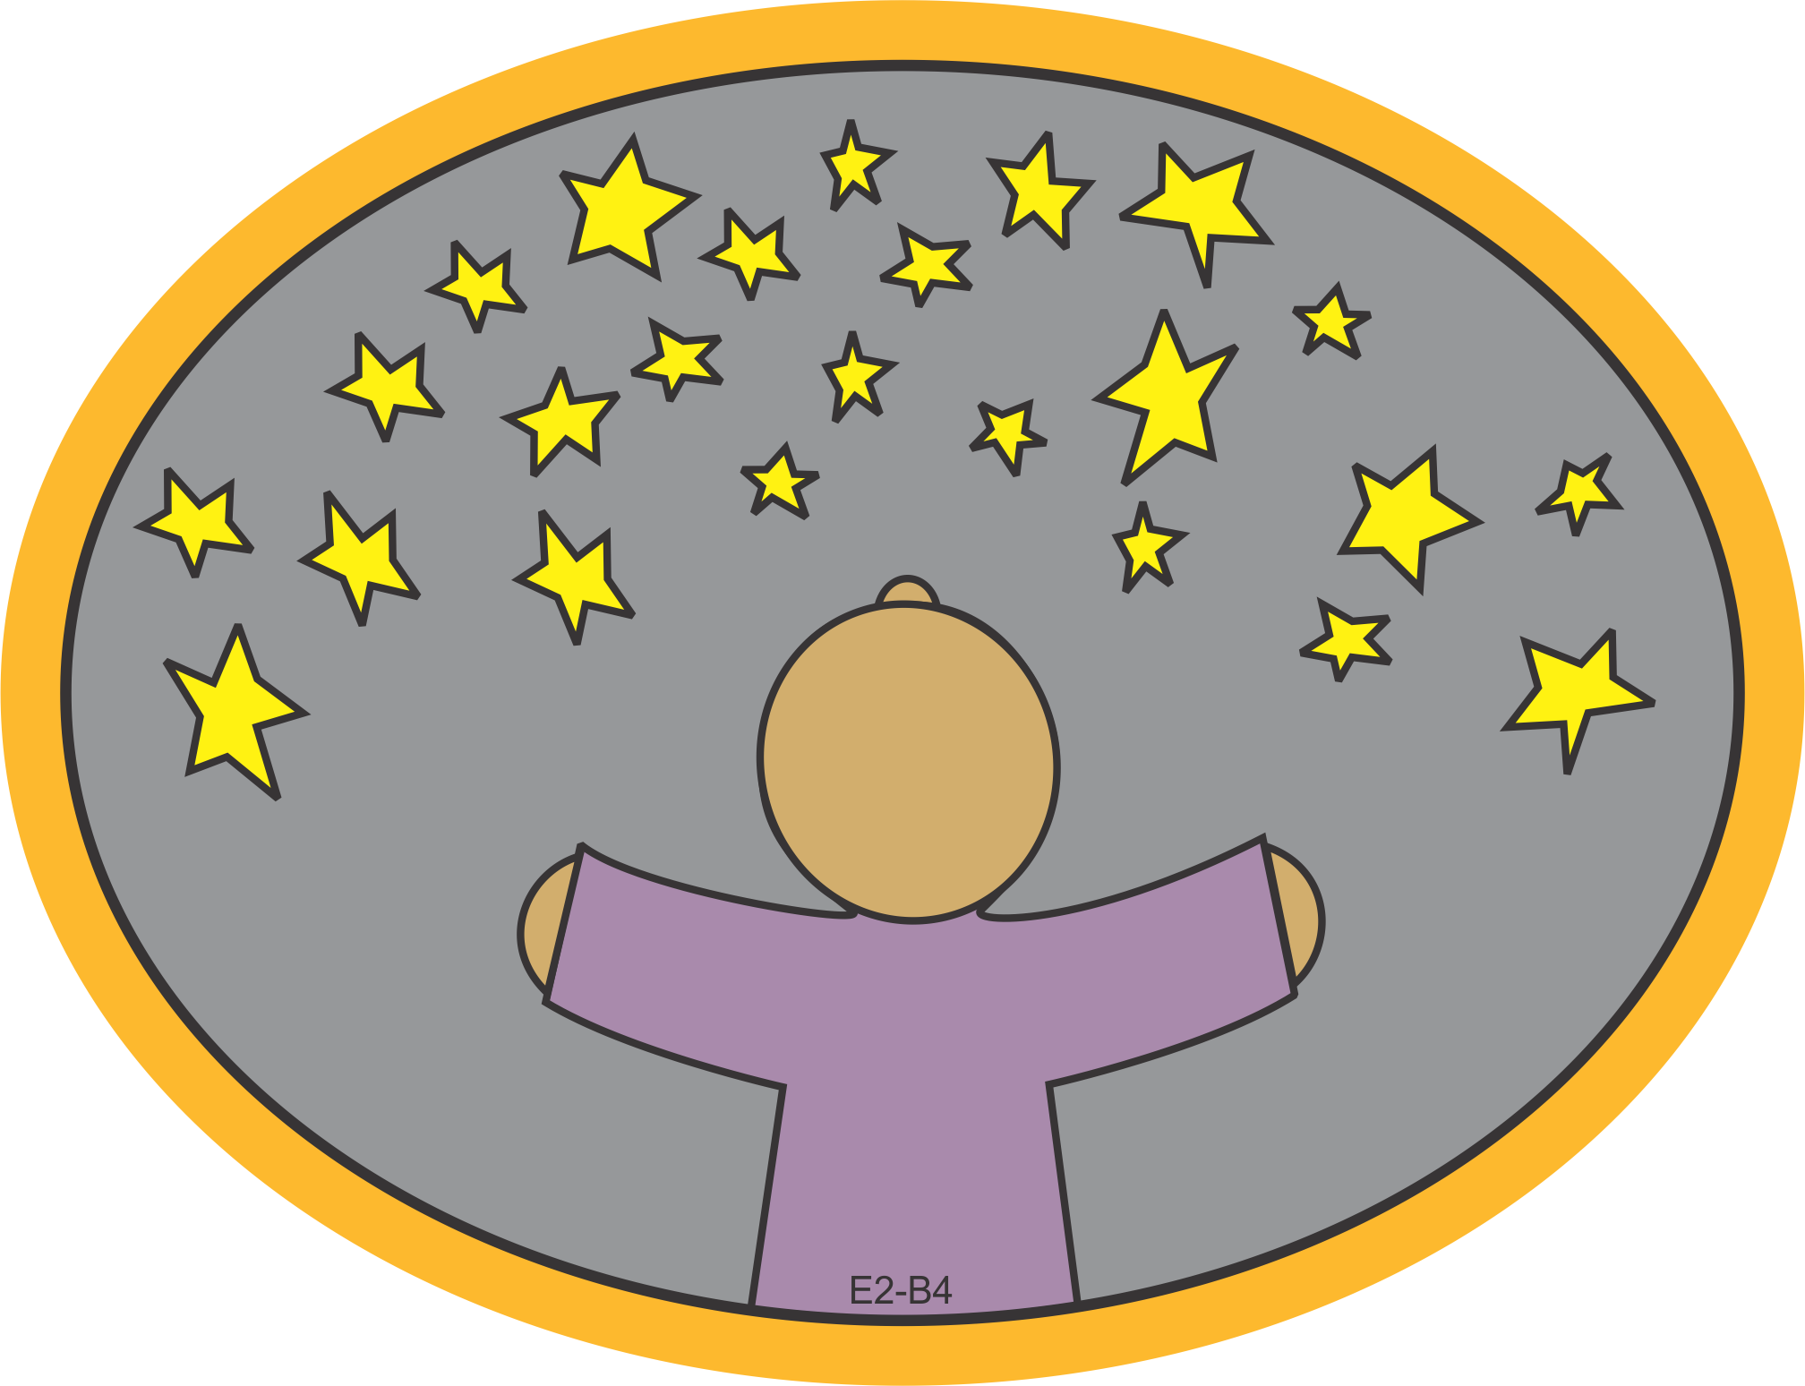
Bible Lesson
Lesson 2: Reason for Covenants

Slide 40
Bible Lesson
Lesson 2: Reason for Covenants
“Look up at the heavens and count the stars—if indeed you can count them. … So shall your offspring be” (Genesis 15:5).
Promise #2: Descendants

Slide 41
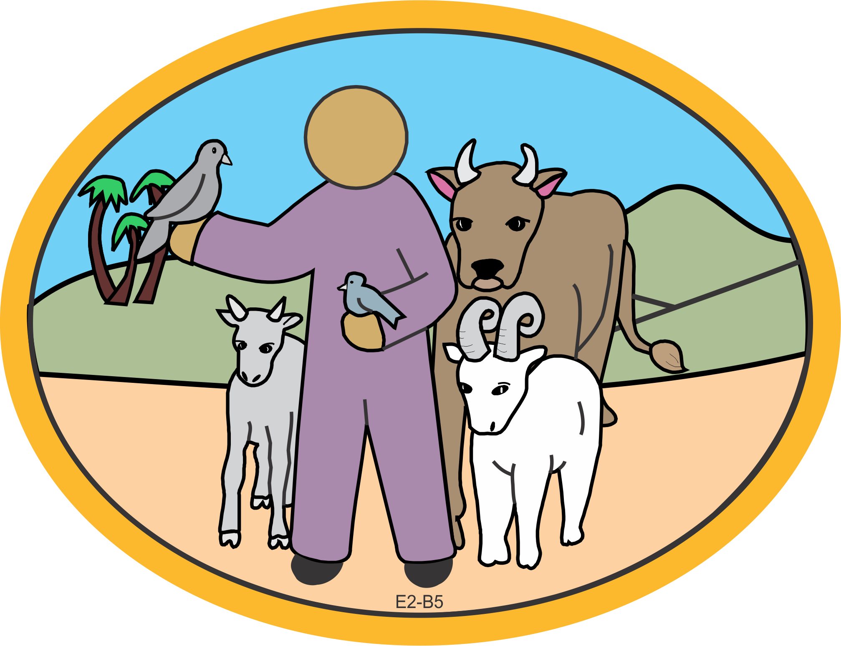
Bible Lesson
Lesson 2: Reason for Covenants

Slide 42
Bible Lesson
Lesson 2: Reason for Covenants
“O Sovereign Lord, how can I know that I will gain possession of [the land]?” So the Lord said to him, “Bring Me a heifer, a goat and a ram, each three years old, along with a dove and a young pigeon” (Genesis 15:8-9).
Promise #1: Land

Slide 43
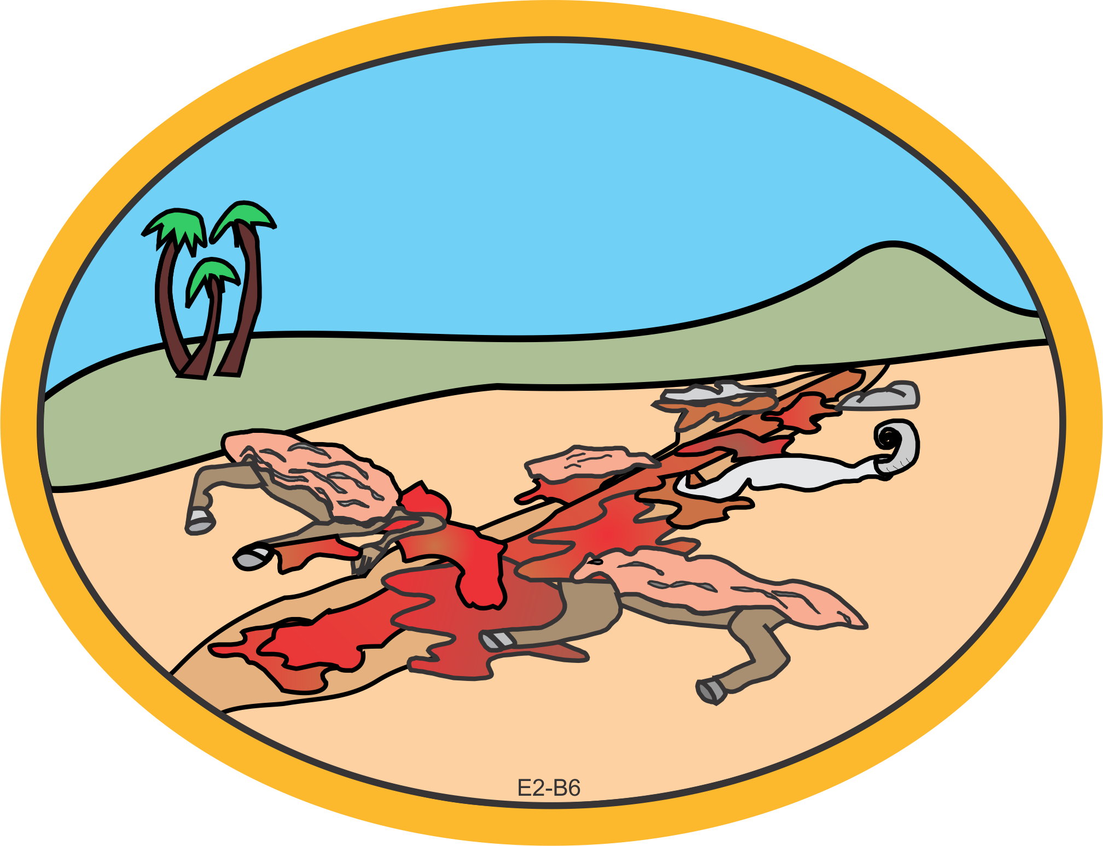
Bible Lesson
Lesson 2: Reason for Covenants

Slide 44
Bible Lesson
Lesson 2: Reason for Covenants
Abram … cut them in two and arranged the halves opposite each other; the birds, however, he did not cut in half (Genesis 15:10).

Slide 45
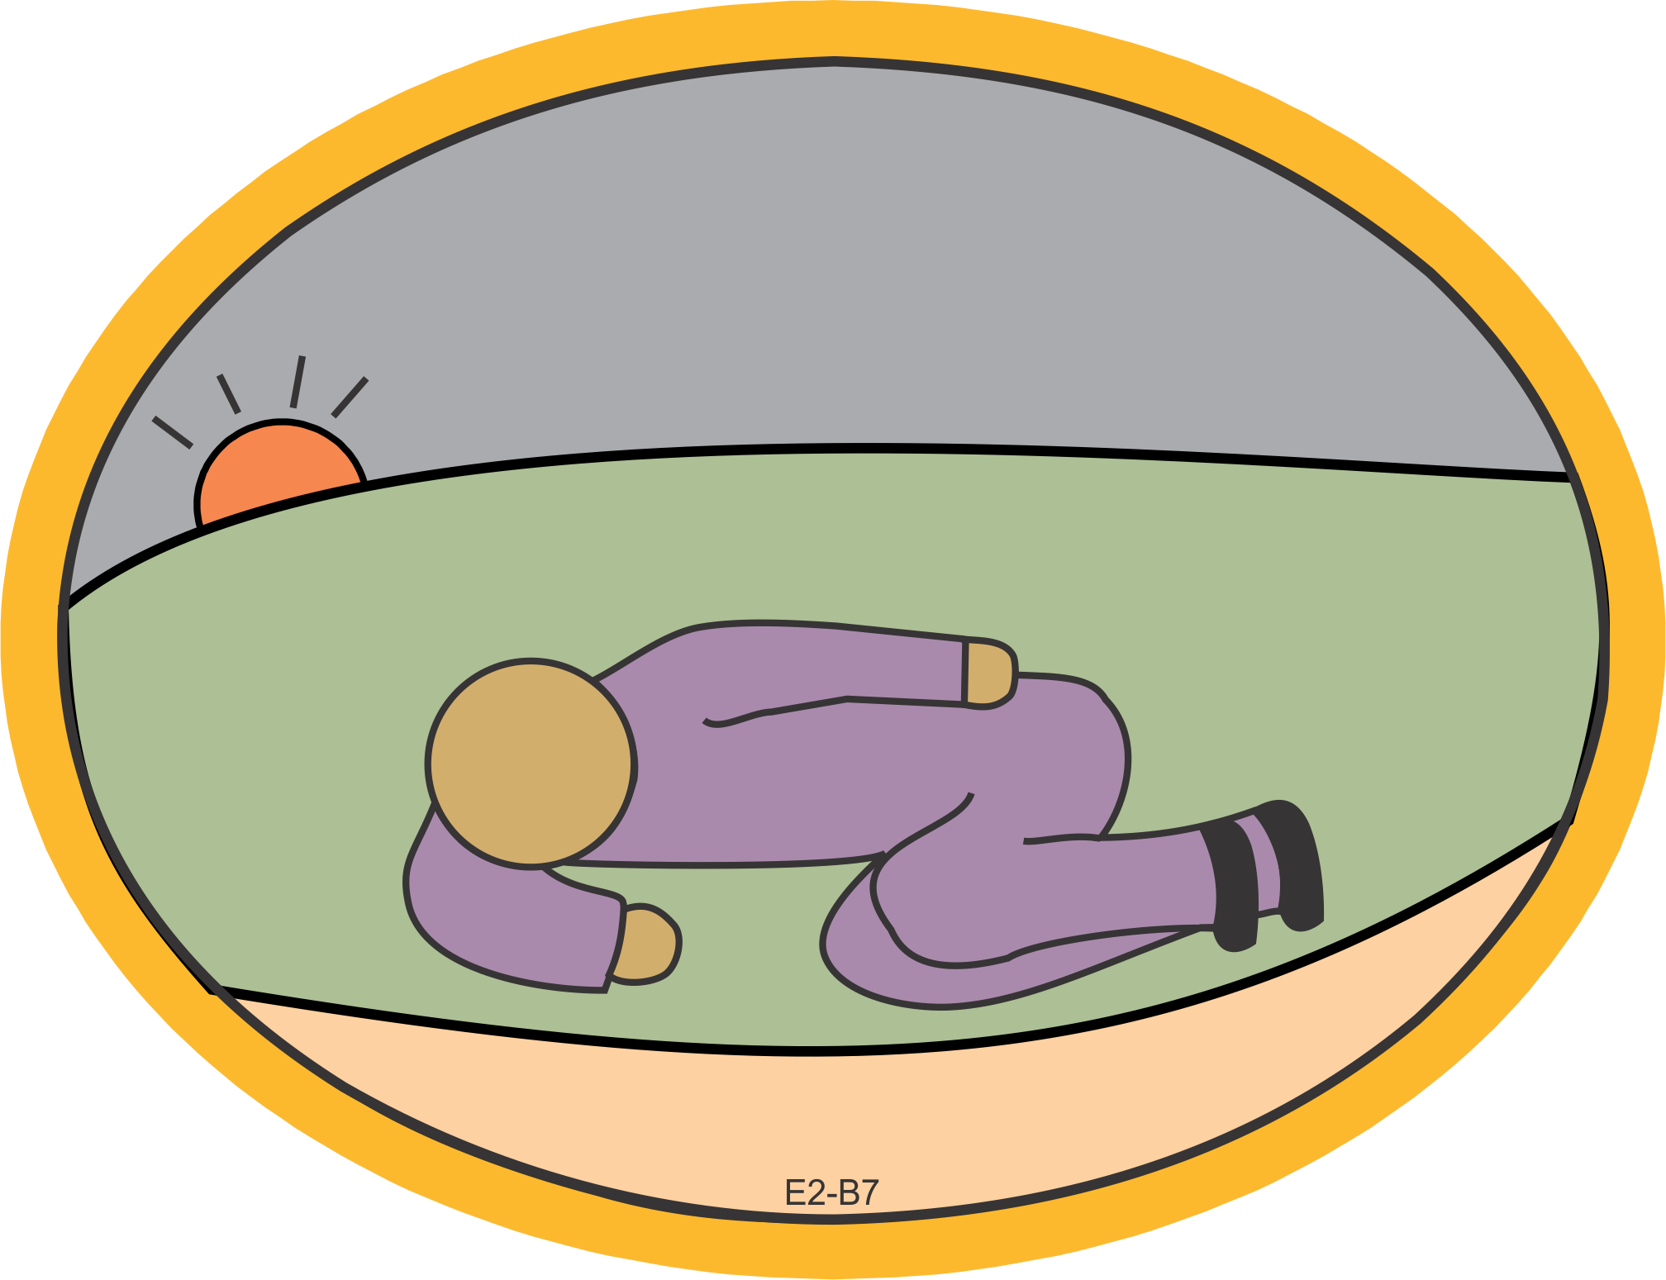
Bible Lesson
Lesson 2: Reason for Covenants

Slide 46
Bible Lesson
Lesson 2: Reason for Covenants
As the sun was setting, Abram fell into a deep sleep, and a thick and dreadful darkness came over him (Genesis 15:12).

Slide 47
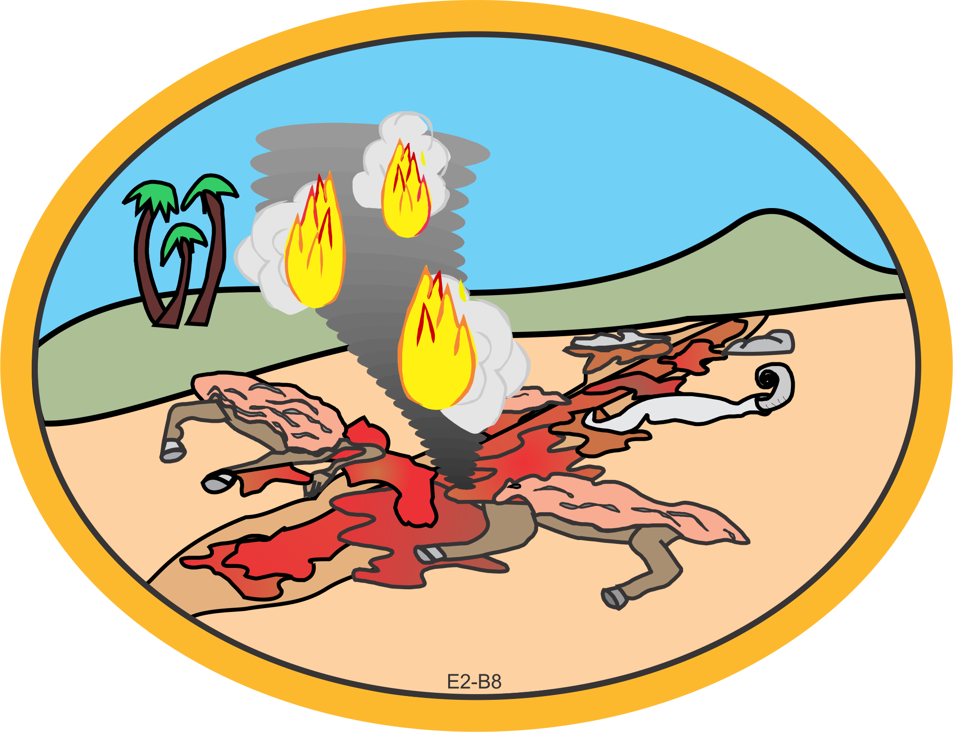
Bible Lesson
Lesson 2: Reason for Covenants

Slide 48
Bible Lesson
Lesson 2: Reason for Covenants
When the sun had set and darkness had fallen, a smoking firepot with a blazing torch appeared and passed between the pieces. On that day the Lord made a covenant with Abram and said, “To your descendants I give this land” (Genesis 15:17-18).
Promise #1: Land
Promise #2: Descendants

Slide 49

Bible Lesson
Lesson 2: Reason for Covenants

Slide 50
Bible Lesson
Lesson 2: Reason for Covenants
Christ died for our sins according to the Scriptures, … He was buried, … [and] He was raised on the third day according to the Scriptures (I Corinthians 15:3-4).

Slide 51
Bible Lesson
Lesson 2: Reason for Covenants
Consider Abraham: “He believed God and it was credited to him as righteousness.” Understand, then, that those who believe are children of Abraham (Galatians 3:6-7).

Slide 52
Review Game
Lesson 2: Reason for Covenants
1. Why did God make covenants with His people?
  God’s eternal plan is to reveal Himself to us through His covenant promises.
2. Recite Jeremiah 32:38-39.
  Jeremiah 32:38-39, “They will be My people, and I will be their God. I will give them singleness of heart and action, so that they will always fear Me for their own good and the good of their children after them,” Jeremiah 32:38-39.
Notes:
The Series E textbook describes the “Fill the Chairs” review game.

Slide 53
Review Game
Lesson 2: Reason for Covenants
3. Why was it necessary for God to reveal Himself?
  Because of sin, man could not know God.
4. What did God promise Abraham?
  He promised him land and descendants.
5. What does our memory verse say God will give to His people?
  “Singleness of heart and action”

Slide 54
Review Game
Lesson 2: Reason for Covenants
6. What are the two kinds of fear?
  First, people fear someone may harm them. Second, they fear displeasing someone they revere and respect.
7. Why did God tell Abraham to bring Him animals?
  He was going to confirm a prior verbal covenant with Abraham.
8. Who walked between the animal parts?
  God alone

Slide 55
Review Game
Lesson 2: Reason for Covenants
9. Why didn’t Abraham walk between them?
  God caused him to fall asleep.
10. Why did God cause Abraham to fall asleep?
  God alone would make the covenant promise.
11. How did God bear the curse of the covenant?
  He sent His Son, Jesus Christ, to die for our sins.
12. What is a God-made covenant?
  A promise that God gives to His people and establishes by His unchangeable Word

Slide 56
Review Game
Lesson 2: Reason for Covenants
13. How does a man-made covenant differ from a God-made one?
  In a man-made covenant, each person agrees to the terms. In a God-made covenant, God alone sets the terms.
14. When God makes a covenant, how can you be sure He will keep it?
  God always keeps His promises.

Slide 57
Review Game
Lesson 2: Reason for Covenants
15. What was the sign of the covenant God made with Noah?
  The rainbow
16. What did God promise in His covenant with Noah?
  He would never again destroy all life with a flood.

