Slide 1




Investigating challenges and health concerns of female firefighters: A Review
#WAFA25
Authors:
Ms. W.D. Ruwandi Fernando
Prof. Marianella Chamorro-Koc
A/Professor Ajay Pandey
Dr. Daniel Cook

Slide 2
#WAFA25
Overview
Introduction
Significance
Methodology
Findings
Systematic review
Literature review
Current research go-forward

Slide 3
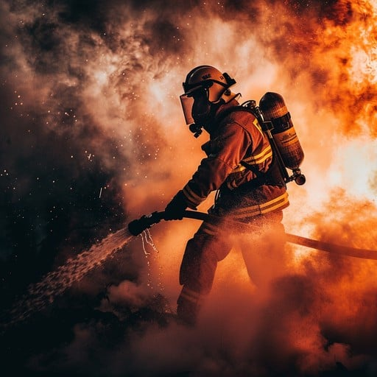

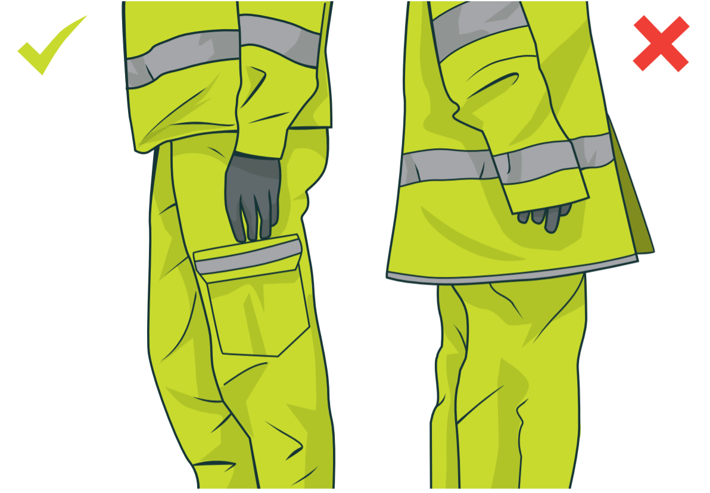
Introduction: Understanding firefighting profession and gender disparities
#WAFA25
Firefighting
Gender disparities
Physically demanding
high-risk
Historically male-dominated
Underrepresentation
9% of U.S & 2% in Australia
PPE: male body structure based
(Source: NFPA, 2022; Fire Recruitment Australia, 2022; McQuerry et al., 2023)
Introduction
Significance
Methodology
Findings
Go-forward
Notes:
Firefighting is a physically demanding and high-risk job: that involves extreme exposure to heat, hazards, and chemicals. These extreme exposure leads to long term health concerns majorly due to heat risk and cancer risk.
Firefighting is historically male dominated. Gendered culture and infrastructure shaped the profession.
Underrepresentation of women persists globally:
Only 9% of U.S. firefighters are women (NFPA, 2022)Only 2% in Australia (Fire Recruitment Australia, 2022)
Considering the PPE, according to literature male body structure based specifications for PPE has been considered. These structural and cultural barriers affect integration, safety, and career progression of female firefighters.
Therefore, literature suggests that there is a need for research on how gender shapes firefighting experiences and health outcomes that aligns with the theme - Courage Under Fire: Building Safety, Inclusion and Respect in the Heat of Change

Slide 4
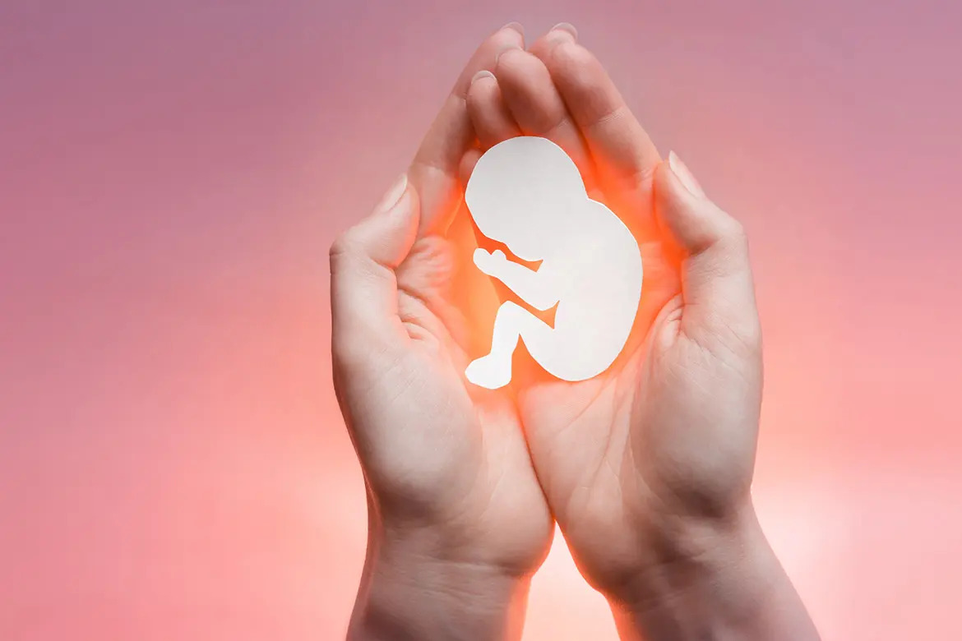



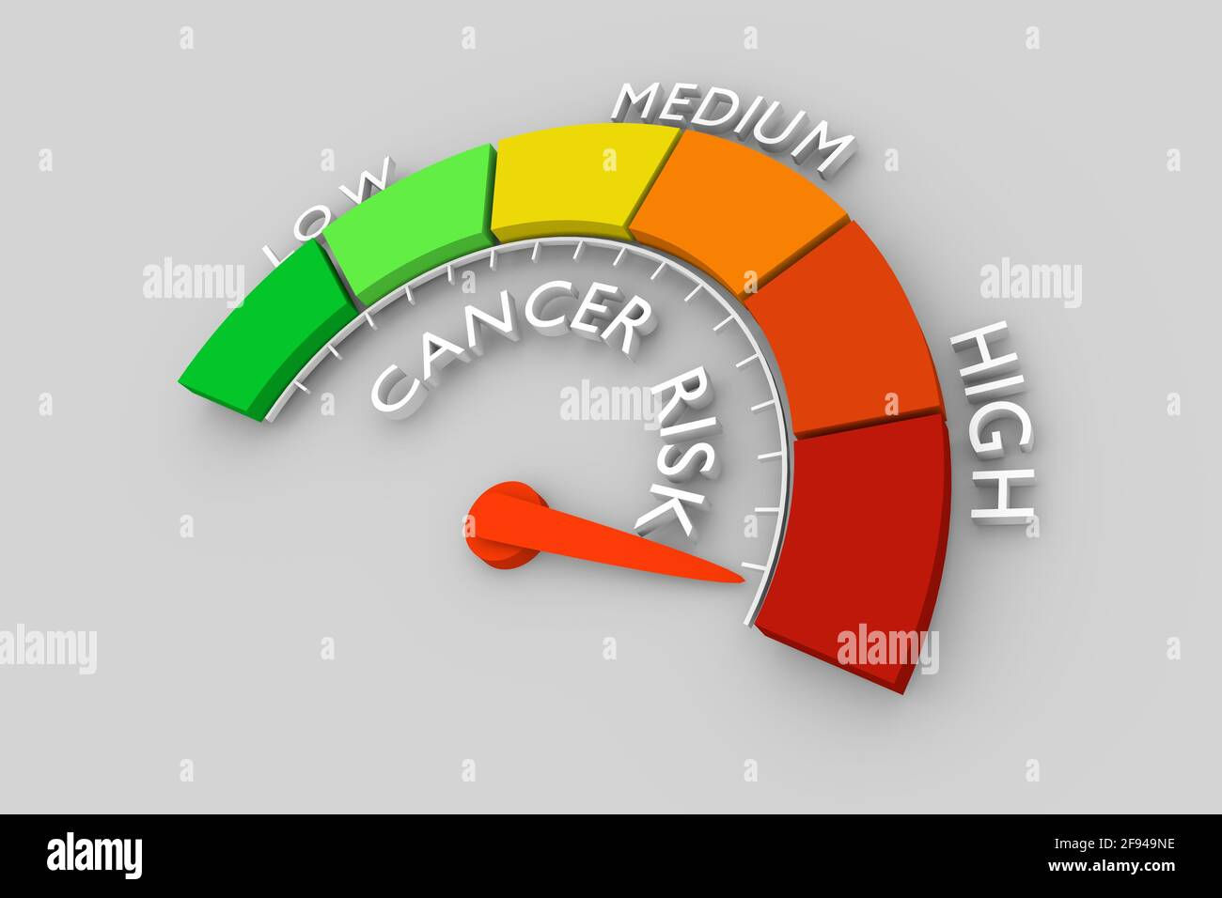
Introduction: health concerns and safety risks
#WAFA25
Elevated health concerns
Health & safety risks
Heat risk
Miscarriages
Pregnancy complications
Menstruation
Cancer risk
Introduction
Significance
Methodology
Findings
Go-forward
Notes:
Challenges for women in firefighting go beyond representation: that impact safety, inclusion and respect.
Biologically set up in such a way…..
Evidence from female firefighter reports and occupational health studies highlights miscarriage as a significant concern. Repeated exposure to heat stress, physical exertion, during early pregnancy may elevate the risk of spontaneous pregnancy loss.
The physical and thermal demands associated with firefighting may contribute to challenges during pregnancy and menstruation, such as increased physiological strain.
Research Gap: Effective heat risk monitoring in firefighters remain underexplored.
Human-centered design can enable informing the wearable tech development focused on heat safety. (Human-centric design enables wearable tech development focused on heat safety.)

Slide 5
Significance
#WAFA25
Acknowledges Understudied Needs
gender-related heat risks
Supports inclusive design
HCD
Improves relevance of technology
Design for Safety
Introduction
Significance
Methodology
Findings
Go-forward
Notes:
Design for safety is a new area of exploration considering safety not as an afterthought element but a foundational element throughout the design process.
While wearable sensor technologies are advancing, research often ignores people’s safety experiences, resulting in devices that don’t fully meet real-world needs.

Slide 6
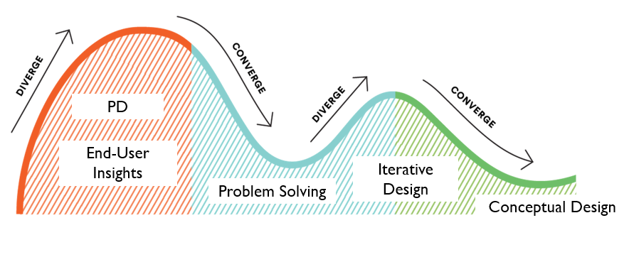
Human-Centered Design approach
#WAFA25
Introduction
Significance
Methodology
Findings
Go-forward
Notes:
HCD is an approach to problem-solving and innovation that prioritizes the needs, lived experiences, and perspectives of the people for whom the solution is intended.
In the context of safety and well-being, HCD ensures that solutions are developed not only with technical efficiency in mind but also with a deep understanding of the human experience

Slide 7

Methodology
#WAFA25
Literature Review (LR)
Reviewed studies on reproductive health, PPE, and workplace conditions to identify gender-specific heat risk factors.
Systematic Review (SR)
Conducted a SR capturing safety needs and experiences in general for firefighter trainees
How SR???
Introduction
Significance
Methodology
Findings
Go-forward
Notes:
Covidence
It is a powerful web-based tool designed to streamline the process of conducting systematic reviews. It supports researchers in managing the extensive and often complex tasks involved in systematic reviews, from screening and data extraction. By automating and simplifying key aspects of systematic reviews, Covidence significantly reduces the time and effort required, enabling researchers to focus on critical analysis and synthesis of evidence

Slide 8
Findings: Systematic Review findings
#WAFA25
Highlights
Under-exploration of safety needs contribute to trainee fatalities | 1st time exploration of safety experiences in the context of training | Only 1 study involves participatory design
Introduction
Significance
Methodology
Findings
Go-forward
Notes:
Initially had 754 articles, then 13 included studies

Slide 9

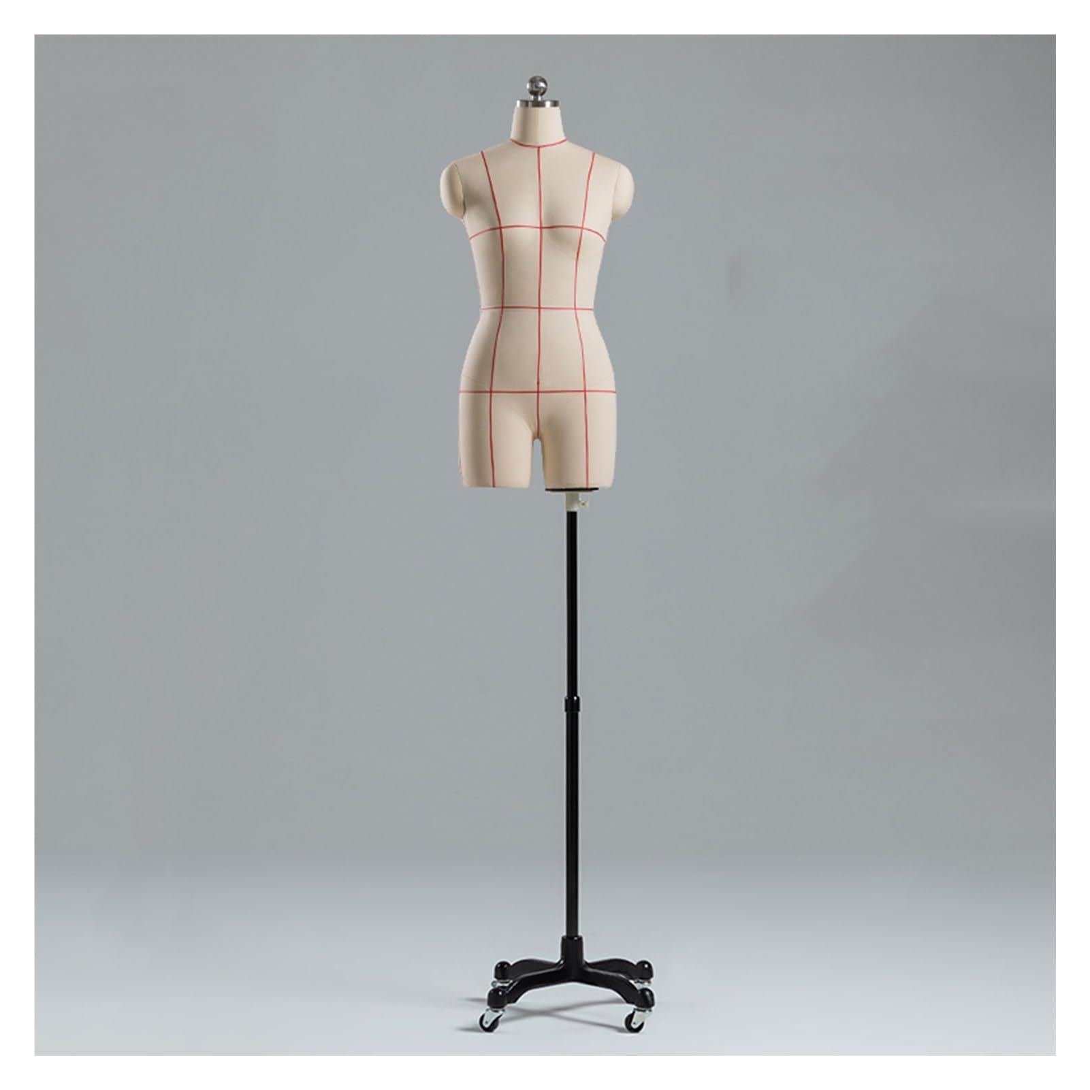
Findings: Identified general challenges
#WAFA25
Gender inequality
gender-based discrimination
workplace harassment
exclusion from certain roles
Inadequate options for PPE
Poor fit, comfort increases injury risk
Disregarding female anatomy
(Source: Hulett et al., 2008; Krause et al., 2023)
(Source: Fahy et al., 2022; McQuerry et al., 2023)
Introduction
Significance
Methodology
Findings
Go-forward
Notes:
According to published reports, female firefighters indicate experiences of gender-based discrimination and workplace harassment, including exclusion from certain roles and inappropriate behaviour. These issues not only affect job satisfaction and mental well-being but also create barriers to progression and retention within the profession (Krause et al., 2023).
Findings from published reports highlight the importance of fostering a workplace culture grounded in inclusion, safety, and respect. Such an environment is essential to ensure that female firefighters are afforded equal opportunities and support. Creating equitable conditions not only enhances their ability to perform effectively but also contributes to long-term retention and well-being within the service. These improvements are key to addressing systemic barriers and promoting a more diverse and resilient firefighting workforce (Hulett et al., 2008).
Findings from the reviewed literature consistently indicate that personal protective equipment (PPE) is often inadequately designed for female firefighters, presenting significant safety and comfort challenges. Most standard PPE is based on male body dimensions, resulting in poor fit for many women. Issues such as oversized gloves, improperly fitting jackets, and restrictive trousers can hinder mobility and increase the risk of injury. Female-specific anatomical features including differing body contours, narrower shoulders, wider hips, and protruding structures like breasts are rarely accounted for in current PPE design. As a result, women may experience discomfort, thermal burden, and compromised protection during operations (Fahy et al., 2022; McQuerry et al., 2023).
Standard PPE is typically designed around male body dimensions, leading to poor fit and functionality for many female firefighters.
Ill-fitting gear such as oversized gloves, restrictive trousers, and loose jackets impairs mobility and increases injury risk.
Current PPE design often overlooks key female anatomical features, including breast contour, narrower shoulders, and wider hips.
Poor fit contributes to physical discomfort, thermal stress, and reduced safety, compromising performance during critical operations.

Slide 10
Findings: Identified health concerns – Hormonal and reproduction related
#WAFA25
Miscarriages
Continuous exposure to heat stress, toxins
Unaware pregnancy
Limited reproductive health assessment
Pregnancy Complications
Heavy PPE adds physical strain
Elevated temperatures
Risks: hypertension, early labor
Menstruation
Facilities often lack menstrual support
Menstrual needs impact readiness, comfort
(Source: Jung et al., 2021)
(Source: Richardson et al., 2019, 2020)
(Source: Höök et al., 2021)
Introduction
Significance
Methodology
Findings
Go-forward
Notes:
Miscarriages
Evidence from female firefighter reports and occupational health studies highlights miscarriage as a significant concern. Repeated exposure to heat stress, physical exertion, and toxicants during early pregnancy may elevate the risk of spontaneous pregnancy loss. In several cases, women continued shift duties without awareness of early pregnancy or without accommodations, potentially increasing vulnerability. Limited access to reproductive health assessments and absence of workplace policies addressing early pregnancy considerations further compound the risk. Addressing these gaps by incorporating routine reproductive health screenings and creating early disclosure support mechanisms may help mitigate miscarriage risk in firefighting roles (Jung et al., 2021).
Pregnancy Complications
The physical and thermal demands associated with firefighting may contribute to challenges during pregnancy, such as increased physiological strain. Factors including the use of heavy personal protective equipment (PPE), prolonged exposure to elevated temperatures, and physically demanding tasks can place additional stress on the body. Some literature highlights around potential pregnancy-related outcomes like hypertension or early labor, although direct causal relationships require further investigation (Richardson et al., 2019, 2020).
Menstruation presents a range of practical and physiological considerations that can affect the experiences of female firefighters during training and operational duties. While the subject has traditionally received limited attention in fire service planning, emerging literature suggest that standard facilities and work environments are not always conducive to managing menstrual health comfortably or effectively (Richardson et al., 2019).
While further research is needed, current findings suggest that gender-sensitive infrastructure, access to sanitary products, and inclusive workplace practices can help support the well-being and operational readiness of female firefighters. Literature suggests a Human-Centered Design (HCD) approach offers valuable insights into their needs and lived experiences, informing more effective and inclusive solutions (Höök et al., 2021). Creating space for open conversation around menstrual health within fire services may also help reduce stigma and promote more equitable working conditions for all personnel.

Slide 11
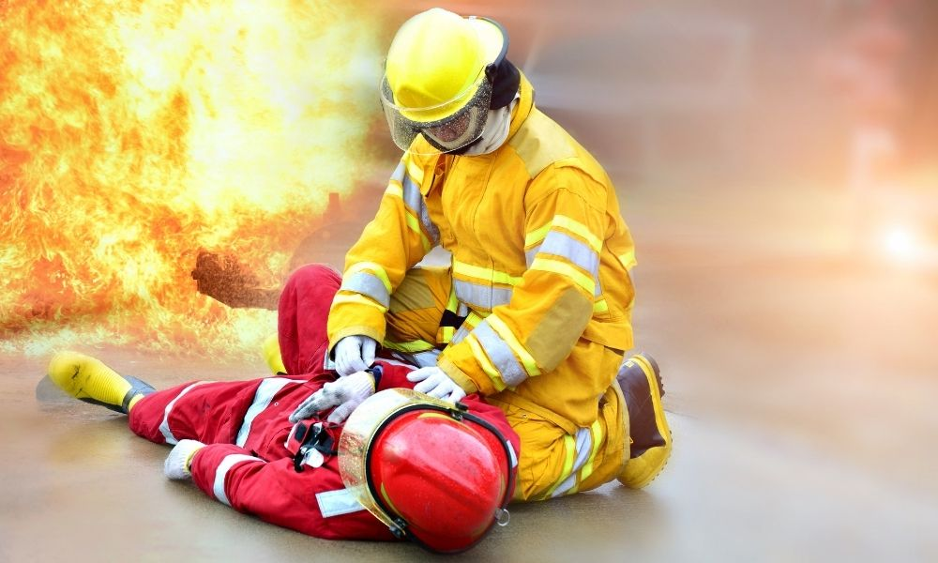

Findings: Heat Risk
#WAFA25
Global Problem
Australia
[473 firefighters F&R NSW lived experiences]
Hottest:
Structural fires (68%) followed by Bushfires (51%)
NFPA reported fatal injuries hike in 2022
Hottest area of body:
Head (58%)
Upper back (40%)
Overexertion / Heat stress
(51%)
(Sources: Campbell & Petrillo, 2023)
(Sources: Fullagar et al., 2021)
Introduction
Significance
Methodology
Findings
Go-forward
Notes:
(This annual study includes only on-duty fatal firefighter injuries that occurred in the 50 states and the District of Columbia) per year)
Australia:
They remove the head gear, water immersion, sit on a shade – which are not standards but general practices that could make an unsafe environment (Specially removing the head gear). Link – exploring existing heat risk monitoring devices and techs

Slide 12
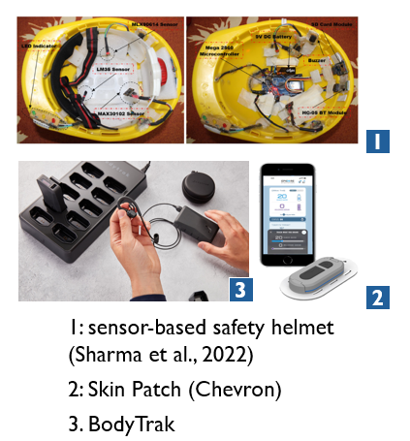
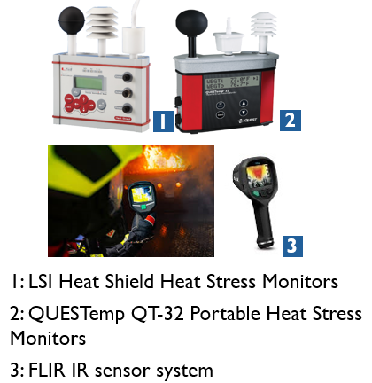
Findings: Existing technologies for heat risk monitoring
#WAFA25
Environmental sensing
Ambient T | RH | WGBT | Radiant Heat
Physiological sensing
CBT | Skin T | HR & HRV | Sweat rate
Introduction
Significance
Methodology
Findings
Go-forward
Notes:
Heat risk is a leading cause of fatalities among firefighters, with early-career firefighters (defined in this research as those with less than 5years of experience) particularly vulnerable to occupational injuries (Campbell & Petrillo, 2023). Heat risk monitoring for firefighters involves assessing both ambient heat stress (e.g., temperature, humidity) and physiological heat strain (e.g., heart rate, respiration, core body temperature [CBT]). CBT is considered the most accurate indicator of thermal strain (Buller et al., 2015; Morrissey et al., 2021). However, current field methods for measuring CBT such as ingestible capsules and rectal probes are invasive, impractical, and inconvenient for firefighting training (Thomas et al., 2019; Wibowo et al., 2024). Emerging approaches suggest CBT may be estimated from heart rate data or skin temperature using wearable sensors, but these remain largely validated under lab conditions (Holm et al., 2016; Zheng et al., 2020).
Limitations of devices for environmental parameter sensing: External monitoring of the ambient temperature, Alert mechanisms, Integration issues
Limitations of end user physiological parameter sensing: Bulkiness, Discomfort, Inhomogeneous on body surface, Integration issues to the PPE

Slide 13
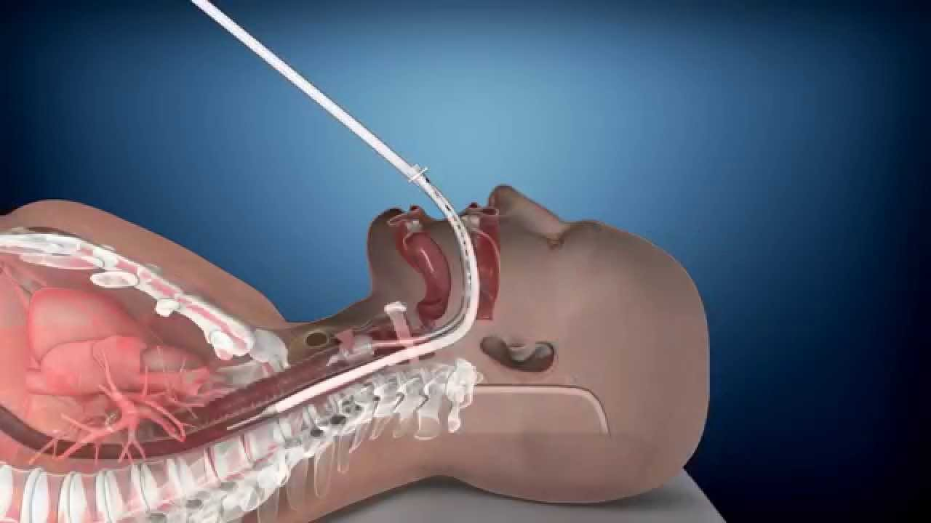
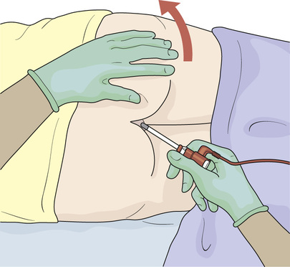
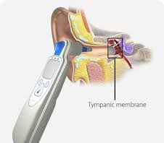
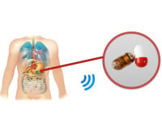
Findings: Comparison of CBT measuring techs (Accuracy vs Convenience)
#WAFA25
Accuracy
Figure 1: accuracy vs convenience plot
Figure 2: Visual representation
Rectal
Telemetry pills
Oesophageal
Tympanic (In-ear)
Oesophageal
Rectal
Algorithm based
Skin
Tympanic (In-ear)
Telemetry pills
Convenience
(Source: Dolson et al., 2022; Agostinelli et al., 2023)
Introduction
Significance
Methodology
Findings
Go-forward
Notes:
Therefore, an accuracy vs convenience map was plotted….
CBT measuring techniques across multiple industries such as firefighting, medical, outdoor workers, athletes and etc
Selection of Tympanic temperature

Slide 14



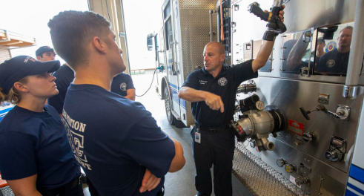
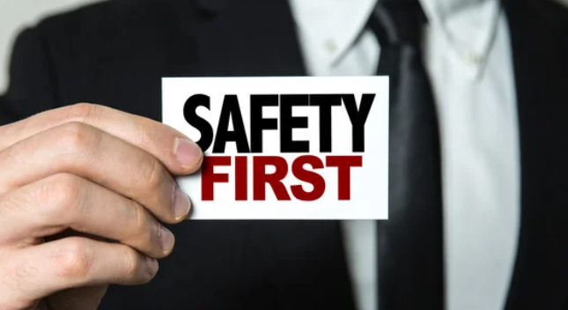
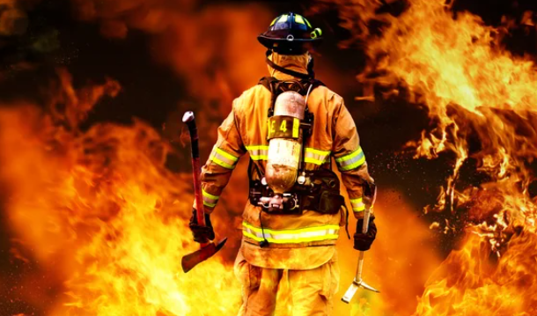
Findings: Design and safety for firefighters
#WAFA25
Designers
HCD in Design for Safety
Offer proactive safety for high-risk professions
Enhance Safety
Support building confidence and resilience
Technology Engineers
Design for Safety
Policy makers
Training Coordinators
OHS Experts
End-User (Firefighter)
Introduction
Significance
Methodology
Findings
Go-forward
Notes:
Explain why we need HCD in DfS approach
As the process focusing on functionality, aesthetics and human experiences in designing devices that has better usability and trust in technology that ensures safety and wellbeing of high-risk professions like firefighters.

Slide 15
Go-forward
#WAFA25
Exploring how wearable sensor technologies can monitor heat risk in firefighter trainees during training
Conduct experimental work
Exploring safety needs and experiences in the context of heat risk
Conduct Focus group discussions
Introduction
Significance
Methodology
Findings
Go-forward
Notes:
Explain the plan of experimental work

Slide 16
Thank you!
Contact Details
Name: W.D. Ruwandi Fernando
PhD Scholar,
Queensland University of Technology
Email: wannakuwattage.fernando@hdr.qut.edu.au
Thank You!

Slide 17
Systematic Review (SR): Study 1
Systematic Review : Study 1
Why SR???
Ensures comprehensive, unbiased coverage
Provides reliable, evidence-based conclusions
How SR???
What RQ???
“What are the safety needs and experiences of firefighter trainees for training?” (RQ1)
Notes:
Covidence
It is a powerful web-based tool designed to streamline the process of conducting systematic reviews. It supports researchers in managing the extensive and often complex tasks involved in systematic reviews, from screening and data extraction. By automating and simplifying key aspects of systematic reviews, Covidence significantly reduces the time and effort required, enabling researchers to focus on critical analysis and synthesis of evidence

Slide 18
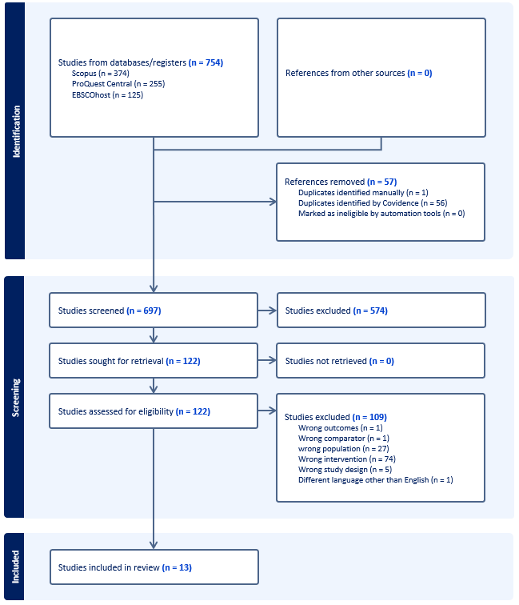
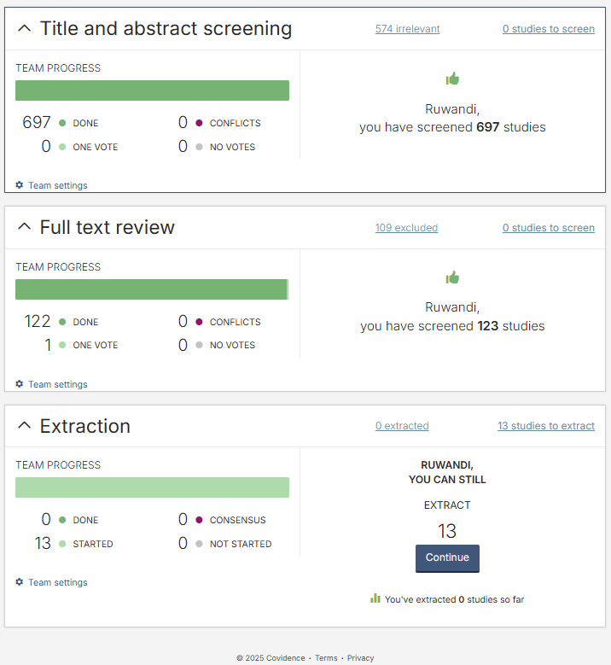
PRISMA Diagram
Systematic Review : Study 1
Covidence Outlook

Slide 19

Quality Assessment Strategy (QAS)
Systematic Review : Study 1
Why QAS ???
Robust evaluation of the evidence supporting the research question (RQ)
Novelty Introduced
Confidence Level | Numerical value
High | 10-12
Moderate | 7-9
Low | 4-6
Very Low | 0-3
Tool used
Numerical-based confidence level analysis
Parameters involved in QAS
Methodological Limitations | Coherence| Relevance | Adequacy of Data
Notes:
CERQual (Confidence in the Evidence from the Reviews of Qualitative Research) tool, as recommended by the CERQual Project Group (2018)
Methodological Limitations (ML): execution of the primary studies supporting the RQ.
Coherence (C): degree of alignment(fit) between the data from the primary studies and the RQ,
Relevance (R): applicability of the evidence from the primary studies
Adequacy of Data (AoD): richness and quantity of the data,
The confidence levels of the included studies were assessed using a novel numerical confidence level model to determine how well the review findings represent the research question's (RQ) interest.

Slide 20
Results | Highlights
Systematic Review : Study 1
Graph 3: Number of publications

