Slide 1


Managing menstruation while deployed operationally: experiences from the Australian emergency management sector
The University of New England respects and acknowledges that its people, courses and facilities are built on Anaiwan land, and surrounded by a sense of belonging, both ancient and contemporary, of the world’s oldest living culture.
Associate Professor Melissa Parsons
Department of Geography and Planning
University of New England, Armidale, NSW
August 2025, WAFA & AFAC Conference, Perth
Human Research Ethics Committee approval HE22-193
Warwick Keen “Always was, always will be” 2008
Gifted by the artist to UNE in 2008

Slide 2

Menstruation intersects with employment
On any given day approximately 800 million people worldwide are menstruating
Menstrual health includes the freedom to participate in all civil, cultural, economic and political spheres of life – including employment - free from menstrual related exclusion, restriction, discrimination or coercion¹ 1. Hennegen et al. (2020) Sexual and Reproductive Health Matters. 29:1-8.
Image: Vector Stock 19596952

Slide 3
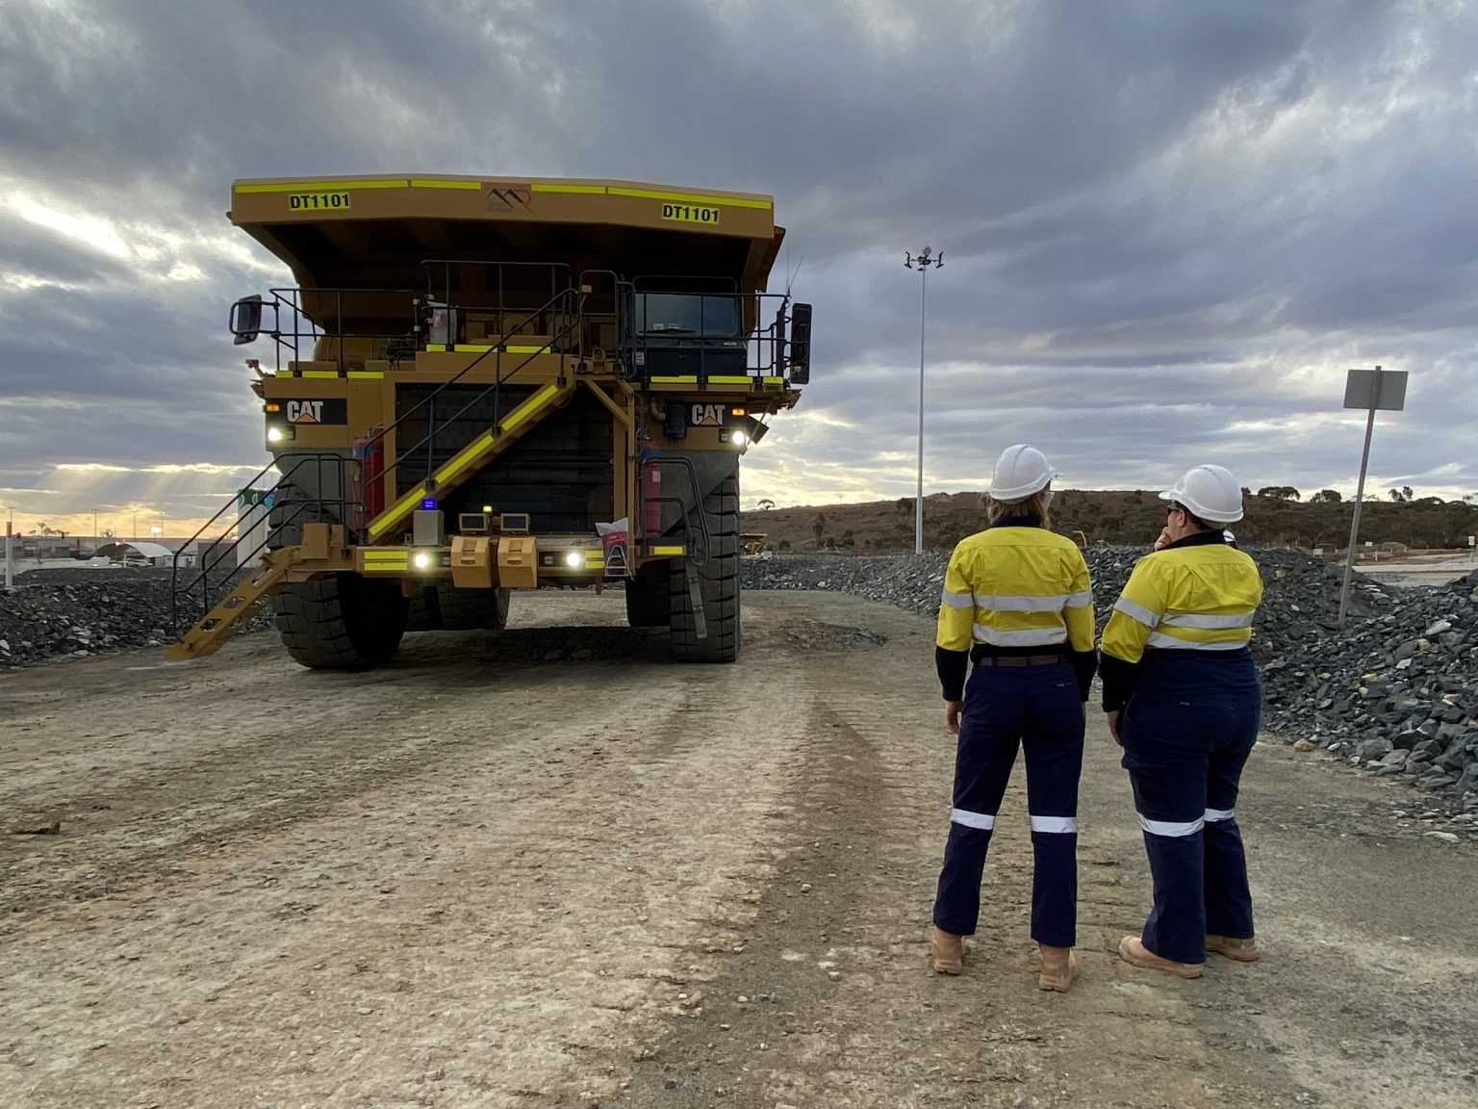
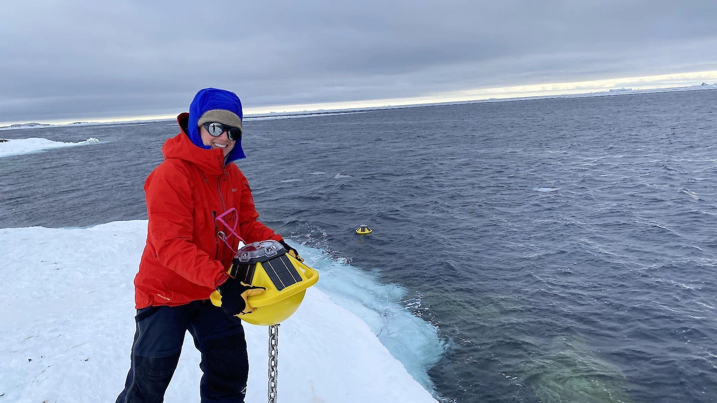
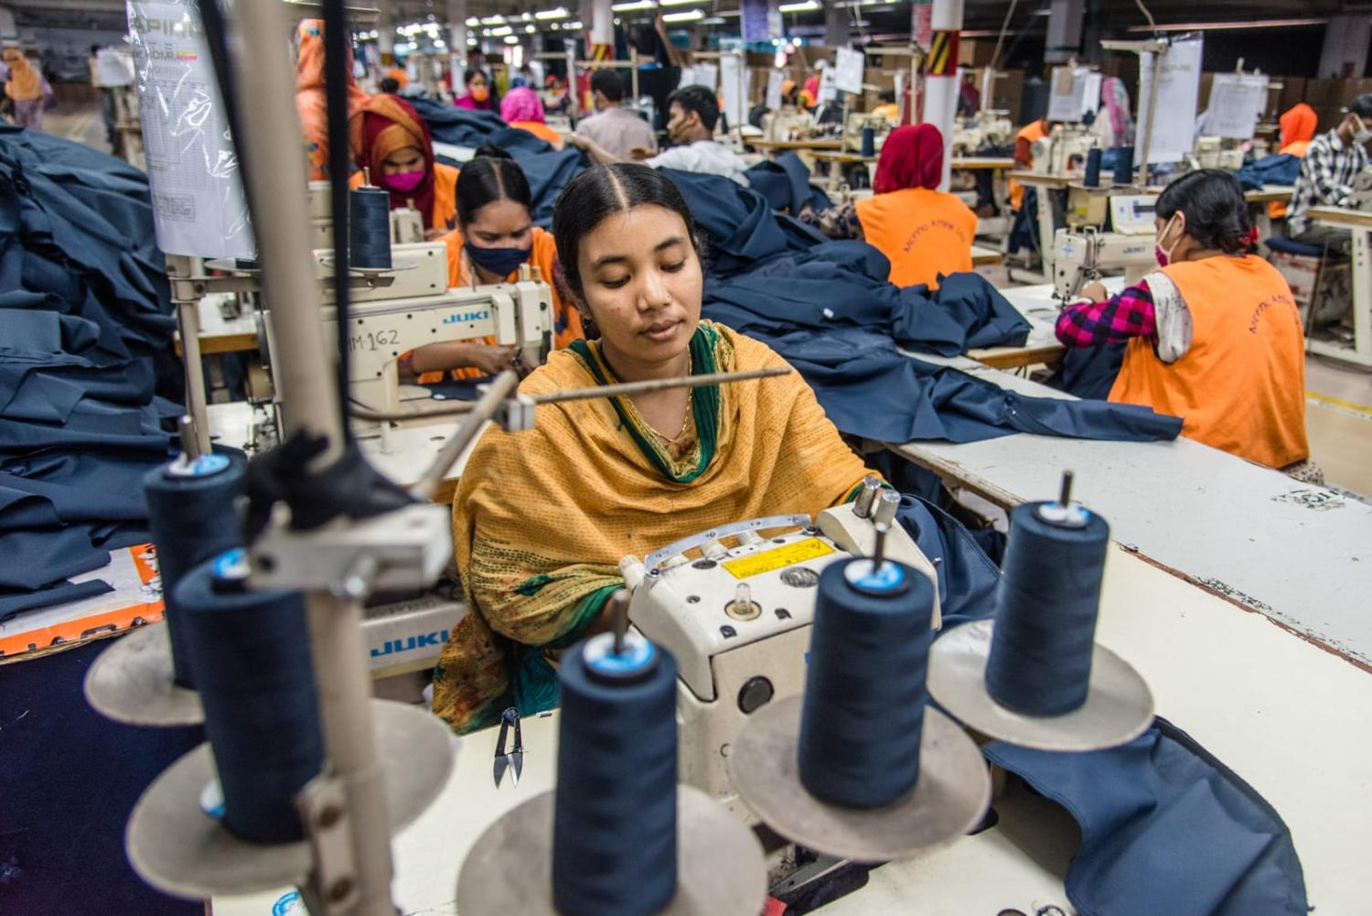
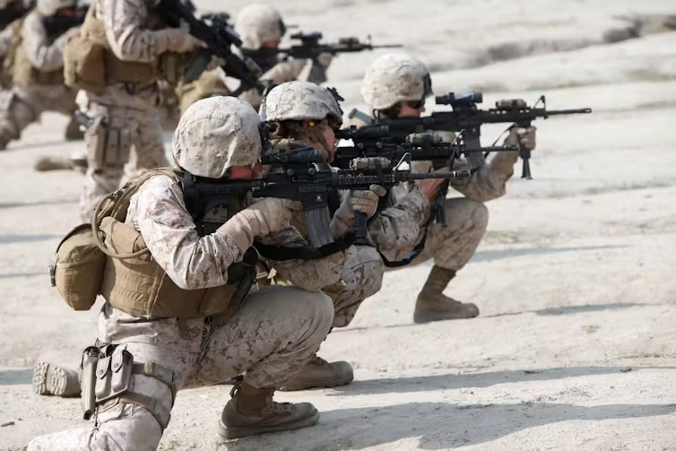
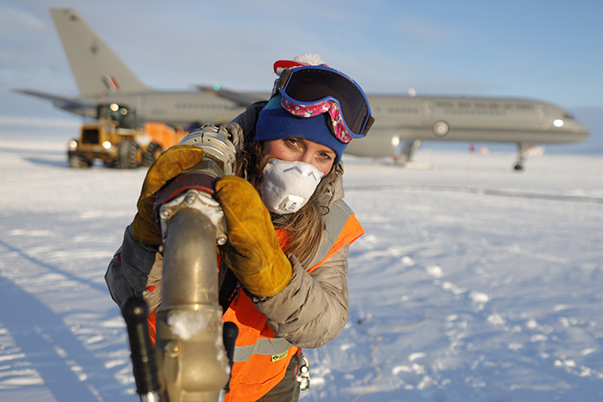

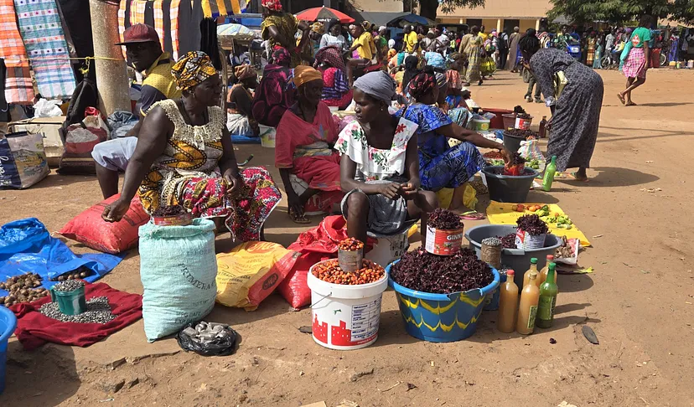
Extreme workplaces
Image: Mineral Resources
Image: Australian Antarctic Division
Image: Mustasinur Rahman Alvi, Getty Images
Image: Cpl. Meghan Gonzales/DVIDS
Image: US Antarctic Program
Image: Shutterstock
Image: Brad Yonaka

Slide 4
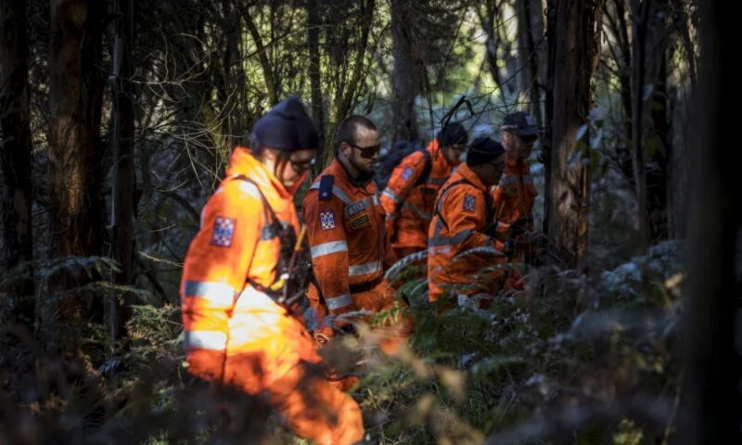
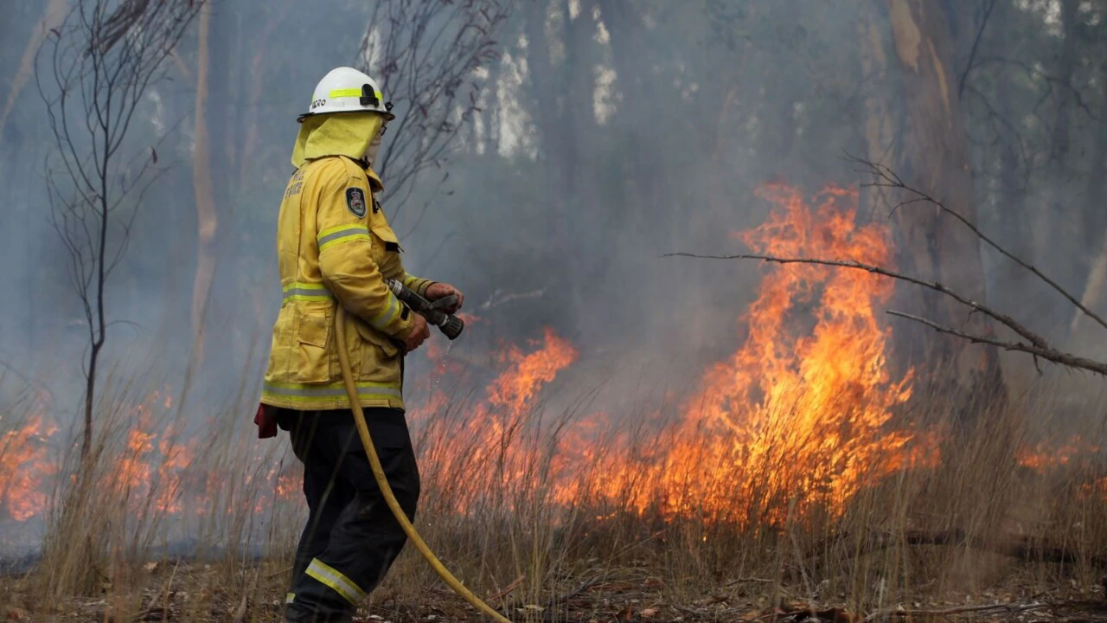
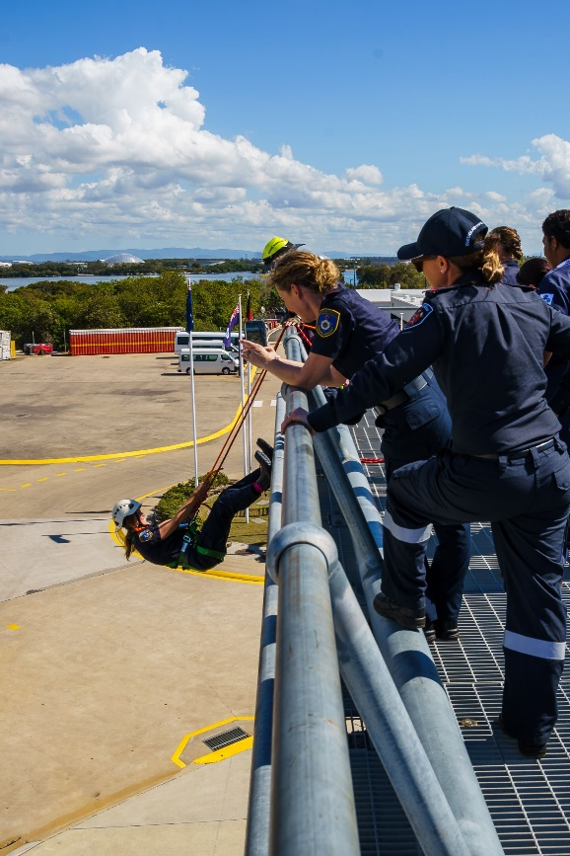
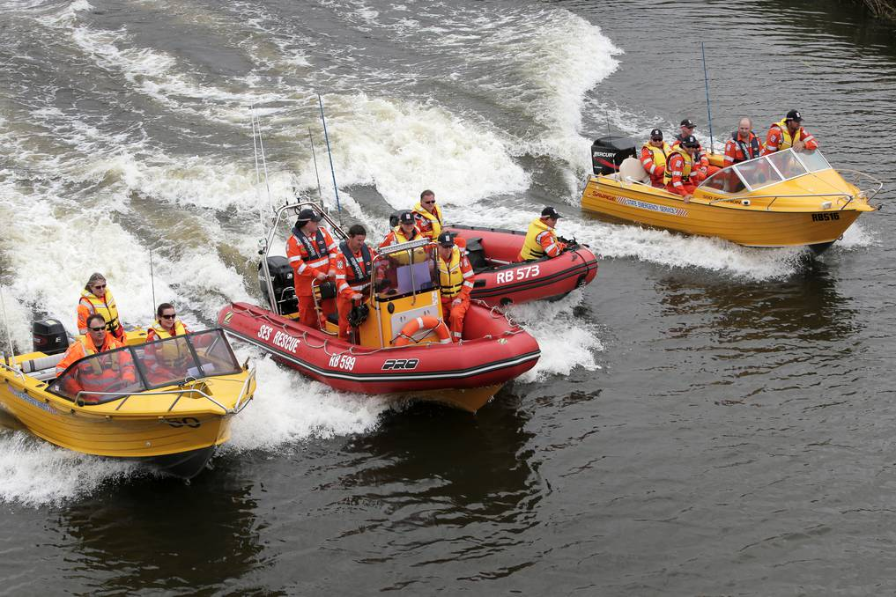
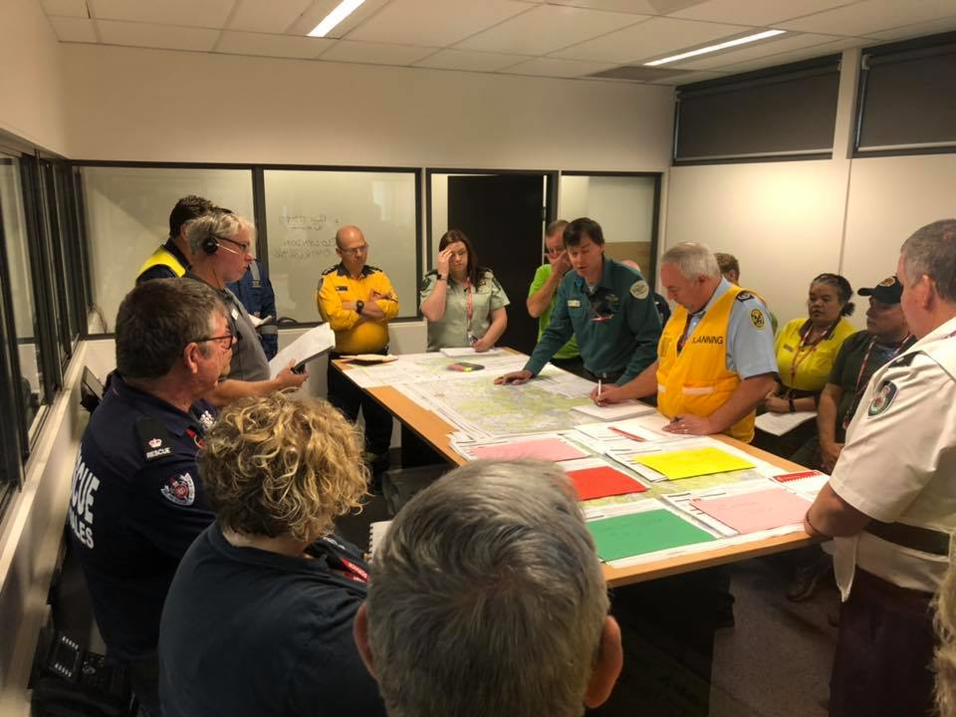
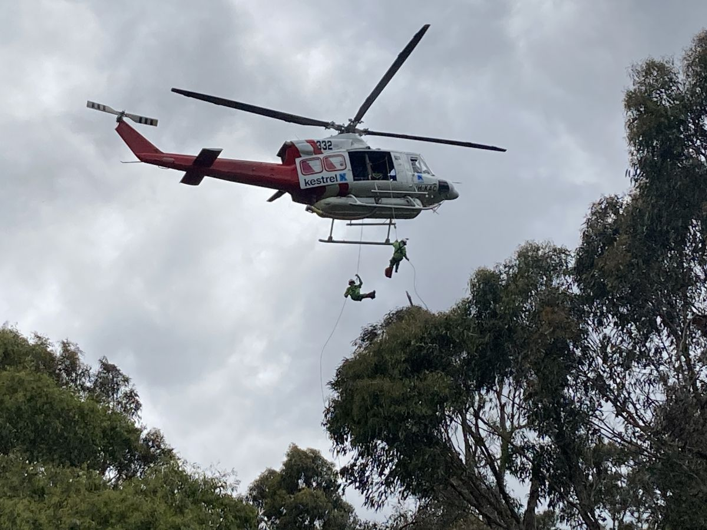
Emergency and disaster sites can be extreme
Image: Daily Telegraph
Image: VIC SES
Image: NSW RFS
Image: WAFA
Image: VIC DELWP
Image: SES Volunteers Association

Slide 5
Study aim and survey
Aim
Examine the attitudes, experiences and practices of managing menstruation by emergency service personnel in Australia while deployed operationally in extreme settings
The survey responses
287 responses
97.9% female, 2.1% non-binary
Age 17-70 (mean = 40 years)
68% menstruating
77% rural fire services
67% volunteers, 24% staff
<1 to 50 years experience (mean=13 years)
65% had >10 deployments

Slide 6
Study aim and survey
Aim
Examine the attitudes, experiences and practices of managing menstruation by emergency service personnel in Australia while deployed operationally in extreme settings
The survey responses
287 responses
97.9% female, 2.1% non-binary
Age 17-70 (mean = 40 years)
68% menstruating
77% rural fire services
67% volunteers, 24% staff
<1 to 50 years experience (mean=13 years)
65% had >10 deployments
>40 operational duties reported
Firefighting
Air or land search and rescue
Flood or surf rescue
HAZMAT incident response
Road accident rescue
Communications
Incident command
Evacuation centre operations
Animal welfare and rescue

Slide 7
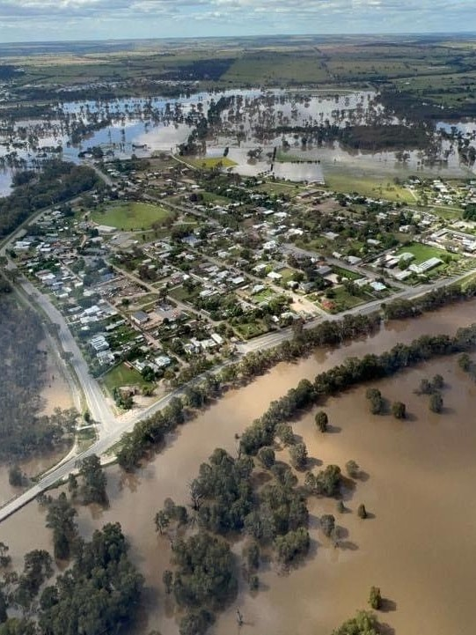


Period management during deployment
Period characteristics and menstrual symptoms
Period stigmatisation

Slide 8
Period management
77% of participants found it somewhat or extremely difficult to manage their period while deployed operationally, 23% found it easy
40% of participants had said no to a deployment or shift because of their menstrual cycle
7% reported health issues (TSS, UTIs) associated with menstruation management or toileting during deployment
60% of participants adjusted their use of menstrual products to accommodate deployment
21% of participants used menstrual suppression to support operational readiness

Slide 9
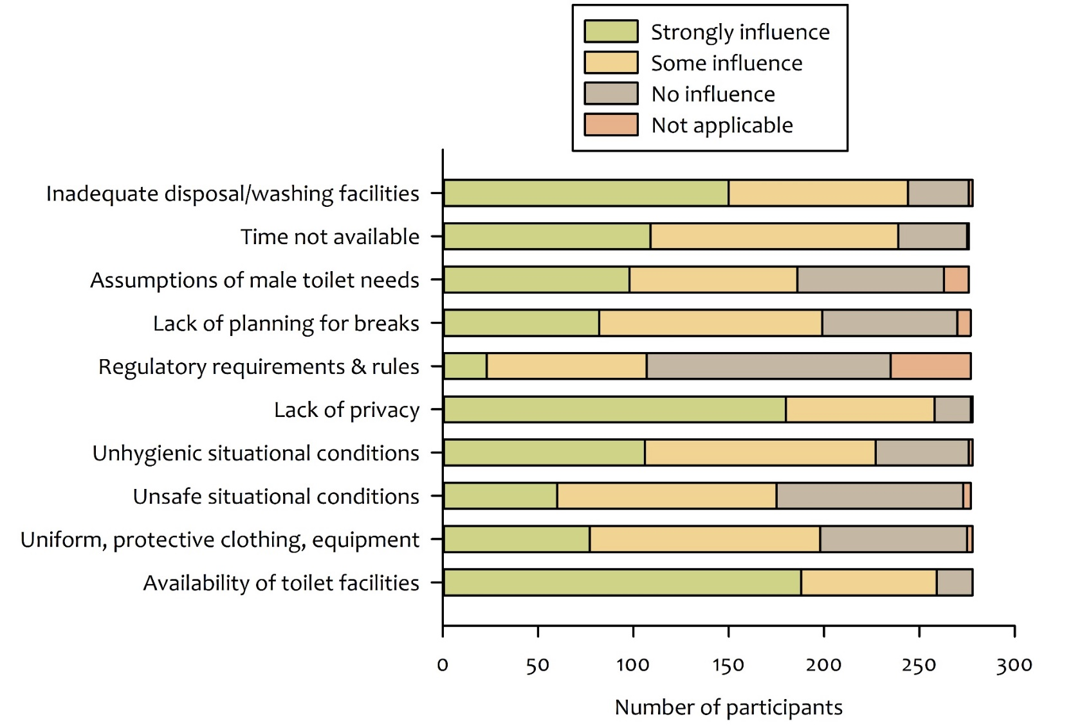
Situational factors influencing period management
Situational factors influencing the management of periods while deployed

Slide 10
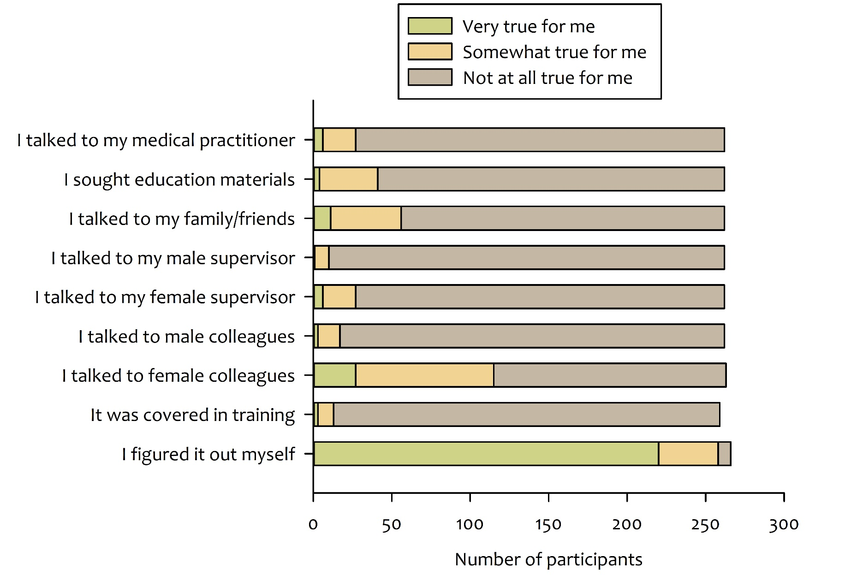
Sources of information
Sources of information for learning about or getting advice on managing periods while deployed operationally

Slide 11





Periods and deployment – thematic analysis
Toileting and toilet facilities
Choice and use of menstrual products
Planning and preparation
Avoidance of deployment
Adaptive unease

Slide 12
Periods and deployment – thematic analysis
Toileting facilities are crucial to period management (privacy within the limitations of field locations, changing products, disposing products, personal menstrual hygiene, scheduled breaks)
…To change a tampon if there wasn’t enough tree cover or privacy I would ask fellow crew mates to stand watch at the work bay doors of the truck and change the tampon there, and then bury the tampon or wrap in a plastic bag until I could dispose of it on return to the station or staging area. That could be very embarrassing but we were all adults and also as an older woman it wasn’t so bad. My daughter found it extremely embarrassing but does the same thing.
Toileting and toilet facilities

Slide 13
Periods and deployment – thematic analysis
Choice and use of menstrual products to accommodate deployment (comfort, absorbency, avoiding leakage, adjustment of product use for deployment, menstrual suppression).
I use disposables when firefighting, whereas normally at home and in the ICC I use period undies, which I prefer. It is not really feasible to take your entire pants off to change on the fireground!
Choice and use of menstrual products

Slide 14
Periods and deployment – thematic analysis
Preparation for menstruation during deployment (planning, purchasing and carrying preferred or additional product supplies, supplies for used product disposal, supplies for symptom management).
The Standard Operating procedures for a Brigade is to be fully self-sufficient for 12 hours before relief or assistance might arrive - by default for general hygiene outside of normal toileting I make sure I have my worst case flow and pain covered for double that…
Planning and preparation
After bleeding all over a [apparatus] I went to my GP and got a pill that stopped my periods. Being a [specialised role] there is nowhere to change products, no water to wash and I’m frequently the only woman. I would carry wipes and products in my pack but on heavy days I just couldn’t change often enough.

Slide 15
Periods and deployment – thematic analysis
Avoidance of deployment (because of situational longevity, period characteristics, menstrual symptoms, lack of facilities, fear of leakage, fear of menstrual status discovery)
As a volunteer firefighter I often have to plan my volunteering around my period. This leaves me at a disadvantage when trying to gain field experience and maintain parity with male field officers.
Avoidance of deployment

Slide 16
Periods and deployment – thematic analysis
Adaptive unease may accompany menstruation management (finding privacy privately, carrying used products in pockets or backpacks, taking health risks, littering, complying with situational safety awareness)
When I have leaks, I have to wear my pants for the rest of the day, and sometimes for the rest of the deployment if I am only able to bring one set due to luggage restrictions when we are flown to a fire. I just hope that no one notices the stains as the pants are pretty dirty anyway.
Adaptive unease

Slide 17


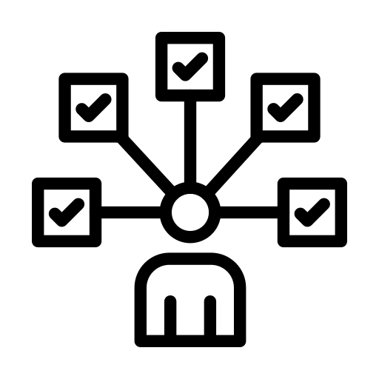
Menstrual symptoms and deployment – thematic analysis
99.7% experienced at least one menstrual symptom – cramps, back pain, fatigue, bowel issues, sore breasts most common
64% some impact on duties, 24% no impact, 12% a great deal of impact
Active continuation despite discomfort
Masking or minimising symptoms
Adjusting product use and modifying routines

Slide 18



Supplementary views – thematic analysis
Menstrual hygiene as standard kit
First responder identity and competency
Understanding and normalising menstruation in deployment
Toileting needs

Slide 19
Supplementary views – thematic analysis
Toileting needs (privacy, bodily functions, menstrual product disposal, menstrual hygiene, rights and equity)
We just need to be able to discretely manage menstruation and a lot of time in logistics that isn’t even a thought.
Toileting needs
I believe that having access to bathroom facilities and access to toilet breaks on deployment or while on a call-out is a right that all male and female volunteers should have. This is a major issue that needs to be addressed.

Slide 20
Supplementary views – thematic analysis
Menstrual hygiene supplies as standard kit (counteracting menstrual characteristics, normalising menstruation in deployment practice, supporting operational readiness)
At my brigade there had been no consideration for the female or menstruating members. Since I joined, I have fought for certain things on all appliances to ensure our ability to turn out at any time of the month.
Menstrual hygiene as standard kit

Slide 21
Supplementary views – thematic analysis
First-responder identities (getting on with the job while also attending to menstruation, competencies, fears of embedding stereotypes).
Women are more than capable of getting the job done, whether they are menstruating or not.
I take the approach that it's not going to hold me back, but I do have to prepare for it…I know that if I am in a prolonged situation with respite not certain, that I may, at worst case scenario bleed through my uniform. If that were to happen, well too bad for those who may be offended. My focus is on preservation of life not someone’s sensibilities……
First responder identity and competency

Slide 22
Supplementary views – thematic analysis
Understanding and normalising menstruation in deployment practice (talking, training, mentoring, advice, reducing stigma and taboos, supportive colleagues and cultures)
I think managing your period while being deployed should be covered as part of basic training. This should be attended by both men and women…. I would be happy to talk about it. Share my experiences, if it helps.
Understanding and normalising menstruation in deployment

Slide 23
Conclusions - First responder identity
Image: Daily Telegraph
Image: VIC SES
Image: NSW RFS
First responders who also menstruate
Image: SES Volunteers Association

Slide 24
Conclusions - Bloodwork
Bloodwork¹
Managing the messy, painful, leaky body
Planning access to facilities
Avoiding feelings of shame and stigmatization
Managing workload in relation to menstruation
Bloodwork in deployment
Pain management
Avoiding leakage and discovery
Finding facilities or privacy
Suppressing periods
Buying additional products
Forgoing opportunity
Adjusting mood
Explaining themselves to others
Caring for others
Lobbying for change
Image: Vector Stock 19596952
1. Sang et al. (2021) Int.J.Env.Res.Pub.Health, 18(4)

Slide 25
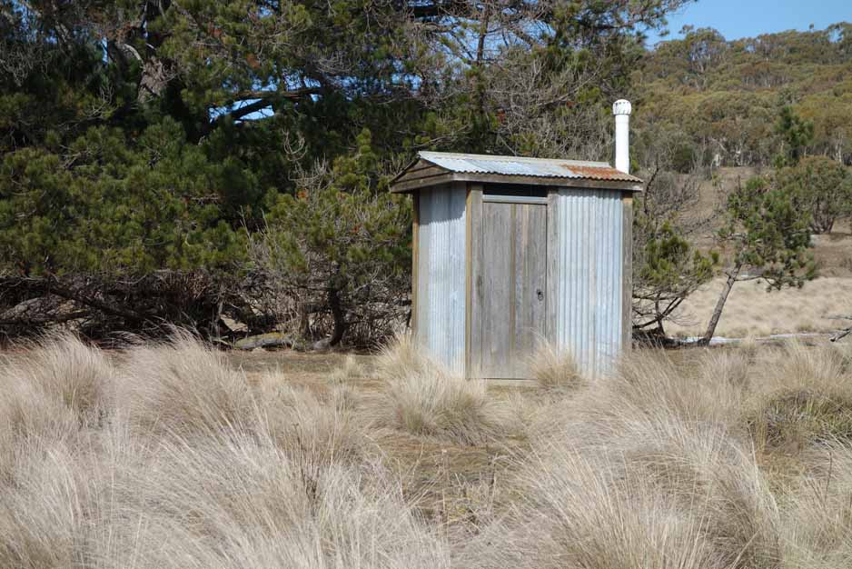
Conclusions - Toilets and toileting
Toilets and toileting practices and logistics are critical to managing menstruation during deployment
Toilets as sites used to maintain hegemonic masculine norms and control access to male occupational domains OR
A need for better toileting logistics for all
Image: Australian Hiker

Slide 26
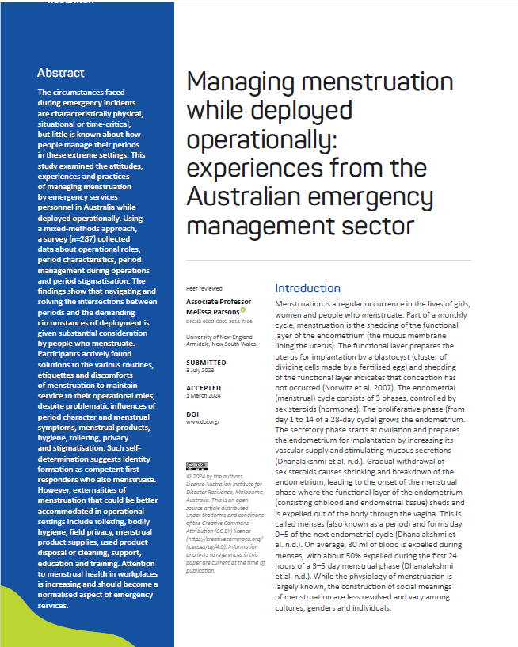
Acknowledgements and further information
Sincere thanks to the participants from Australian emergency service agencies who generously shared with me their experiences of managing their periods while deployed operationally
Publication (open access)
Parsons, M. (2024) Managing menstruation while deployed operationally: experiences from the Australian emergency management sector. Australian Journal of Emergency Management, 39(3): 16-33. www.doi.org/10.47389/39.3.16

