Slide 1

Project Inspire: Safe, Functional and Better Fitting Personal Protective Clothing (PPC)

Slide 2

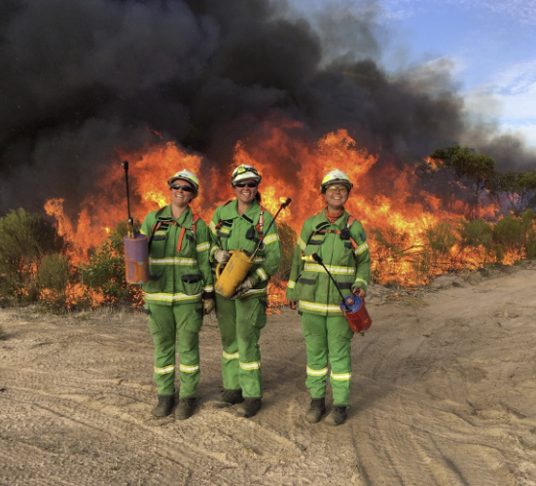
Topics for today:
Project Inspire: Background
FFMVic PPC/E Survey Findings
Research and Trials of International PPC/E
The Future

Slide 3
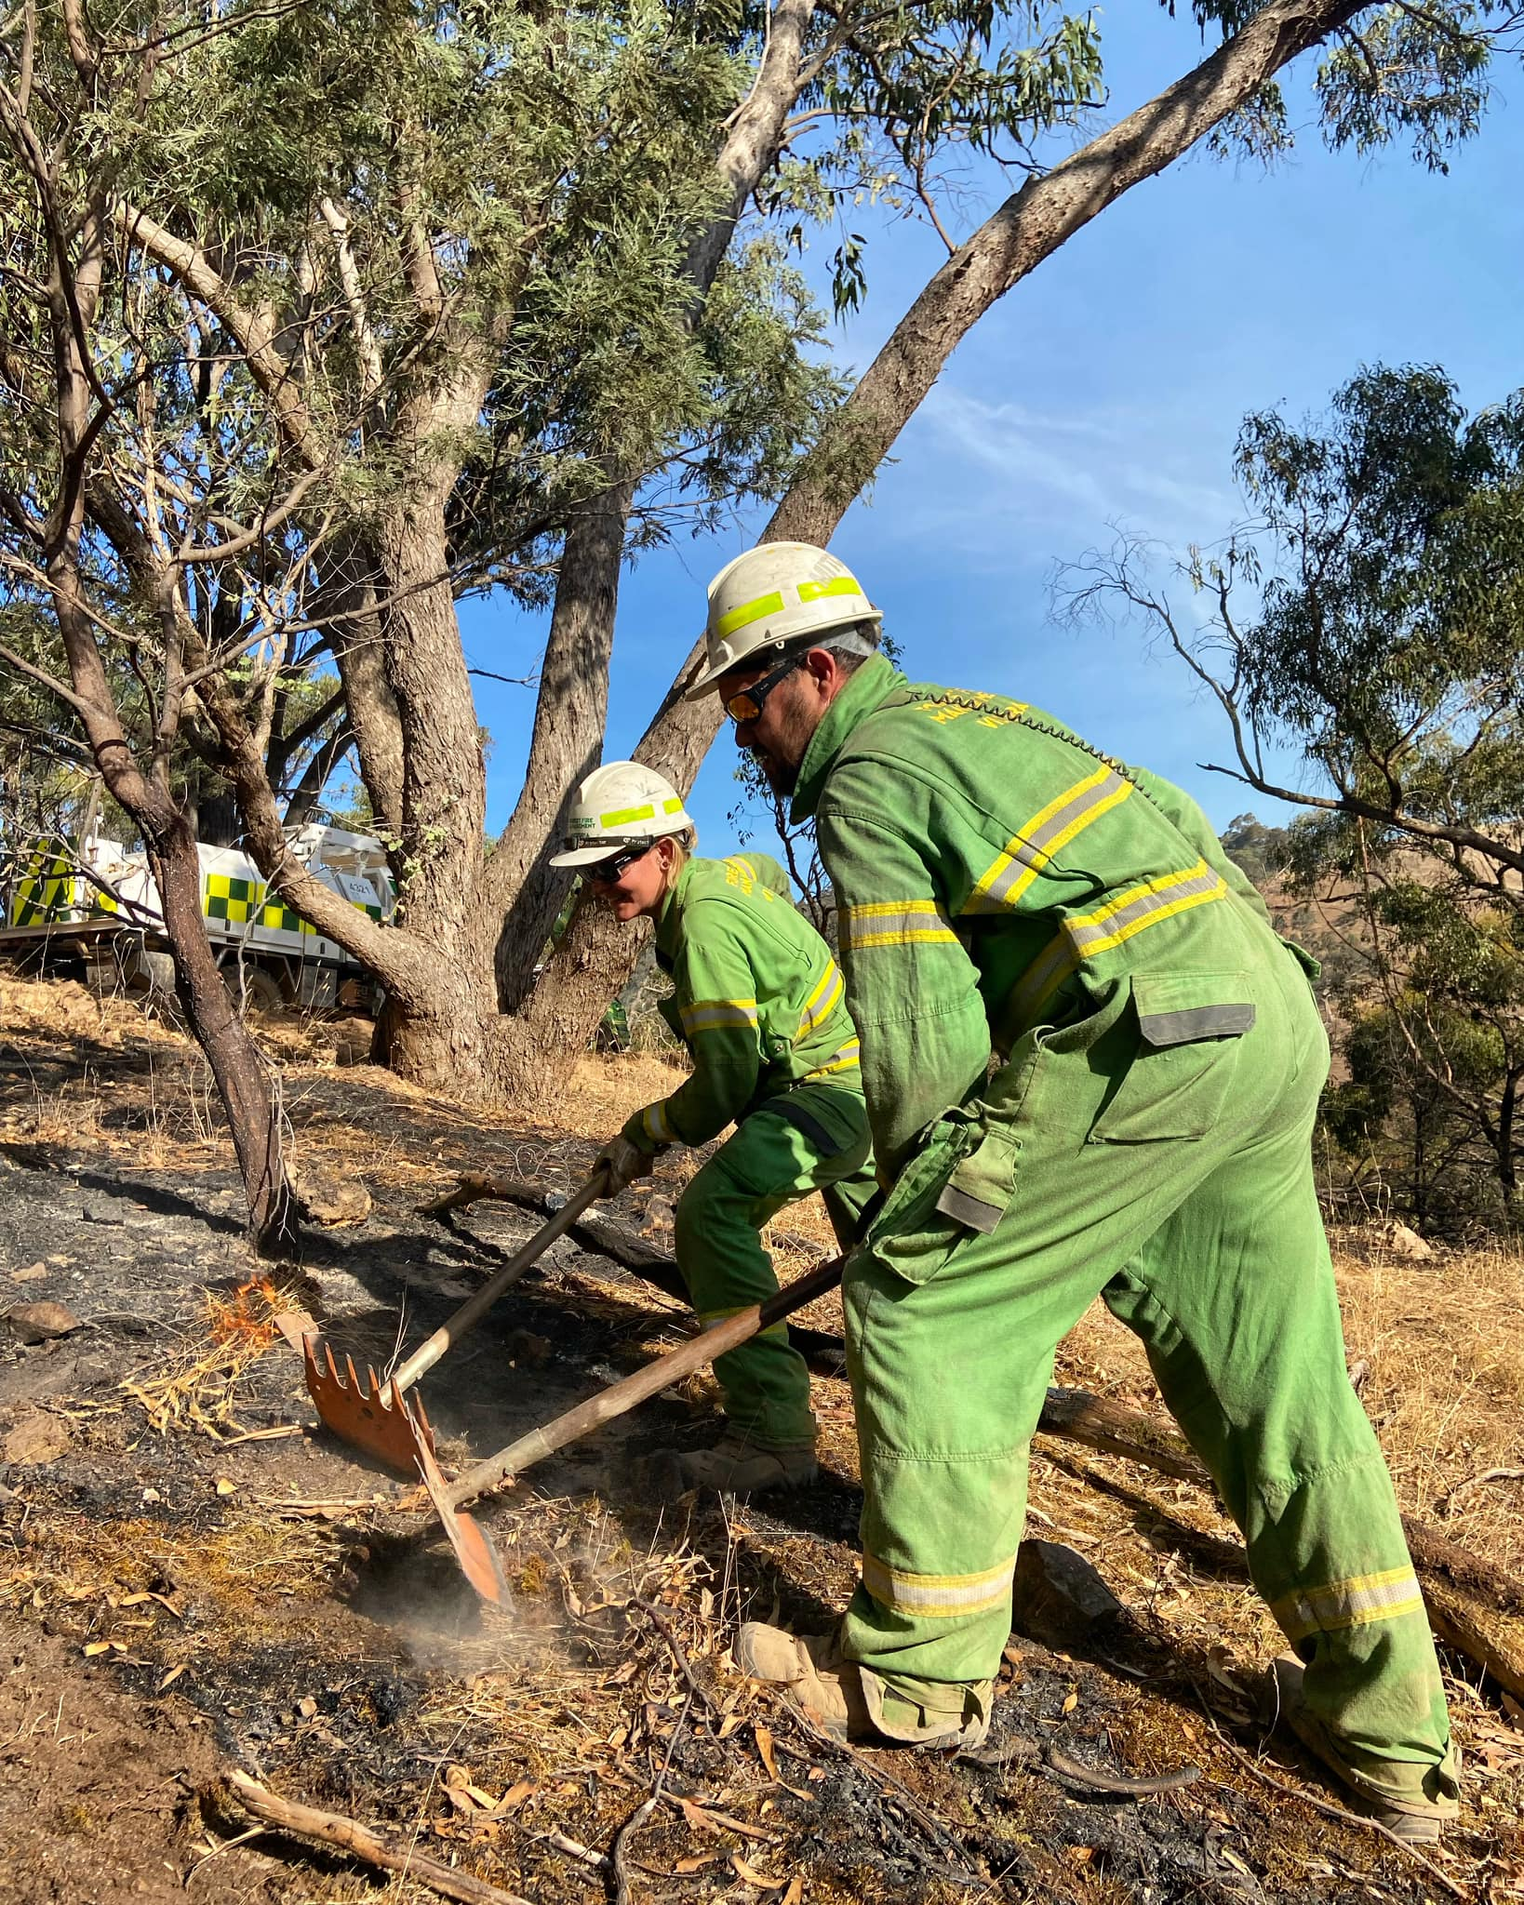
Project Inspire: Background
Forest Fire Management Victoria:
Forest Fire Management Victoria (FFMVic) is Victoria’s dedicated team of frontline forest firefighters working to reduce the risk and impact of bushfires on Victoria’s parks, forests and other public land
FFMVic is made up of permanent and seasonal firefighters who work year-round to protect communities and the environment from bushfires and assist in other emergencies as required.
This team comprises more than 1,000 skilled staff from the Department of Energy, Environment and Climate Action (DEECA), Parks Victoria and Melbourne Water.
Our core purpose is to protect people, property and the environment.

Slide 4
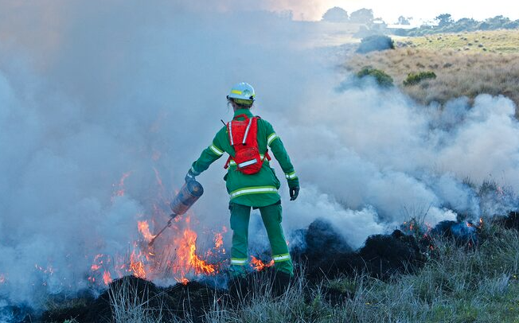
Background: Project Inspire
Project Inspire was born though a critical need to address ill-fitting PPC/E for FFMVic firefighters.
Our leaders have taken a direct and bold approach to identify the issues and problems with current personal protective clothing (PPC), with a focus on the environment and conditions our firefighters work within.
Addressing the challenges of gender-inclusive PPC for wildland or bush firefighting requires a comprehensive approach that ensures safety, fit, functionality and comfort for all firefighters, regardless of gender.

Slide 5
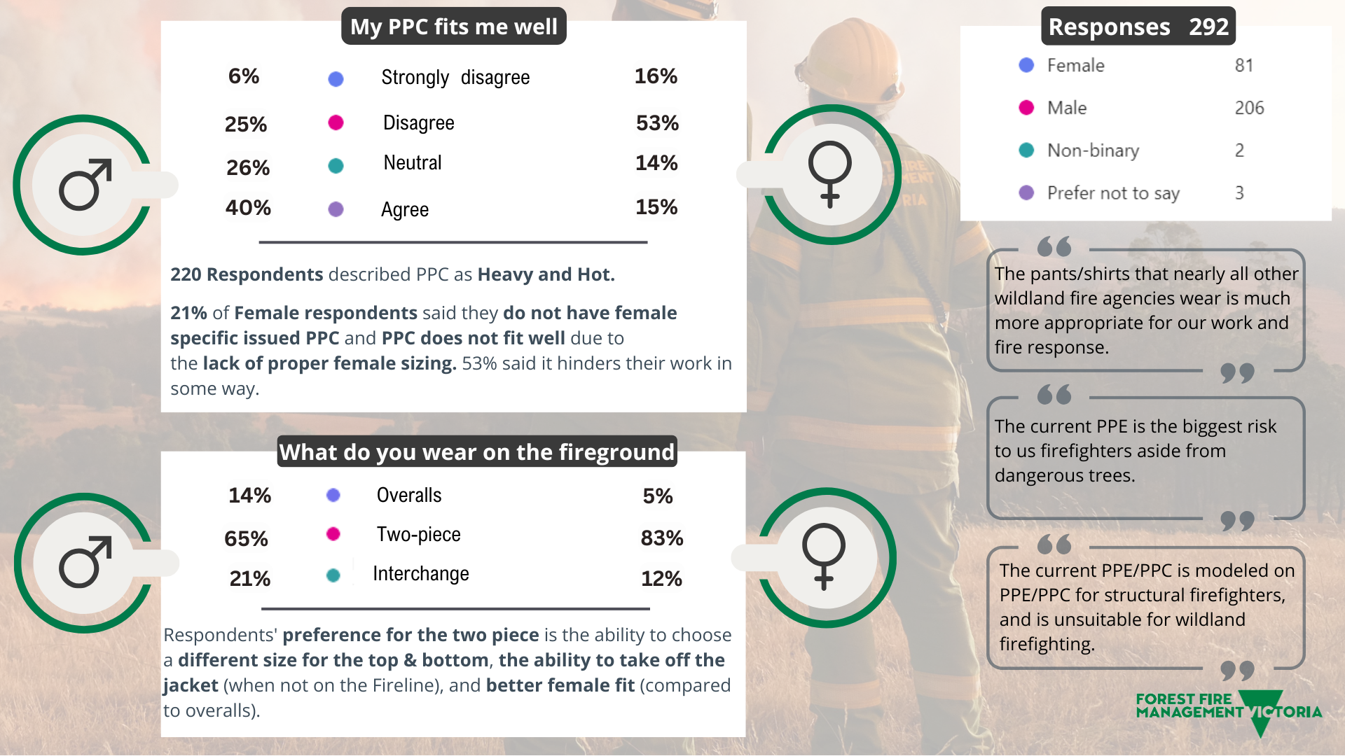
FFMVic Survey Findings: setting the baseline

Slide 6
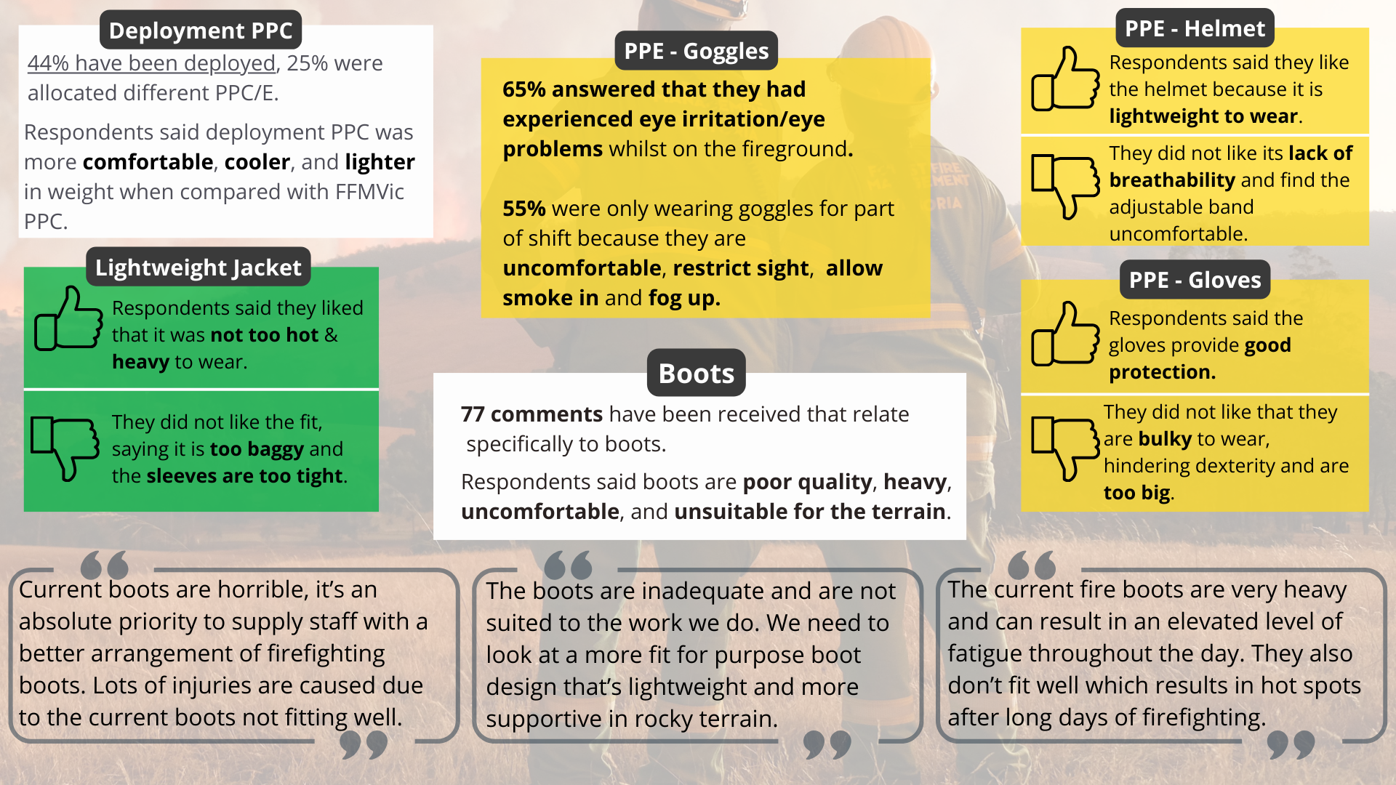
FFMVic Survey Findings

Slide 7
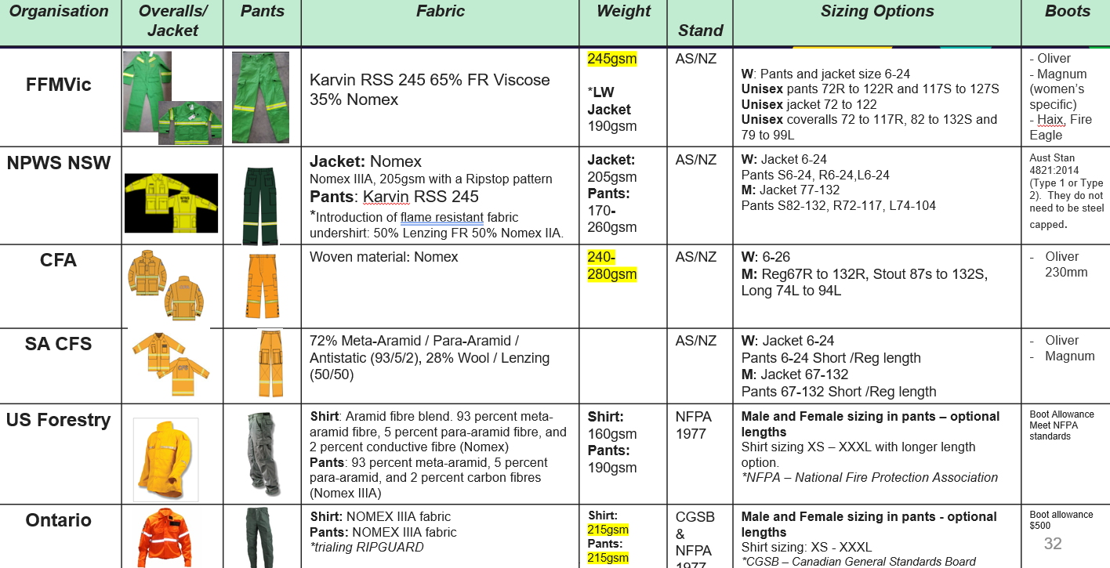
Research: wildland firefighting PPC

Slide 8
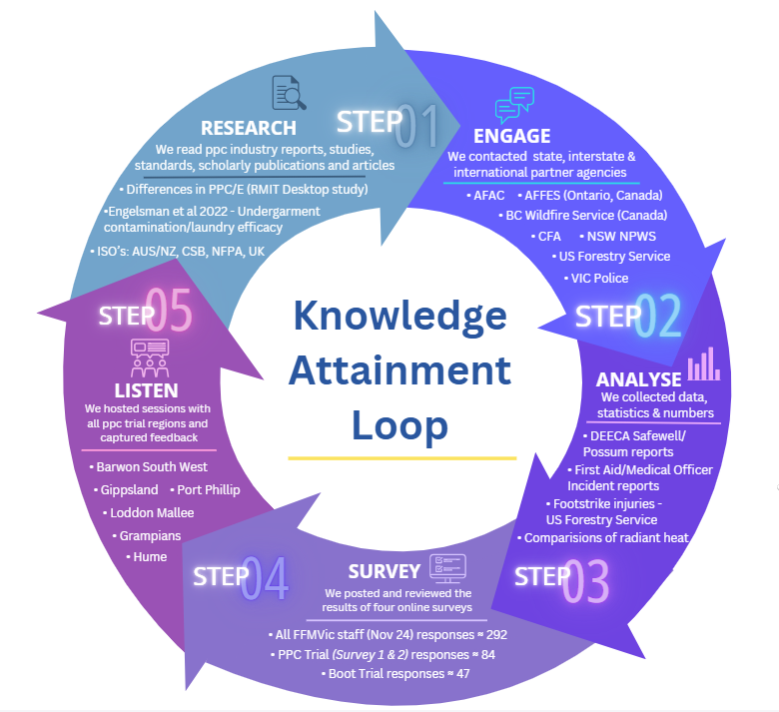






Research: Consultation with our partners
Stakeholders engaged with:
Victoria Police
Country Fire Authority
New South Wales National Parks and Wildlife Service
US Forest Service
Ministry of Resources - Ontario Canada
British Columbia Wildfire Service
RMIT University:
‘Recent development in equipment, protective materials and garment systems for wildland firefighting’

Slide 9

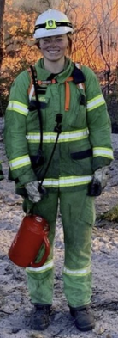
Research: RMIT Findings:
Total PPC/E Ensemble Weight:
Overalls 3.8kgs
Jacket / Trouser 4.2kgs
Light Jacket & Trouser 3.5-3.6kgs
Boots constitute 40-50% of the total ensemble weight.
Research of the physiological burden placed by PPC/E on firefighters found that carrying 1kg on the feet (boots) is equivalent to carrying approximately 8.7 kg on the back.
The overall effect of PPC and hot conditions can lead to cognitive impairment, discomfort, fatigue, reduced manual performance and injury.
Differences Between Performance Standards:
AS/NZS 4824:2021 Protective clothing for firefighters - Laboratory test methods and performance requirements for wildland firefighting clothing
NFPA 1977:2022 (National Fire Protection Association)
Comparison of FFMVic/US Forestry/Canadian PPC
Materials:
FFMVic PPC has the lowest aramid content in both trousers and shirts when compared with USA/Canada, which will impact material strength and possibly other attributes, such as garment durability.
Ergonomics:
Shirt bellows are also included in the USA specification which will provide improved fit and range of movement.
Closure Systems:
FFMVic snap closure easier functionality however, tendency to rip or pull out over time.

Slide 10
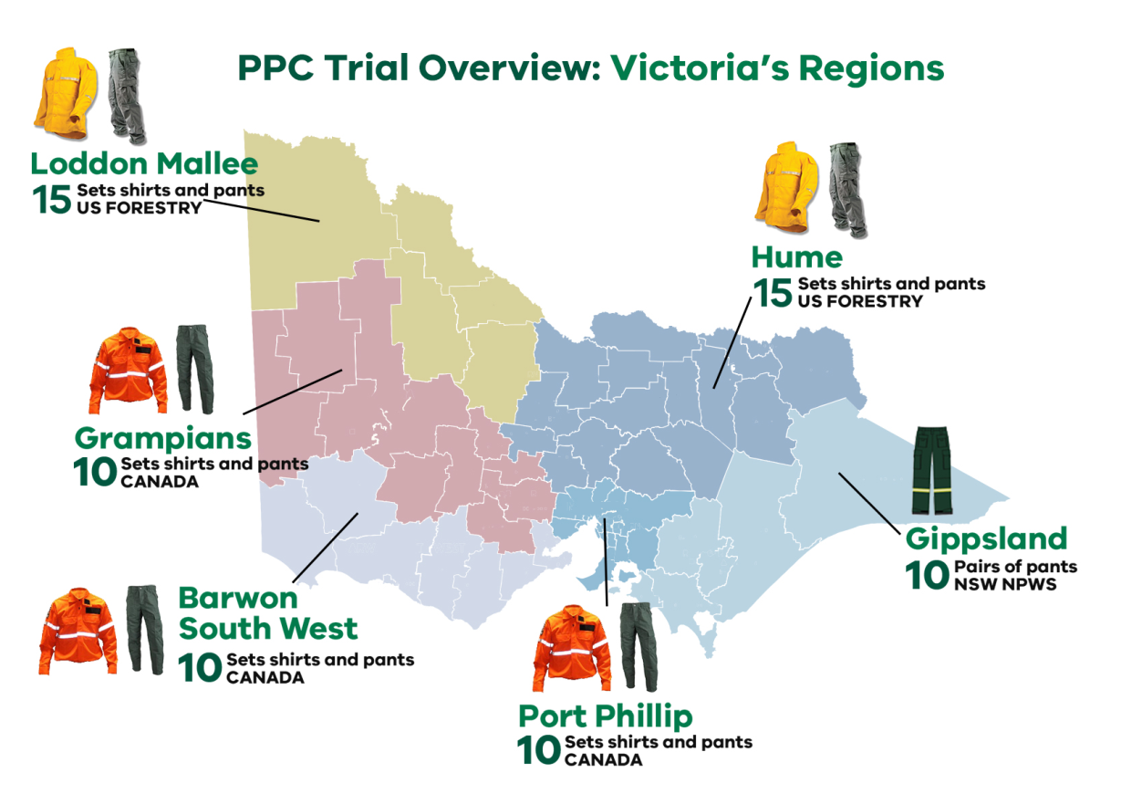
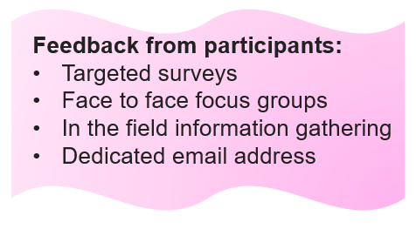
Trials of International PPC

Slide 11
PPC trial comments – Shirt and Pants
‘Cooler and lighter compared the greens’
‘Felt like I had more energy for the whole shift on the saw. I could move so much easier, the gear is much lighter to work in’
‘Tested the radiant heat protection– felt safe and it worked well’
‘Functionality so much better – I can step over logs with out hitching up my pants – or ripping out the crutch.
Ontario, Canada
US Forestry
Ontario, Canada
Ontario, Canada
‘We look professional – this will help attract professionals to the job we do’
‘Quick drying and they don’t stick to your body’
US Forestry
‘Movement in and out of vehicles was so much easier. The pants did not rip or tear and held up well in rye grass.’
Ontario, Canada
“Expected to really feel the radiant heat as the gear is lighter – but it held up well. Also took a few steps back if needed’
‘Do we have to go back to the greens? Love to stay in this PPC its so much better’
Ontario, Canada
Ontario, Canada
Ontario, Canada

Slide 12
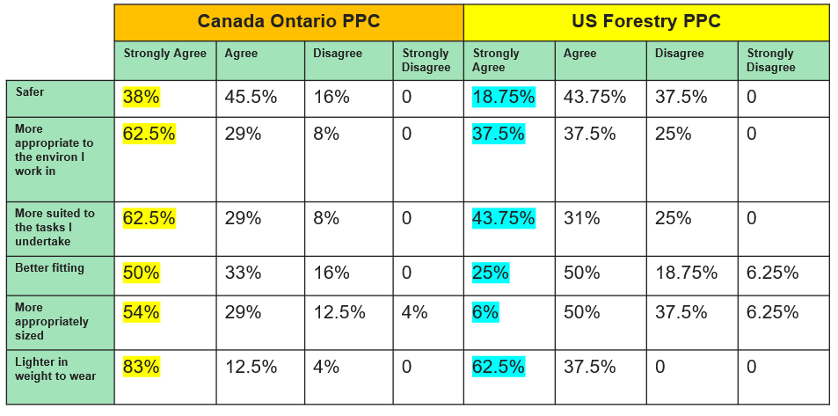
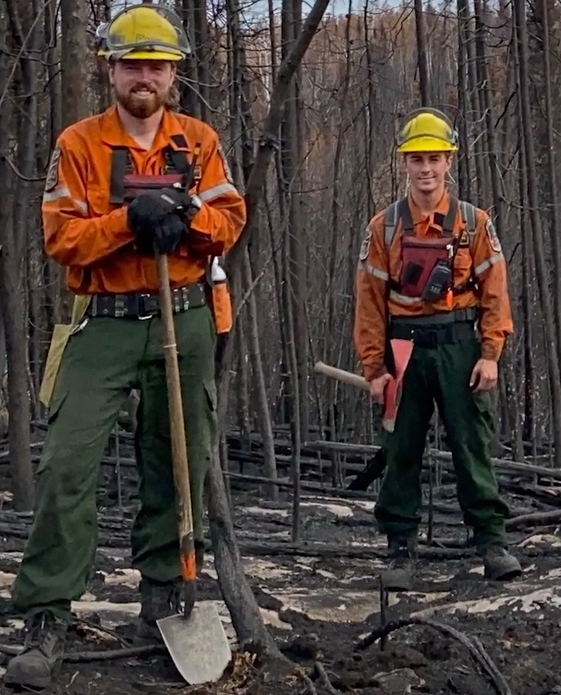
Results from PPC trial:

Slide 13
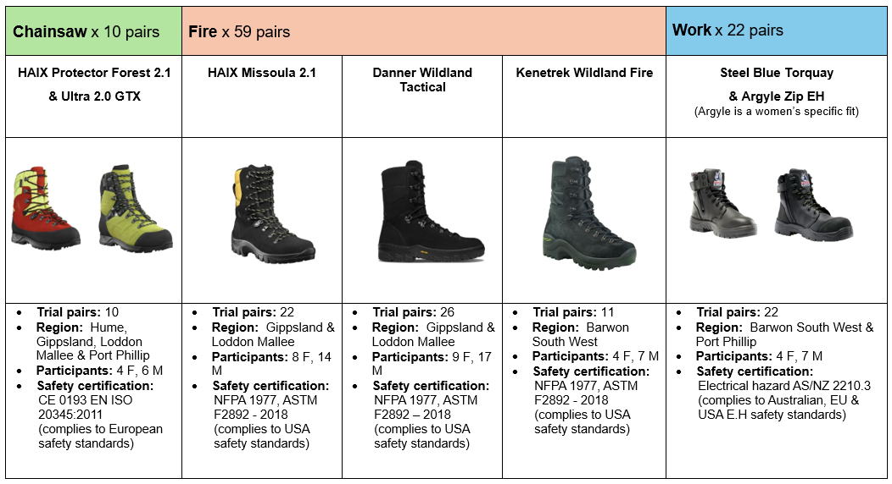
Trial Boots

Slide 14

Boot survey: Comments
‘These boots are great. However, not having a steel cap toe is a bit annoying to have to always carry a second set of boots for chainsaw work.’
‘If these boots could be fire rated, that would be ideal for fallers to wear them on the fire line, especially for long walks and arduous terrain. Fit was good, sizing chart gave good advice about fit, and sizing, which I found true to description. Overall, I find the boot significantly better and fit for purpose for our industry, just need a fire rating, as I could have used these at the Grampians fire while doing hazardous tree work - would of been prefect.’
‘These are by far the best boot I have worn for work in the 9 years I have been here.’
Danner Wildland Fire Boot
Danner Wildland Fire Boot
‘These boots prove their value as soon as you take them into the bush. They lock to your foot and add stability when in challenging terrain. They limit the 'sloppy feel' which is common with our standard issue boots.’
HAIX Protector Chainsaw Boot
‘These boots have been good, although it has been hard to find appropriate days to wear them when I don’t need to operate a chainsaw.’
‘Not being able to use them with a chainsaw if a real disadvantage, If they were chainsaw rated, they would be the perfect boot.’
HAIX Missoula Fire Boot
HAIX Missoula Fire Boot
Danner Wildland Fire Boot

Slide 15
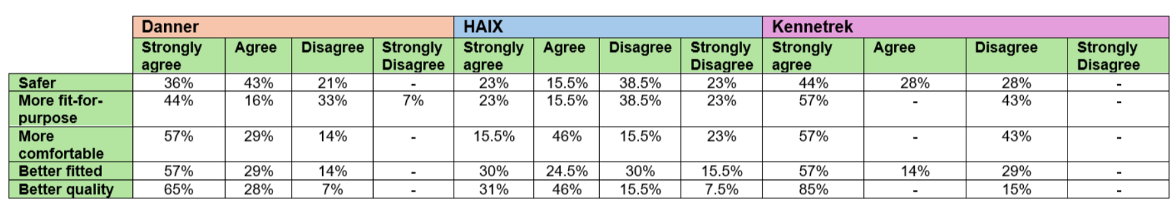
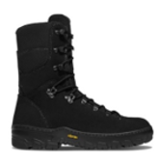
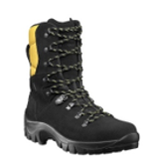
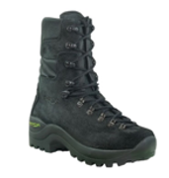
Boots: Survey and Results
Outcome:
The preferred option from the trial boots is the Danner boot.
The comments received and conversations undertaken with trial participants has confirmed the Danner boot is comfortable to wear, is supportive in difficult terrain and did not need any time to break in.
There were no issues with hot spots, rubbing or blistering from wearing this boot.

Slide 16
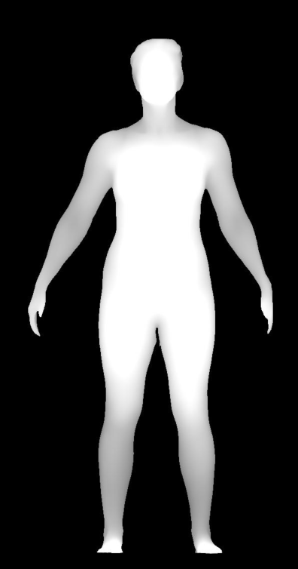
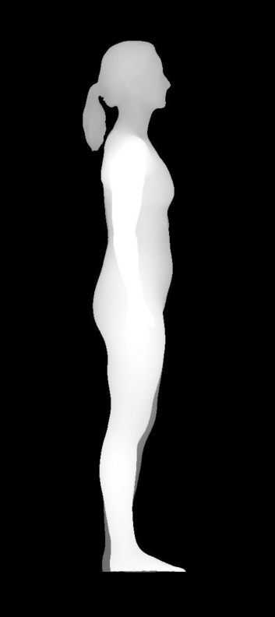
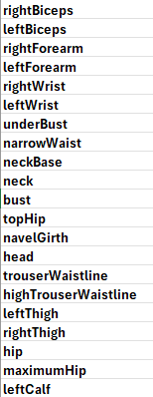
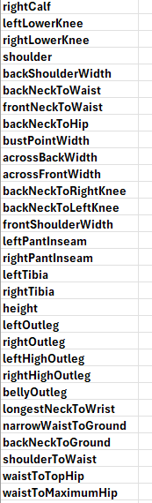
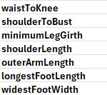
The Future: 3D Body Scanning - Data capture
Data Capture:
Data across the entire body, including head, feet and hands.
Over 400 measurement points are generated from each scan session – including point-to point or circumference measurements.
In under a minute, a scan provides body sizing and biometric data.

Slide 17
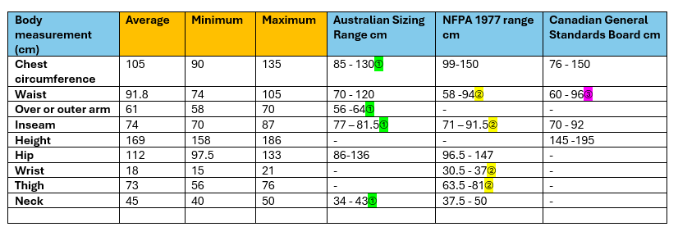
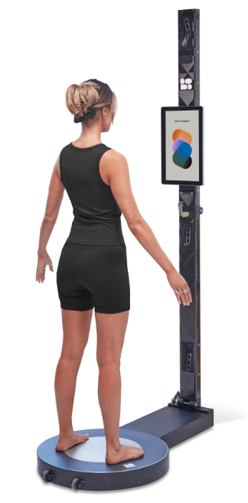

The Future: 3D Body Scanning – Females are not small men
We need to do better for our female firefighters:
Address design issues, prioritise fit for safety, comfort and mobility.
Include female firefighters in working groups to gain specific feedback on fit and address concerns
Female specific patterns for PPC – to cater for differing bust, waist, hip, thigh, neck and wrist sizes.
Ensure women's patterns and sizing are part of the tendering process.
No unisex fit options to be accepted.

Slide 18
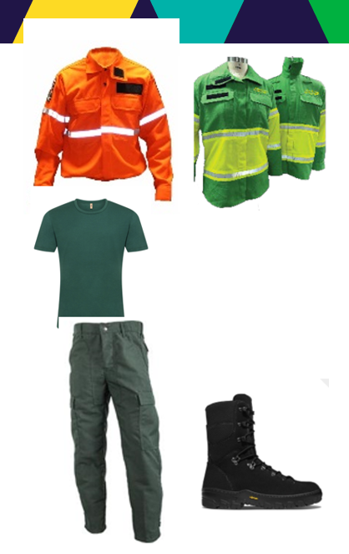
The Future: next steps
Systems approach to PPC/E:
Introduce new PPC/E that will match the operational demands in how FFMVic responds to bushfires - as much of our response to firefighting is completed on foot, constructing hand trails and completing hazardous tree work.
Constant checking back with stakeholders on requirements, fit for purpose and influencing industry on future offerings.
It will keep our firefighters safe, allowing them better functionality in very difficult terrain and hot conditions.
The PPC/E will be fit for person, allowing for different body shapes and be inclusive of all of our people.
The lighter materials will help alleviate heat stress or illness, ongoing issues with fatigue and increase comfort during extended operations.

Slide 19
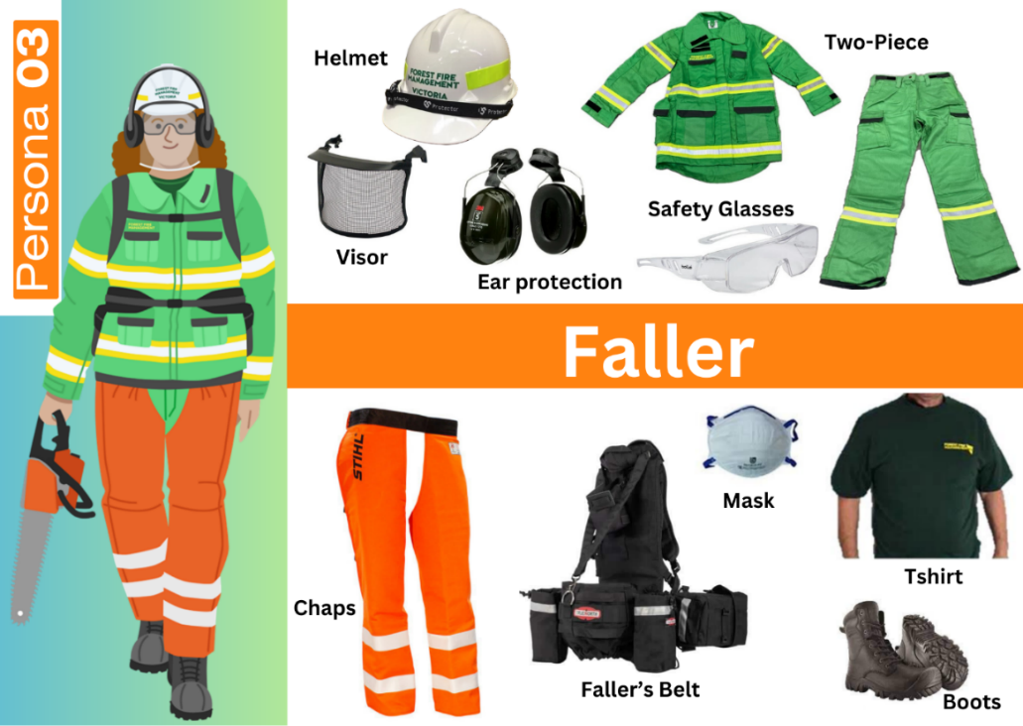
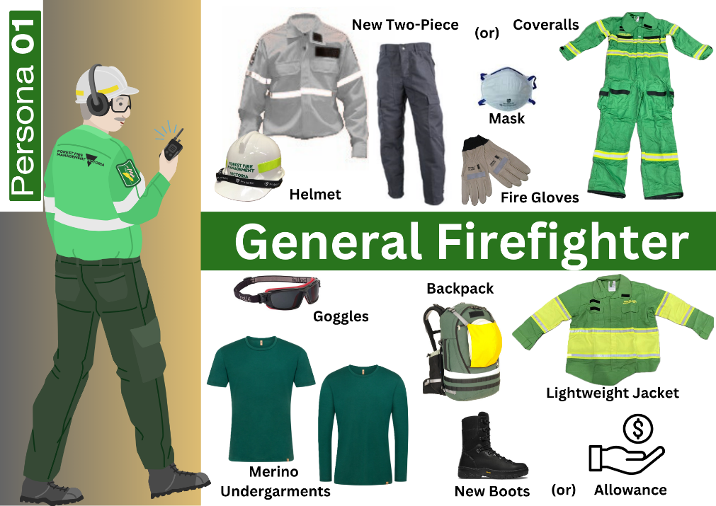
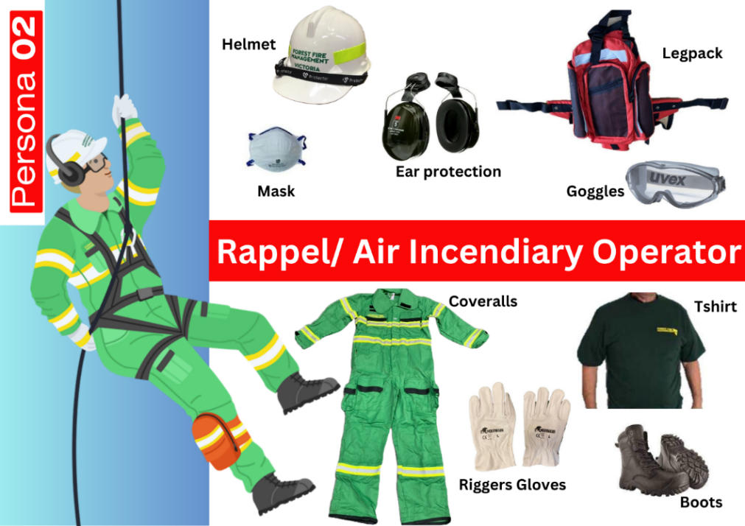
The Future: Persona/s
Firefighter Persona’s:
Each firefighter will be allocated to their matched persona/s and receive the functionally appropriate gear.
Will ensure fit for purpose of equipment in the role they are undertaking.
Allow for equity in allocation across the State.
Introduce new data and tracking component in existing FFMVic systems to track replacement rates and feedback from users.

Slide 20
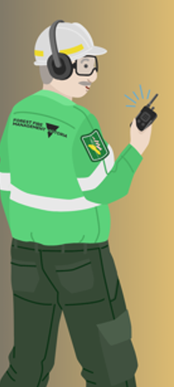
The Future: Actions
Roadshow of preferred pants to all operational staff to check appropriate sizing and understand the need for modifications or tailoring.
Shirt focus group: to ensure correct design and best fit, with operational staff input.
Introduce a system and layering approach for safety, comfort and warmth.
Education and training materials developed to understand correct fit and best sizing decisions. This will also include correct PPC laundering processes.
Tools introduced via existing systems to track persona PPC allocation by accreditation. A new ticketing system trialled to capture user feedback and ideas for innovation
Working with manufactures to ensure correct sizing models are established. Use of 3D scanning to capture as much data as possible to match the work force to influence sizing definitions.

Slide 21
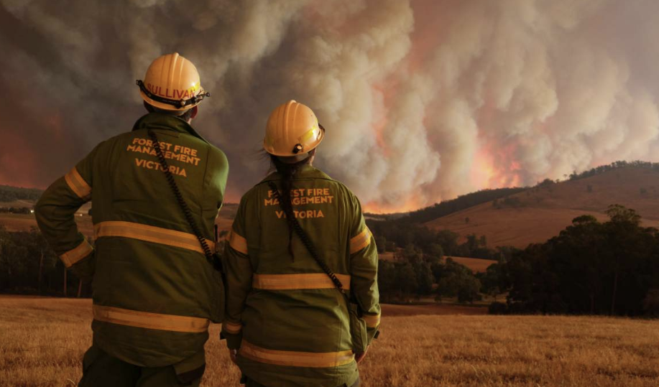
Questions ??
Further information on the project:
Contact Details:
Kelly.Edwards@deeca.vic.gov.au

