Slide 1
Advancing Gender Equality and Sustainability
Strategic Volunteer and Youth Programs
Dr Catharine Phillips
Jenny O’Brien

Slide 2
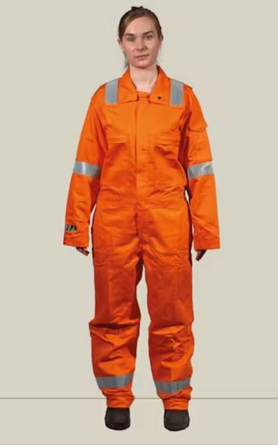
Strategic Volunteer and Youth Programs
Jenny’s Story
(Picture – Not Jenny)
Source – Redwingeurope.com

Slide 3
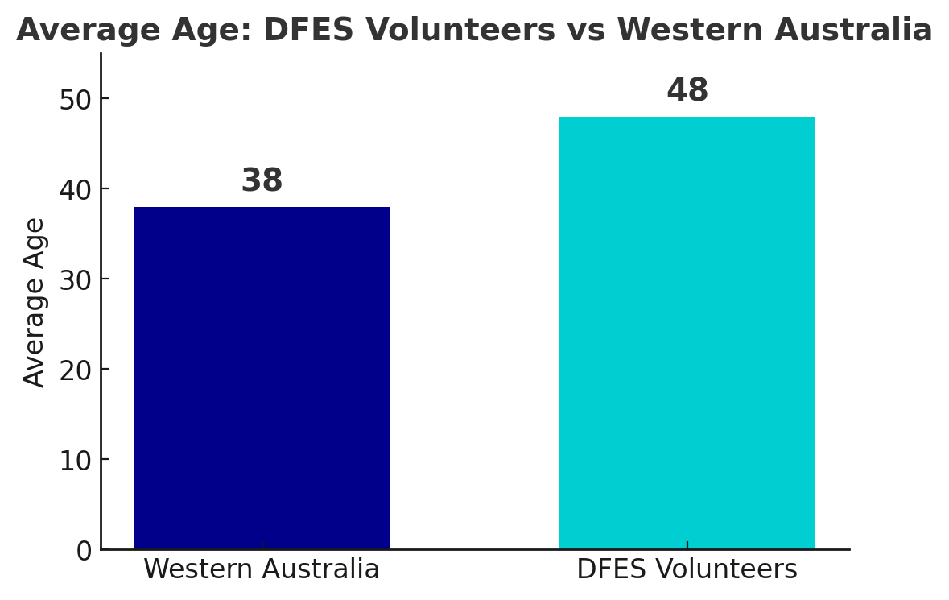
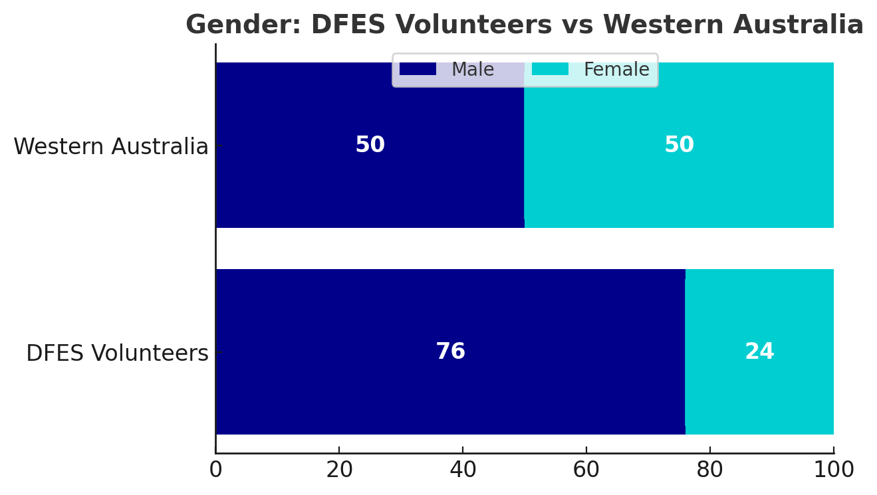
DFES
Average Age
48 yrs
Strategic Volunteer and Youth Programs
The Shared Challenge

Slide 4

Strategic Volunteer and Youth Programs
Volunteer Sustainability Strategy 2023 – 2026
A Vital Future
Inclusion = Sustainability

Slide 5
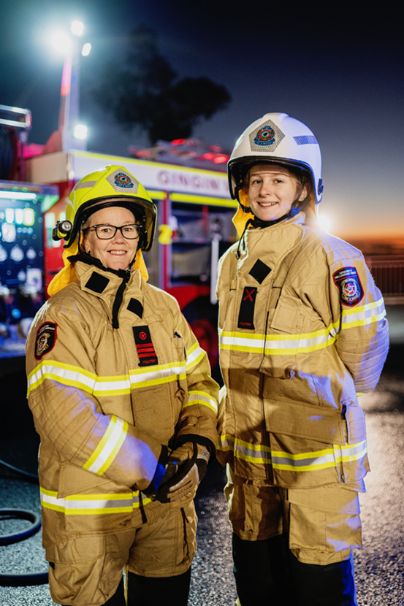
Strategic Volunteer and Youth Programs
Youth in Emergency Services
Building the next generation
Hands on training
Leadership skills
Volunteer pathways

Slide 6
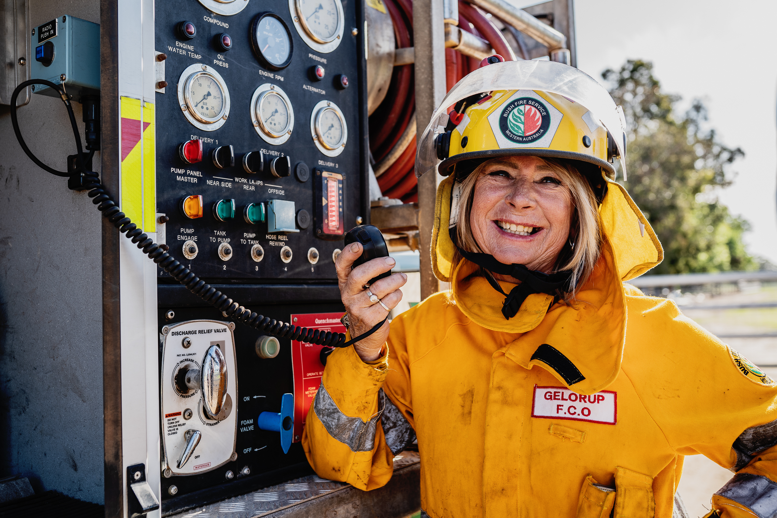
Strategic Volunteer and Youth Programs
Women in Volunteer Emergency Services
Driving reform
Flexible pathways
Pregnancy policy
Leadership development

Slide 7
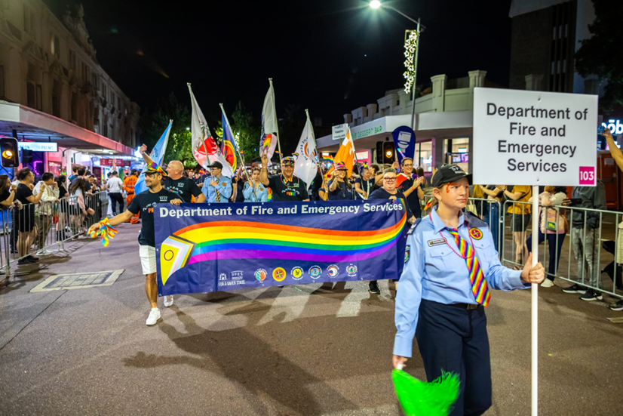
Strategic Volunteer and Youth Programs
Representation Matters
Creating safe spaces for all
Culturally and Linguistically Diverse
People with Disabilities
LGBTQIA+

Slide 8
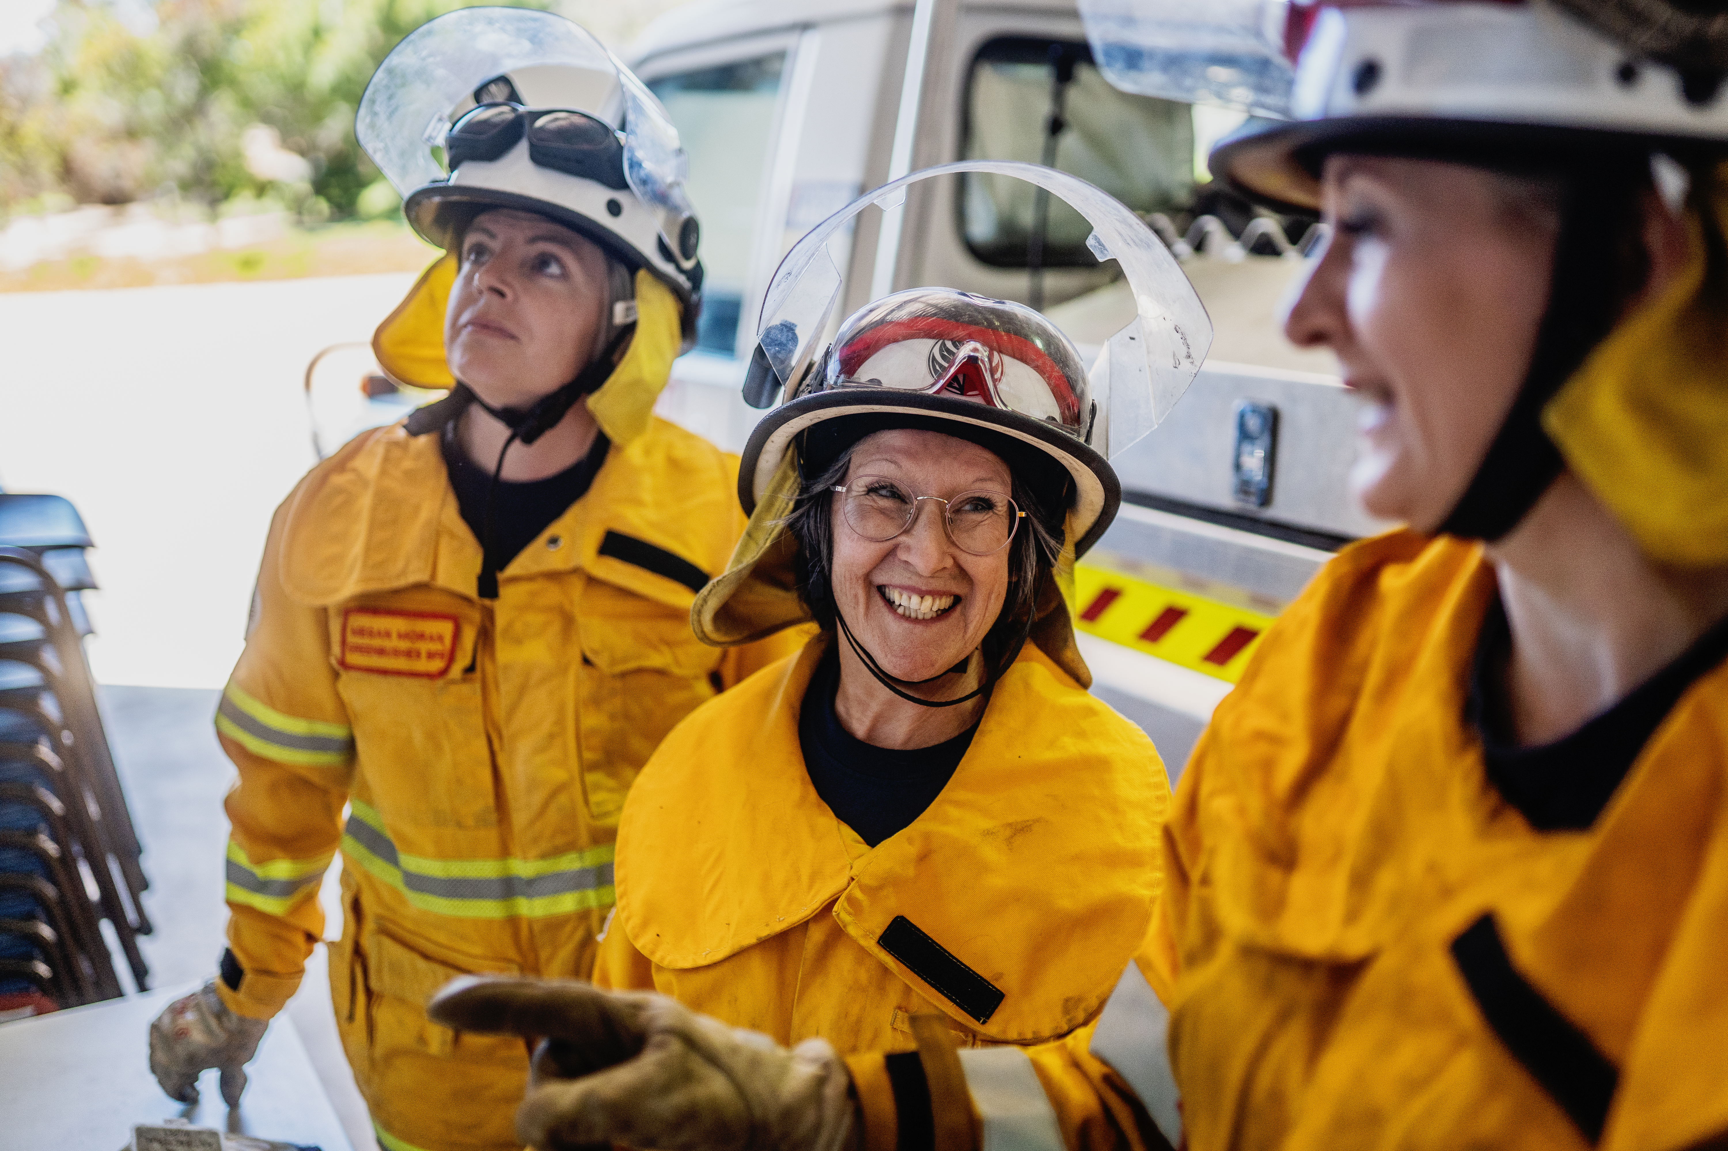
Strategic Volunteer and Youth Programs
Inclusive Leadership
Action for lasting change
Allyship training
Mentoring
Strategic leadership
Partnerships

Slide 9
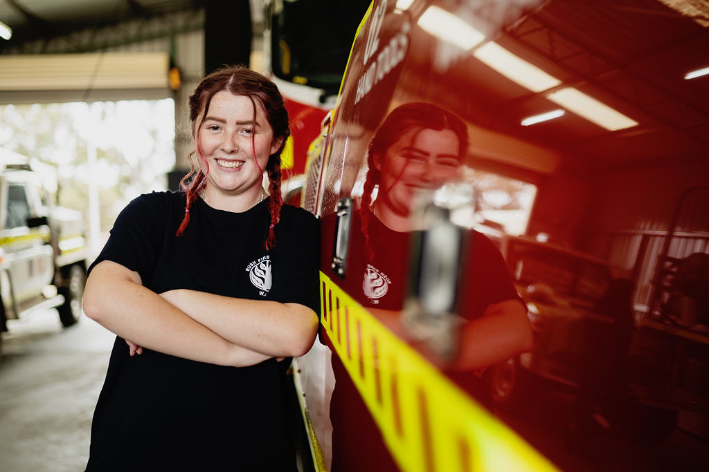
Strategic Volunteer and Youth Programs
Data Driven Accountability
Listening, learning and leading
Volunteer Data Dashboard
Surveys
Evidence based action

Slide 10

Strategic Volunteer and Youth Programs

Slide 11
Strategic Volunteer and Youth Programs
Contact details:
volunteering@dfes.wa.gov.au
Phone (08) 9395 9410

