Slide 1




#WAFA25
Targeted Community Risk Reduction:
PRIORITIZING VULNERABLE AREAS FOR MAXIMUM IMPACT
Selena Silva
Global Risk Reduction Specialist

Slide 2
#WAFA25
We begin by respectfully acknowledging that we are meeting on Whadjuk Noongar boodja — the traditional lands of the Whadjuk people of the Noongar nation.
We honor their enduring cultural and spiritual connection to this land, and pay our respects to their
Elders past, present, and emerging.

Slide 3
#WAFA25
Right
RESOURCES
Right
PLACE
Right
TIME

Slide 4
#WAFA25
GOALS
Targeted CRR = Strategic allocation of resources where risk is highest. Limited resources are universal; vulnerabilities differ by region.
Learning Goals:
1. Define targeted CRR.
2. Identify methods to prioritize vulnerable areas anywhere.
3. Share adaptable intervention strategies.
4. Explore universal impact measurements.

Slide 5


#WAFA25
INTRODUCTION
Thanks to my generous partners.
My opinions are my own and not of theirs, nor of the agencies I work for/contract with.

Slide 6

#WAFA25
CRR FOUNDATION
5 E’s: Education, Engineering, Enforcement, Emergency Response, Economic Incentives
CRR Process Flow: Risk Identification → Prioritization → Targeted Action
NFPA 1300: Standard on CR Assessment and CRR Plan Development

Slide 7
#WAFA25
Defining Vulnerable
AREAS GLOBALLY
Geographic hazards: wildfire, flood, earthquake, drought.
Infrastructure resilience: housing, road access, water supply.
Socioeconomic indicators: poverty, literacy, unemployment.
Demographics: children, elderly, newcomers.

Slide 8
#WAFA25
IDENTIFICATION
Pinpoints actual risks: CRR efforts can be too broad or misaligned without factual identification of hazards, demographics, and vulnerabilities.
Reveals patterns and causes: Fire and EMS data reveals where incidents occur.
Builds community understanding. Community input ensures interventions reflect real needs, not assumed needs.
PRIORITIZATION
Focuses resources where they matter: We work too hard to miss the mark.
Prevents copy X paste: there is no “one size fits all”.
Drives measurable impact: This distinguishes real risk reduction and performative outreach.
Promotes equity: brings disproportionately affected communities into the forefront and reduces gaps.

Slide 9
#WAFA25
TARGETED APPROACHES ACROSS BORDERS
QUANTITATIVE
QUALITATIVE
THE NUMBERS
“WHY” BEHIND THE NUMBERS
Incident counts tell us what happened. We can trend this data to monitor frequency of events over time.
Reveals how people feel, perceive, and respond to risks and safety.
This helps builds cultural and contextual understanding.
ONGOING MEASUREMENT BUILDS SUSTAINABILITY

Slide 10
#WAFA25
MEASURING IMPACT
RURAL EAST AFRICA
METRO HIGH RISES
COMMUNITY BASED FIRE MANAGEMENT & INDIGENOUS FIRE STEWARDSHIP
GIS MAPPING PRIORITIZES SPRINKLER INSPECTIONS
BLANKET PROGRAMS WASTE RESOURCES
CRR TAKES MULTIPLIES LIMITED RESOURCES
FOR MAXIMUM IMPACT

Slide 11
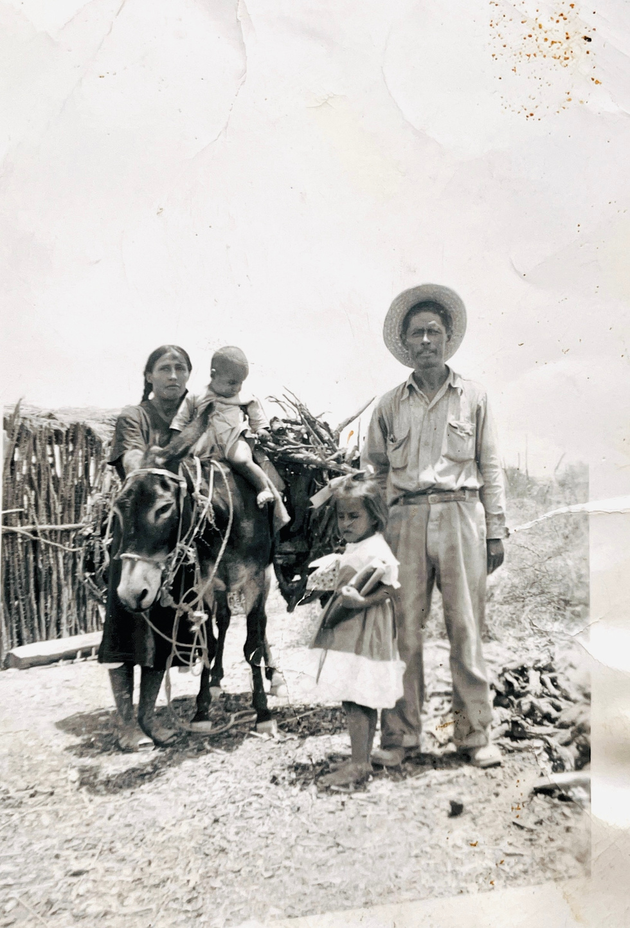
#WAFA25
TAILORING
Involve leaders and elders in the
CRR process.
Shared ownership increases adoption, sustainability, and pride in the risk reduction program.
Adapt language and approach for maximum impact.
Respect local community leadership.
Seek permission before using the stories of a community.
INTERVENTIONS

Slide 12
#WAFA25
Global Challenges
AND SHARED SOLUTIONS
Challenges: funding, political delays, engagement barriers.
Solutions: consistency, adaptable models, partnerships, stakeholder engagement.
Leverage networks for knowledge sharing

Slide 13
#WAFA25
SMALL, BUT MIGHTY
Start small.
Target well.
Scale what works.
INSPIRE AND LEARN
Share successes nationally.

Slide 14

#WAFA25
CLOSING
Every community is unique.
But no community is alone.

