Slide 1
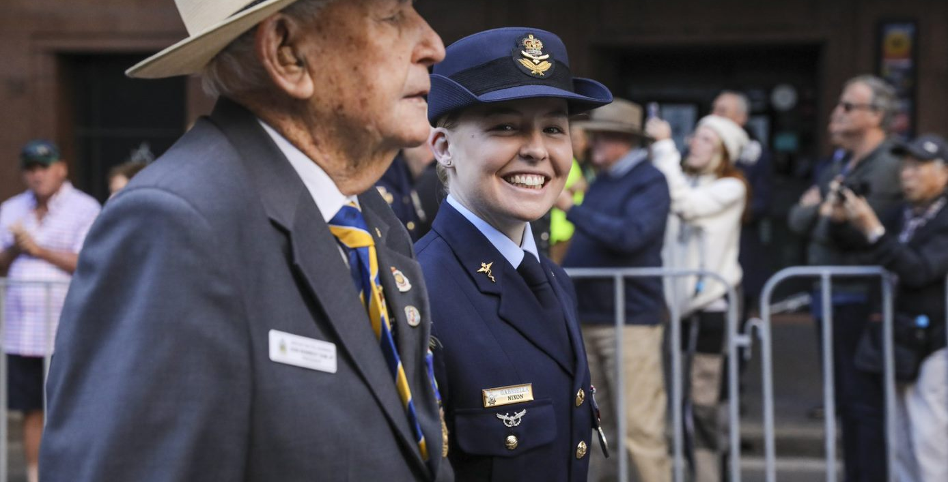
A case study in inclusion:
Challenging perceptions and uniting veterans for a revitalised RSL NSW
Trina Constable, RSL NSW
General Manager Stakeholder Engagement
WAFA & AFAC Conference 2025
Notes:
Good afternoon, and thank you for the opportunity to present today. I'm Trina Constable and I’m the General Manager for Stakeholder Engagement at RSL NSW. I’d like to share how we managed to revitalise one of Australia's oldest and most traditional institutions by prioritising inclusion, particularly of younger and women veterans.
I’m particularly glad to be talking to you today because I see many parallels between RSL NSW and the fire and emergency services.
Of course, both of our organisations operate in a male-dominated context. We’re also organisations that contribute more to our communities than many people might first assume. We’re both striving to help our leadership shed the weight of tradition while retaining its legacy, and we’re both facing similar challenges when it comes to attracting and recruiting from a more diverse demographic.

Slide 2
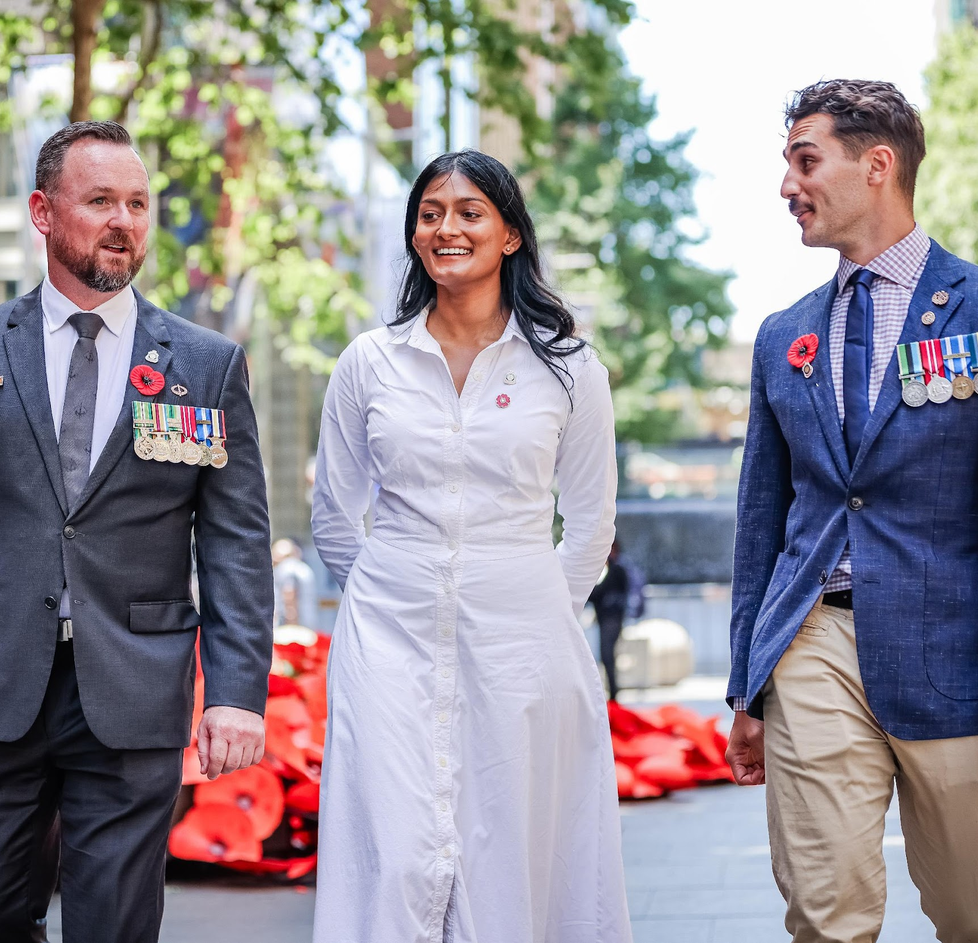



The challenge
A declining, ageing membership
The results
First membership
increase in 40 years
Notes:
Before diving into the RSL NSW journey, I want to outline the key challenge we were when I joined the organisation five years ago, and what we have achieved.
Five years ago, we were dealing with a severe decline in membership that was threatening the very existence of the organisation, and we were facing a significant underrepresentation of younger and female veterans.
Through bold storytelling and targeted campaigns, we’ve reversed that membership decline and completely reformulated our gender balance so that it now reflects today's Australian Defence Force, making the League more relevant and diverse than ever.
Let me tell you how we did it.

Slide 3
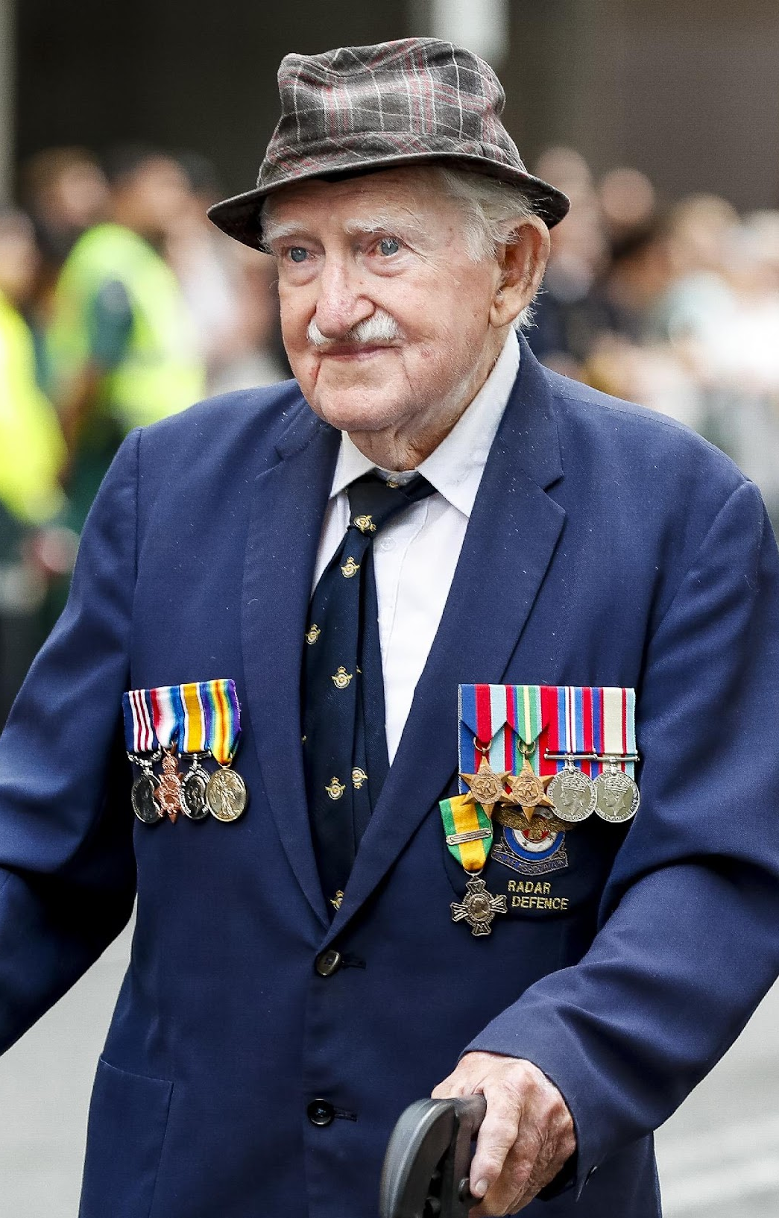


Context and challenge
Membership fell from
120,000 (1982) to 21,000 (2021)
One-third of members older than Australian male life expectancy
Notes:
I don’t think it’s an exaggeration to say that in 2021, RSL NSW was facing an existential crisis. Our membership was at a 40-year low – from over 120,000 members in 1982 we were down to just 21,000. A large proportion of the public didn’t understand what RSL NSW even was.
[based on room – consider here asking the question: “How many of you here today understand the difference between RSL Clubs and ‘the RSL’?”]
In NSW, RSL NSW is a veterans’ charity – we are not related at all to RSL Clubs. RSL Clubs are in almost every local area – they are often large ‘pokie palaces’ with multiple bars, restaurants and gambling areas.
Many people in NSW hear ‘RSL’ and they think of the clubs, and of their pokies; our research showed that a third of veterans shared this brand confusion. So our first mission was to educate our audience – to show them that our organisation was separate to clubs and existed for them, and tell them about the support we provide for veterans and their families.
In terms of demographics, fewer than 2,000 – or 10% – of our members were under 55. Fewer than 1,000 were under the age of 39.
Perhaps most startling of all was the fact that a third of our members were older than Australia's average male life expectancy.
The future of our organisation was at great risk. That meant that, without significant change, iconic events that are staged by RSL NSW and sub-Branches, including ANZAC Day services throughout the state, faced an uncertain future.
Most relevant for our discussion today, though, is the fact that like the fire services, efforts to recruit and retain diverse representation had been inconsistent. Female veterans were telling us they felt disengaged and underrepresented by the League.
The message was clear – the League was out of touch with an evolving veteran community.

Slide 4
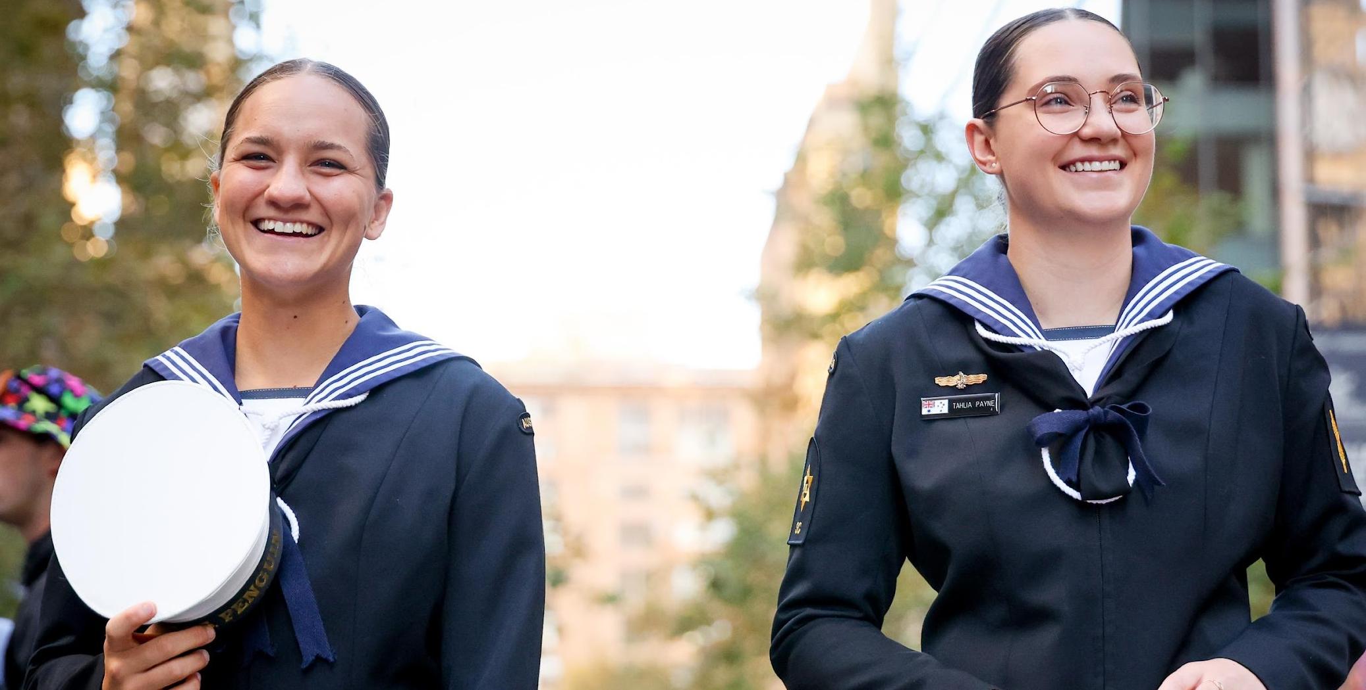
A five-year plan
Notes:
To address these challenges, we took an uncompromising stance: radical change was essential rather than optional, and so we launched with a bold new five-year plan in 2021.
Our research had revealed a clear disconnect between older members – many veterans of the war in Vietnam – and younger veterans with far different experiences and from a greater range of demographics. So our strategic vision placed inclusion and cultural renewal at its core.
We knew we needed to educate our current members on the challenge we were facing and why they needed to be part of urgent action. We knew that we could do that by shining a spotlight on real, younger veterans and helping tell their stories.
And we knew that by amplifying the voices of female veterans, both as spokespeople and in positions of leadership, we could build a more inclusive and welcoming RSL.
This was a strategy that wasn’t just about boosting numbers. We wanted to fundamentally shift perceptions about who belonged in the League. A message that fire and emergency services can take away today is this: visibility matters.
I won’t see ‘you can’t be what you can’t see’ in this forum – there are many in this group who have indeed achieved very different goals than what they could see in the role models presented to them.
But visibility matters – because by empowering people to tell their stories and amplifying their voices we say two things: “this person has a place in our community” and “this community supports this person”.
We tell a story of a sailor whose kids love going to RSL NSW events with their mum when she’s not at sea. Or of that sailor’s wife, who has a community in the sub-Branch for support when she is at sea. Or of the work the sailor does for the sub-Branch when she is at home.

Slide 5
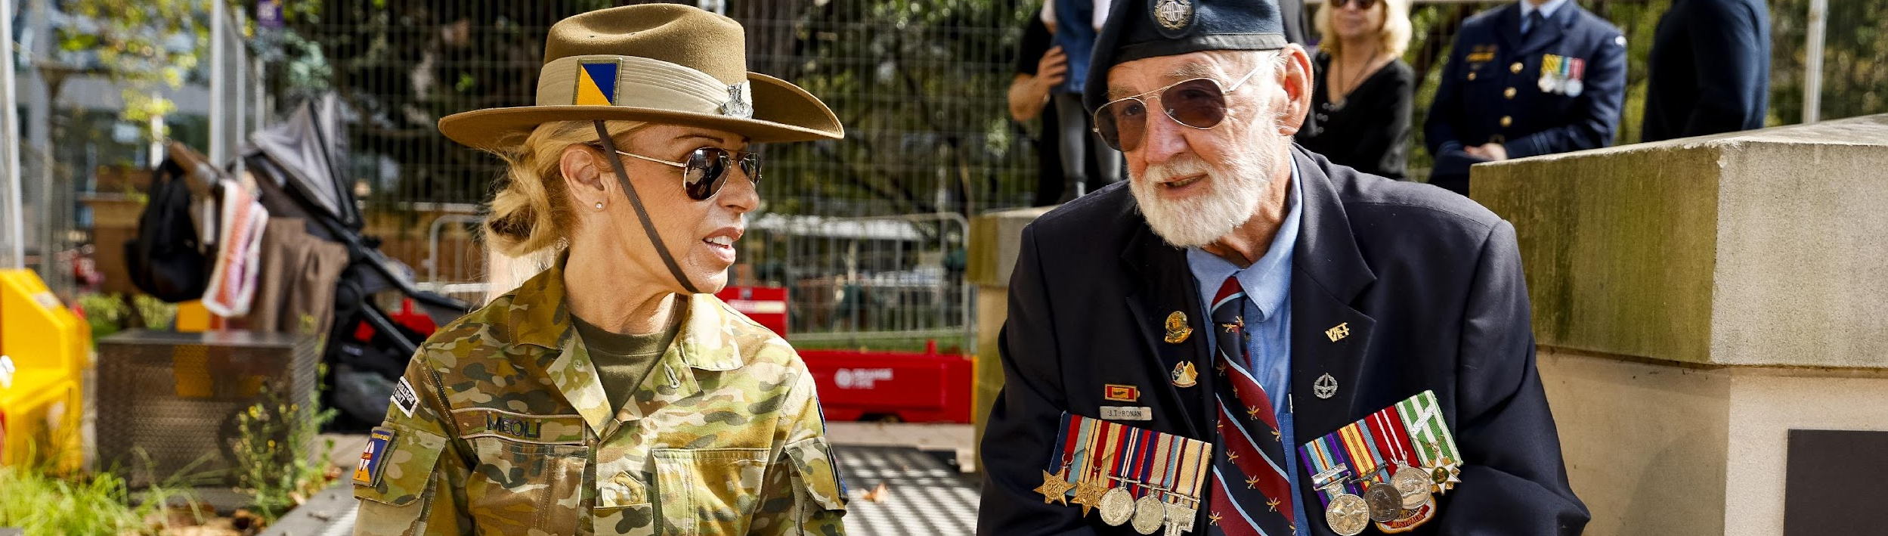


Internal
cultural education
Inclusivity training
for sub-Branch leaders
Peer-led workshops
on unconscious bias
Notes:
And that last point – a portrait of the contribution young veterans make to their sub-Branches – was crucial. We had to address our existing community, including the leaders within it, across RSL NSW. This presented a challenge in itself – many of our volunteers liked the ‘old’ RSL NSW, and were not particularly interested in changing their ways.
So we designed an internal education program that helped long-standing members to understand the importance of welcoming all veterans, regardless of age, background, or gender.
We also ran inclusivity training for sub-Branch leaders, and invited them into peer-led workshops that addressed unconscious bias and respectful engagement.
An important outcome of this training was ingraining the message that this new focus on inclusivity was not performative, or ‘for the cameras’ – it was a total, ground-up reinvention of how RSL NSW as an organisation thought and acted, and it laid the groundwork for genuine, long-term change.

Slide 6
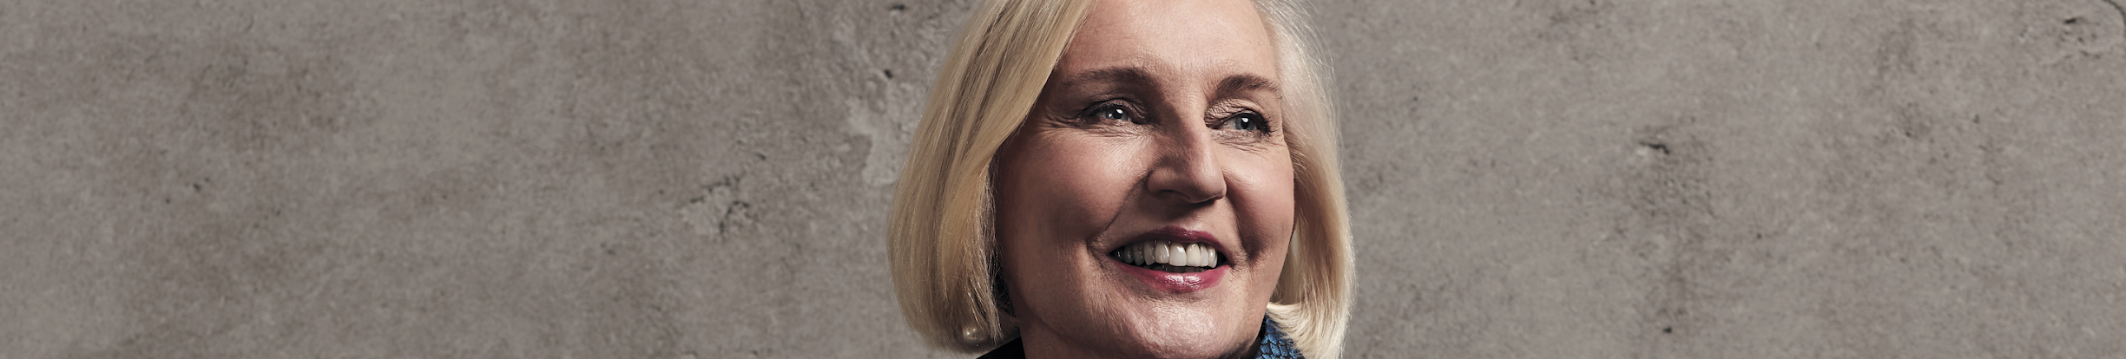
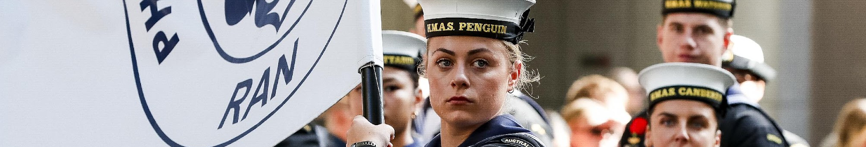
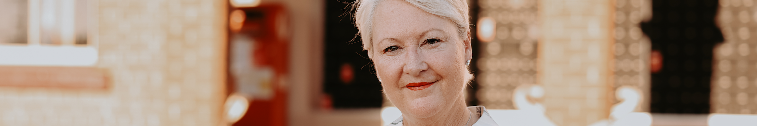
Visibility
Responsibility
Advocacy
Notes:
To help shift perceptions both inside the organisation and with the wider public, we intentionally ramped up the presence of women veterans across all our communication platforms.
The relaunch of our member magazine, the Reveille, gave us the opportunity to rethink how we featured women's voices, and allowed us to position them as core to our identity rather than peripheral. I’ll talk more about the Reveille in a moment.
Internally at RSL NSW we made sure that governance committees had women veterans in significant roles, giving them a platform to effect change, and clearly demonstrating our commitment to authentic representation and leadership.
And by raising the profile of younger and female veterans, and having them act as spokespeople for RSL NSW at events such as ANZAC Day, we showed the veteran community, and the wider world, that despite what they might have thought in the past, the League was for, and populated by, people just like them.
I want to emphasise that these efforts were not about tokenism. They were about resetting cultural expectations and acknowledging that today’s veterans, like today’s emergency service workers, look a little bit different from those of past generations.

Slide 7
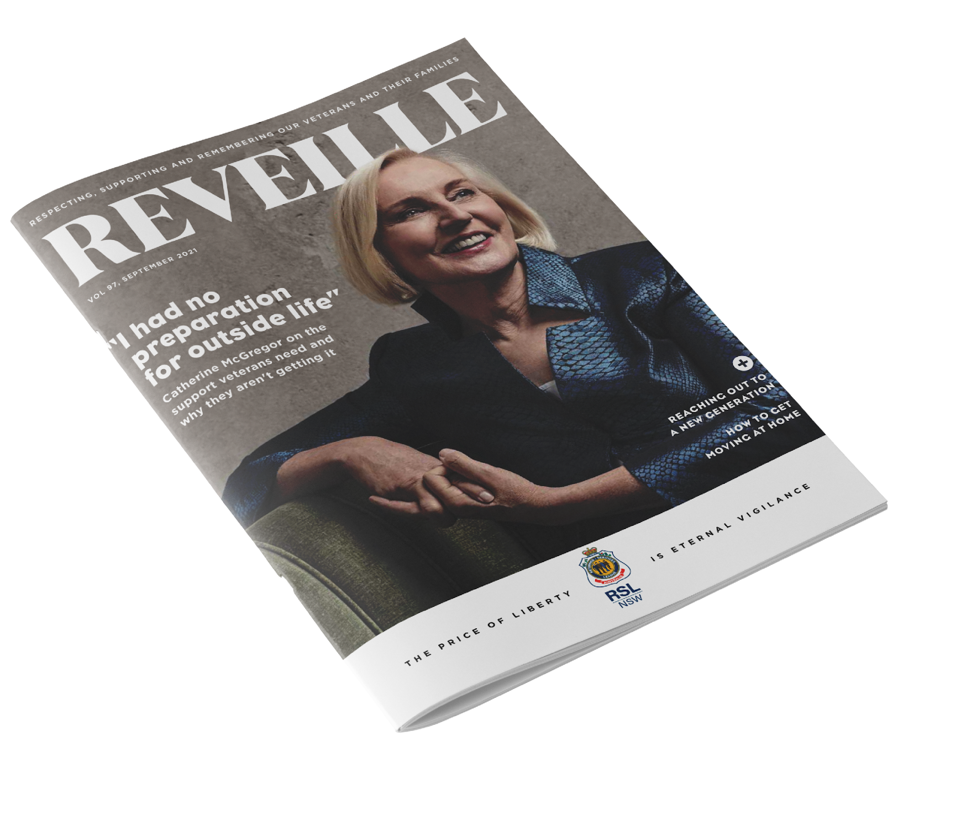


Reveille magazine: Driving cultural change
Relaunched in
2021
82%
of members said that it had improved
Notes:
Central to our reimagining of RSL NSW was the relaunch of our member magazine, Reveille.
The magazine had traditionally been retrospective and ceremonial. If I’m totally honest with you, it was a little dry, and in sore need of a refresh.
We relaunched with a new editorial strategy, to hero the younger voices in our community, to portray the pockets of diversity within our community, and to show our existing community the future they could achieve and be part of.
This front cover on screen is our relaunch issue. If you know who that is on the cover, and heard me when I told you that 90% of our members were over 55, you know this made a splash.
We chose to profile respected veteran Catherine McGregor for our first issue after the relaunch – because she is a veteran herself, having served across two branches of Defence, because she was a member of the League, and because she turns her sharp mind to advocating for veterans and for better transitions out of Defence. Catherine is also a transgender woman. On this cover, her presence said ‘this is what we stand for – veterans’. This was a new Reveille for a more modern veteran community.
That relaunch won us publishing awards, and I had emails from veterans with positive feedback. I’m still very proud of it, almost five years on.
Since then we’ve transformed the magazine into a tool for inclusion and inspiration. Our editorial strategy prioritises contemporary stories and practical resources. It honours the past but doesn’t dwell on the forensic – what could have been or what was – instead focusing on the future and prominently elevating female and younger veterans.
Importantly, we don’t just talk about women – we make space for women to tell their own stories, front and centre. From cover stories to opinion columns, women veterans are shown leading, mentoring and contributing. This visibility has been crucial in shifting perceptions and encouraging new membership.
And the feedback has been overwhelmingly positive – 82% of our members say the new magazine is an improvement over the old format.

Slide 8
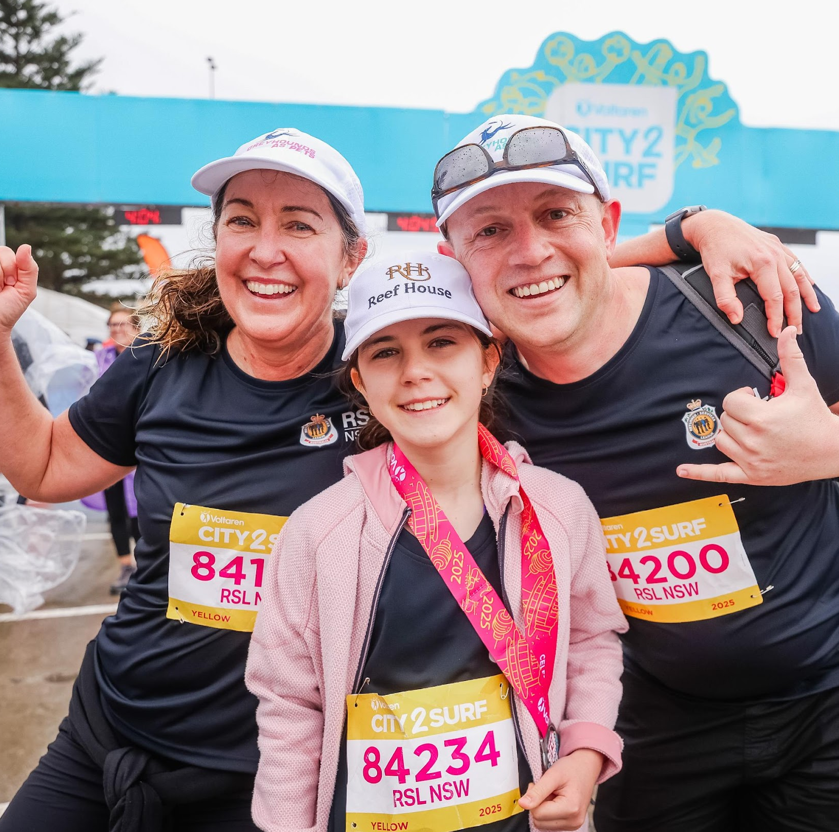
RSL NSW Sport & Recreation Program:
A vehicle for inclusion
Largest program of its kind in Australia
Notes:
Of course, storytelling is nothing without action. The launch and growth of the RSL NSW Sport & Recreation Program, which is now the largest veteran sports program in Australia – has had an incredibly positive impact.
Younger veterans had told us they wanted events that their partners and children could come to, so we designed a program that enables local sub-Branches to host team and individual activities that build camaraderie, physical wellbeing and social connection.
For many veterans, particularly women and younger members, this program provides a soft entry into RSL NSW. It removes barriers of rank, gender and past conflict. Importantly, family involvement means that support is holistic, and belonging extends beyond the individual.
Veterans and their children, spouses and friends can take part in everything from yoga and hiking to community sports days and inter-service competitions.
We piloted the program in 2022 and it’s gone from strength to strength since then, to the point where last year the program put on more than 1,500 activities, and we’ve seen a 450% increase in the number of sub-Branches taking part.
The program has allowed veterans across the state to build new friendships, as well as become community leaders. It’s put a new face to the name of ‘veteran’, and in many cases that face belongs to a woman.

Slide 9
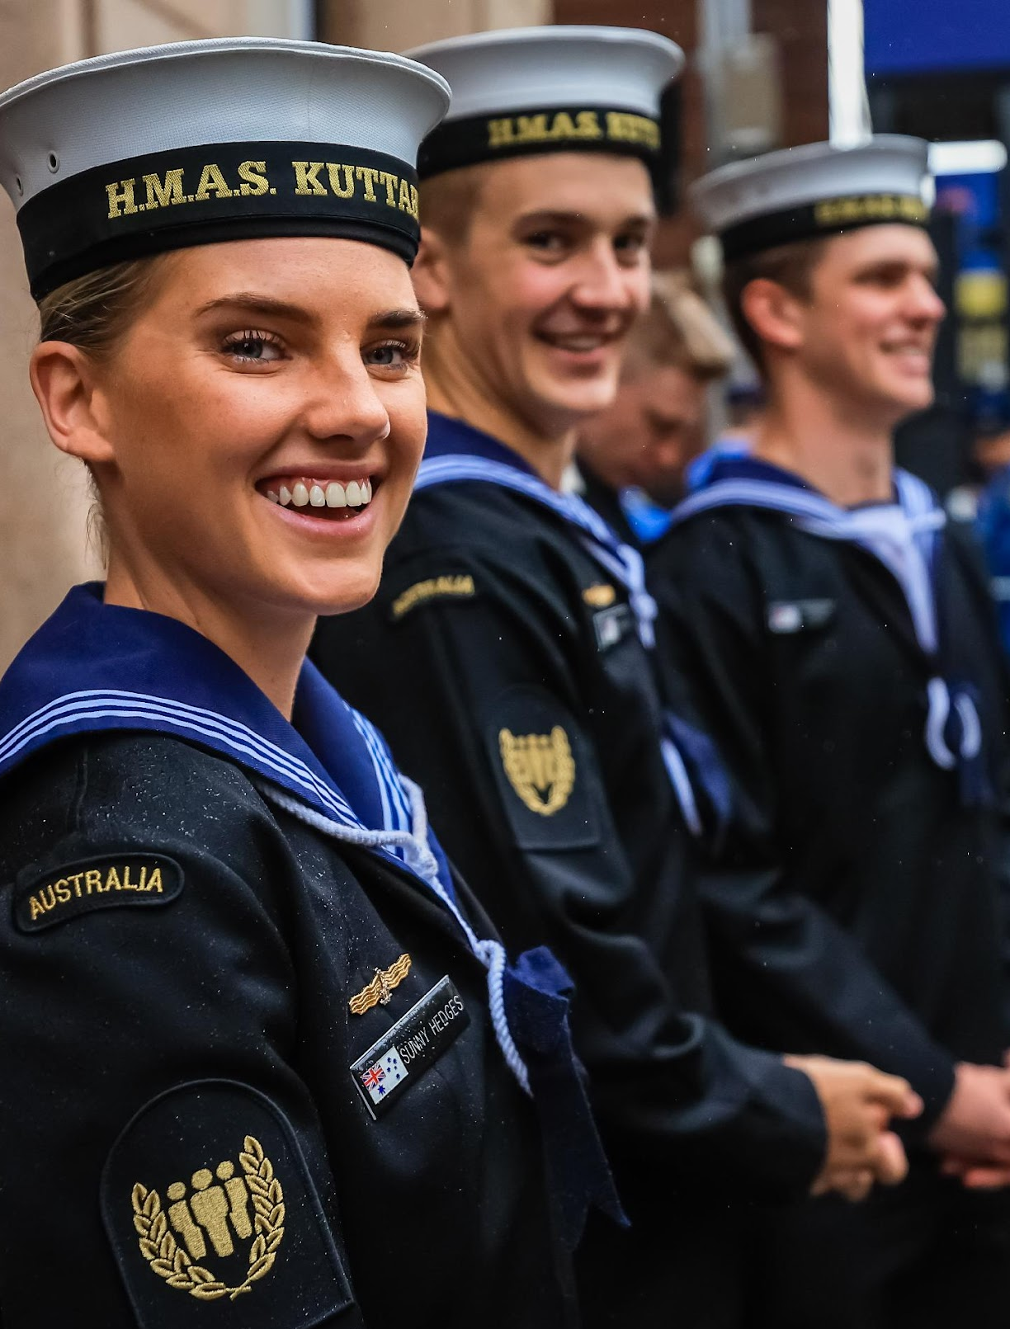


A wake-up call to the nation: Save ANZAC Day
Campaign reach:
50.2 million
507
new members joined post-ANZAC Day 2022
Notes:
I’d like to turn our attention to a couple of our communications campaigns now – which we stand up alongside the ‘always-on’ activity I’ve shown you so far.
Our "Save ANZAC Day" campaign, which we launched on ANZAC Day 2022, needed to be a wake up call to the nation. We explicitly linked the continuing survival of ANZAC Day events to our membership crisis, urging younger veterans to step forward. It’s not untrue to say that without revitalising our regional sub-Branches, and encouraging younger veterans to take over the organisation of ANZAC Day events, those commemorations would simply not happen.
We engaged media at every level to show what would be lost if we didn’t act. We used trusted, diverse voices to tell the stories of real veterans in regional communities – we think it was this authenticity that resonated with the veterans in those communities, and by highlighting local heroes we were able to show how they could contribute, too.
This emotional, strategic storytelling worked.
In the end, the campaign had a reach of more than 50 million, a fact which we were very proud of. In the month that followed ANZAC Day 2022 we had 507 new members sign up – seven times the number of new members that had joined around ANZAC Day in previous years.

Slide 10
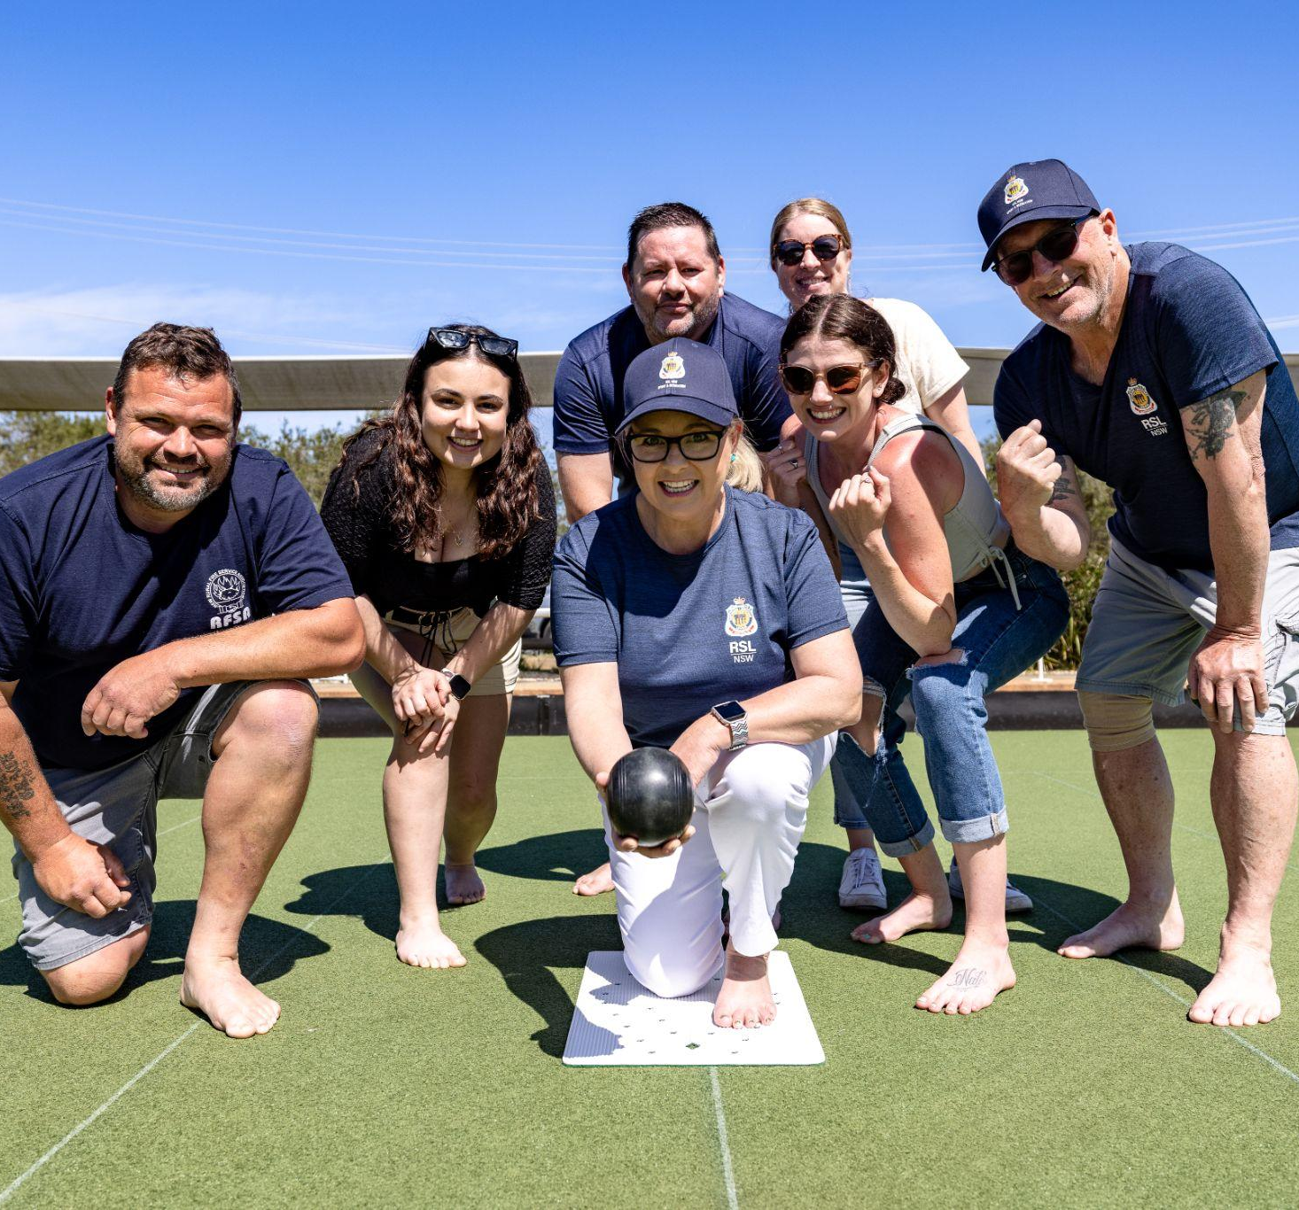


Changing the narrative: The Real RSL
First membership increase in 40 years
Average member age dropped by six years
Notes:
This year’s ANZAC Day campaign – ‘the Real RSL’ – tackled brand confusion head-on.
One of the incredible things we see every day at RSL NSW is the camaraderie and peer support our community provides. We wanted to shake loose the idea many Australians and veterans have of the RSL brand – the pokie palaces that NSW residents lose $1 million to every hour. And we wanted to replace that idea with a new one – the people who make up our not-for-profit community organisation dedicated to connection, mental health, and wellbeing for veterans and their families.
By harnessing digital storytelling and influential veteran voices, the campaign reshaped public perception, especially among younger veterans and women, who previously felt disconnected from our identity.

Slide 11

Integration across channels
Consistent messaging
and tone across all channels
Reveille + media + social + events + sports programs
Family-friendly, inclusive, renewal, forward-looking
Notes:
These are two of our large campaigns – we run two large campaigns each year.
Over the past five years, all of this effort has added up to great impact.
We have achieved our first growth in membership in 40 years – growing our membership by 57%. And crucial for the ongoing sustainability of our organisation, we reduced our average member age by six years.
I think these results demonstrate the power of inclusive community-building and inclusive communication. I also think that’s something the emergency services can replicate.
What made these efforts work was integration.
What I mean by that is every touchpoint, from our magazine and media appearances, to local barbecues and sports programs, carried a consistent message: we are for all veterans and their families, and we are here for today’s challenges.

Slide 12
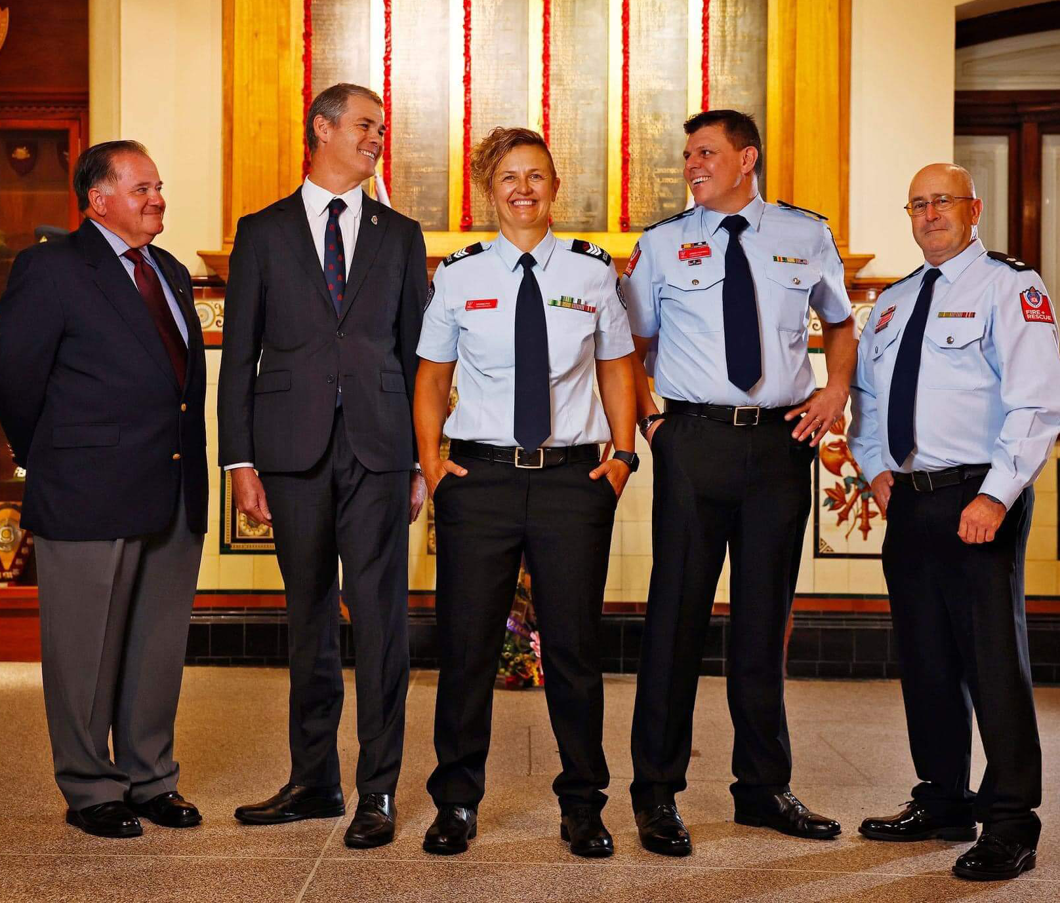
Working with Fire & Rescue NSW
Notes:
Our campaign didn’t just result in more women joining the organisation and taking up leadership roles. It also helped revitalise sub-Branches.
Last year, the NSW Fire Brigades RSL sub-Branch was reestablished, after closing in the 1980s as membership declined. We know there are more than 400 veterans working in Fire and Rescue NSW – and those veterans now have their own community to support them, and know where to turn for veteran-specific support when it’s needed.
We’ve also had conversations with the RFS to establish a sub-Branch to connect and support veterans in their community.

Slide 13
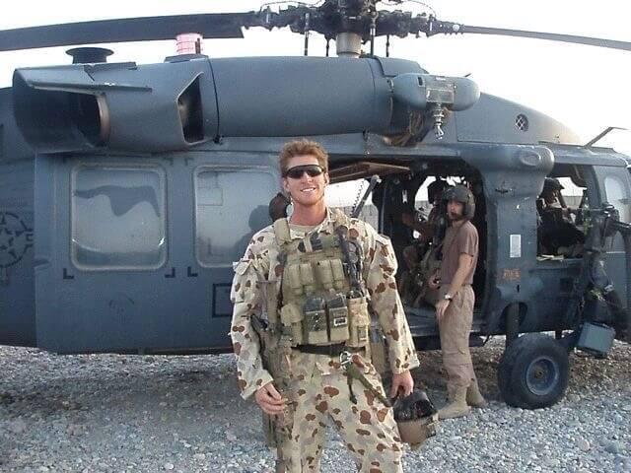
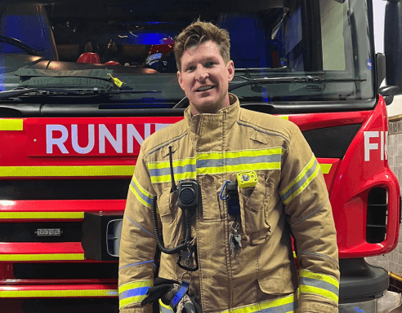
A natural transition
Notes:
For many veterans, the transition from military service to civilian life can be a challenge. Often, veterans want a career that offers the same purpose, teamwork, and opportunity to make a difference that their military service offered.
So that’s why we worked with Fire & Rescue NSW on their recruitment campaign this year – highlighting employment opportunities for veterans within Fire & Rescue NSW and how their skills are aligned with a career in firefighting.
For fire and emergency services organisations looking to expand their memberships beyond the usual demographic, partnerships like this can be mutually beneficial.

Slide 14
Progress through inclusion
Membership grew 57% over five years
Average member age decreased by 6 years
Membership gender ratio reflects current ADF service ratios
Notes:
Before we wrap up, I will recap some of the impactful actions and results, and I’ll share key takeaways on the next slide.
The strategy we developed in 2021, and the work that has taken place every day since then, has genuinely reshaped the League’s identity by creating and portraying an organisation that offers real value to younger veterans, and which must survive – think ‘Save ANZAC Day’.
Thanks to our focus on inclusion, relevance, and visibility, RSL NSW achieved its first membership increase in four decades, and has grown by 57% over just five years.
We dropped the average age of our members by six years, ensuring the sustainability of our future volunteer base.
And we rebalanced our gender ratios so that they now reflect the current Australian Defence Force.

Slide 15





Key lessons for emergency services
Inclusion is not a program; it is a posture
Representation must be intentional
and ongoing
You can’t grow if you don’t let go
Programs must reflect the people you want to reach
There is no better time than now
Notes:
Our experience offers crucial lessons, particularly relevant to emergency services organisations facing similar inclusion and sustainability challenges.
First, authentic inclusion is a posture that must be embedded into leadership, culture and communication from the ground up. It’s all well and good to attract women and indeed veterans to your organisations – but support mechanisms also need to be embedded for them to thrive in male-dominated environments.
Second, representation cannot be superficial – it must be consistent and intentional. Elevate the voices of women and diverse members regularly, not just on significant dates or “awareness days”.
Third, traditions need re-evaluation in light of modern realities to remain meaningful to contemporary audiences. Like RSL NSW, you can preserve the essence of your organisation while modernising the container in which it’s held.
Fourth, and here I’ll repeat the phrase from earlier – visibility is key. Your programs need to reflect the people you want to reach if you want them to be successful. From sport and recreation programs to family-friendly events, engagement strategies must centre on what people actually value.
And finally, this is last in my list up there, but it’s the most important. The best time to start on a campaign like this was 10 years ago. The second best time is today – now. Waiting for the “right moment” to start meaningful inclusion work all but guarantees that the moment will never come. RSL NSW acted with urgency, and so must you. It’s a message we’ve seen all over the WAFA conference this week…
[Share an insight from one other presentation, and from one conversation with another delegate.]

Slide 16
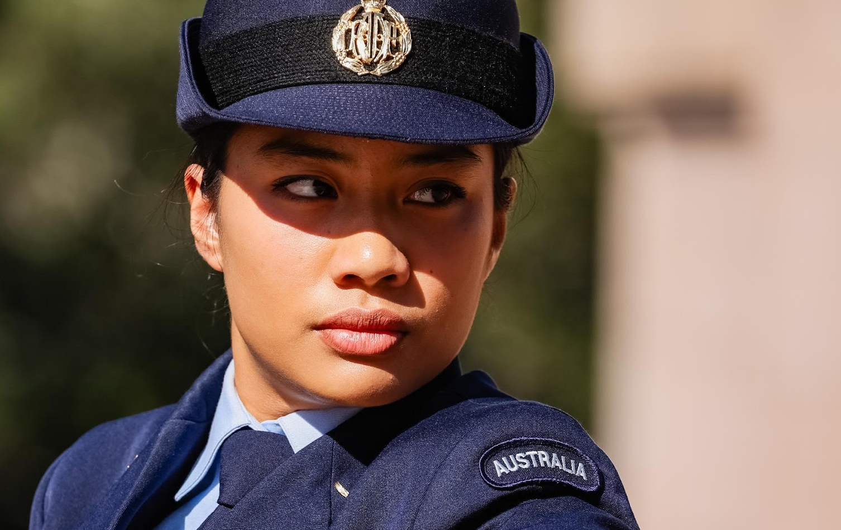
If not now, then when?
Notes:
Our journey at RSL NSW demonstrates that bold leadership and inclusive communication can profoundly revitalise even deeply traditional organisations.
I hope our experience, and this presentation today, provides actionable insights for your work.

Slide 17
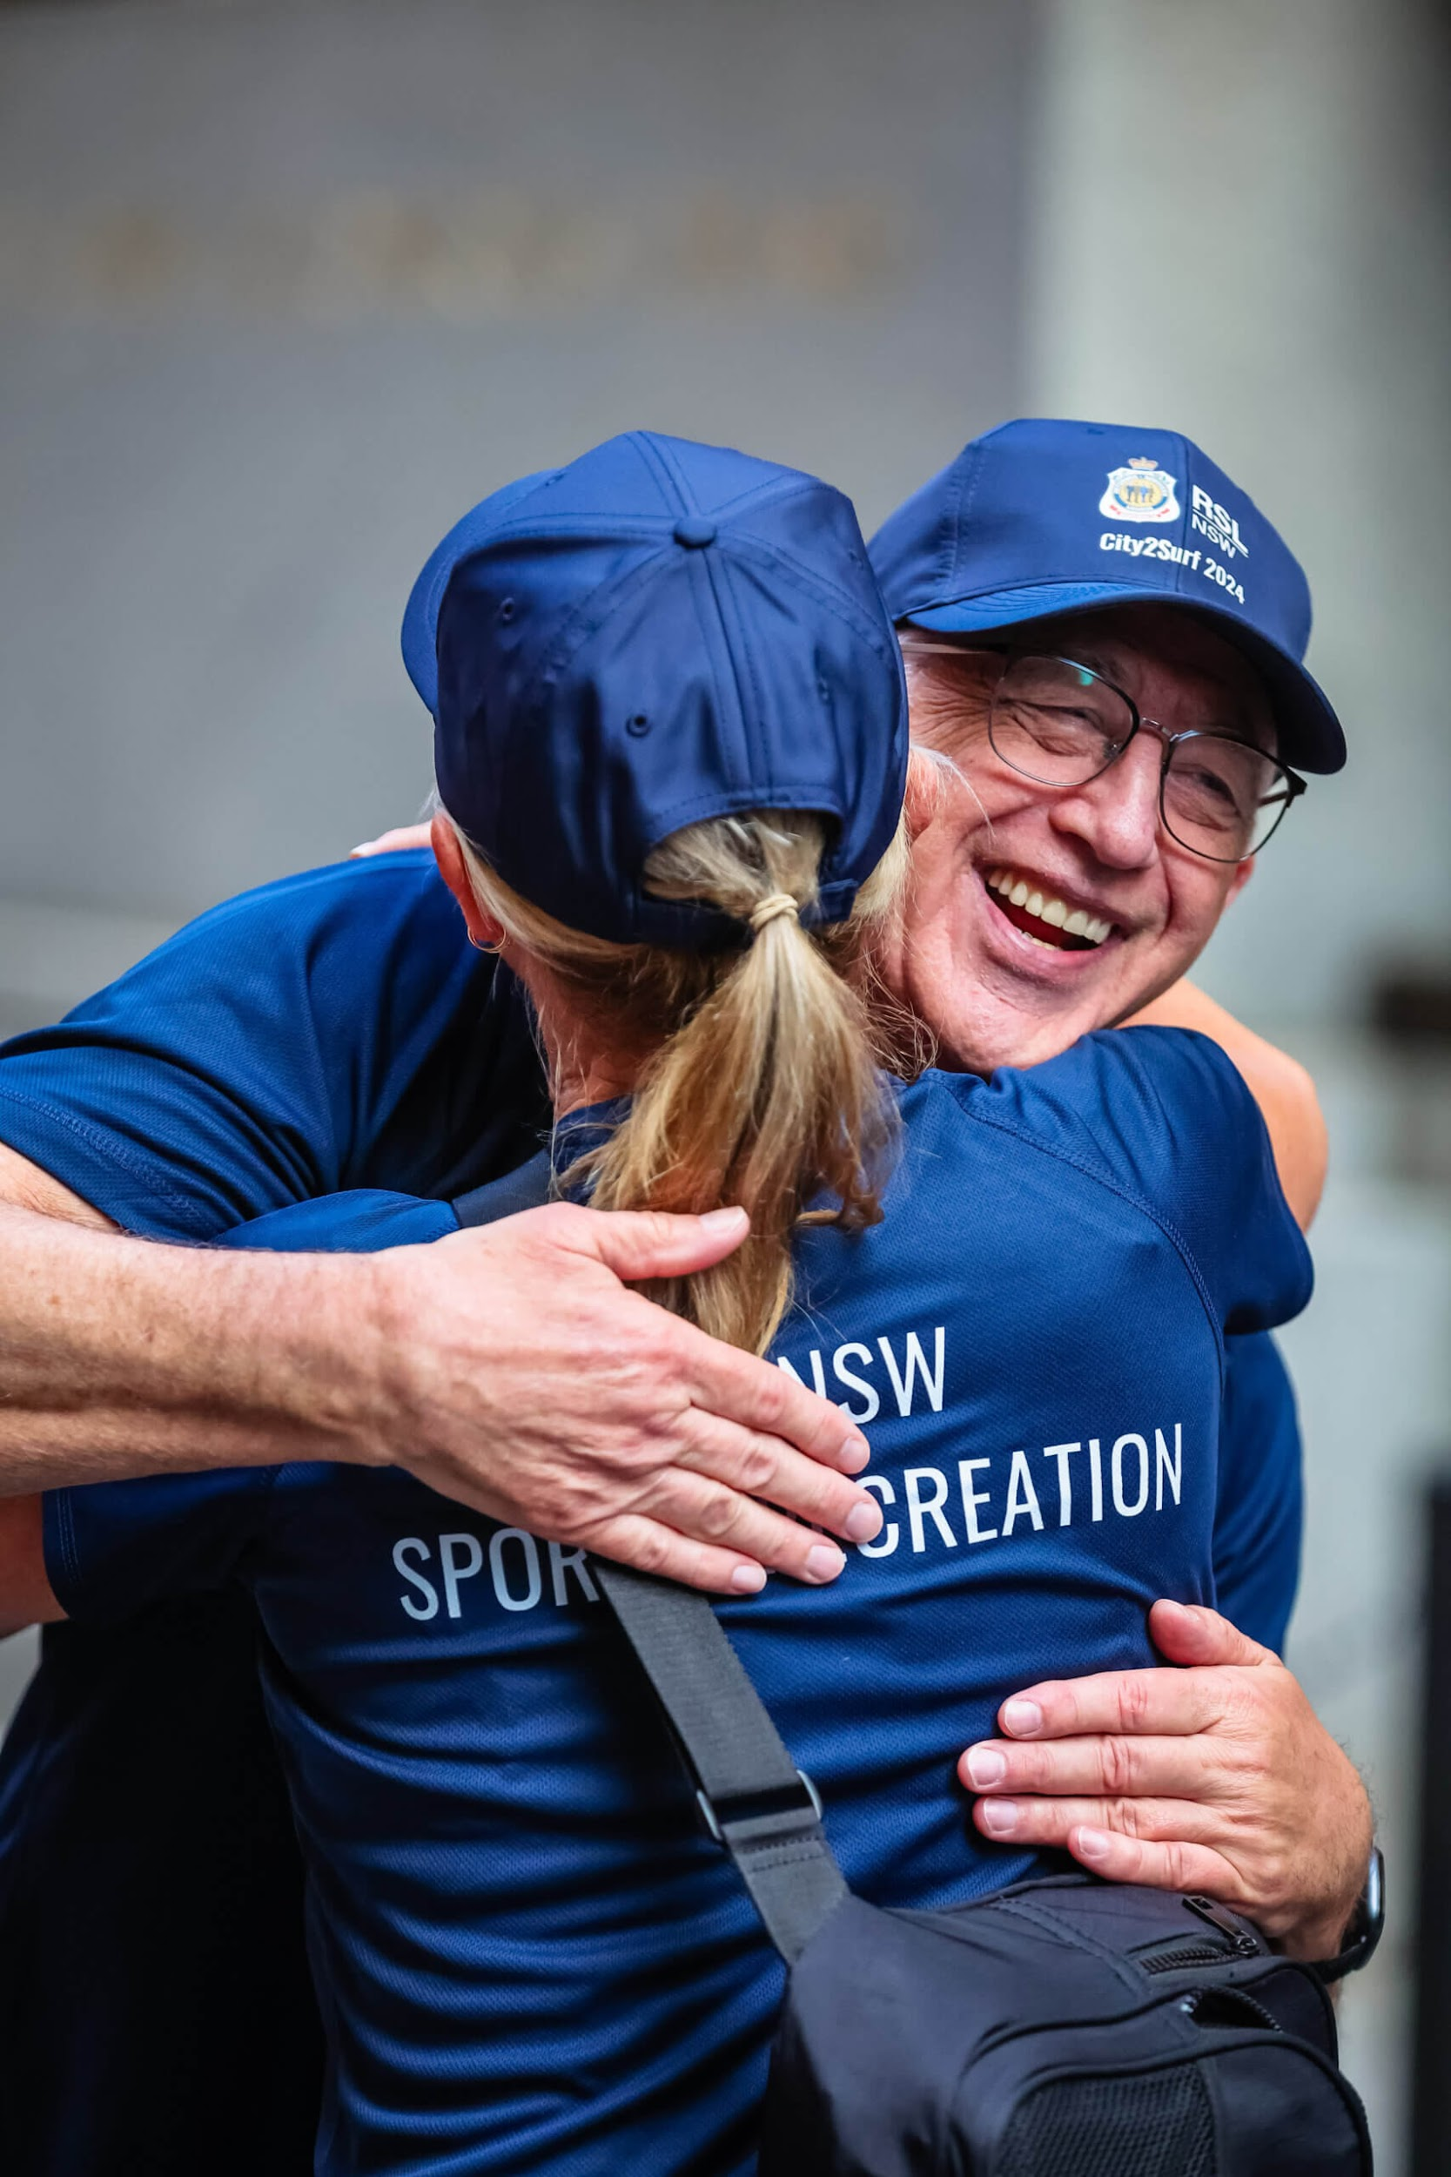
Thank you
Trina Constable support@rslnsw.org.au www.rslnsw.org.au
Notes:
Thank you so much for your attention.
I’d be happy to answer any questions.

