Slide 1



Fire Rescue Victoria’s
Women's Support Unit
#WAFA25
Presenters: Paula Treacy and Sarah Hammond

Slide 2

Welcome
Acknowledgement of Country
We acknowledge the Traditional Custodians
of Country throughout Australia and recognise their continuing connection to land, waters and culture.
We pay our respects
to their Elders past,
present and emerging.
Notes:
CHRIS - Deliver an Acknowledgement of Country.
Prompts for consideration:
I would like - begin by acknowledging the Traditional Owners of the land on which we meet today, which is Whadjuk country (pronounced WOD-JUK)
I pay my respects - their Elders past, present and future
I extend this respect - Aboriginal and Torres Strait Islander people joining us today and - all First Nations people across Australia, in recognition of your rich cultures, histories, and ongoing connections – to the land and water
Thank you
Notes on the artwork:
The themes of our artwork combine Victorian Indigenous art, fire, and the work that FRV does in the community.
The artwork is layered, using traditional Wurundjeri symbols.
The story is about our stations across the community, represented by the large red and black circle. These are surrounded by smaller circles; meeting places where everybody talks.
The layers of red, yellow and orange represent the situations we respond to, and landscapes across Victoria, from the three triangles of mountain ranges, to the four circles of water, and the lines of everything in between. The double circles represent the physical, mental and emotional strength of FRV members and their dedication to using combined knowledge: the single circles, to assist in supporting the community.

Slide 3
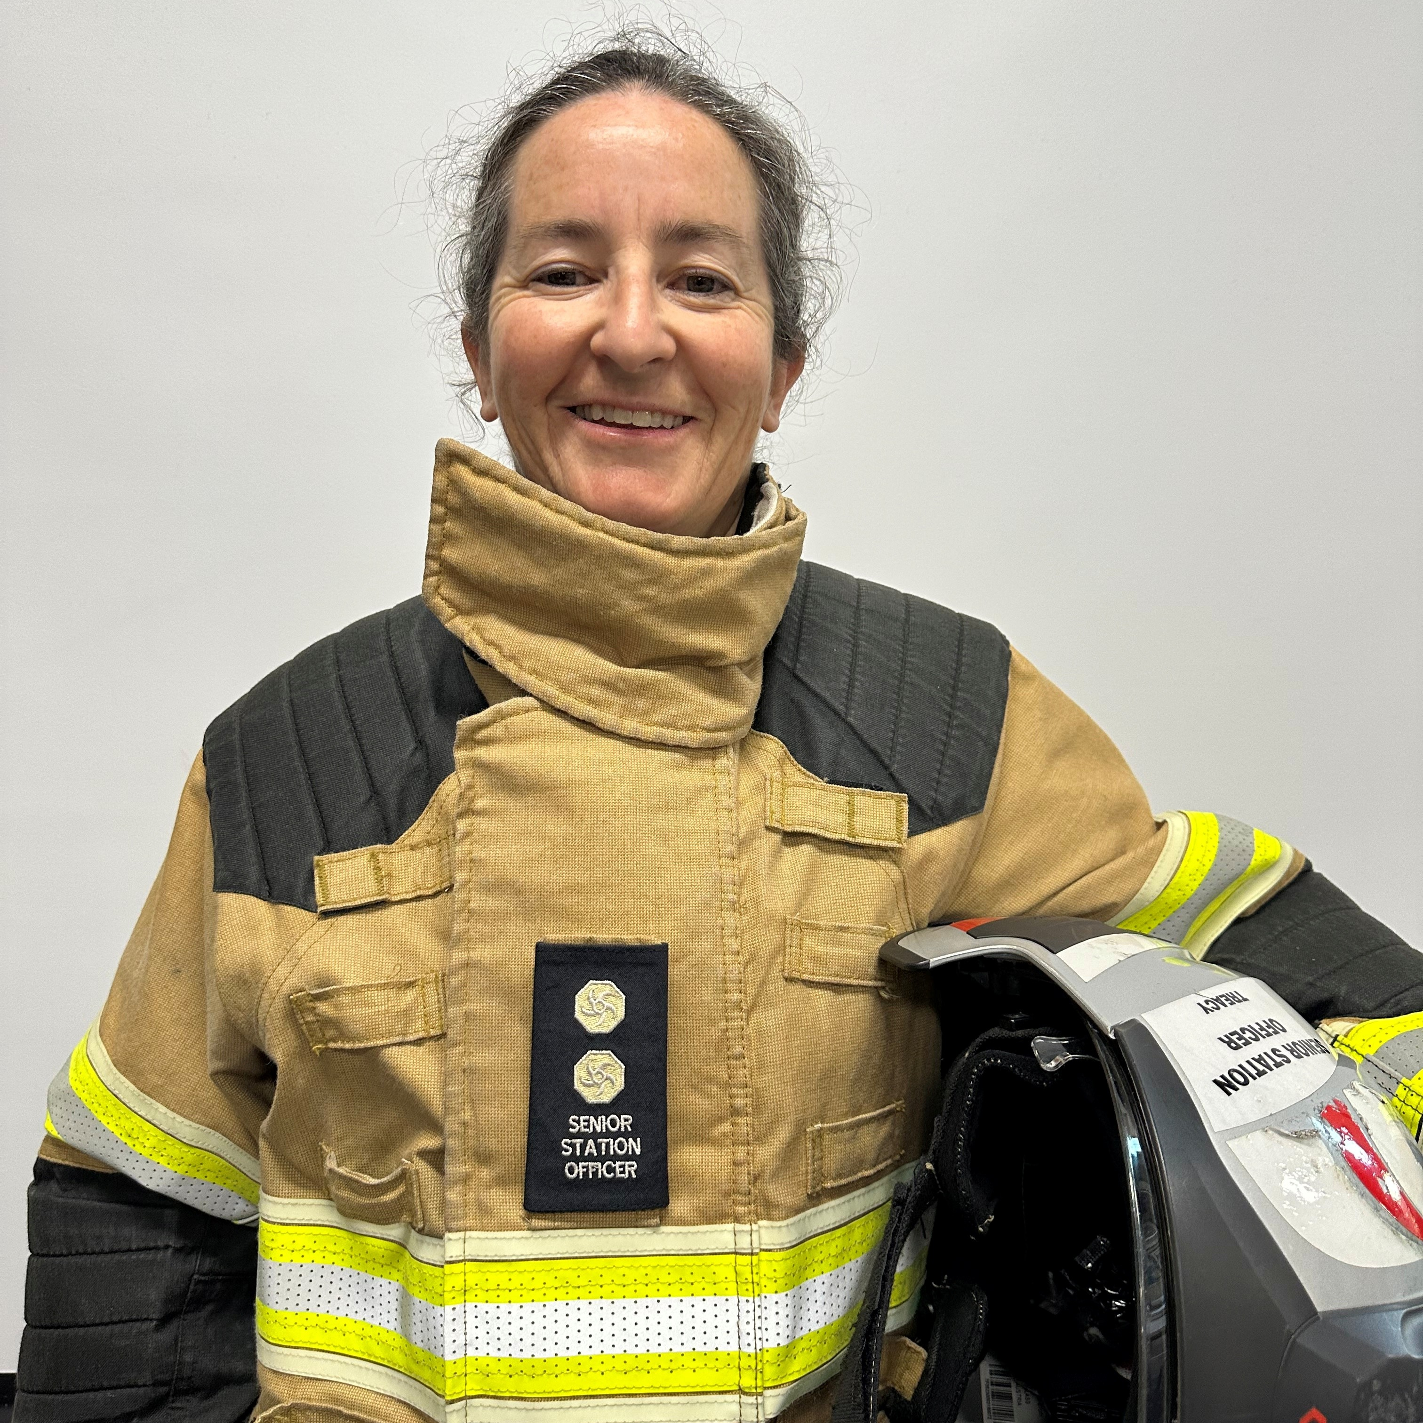
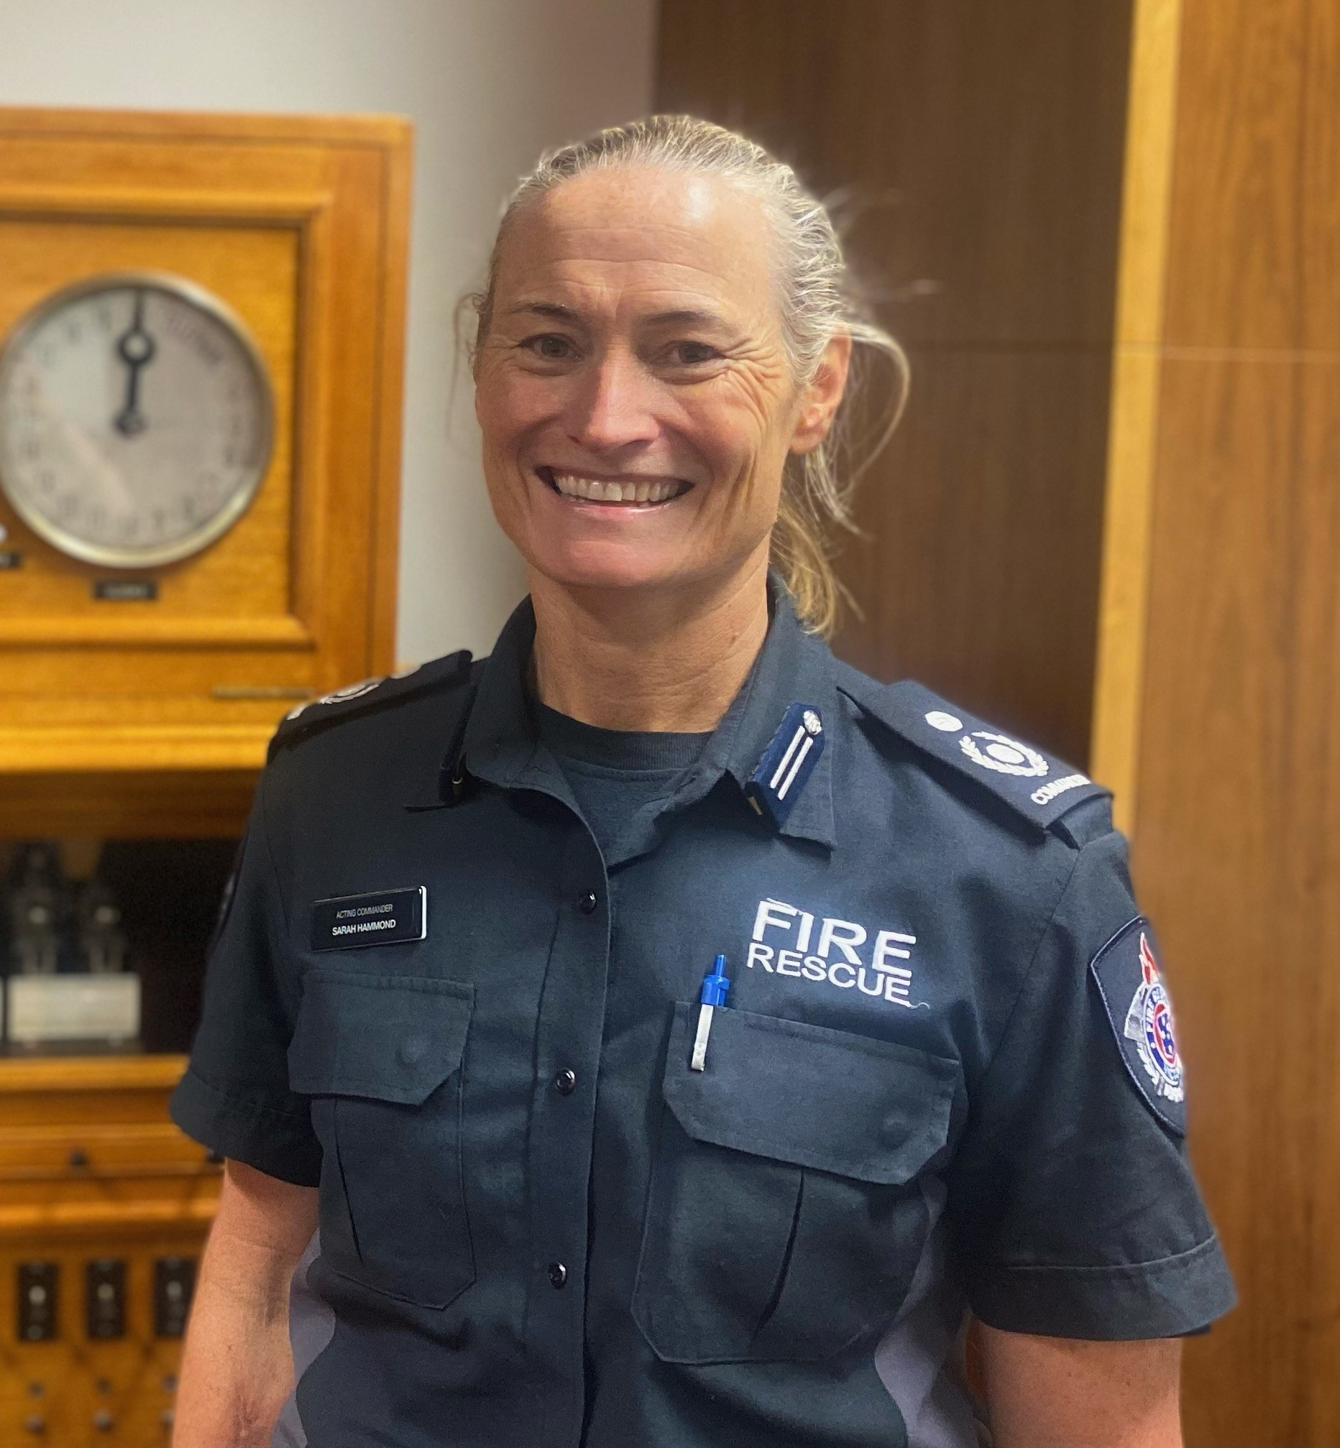
Welcome and introductions
Paula Treacy
Acting Commander, Women's Support Unit
Joined Fire Rescue Victoria (CFA) in 2003
Sarah Hammond
Senior Station Officer, FS42 Newport
Joined Fire Rescue Victoria (MFB) in 2007
Notes:
Will be introduced by WAFA according to our Bios.
Some points of interest though
Paula Treacy
Firefighter since 1998 in SAMFS, and 2003 with CFA, and 2020 with FRV
Loves field hockey, represents Victoria and Australia in Emergency Services Games
Sarah Hammond
Firefighter since 2007 with MFB, and 2020 with FRV
Represented Australia in Handball at the 2000 Sydney Olympics, played 2 years in Danish National League prior to this

Slide 4

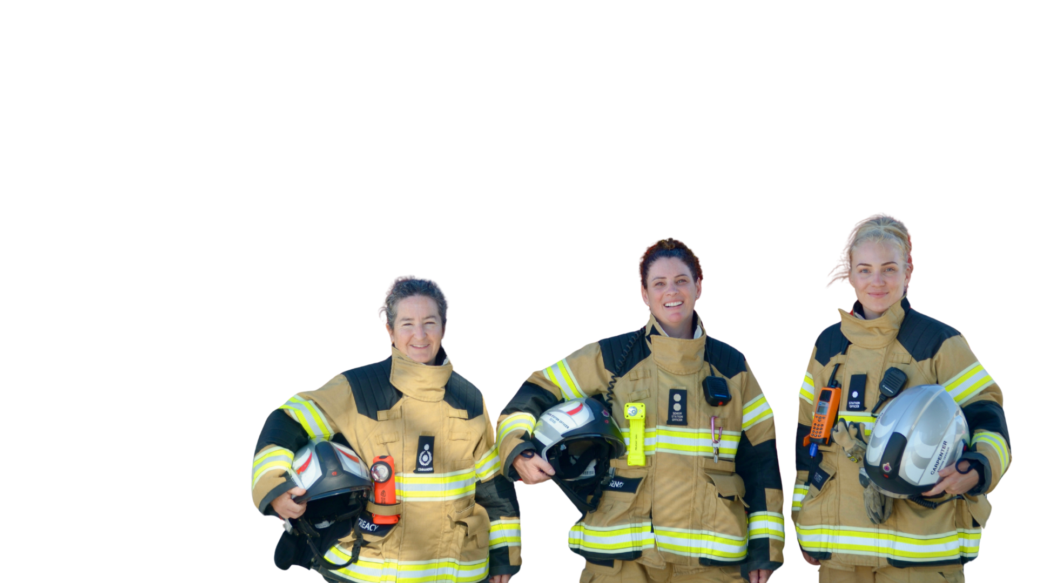
WOMEN’S SUPPORT UNIT
History
Formed in 2020
Aligns with Gender Equality Act (2020) Vic and FRV's commitment to inclusion
Purpose
To increase gender diversity in
Fire Rescue Victoria through:
Recruitment
Retention
Promotion

Slide 5
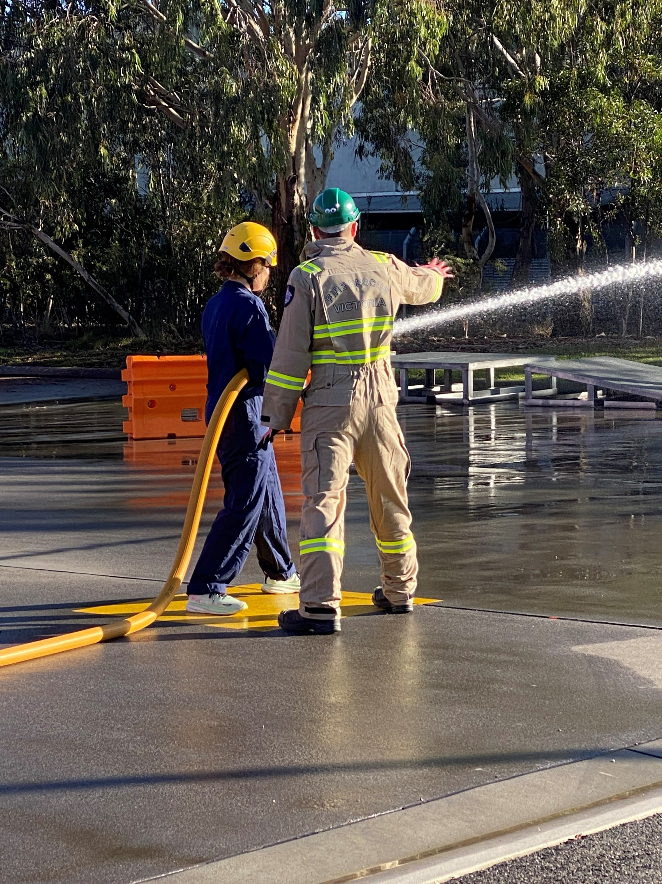

RECRUITMENT
Signal support group – peer support and networking for women applicants
Women in Firefighting workshops – hands on experience and physical and psychological readiness training
Information sessions – guidance through recruitment stages, clarify recruitment stages and reduce barriers

Slide 6
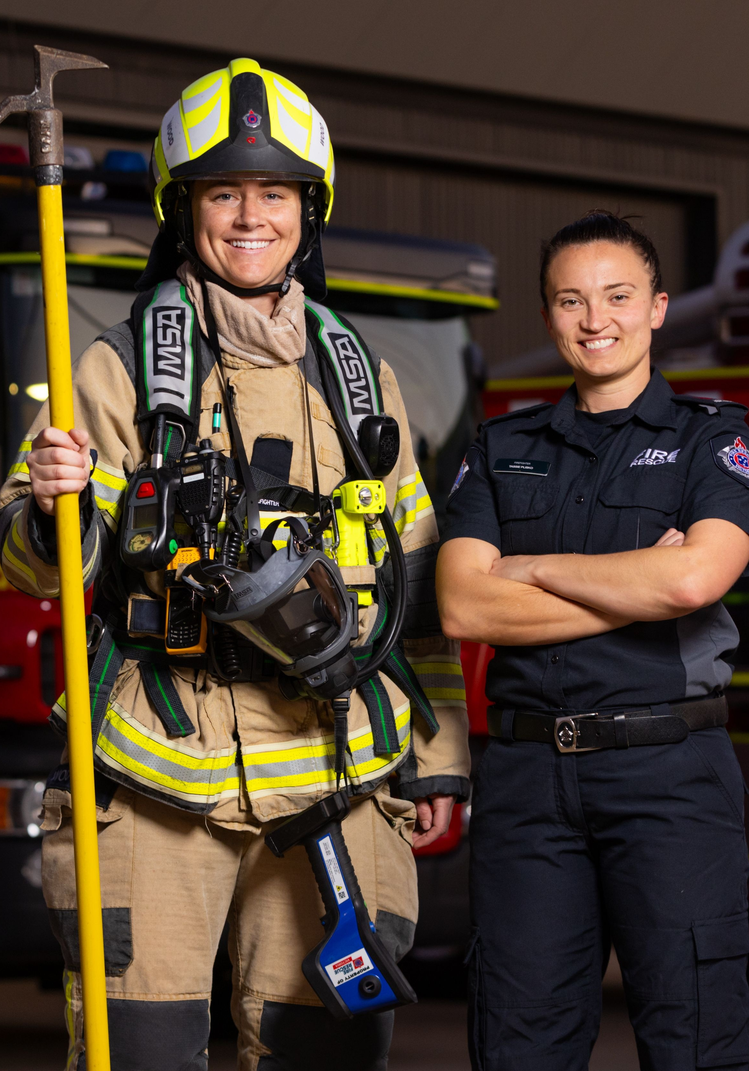
RECRUITMENT
Career days
Challenge stereotypes
Inspiring through personal stories
Representation
Strategic partnerships
Collaborations with Victorian Institute of Sport and AFLW
Engaging elite athletes

Slide 7
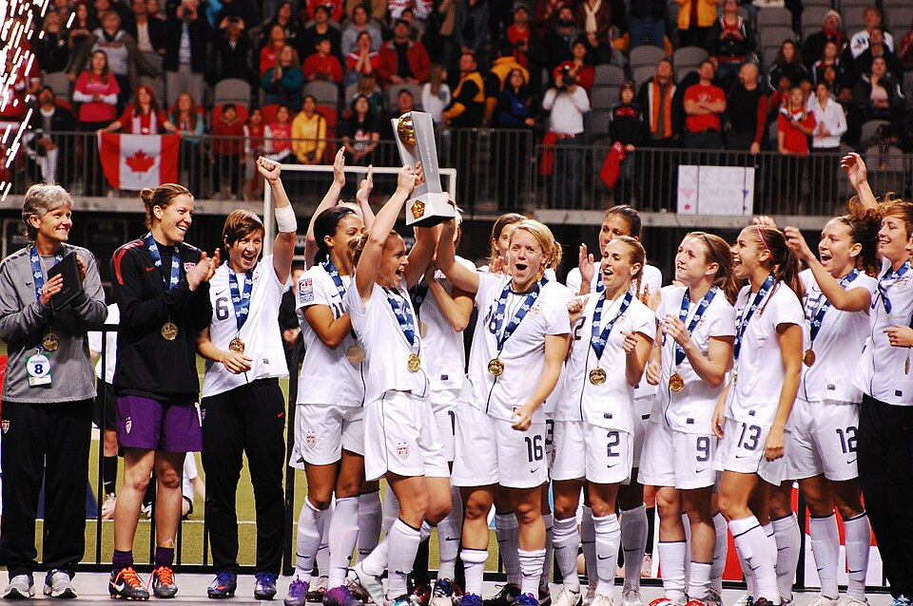
“A woman who doesn't give up, can never lose.”
Abby Wambach – US soccer legend
Notes:
Abby Wambach – US Soccer player 2001-2015 2nd all time goal scorer (male and female)
Women are learning that we can be grateful for what we have AND also pursue what we deserve
Use your TEAM around you to support yourself to go further, to demand more
RULES
Make failure your fuel
Lead from the bench
Champion each other
Demand the ball

Slide 8
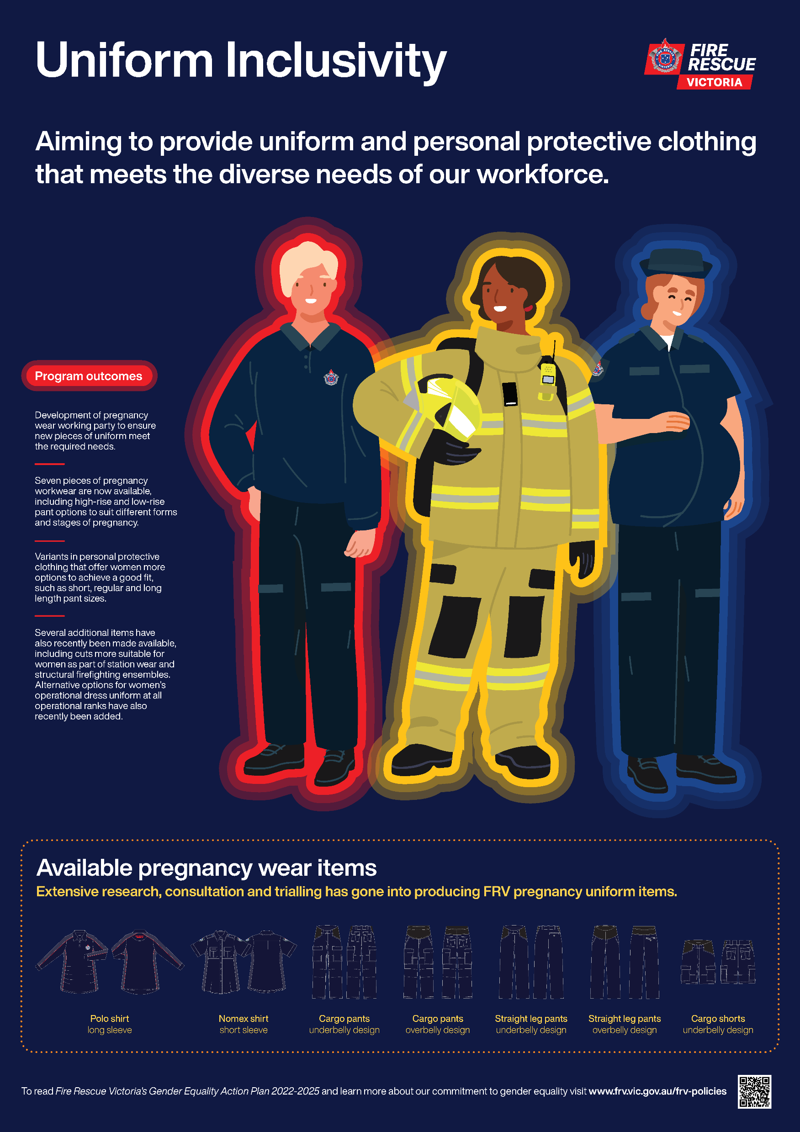
RETENTION
Health and wellbeing
Pregnancy, parental leave, breastfeeding, menopause
Prenatal exercise and post-partum physiotherapy
Access to psychological support, injury prevention and annual health monitoring
Infrastructure
Sanitary provisions across FRV
Breastfeeding facilities
Fit-for-purpose PPC/E designed for diverse body types, including maternity wear

Slide 9
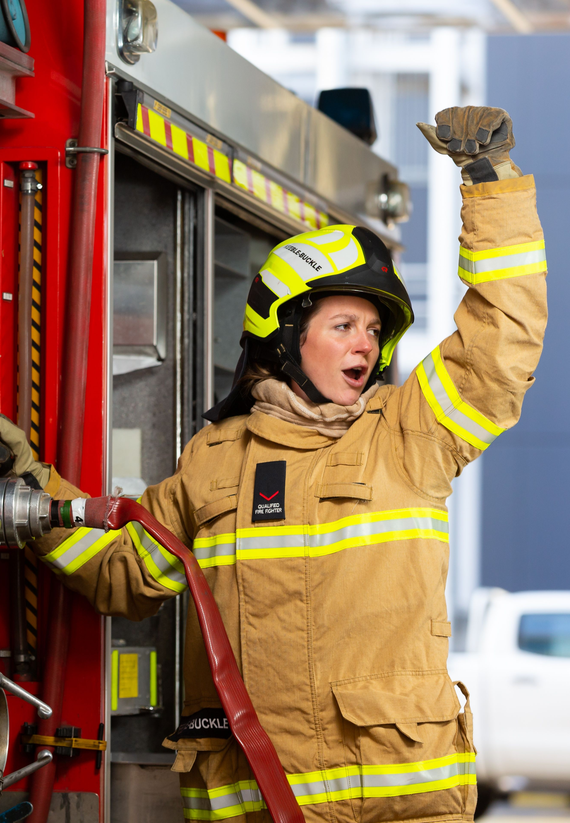
RETENTION
Career support
Flexible duties and work arrangements to support women through childbearing and caregiving phases
Cultural change and education
Workplace Behaviour Training
Diversity and Inclusion team
Breastfeeding and menopause policies aim to normalise conversations about women's health
Online coffee catchups
Foster informal networks

Slide 10
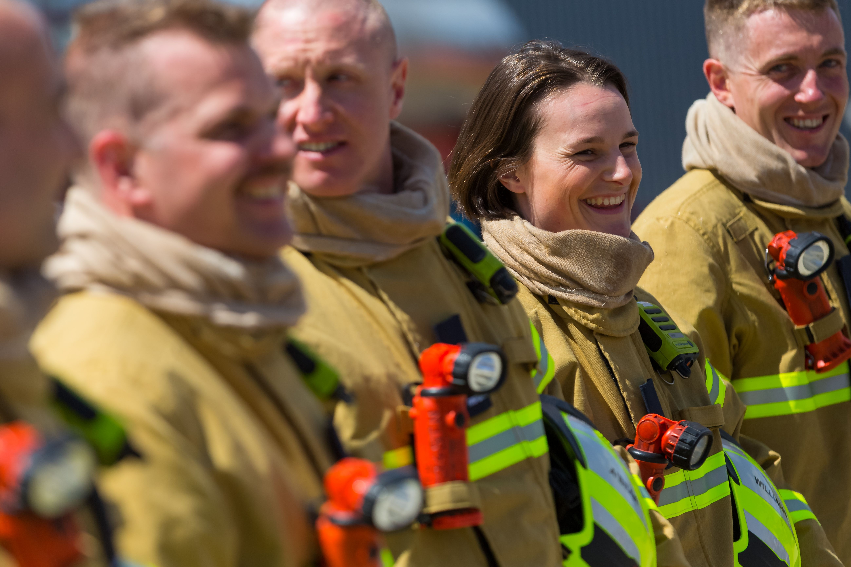
PROMOTION
Annual Operational Women's forum
Foster peer support and feedback
Create inclusion and sense of community
Mentoring program
Formalise and recognise value of sharing experience and knowledge
Benefits both mentors and mentees
Targeted professional development opportunities
AIPM Balance
WAFA

Slide 11
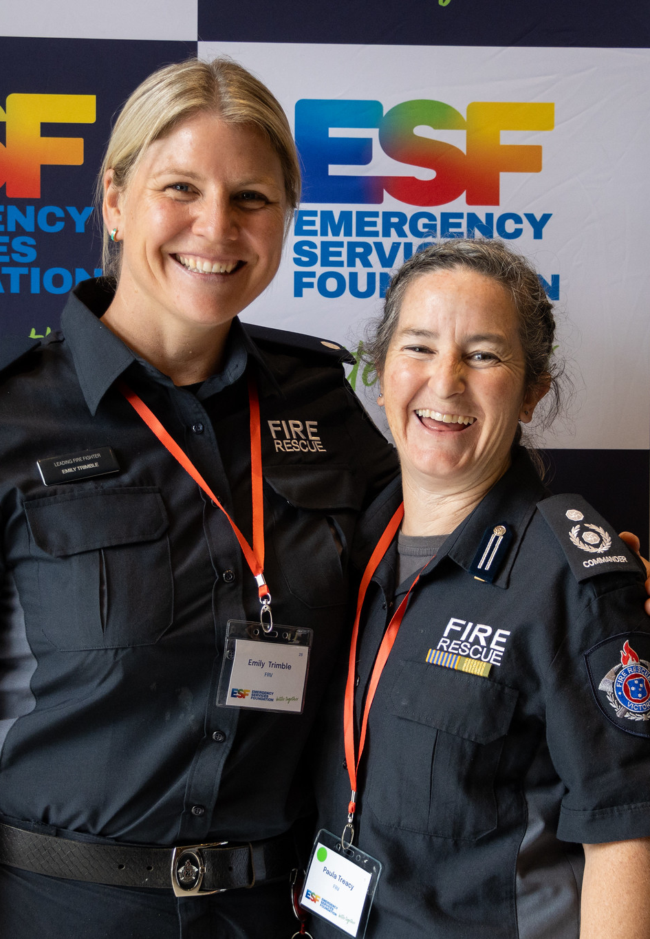
ACHIEVEMENTS
Recruitment
240 women have participated in Women in Firefighting workshops over the past two years
Physical aptitude test success rates rising from 50% to 80% on last course
More women in operational roles (5.7%)
Retention
100% retention of operational women post parental leave
Awards
Emergency Services Foundation awards 2024 Women's Equality Initiative – FRV Women's Support Unit
Notes:
DATA FROM RECRUITMENT
Feb 2024 – 10 out of 120 candidates employed were women (8%)
July 2024 – 8 out of 60 candidates employed were women (13%)
Feb 2025 – 7 out of 60 candidates employed were women (12%)
July 2025 – 12 out of 60 candidates employed were women (20%)
PAT WOMEN success rates over 2024-2025 campaigns
46%, 86%, 100%, 80%
OPERATIONAL WOMEN
2020-2021 Annual report 4.7%
2023-2024 Annual report 5.7%

Slide 12
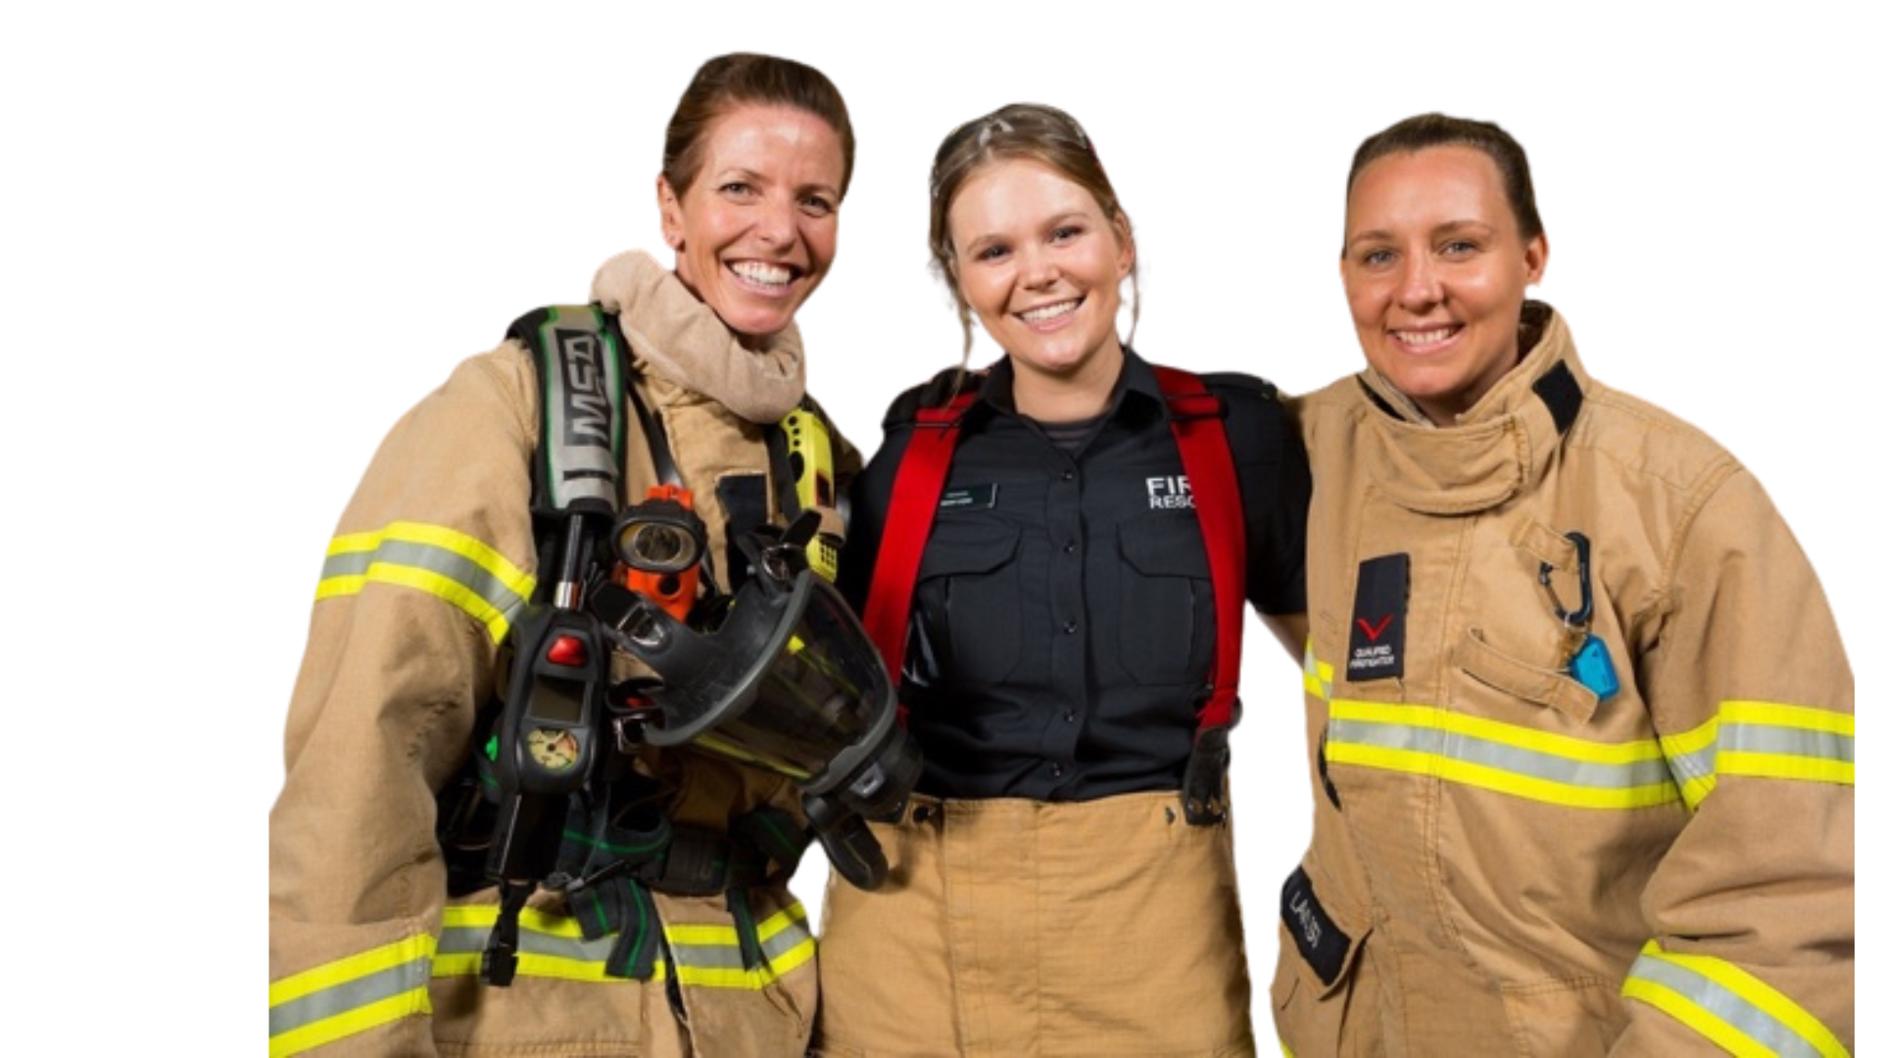
CONCLUSION
Recruitment, Retention and Promotion of women in firefighting is both a challenge and an opportunity.
FRV’s Women’s Support Unit offers a replicable framework of policies and programs for other agencies seeking to build inclusive, resilient workforces.
By investing in the wellbeing, development, and leadership of women, FRV is not only
strengthening its own organisation but
contributing to a more equitable emergency
services sector.

Slide 13
Questions?

