Slide 1



#WAFA25
Tradition to Transformation
Building Gender Diversity in Senior Duty Officer Teams
Presented by:
Fiona Dunstan AFSM
Deputy Chief Fire Officer, FFMVic
Director, Bushfire and Emergency Management, DEECA
Notes:
Note: Presenters will be introduced by the WAFA chair, using information provided in the bios provided.

Slide 2

Mirring - Country
#WAFA25
Mirring – Country
DEECA’s
Aboriginal Cultural Identity
by artist Tom Day
of the Gunditjmara, Yorta Yorta and Wemba Wemba tribes.
Notes:
Notes:
I'm from Victoria - this presentation was largely written on the land of the Wurundjeri and Wada Warrung peoples.
But today, we're here in Perth, so I wish to acknowledge the Whadjuk people of the Noongar nation.
I pay my respects to the elders of the Whadjuk Noongar people, past and present, and their ongoing connection with land, water and culture.
I wish to acknowledge any other aboriginal people that may be joining us today.
And I wish to acknowledge that this land was never ceded.
---------------
Scrapped notes
We acknowledge the Traditional custodians of the land on which we meet today - the Jagera people and the Turrbal people as the Traditional Custodians of Meanjin (Brisbane). Need to check this.
I pay respects to their Elders, past and present.
We acknowledge the ongoing connection Traditional Owners have with their land, sea and community.
I also wish to acknowledge any other aboriginal people here today.
**
A quick note about this image - Mirring means Country.
Signifying DEECA's Aboriginal Cultural Identity, it is a commissioned piece created by artist Thomas Day, a Gunditjmara, Yorta Yorta and Wemba Wemba man.
The artwork was created in collaboration with Aboriginal staff to better understand the work DEECA does and the values our staff hold which is reflected in the artwork.
The painting depicts country.
The background colors represent the landscapes with sea country at the bottom flowing into the forest and grasslands country then we see the desert country flowing into the wetlands and into the mountain country.
The foreground designs represent scars that have been left within the landscape by our old people, serving as reminders but more importantly guides to show places of importance.
The 4 scar trees represent the 4 directions of north, east, south and west with spirits peeking behind them. This represents the our ancient connection and our inherent responsibility to protect country.
The boldest designs represent what is visible to us today with the powerful river standing out the other designs represent markings to signify ceremony.
Each white line signifies our ongoing connection to country by representing our generations that is our bloodline.

Slide 3
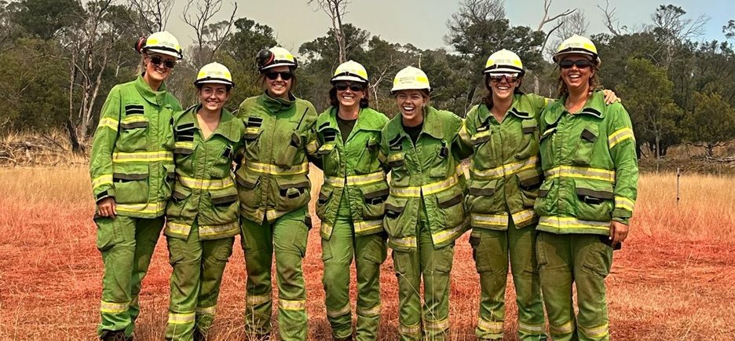
Introduction​
#WAFA25
FFMVic - who are we?
Our gender equality journey
D&I Outcomes Framework
Senior Duty Officer Rosters
Barriers to success
Setting a bold target
Listening to our people
Options for change
Principles and Weightings
Co-design using Mentimeter
The feedback
Amending the target
The progress so far
Lessons learned
Looking ahead
Call to Action: Let’s Talk
Questions
Notes:
My name is Fiona Dunstan – I'm Deputy Chief Fire Officer with FFMVic.
Today I'd like to share with you some of our work in the Diversity, Equity and Inclusion space
At FFMVic, we are committed to working together towards creating a more equitable and inclusive workforce.
We want our organisation to be a safe place for everyone to be able to bring their full selves to work.
I'll talk about who we are as an organisation, what we do and then go into a bit more detail around one of our current initiatives – Roster Reform.

Slide 4
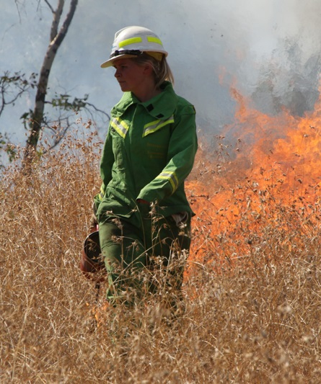
Who are we?​
#WAFA25
Forest Fire Management Victoria (FFMVic) consists of around 2,600 specialist staff drawn from the Department of Energy, Environment and Climate Action (DEECA), Parks Victoria and Melbourne Water.
FFMVic works alongside the Country Fire Authority (CFA), Fire Rescue Victoria (FRV), other emergency services and communities across Victoria to deliver the best local approaches to public land management in Victoria.
Risk-based bushfire management and planning
Fire prevention and preparedness
Fuel management programs (including planned burning)
Emergency response and recovery
Notes:
So who is FFMVic?
Around 2600 people in total, FFMVic includes staff from three separate organisations: DEECA, Parks Victoria and Melbourne Water.
Our core purpose is to protect people, property and the environment.
Managing bushfires and bushfire risk in Victoria’s parks, forests and other public land, minimising the impact of fire on our communities, environment and everything we value most.
Preserve and upgrade our parks and state forests across Victoria to provide more accessible opportunities to get outdoors and enjoy nature.

Slide 5
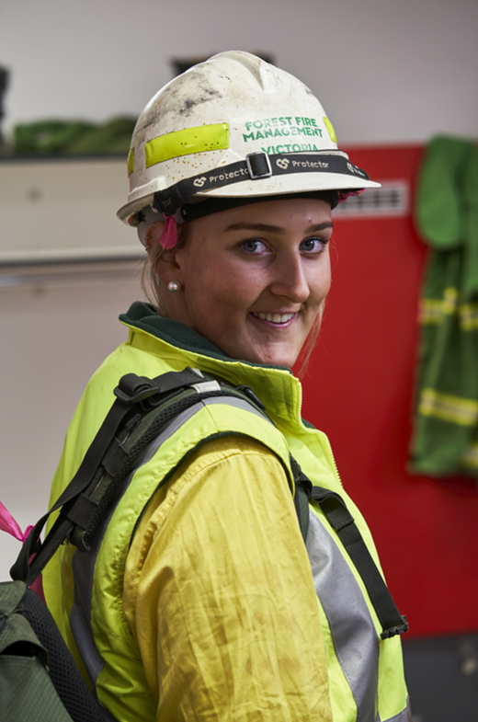
Our Gender Equality Journey
#WAFA25
We are committed to:
  keeping communities safe year-round
  developing an inclusive environment
  confronting all forms of discrimination
  ensuring staff feel safe
  comfortable coming to work as themselves
  ensuring our workforce represents the community that we serve
Notes:
We're pretty good at protecting people out there, in the community – but what about looking after our own people?
Our work can be split into two main categories – forestry and emergency management, primarily firefighting. Both industries historically dominated by men.
Around ten years ago, we formally recognised the gender disparity in our workforce. Our workforce just didn’t reflect our communities. That needed to change.
We're an all genders organisation – we have plenty of non-binary staff in the mix – but our biggest gap is women – this is where we have put a lot of our energy.

Slide 6
D&I Outcomes Framework​
#WAFA25
Attraction
Recruitment
Retention
Progression
Roster Reform
Sponsorship of Diverse Talent
Women-only events
Shadow for a Day
Deployment Tracker
Mentoring discussions
Girls on Fire
Women in Aviation
Regional Attraction Plans
Staff Led Networks
Graduate Programs
Recruitment Reform
Manual Licences
Group Interviews
PFF Job-Share Pilot
Project Inspire
Unconscious Bias
Medical & TBA Review / Procure
Colourblindness in FFMVic
Leadership Shadow
Measurement and reporting
Notes:
But where to start? In short - everywhere.
To help guide our work, we developed a Diversity and Inclusion Outcomes Framework that articulates exactly what we are working towards.
It follows the general pipeline – from how people join our organisation right through to rising through the ranks.
The domains or buckets you see here – they're not particularly unique – in building this we looked closely at what had been done before.
We are riding on the coattails of many who are ahead of us. We have absolutely no problem with stealing good ideas.
The fifth box you see – measurement and reporting – this is not a pillar within the framework, but a pivotal part of that we do.

Slide 7
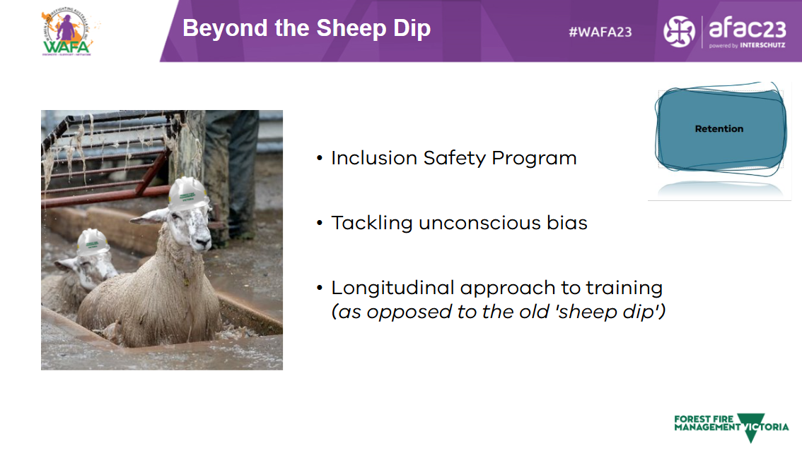
#WAFA25
Notes:
Some of you might remember - two years ago we presented in Brisbane, sharing our journey in tackling Unconscious Bias.
Over 300 leaders took part in the program, each contributing around 20 hours - a huge investment of time – but with good reward. The 'sheep dip' reference was because we wanted to move beyond that typical training where you chuck people in a room, dunk them in some new information for a few hours, and expect them to walk out transformed. Everything's fixed!
No – it doesn't work like that. It takes time. Time to think, and time for good conversation. Sometimes challenging conversation. That's where we grow as individuals, and as an organisation.
Link to 2023 presentation:

Slide 8
D&I Outcomes Framework​
#WAFA25
Attraction
Recruitment
Retention
Progression
Roster Reform
Sponsorship of Diverse Talent
Women-only events
Shadow for a Day
Deployment Tracker
Mentoring discussions
Girls on Fire
Women in Aviation
Regional Attraction Plans
Staff Led Networks
Graduate Programs
Recruitment Reform
Manual Licences
Group Interviews
PFF Job-Share Pilot
Project Inspire
Unconscious Bias
Medical & TBA Review / Procure
Colourblindness in FFMVic
Leadership Shadow
Measurement and reporting
Notes:
This sits under our 'retention' bucket, though arguably unconscious bias impacts every single bit of the pipeline. If you're looking at a part of your business for the first time and can't see some bias baked into it somewhere, you're not looking hard enough.
Today we'd like to put the spotlight on another story, one that sits under 'progression'.
On the whole, we are tracking well, but focus in and it becomes quickly evident that there are pockets which need attention. Senior Operations roles. Aviation roles. Heavy plant operators. Advanced fallers. (looks up - ‘previously known as fellas’ - smiles)
And then there are Senior Duty Officer roles...

Slide 9
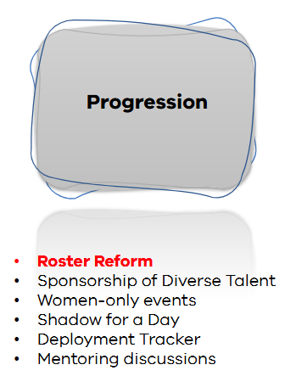

Senior Duty Officer Rosters
#WAFA25
State Agency Commanders (SACs)
Regional Agency Commanders (RACs)
District Duty Officers (DDOs)
Well-remunerated​
Guaranteed (not cancelled)​
Leadership (looks great on a CV)
Notes:
Like many of you, we have rosters – here the main ones over in our patch.
So what are the carrots? Why would people jump at these roles?
Remuneration
Includes overtime and additional annual bonuses.
The financial rewards are significant and measurable.
Certainty
Unlike weather-dependent rosters, these roles are locked in ahead of time.
You know when, where, and how much — ideal for planning and stability.
Respect & Recognition
Selection into these roles is limited — not everyone gets in.
Completing them brings credibility and is seen as a tangible proof of capability.
It’s great for your CV and opens doors to future opportunities.

Slide 10

Barriers to women
(and many men...)
#WAFA25
Notes:
So why wouldn't you do it?
If we start off with the most important criteria for the role – aptitude – then we have an excellent pool of staff to draw upon.
But.
This isn't the only criteria...

Slide 11

Barriers to women
(and many men...)
#WAFA25
24 hour shift
Notes:
You need to be available 24 hours a day.
Which sees our pool shrink a little.

Slide 12

Barriers to women
(and many men...)
#WAFA25
24 hour shift
7 days stint
Notes:
And not just 24 hours a day, but 7 days straight.
Which sees our pool shrink even further

Slide 13

Barriers to women
(and many men...)
#WAFA25
24 hour shift
7 days stint
Operational experience / accreditation
Notes:
Not to mention Operational experience...

Slide 14

Barriers to women
(and many men...)
#WAFA25
24 hour shift
7 days stint
Operational experience / accreditation
Incident Control experience/ accreditation
Additional constraints​
Nomination process inconsistent (tap on the shoulder...)​
Few places available (short rotation cycles​)
Tenure (these roles are often long-held)
Some people sit on multiple rosters​
Notes:
And on to op that, experience in Incident Control.
The pool gets smaller again.
(click)
Add to this some of the other systemic constraints that have been characteristic of our rosters in the past, and you can see why there has been little change over the years.
So.
Let’s look at some numbers. Given all these barriers – what did it look like for FFMVic at the start of this project? (next slide)

Slide 15
Setting a bold target
#WAFA25
"30% women across all Senior Duty Officer rosters by 2024-25"
Notes:
Just 18% of these roles were held by women.
Note that this sits below our broader workforce statistics (around 34% of our EM workforce identified as women at that time – now just under 37%).
(click)
As a result, we proposed the following target: " 30% -50% women across all SAC, RAC and DDO rosters by 2024-25“.
But before going further - we shopped it around for feedback.

Slide 16
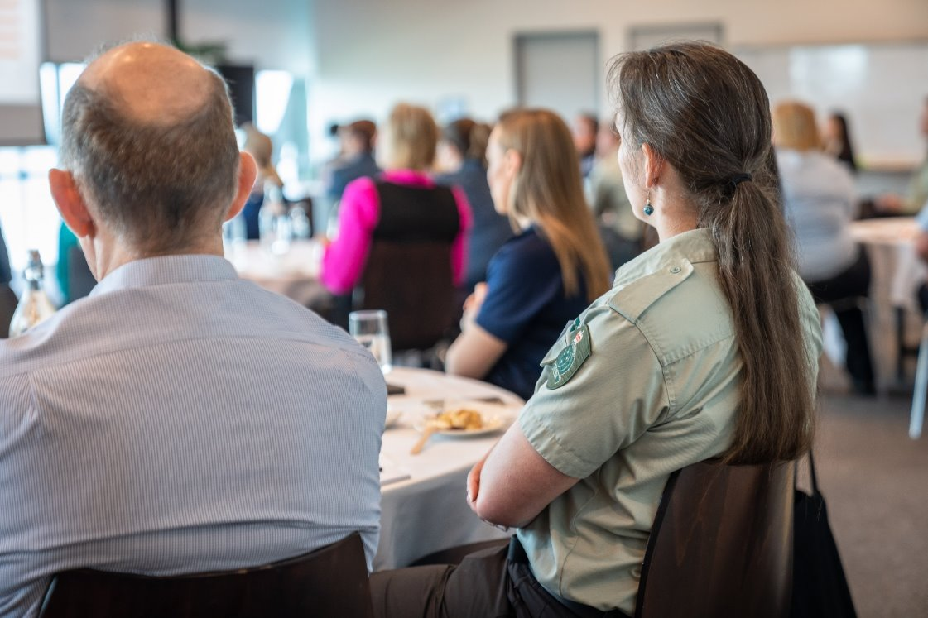
Listening to our people​
#WAFA25
Extensive engagement
Dedicated focus group
Lived experience
Notes:
We cast the net wide, engagement with multiple groups across the business, as well as a dedicated focus group.
The focus group was from across the state, and mixed gender though a majority identified as women. We wanted loads of lived experience in the mix.
We were looking for feedback on multiple fronts:
The target
Barriers
Proposed actions

Slide 17
Options for driving change
#WAFA25
Review & update role statements
Lateral entry pathways (identify the gap and train to that)
Review pre-requisites (i.e. remove IC1 and Ops 1). Co-roster instead?
Annual nominations process for rosters
Increased flexibility around prerequisite training
Increased number of prerequisite training events (i.e. IC 1, Ops 1)
Coaching provisions (i.e. coachee co-rostered with dedicated coach)
An individual cannot be on multiple Duty Officer rosters (opens up spaces)
Coupling Duty Officer role expectations with specific BAU roles (remove the voluntary aspect)
Increase rotation cycle - shift from 1:3 to 1:6 or 1:8 (opens up places)
Reduce shift length from 7 days to 4/3 split
Notes:
And feedback we got!
Lots of actionable options to improve &/or change current practise around these rosters.
We’ll look a little closer at some of these shortly.
But much of the feedback received was not tangible actions – rather it was feelings / fears / general insights and broader commentary.
We worked hard to capture this, rather than just leaving it on the cutting room floor. And we did this in two ways. (next pages)

Slide 18
The Principles​
#WAFA25
1. A zero-harm approach
2. Positive framing of targets
3. Support through change
4. Strong and universal leadership
5. We will listen
7. Regional variation is to be acknowledged
8. Acknowledge & celebrate the progress already made
Notes:
Firstly – we captured much of this input as Principles for implementation.
A zero-harm approach
No one should be forced into training / role / roster unwillingly, and without whatever support is required to maintain good psychological safety for individuals.
Positive framing of targets
Targets and quotas will not be overtly broadcast.
FFMVic GERP 2022, Opportunity 6: The reception and understanding of gender quotas amongst staff is an area FFMVic should take action to explore further. It is essential to consider how gender quotas are promoted and used in training and education, and ensure their function is explained, positively framed and understood by the entire workforce
Support through change
To achieve gender equality across all rosters, it is likely that there will be change required – financial commitments may also be a factor.
This will be approached with sensitivity, working with P&C / HR for appropriate guidance & support as a result of any rostering change.
Strong and universal leadership
District EM Managers need to be supported by senior leaders with whatever changes are made going forward.
FFMVic GERP 2022, Opportunity 10: Leaders, through visible courageous and caring and transformative leadership... must also show support and take actions that facilitate achieving gender equality. Their support of gender equality and inclusivity needs to be expressed and visible. Leaders play an essential role in addressing backlash and promoting and framing gender equality initiatives in a positive light.
We will listen
We will listen to our workforce – this should not be about offering solutions based on assumptions.
Regional variation is to be acknowledged
Each region has its own constraints, such as the existing broader workforce demographic upon which we draw for EM roles.
Acknowledge & celebrate the progress already made
Much progress has already been done in this space, both at the state and regional level.
While a state approach is warranted, regional initiatives should be acknowledged as much planning and work is already under way.

Slide 19
#WAFA25
Weighted Criteria​
 | Criteria | Statement (focus group to gauge their level of agreement) | Weighting (100%)
1 | Zero Harm | This option is unlikely to cause harm to any individual | 20%
2 | Speed | This option can be implemented quickly (i.e. actionable in 23/24) | 15%
3 | Complexity | This option is easy to implement | 15%
4 | Problem Shift | This option will not create a resource pressure elsewhere | 15%
5 | Doctrine | This option is supported by doctrine | 15%
6 | Tested | This option is already tested and in play in some regions / districts | 10%
7 | Fiscal | This option is low cost | 5%
8 | Reach | This option will benefit everyone (not just women) | 5%
Notes:
Secondly, we used the feedback to develop criteria for ranking each action.
It was acknowledged across the board that some criteria was more important than others, so each was weighted.
At the top you can see safety. Not just safety for the community, but personal, psychological safety for any individual looking to undertake a rostered role.
At the bottom, those deemed less important.
We’re big fans of actions that benefit everyone – but in this case it was women who really needed the equity.

Slide 20
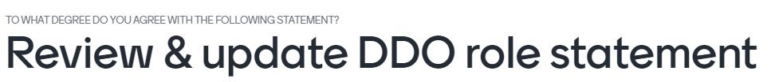

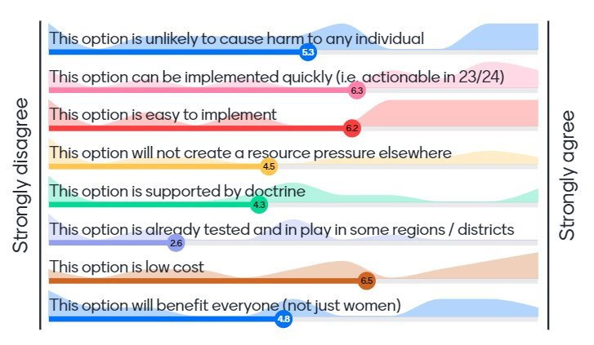
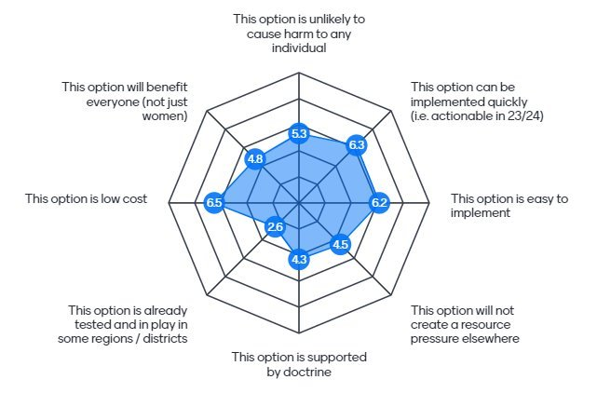
Mentimeter​
#WAFA25
Notes:
When it came to scoring the proposed actions, the tool we used was Mentimeter, which allowed the focus group to score using those weighted criteria.
It’s democratic, but also anonymous – which is important for many people. We didn’t want people to feel swayed, or judged, by the broader group.
We also wanted to avoid anchoring bias.
So where did we land? (next slide)

Slide 21
What ranked low?
#WAFA25
Review pre-requisites (i.e. remove IC1 and Ops 1). Co-roster instead?
Coupling Duty Officer role expectations with specific BAU roles (remove the voluntary aspect)
Notes:
These ones ranked very low.
The roles were very much valued in their current form, with the current pre-reqs retained.
This isn’t to say that we would always follow this path for all roles – we do believe that co-rostering skillsets is a valuable tool (as opposed to having all the knowledge in the one human), but in this instance the consensus was to keep things as they were.
The actions that rated high, were much more aligned with equity measures allowing people to build this skills base.
That, and the broader roster mechanics. (next slide)

Slide 22
What ranked high?
#WAFA25
Increased flexibility around prerequisite training
Increased number of prerequisite training events (i.e. IC 1, Ops 1)
Coaching provisions (i.e. coachee co-rostered with dedicated coach)
Reduce shift length from 7 days to 4/3
Increase rotation cycle - shift from 1:3 to 1:6 or 1:8 (opens up places)
Notes:
These actions ranked very high.
The first three – focused on attaining the knowledge and experience.
And the bottom two actions – the broader mechanics of the roster.

Slide 23
Amending the Target​
#WAFA25
30% women across all Senior Duty Officer rosters by 2024-25
30-50% women across all Senior Duty Officer rosters by 2026-27
Notes:
We took the time and listened to our people through genuine consultation, and find a pace of change that does not put anyone at risk of psychological harm.
As a result, we modified our target as well as our timeline.
(click)
Different parts of the business are starting from a different place, and this needed to be acknowledged.
Some will get there ahead of schedule, and some will need more time.
To rush it would do more harm than good, and create likely resource pressures elsewhere.
So… a year or so down the track, have we made a dent?
(next slide)

Slide 24
The progress so far
#WAFA25
Notes:
I’m happy to say that we have.
A rise of around 7% in this space – in a pool of around 150 individuals.
We expect to see this rise further over the next couple of seasons.
So a good journey so far, but with some lessons along the way. (next slide)

Slide 25
Lessons learned
#WAFA25
Engagement trumps assumption.
Equity ≠ lowering standards.
Measurement is vital. Transparency builds trust.
This is not a finite game. This is continuous improvement.
Notes:
Engagement trumps assumption – engage widely, and make sure you have LOTS of lived experience in the mix.
Equity ≠ lowering standards – In this instance, it was made very clear to us that most did not want the role to change – it was more about building equity in getting there.
Measurement is vital. You can’t change what you can’t measure. Transparency also builds trust – Being able to track our progress and openly share this across the business is important.
This is not a finite game. This is continuous improvement, and the goalposts will continue to shift as our society evolves. That’s a wonderful thing.

Slide 26
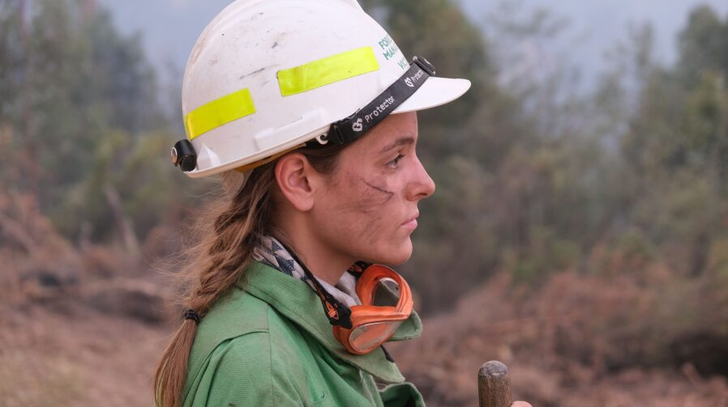
FFMVic - Looking ahead​
#WAFA25
Continue to support pipeline into Senior Duty Officer roles
Improve data tracking and monitoring
Apply insights to other roles
Share with sector — like here today at AFAC
Notes:
Continue to support pipeline into Senior Duty Officer roles – we’re not going to take our foot off this pedal
Improve data tracking and monitoring – you can't change what you can't measure...
Apply insights to other roles - e.g. aviation, senior operations, heavy plant, international deployments
Share with sector — like here today at AFAC

Slide 27

Come talk to us!
#WAFA25
  People lens: Wed 27th – now - Room 6 (WAFA)
  Fiona Dunstan AFSM – FFMVic
  Roster Reform: What inclusive leadership looks like
  **
  Design lens: Thurs 28th – 11:40am - Room 6 (WAFA)
  Kelly Edwards – FFMVic
  Project Inspire: What physical inclusion looks like
  Strategic lens: Thurs 28th – 12:10pm - Room 1&2
  Emma Welsby & Chris Hardman AFSM – FFMVic
  Beyond the Cupcakes: Why structural change matters
Notes:
We've had a good presence here at AFAC this year, who have been very kind to us – this is just one of three presentations for us, and all in the D&I vein.
We have two more presentations tomorrow – I’d really encourage you to join us if you’d like to hear a bit more about our efforts.
If you've seen something you've like – any of us are totally up for a good yack.
Or even some constructive criticism, if it's warranted.
Chris Hardman – our Chief Fire Officer (waves hand) is always up for some healthy debate!

Slide 28

Thank You​
#WAFA25
Questions?
We would love to hear from you.
ffmvic.diversity.inclusion@deeca.vic.gov.au
Presenter
Fiona Dunstan AFSM
Deputy Chief Fire Officer, FFMVic
Director, Bushfire and Emergency Management, DEECA
Notes:
Or shoot us an email down the track.
Thanks again everyone, for making the time to join me today.
Safe travels.

