Slide 1
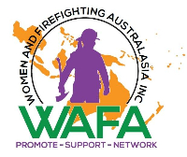


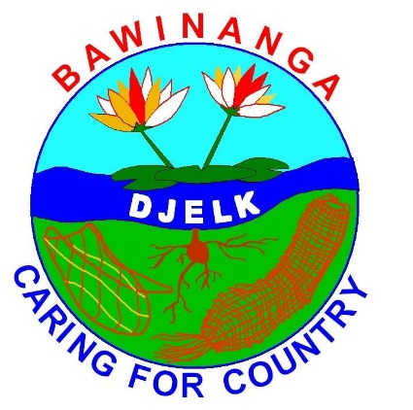
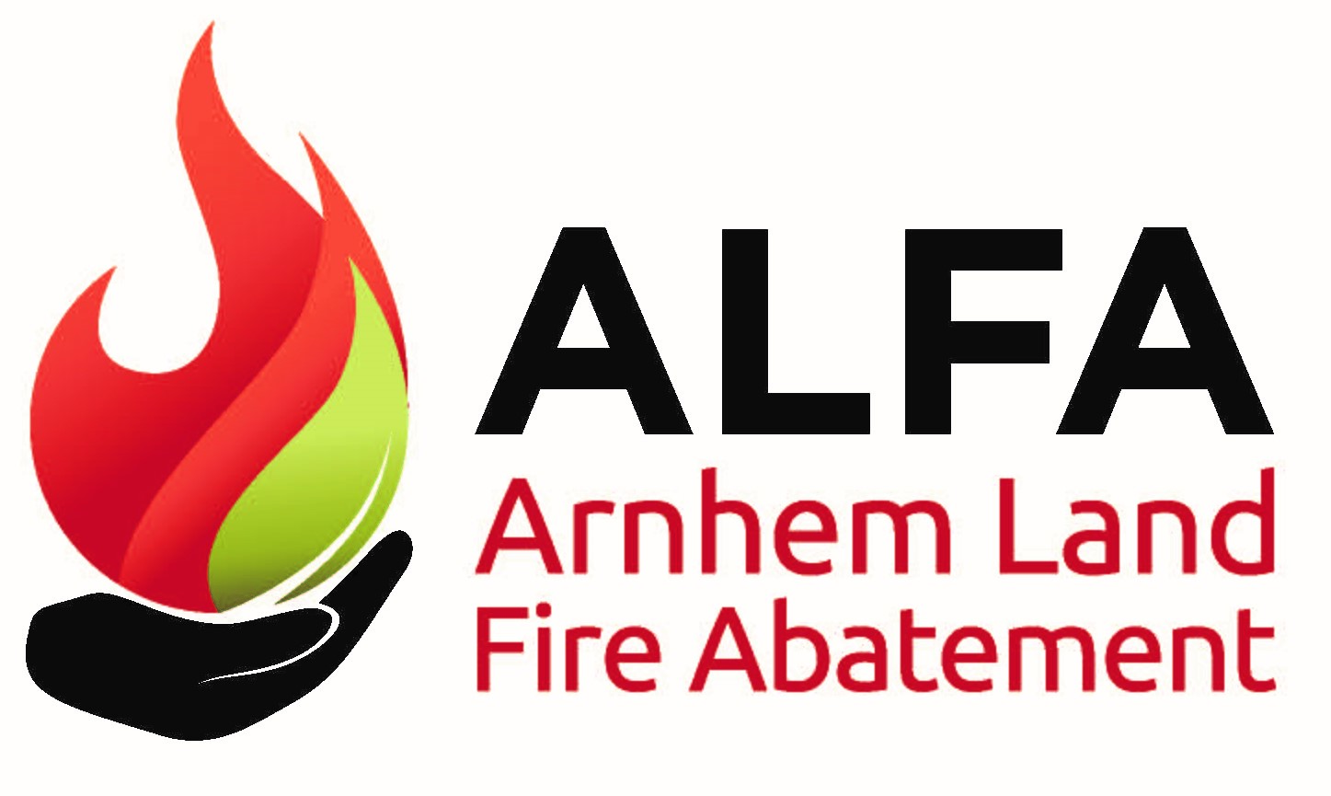
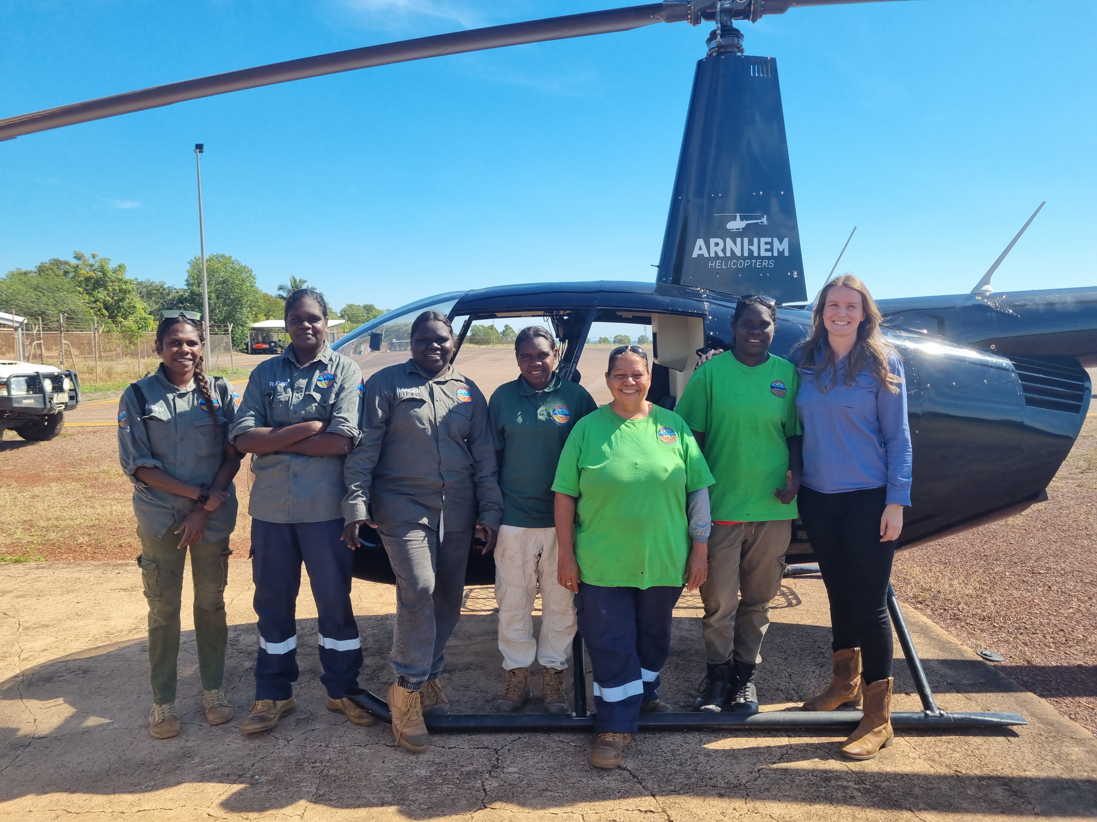
#WAFA25
Indigenous Women Stepping Up:
Empowering the Next Generation
in Arnhem Land Fire Management

Slide 2
Aboriginal people should be aware that this presentation contains images of deceased persons.

Slide 3
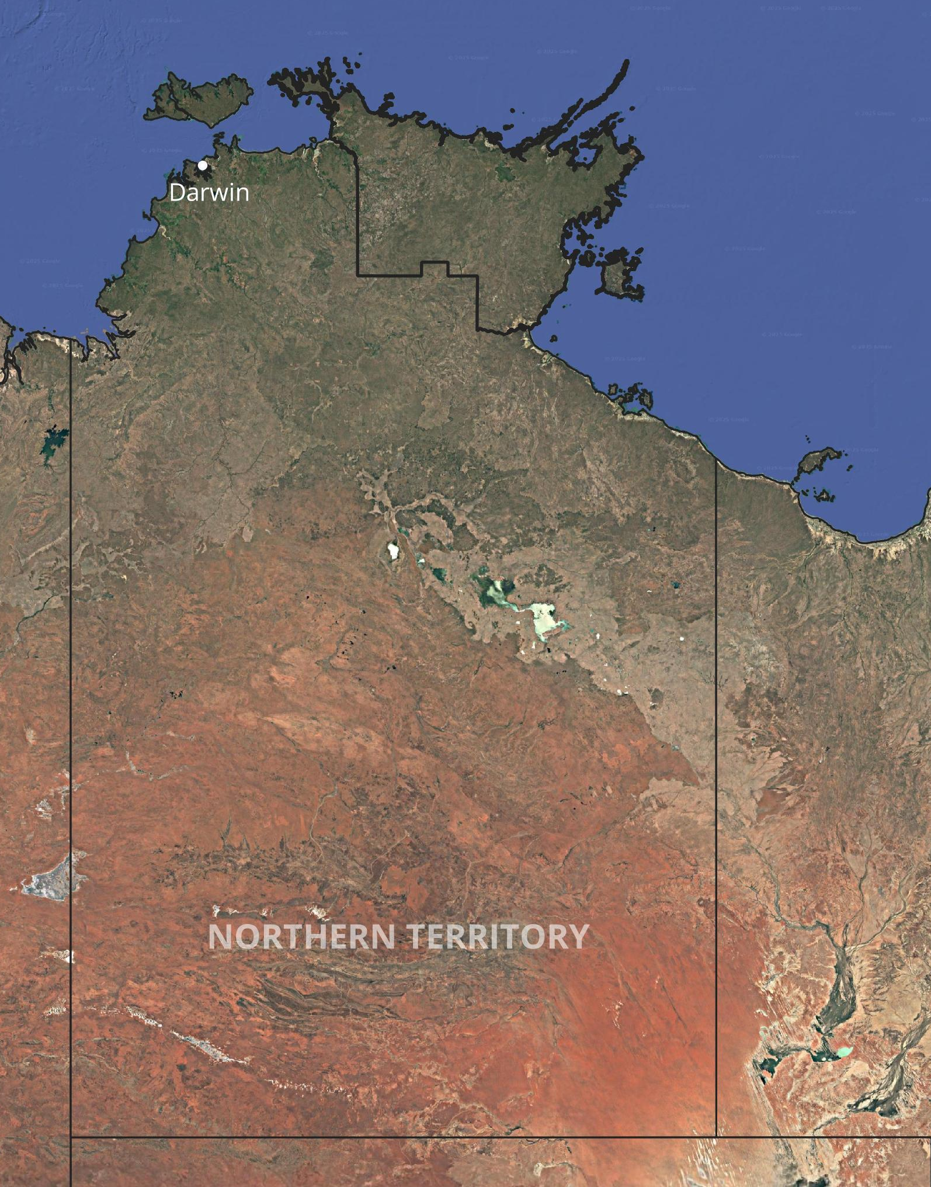
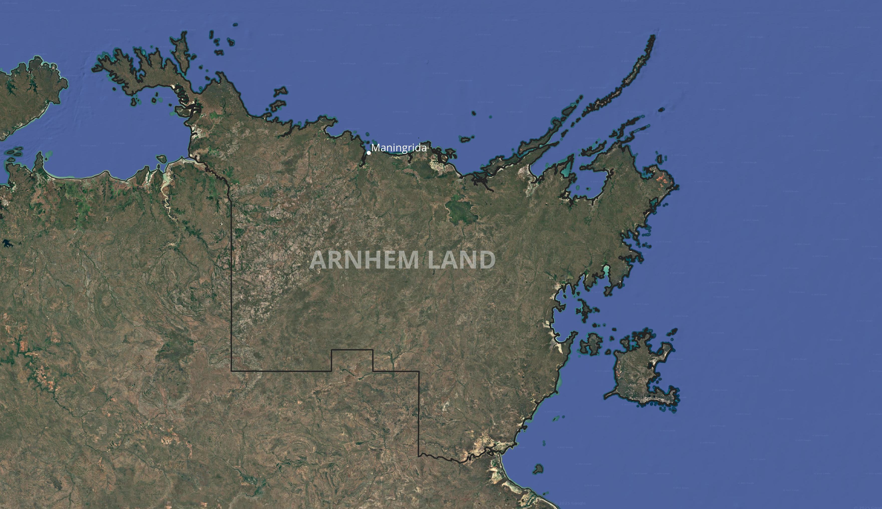
Arnhem Land
Over 60,000 years of land stewardship.
Connection to country grounded in cultural law, kinship systems and traditional knowledge.
Emergence of Aboriginal ranger programs.
Balancing tradition with modern environment.
Notes:
Steph
Arnhem land has a continuous history of Aboriginal land use dating back more than 60,000 years.
Traditional knowledge and customs have been passed down over generations.
Recent decades as seen establishment of aboriginal ranger programs
Ranger programs support biodiversity and cultural heritage but also encourage meaningful employment, training and leadership for local people – keeping them on country.
Djelk rangers was one of the first ranger programs established.

Slide 4
This logo was designed by the Caring for Country Team
Bawinanga is the name of the Aboriginal Organisation we work for. It’s and Aboriginal Corporation which services the people who live in the Maningrida Homelands Region.
Djelk is a Gurrgoni word which means ‘land’ and ‘caring for the land’. It’s a strong Aboriginal word.
Caring for Country is the name of the project.
The water lily links the earth, the water and the air. It is a thing of beauty and a source of food. The stem and bulb are edible. The two stems of the water lily stand for the two laws: traditional law and non-Aboriginal (Balanda) law. The lily bulb and roots represent people within our district.
The dilly bag holds all important messages for all important people in our district. It carries the message of Caring for Country just as the dilly bag is used to carry the letter sticks for messages about ceremony.
The fish trap or net holds the key by bringing people together for decision making. It gathers us together like fish in a net.
Notes:
Introduction to Djelk Ranger group – Joyce DON’T READ OUT SLIDE
Located in Maningrida NT 500km east of darwin
Djelk rangers began in 1991
Number of rangers: land and sea/men and women
Involved in many land management activities – fire, weeds, crocodile egg collection, feral animal control, sea patrols, biosecurity work, supporting LOC program and more.

Slide 5
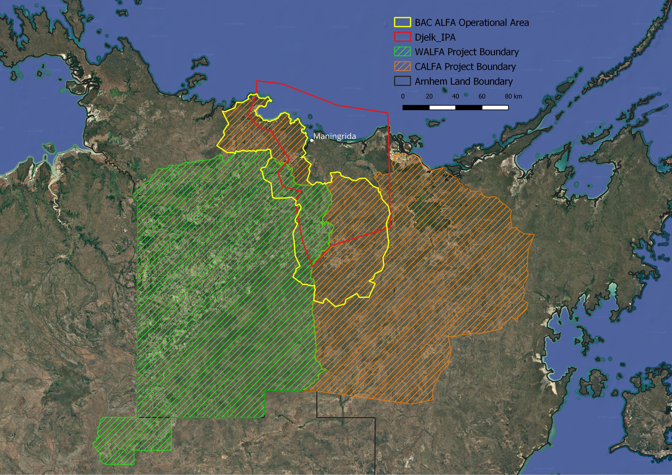
Djelk IPA
Declared in 2009
~ 6,700km2
Land and Sea
Djelk ALFA Operational Area
WALFA and CALFA were both registered with the Clean Energy Regulator in 2014
Notes:
Steph
- Particular focus of Djelk rangers is development and operation of large landscape scale fire management projects.
Djelk IPA and fire project boundaries.
Brief outline of Carbon Projects – how this supports the fire work in Arnhem

Slide 6
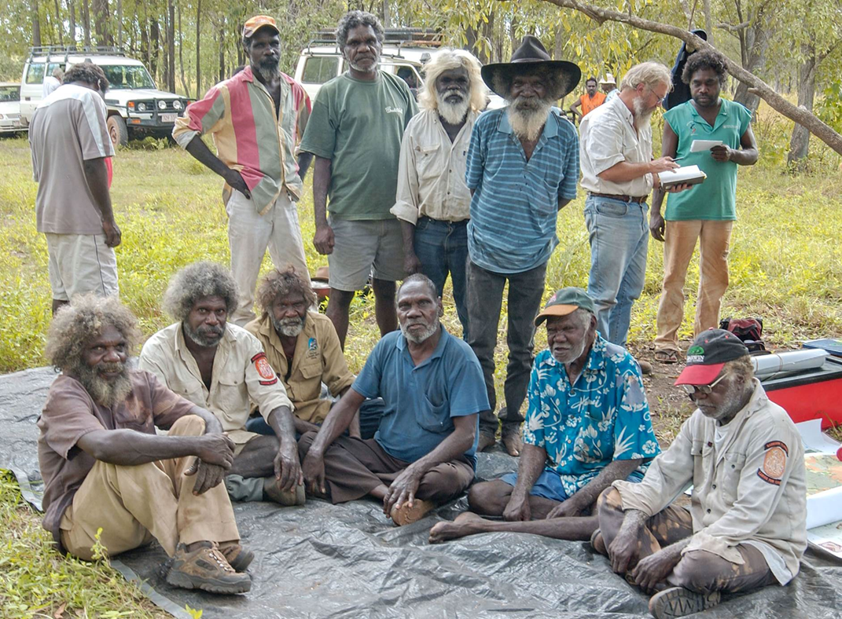
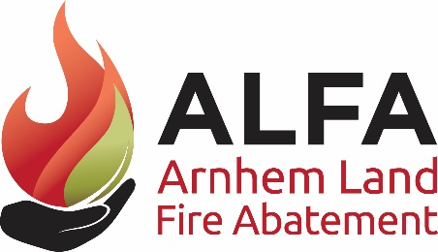


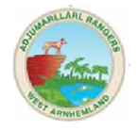
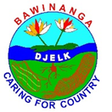
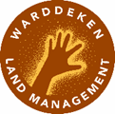
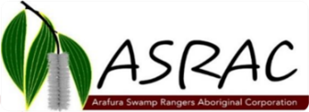
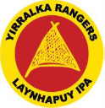
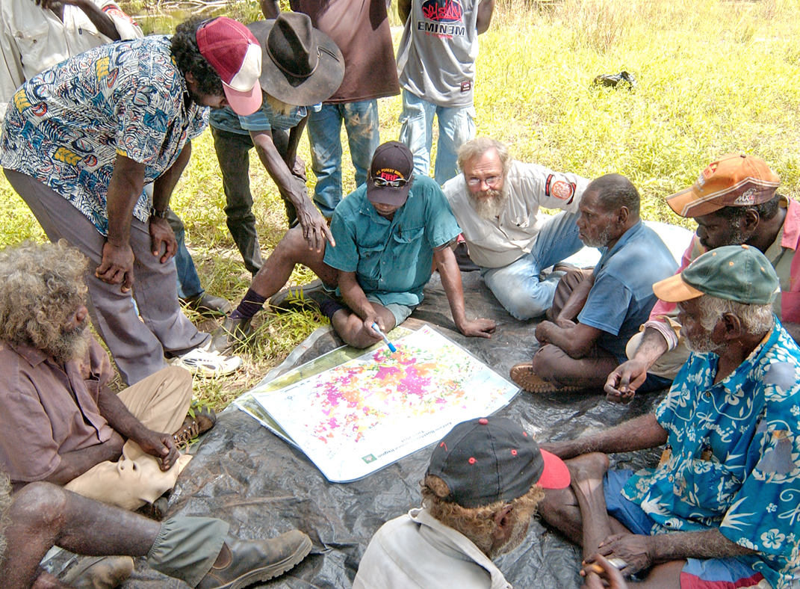
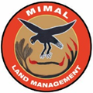
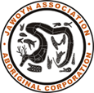

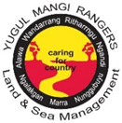
ALFA NT
Mid 1990’s landowners and NT-based scientists started talking about problems with fire.
With leadership from elders, Landowners started Arnhem Land Fire Project.
Carbon laws helped financially support fire management by Aboriginal ranger groups.
Notes:
Steph

Slide 7
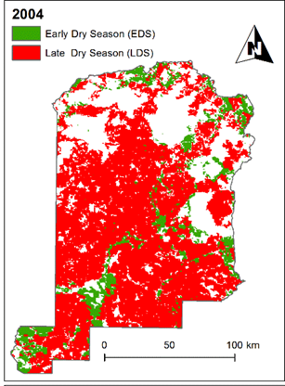
WALFA – baseline fire scars
Notes:
Steph

Slide 8
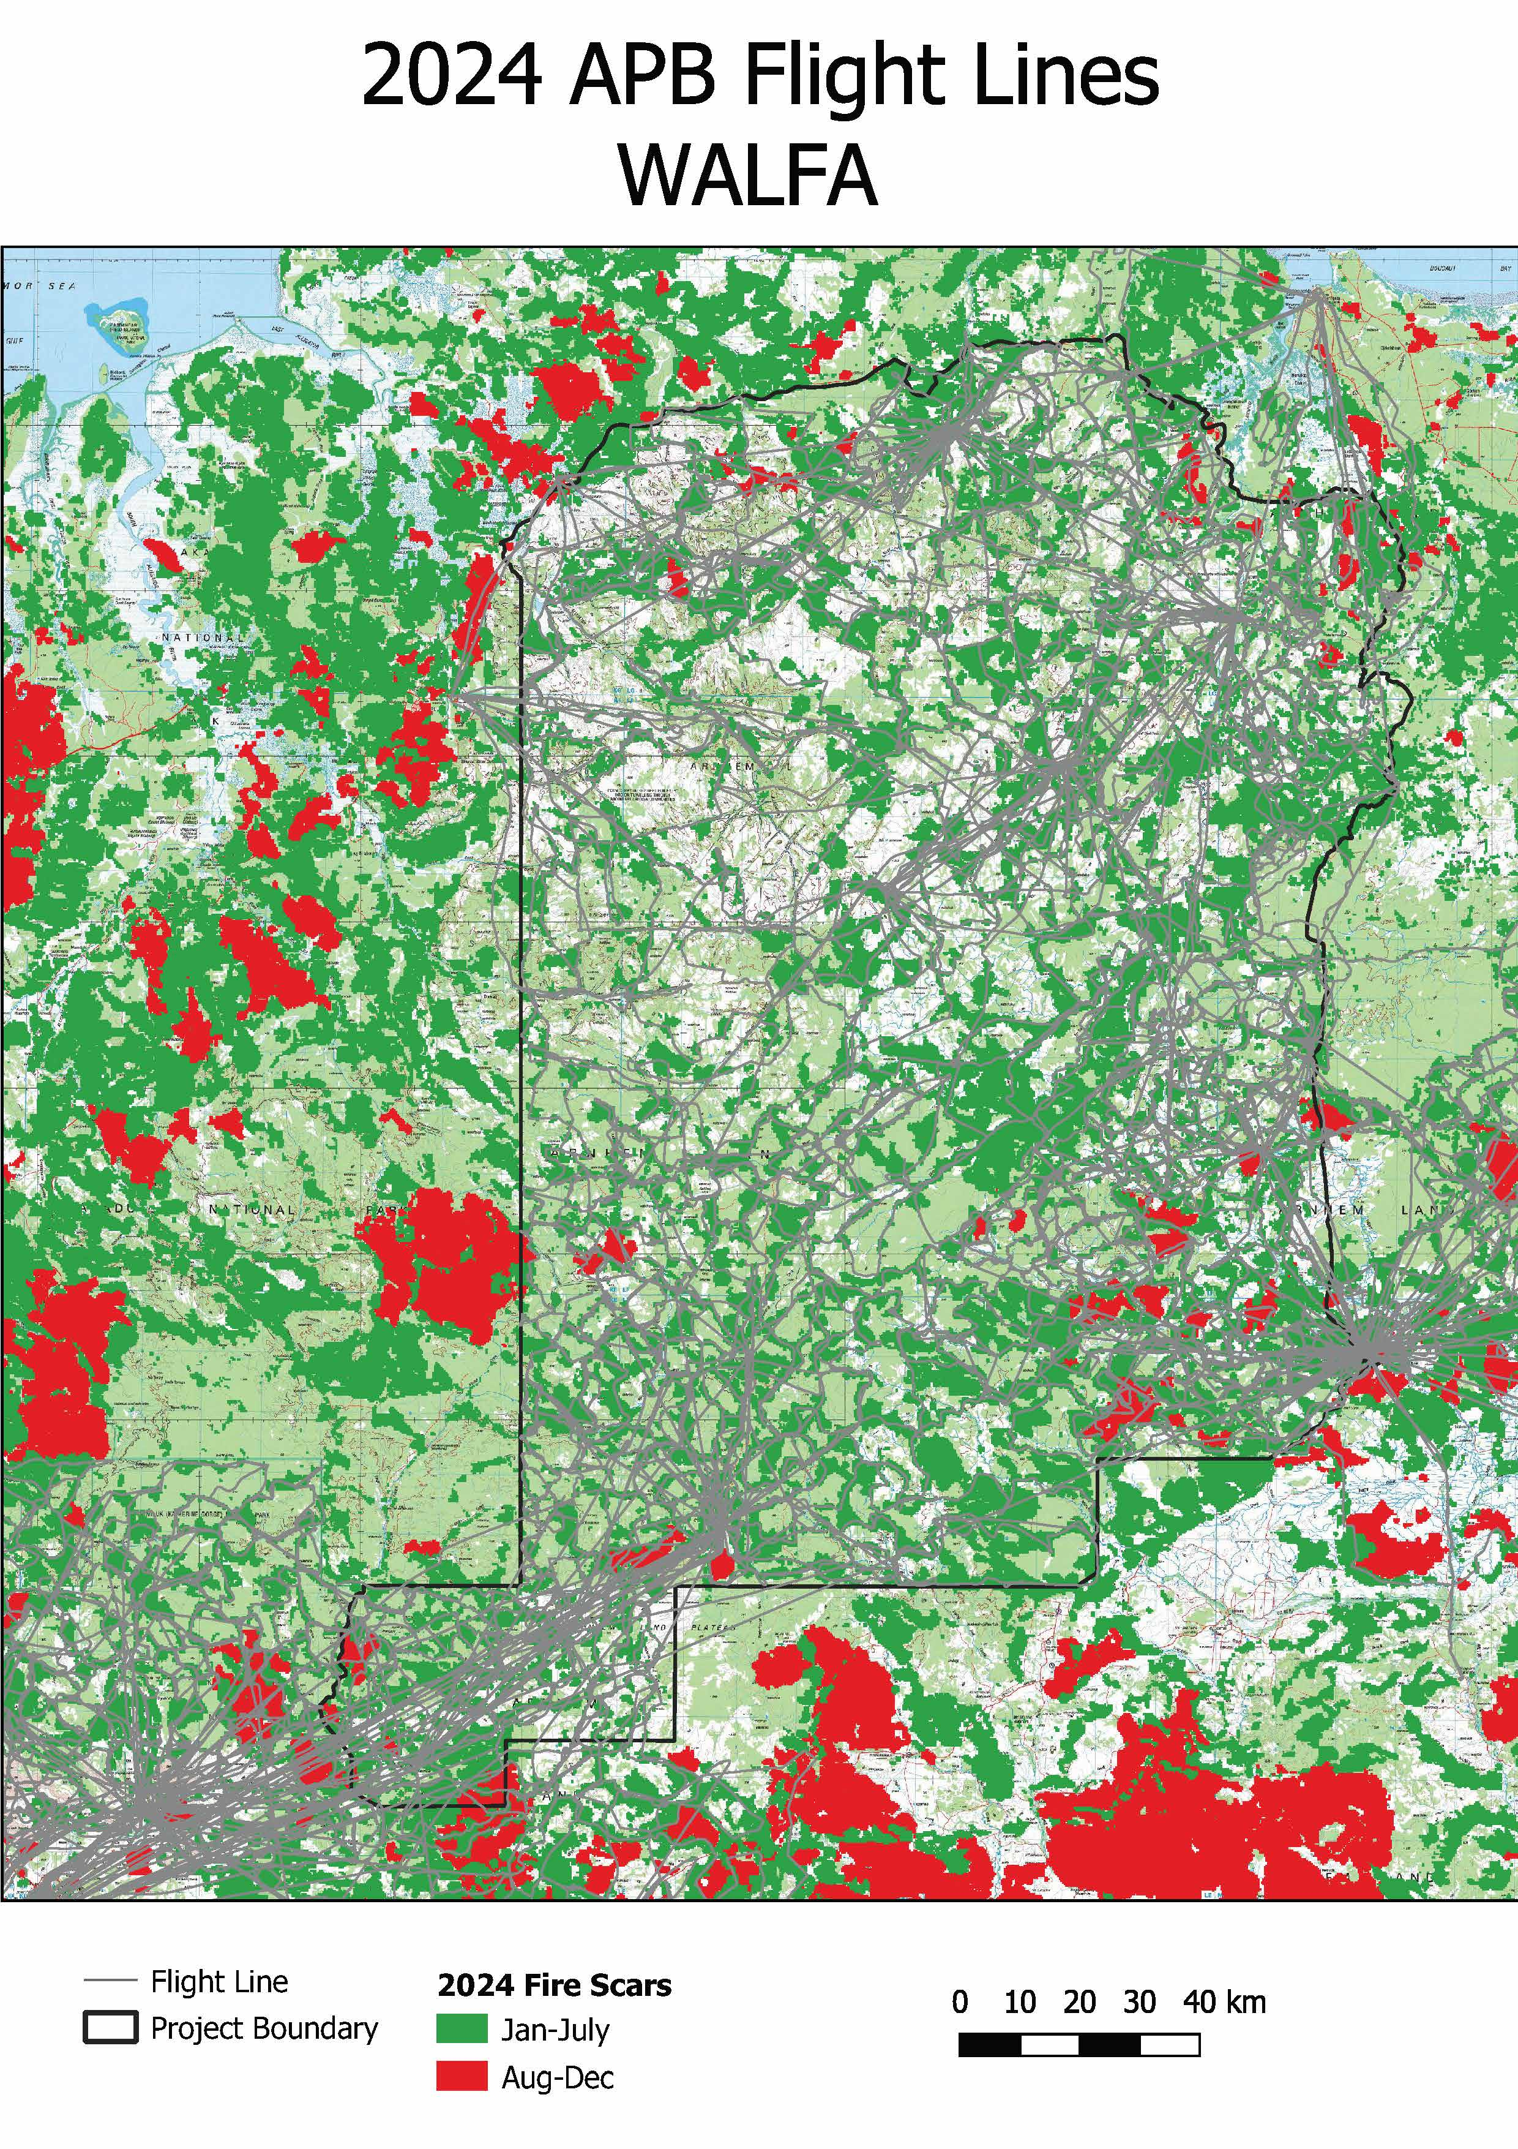
WALFA – project fire scars
Notes:
Steph

Slide 9
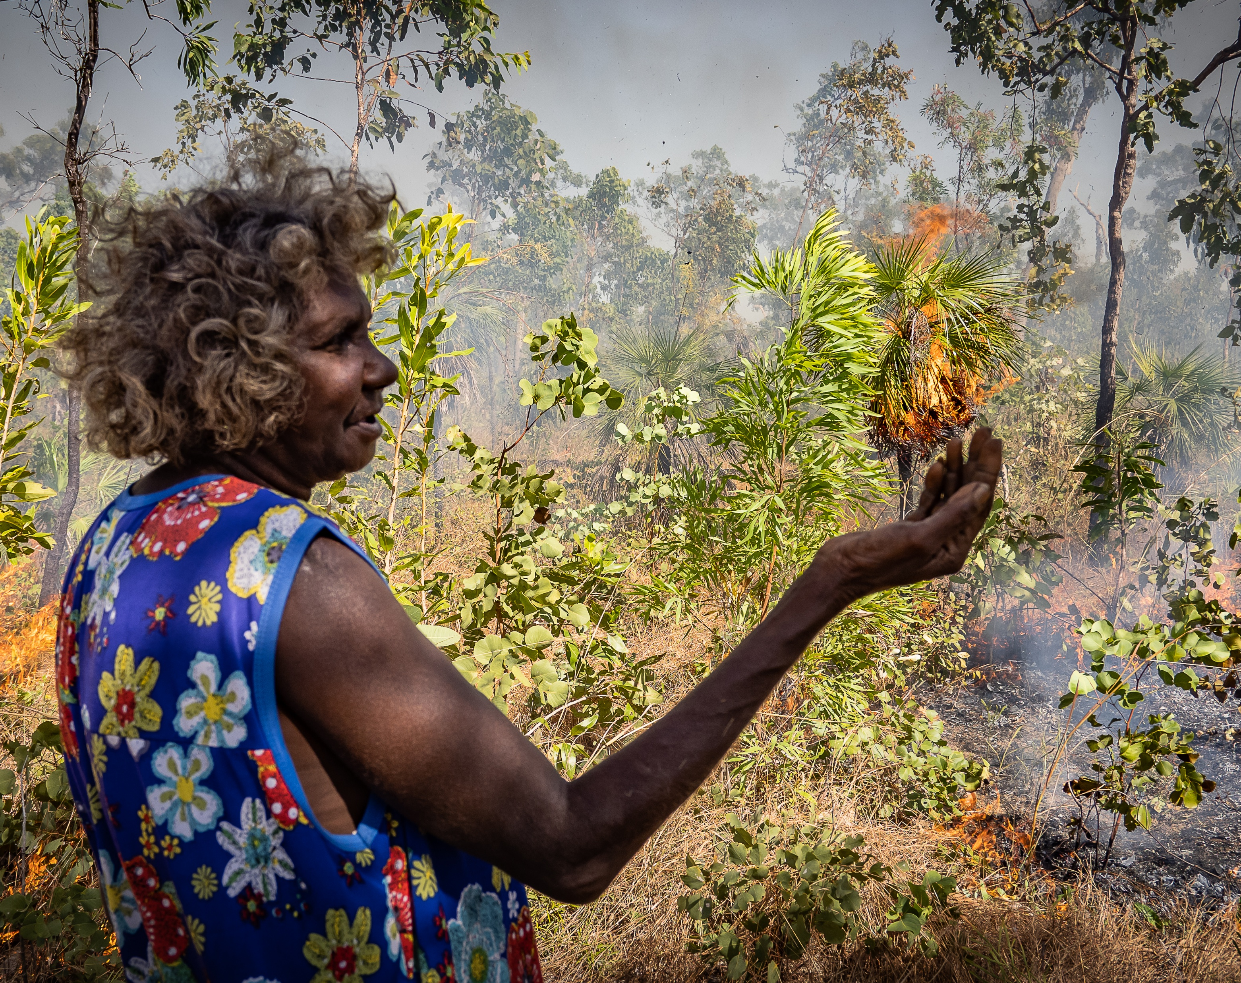
History of Women in Fire
Fire was always used practically, not without reason:
Cooking
Warmth
Regrowth for animals
Navigation
Communication
No technology: used the landscape and weather to control extent of burn.
Men traditionally managed fire. Women participated passively, linked to food gathering.
Notes:
Joyce
- Fire was used for many reasons historically, but always practically – cooking food, keeping warm in caves at night, facilitating regrowth for animals. Also had deep cultural meanings: navigation, communication and maintain healthy landscapes. Fire was never just used for the sake of it.
- No technology, used the natural landscape and weather to control the extent of the fires.
- Generally considered a mens role, women participated passively usually only when gathering food or accompanying men. Due to fire only being used with purpose, women only participated in burning when aligned to their roles such as food gathering.

Slide 10
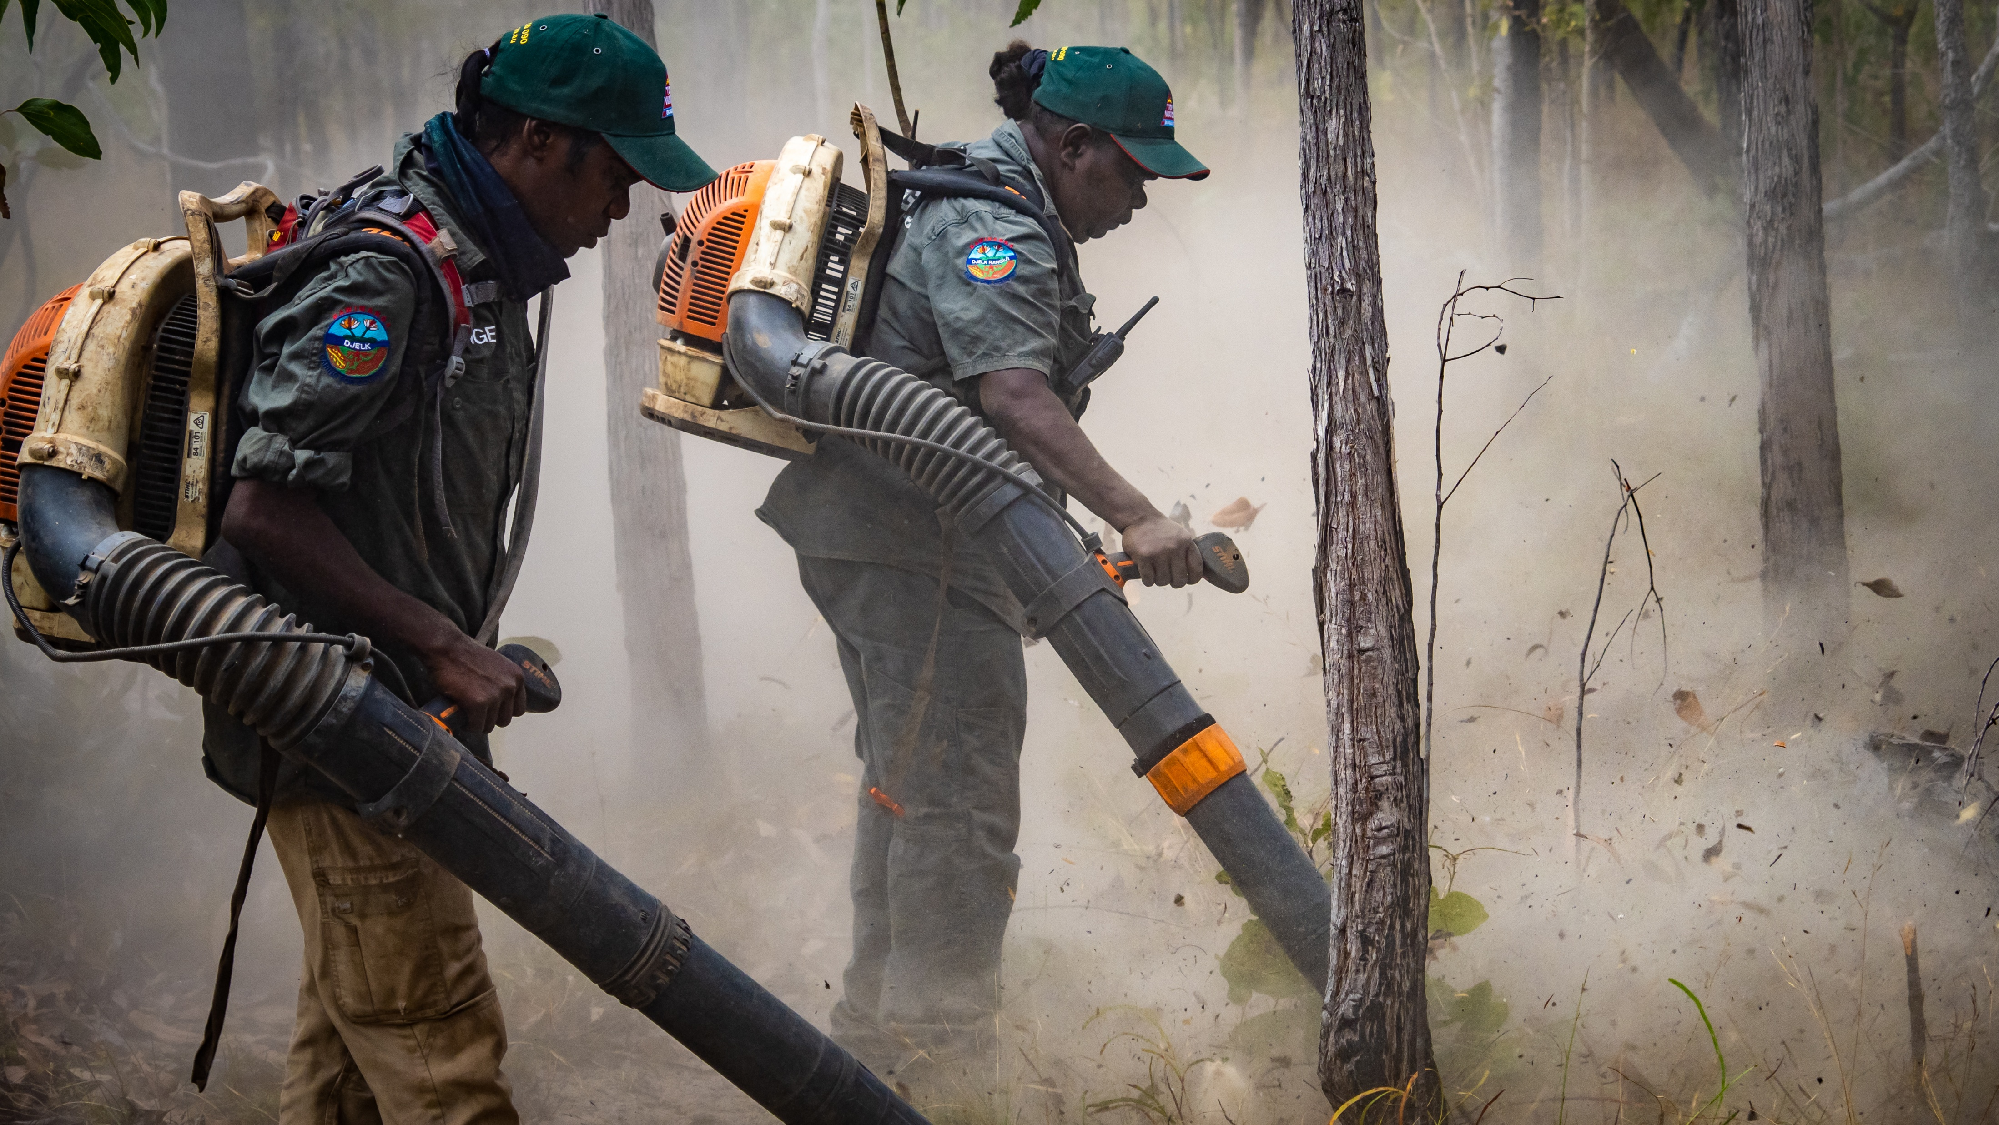
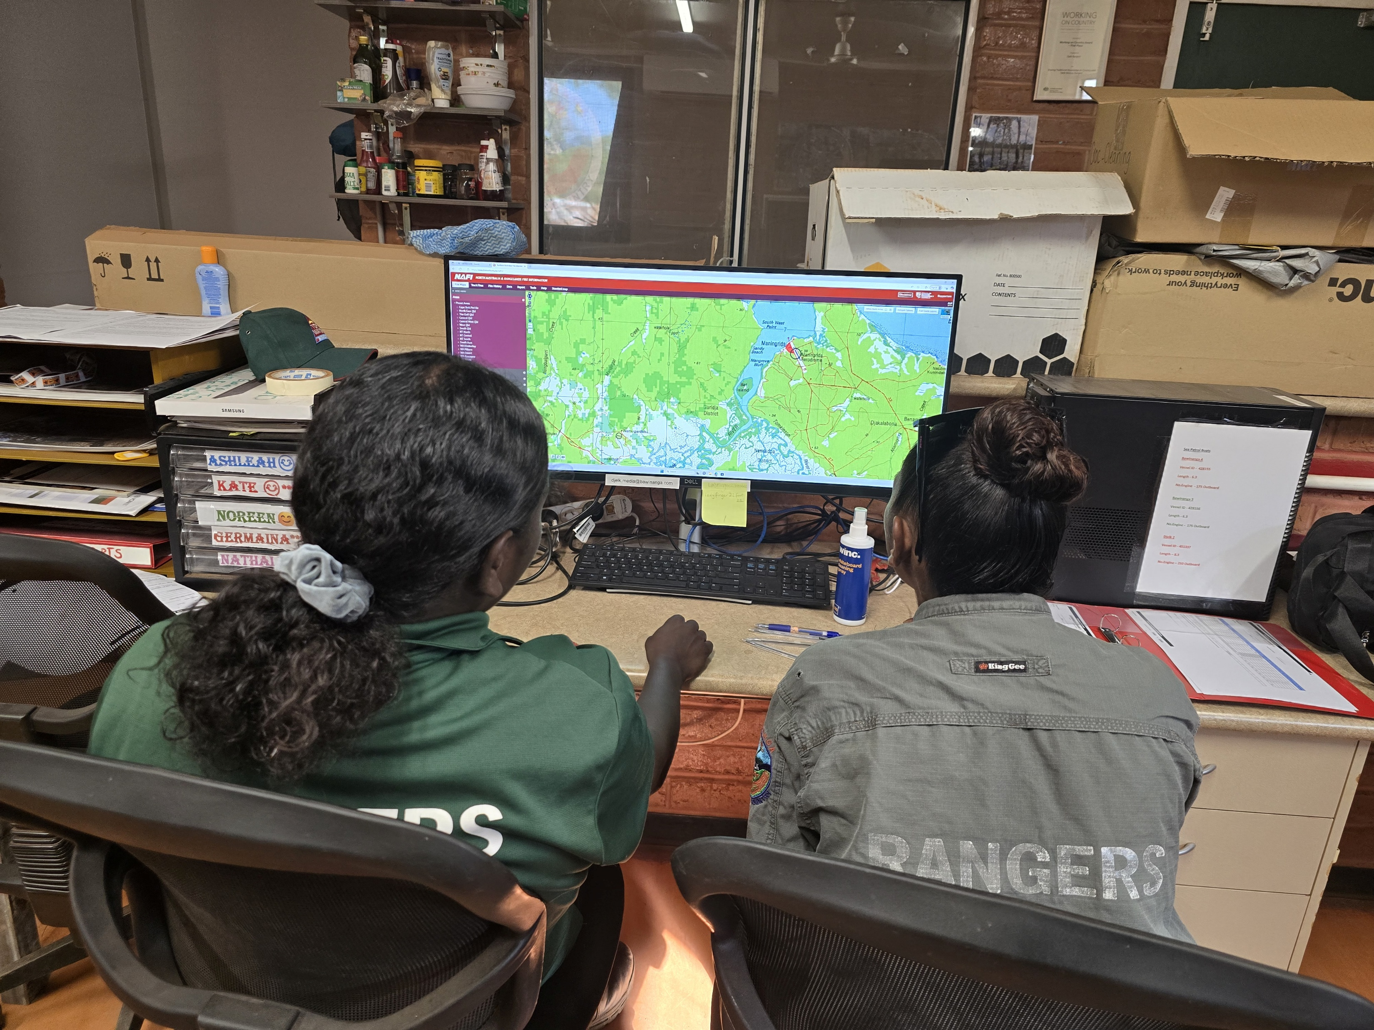
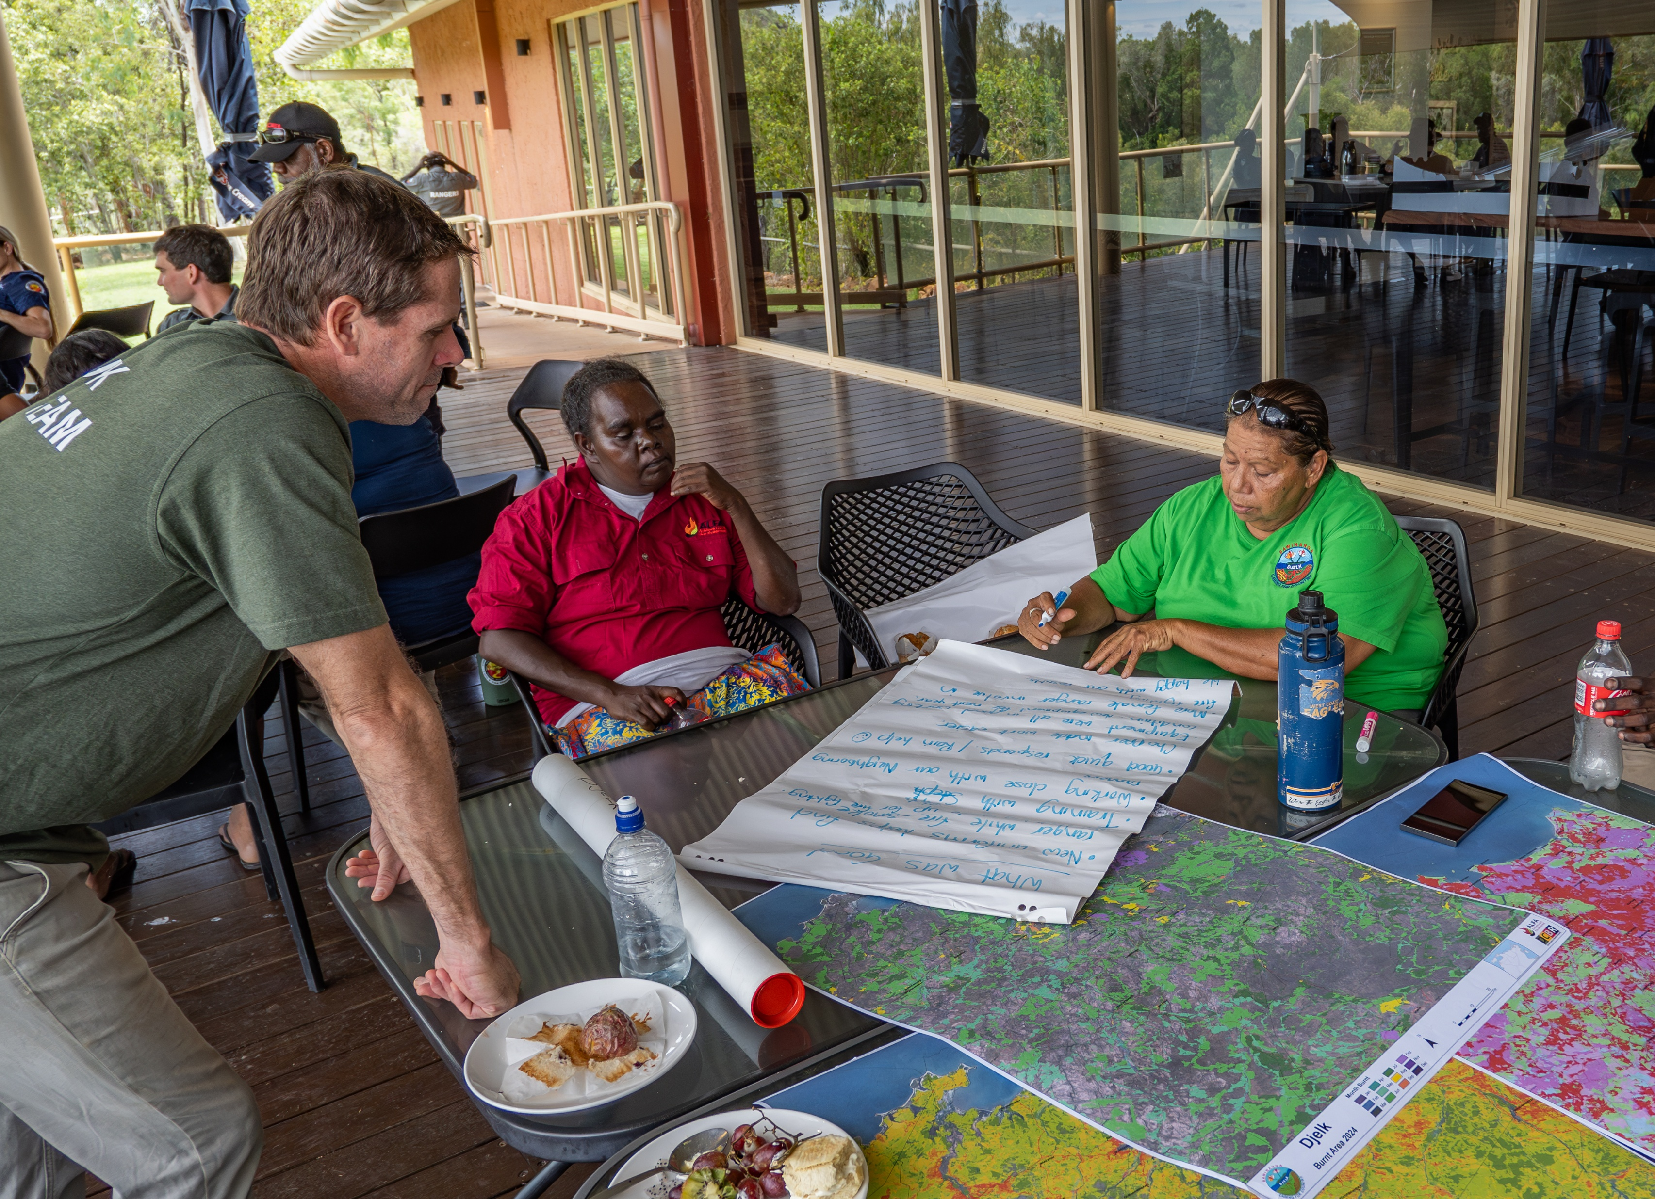
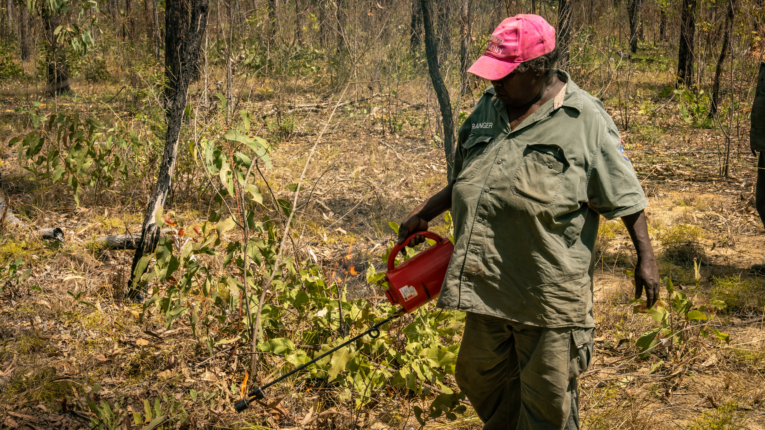
Opportunities for Women in Fire Management
EDS burning = safer, family-friendly.
Structured training builds confidence.
Role models & mentors are critical.
Women excel in mapping, planning, logistics.
Notes:
Joyce/Steph
Entry to fire management through employment as rangers
EDS safer and predictable – can plan life around it.
Female leadership help create a safe and supportive environment
Fire planning has peaked the interest of these women – like the computer work

Slide 11
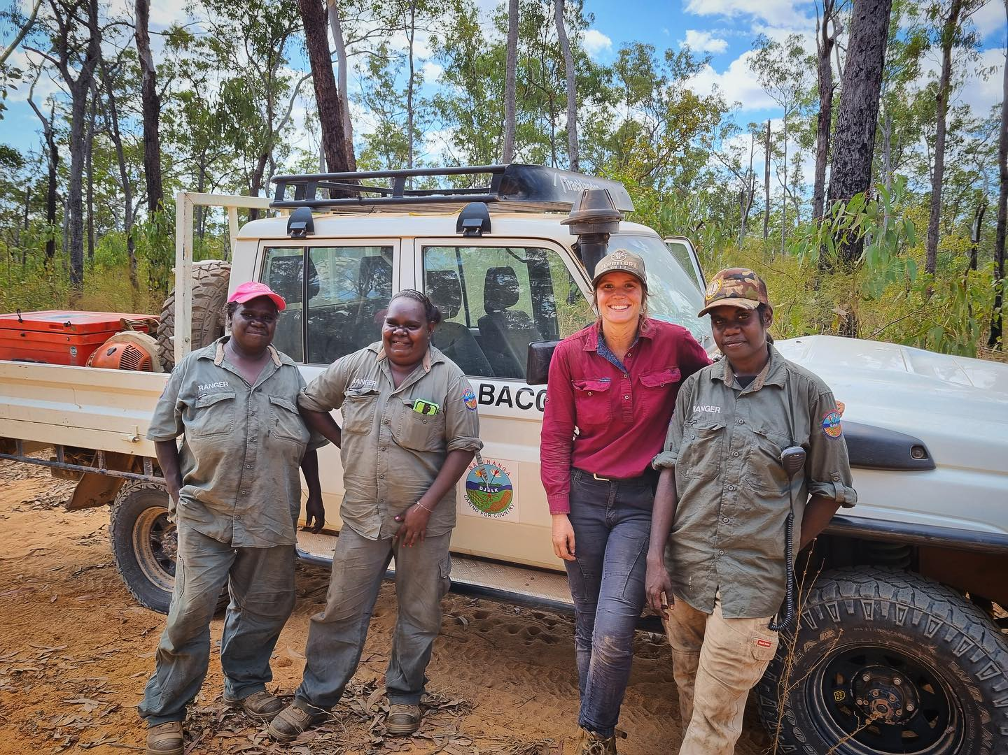
Building a Strong Women’s Fire Team
Shift from separate to integrated programs.
Increase of female rangers since 2021.
Flexible schedules & supportive workplace culture.
Cultural safety through female Indigenous supervisor.
Gender-specific camps support learning.
Emphasis on safety, planning, cultural protocol.
Notes:
Steph/Joyce
Djelk were one of the first ranger groups to develop a dedicated womens ranger program
Since then they have shifted to a more inclusive program that involves both men and women in their works programs – chosen to be this way by this ranger group
Some other ranger groups prefer the separate womens ranger programs for variety of reasons
Increase in women since 2021 – having good leadership is the main contributing factor
Indigenous supervisor supports cultural connection and supports family ties with the women rangers
Women have an important cultural role in fire (joyce)
Gender specific camps help provide a safe learning environment for women and allow groups from various locations to come together to learn.

Slide 12
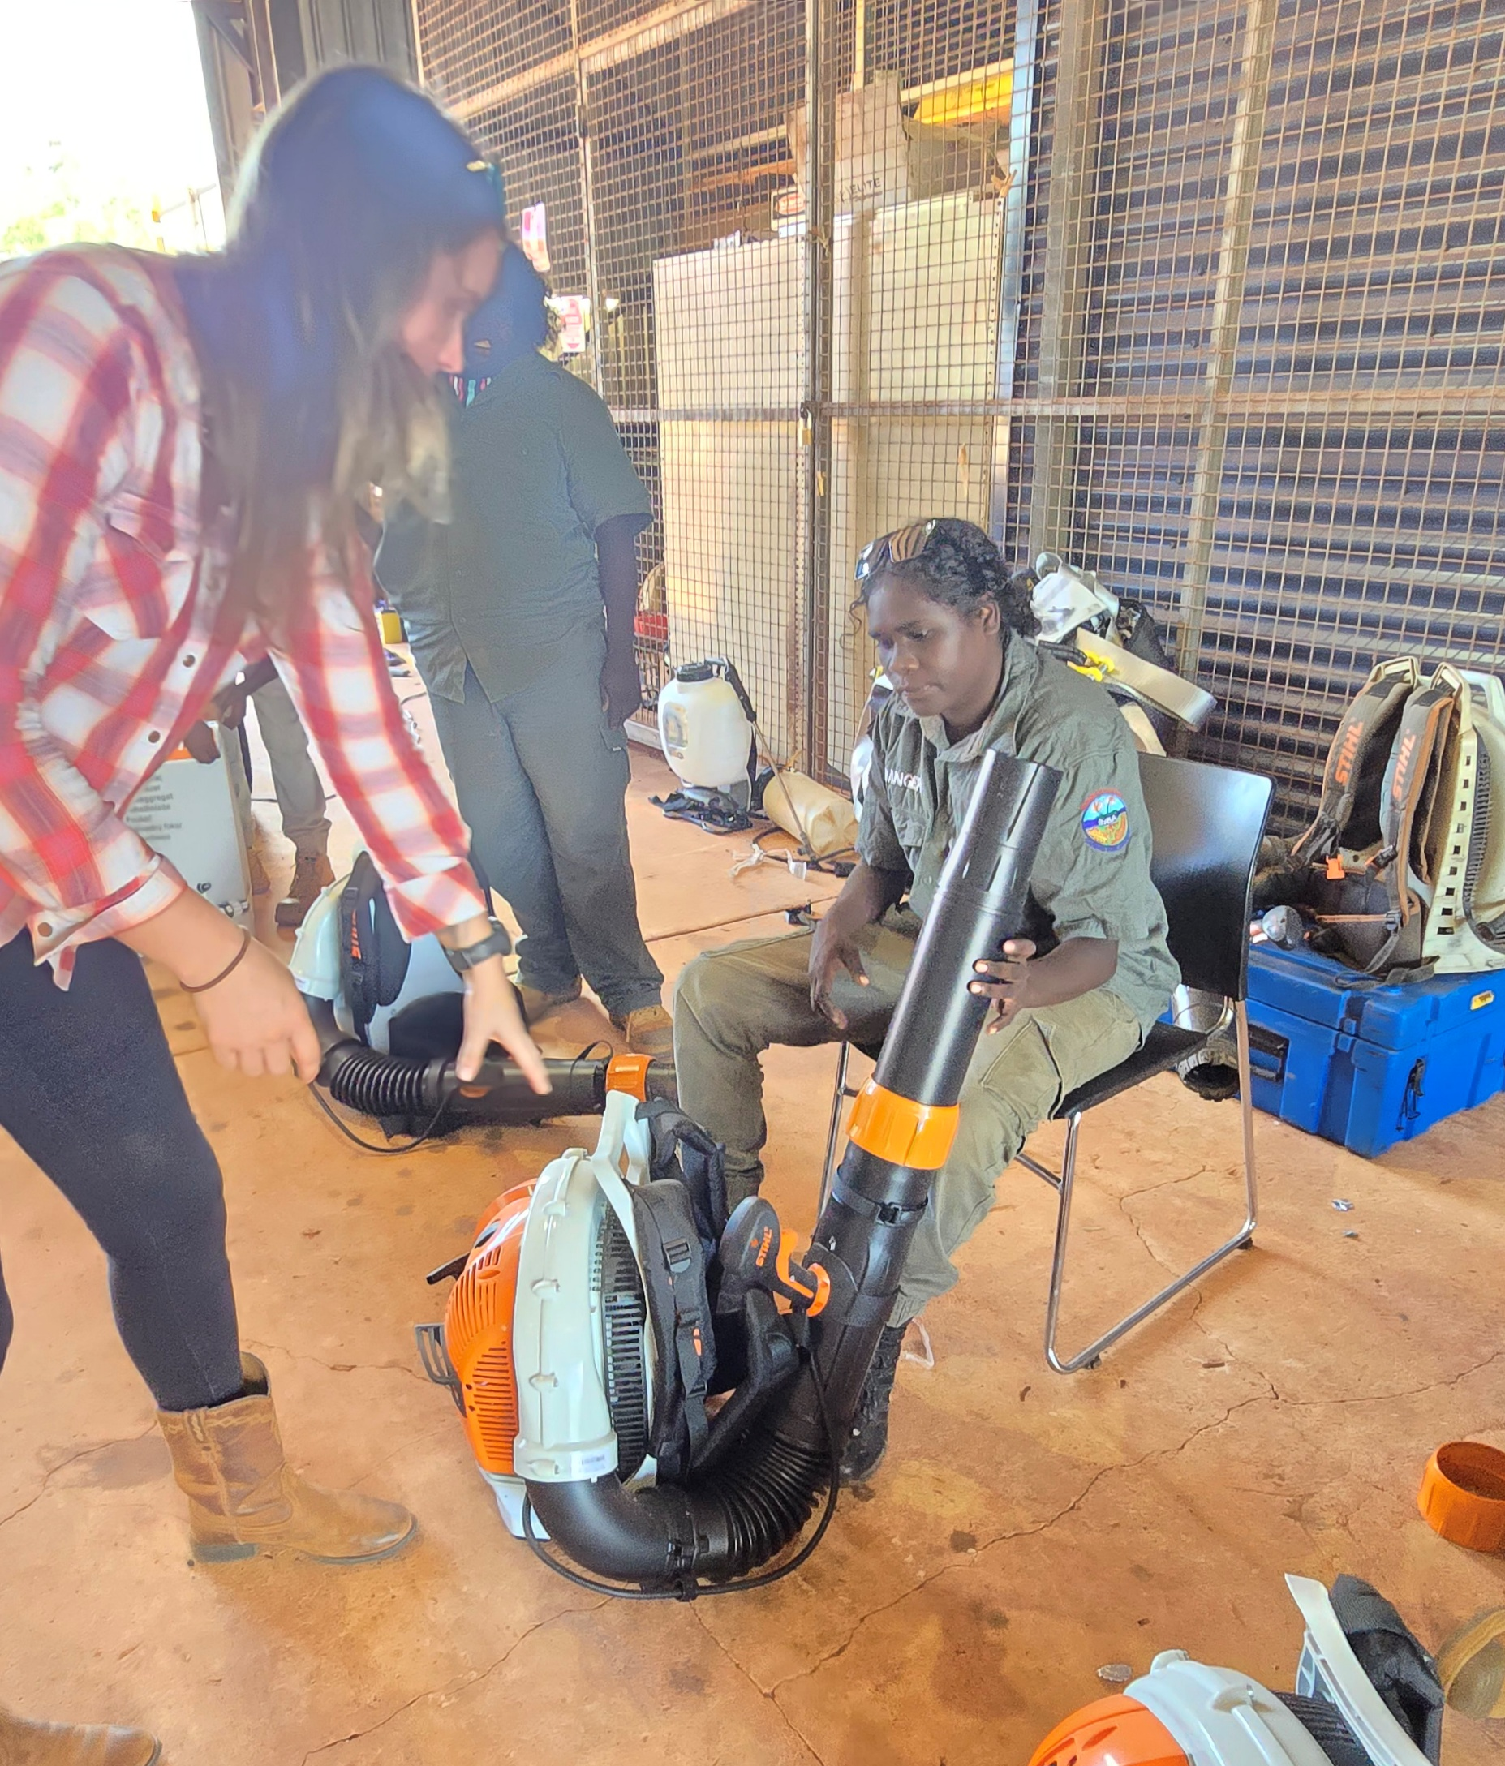
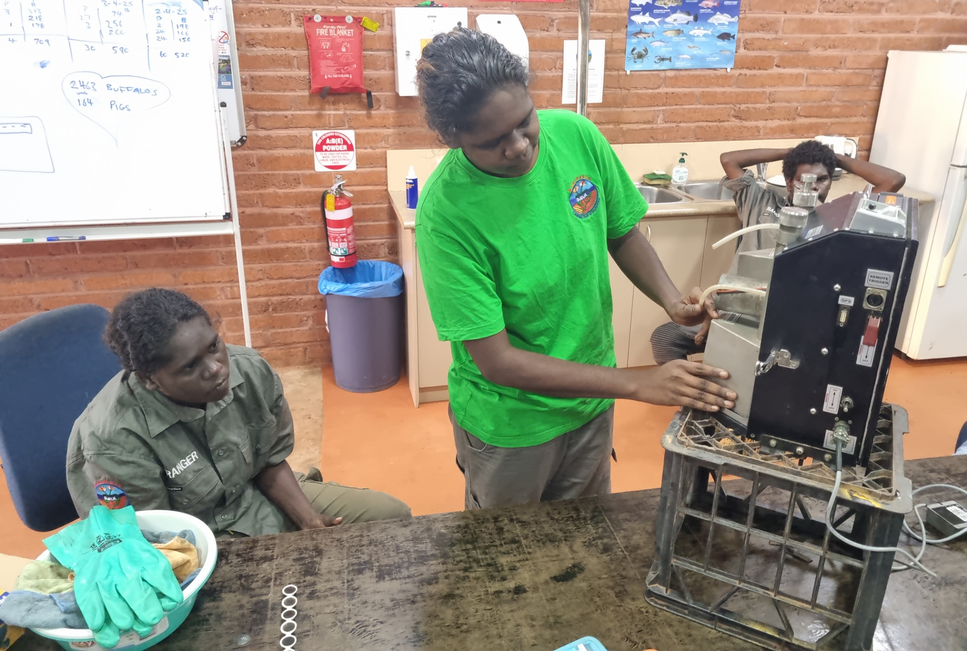
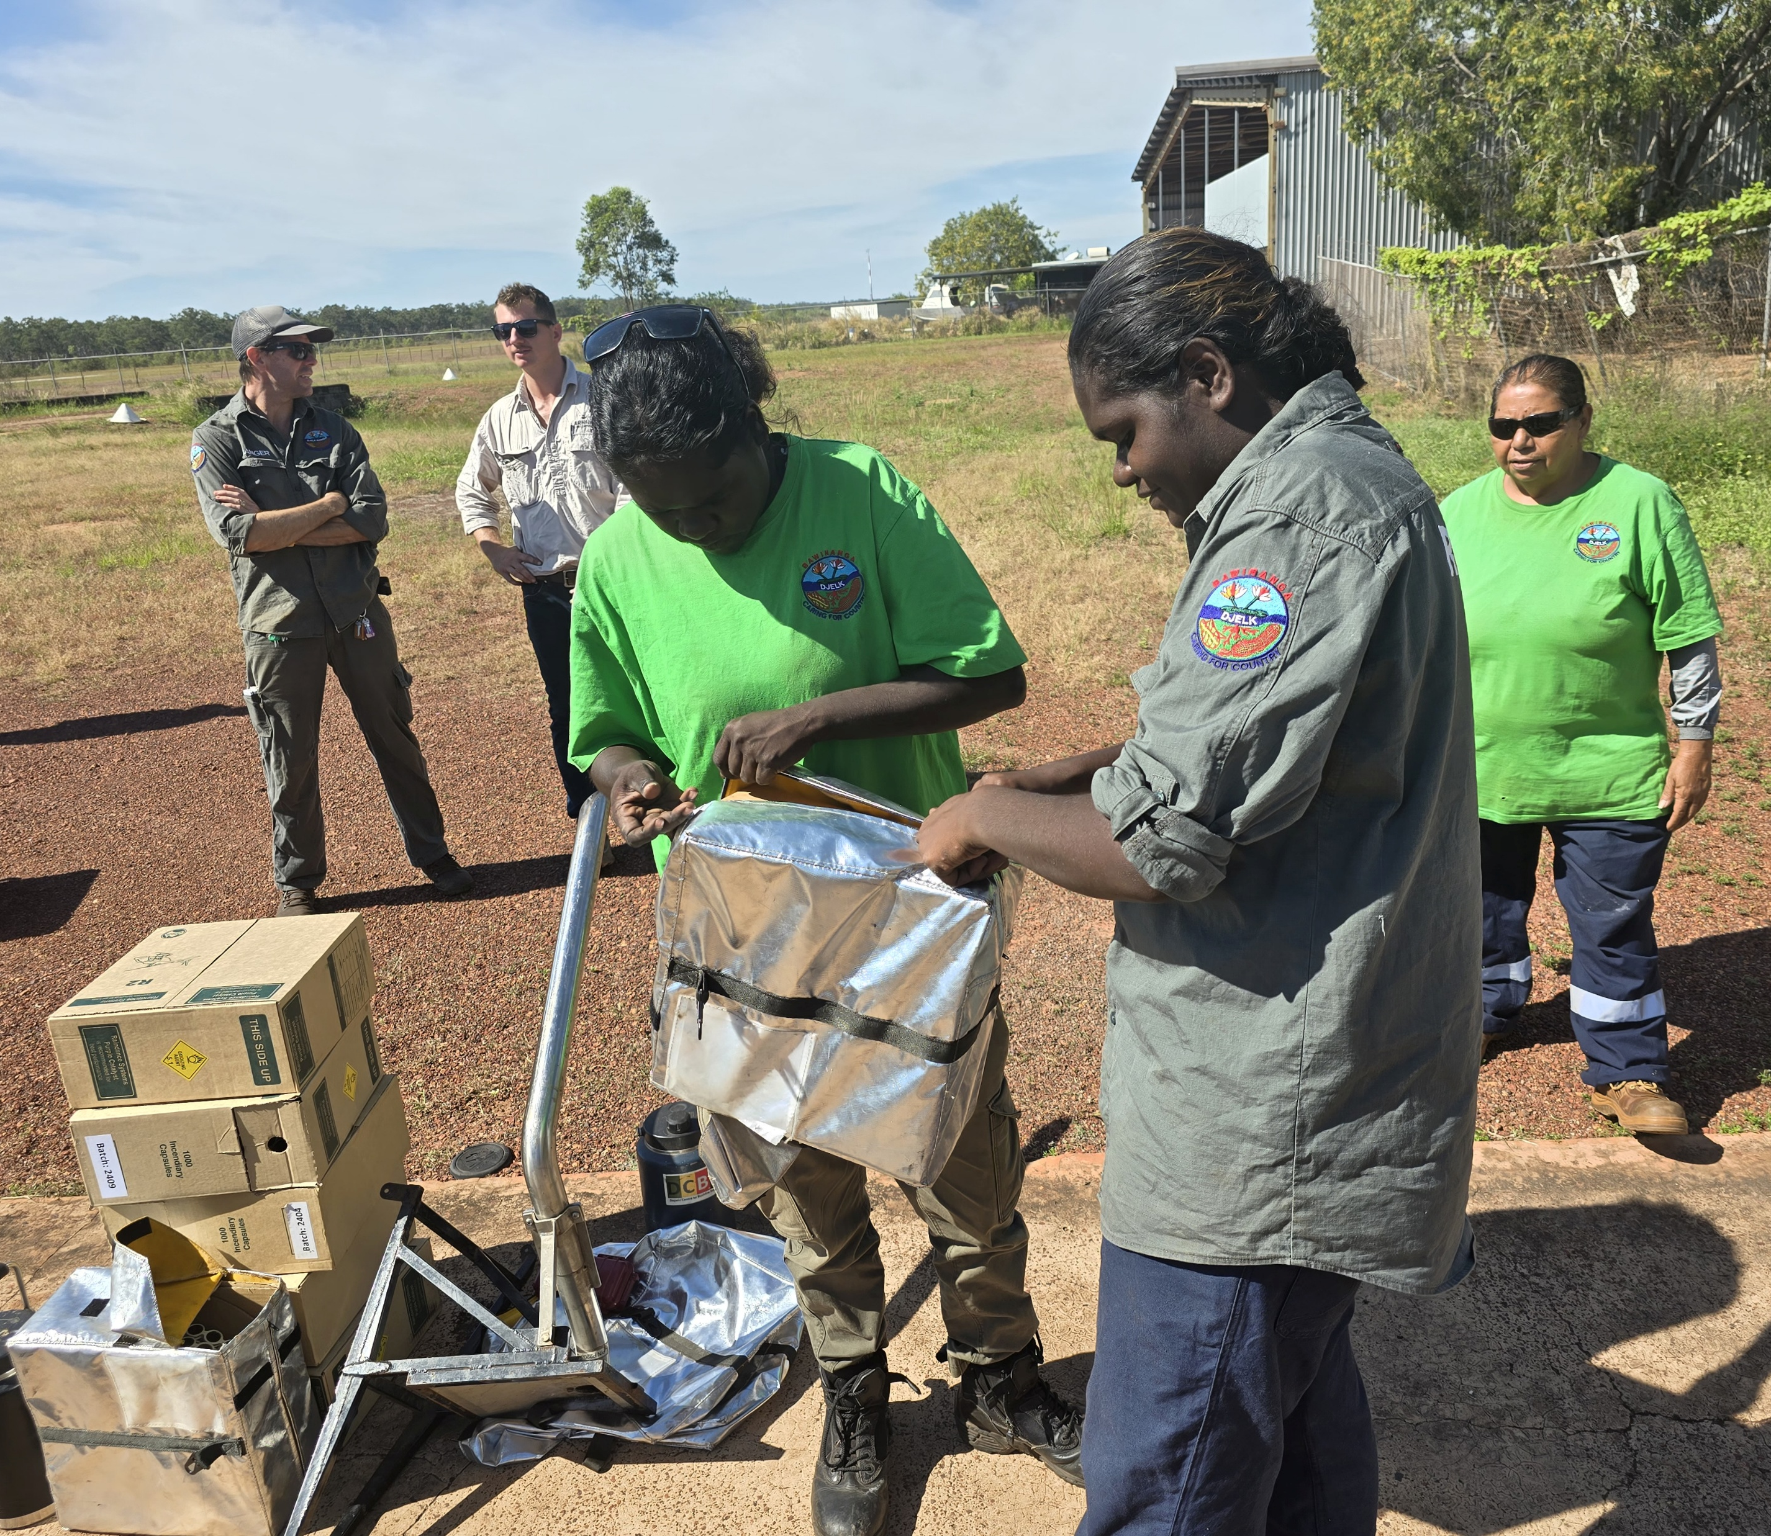
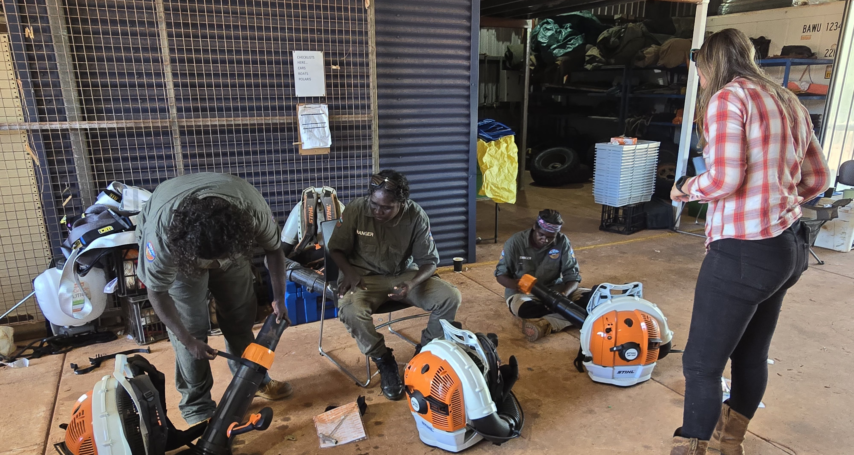
Enhancing Women Rangers’ Experience Through Female Trainers
ALFA’s female Bush Fire Project Officer.
Builds trust, comfort, and engagement.
Practical, patient, culturally safe approach.
Role modelling challenges gender stereotypes.
Notes:
Steph /Joyce
ALFA employs Steph who has engaged in both accredited and non accredited training to both men and women.
Feedback has shown women feel safe and more comfortable learning with a female in some circumstances.
Trainees feel trainer is patient, and feel as through they can readily ask for assistance without feeling shame.
Having a female trainer is a great role model example for women showing that they can succeed in the fire industry which challenges gender stereotypes and encourages the women to get involved.

Slide 13
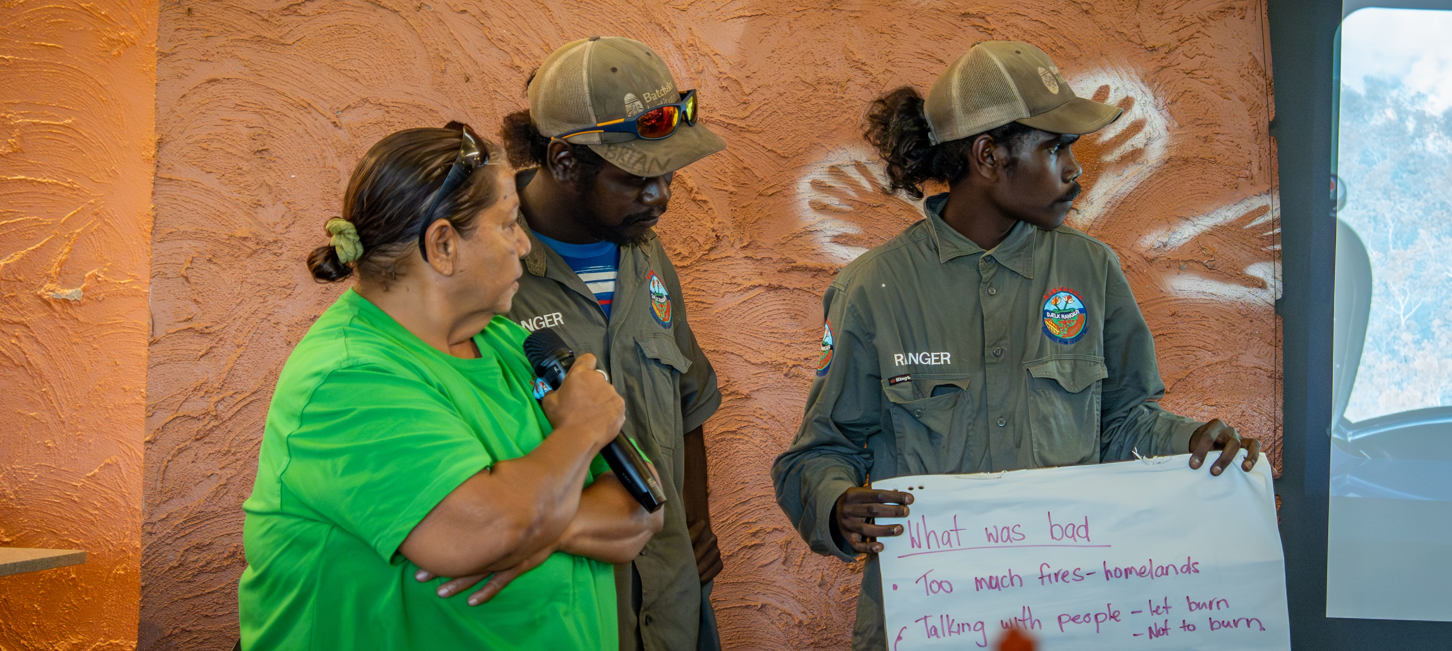
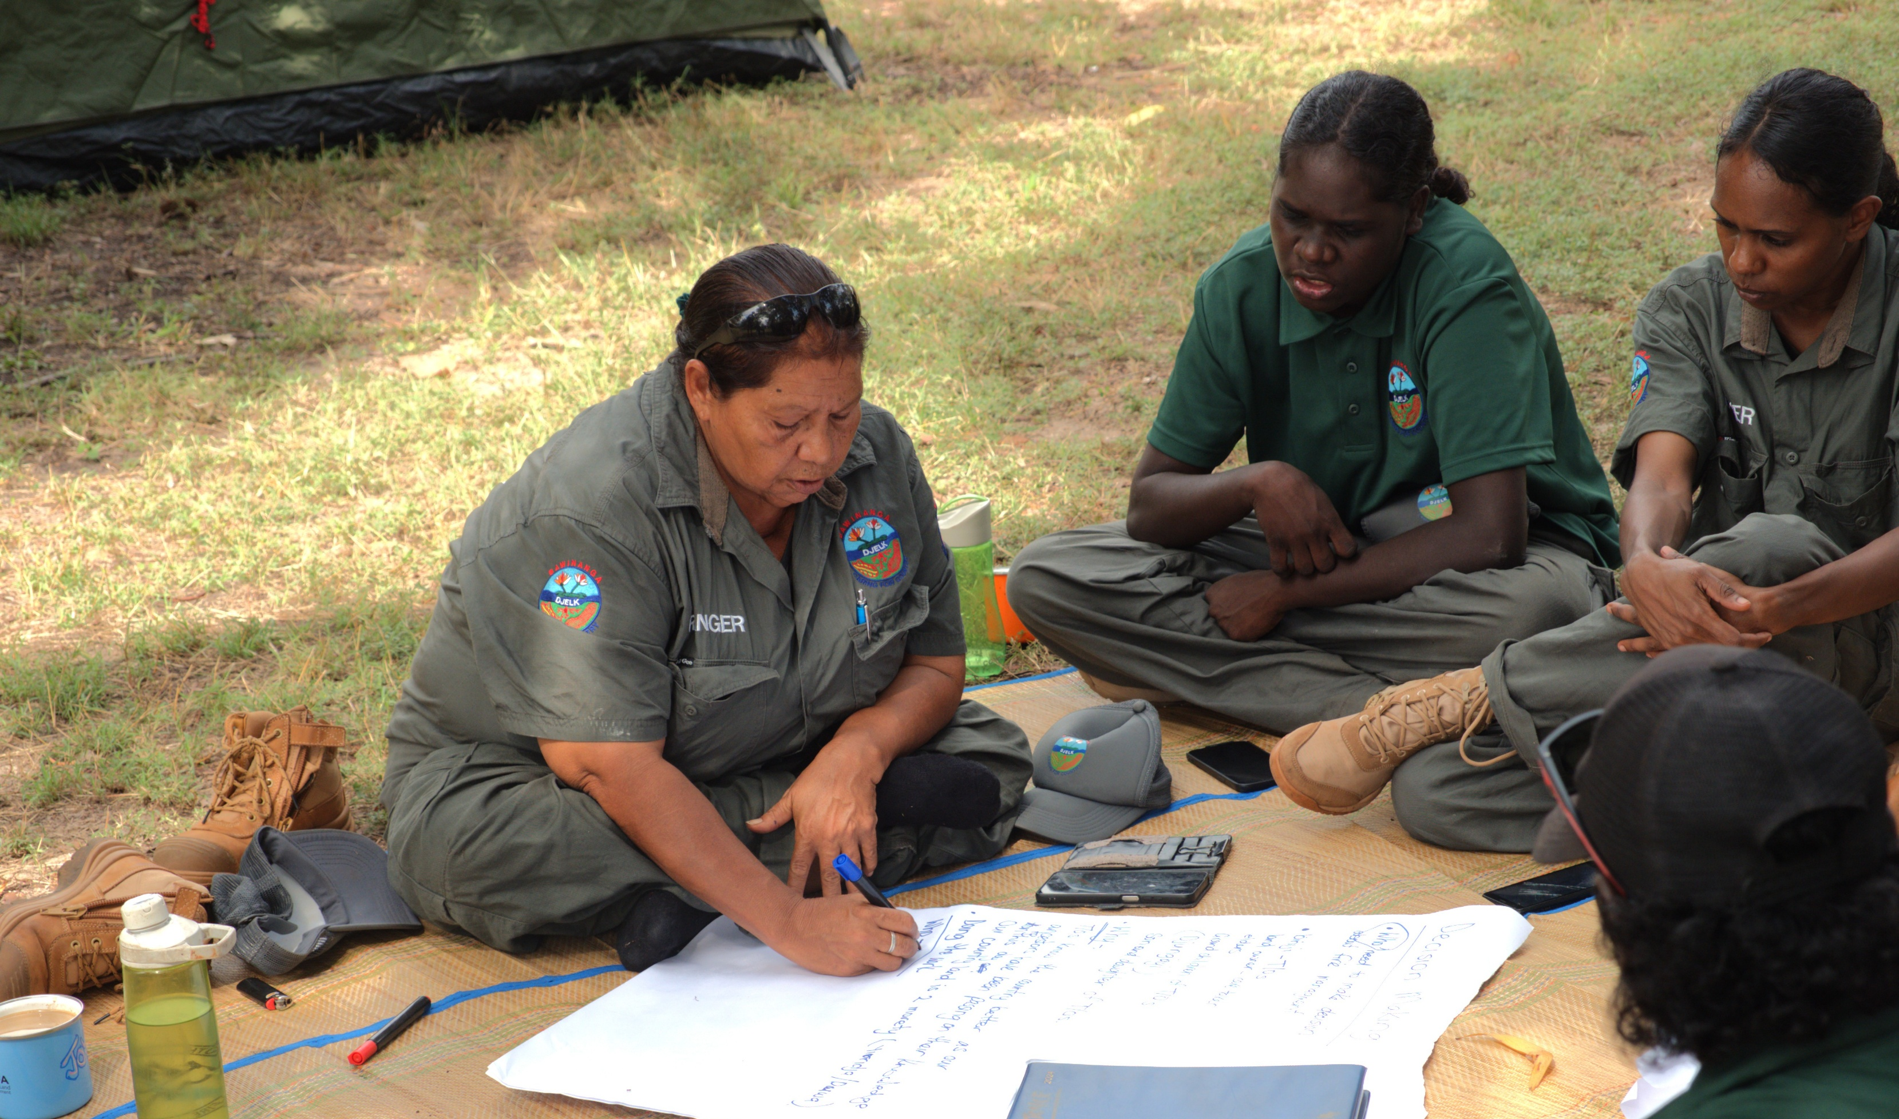
Pathways and Cultural Leadership
Indigenous Women Coordinators = critical.
Supportive mentoring & clear pathways.
Cultural + technical leadership development.
External programs build skills & confidence.
Notes:
Steph/Joyce
Having an indigenous womens coordinator has greatly benefited the Djelk rangers – draw from own experiences and create a positive and supportive environment for younger and new rangers.
Demonstrated a leadership pathway for women rangers – they don’t have to stay junior rangers but can progress to senior rangers and possibly eventually coordinators which is what Joyce wants to achieve for when she retires. Mentoring is a huge part of Joyce’s role as coordinator.
Assists in cultural connection, being able to teach in language and cultural ways.
Other programs such as Strong Women for Healthy Country and Top Watch Biosecurity have also allowed women to take on leadership roles in certain projects, building their confidence.

Slide 14
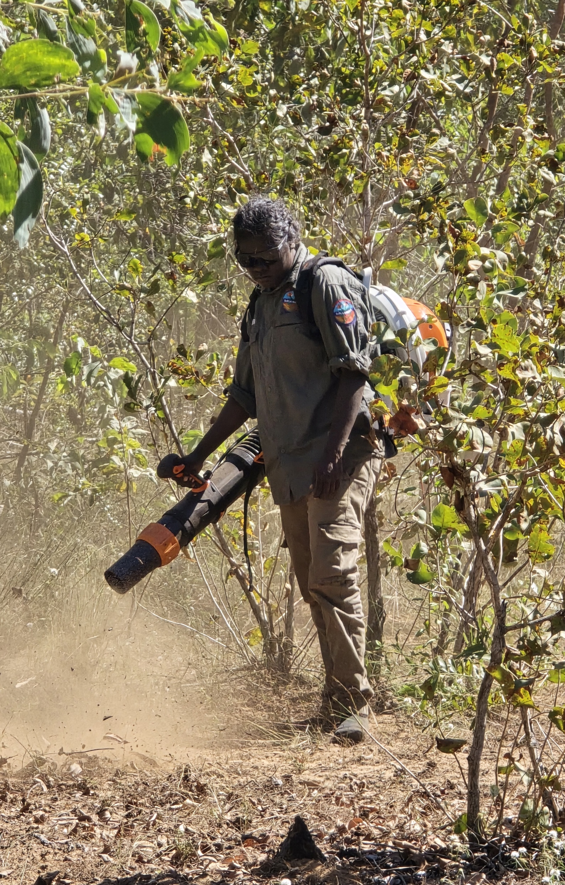
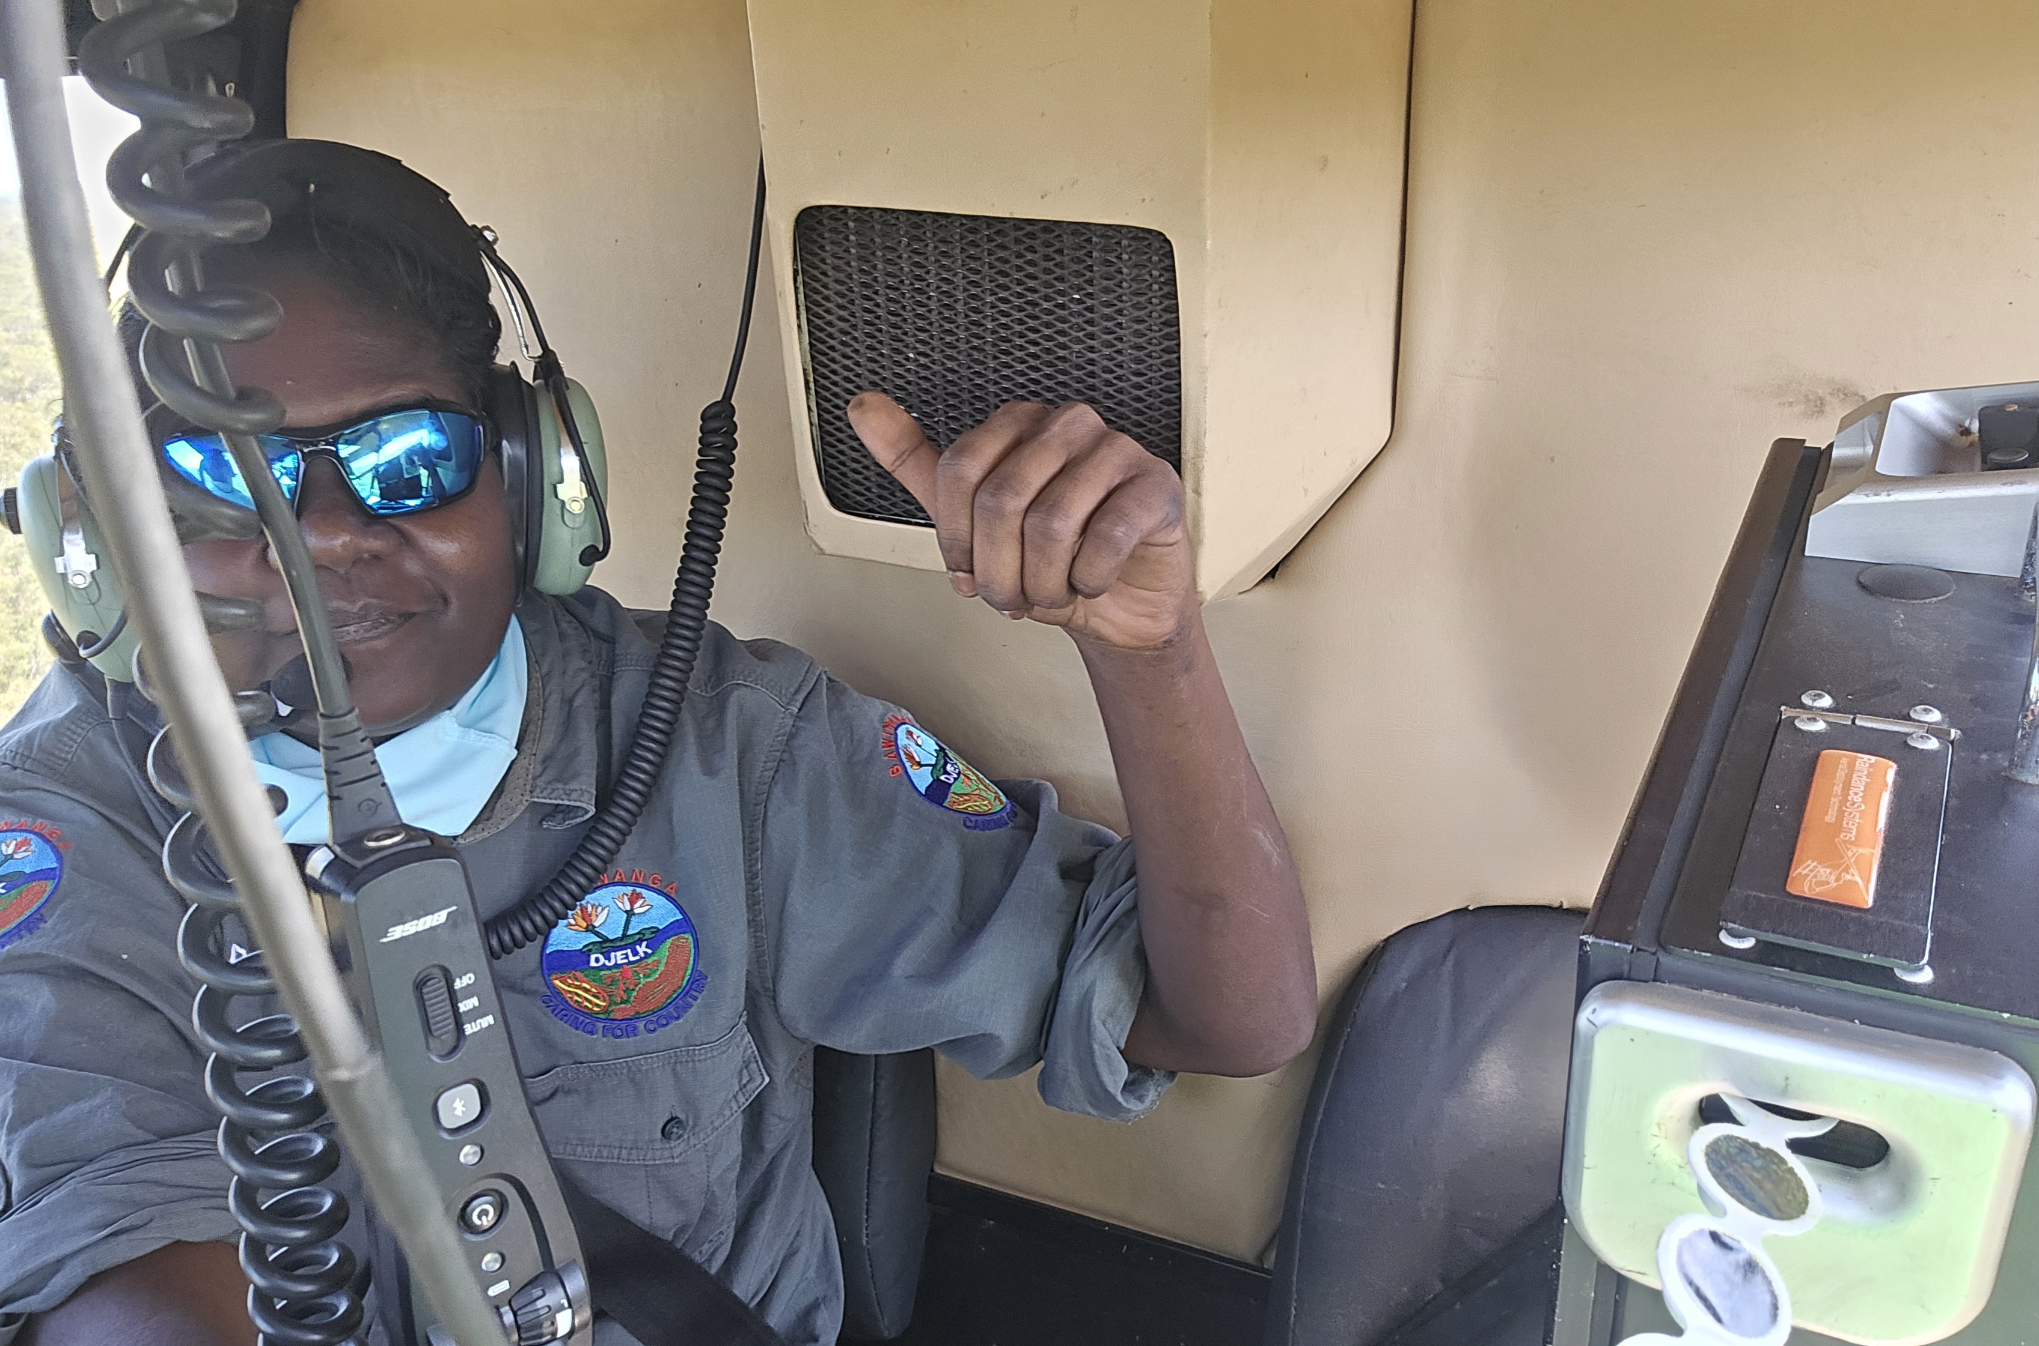
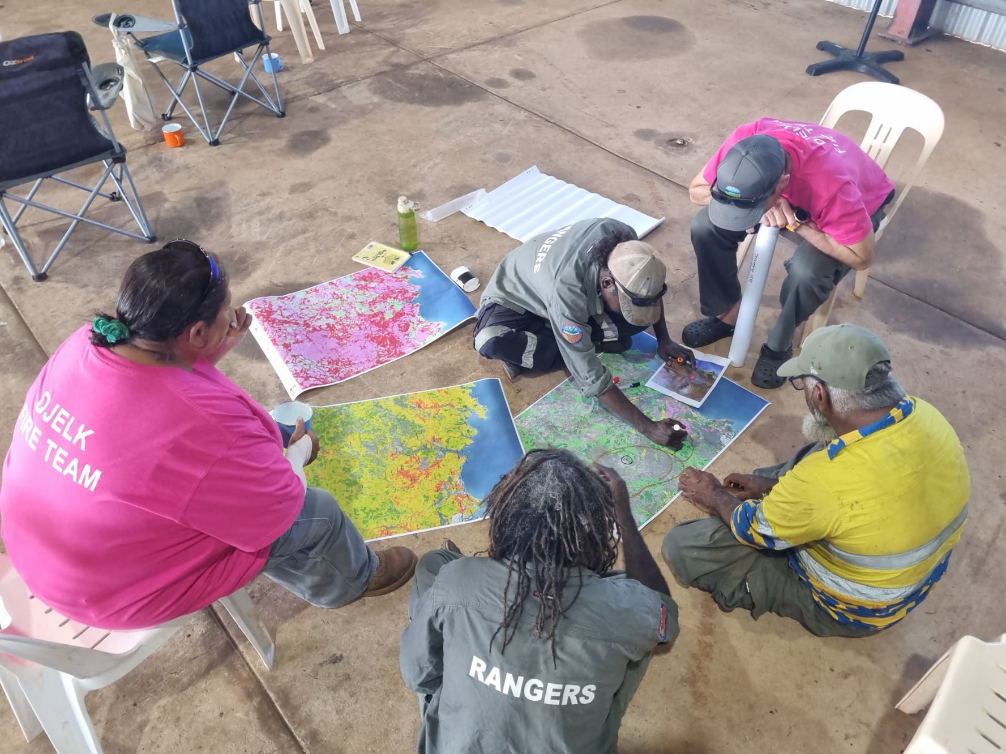
Challenges and Opportunities
Cultural views: fire = men’s work.
Limited funding/staffing capacity.
Physical demands + ill-fitting equipment.
More women in fire roles than ever before.
Participation in decision-making increasing.
Inclusive training & planning.
Strong support from male rangers & leadership.
Notes:
Joyce/Steph
Joyce has few direct challenges as coordinator, but is very well supported by the Djelk ranger manager.
She uses constructive feedback to support on the job teaching moments and encourage resilience and self pride in younger girls.
Funding capacity limits recruitment of rangers – but this is for both men and women
Traditional views still play a major part in the wider acceptance of women in fire. But these views are slowly changing the more women are involved and prove their abilities.
Women are actively participating more in decision making surrounding fires and within the Djelk rangers have excellent support from their male colleagues.
Equipment, gear and the physical demands of fire work in Arnhem remain a challenge, however the use of appropriately fitted gear, and the understanding of fatigue and physical capabilities boosts womens confidence and encourages them to continue to get involved where and when they can.

Slide 15
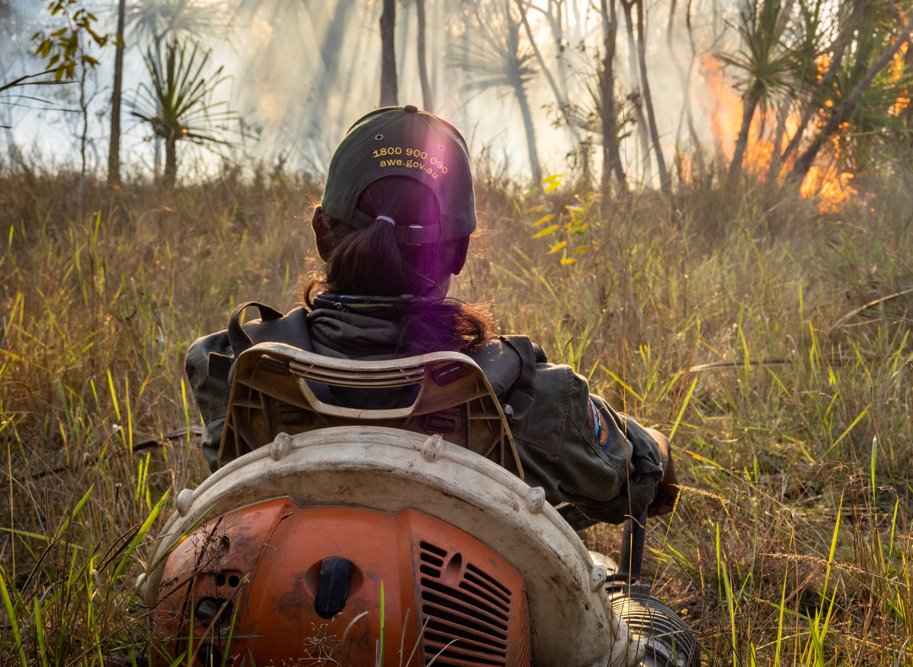
Conclusion
Meaningful shift in women’s fire roles.
Cultural + contemporary skills = stronger workforce.
Female trainers and mentors vital.
Integration enriches fire management & cultural leadership.
Notes:
- The journey of Indigenous women’s involvement in fire management in Arnhem Land reflects a meaningful shift from traditional roles toward greater inclusion, leadership, and cultural empowerment.
initiatives led by the Djelk Rangers and supported by partnerships such as ALFA, women have gained access to training, mentoring, and career pathways that respect both cultural values and contemporary fire management practices.
challenges remain—including cultural stereotypes, funding constraints, and physical demands—ongoing efforts to create safe, supportive, and flexible work environments have allowed growth and confidence among women rangers.
The increasing presence of female trainers, Indigenous coordinators, and strong role models is crucial in sustaining this positive momentum.
Ultimately, the integration of women into fire management not only enriches the ranger workforce but also strengthens cultural leadership and connection to country, ensuring a more inclusive and resilient future for fire and land stewardship in Arnhem Land.

Slide 16
#WAFA25
Indigenous Women Stepping Up:
Empowering the Next Generation in Arnhem Land Fire Management
THANKYOU!
QUESTIONS?
Joyce Bohme– Djelk Rangers
Email: rangerwomens.supervisor@bawinanga.org.au
www.bawinanga.com/what-we-do/bawinanga-rangers
Steph King – ALFA NT
Email: stephanie.rouse@alfant.com.au
www.alfant.com.au

