Slide 1
Welcome
Fall 2026 Referee Orientation

Slide 2



Slide 3
Meeting 2026 Agenda:
This season’s point of emphasis:
1. Vision
2. Managing the game
3. Rule changes
4. The 2-man system
5. Fall schedule

Slide 4
1. Vision
Sporting LS Vision
  The primary vision of Sporting Lee’s Summit is to provide our players with soccer programs that teach fundamentals and encourage player development in a fun, supporting environment.

Slide 5
1. Vision
Sporting LS Vision
  The primary vision of Sporting Lee’s Summit is to provide our referees with soccer programs that teach fundamentals and encourage referee development in a fun, supporting environment.

Slide 6
1. Vision in reality
To provide supportive environment so when you get to college, you can make your spending money by refereeing soccer.
Mr. Andrew Nitsche

Slide 7
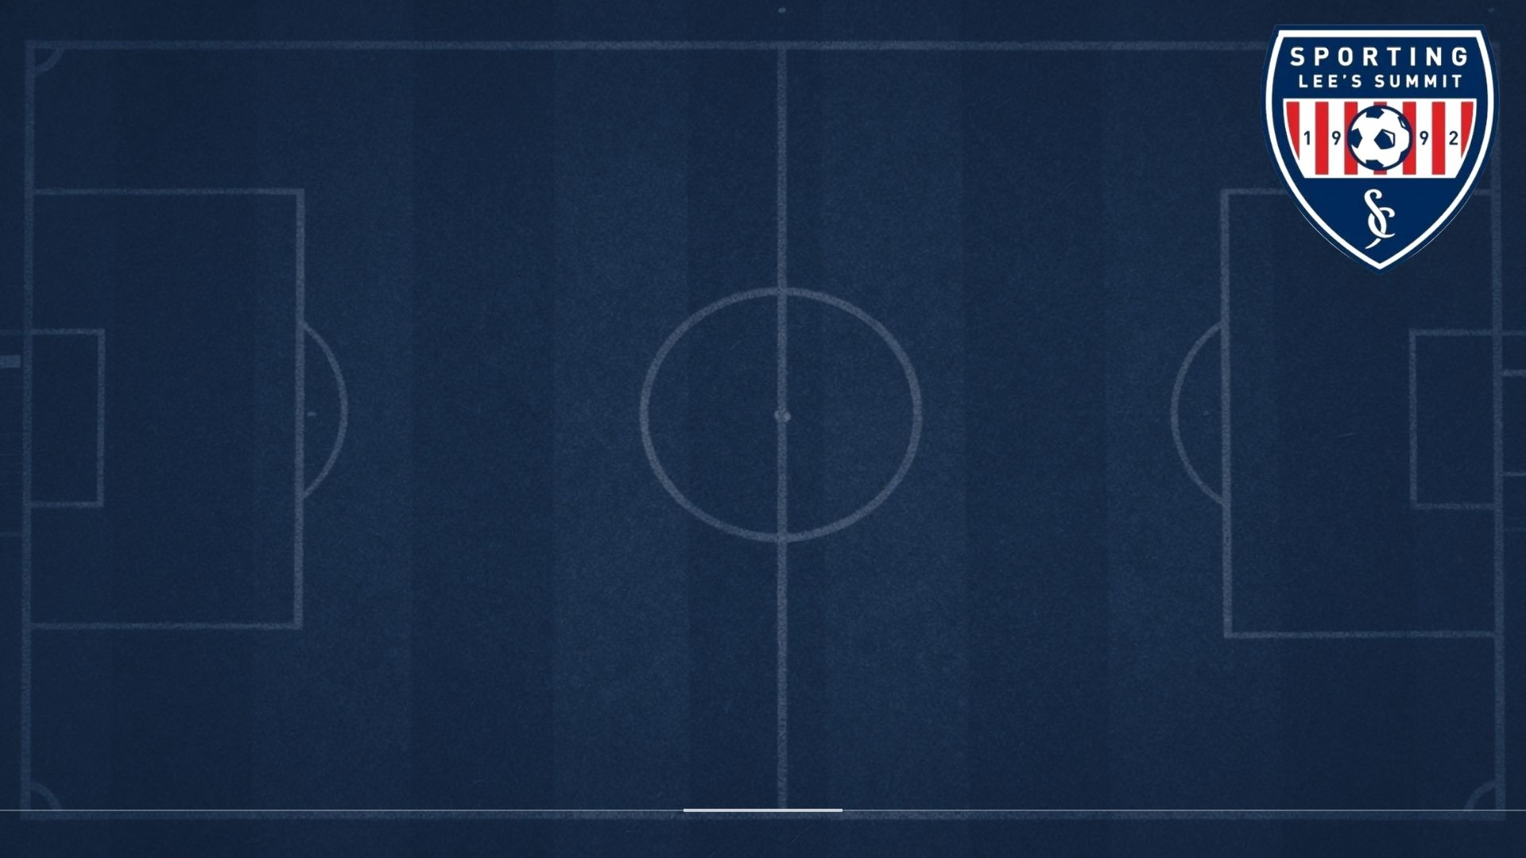
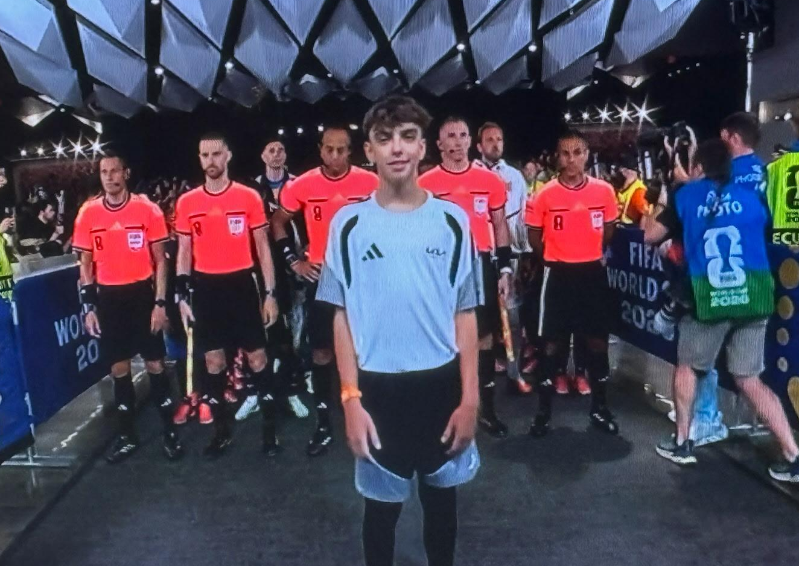
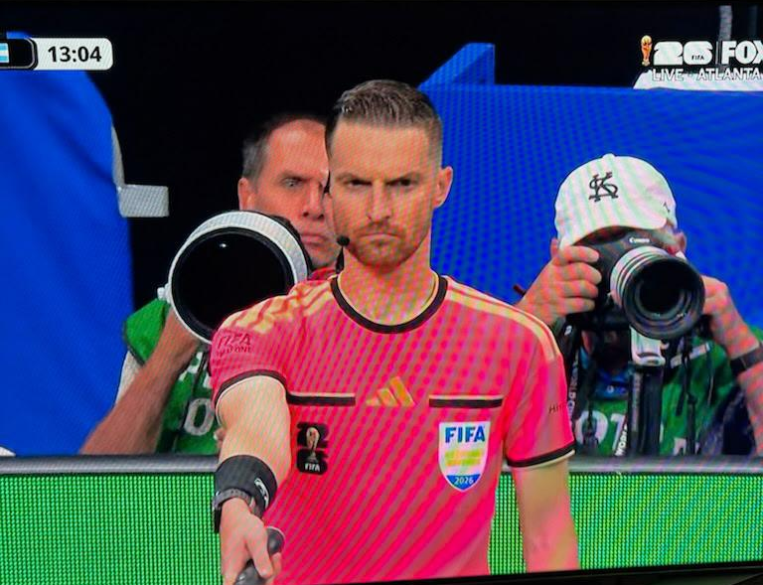
4. 2-man system
images

Slide 8
Scheduling and pay process

Slide 9
Scheduling and pay process
Availability is expected by Sunday night—best practices
Any changes to availability after submitting—text Art
Schedule is posted on Tuesday-later when tournaments

Slide 10
Scheduling and pay process
When posted, an email will be sent out and availability for next week of games will be open
Check schedule and text Art acceptance of assignments Wednesday 9pm. It is your responsibility, Art should not have to text you

Slide 11
Scheduling and pay process
If something changes in your ability to attend games, contact immediately up to 7am of game day. That day, contact check-in
If running late, text person checking in
Pay scale & pay dates are on referee payroll tab. Paperwork must be submitted to get paid timely

Slide 12
2. Managing the game
Get parents and coaches on your side
look sharp, strong signals, hustle,
explain fouls

Slide 13
2. Managing the game
“Ask, Tell, Dismiss” has evolved to
Warn, Caution, Dismiss

Slide 14
2. Managing the game
“Ask, Tell, Dismiss” has evolved to
Warn, Caution, Dismiss
Q: Does ‘Warn, Caution, Dismiss’ work with
players also?

Slide 15
2. Managing the game
“Ask, Tell, Dismiss” has evolved to
Warn, Caution, Dismiss
Q: Does ‘Warn, Caution, Dismiss’ work with
players also?
Yes! Communication… with captain, players & substitutes

Slide 16
2. Managing the game
“Ask, Tell, Dismiss” has evolved to
Warn, Caution, Dismiss
Q: How do I manage the game as an
Assistant Ref?

Slide 17
2. Managing the game
“Ask, Tell, Dismiss” has evolved to
Warn, Caution, Dismiss
Q: How do I manage the game as an
Assistant Ref?
Communication… with referee & players, eye contact, signals, position & hustle.

Slide 18
2. Managing the game
Support structure at Legacy:

Slide 19
2. Managing the game
Support structure at Legacy:
On game day
Fellow referees, referee mentor/referee monitor, field marshals, check in/out person
Recognize early if pennies or alternate ref jerseys are needed

Slide 20
2. Managing the game
Support structure at Legacy:
After game day (if follow up is needed)
Dave Lammers, Art, Sporting LS Board

Slide 21
Referee abuse prevention
USSF will not allow abuse.
Policy instituted last season.
Sporting LS Board has your back.

Slide 22
Referee abuse prevention
USSF will not allow abuse.
Policy instituted last season.
Sporting LS Board has your back.
Your responsibility: online report, supplemental reports with CR & AR names, photo of game card, team names, which coach, players # involved.

Slide 23
Referee abuse consequences
Dave Lammers will follow-up with referees, Art & Lucy will assist.
Sporting LS Board will review and decide how to proceed.

Slide 24
Referee abuse consequences
 | ATHLETIC STAFF AND VOLUNTEER ABUSE PREVENTION MATRIX
Level | NON-PHYSICAL* of gross misconduct, abuse, and/or assault | Min. Games | Time |  | KEY PENALTY FACTORS
1 | Insulting, Belittling, Insinuating, or Taunting Behavior Undermining Athletic Staff or Volunteer Authority | 1 |  |  | * Single offenses are at a minimum the prescribed game penalty or time penalty for non red zone offenses
2 | Harassment, Intimidation, Retaliation, Abusive, or Threatening (non-physical) Language | 2 |  |  | * Penalties can be both game and time depending on severity / circumstances
3 | Aggression, Attacking, Derogatory, Cyberbullying, Doxing or Threatening (Physical/Violence) Language | 6 |  |  | * Second time offenders receive double punishment.
4 | Offensive or Discriminatory Act | 10 |  |  | * Third time offenders receive a lifetime ban.
 |  |  |  |  | * More than one offense at the same time is at least the punishment for the most serious offense.
 | PHYSICAL* of gross misconduct, abuse, and/or assault | Min. Games | Time |  | * Offenses against minors who are athletic staff and volunteers may be subject to a "minor multiplier" resulting in up to triple punishment.
1 | Minor or Slight Deliberate Touching | 3 |  |  | * Optionality for 50% penalty for first offense from a minor.
2 | Pushing, Grabbing, Pulling, Squeezing, Pinching, Use of Object in Non Striking Manner, or Physical Property Damage | 10 | 12 mo |  | Law Enforcement: initial call will receive a 2-game suspension, penalty will be more severe if trespass citation is issued (6 games)
3 | Hitting, Punching, Elbowing, Kicking, Slapping, Biting, Spiting, Choking, Tackeling, Throwing or Use of Object or Any Part of Body (Forearm, Knee, Head) in a Striking Manner |  | Lifetime
 | *Disclaimer: These are only a few examples of abuse - other actions or statements may also fall into this category.

Slide 25
Coaches code of conduct
All Sporting LS coaches are expected to sign and adhere to the code

Slide 26
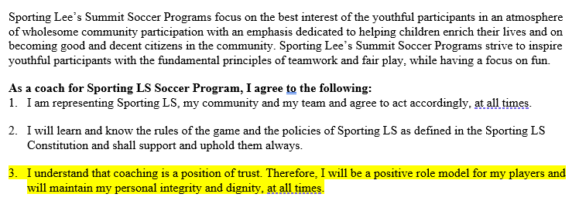
Coaches code of conduct

Slide 27
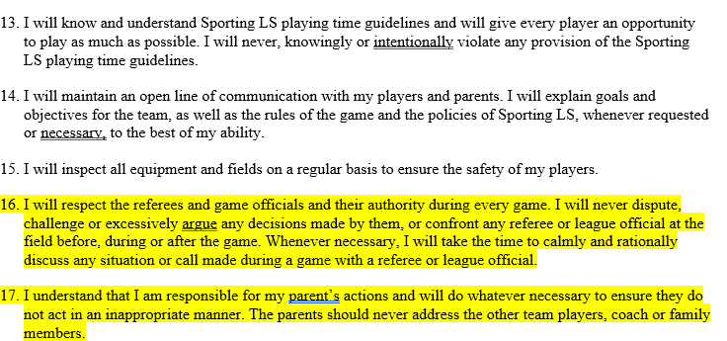
Coaches code of conduct

Slide 28
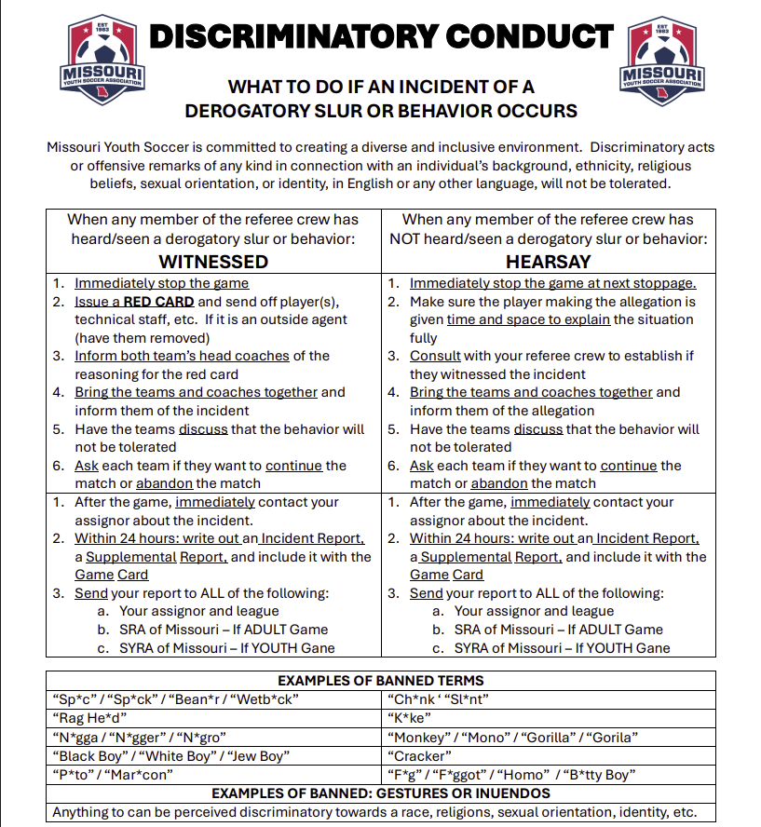
Discrimination policy

Slide 29
Discrimination policy
MYSA now requires form to be submitted for any transgression in an affiliated game.

Slide 30
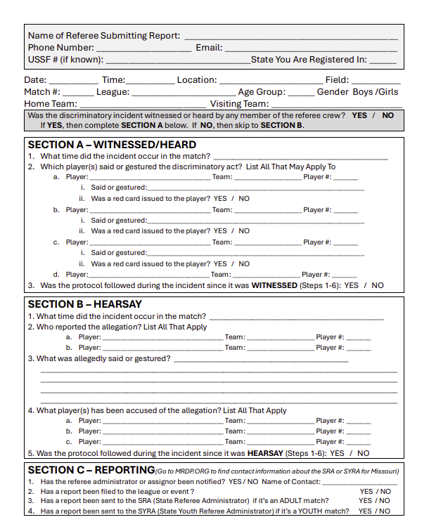
Discrimination policy

Slide 31
3. Rules Changes
US Soccer federation
www.ussoccer.com/laws-of-the-game-changes

Slide 32
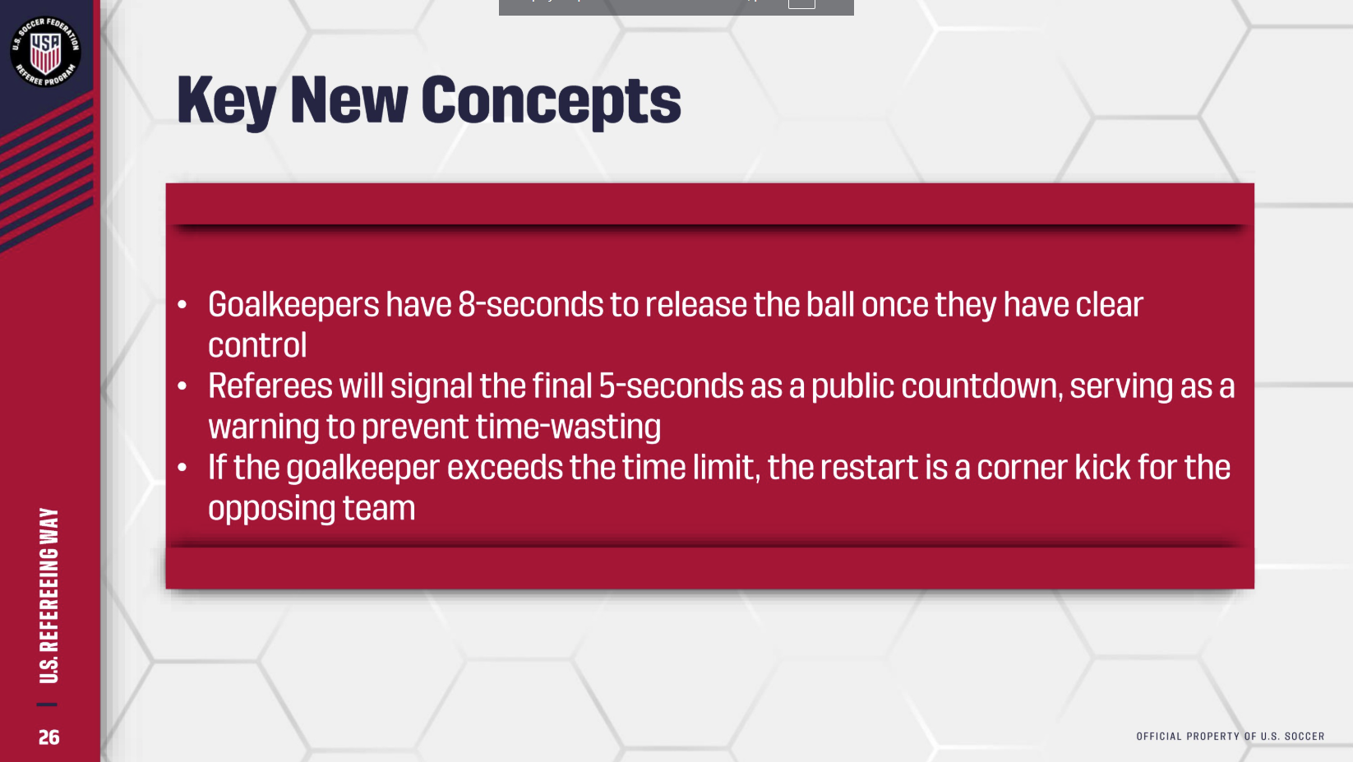

Slide 33
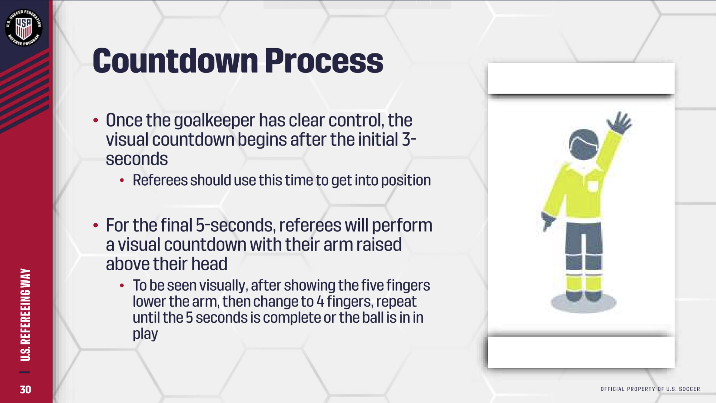

Slide 34
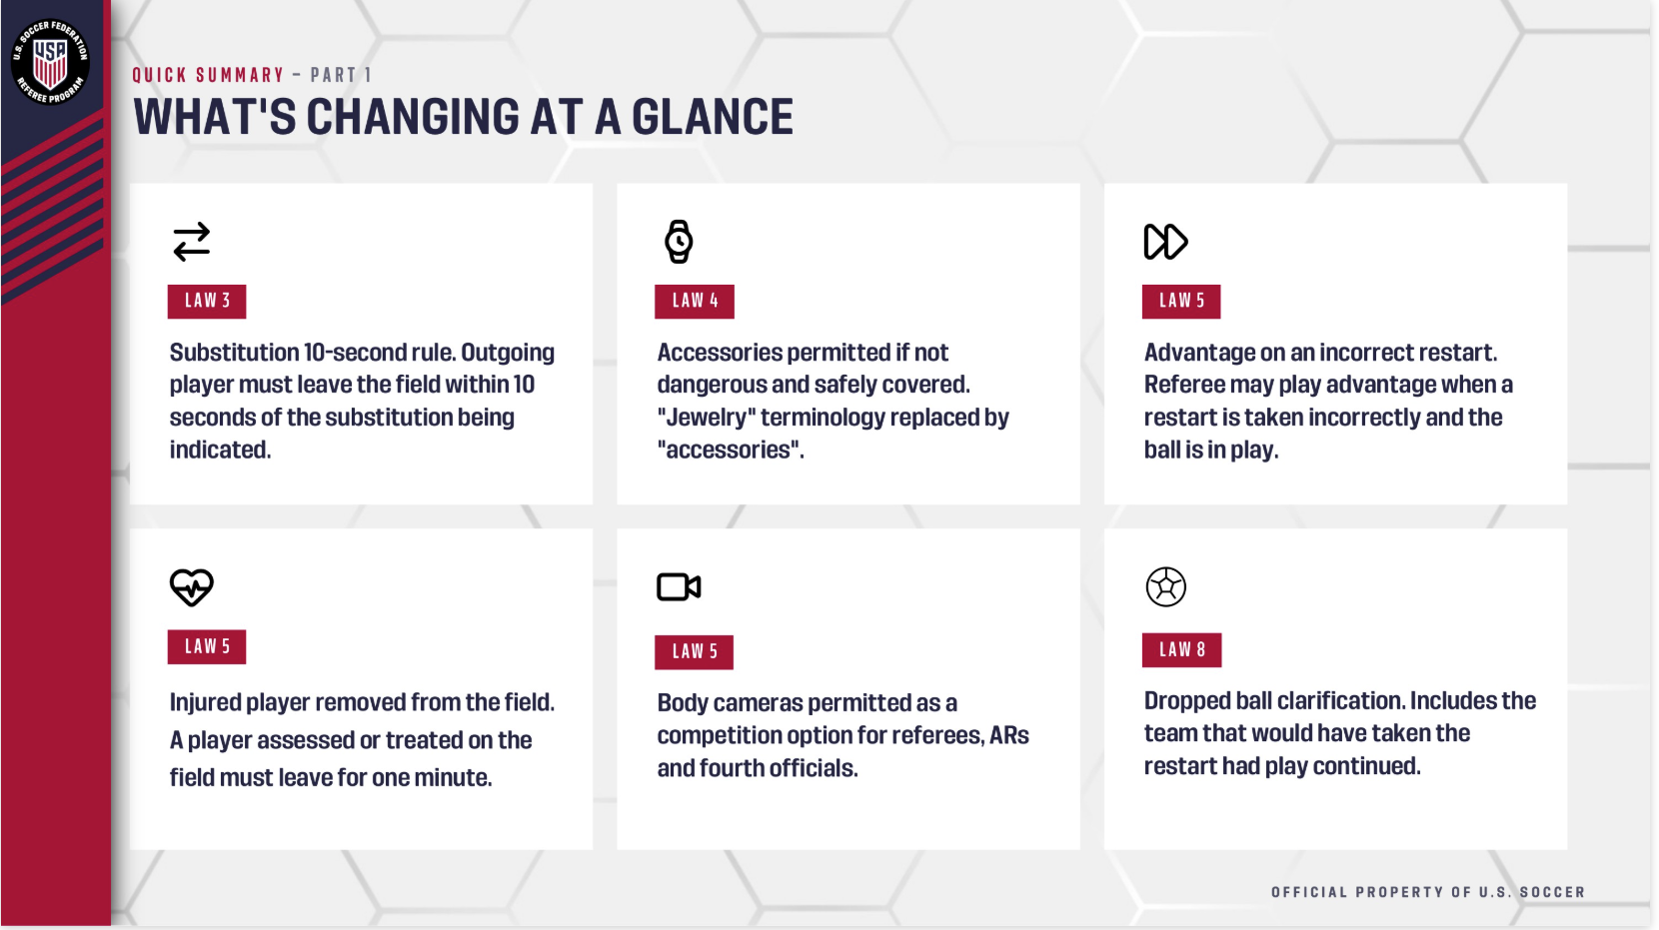

Slide 35
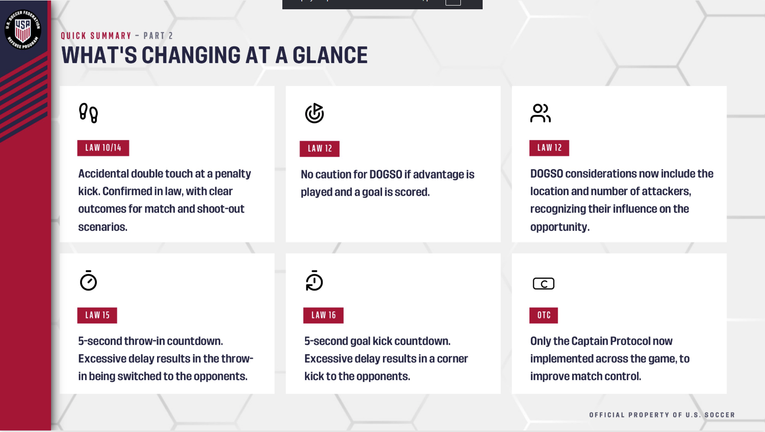

Slide 36
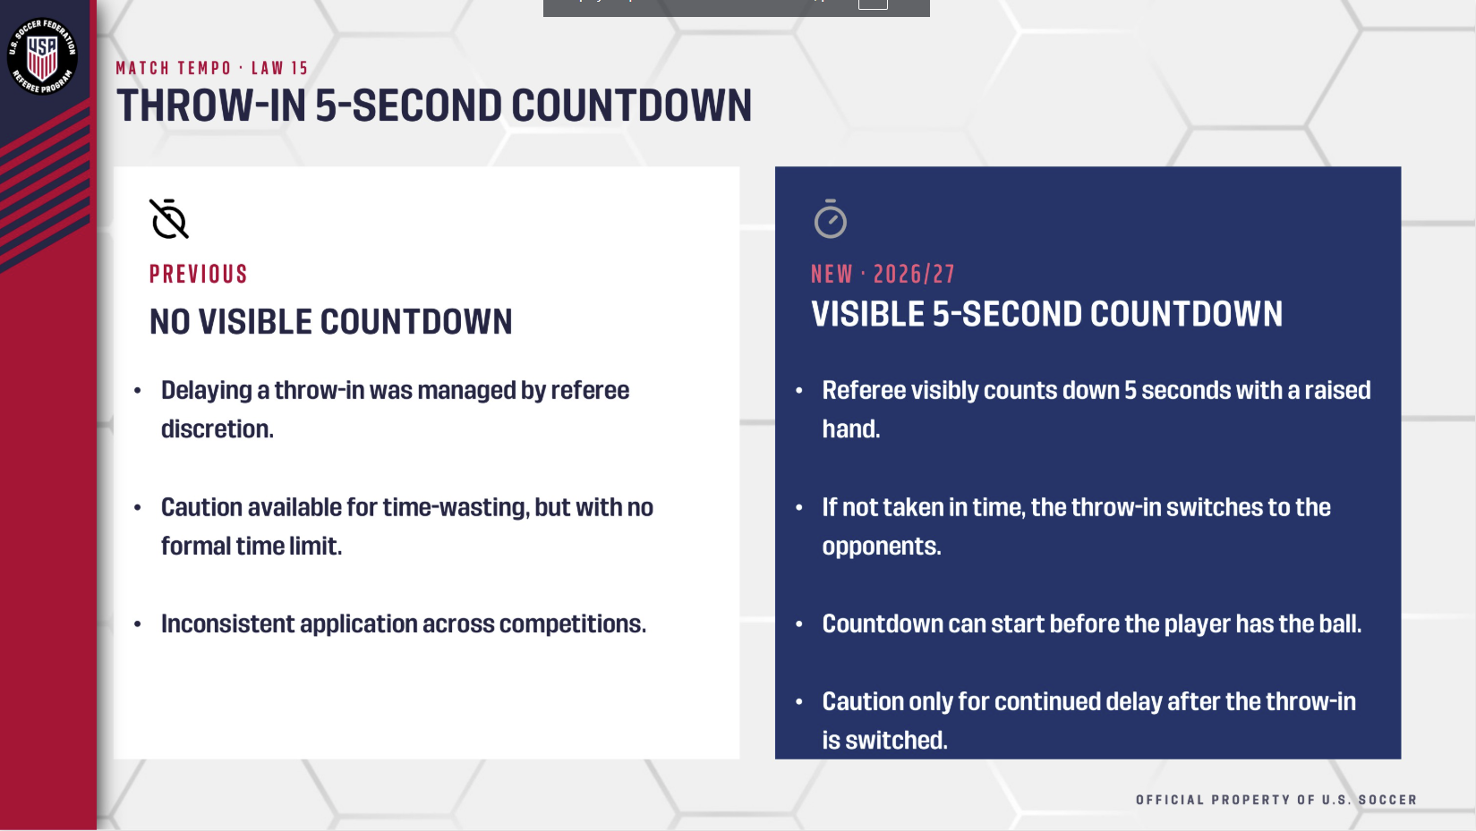

Slide 37
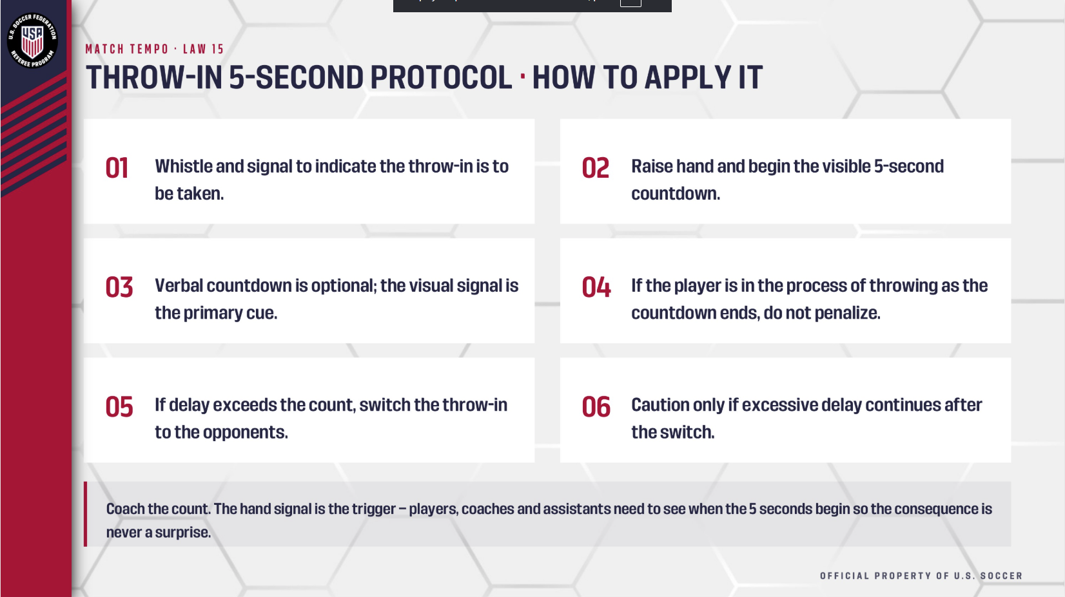

Slide 38
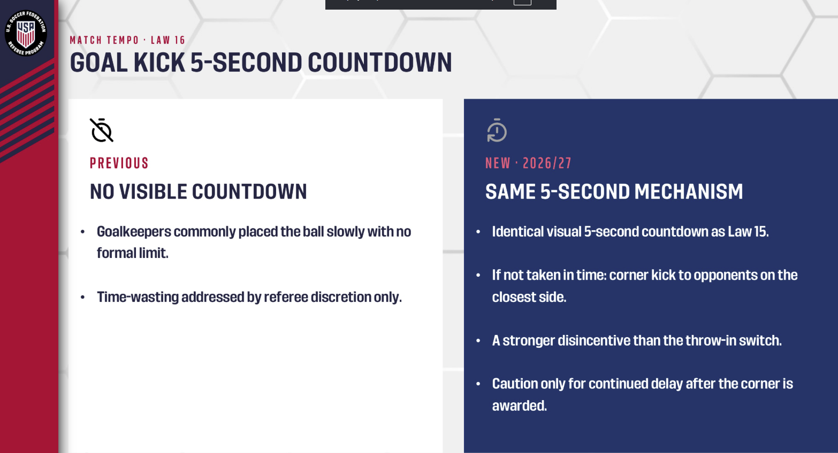

Slide 39
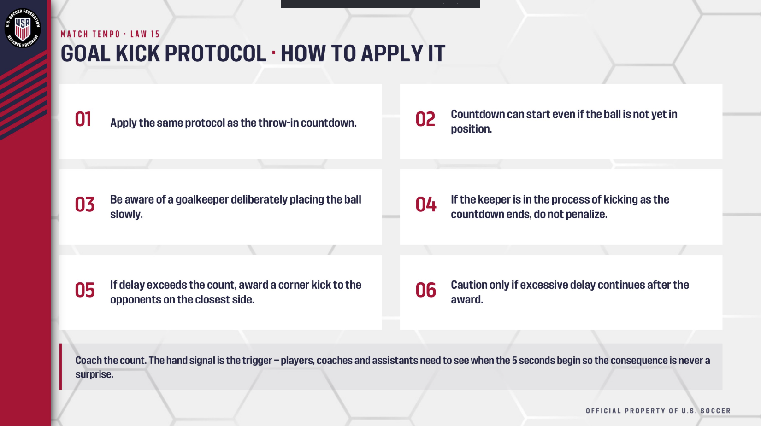

Slide 40
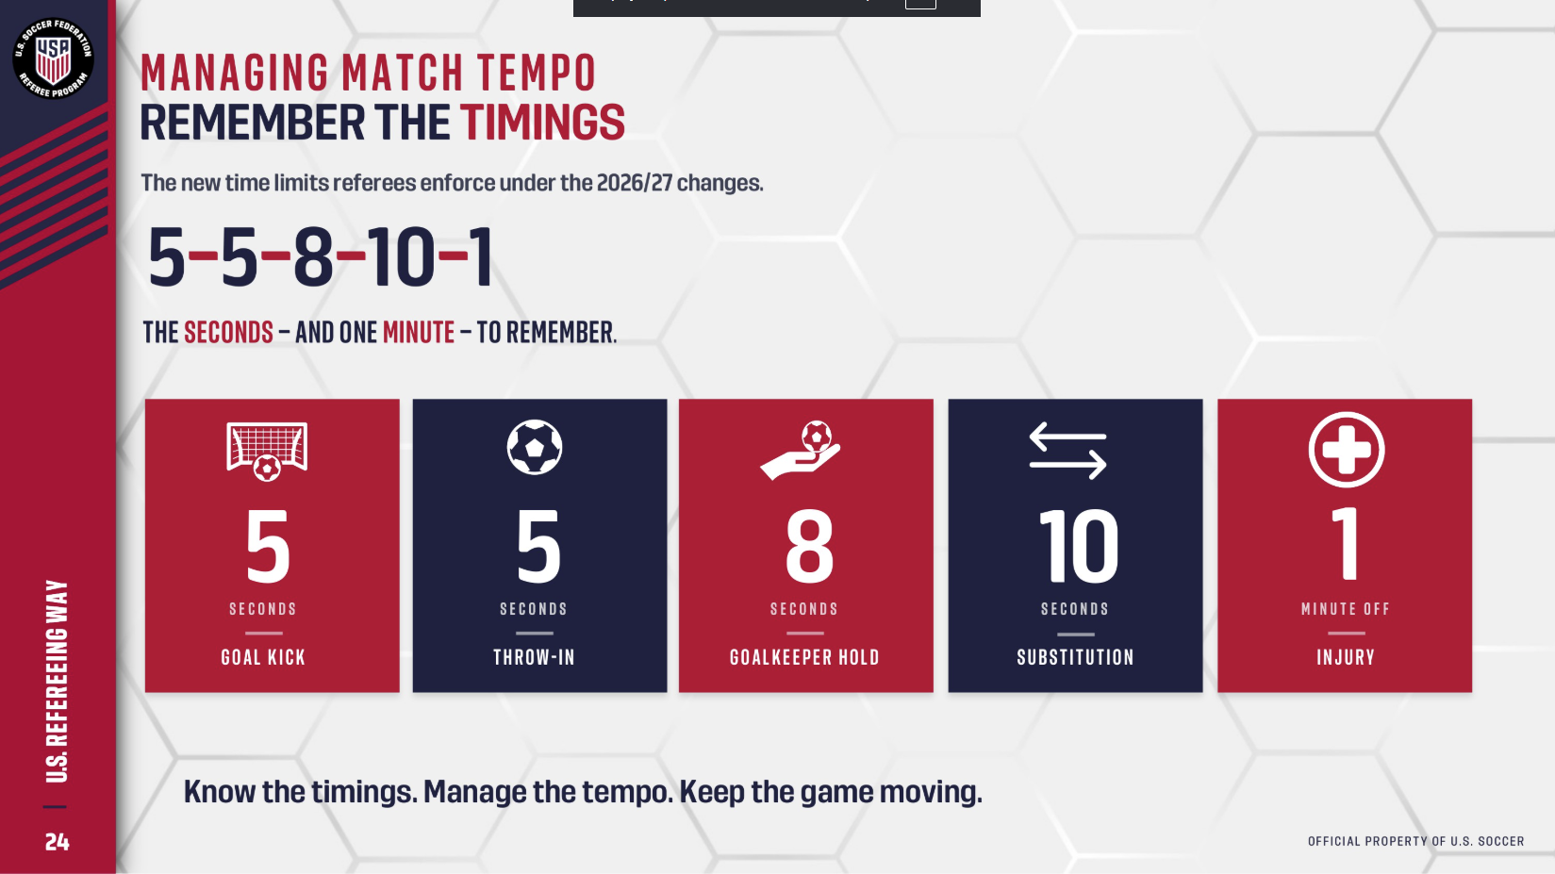

Slide 41
3. Rules Changes at Legacy
Important:
At Legacy we will enforce for only
5/6th grade games & above:
8 second count for goalies
5 second counts for goal kicks & throw-ins

Slide 42
4. The 2-man system
1st & 2nd grade

Slide 43
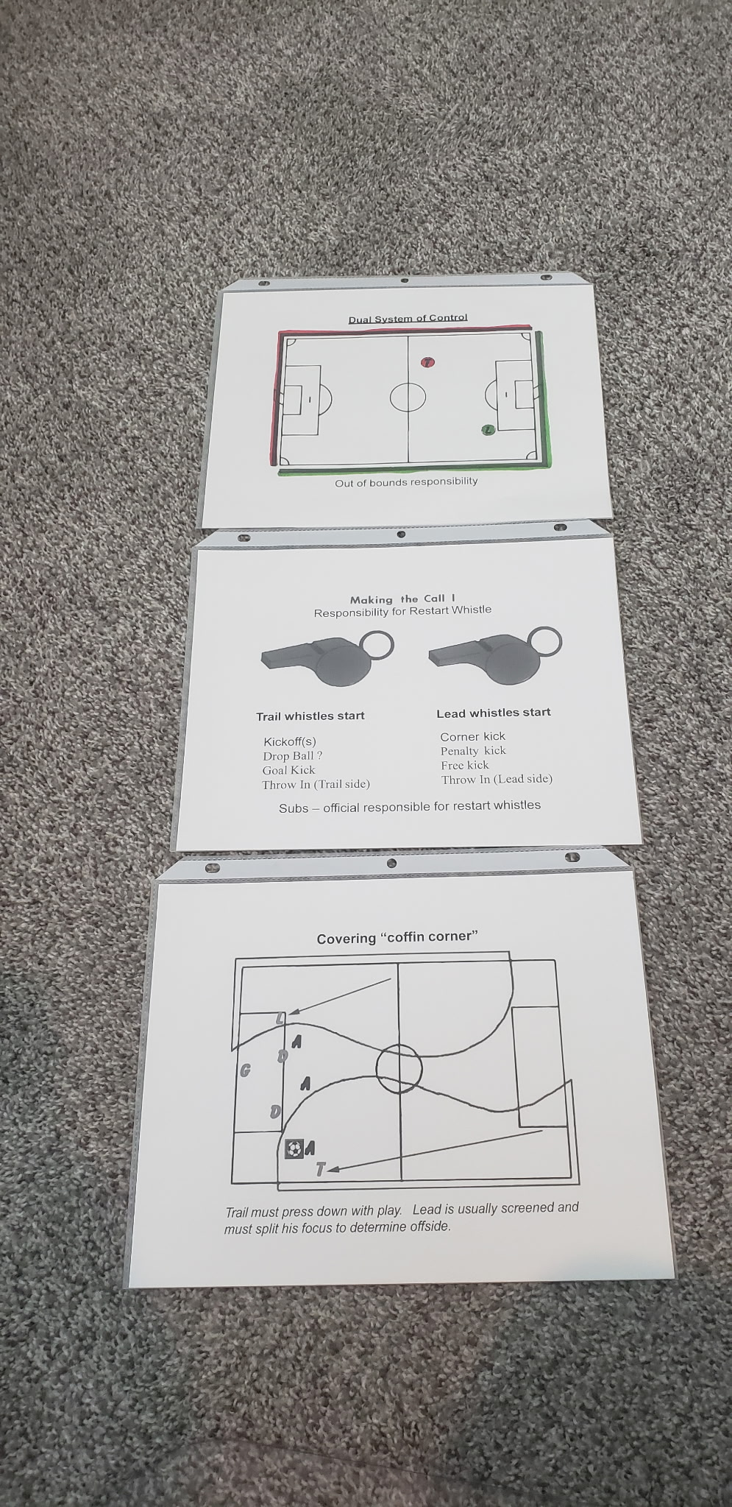
Dual System of Control

Slide 44
Making the Call

Slide 45
Covering ‘Coffin Corner’

Slide 46
5. Fall schedule
Sporting LS willingly invests time and money to support the development of referees at Legacy as discussed earlier.
Please consider Legacy your home base for your career.

Slide 47
5. Fall schedule (times)
Saturday 8am – 4pm (3v3 to middle school)
Sunday 2pm – dark (high school and adult)

Slide 48
5. Fall schedule (dates)
Weather makeup dates
Sunday Sept 13
Sunday Sept 27
Sunday Oct 11

Slide 49
5. Fall schedule (dates)
Tournament dates
Challenger competitive tournament September 25,26,27
Season end recreational tournament
October 16,17,18

Slide 50
5. Fall schedule (dates)
Tournament dates
Challenger competitive tournament September 25,26,27
Season end tournament
October 16,17,18
No games Labor Day Weekend (Sept. 4-6)

Slide 51
6. Closing
Hustle, know the rules, have fun!
www.ussoccer.com/laws-of-the-game-changes

Slide 52
6. Closing
Hustle, know the rules, have fun!
www.ussoccer.com/laws-of-the-game-changes
Prepare your referee kit (bag) ahead of time.
Put your availability in for August 22 weekend.

Slide 53
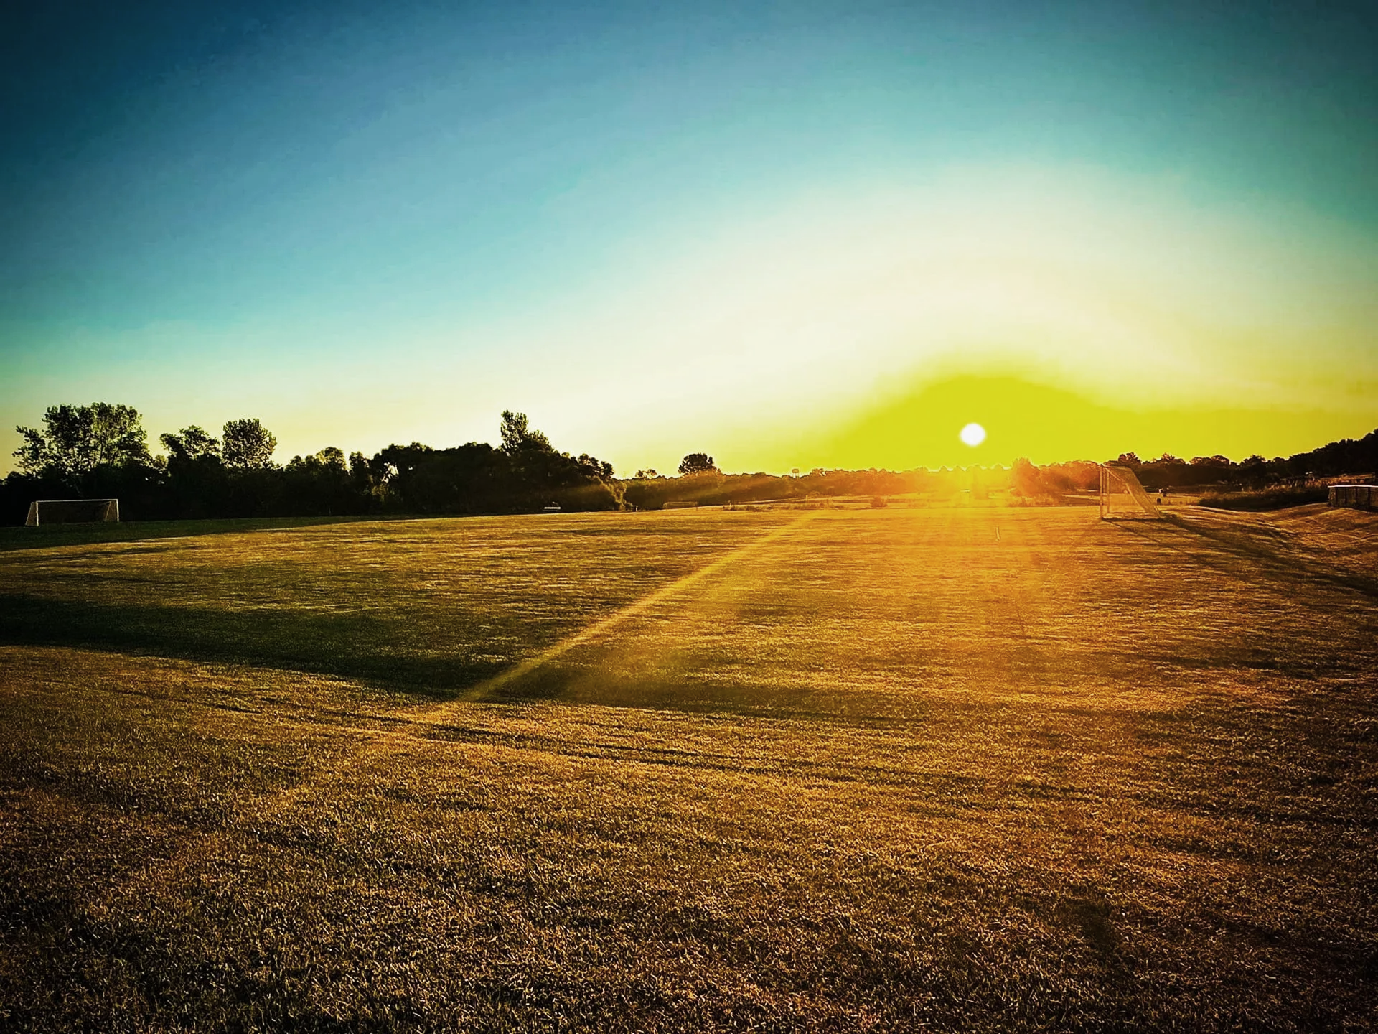
Thank you! Have a great season!

