Slide 1



Slide 2
Match Info
Equipment Necessary:
  Size 4 Soccer Ball
  Cleats (no toe cleats as is present in football and baseball cleats – player safety)
  Shinguards (to be worn under socks)
Field Dimensions
  25 yards wide x 35 yards length
Goal Dimensions
  12 feet wide x 6.5 feet tall

Slide 3
Pre-Game Process
HOME team will wear BLUE uniform
AWAY team will wear WHITE uniform
We recommend arriving 20 minutes before your scheduled kick-off time.
Warm-ups should include stretching, players with a ball dribbling, practicing attack moves, passing, and shooting
Team benches will be on the opposite side of each other. Parents will be on the same side as their team bench. (Home team will choose side unless they are not at field 20 minutes prior to game or when the field clears from previous game. We ask that you conduct yourself in a positive manner even if you don’t get your way on which side your team sits. The games slots are an hour long and we can endure for an hour.)
Do not set up too close to the field. The players need space on the outside of the field for safety. Minimum 4 feet from field as space allows)
  Please mind players placing water bottles near the field (rolled ankle hazard)

Slide 4
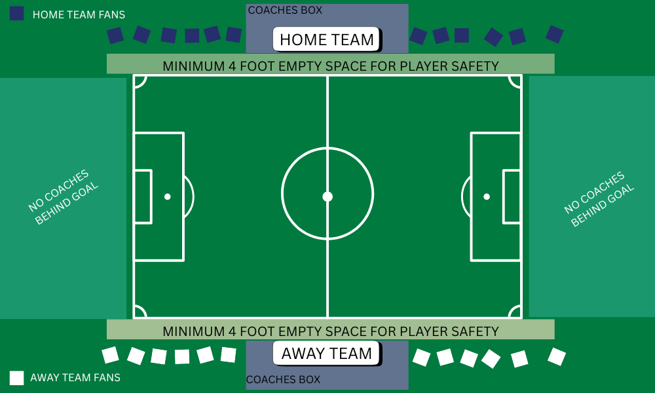
Field Arrangement

Slide 5
Game Flow
5v5 (4 field players with 1 goalkeeper on each team)
3 periods of 15 minutes each. (2-minute water break between each period)
There will be no throw-ins – There are kick ins for throw-ins, corner kicks, and goal kicks.
  Players have 5 seconds to make the decision to keep the game flowing
  Goals cannot be scored directly from a kick-in (throw-in)
  Goals CAN be scored from goal kicks and corner kicks
  Second half of season, league play will transition to throw-ins.
Players must retreat to their own half on goal kicks. Once the ball is played, the players can pressure the ball
One coach per team can act as referee and be on the field during the game. All other coaches must remain in the coaches’ box.
  During the second half of the season, coaches will not be on the field, but will officiate from the sideline.
Teams will switch sides at the end of each period.
All players should receive equal playing time (regardless of skill level) – Coaches should act at their discretion for playing time regarding effort.

Slide 6
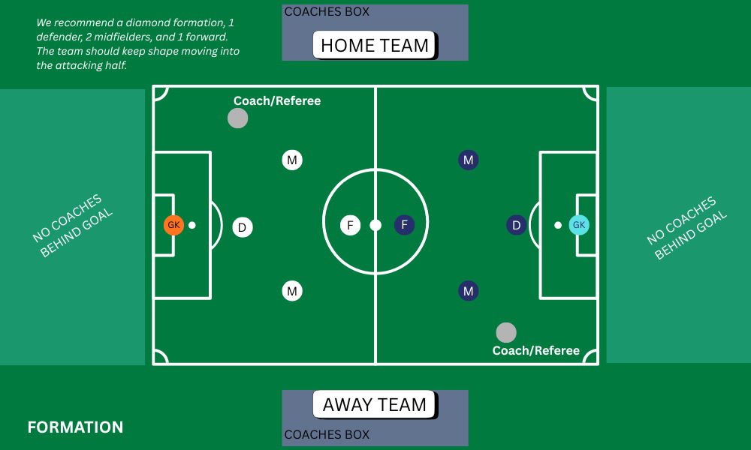

Slide 7
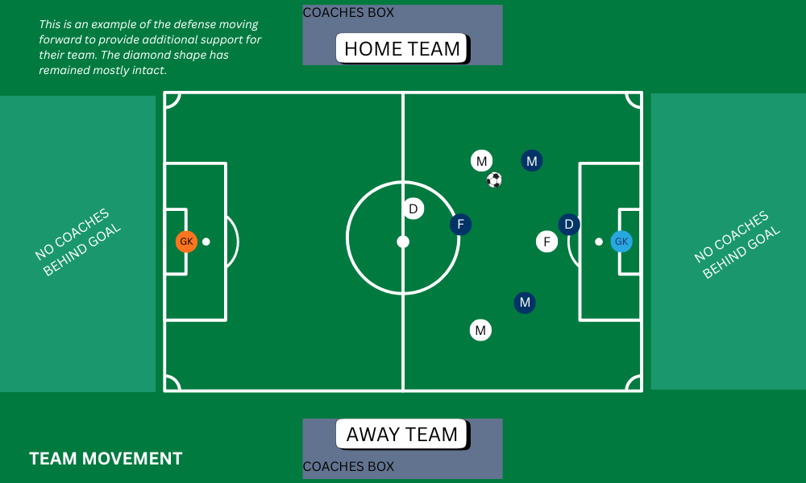

Slide 8
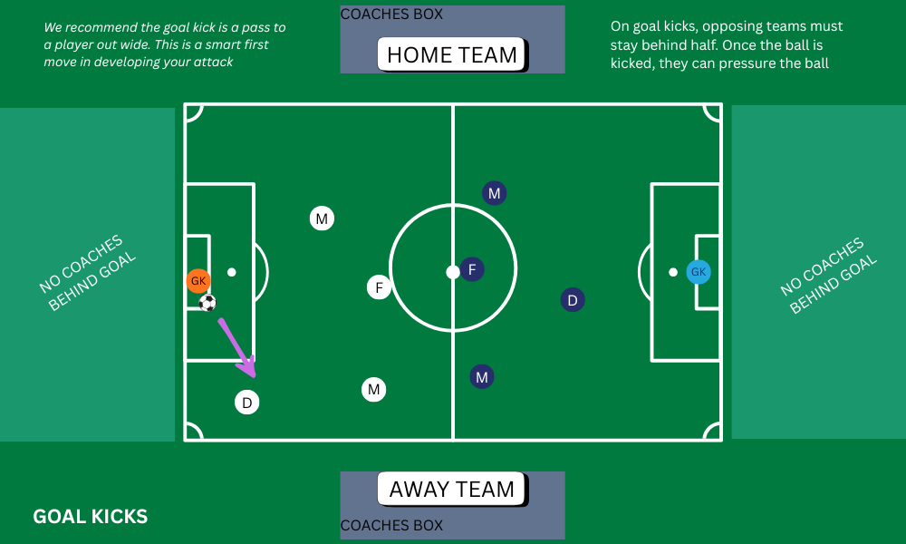

Slide 9
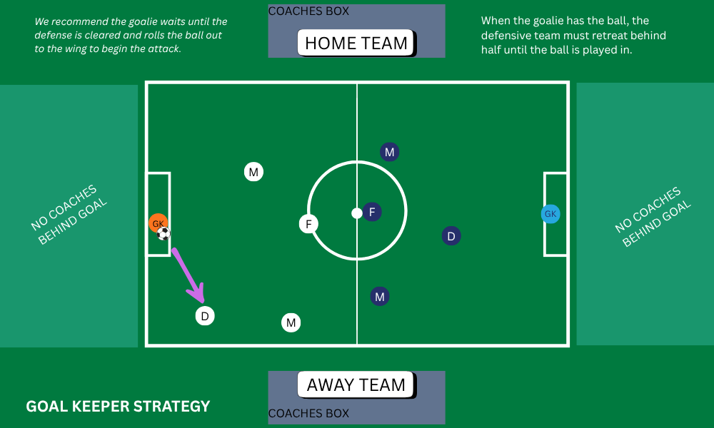

Slide 10
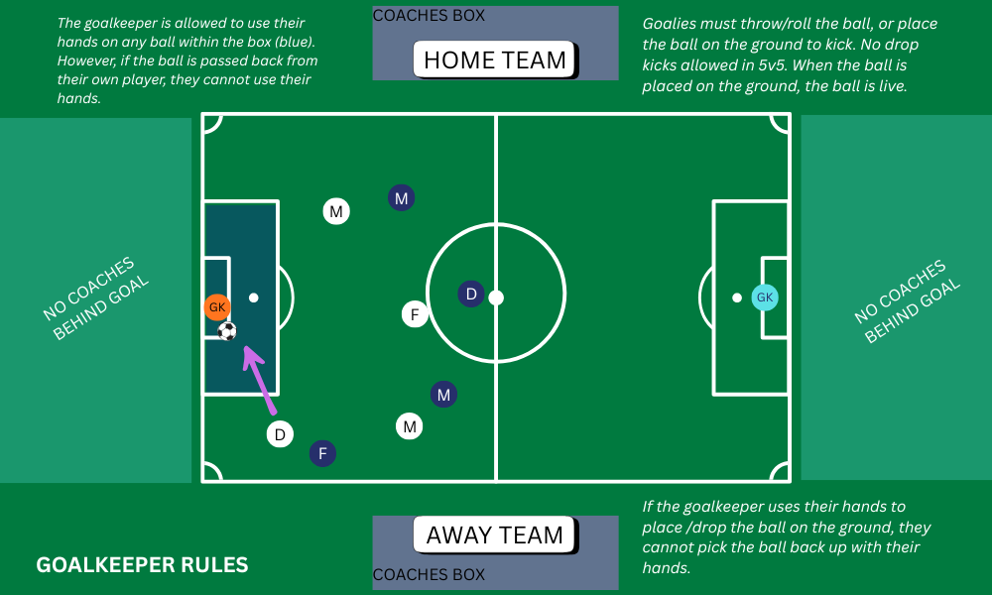

Slide 11
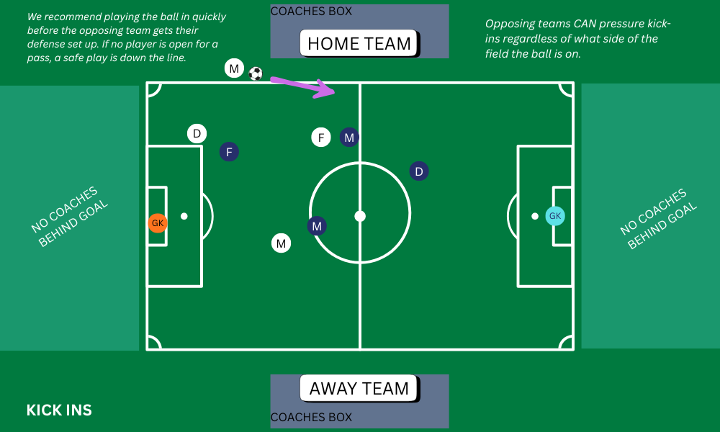

Slide 12
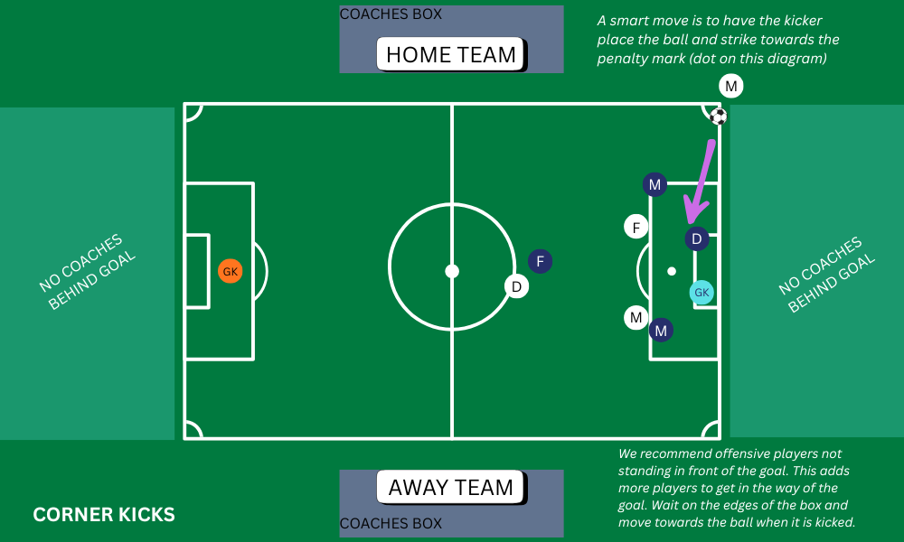

Slide 13
Post Game
Please have all players line up ready to shake the other team’s hands (high fives/fist bumps)
Parents are welcome to form tunnels for players to run through. (Click here to see example)
Once you have completed the tunnel, please clean up your side and leave the field to allow other teams with games after you to set up and get their players warm.
Any postgame talk by the coaches should not be completed on the sidelines, but instead in an area off to the side where players can meet you.
Please submit scores. The league is not worried about wins and losses nor exact scores. We do want to know if the games are evenly matched though. For the best experience, we want to make sure the second half of the season is re-seeded so that each player gets to have fun competition instead of having lopsided matches.

Slide 14
Runaway Scoring
We do not want to have runaway scoring. This is when there is a large goal differential between one team and another. Placer Alliance defines runaway scoring at 6 or more goals.
  It is ok to make adjustments before the 6-goal differential.
Recommended Adjustments if your team is ahead
  Require additional passes before shooting.
  Require goals to be scored by one of your players only.
  Put weaker players in positions for success and stronger players in positions to support.
  Force players to score with their off-foot
  Force a goal to be scored only with a dribble
  Force a goal to be scored only from a certain distance away
  Make the goals be scored off of crosses only
  Allow the other team to bring on more players

Slide 15
Questions, Comments, Concerns
The league is here to help. If you are unable to resolve a conflict on your own, need assistance with practice plans, or have questions, feel free to reach out to recreation@rocklinfc.org. We will do our best to help!

