Slide 1


Slide 2

Equipment Necessary:
Size 3 Soccer Ball
Cleats (no toe cleats as are present in football and baseball cleats – player safety)
Shinguards (to be worn under socks)
Field Dimensions
25 yards wide × 35 yards long
Goal Dimensions
6 feet wide × 4 feet tall

Slide 3
Pre-Game Process
HOME team will wear BLUE uniform
AWAY team will wear WHITE uniform
We recommend arriving 20 minutes before your scheduled kick-off time.
Warm-ups should include stretching, players with a ball dribbling, practicing attack moves, passing, and shooting
Team benches will be on the opposite side of each other. Parents will be on the same side as their team bench. (Home team will choose side unless they are not at field 20 minutes prior to game or when the field clears from previous game. We ask that you conduct yourself in a positive manner even if you don’t get your way on which side your team sits. The games slots are an hour long and we can endure for an hour.)
Do not set up too close to the field. The players need space on the outside of the field for safety. (Minimum 4 feet from field as space allows)
  Please mind players placing water bottles near the field (rolled ankle hazard)

Slide 4
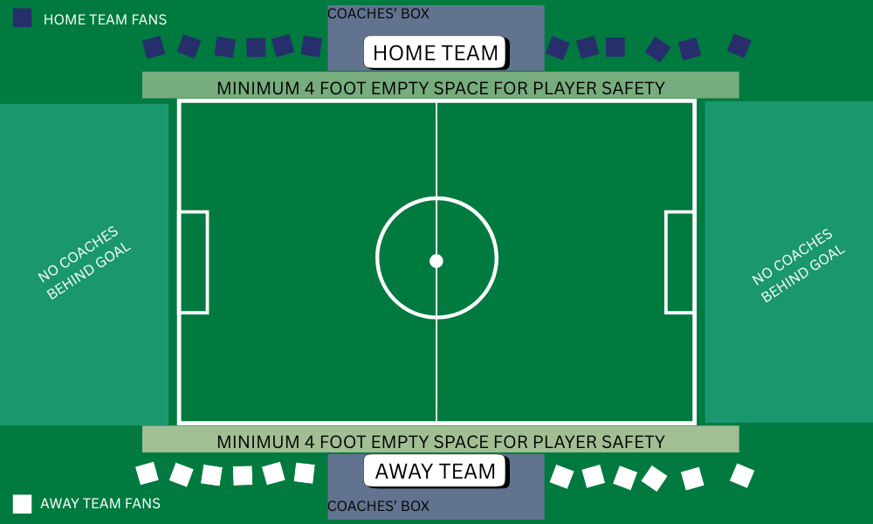
Field Arrangement

Slide 5
Game Flow
4v4 (4 field players – no goalkeepers)
4 periods of 10 minutes each. (2-minute water break between each period)
There will be no throw-ins – There are kick-ins instead (players place the ball on the ground where it went out of bounds and kick the ball back into play – The entire ball must cross the line for it to be out of bounds. If any portion of the ball is on the line, the ball remains in play)
  Players have 5 seconds to make the decision to keep the game flowing (a coach counting 1, 2, 3 kick – can help this a lot)
  Goals cannot be scored directly from a kick-in from sidelines
When a ball is kicked past the end line it will be a goal kick or corner kick, depending on which team kicked it out.
  Goals CAN be scored from goal kicks and corner kicks
  Players must retreat to their own half on goal kicks. Once the ball is played, the players can pressure the ball
One coach per team can act as referee and be on the field during the game. All other coaches must remain in the coaches’ box.
Teams will switch sides at halftime.
All players should receive equal playing time (regardless of skill level) – Coaches should act at their discretion for playing time regarding effort.

Slide 6
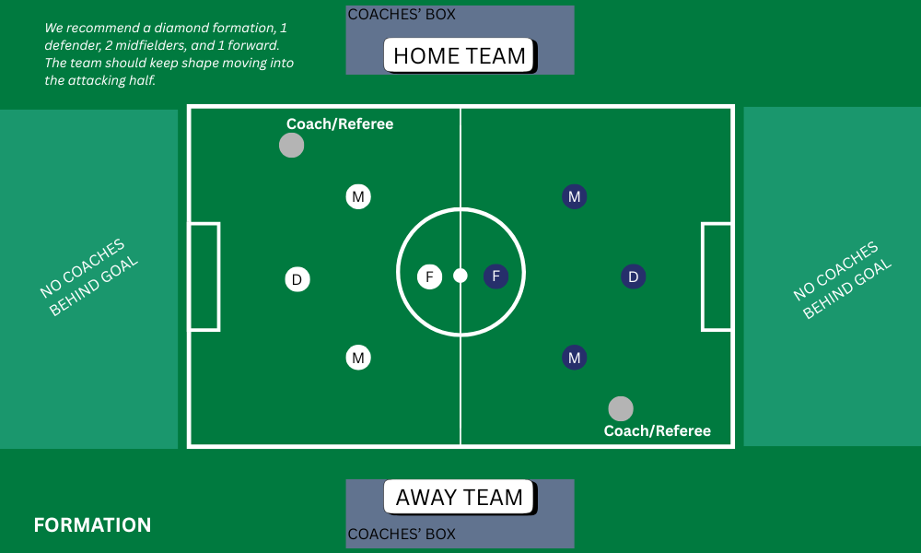

Slide 7
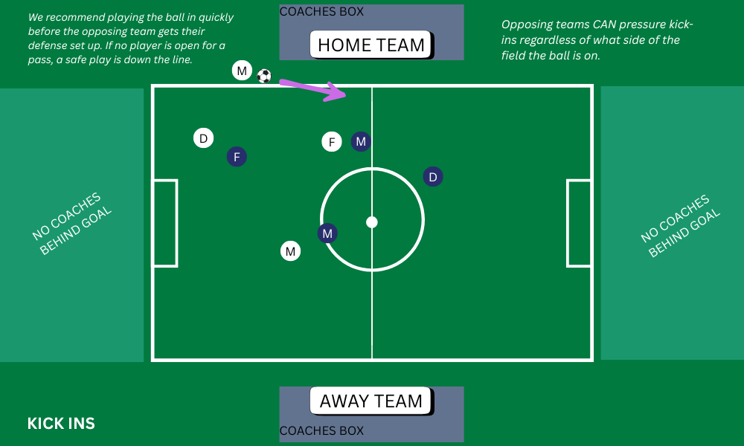

Slide 8
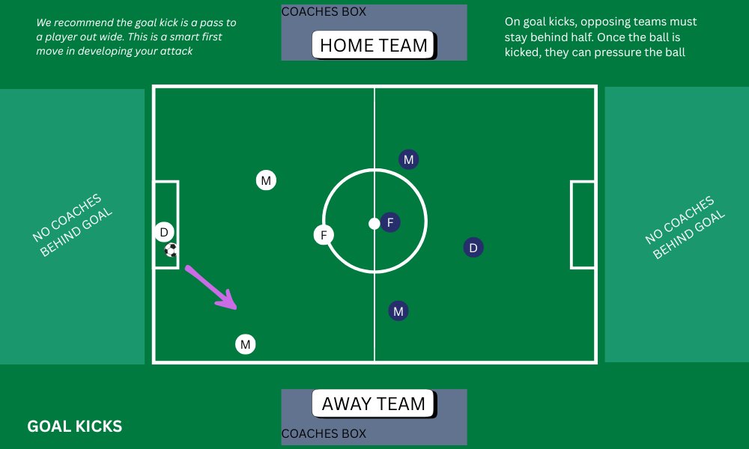

Slide 9
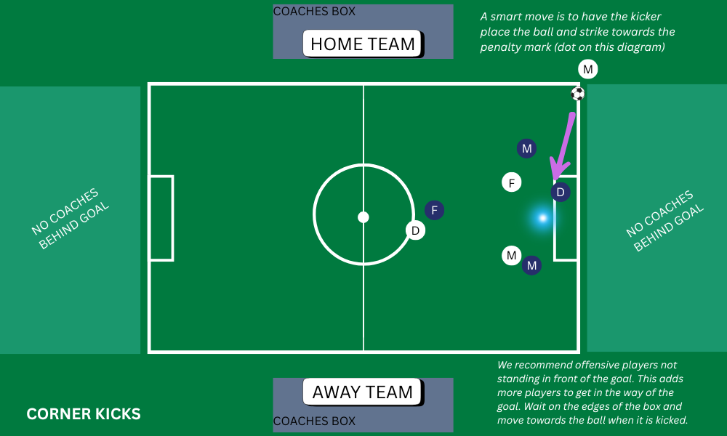

Slide 10
No De-Facto Goalkeepers
Players are NOT allowed to stand in front of the goal to act as a de-facto goalkeeper. The goal of the league is to provide intelligent development of game principles.
With a player standing in the goal (or “puppy-guarding”) they are learning to continually be out of position and not support their teammates in a good pass-receiving position. The defensive player should move forward with the ball to provide support should their teammate need a player to pass to.
We appreciate an understanding of the spirit of this rule. It is not “they are out of the goal box, it is fine.” The goal box is small in 4v4, and standing 3 feet from the goal is the same as standing in the goal.
We ask you to understand that this may result in more goals for the opponent. Both teams are playing by the same rules and while those who disregard this rule may have fewer goals against them in the short run, they are effectively robbing their players of a solid understanding of the fundamentals of the game.
Key Principle: Take away space from opposing players. You do not do this by standing your defender in the back.

Slide 11
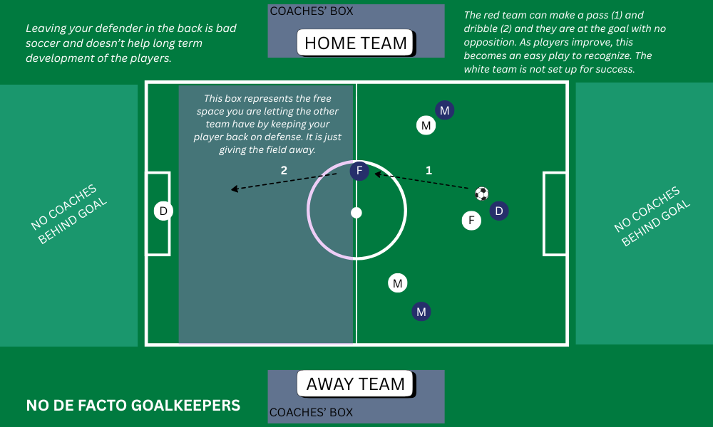

Slide 12
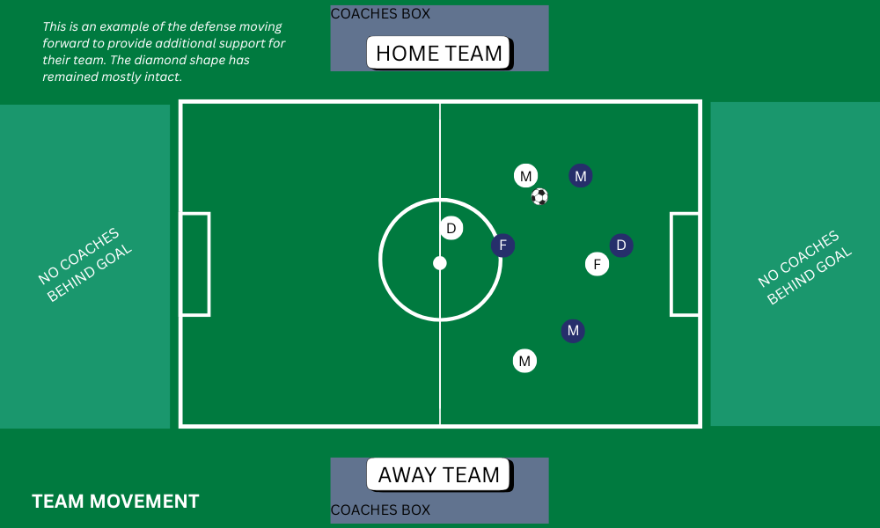

Slide 13
Post Game
Please have all players line up ready to shake the other team’s hands (high fives/fist bumps)
Parents are welcome to form tunnels for players to run through. (Click here to see example)
Once you have completed the tunnel, please clean up your side and leave the field to allow other teams with games after you to set up and get their players warm.
Any postgame talk by the coaches should not be completed on the sidelines, but instead in an area off to the side where players can meet you.
Please submit scores. The league is not worried about wins and losses nor exact scores. We do want to know if the games are evenly matched though. For the best experience, we want to make sure the second half of the season is re-seeded so that each player gets to have fun competition instead of having lopsided matches.

Slide 14
Runaway Scoring
We do not want to have runaway scoring. This is when there is a large goal differential between one team and another. Placer Alliance defines runaway scoring at 6 or more goals.
  It is ok to make adjustments before the 8 goal differential.
Recommended Adjustments if your team is ahead
  Require additional passes before shooting.
  Require goals to be scored by one of your players only.
  Put weaker players in positions for success and stronger players in positions to support.
  Force players to score with their off-foot
  Force a goal to be scored only with a dribble
  Force a goal to be scored only from a certain distance away
  Make the goals be scored off of crosses only
  Allow the other team to bring on more players

Slide 15
Questions, Comments, Concerns
The league is here to help. If you are unable to resolve a conflict on your own, need assistance with practice plans, or have questions, feel free to reach out to recreation@rocklinfc.org. We will do our best to help!

