Slide 1

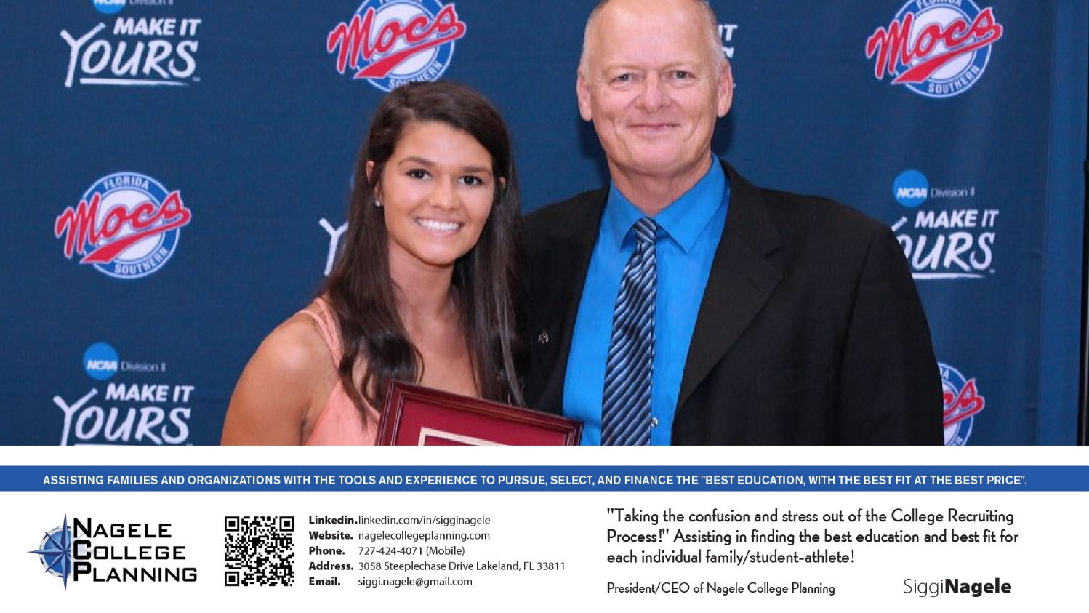

Siggi Nagele Certified College Advisor with Advanced Credentials
College Recruiting Process Overview
* Dos and Don’ts*

Slide 2

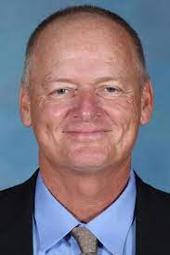

Who is Siggi Nagele?
Coaching Experience/Career:
40+ years experience at ODP, Club, HS, College Level
Women’s College Soccer
Eckerd, Head Coach
Florida Southern, Head Coach
Marshall University- Asst Coach
Olympic Development Program- FYSA Region 3
English/ German Teacher- Ridgewood HS
Soccer Administration:
NCAA National Chairman- Div II Women’s Soccer Committee
NSCAA South Region Chair All American Committee
College Recruiting Company Founder and Owner
Soccer Experience:
Alderson- Broaddus College
4-year Collegiate starter with Full Scholarship
2-time National Championship Finalist
Education:
Master of Science, Marshall University

Slide 3
The Only Competition is Yourself – Control what you can, accept what you can’t
Self-Improvement – daily progress in academics and athletics
Accountability – Instill a sense of responsibility in your child for training, etc.
Discipline – Consistency is key. Routines and Commitments set you apart and builds a strong foundation.
2. Cheer from the Stands: Let Your Child Take Charge of Their Future
Provide Informed Guidance –Share insight and facts about potential colleges.
Encourage Autonomy – Final choice rests with player and should reflect their preferences, not parents.
Promote Holistic Evaluation – assess each school based on balance of athletics, academics and personal fit.
Trust Their Judgement – Acknowledge the effort your child has invested in the process and trust their instincts.
Express Unconditional Support – Reinforce that you stand behind them regardless of the choice they make.
3. The Early Bird Expands Its Horizon – It encompasses early planning, personal development and strategic outreach.
Assess Strengths and Identify Areas for Improvement – know your current abilities and focus on development.
Maintain Consistent Training and Academic Excellence – colleges seek well-rounded individuals who excel both and off the field.
Research and Select Target Colleges – Identify institutions early that align with their athletic and academic goals.
Monitor Recruiting Timelines – Be aware of key dates and deadlines for showcases, applications or communications.
Proactively Communicate with Coaches – Initiating contact demonstrates interest and commitment.

Slide 4
4. Blueprint your Recruiting Journey – A strategic approach is needed with each high school year serving a distinct purpose.
Freshman & Sophomore Years – Foundation Building
* Academic Excellence – Strong GPA and meet NCAA eligibility
* Athletic Development – Be enthusiastic about skill enhancement and versatility – not results.
* Exploration – Participate in various extracurricular activities to discover interests beyond athletics.
* Visit College Campuses – Start getting familiarized with different college environments.
Junior Year – Active Engagement
* Strengthen Your Academics – Crucial to get strong grades and enhance your academic profile with extracurricular activities, community service and other academic pursuits.
Goal Refinement – Assess your athletic and academic standing to identify realistic college options. Camps/Showcases
Coach Communication – Contact with coaches through personalized emails, expressing genuine interest in program.
Showcases & Camps – Attend events to display your talents and gain exposure.
Senior Year – Decision-Making
* Campus Visits- Schedule official and unofficial visits to experience campus life and meet team members.
* Finalizing Choices – Evaluate offers, considering both athletic opportunities and academic fit.
* Meeting Deadlines – Ensure all applications and eligibility requirements are completed promptly.

Slide 5
5. Assemble Your Dream Team – Establishing a robust support system is crucial for student-athlete success.
*Athletic Coaches
Role – Develop skills, offer feedback and advocate to recruiters/college coaches.
Support – Provide training, mentorship and facilitate connections with college programs.
*Academic Advisors
Role – Ensure academic eligibility and guide course selection.
Support – Monitor academic progress and provide resources for balancing sports and studies.
*Recruiting Advisors
Role - Offer expertise on the recruitment landscape and strategies.
Support – Assist in building athletic profiles, understanding timelines, building the right college list and get coaches interested.
*Parents
Organization – Help track important dates, communications and application materials.
Emotional Support – Offer encouragement and assist in managing stress.
Promoting Independence – Encourage your child to take ownership of the process, fostering maturity and self-advocacy.

Slide 6
6. Invest in Professional Guidance for Recruiting Success – significantly enhances your child’s college future
*Proven Track Record
Success Stories – documented history of placing athletes in collegiate programs. Indicates reliability and effectiveness.
Experience – extensive networks and insights into the recruiting process, increasing likelihood of successful placements.
*Transparency
Clear Services and Costs – detailed information about services and fees up front.
Realistic Expectations – sets achievable goals and provide honest assessments of an athlete’s prospects, true partnership.
*Strong College Relationships
Established Networks – robust connections to college coaches and programs can offer increased exposure and opportunities
Credibility – respected by educational institutions enhances an athlete’s profile
*Customized Approach
Personalized Strategies – avoid generic, one-size-fits-all methodology but opt for tailored plans that align with your child.
Individual Attention – personalized guidance ensures that the athlete’s specific needs are addressed, optimize the process.
*Caution Against Red Flags
Mass Emails – a personalized communication is more effective than mass emails.
Pressure Tactics – avoid high pressure sales tactics and prioritize athlete’s best interests.

Slide 7
7. Academic Excellence Enhances Recruitment – Presenting a strong academic profile is crucial for college recruiting process.
*Coach Confidence
Dual Competence – coaches seek recruits who can manage both athletic and academic demands.
Indicative Traits – Excelling academically reflects personal attributes such as leadership, time management, responsibility and goal orientation – qualities highly valued in team settings
Scholarship Opportunities – Many schools offer scholarships rewarding academic excellence. Strong grades and test scores.
Expanded Options – a robust academic profile broadens the range of schools and programs available. Athletic/Academic fit
*Competitive Edge
Differentiation Factor – When athletic abilities are comparable, superior academics can set a recruit apart.
Decisive Advantage - Coaches often face tough choices between athletes with similar skills. Better grades/better chances.
8. College Admissions is More Than Just Sports – present a well-rounded profile is essential for student-athletes.
*Influence of Coaches on Admissions
Institutional Variability – degree to which coaches can influence admissions decisions varies by institution.
Selective Institutions – admissions criteria are stringent and coaches often have limited sway.
Other Institutions – at many other colleges, coaches have more influence over admissions, as long as recruit is

Slide 8
*Beyond GPA and Test Scores
Extracurricular Involvement – active in clubs, sports and volunteer work demonstrates leadership, commitment and time-management skills
Personal Projects – showcase creativity, problem-solving and drive to make a unique impact
Community Contributions – indicates a willingness to contribute to society and influence others positively.
9. Find your “X-Factor” – authenticity and self-awareness are paramount
“I’m a hard worker.” “I give 100%.” “I’m a team player.” “I’m very responsible.” are good but these are better:
“I thrive in high-pressure moments and have a track record of delivering when my team needs me most.”
“I study my opponents and teammates as much as I study the game, always looking for ways to improve my team.”
“I take pride in being the first to arrive and the last to leave.”
“I’ve built my game on discipline and adaptability, analyzing my mistakes and turning them into strengths.”
“I see leadership as more than just being vocal, lead through my actions, energy and ability to bring best out of teammates.
“I embrace feedback and actively seek constructive criticism because I know that’s where growth happens.”
“I’m relentless in my pursuit of improvement, every practice, game, rep is a chance to get better.”
*Self-Discovery – Uncovering Your Unique Qualities
Seek External Perspectives – Engage with those who know you well to gain insights into your distinctive traits.
* Friends – Inquire about the qualities they value in your friendship
* Family – Ask family members how they describe you to others
* Coaches and Teachers – Request feedback on your behavior and performance within and outside your sport

Slide 9
Reflect on Feedback – Analyze the input to identify recurring themes and unique attributes.
Crafting Your Authentic Narrative
* Highlight Specific Strengths – Instead of saying “I work hard”, describe a time when your dedication led to a significant achievement
* Demonstrate Impact – Show your influence on your team or community, illustrating leadership and initiative.
* Express Genuine Passion – Clearly articulate your love for the sport and how it has shaped your personal development
The Importance of Sincerity in Communication
* Authentic Engagement – Present yourself honestly. Authenticity fosters trust and sets foundation for relationship.
* Avoid Cliches – Common phrases like “I give 100% effort” are overused and lack impact. Give concrete examples that truly represent your work ethic and commitment.
Practical Steps to Develop Your Personal Narrative
* Self-Assessment – Reflect on your experiences, achievements and challenges to understand what defines you.
* Gather External Insights – Engage in conversations with friends, family, coaches and teachers to gain diverse perspectives on your character.
* Synthesize Information – Combine your reflections with external feedback to identify your unique strengths/qualities
* Articulate Your Story – Craft a narrative that authentically represents who you are, focusing on specific examples that highlight your unique attributes.

Slide 10
10. Design your College List with Strategic Balance
Balance your athletic aspirations with academic goals
Encourage yourself to create a diverse list of potential colleges that align with your athletic abilities, academic achievements and personal preferences.
This approach increases the likelihood of positive responses from coaches and admissions.
While it’s natural to include “dream or reach schools” it’s essential to ensure that the list also contains institutions where your profile matches the program’s criteria. This strategy will enhance chances of recruitment and a fulfilling college experience both on and off the field.
11. No Second Chances for a First Video Impression
Coaches can discern genuine talent from overproduced footage.
Prioritize Authenticity and showcase unedited, game-realistic footage.
Highlight Competitive Play against strong opponents showing readiness for collegiate-level sports.
Maintain Conciseness by aiming for 3-5 minute long video, featuring the most impactful plays at the beginning. Coaches often make quick judgments so capturing their attention is vital.
Demonstrate Versatility and Decision-Making by selecting clips that showcase strategic thinking, adaptability and a comprehensive understanding of the game.
Facilitate Quality Recording as clear, stable video is essential for evaluation.
Guide the Editing Process by parents/professionals that best represents their child’s skills and on-field intelligence.
Encourage Genuine Representation by presenting your true abilities, including moments of resilience and recovery from errors, as coaches value authenticity over perfection.
A compelling video can open doors but is only one component of the recruitment process. For the international student-athletes it becomes an even more important element as they have limited exposure ability to USA coaches.

Slide 11
12. Step onto Campus – Go beyond the brochure
An important moment for any student-athlete is to visit the campuses of their top schools
Immersive Experience of 2-3 days on campus would provide invaluable insight into daily life there.
Firsthand Evaluation by touring dorms, dining halls and academic buildings shows where they will live, eat and learn.
Athletic Insight is learned by observing potential teammates in action and interacting with them offers a realistic perspective on team dynamics and culture.
Community Familiarity is gained by exploring surrounding area and building comfort in their surroundings.
Accompanying your child during these visits is invaluable but also gives parents into the environment that surrounds them.
Final Thoughts
* College recruiting is complex, but with the right mindset, preparation and strategy its completely manageable.
* By being proactive, organized and realistic, student-athletes can find the best opportunity for their future.
* As a parent, your role is to support them without overpowering, to guide them without micromanaging and to help them stay focused on the big picture.
* Getting professional help is always a good idea.
* Approach the process with clarity, confidence and teamwork and the right college fit will follow.

Slide 12

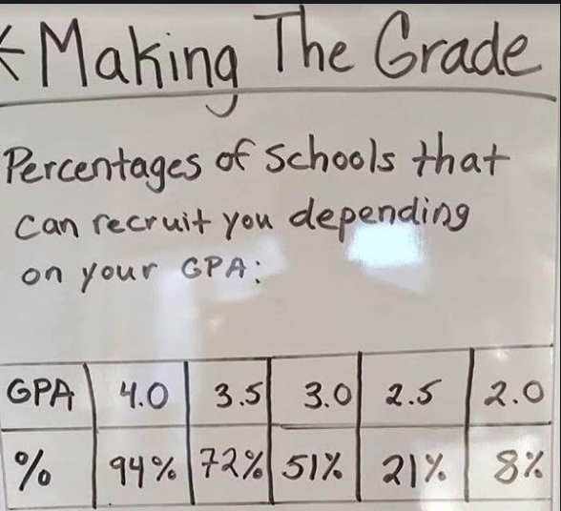
The importance of your Grades
A higher GPA= More Recruiting Possibilities
The Message:
Excelling in school opens up your possibilities of where you can play!!!

Slide 13
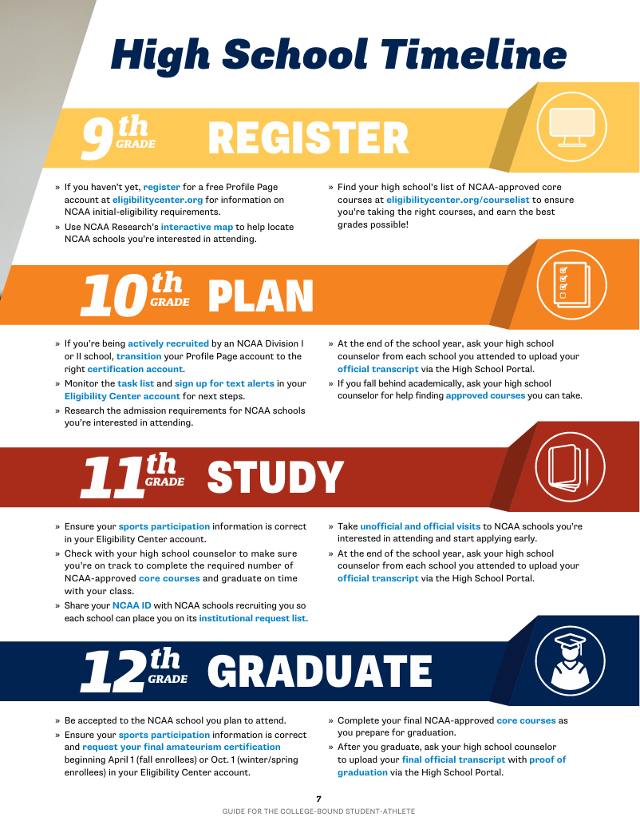

Slide 14
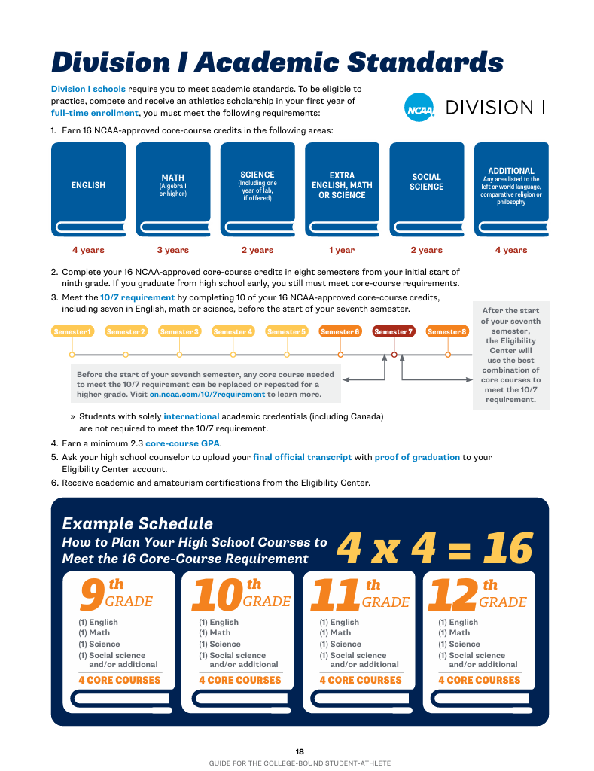

Slide 15
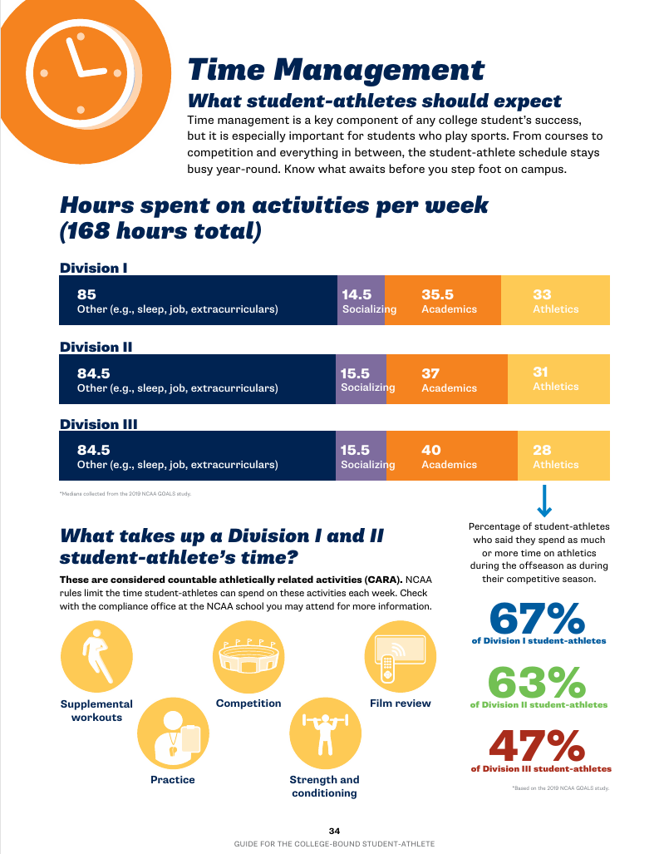

Slide 16
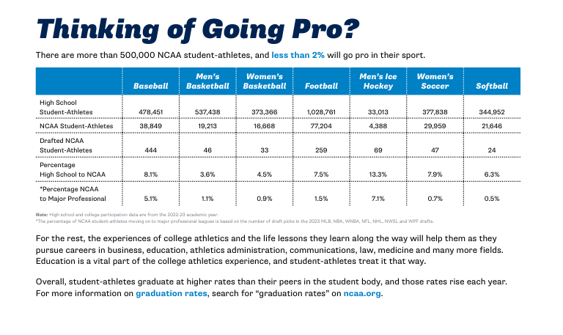

Slide 17
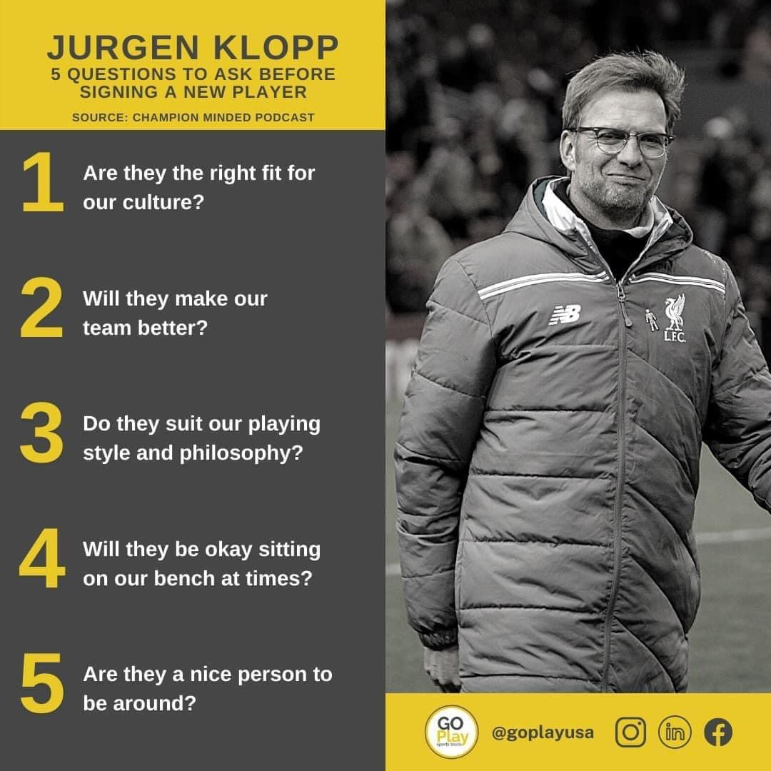
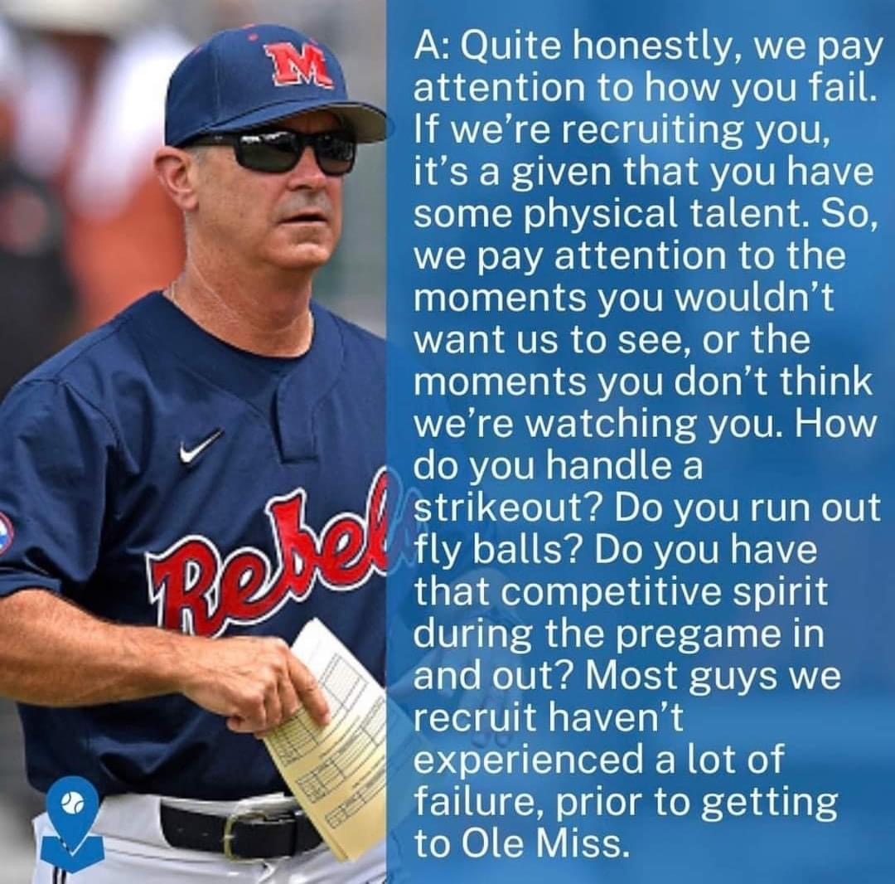
What are coaches looking for?

Slide 18
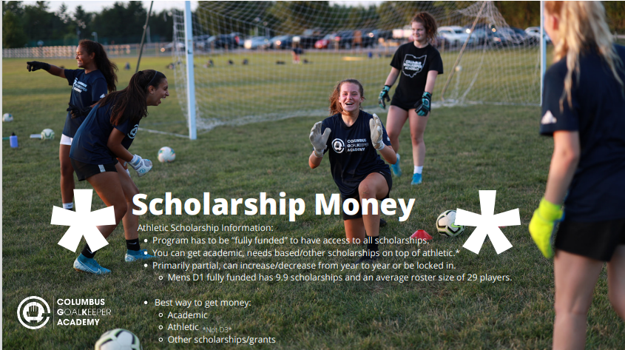

Slide 19
How does Nagele College Planning help me?

Slide 20
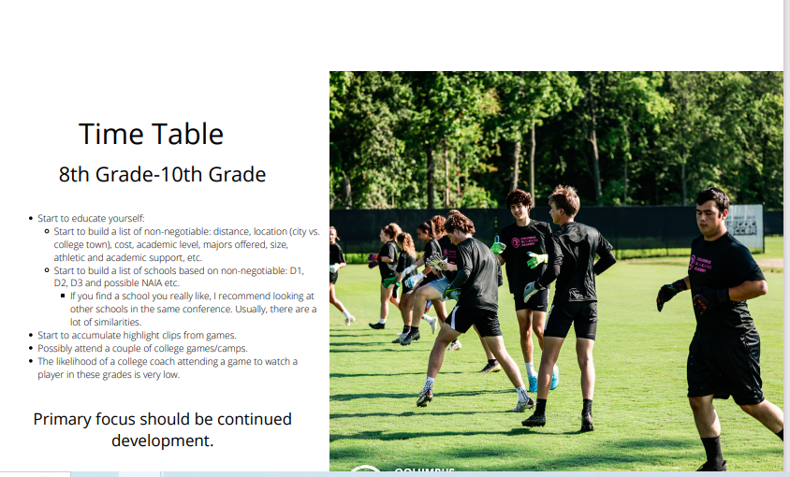
When should we start working together?

Slide 21
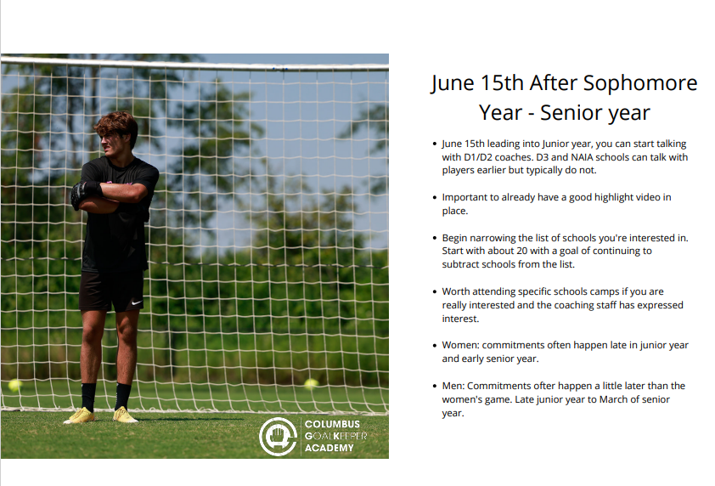

Slide 22
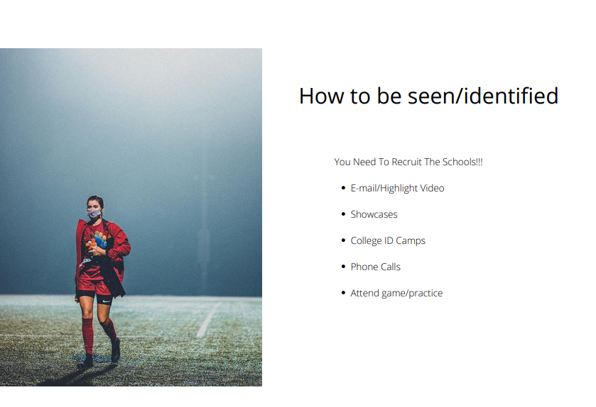

Slide 23
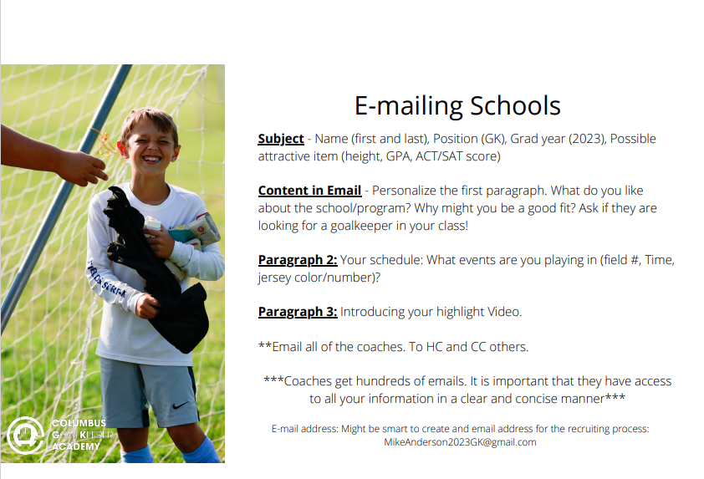

Slide 24
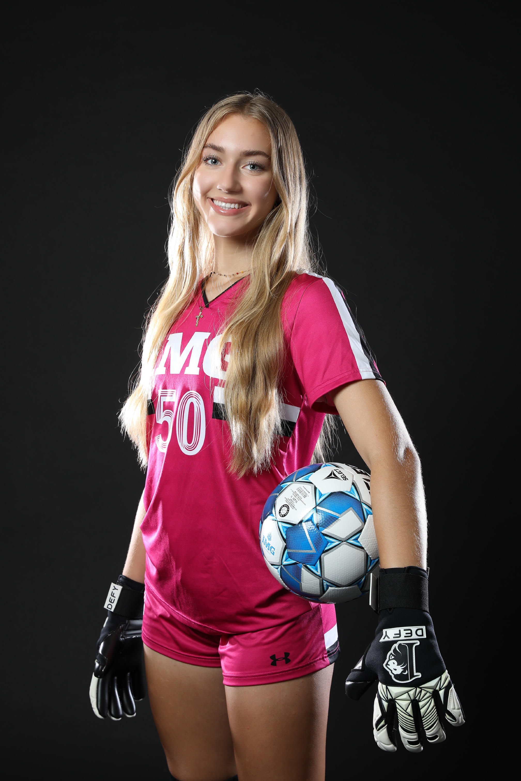
Email Signature Best Practice
Kaiya Scarpo
Class of 2024
5'11 Goalkeeper
IMG U19 Premier
Personal Contact: 813-997-7192/kaiya.scarpo@img.education
Head Coach: Ray Leone (941-524-1537/raymond.leone@img.com)
Assistant Coach: Kelsey Harris (602-639-1466/kelsey.harris@img.com)
Head of Goalkeeping: Paul Jennison (941-243-1569/paul.jennison@img.com)
Certified College Advisor with Advanced Credentials: Siggi Nagele (727-424-4071/siggi.nagele@gmail.com)
Link to Profile (to learn more about you)
Link to Highlight Video (to get an initial idea of your skill set)
Link to Transcript (to see what kind of student you are and possibly use to make an offer)

Slide 25
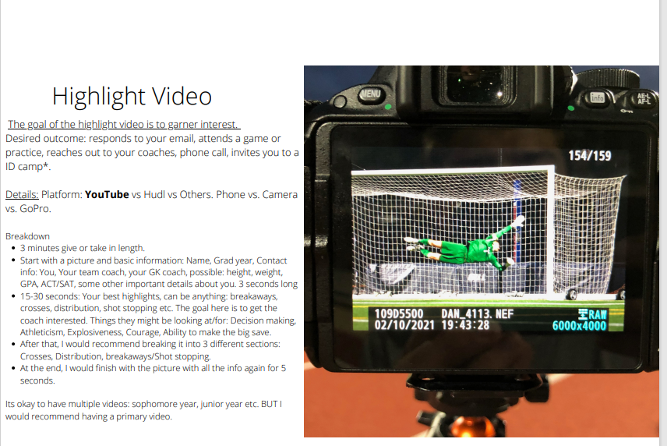

Slide 26
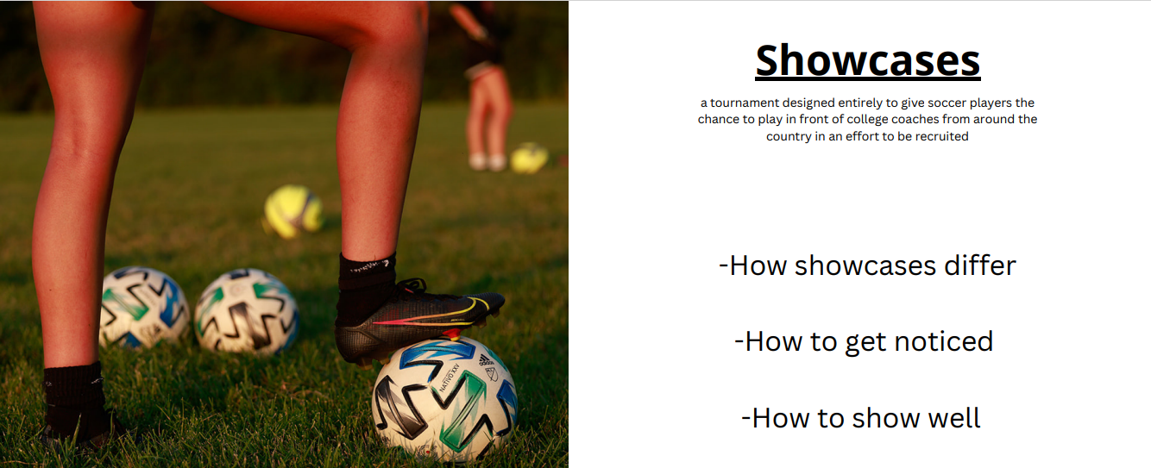

Slide 27
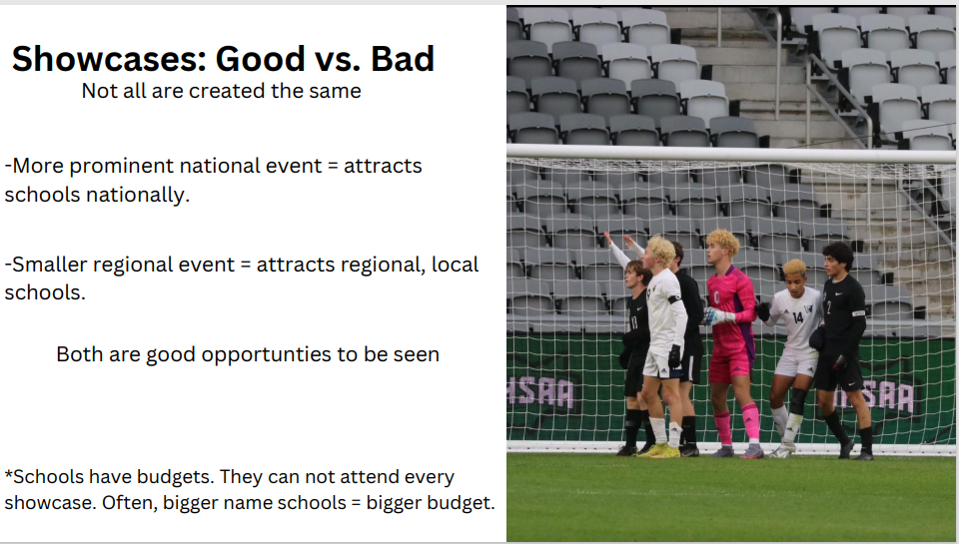

Slide 28
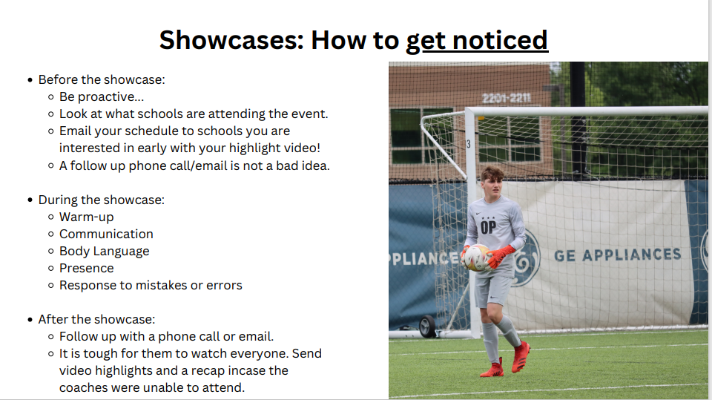

Slide 29
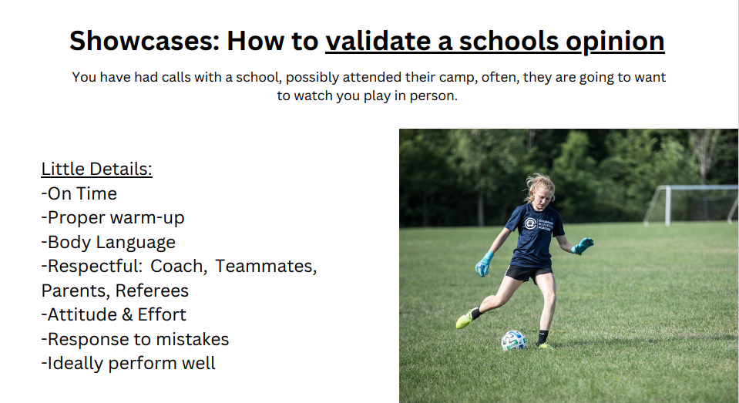

Slide 30
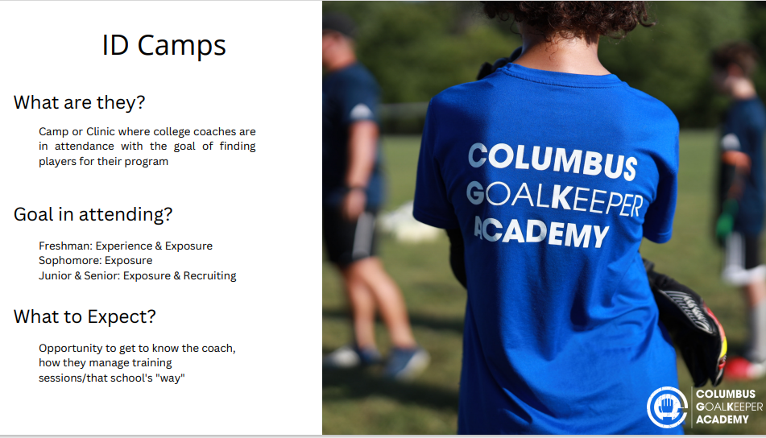

Slide 31
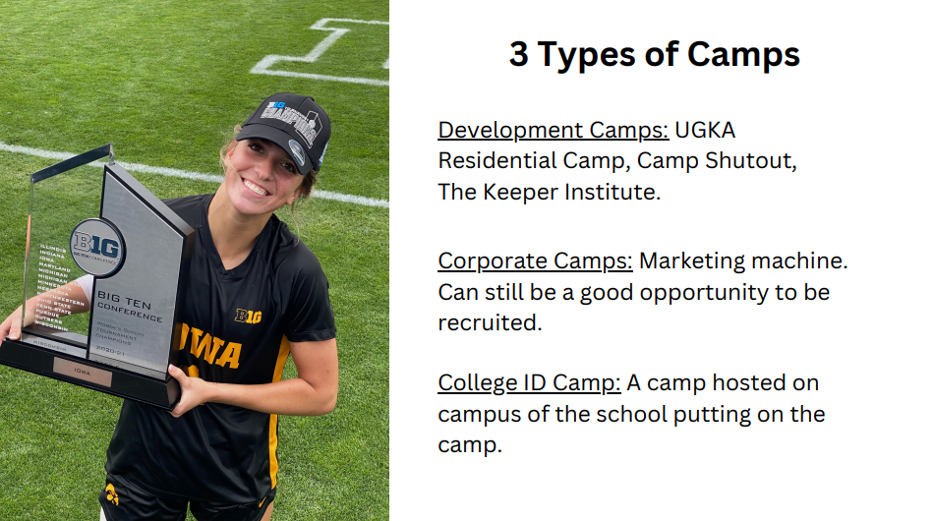

Slide 32
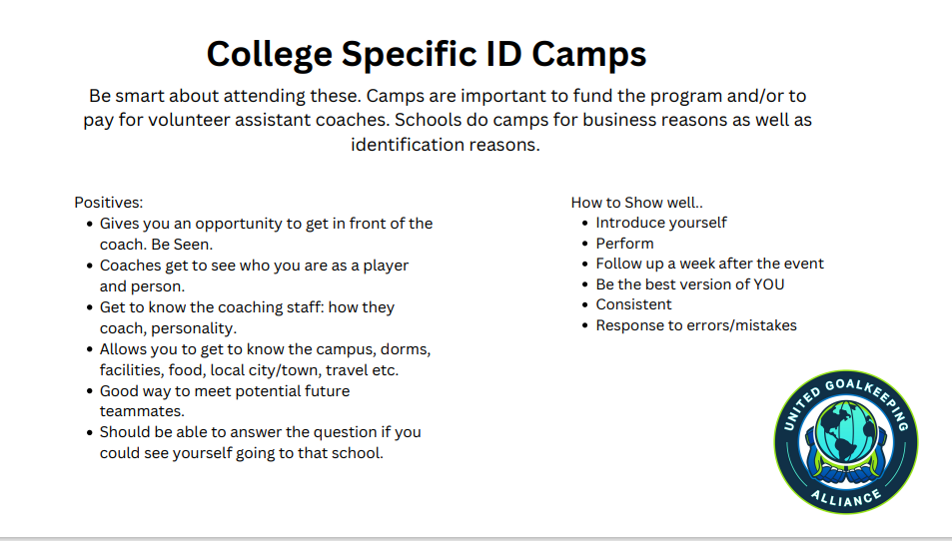

Slide 33
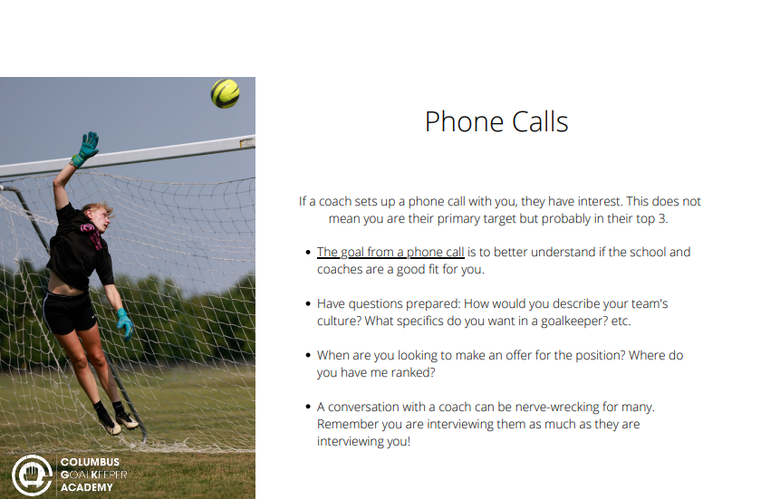

Slide 34
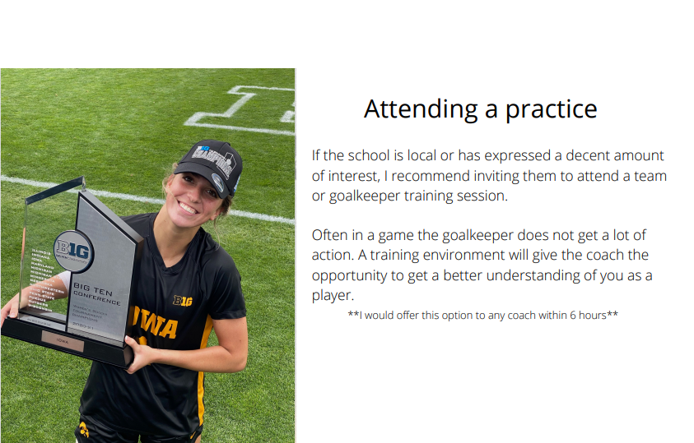

Slide 35
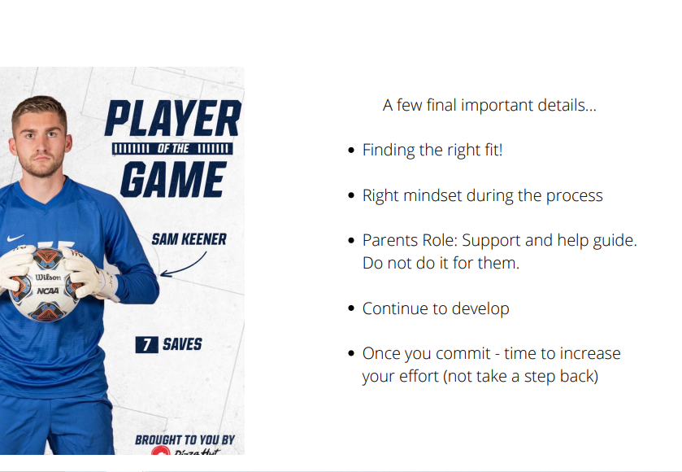

Slide 36
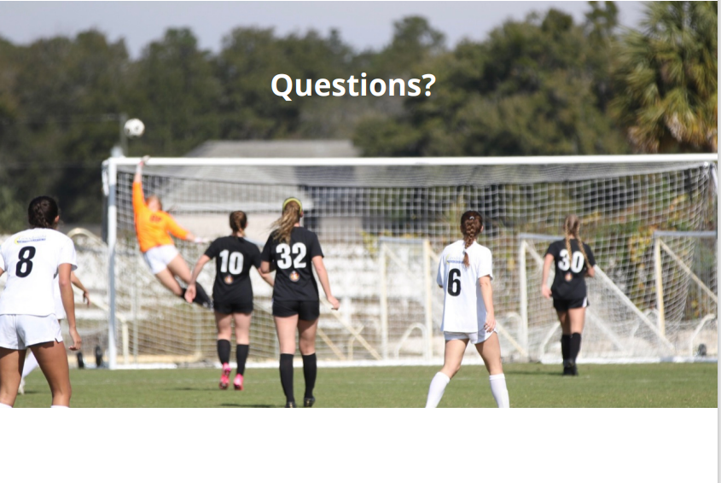

Slide 37
Thank you from:
Siggi Nagele, President/CEO
727-424-4071
Siggi.Nagele@gmail.com

