Slide 1


"Take courage!
I have overcome the world"
John 16:33

Slide 2


Slide 3
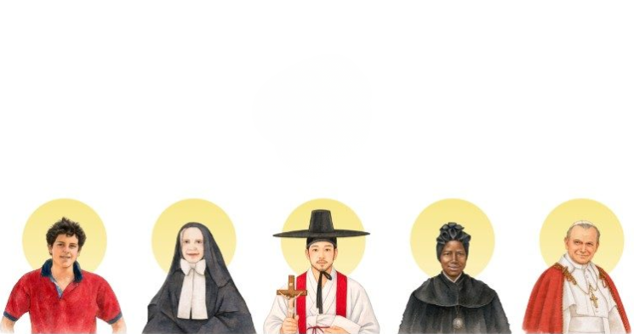
  What
  When
  What to expect
  How much
  Payments
  Q&A

Slide 4
What?
World Youth Day (WYD) 2027 is a global Catholic youth festival taking place in Seoul, South Korea. It is the first WYD held in mainland East Asia and the first in a country where Christians are a minority, led by Pope Leo XIV as his first World Youth Day.

Slide 5
When?
  Travel July 30/31 to Aug 8
  Mission Trip in Vietnam Aug 9 to 14
  WYD Aug 3 to Aug 8

Slide 6



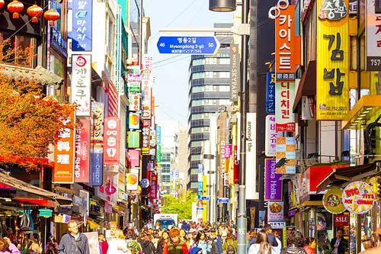
What to expect...
Aug 1 to Aug 2 for cultural immersion
Gyeongbokgung
(경복궁)
Cheonggyecheon
(청계천)
Namsan Seoul
Tower
Myeongdong
(명동)

Slide 7
What to expect...
Aug 3 to Aug 8 WYD Activites
  Key Activities: The event features catechesis sessions, a Youth Festival, a Walking Pilgrimage, Confession, Stations of the Cross with the Pope, and a Night Vigil with the Pope.

Slide 8
What to expect...
  Spiritual Focus: It highlights the faith of Korean martyrs and encourages young people to be "pilgrims of hope" and "courageous missionaries."

Slide 9
What to expect...
What’s Included:
  4-star hotel accommodations
  Three meals per day
  Local transportation
  World Youth Day registration fees
  Visa processing fees
  Medical insurance (July 31/Aug 1 to Aug 8)
What’s not Included
  Trip insurance
  tipping (optional)
  Expenses not mentioned

Slide 10
How much and expectation
  Land package: $2,500
  Mission trip: $500
  Airfare: $1500 – 1800
  Will search price and announce for individual to buy
    Tr. Bao huong can help to buy
  Participant pays land package + Airfare
  fundraising For mission trip to Vietnam

Slide 11
payments
Payment Schedule
Please note: All payments are non-refundable.
  Now - November 1, 2026: $1,000
  January 31, 2027: $1000
  February 28, 2027: $500 (or $1,000 if go to mission trip)
  airline price: We will search the good price

Slide 12
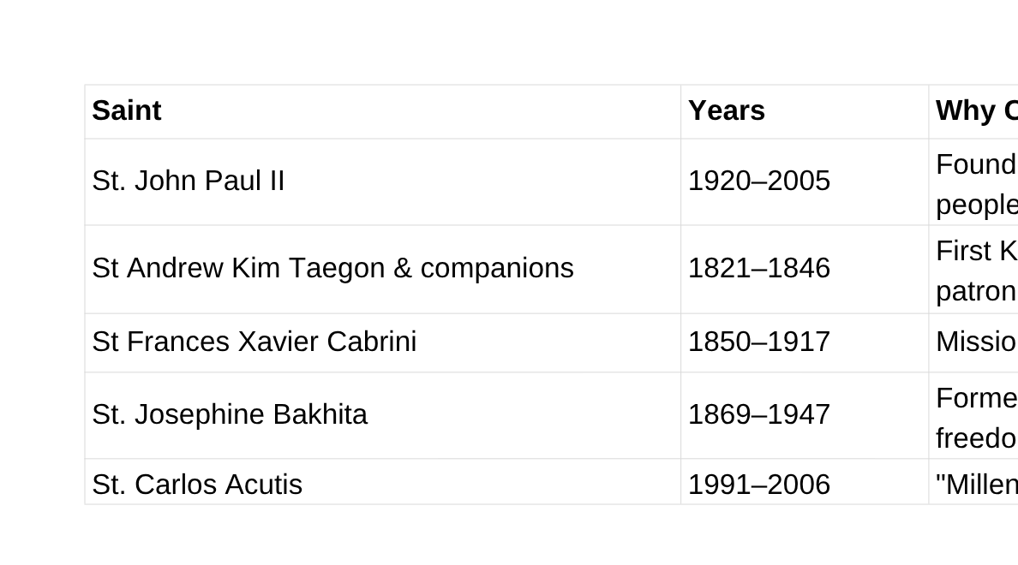
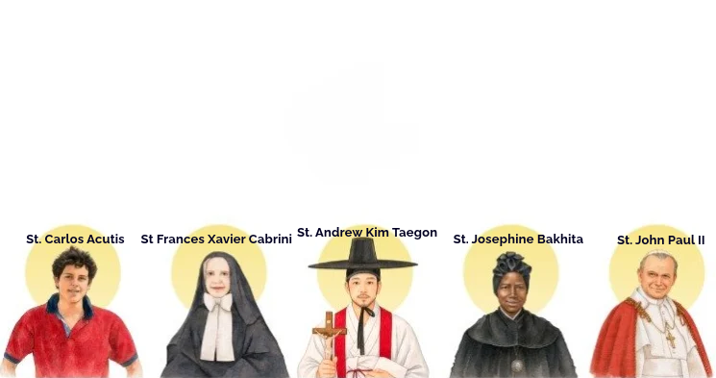
The five were chosen to reflect the event's themes of truth, love, and peace, spanning different continents and eras.

Slide 13

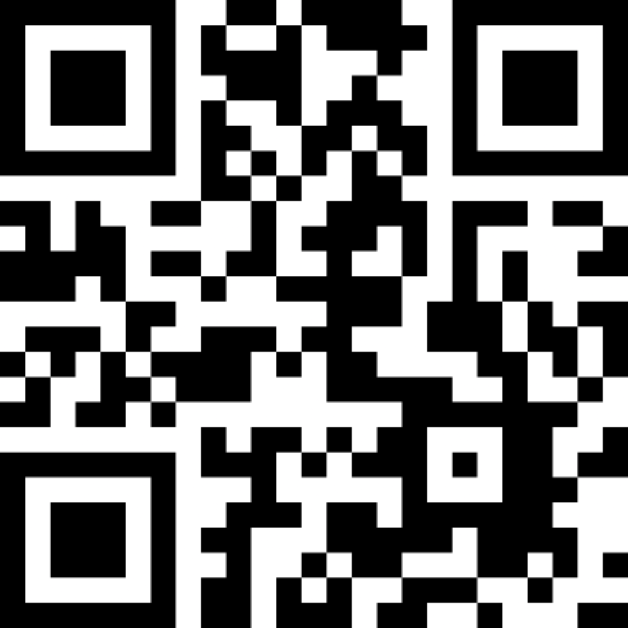
Q & A

