Slide 1


Rhodiasolv©
A range of Green Solvents
24.02

Slide 2
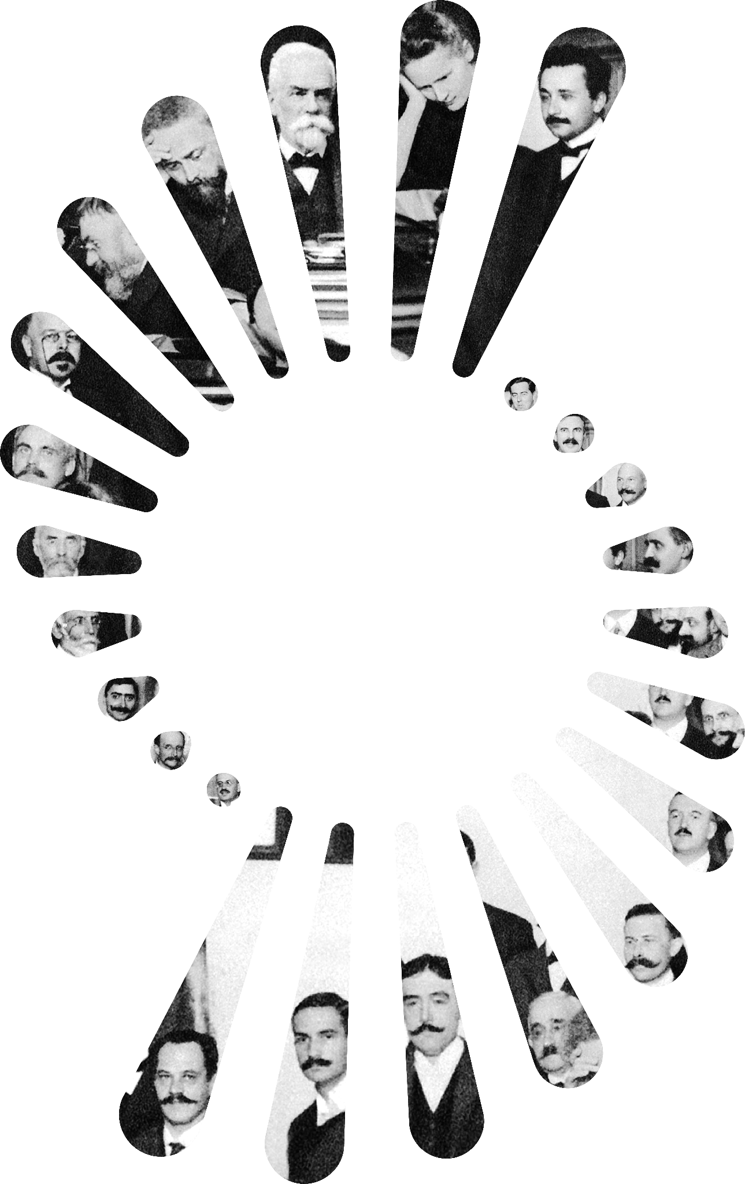

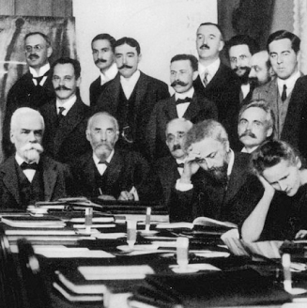

We are explorers creating
breakthroughs that advance humanity
1st Solvay Conference
1911

Slide 3
Syensqo’s range of Green Solvents
AMIDE BASED SOLVENTS
ESTER SOLVENTS
SOLVENT BLENDS & OTHERS
Rhodiasolv® Polarclean
Rhodiasolv® ADMA 810 & 10
Rhodiasolv® RPDE
Rhodiasolv® IRIS
Rhodiasolv® Infinity
Rhodiasolv® Strip
Characteristics
Non VOC in EMEA
High solubilisation performance
Solvency profile similar to NMP, NEP
Synergistic combination between ADMA & Polarclean
Characteristics
Non classified solvents
High boiling point, low VOC
Very good to clean and dissolve resins : Acrylic, Alkyd, Polyurethane, Epoxy, Polyester, Vinyl…..
Characteristics
Infinity : multi purpose applications, efficient at neutral pH, infinitely dilutable concentrate.
Strip : Non classified, high flashpoint, low VOC, non flammable, uncured paint cleaning, fresh graffitis removers, easy to formulate.

Slide 4
Syensqo’s range of Green Solvents for Industrial applications
¹ @1000 hPa
² closed cup
³ OECD
⁴ Not Classified
⁵ Eye irritation
Product | Techno. | Freezing / Pour point (°C) | Boiling Point¹ (°C) 760 mm Hg | Flash point² (°C) | Vap. Press. (Pa) @20°C | Solub. in water (g/l) @20°C | Surf. tens. mN/m @20°C approx | Polarity | Biodeg³ | Labelling | Application and Functions | Alternative to
Rhodiasolv® RPDE | Blend of Diesters | -55.4//-20 | 195-216 | 100 | <10 | 26 - 40.5 (5%) | 67.3 | Medium Low | Readily | NC⁴ | Coil & can coatings, foundry, polymer solubilization, resin cleaning, adhesives, ”Catalyst” for cold cure phenolic urethane hybrid resins, | Methylene chloride, NMP
Rhodiasolv® Polarclean | Ester-Amide | <-60//< -20 | 280 | 146 | <0.01 | Soluble (50%) | 69 | High | Readily in the 60 days enhanced test | H319⁵ | High efficient polar solvent. Low Mw PVDF solubilization (membranes) | NMP, Acetone
Rhodiasolv® IRIS | Branched Diester | -75//< -20 | 216 | 98 | 6.3 | 25 (2,5%) | 64 | Medium | Rapidly | NC⁴ | Resin Clean-up, Paint Stripping Stain/grease & Graffiti Removal | Ketone : Cyclohexanone, ketones, MEK, Acetone d-Limonene, MeCl2. Blended with DMSO to replace NMP
Rhodiasolv® Infinity | Blend | -35 -10// -20 | 145-230 | 141 | 2 | Soluble |  |  | Biodeg not relevant for mixtures. All components were assessed individually & all or most are considered to be rapidly degradable in the environment | H302/H318 | Adhesive remover, Graffiti remover, Degreaser, asphaltene Remover | D-limonene (replacement or extender)
Rhodiasolv® Strip | Blend | N/A | 187 | 104 | 5 | 10 |  |  |  | NC⁴ | Formulation of paint cleaner for uncured paint, Graffiti & Adhesive removal, Resin & paint cleaning | DCM, NMP
Rhodiasolv® ADMA 810 | Amide | xx//< -15 | 270-280 | >110 | 3 | ~ 0.5 |  | Medium low | Readily | H315,H318, H335, H412 | Degreasing, good solvent for adhesives before curing
Rhodiasolv® ADMA 10 | Amide | xx// ~ -10 | 300 | 147 | 0,11 | < 0.2 |  | Medium low | Readily |  | Versatile solvent with reduced solubility in water
Rhodiasolv® DIB | Blend of Diesters | <-70//<-21 | 250-285 | 134 | 1@25°C | 0.068 | 50.3@19.6°C |  | Readily | NC⁴ | Coalescent, plasticizer | Texanol/Alcohol esters
Notes:
DIB 270 °C Boiling point to be rechecked

Slide 5
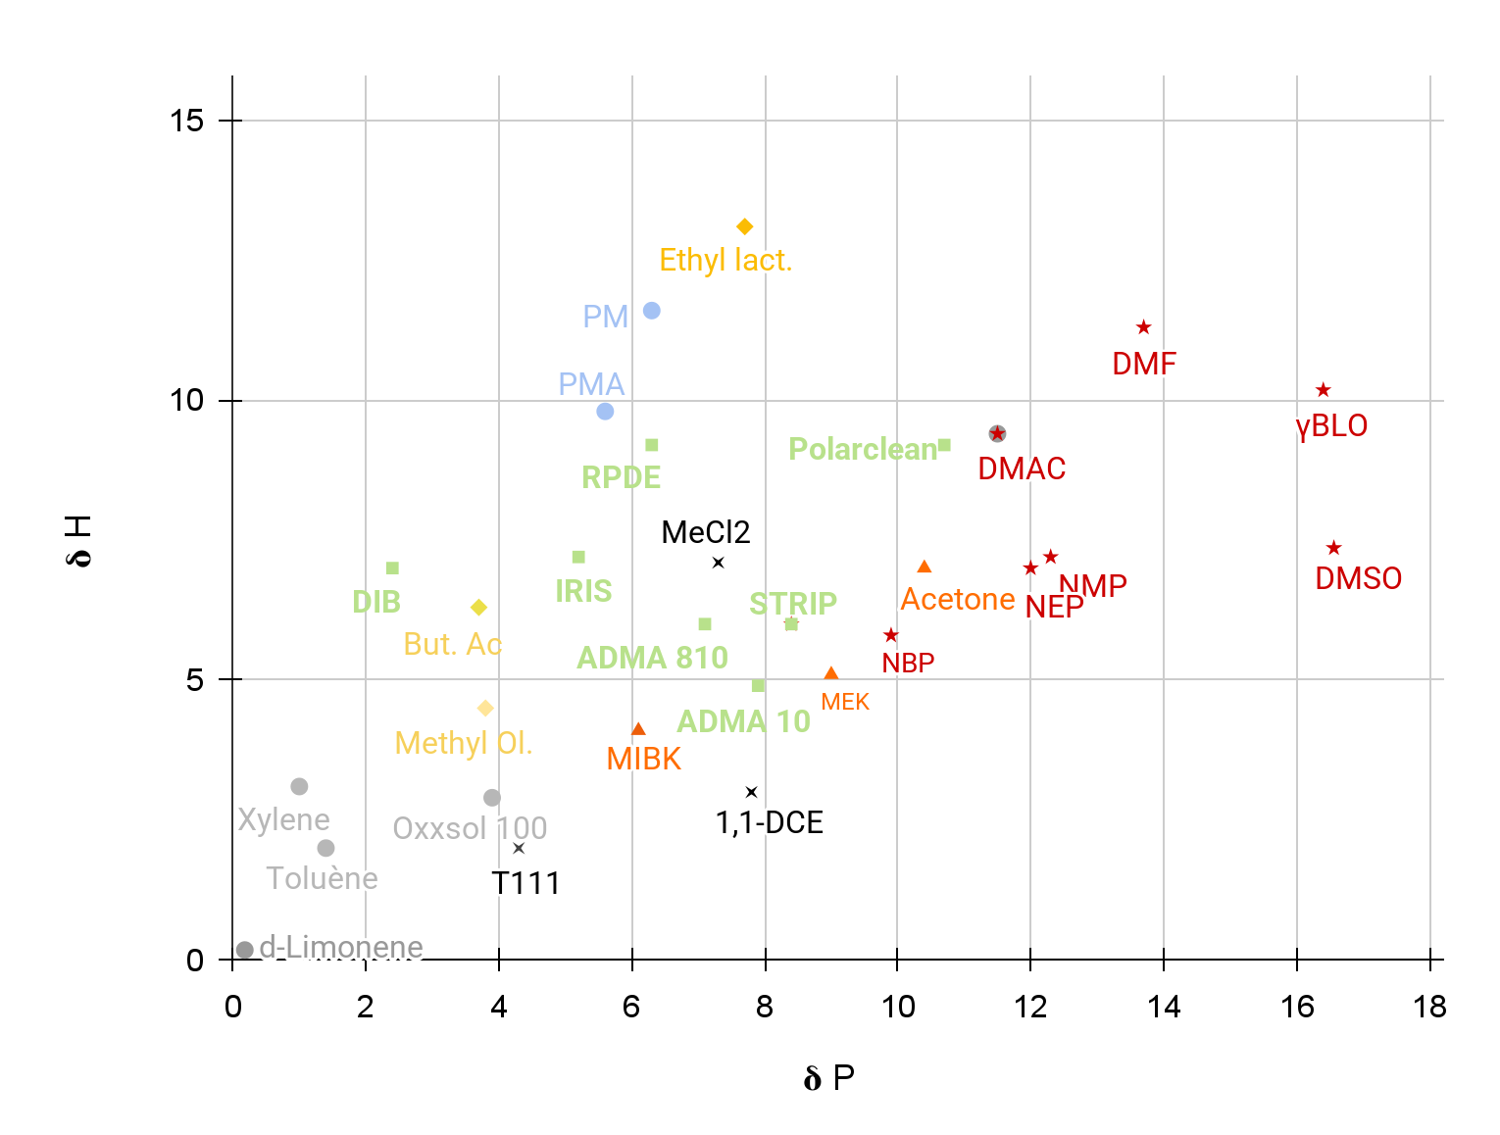
RHODIASOLV ® MAPPING
Solvent | 𝛅D | 𝛅P | 𝛅H
Rhodiasolv® IRIS | 16.5 | 5.2 | 7.2
Rhodiasolv® Polarclean | 15.8 | 10.7 | 9.2
Rhodiasolv® RPDE | 17.2 | 6.3 | 9.2
Rhodiasolv® DIB | 15.9 | 2.4 | 7
Rhodiasolv® ADMA 10 | 18.3 | 7.9 | 4.9
Rhodiasolv® ADMA 810 | 16.4 | 7.1 | 6
Rhodiasolv® STRIP | 16.4 | 8.4 | 6
Hydrocarbons & Aromatics
PM : Propylene Glycol MonoMethyl Ether
DPM : Dipropylene Glycol Monomethyl Ether
PMA : Propylene Glycol Monomethyl Ether Acetate
NMP : N-Methyl-2-Pyrrolidone
MEK : Methyl Ethyl Ketone (Butanone)
Acetates
Alcohol & Glycol Ethers
Ketones

Slide 6
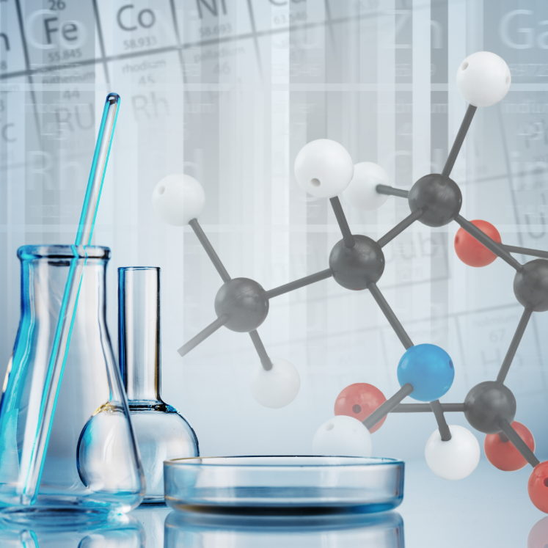
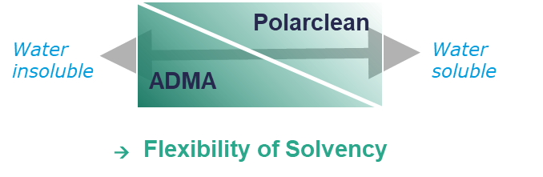
Rhodiasolv® ADMA series
Highly efficient & versatile solvents
N, N-DIMETHYLOCTANAMIDE
CAS no. 1118-92-9
N, N-DIMETHYLDECANAMIDE
CAS no. 14433-76-2
SOLVENT PROFILE
APPLICATION
Very good solubilisation performance
Medium polarity solvent
Reduced solubility in water
Crystallisation inhibitor properties
Non Flammable, high boiling point, Non VOC *
Low pour point
REACH compliant
Cleaning of adhesives before curing
Degreasing
*2010/75/EU

Slide 7
Rhodiasolv® Polarclean
High efficiency polar solvent
SOLVENT PROFILE
APPLICATION
O
O
CH₃
Powerful polar and water soluble solvent
Excellent toxicological & eco-toxicological profiles
Non-VOC*, Non-flammable and with very low vapour pressure
Hansen parameters close to NMP, NEP, also possible to replace DMAC, DMF, DMSO
REACH & TSCA compliant
Cleaning
  Resin clean-up (polyester, epoxy, polyurethane)
  Industrial cleaning applications (electronics…), stripping
Process
  Solvent casting of membranes :polysulfone PSU, polyethersulfone PES, (DMAC, DMF,NMP)
  Wire enamels : polyamide-imide PAI, Polyimide PI resins
  To solubilise dimethylolpropionic acid (DMPA) in polyurethane Dispersion (PUD) (vs NMP)
  Batteries electrodes PVDF, and poly(ether)ether ketone (PEEK)
Others
  Stabilizers in organic peroxides synthesis
  Lubricants (Disperse graphite or MoS2)
CH₃-O-C- -C-N
Branched
C4
CH₃
Patented Technology
N°WO 2009092795 A1
*2010/75/EU

Slide 8

Rhodiasolv® RPDE
Classical Dibasic ester with excellent HSE profile (toxicity, VOC and biodegradability) in a wide range of applications
Dimethyl glutarate (59-67%)
Dimethyl succinate (20-28%)
Dimethyl adipate (9-17%)
SOLVENT PROFILE
APPLICATION : deal solution to dissolve polar substrates
Non classified, non toxic
0.2% VOC acc to 2010/75/EU
Good solubilisation performance of non cured resins (polyester, epoxy, isocyanates)
Medium polarity solvent
Reduced solubility in water
Non Flammable, high boiling point, high flashpoint
REACH compliant
Paint formulation : Can & coil coating, Polyester and epoxy sealing coat, Industrial paints
Solvent for foundry core binders (cold box technology)
Cleaning & stripping : paint stripping, PU & polyester resin clean-up, Graffiti removals. Can solubilise cellulose nitrate, acrylic, polyurethane, polyester, aminoplast, phenoplast, alkyd, epoxy and vinyl.
Formulation : Textile lubricants, corrosion inhibitors, printing inks
Targets for replacement : MeCl, acetone, BTX , cyclohexane, isophorone

Slide 9
Rhodiasolv® RPDE
Classical Dibasic ester with excellent HSE profile (toxicity, VOC and biodegradability) in a wide range of applications
Solubility of resins in
Rhodiasolv® RPDE
REPLACEMENT TARGETS
EXAMPLES OF SUBSTITUTION
Paint Stripping | MeCl
PU Equipment | MeCl
Polyester manuf. Equipment | Acetone
Rubber Processing | MeCl
Graffiti removers | MeCl
Ink Processing Equipment | BTX
Vitamin Manuf. Equipment | Cyclohexane
Metal Parts Cleaning | Xylene, acetone
Textile Cleaning | BTX
For cleaning or stripping, Rhodiasolv® RPDE used alone or formulated can substitute methylene chloride (MeCl) which is classified CMR
For coil coating, Rhodiasolv® RPDE can be used to substitute isophorone or glycol ether in order to reduce the impact on the environment of this application.
In foundry applications, Rhodiasolv® RPDE is an excellent and safe solvent to formulate resin core binders.
Nature of resin | Solubility in Rhodiasolv® RPDE
Cellulose nitrate | Soluble
Acrylic | Soluble
Polyamide | Insoluble
Polyurethane | Soluble
Polyester | Soluble
Aminoplast | Soluble
Phenoplast | Soluble
Alkyd | Soluble
Epoxy | Soluble
Vinyl | Soluble
VInyl toluene | Insoluble
Polychloroprene | Insoluble
Polyvinyl acohol | Insoluble

Slide 10
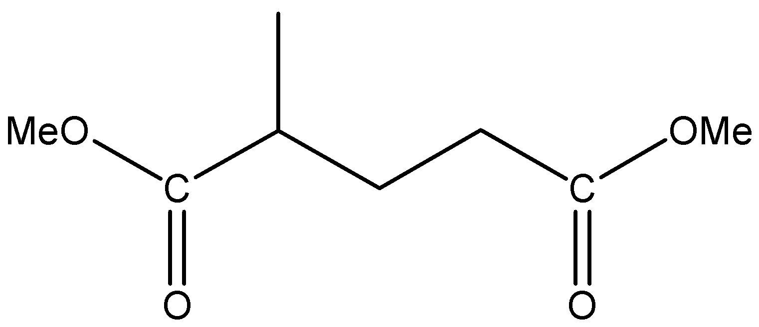
Rhodiasolv® IRIS
An eco-friendly high-performing versatile oxygenated solvent
INCI : Dimethyl-2 methyl - glutarate (89%)
CAS no. 14035-94-0
SOLVENT PROFILE
APPLICATION
Ketone like solvency.
Outstanding cold temperature behavior
High purity diester with a narrow high-boiling temperature range, Improved hydrolysis resistance & broader solvency vs RPDE
Fully miscible with paraffins/aliphatics
Low vapor pressure, 0.11% VOC acc to 2010/75/EU
Readily Biodegradable, non toxic, non carcinogenic, non irritant
Non Flammable, high boiling point
Low evaporation reduces volumes consumed. Easy to recycle by distillation
REACH compliant
Cleaning - Listed on CleanGredients*
  Electronic cleaning (PCB)
  Ink & industrial cleaning
  Polyester resin cleaning, for glass fibers reinforced (to replace acetone)
A powerful solvent for resins, polymers, greases, plastic manufacturing…
  Will dissolve readily : Acrylics, Alkyds, Epoxy, Polyurethane, Polyester, Vinyl (Resins)
Targets for replacement : Chlorinated (MeCl) , Amides (NMP, NEP), Ketones (Acetone, MEK, Isophorone)
*CleanGredients.org is an online database of industrial & institutional cleaning ingredients that support
the formulation of products with human & environmental health benefits

Slide 11
Rhodiasolv® Infinity
Microemulsion infinitely dilutable highly performing on cleaning
SOLVENT PROFILE
APPLICATION
Developed as replacement for d-limonene → degreasing
Based on Rhodiasolv IRIS and biodegradable surfactants, backbone for pH neutral water based systems (Efficient from pH 4 to 9)
Excellent Health, Safety and Environmental profile
Low VOC and Non Flammable
Neutral odor
Infinitely dilutable microemulsion in both hard and soft water
Replacement alkaline cleaners, as well as aromatic solvent based cleaners (d-limonene)
REACH compliant
Spot cleaners
D-limonene extender
Multi purpose degreaser & cleaner
  Degreasing (Dilutions from 5% Light decreasing up to 35% Heavy duty)
  Sensitive substrates cleaning (ex polycarbonates)
  Adhesive removal
  Floor resin clean-up (polyester, epoxy and PU cleaning)
  Printing UV ink cleaning (MEK replacement)
  Leather cleaning

Slide 12
Rhodiasolv® Strip
Sustainable ingredient to design outstanding paint strippers formulations
SOLVENT PROFILE
APPLICATION
Based on Rhodiasolv IRIS, can make aqueous products from this
Environmentally friendly.
Substitute to classic solvent.
Waste reduction (paint) .
Useful in closed system.
Non Labelled technology.
High Flash point Non VOC in Europe and Non Flammable
High Performance and flexible to formulate
Cleaner and paint remover for Paintshop
  Guns , circulatings systems, bucket,
  Paintshop floors
For Solvent and waterborne paint
  PU, Ecoat-KTL, époxy, polyester, hydro,
  Non cured, non polymerised paint
  Latex removal

Slide 13
Syensqo LOF
Laboratory of the future
High Throughput Methodologies
to design and select
Solvents for formulation

