Slide 1
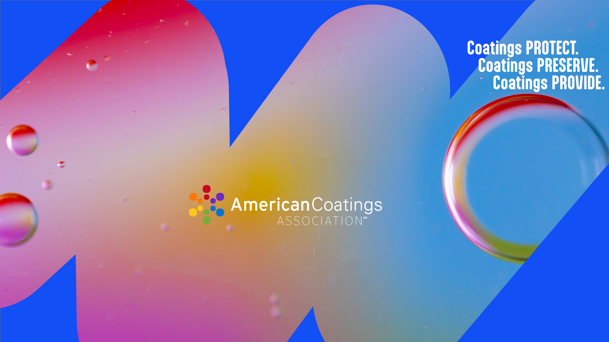

Slide 2




ACA
In Brief
177
Corporate Members
Founded in
1888
Headquarters
Washington, D.C.
Representing
more than
90%
of U.S. coatings
production
MEMBERSHIP
Coatings Manufacturers,
Raw Material Suppliers, Chemical Distributors, Adhesive and Sealant Manufacturers

Slide 3

ACA in Focus
New Strategic Conception
MISSION
Unite, advocate and advance the coatings industry through policy leadership, scientific excellence, and meaningful industry engagement
PURPOSE
Champion polices that spark innovation and fuel growth in the coatings industry
VISION
A thriving, innovative coatings industry powered by a smart, supportive policy environment

Slide 4

Day 1: Paint and Coatings Power Our Essential Industries
Day 2: Paint and Coatings Power Our Infrastructure
        Paint and Coatings Color Our Architecture & Built Environment
Theme: Coatings Touch Everything to Power Our World
Each day celebrates the extensive and essential reach of coatings and their contributions that make our world safer, more functional, sustainable, & resilient, as well as the value and benefits the global coatings industry brings to its customers, national economies and the world at large.
Day 3: Paint and Coatings Power the Global Economy
Day 4: Paint and Coatings Power Global Sustainability Efforts
Day 5: Paint and Coatings Power Innovation Across the Spectrum
Official Unifying Hashtag: #WorldPaintAndCoatingsWeek
March 23-27, 2026
Notes:
Theme: Coatings Touch Everything to Power Our World
Each day celebrates the extensive and essential reach coatings and their contributions that make our world safer, more functional, sustainable, & resilient, as well as the value and benefits the global coatings industry brings to its customers, national economies and the world at large.
Day 1: Paint and Coatings Power Our Essential Industries
From protecting our medical equipment, transportation systems, communications infrastructure, food packaging, and more, coatings touch everything and provide performance enhancement for critical applications and essential industries that keep our world running.
Day 2: Paint and Coatings Power Our Infrastructure; Paint and Coatings Color Our Architecture & Built Environment
Coatings touch every part of our infrastructure to preserve the products to which they are applied, delaying corrosion and extending the lifespan of bridges, railroads, water pipes, and more.
Paints and coating, add invaluable aesthetic value that transforms and beautifies our built environments, creating spaces that convey and elicit feelings and emotions held within space. For example, certain colors can make a room feel calmer and more relaxed, while others evoke a sense of excitement.
Day 3: Paint and Coatings Power the Global Economy
The paint and coatings industry provides significant value –creating jobs and products for industry and downstream users–Automotive, Aerospace, Defense, Communications, etc.– powering significant contributions to national, state and the global economy.
Day 4: Paint and Coatings Power Global Sustainability Efforts
Paint and coatings touch innumerable enhancements to the products to which they are applied– to preserve them and provide protection from degradation and boost energy efficiency, powering sustainability efforts worldwide.
Industry is a Sustainability leader in the EPR space: PaintCare and similar paint stewardship programs
Day 5: Paint and Coatings Power Innovation Across the Spectrum
The paint and coatings industry powers scientific and technological innovation and provides myriad professional opportunities across a range of career pathways, from research and development, sales, marketing, engineering, transportation, and more.
Official Unifying Hashtag: #WorldPaintAndCoatingsWeek

Slide 5

May 5-7, 2026
Over 500 exhibitors from across the world who will share the latest and most innovative coatings products and technologies
Vital platform for exhibitors to connect with new and existing customers and excellent business development opportunities
Unparalleled technical presentations including valuable coatings applications, sustainability, weathering & durability and how innovations in digitalization and AI are driving the industry forward
A focus on workforce development at American Coatings Industry (ACI) Career Center – a booth on the show floor – connecting new entrants to the coatings industry with potential employers

Slide 6
Roadmap
2026-2030
Advocacy First
Shape legislation and regulation to accelerate industry growth and innovation – federally and in every state.
One Voice, Big Impact
Tell a consistent narrative, backed by sound science, about coatings’ value and contributions – to people, planet, and economy.
Think Long Term
Anticipate challenges, seize opportunities, and align strategy with future-forward trends like sustainability and workforce shifts.
Collaborate to Win
Redesign member engagement, spark pre-competitive innovation, and break down silos across the value chain.
Build the Talent Pipeline
Attract and empower the next generation of leaders through education partnerships and strategic workforce development.

Slide 7
Envisioning
Success
By 2035:
ACA is the recognized policy powerhouse and unified voice of a sustainable, expanding coatings sector.
ACA sets the proactive agenda, shaping policies that advance industry circularity, sustainability, and innovation.
ACA influence is backed by strong data, collaborative research, and cross-sector partnerships.
ACA Membership is growing, engagement in deepening and ACA is recognized as both a catalyst for progress and a connector of people, idea leaders, and a driver of outcomes.

Slide 8

ACA’s Federal Priorities/Objectives
Trade and Tariffs
Microplastics
Chemicals Management/ TSCA Reform/ PFAS
Infrastructure
Increased Construction Activity Related to Housing
Notes:
Increased Construction Activity related to Housing – Previous data shows that increased housing construction (new homes and renovations) are a significant factor in increased sales of architectural coatings. ACA seeks to promote volume creation for the P&C industry and are actively promoting policies of accessibility and affordability.
ROAD to Housing Act aims to expand and preserve our country’s housing supply, improve housing affordability, and job growth
Infrastructure and Manufacturing – the construction and maintenance of highways, bridges, airports and other transport entities require high performance coatings which have corrosion resistance, UV reflectivity. Hydroponic aspects and many other performance characteristics. ACA supports infrastructure reauthorization bills which provide for additional research
Trade and Tariffs: Objective – Secure the supply chain for coatings and help ensure reliable and growing profit margins
Microplastics – Ensure that paint and coatings products are viewed as essential products to the built environment and that efforts to address microplastics pollution does not inhibit the coatings marketplace or innovative research/product development
TSCA Reform: Objective – Remove barriers to innovation and streamline TSCA procedures such as the timeline for the Pre-manufacture application, eliminate or significantly modify the use of SNURs and expansion of specific exemptions for the paint and coatings industry

Slide 9
ACA’s State Priorities/Objectives
Trends
  17 PFAS Bills in 8 states
  16 EPR Bills in 11 states
  8 Plastics/Microplastics Bills in 6 states
Microplastics
Chemicals Management/PFAS
Extended Producer Responsibility
Paint Stewardship
Judicial Reform
Air Quality
Notes:
Paint Stewardship – PaintCare is the premier award-winning stewardship program for paint and is responsible for over 74 Million gallons collected and responsibly managed; approximately 85% of latex paint is recycled and 100% of solvent base paint is sent for energy recovery where the solvent value is captured. Currently operating in 11 states and 2 more begin managing paint in 2025 (IL) and 2026 (MD).
Chemicals Management/PFAS – ACA is seeking a more reasonable definition of PFAS so that it excluded PCBTF and fluoropolymers, which are used extensively in high performance coatings. In addition, ACA seeks to promote coatings as essential products to the built environment and gain certain exemptions in the PFAS reporting rules as well as the “safer consumer products” types of programs that currently exist in a few states (CA, WA, VT)
Extended Producer Responsibility – Many states are considering EPR programs to manage the end of life of certain products, including packaging and household hazardous waste. PaintCare is the most effective EPR program and ACA wants to make sure that any other EPR requirements do not undermine PaintCare’s program. ACA also wants to ensure that PaintCare is the primary PRO for our member’s products so that there is no need to participate in packaging or HHW EPRs for coatings products. ACA has secured exemptions in all currently adopted laws for the PaintCare program and will continue to seek such exemptions.
Microplastics – Several states are considering MP proposals which range from bans on intentionally added MP to requirements for reporting. ACA’s goal is to ensure that the definition of MP does not inadvertently include paint, recognition of the essential nature of paint
Judicial Reform – Several states are also considering proposals that would increase the volume of tort litigation and pervert the judicial balance in favor of plaintiffs. ACA has opposed proposals which would subject our member companies to the jurisdiction of a state where there are no clear business ties or relationships (oppose general jurisdiction proposals) and supported third party litigation funding reform, requiring disclosure to parties regarding any funding support.
Air Quality - ACA has consistently sought to ensure that air quality standards adopted for coatings products are reasonable and based upon sound science. This effort extends to state standards as well as local standards.

Slide 10
State-Level PFAS Bills and Rule
Applies to PFAS, defined as substances having one fully fluorinated carbon atom.
State | Product Bans | CUU | Product Registration/ Reporting | Additional Requirements
Maryland AB 7738 | paint (no definition) Jan. 1, 2029 “covered products” | Health Safety Social Alternatives | Yes, but sponsor will remove. | Restrictions on AFFF
New York A7738 | “architectural paint” “covered products” Jan. 1, 2027 | No process. | No | Certification for covered products without PFAS
New Mexico Proposed Rules | General prohibition Jan. 1, 2032 Specified products earlier | Health Safety Social Alternatives | Yes | Labeling Fluoropolymers exempted from product bans only.

Slide 11


^{THANK YOU}
^{Questions/Feedback}
Heidi McAuliffe
hmcauliffe@paint.org
202-462-6272

