Slide 1

Notes:
Hello everyone thank you for taking the time to come to our first training workshop. Todays workshop is about how to grow our team and help us become the best we can be. We will learn the steps needed to recruit and hire the best additions to our team.

Slide 2
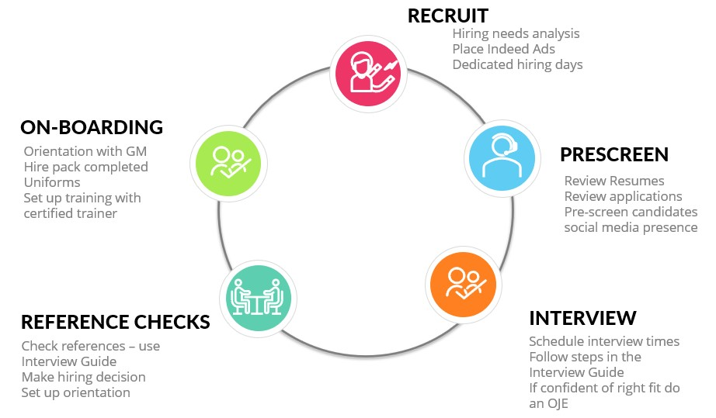
THE HIRING PROCESS
Notes:
The hiring process plays a major role in the success of our company. We need to make sure we are spending enough time and energy on growing our team. The hiring process is the manner of identifying our hiring needs, reviewing applications, choosing the right candidates to interview, perform reference checks, and on-board them.
The only way we can grow our business is to attract, hire and train great talented people. This includes part time employees as well as those that possess the competency required to grow with the leadership team. Hiring part time employees allows for greater control of your schedule and business. The person you decide to bring on to your team is the most important decision you will make. They can help build your business or they can hurt it along with all the positive work you and your team have been working on.

Slide 3
RECRUITMENT VS HIRING
Notes:
Recruitment is the process of advertising, attracting, interviewing, selecting and hiring. Involves everything from Identifying the need to hire to filling the role.
The main goal is to encourage a large number of people to apply for the position.
The recruitment mindset ”we are always looking for talent to join our team”. It is a constant process of attracting talent. We are always looking to improve our bench strength so we keep control of the business.
Hiring is when we just pick the best candidate out of the applications we have on hand. Doesn’t matter if they have any experience or the can do attitude. We just need to fill the gap in the schedule.
The Hiring mindset is telling an amazing rock star “I’m sorry we don’t have any openings right now” We are only hiring to fill a gap in the schedule not to build talent.
Recruitment is going out and searching for the best talent available. Always looking to grow the talent.

Slide 4

recruiting
Internal
  Existing Team Members
  Walk-ins
External
Notes:
The key to successful recruiting is adopting the mindset that we are ALWAYS hiring.
We all know what it’s like to be short-staffed and how that impacts hiring the right people. When we’re desperate, we fall into the “warm body” syndrome and hire anyone just to fill an open role. Superstars don’t show up when it’s convenient, so we need to shift our mindset to one that is always looking around at who might be that next great hire for our team.

Slide 5
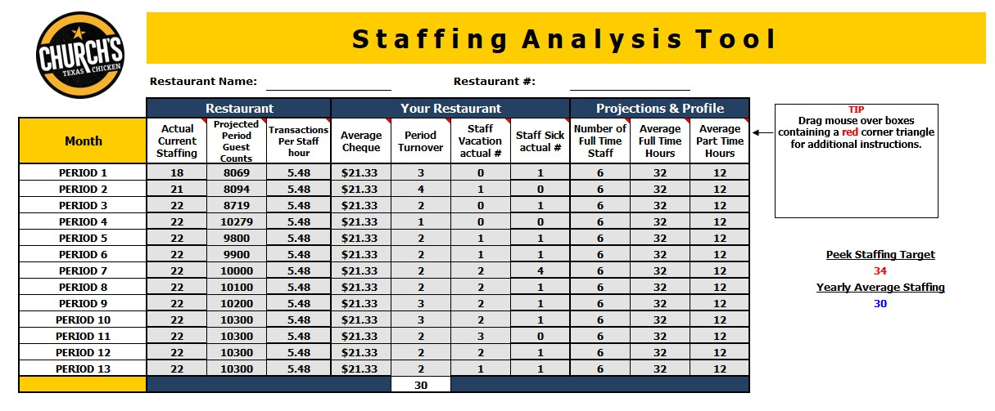
STAFFING ANALYSIS TOOL
Notes:
The first thing we need to do to start the hiring process is to know how many employees we need to effectively run the restaurant. This should be completed 2 months in advance of your needs to ensure we can on-board them correctly and in time for the volume shifts which is why you were required to add additional staff. So in May we should be hiring for July. If we haven’t already started this process, we are behind.
Ken has made a fancy easy to use tool to help give us accurate numbers.
Steps to complete the tool
Enter current staffing numbers only hourly staff. (find on PSR do not include borrowed staff and LOA)
Enter projected guest count for the period. (your projected sales from your 2022 labour plan divided by your average check)
Transactions per staff hour. (take total number of transactions and divide by the total number of staff hours used find the total staff hours on the PSR)
Average check total is total sales divided by transaction count
How many staff will leave this period based on recent trends. High may/June/sept check last year.
How many staff members will be on vacation this period? Use the actual number of staff away.

Slide 6
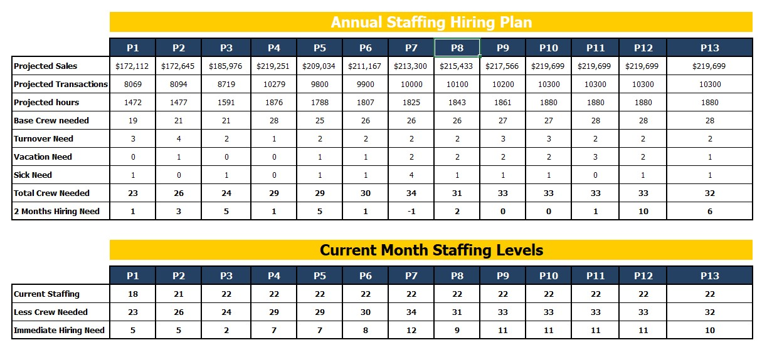
STAFFING ANALYSIS TOOL
Notes:
7. How many staff members will call off sick this period based on recent trends? Use the actual number of staff.
8. Total number of full time staff. Do not include salaried management.
9. The average number of hours given in a full time shift. (to calculate take the total number of full time hours used in a period and divide by the total number of full time staff, use your WPR for these numbers)
10. The average number of part time hours given in a part time shift (to calculate take the total number of part time hours used in a period and divide by the total number of part time staff, use your WPR for these numbers)
Please only fill in the top section of the form. The rest will populate itself with the formulas that are already connected.

Slide 7
RECRUITING
PART TIMERS
Notes:
Part time staff are going to be your best addition to your team. 3-4 hour shifts will help you hit your labour target. Your staff will be fresh and ready to take care of our guests. Part time staff are stackable! Double up dinner coverage. Need a late night bar closing helper done! More part time staff will give greater flexibility and control of your schedule. Extra short shifts to cover your rush times. Cheaper payroll on Stat holidays gives you more coverage.
More staff to cover sick calls. And help when you need it most.
Better pool of candidates to choose from. Attracting team that are students and constantly learning and growing. Staff that are active and bring fresh ideas and energy to the team.

Slide 8
INTERNAL HIRES
When a team member or management team refer a friend or family member to join our team they can earn $50.
The new hire must be successful and stay past the 3 month probation.
Constantly encouraging our staff to grow. Succession Plans are in place to map out the journey.
This is a win win situation for all parties.
Notes:
There are a few different ways we can recruit candidates. Internally is always the absolute best way to recruit. Good employees have good friends.
Put the word out to your team that if they recommend a friend or family member to join our team, and that person rocks and passes the 3 month probation period they will get $50 (in the form of a cheque separate from taxable payroll) This is your best tool for recruitment.
Have conversations with your team and help them grow. Do you know what your teams goals are? Do you talk with your part time staff and find out if they are interested in becoming a team trainer or shift leader? Or do we still have the old outdated mindset that only full time employees can lead a team? Set them up with a training plan to reach their goals.
Setting your team up for success sets the restaurant and you up for success.

Slide 9

EXTERNAL HIRES
Notes:
External hiring is done using many different tools to get the word out that we are looking to grow our team.
It is very important to maintain a high standard when using outside sources. We need to make sure that we are keeping all postings uniform, professional and accurate.
Your Market Leader will be your best ally in this venture. They will help you post hiring ads that will attract the type of candidates you are looking for.

Slide 10
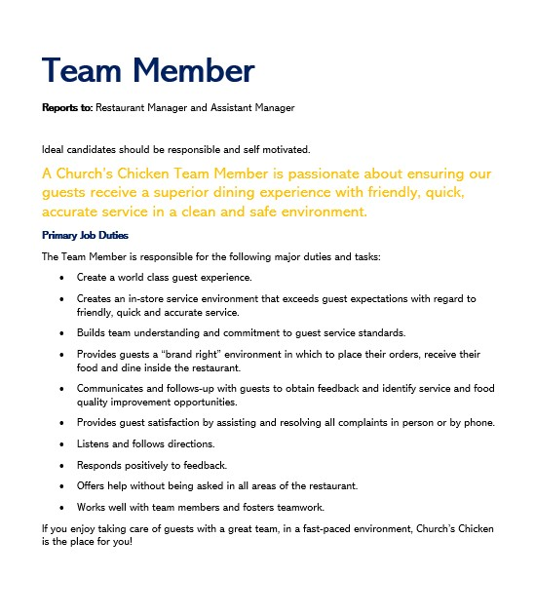
JOB DESCRIPTIONS
Accurate job descriptions will help attract the right potential when we place a ad.
They will also help us keep focussed on who we need to hire.
Notes:
Now that we know how many staff we need, we need to figure out what positions we need to hire for in order to compliment the team and fill any gaps we currently have or that we can foresee.
You need to know who you are looking for before you cast out the net.
Having an accurate job description is going to help attract the right candidates.

Slide 11

POST AN AD ON INDEED
Notes:
Indeed is a good way to get a large number of candidates. Your Market Leader can help place accurate professional ads for you.

Slide 12
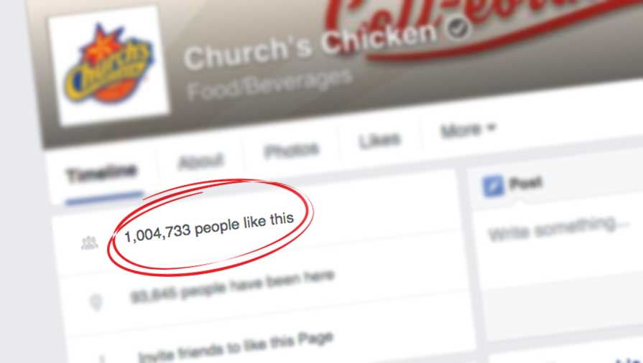
POST ADS ON OUR SOCIAL MEDIA
Notes:
We already have ads made on social media directing them to our careers page to apply.

Slide 13

APPLICATIONS THROUGH OUR WEBSITE
Notes:
Use the careers page applications. Already tailored for each restaurant and emailed directly to the restaurant. Act fast so you don’t miss out.
Make checking online applications part of your morning routine. Get them scheduled right away.

Slide 14

SERVICE CANADA JOB BANK
Notes:
Service Canada has a job bank that is easily accessible to people in the building applying for unemployment insurance.

Slide 15

HOST A JOB FAIR
Notes:
We can use our website social media and in house a-frame signs to host a job fair. You can arrange to have a few stores close together join each other with their Market Leaders to hold a day where they meet potential candidates and can host interviews right on the spot.

Slide 16
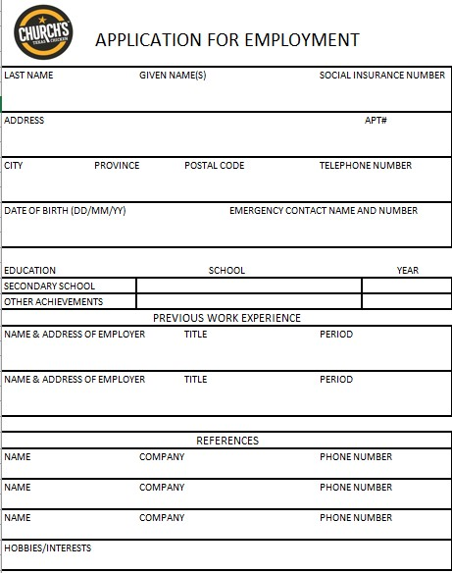
APPLICATION FORM
New form was created to keep on hand for any potential candidates that walk in.
Please keep copies at the front for easy access.
Have management receive them so they can be scheduled for an interview right away. We don’t want to lose anyone to our competitors.
Notes:
Keep application forms ready to hand out at all times.
Train your management to do a quick pre-screen when they receive a resume/application form.
A quick look to make sure everything is filled in and they can ask a few questions if needed.
If they look like they may be a good fit, set up the interview don’t let them leave without a time.

Slide 17
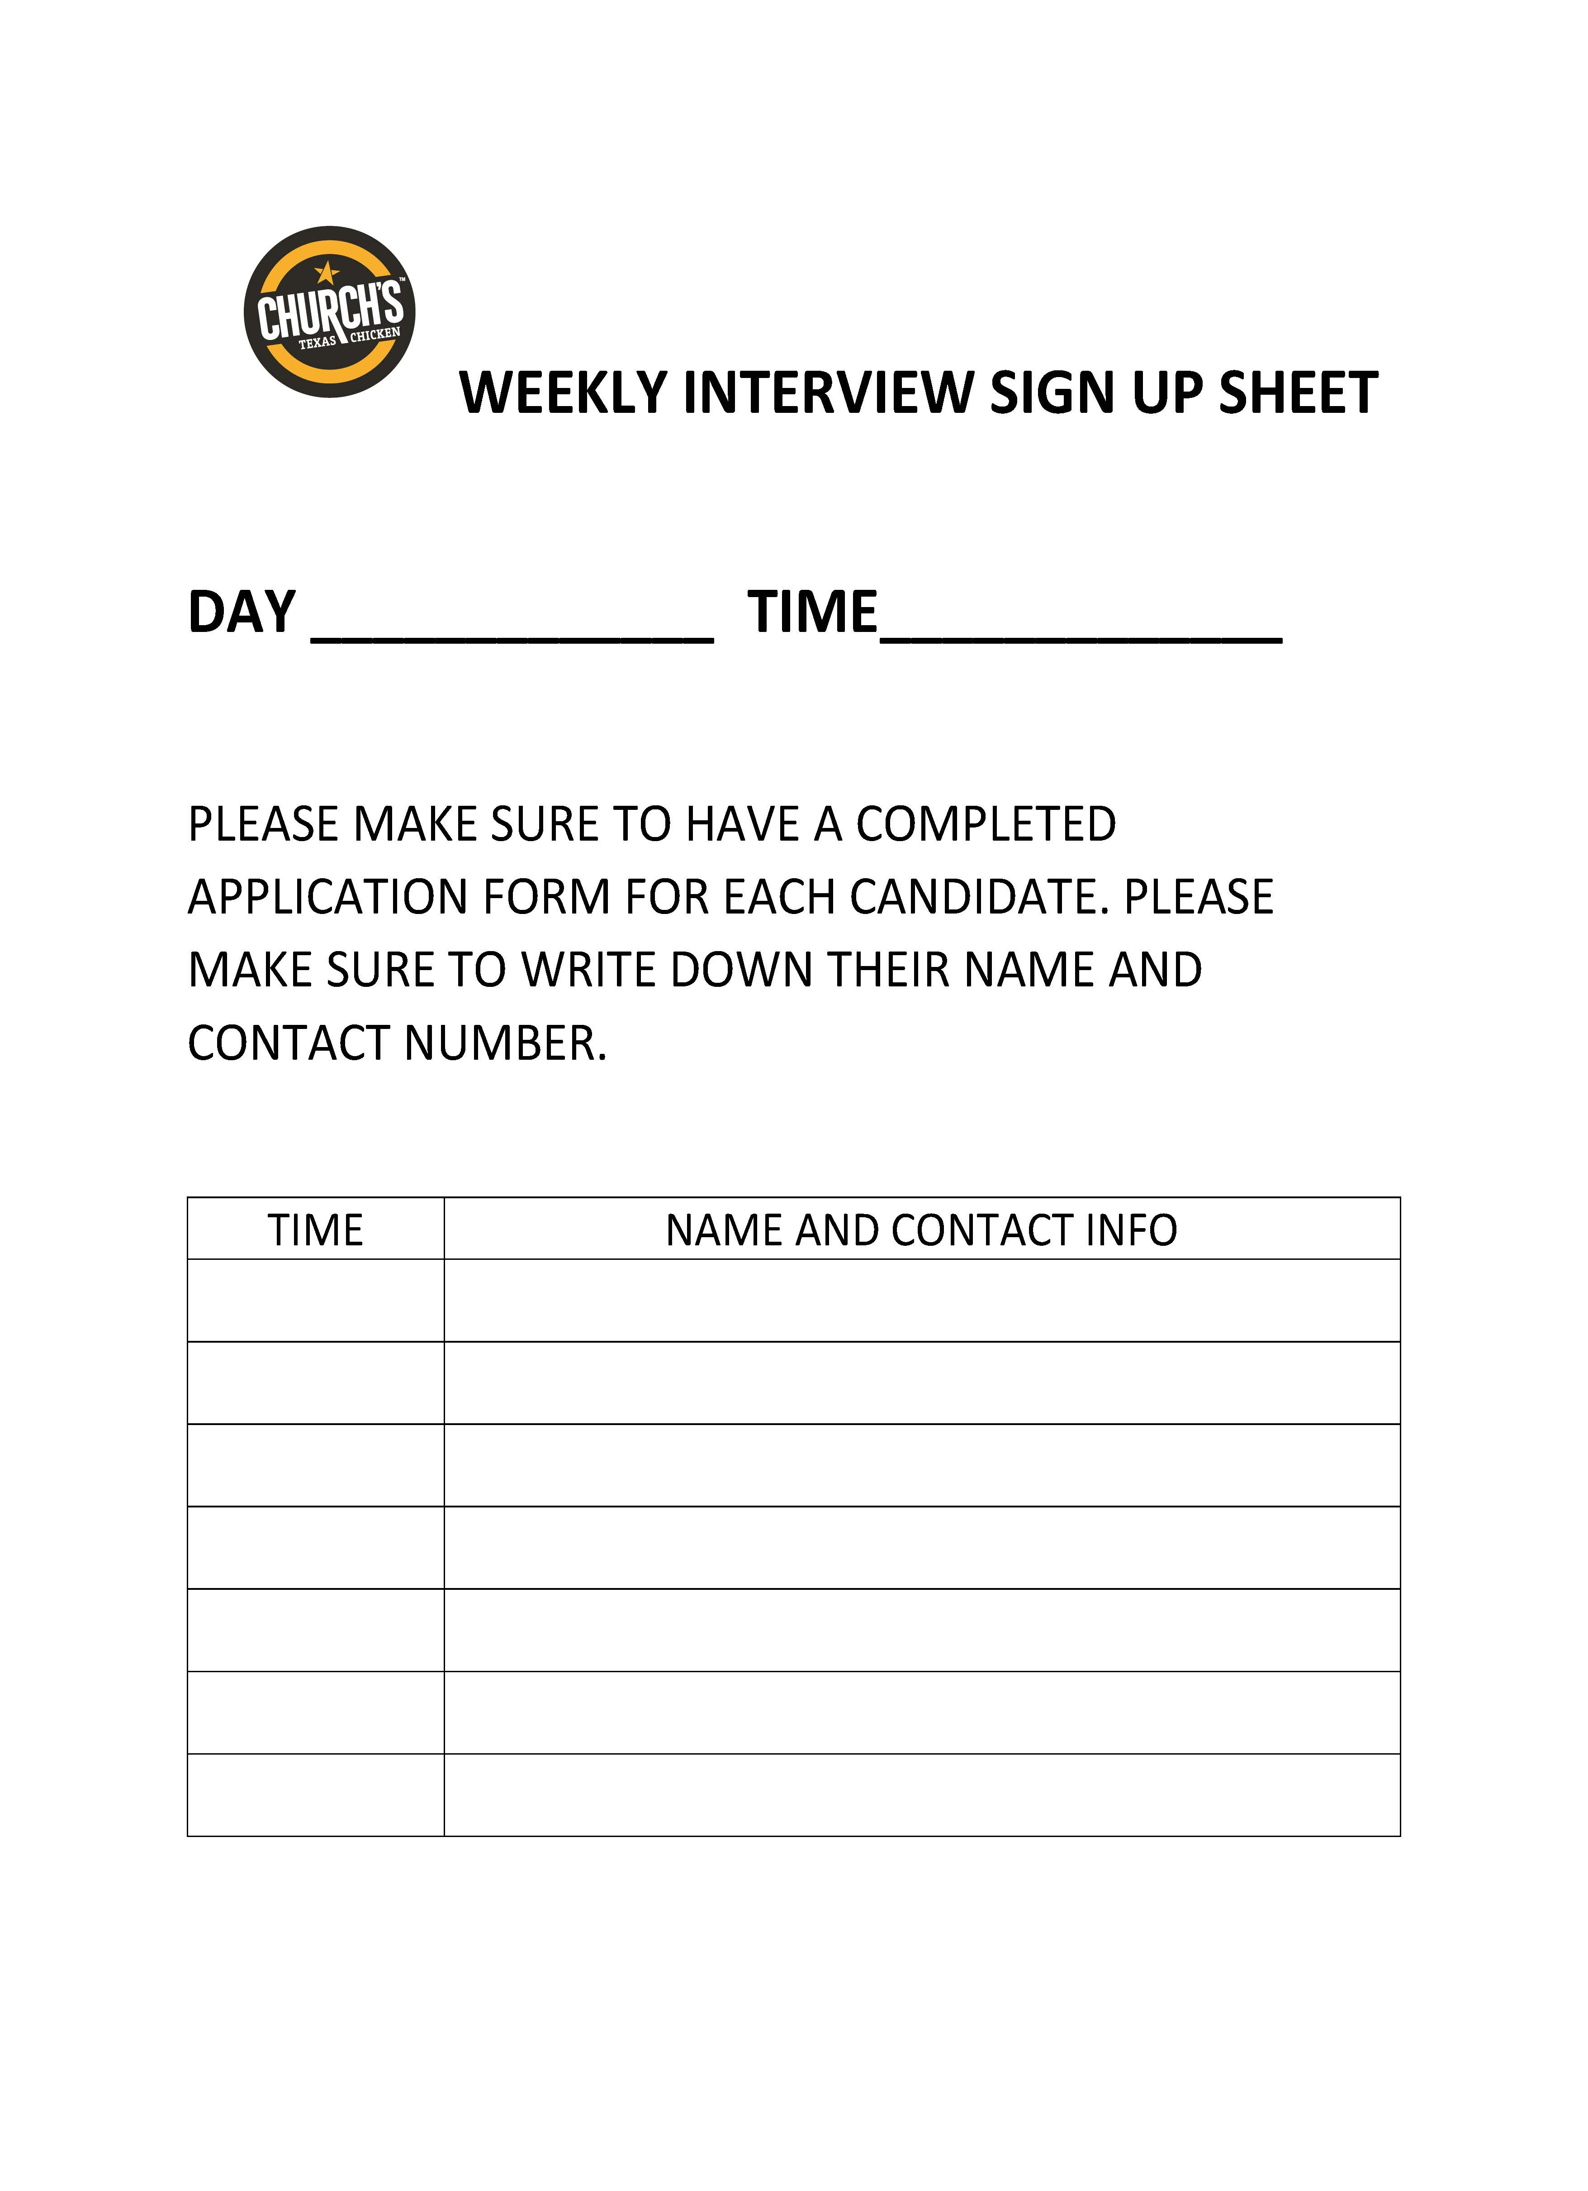
DEDICATED HIRING DAYS
What a great way to let people know you are serious about hiring.
Set aside a certain day each week and block off time for interviews.
Write on the schedule and make sure you have floor coverage during that time.
Notes:
We don’t want to lose them to our competitors. Keep your weekly sign up sheet updated and available for use. Make sure you have set the time aside and have management coverage during that time.
To make this work we need all management and staff know what is happening and when.
Restaurant manager sets up the date and time range to host interviews. Has this time blocked off on the schedule and has management coverage for that time. Also sets up the sign up sheet with the proper timings and placed where management can have easy access to it.
If a candidate comes in and applies in person the management can do a quick pre-screen and if they look good can set them up with and interview time before they leave.
Staff can let their friends know when the interview day is and they can come in and apply and get their timeslot.

Slide 18
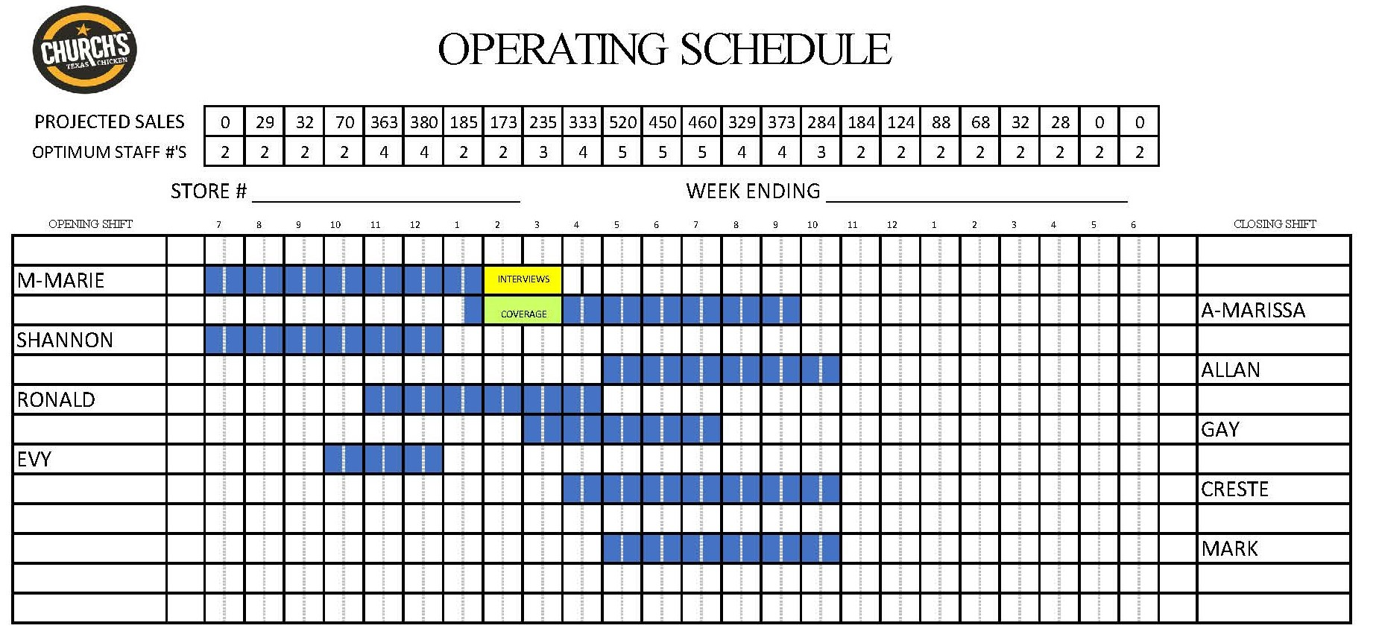
SCHEDULING INTERVIEWS
Make sure to clearly schedule and block off both the interviewer and coverage.
Notes:
Post the day and time on your schedule and make sure to block off your coverage too.

Slide 19
PRE-SCREEN
Notes:
Now that we have resumes and application show do we narrow down the pile? We know you don’t have enough time or energy to interview everyone.

Slide 20
RESUME/APPLICATION SCREENING
A quick skim will help eliminate candidates that do not need another minute spent on them (inexperience, many short stay jobs, looking for a position you are not able to offer)
Check the candidate’s social media presence.(Facebook, Instagram) look for red flags. (racial content, violence etc)
A quick phone call could help clear up any questions you may have before setting up an interview.
Help your management do a quick screen when a candidate comes in to drop off a resume/application form. Let them know what you are looking for good and bad.
Notes:
What should we look for when pre-screening resumes?
Experience, short job stays.
Check social media presence.
Quick phone call.
Ask team if attend same school etc.

Slide 21
INTERVIEW
Notes:
Effective interviewing is an art that takes time to master. As you progress your ability to ask the right questions and probe for the right answers will grow.

Slide 22

Notes:
You need to remember to talk less and listen more. Don’t be afraid of a few seconds of silence. Not every second needs to be filled. Give the applicant some time to finish an explanation. Make the few seconds of silence less awkward by finishing your notes. Then maybe rephrase the question or ask a more probing question. Be an active listener. Be present – if you are truly present in a conversation you are not doing anything else.
Find the best location away from other guests.
Remove distractions, let the staff know who to go to with questions or concerns.
Listen with your whole body, make eye contact, nod your head in agreement, echo back to them what you’re hearing.
Take notes it helps to keep you grounded in the moment.
Talk less listen more.
Listen listen listen
It’s a lost art.
Practice talking 10-20% and listening 80-90% of the time.
Ask clarifying questions. Dig deeper “what exactly do you mean by that?” or “why is that important to you?”

Slide 23
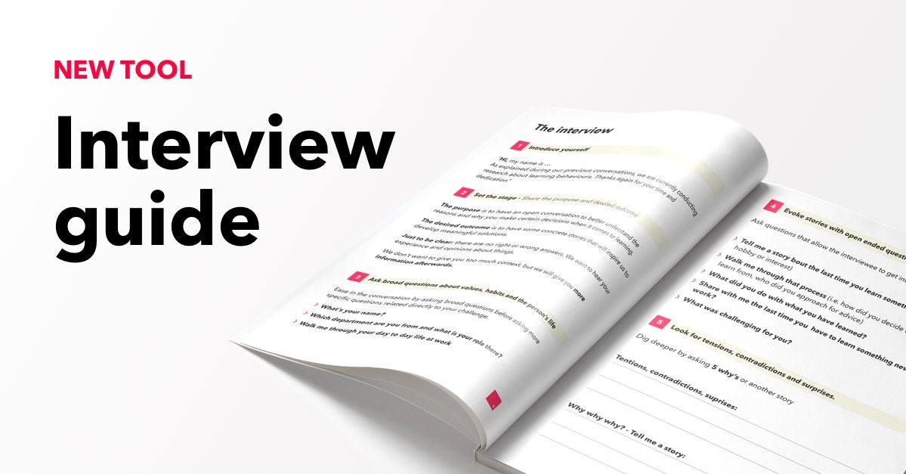
Notes:
We have created a new tool to use called the Interview Guide.
It has all of the steps laid out to host a successful interview. Remember successful doesn’t mean a hire. It could mean an elimination which will save time, energy and money in the grand scheme of things.
Before the interview make sure you are on time and look professional neat and tidy. First impressions are important. This is the candidates first impression of you and the company.
Make sure you are prepared with the candidates resume/application and interview guide. Know their name and everything is fresh in your mind. Make sure you are seated away from other guests for privacy and have a bottle of water ready for them.
Now the big event. Make sure you greet them warmly with a handshake and a smile. Introduce yourself and the role being interviewed for. Explain that you will be taking notes during the interview.
Start with some ice breaker questions to make them feel comfortable. Tell me about yourself? Are you currently in school? What are some of your favourite things to do? This will warm them up and allow for a more comfortable conversation.

Slide 24
HOSPITALITY QUOTIENT
It is the value of emotional intelligence. There are 6 traits of HQ
They are kind and optimistic.
They look at each day as an opportunity to learn something new.
They have an amazing work ethic.
They are highly empathetic (they can put themselves in your shoes).
They are self-aware (they are responsible for how they make others feel).
They have integrity (they have the judgement to do the right thing, even when no one is watching).
Notes:
Get ready to get to know more about your candidate using behavioural based questions. Behavioural based questions are a quick way to learn more about a candidates personality before you hire them. It is an assessment on traits that are not trainable. If you feel like their personality might be problematic move on. We will be measuring the hospitality quotient of each Q&A we ask. This is one way to evaluate a candidate. Either they possess these traits or they don’t. Your job is to get the answers you need to make that decision.

Slide 25
You are looking for them to describe the: Situation, Action & Result
SITUATION: Give a brief description of the situation.
ACTION: What specific action did you take?
RESULT: What was the result and how did you feel about it?

Slide 26
EXAMPLE QUESTION & ANSWER
TELL ME ABOUT A TIME WHEN YOU HAD A GREAT DINING EXPERIENCE? WHAT MADE THE EXPERIENCE SO GREAT AND WHY?
She went to Porter’s steakhouse with her boyfriend. She loved the atmosphere and the people. Everyone was friendly and the staff talked as if they were friends. The service was quick and friendly but most of all the food was fantastic. She even went out of her way to personally thank the manager when he came to the table. Great music, great service and great food. She will definitely go back. She felt extremely happy and told most of her friends about the experience.
Notes:
Read Q&A how do you feel about this answer? Do you think this is a yes or no for the HQ?

Slide 27

Notes:
Remember to listen more than you talk. Let the candidate respond before jumping into the next question.

Slide 28
PROBING QUESTIONS
What was the situation?
What did you do?
What was your role?
What was the result?
What would you do differently if faced with this situation again?
Notes:
Now that you have a good understanding of the type of person you are looking for please go through the guide questions with your candidate.
Please help them answer the questions if they are struggling.
You can try rephrasing the question or if you would like them to elaborate ask probing questions like the ones on the slide.
Listen to your candidates answers in order to not repeat questions.
How to gather the most information in a short period of time is through probing questions.

Slide 29
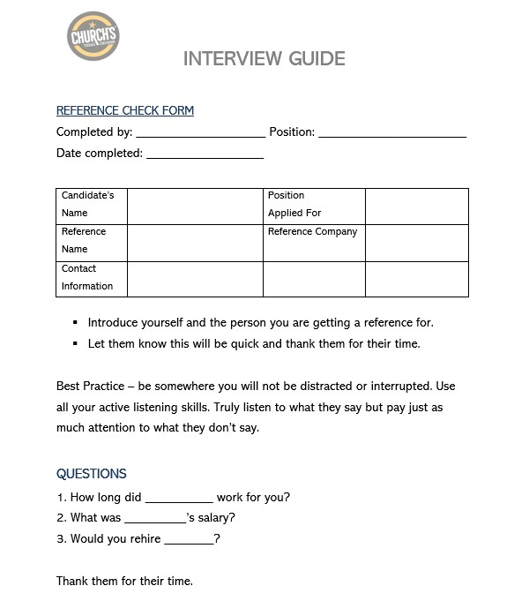
REFERENCE CHECK
Notes:
After a successful interview it is always a good idea to do a reference check. Just one more way to guarantee what you see is what you get. Follow the reference check form at the end of the Interview guide to help take the guess work out of it.

Slide 30
HIRING DECISION

Slide 31
HIRING DECISION
You have reviewed the candidates answers and done your evaluation.✓
Check references. ✓
Do you feel this candidate hit all of your must haves?
Notes:
First Impression.
Evaluation.
Reference Checks.
Communication Skills (Verbal and non-verbal)
Customer Service Skills
Previous Experience.
Enthusiasm.
Willingness to learn.
Do you feel they have checked all your boxes?
If yes, then hire them! Don’t waste time.

Slide 32
ON-BOARDING
Notes:
Take the most important next steps. Setting your new employee up for success from the very first day.

Slide 33

ORIENTATION
Notes:
It is very important that the orientation is conducted by the restaurant Manager.
It is super important to start our new employees journey with us correctly.
We need to make sure we are setting them up for success from the very beginning.
Let them know what is expected and how we are going to help them achieve any goals they may have.
This makes a better more loyal employee.
A properly executed orientation can reduce your turnover rate by 35%!!!!!

Slide 34
ORIENTATION
Orientation shifts are pre-planned and blocked out on the schedule just like the interviews.
Scheduled to be completed by the Restaurant Manager.
Uniform, all documents that need completion, passwords and training to punch in and out are ready and available.
Introduce to the team and give a restaurant tour.
Have the next training shifts planned and scheduled with a certified trainer.
Notes:
Set up their orientation and make sure you have it scheduled properly with you the restaurant manager hosting the orientation with your coverage by a shift leader or management.
Be prepared ahead of time with uniform, hat, name tag, all documents that need to be filled out and any password s and log in information they will need.
Be ready to show them how to punch in and out as well as long into the PTEU website to start their training.

Slide 35
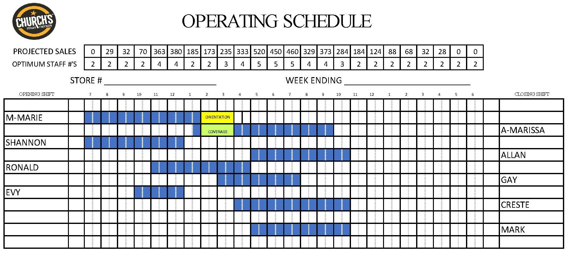
ORIENTATION SCHEDULED

Slide 36
ROLE PLAYING PRACTICE
This is a great opportunity for hands on practice in a safe and fun atmosphere.
Break into groups of 3 to do mock interviews. Each person will have the chance to be each of 3 parts, the observer, Restaurant Manager and the candidate.
This will give hands on practice with the interview guide.
It will allow you to ask questions and practice probing for answers.
It will help you feel confident to bring on great additions to your team.
Notes:
And most important have fun!!

Slide 37
Role of Candidate
To play a candidate selected for an interview. To help the interviewer practice questioning and probing for clear answers. To help the interviewer become confident and able to successfully host a productive interview.
Role of Observer
Observe the interview during the group practice round and complete this questionnaire, so that you can provide the interviewer with constructive feedback at the end of the interview.
Role of the Manager
Follow the Interview Guide and have practice asking probing questions. Feel confident with the process.

Slide 38
ROLE PLAYING

Slide 39
MANAGERS ROLES & RESPONSIBILITIES
Notes:
Managers job is to run the business. This doesn’t mean you are not responsible for the Operations or that you don’t help during volume or peak periods, however, you spend a significant time of the day Managing The Business.
Reviewing labour from previous day and balancing the week – every day
Reviewing sales projections for the day
Ordering
Cash Management
Orientations
On boarding – initial training – discuss the impact and loyalty created by taking an interest
On Floor coaching and training (recognize Manvinder / Joseph)
These are the roles of the Manager. These are serious responsibilities and need to be treated as such. You run 2, 3 or sometimes 5 million dollars businesses. That’s a big deal. That takes a serious professional to optimize the return that ownership deserves to make. It’s not a game.
The Assistant Managers jobs are to run the Operation –
Improve DT speed
Improve procedures and ultimately yields and food cost
Floor control at an exceptional level
Ability to coach and train – make people better tomorrow than they were today

Slide 40
ASSSTANT MANAGER DEVELOPMENT
Notes:
We have brought in a lot of new talent and also starting to promote some great talent from within, which is fantastic.
But with this support, there is expectations…….DEVELOP THEM!!!!!
They are not here to be glorified counter staff. If you don’t know how to develop a leader, reach out to your Market leader for help. Don’t discard this talent and support in running your business. I would hire or promote 30 assistants today. That means some Restaurants might have 3 assistant Mgrs. As a Manager, how are you going to:
develop them
challenge them
engage them
Have them contribute to the success of the Restaurant while growing themselves.
That’s the job of a Restaurant Manager!!!!
For the assistants, if your not receiving this, talk to you Manager. We are all here, I’m here to support you and your growth. But real growth. Real Learning. Real contributions.

Slide 41
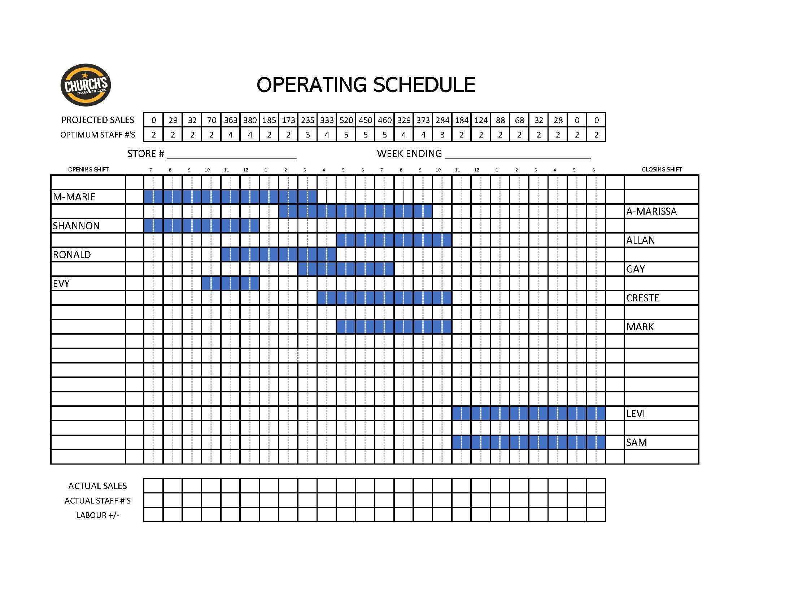
SCHEDULING
Staffing
Part-time 4 hour shifts.
Purpose of schedule.
People Development.
Time to run the business.
Scheduling.

Slide 42

HIRING & ORIENTATION
Notes:
More to come
This will be a Managers responsibility

Slide 43
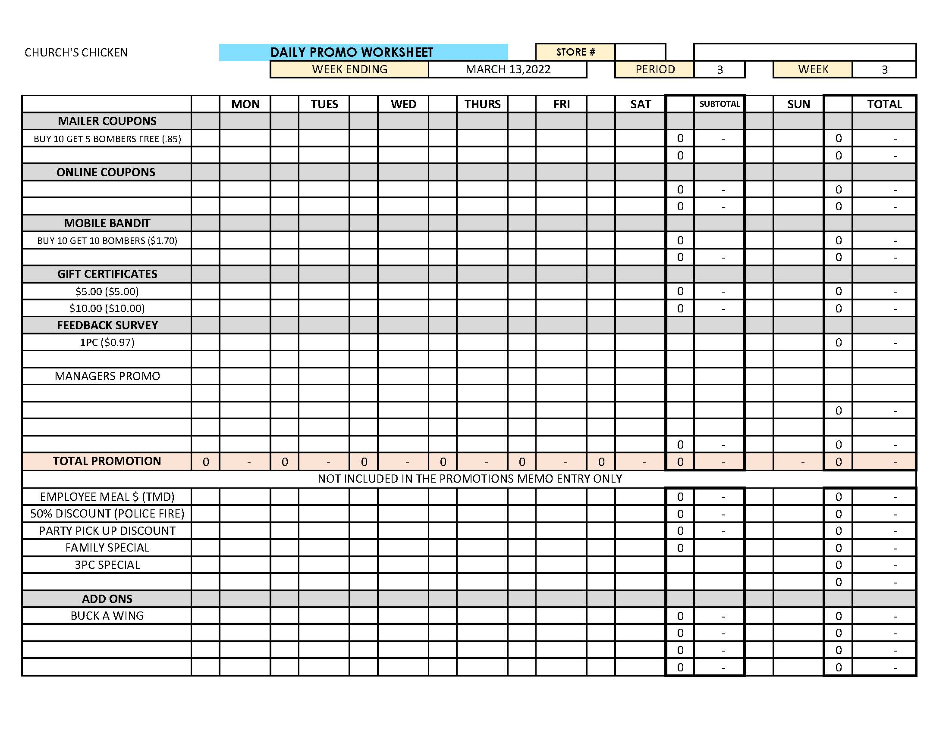

PAPERWORK
Notes:
Pretty clear – a professional Manager would take their paperwork completion, timeliness and accuracy seriously. If you don’t know, ask.

Slide 44
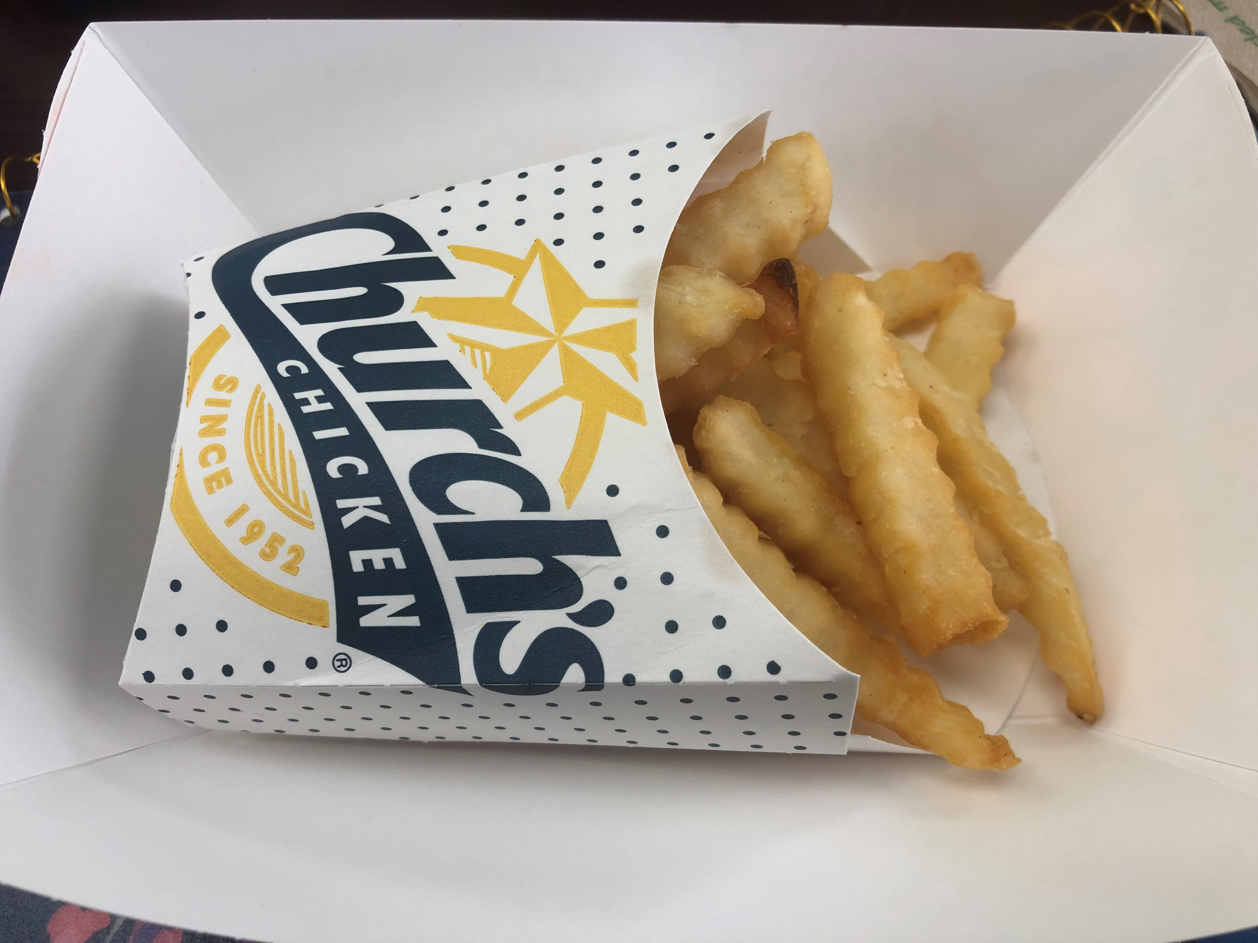
FRIES
Salting.
Packaging.
Shortening Management.
Yield.
Production Management.
Notes:
This is something that would be part of an Assistants job – Fries, totally operational.
When will we start salting the fries? It’s a procedure. We have purchased the salt shakers?
Shortening Management – food cost directly. An assistant should be responsible for filtering, how washes, oil changes and even boil outs. Measure by the extension of the oil while still maintaining quality standards
Yield – operation. Satisfaction of customers balanced with food cost.
Production management – negative impact on speed of service.

