Slide 1
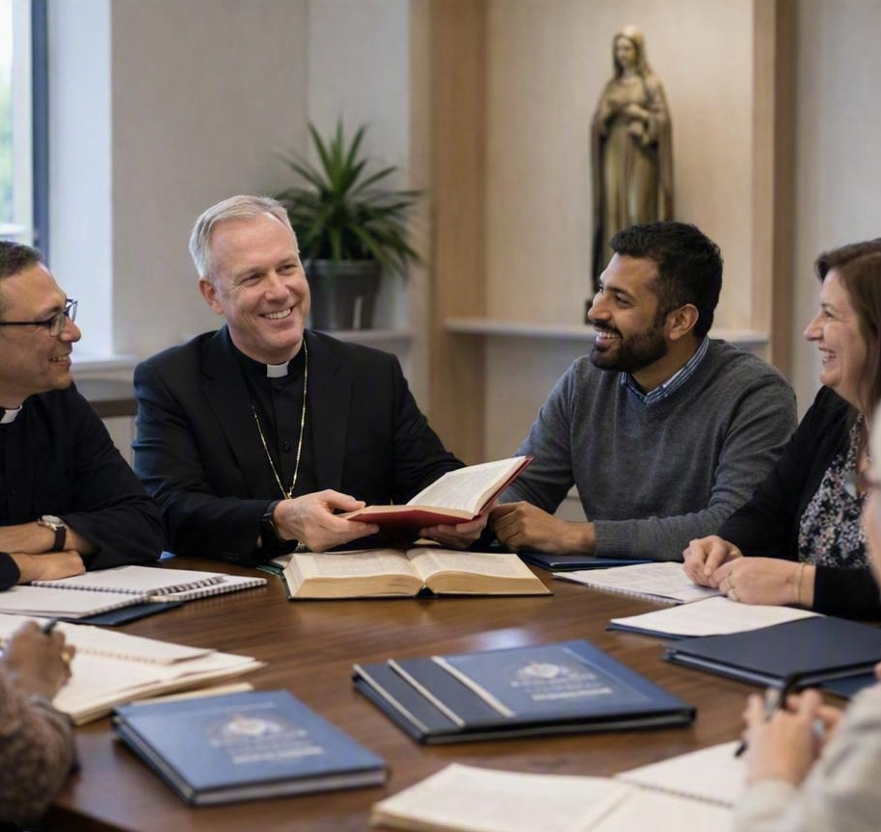
FROM CLASSES
TO DISCIPLES
Why our deanery needs one shared OCIA catechetical mission
13 parishes • one Church • one journey of initiation
Deanery OCIA Collaboration

Slide 2
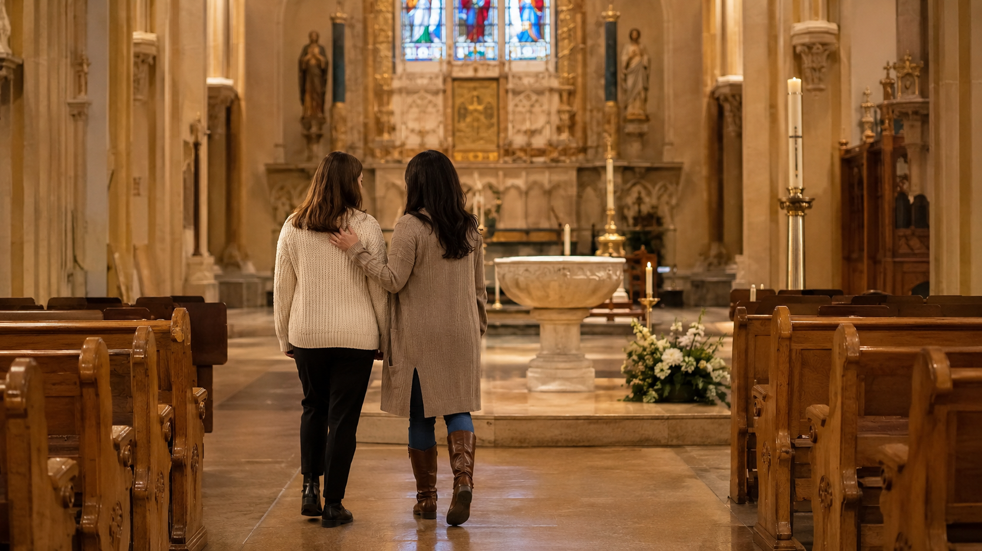
THE PASTORAL PRIORITY
We are teaching doctrine. But are we making disciples?
The challenge is not effort. The challenge is fragmentation.
Uneven catechesis
Lessons without accompaniment
Some parishes have gifted teachers; others lack consistent depth and rhythm.
Doctrine is presented, but sponsors are often under-formed and underused.
A program with an endpoint
Weak parish belonging
When everything aims at Easter Vigil, mystagogy becomes optional or disappears.
New Catholics may receive sacraments but never feel integrated into a community.
If people receive sacraments and do not return, we have completed a program—not formed a disciple.
Deanery OCIA Collaboration • Liturgy & Life: The Emmaus Journey
02

Slide 3
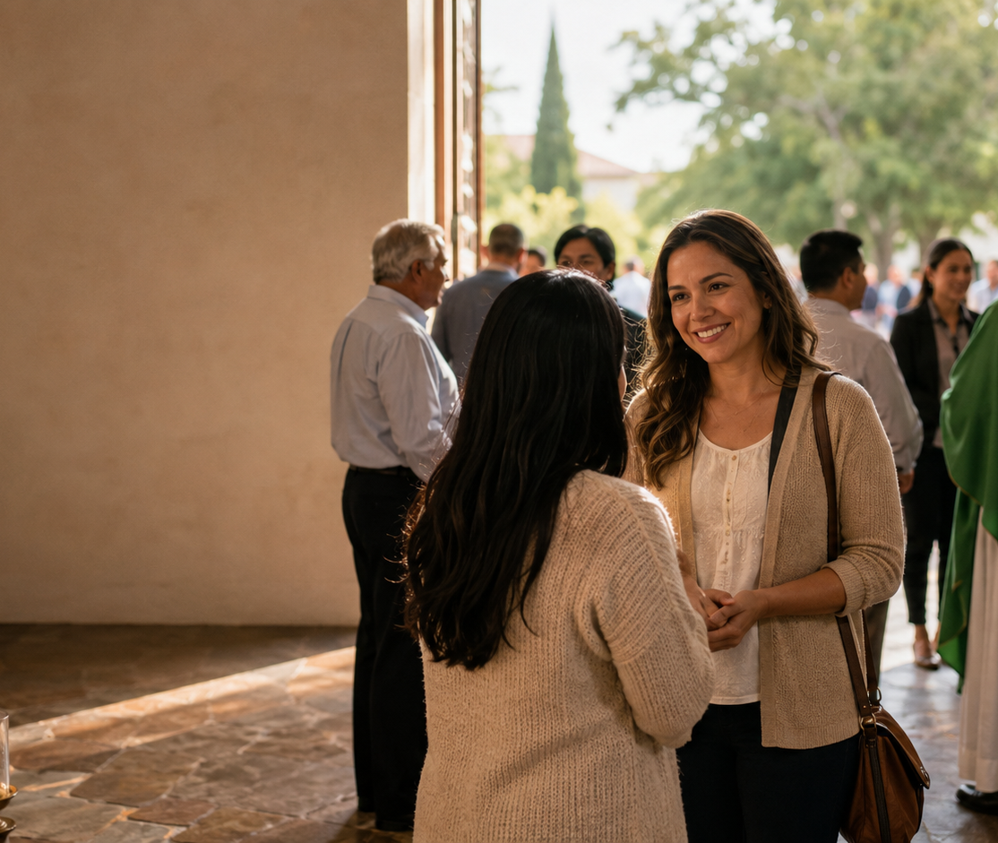
THE GOAL
OCIA is not a class. It is a journey into the life of Christ.
Initiation forms the whole person: mind, heart, habits, worship, belonging, and mission.
What OCIA forms
A disciple learns to live, pray, worship, belong, discern, and witness as Catholic.
What Easter Vigil begins
The sacraments are not graduation. They begin a visible life of parish communion and mission.
What collaboration protects
A complete journey: inquiry, catechesis, rites, mystagogy, and mission.
Deanery OCIA Collaboration • Liturgy & Life: The Emmaus Journey
03

Slide 4
Sharing our Gifts
A deanery-wide collaboration: one excellence, many homes
We share what should be shared—and protect what must remain local.
Deanery provides excellence in liturgical catechesis
Each parish provides the irreplaceable local journey
• A gifted catechetical team of priests, deacons, and lay leaders
• Weekly liturgy-based formation
• Catholic Updates aligned to the Sunday readings
• Consistent doctrinal depth across all parishes
• Shared preparation resources for clergy, catechists, sponsors, & OCIA Leaders
• Pastoral accompaniment of inquirers
• Formation and mentoring of sponsors
• Participation in parish community life
• Discernment with candidates and catechumens
• Celebration of the rites within parish life
Not centralization. Collaboration.
Deanery OCIA Collaboration • Liturgy & Life: The Emmaus Journey
04

Slide 5
Shared Liturgical-based Catechesis
Let Sunday lead the formation
Catholic doctrine is taught through the liturgical year—not as disconnected topics.
1
2
3
4
Monday Catechesis
Scripture Summary
Sponsor Accompaniment
OCIA formation
Breaking open the Word Guide provides a reflection on the Readings for the Priest/Deacon, and for the Parish Leaders
SPONSOR GUIDE provides practical approach to Accompany the Candidate/Catechumen through Witness, Faith Sharing, Practical Application, a Holy Habit, and Introduction to Parish.
LEADERS GUIDE provides practical recommendations for Parish Involvement and Home/Family Application.
The readings set the theme. The Catechetical Guide is Liturgically Based providing Doctrinal Instruction and Preparation for the Scriptures..
Each week becomes one coherent movement: hear Christ • learn with the Church • respond as disciples • go forth as witnesses.
Deanery OCIA Collaboration • Liturgy & Life: The Emmaus Journey
05

Slide 6
At the PARISH
The parish does what no deanery team can do
The deanery can teach together. Only the parish can accompany, welcome, discern, and celebrate locally.
Pastoral accompaniment
Know the story, wounds, questions, and pace of each inquirer.
Sponsor formation
Train sponsors to witness first, listen well, and walk consistently.
Parish life
Move people from attending sessions to belonging to a community.
Discernment
Help candidates and catechumens recognize readiness, conversion, and obstacles.
Rites
Celebrate the steps of initiation in the life of the local Church.
The deanery strengthens catechesis so parishes can strengthen accompaniment.
Deanery OCIA Collaboration • Liturgy & Life: The Emmaus Journey
06

Slide 7
SPONSOR MINISTRY: A Ministry of Accompaniment
The sponsor is not a name on a form. The sponsor is a companion.
We will stop treating sponsors as passive witnesses and start forming them as ministers of accompaniment.
Reflection
Conversation
The sponsor begins by examining his or her own discipleship.
Faith-sharing follows witness—not interrogation.
Action
Accompaniment
Each week includes one Catholic practice to do together.
Each week connects the person to parish life and relationships.
Practical example: sponsor and candidate attend Mass together, meet two parishioners after Mass, pray one decade of the Rosary, or serve together in parish outreach.
Deanery OCIA Collaboration • Liturgy & Life: The Emmaus Journey
07

Slide 8
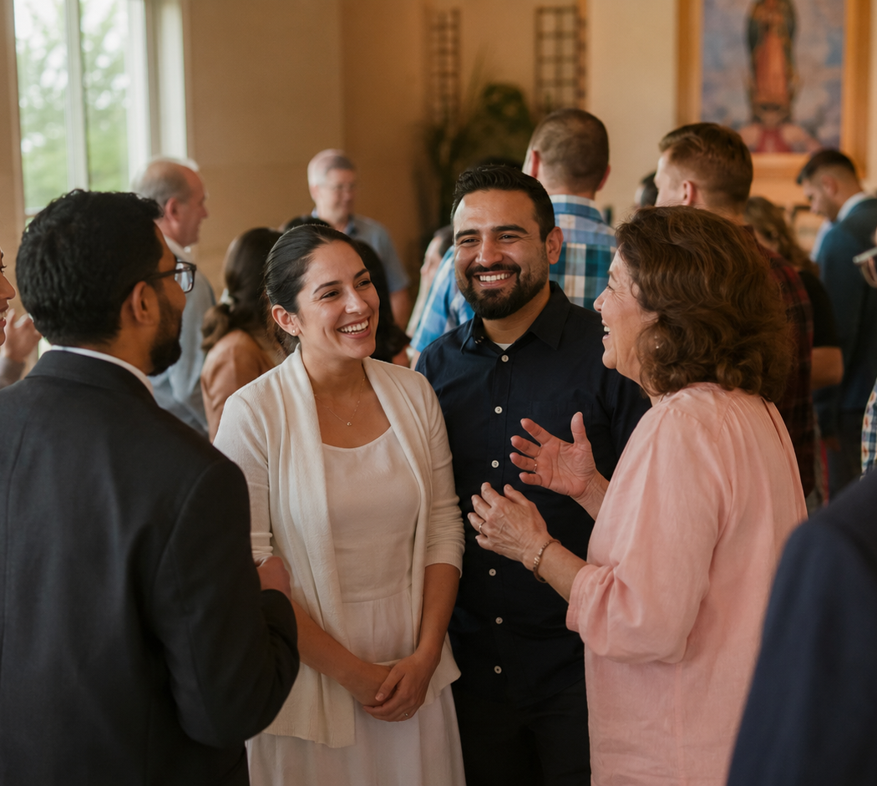
BELONGING
People return where they are known
Sacraments introduce people into communion. Parish life helps communion become home.
1
Name
Greet them by name at Mass and parish events.
2
Invite
Invite them to coffee, service, prayer, and seasonal devotions.
3
Introduce
Sponsors connect them with parishioners and ministries.
4
Remember
Follow up after rites, absences, and milestones.
Belonging is a pastoral strategy.
Deanery OCIA Collaboration • Liturgy & Life: The Emmaus Journey
08

Slide 9
AFTER EASTER VIGIL
Mystagogy is where the newly initiated learn how to stay
The Easter Vigil completes initiation sacramentally; formation continues as neophytes enter mission
Pentecost
At least through the season
Easter Vigil
Mission
Sacraments of Initiation
Serve Christ and the Church
Deanery catechesis should prepare the parish for mystagogy—
not replace it.
Source note: USCCB describes the period of Mystagogy as continuing at least until Pentecost and focusing on Scripture, Sacraments, service, mission, and outreach.
Deanery OCIA Collaboration • Liturgy & Life: The Emmaus Journey
09

Slide 10
WHAT PARTICIPATION LOOKS LIKE
A practical model for the 13 parishes
Simple enough to implement. Strong enough to change outcomes.
Deanery catechesis
Mystagogy plan
Parish accompaniment
Sponsor practice
Weekly liturgical catechesis using Sunday readings and designated Catholic Updates. Shared catechist preparation and materials.
Each parish guides inquirers, forms sponsors, celebrates rites, and integrates people into community.
Sponsors receive weekly practical actions: prayer, parish introduction, service, devotions, reflection.
After Easter, parishes continue Eucharistic reflection, mission, and ministry integration.
The shared deanery lesson becomes the launchpad—not the whole journey.
Deanery OCIA Collaboration • Liturgy & Life: The Emmaus Journey
10

Slide 11
WHY SAY YES?
Collaboration gives every parish more than it could provide alone
The fruit is not efficiency alone. The fruit is discipleship.
For candidates
consistent teaching, personal accompaniment, visible parish belonging
For sponsors
formation, confidence, practical weekly mentoring and ministry
For catechists
shared preparation, stronger content, better use of gifts
For pastors
Scripture Summaries AND quality formation without each parish carrying the whole burden
For parishes
new Catholics who return, serve, and belong
We will not simply improve OCIA sessions. We will change the way people are accompanied into the Church.
Deanery OCIA Collaboration • Liturgy & Life: The Emmaus Journey
11

Slide 12
THE ASK
What we are asking each parish to commit
A deanery model only works when each parish embraces its own part of initiation.
1
Name a parish OCIA contact
one person who communicates with the deanery team
2
Identify a sponsor lead
someone responsible for sponsor formation and follow-up
3
Use the weekly deanery catechesis
align doctrine and liturgy across the 13 parishes
4
Build local accompaniment
coffee, check-ins, Mass, devotions, service, parish introductions
5
Plan rites and mystagogy now
do not wait until Holy Week to decide what happens after Easter
Deanery OCIA Collaboration • Liturgy & Life: The Emmaus Journey
12

Slide 13
The Emmaus model
Christ walks with them.
He opens the Scriptures.
He is known in the breaking of bread.
He sends them back as witnesses.
That is the pattern of OCIA.
That is the promise of deanery collaboration.
Let us not merely provide doctrine.
Let us form disciples.

Slide 14
WHAT PARTICIPATION LOOKS LIKE
A practical model for the 13 parishes
Simple enough to implement. Strong enough to change outcomes.
Enlightenment
Mystagogy plan
Period of Inquiry (PARISH)
Catechumenate (Deanery/Parish)
Deanery Provides Monday Mystagogical Catechesis
Parish (After Easter), parishes continue Eucharistic reflection, mission, and ministry integration, and Program for ongoing Formation.
Ongoing, Continuous
Monthly / Bi-Monthly
Deanery Provides Catechetical Instruction (Monday Evenings via Zoom)
Parish builds on Catechetical Instruction with Breaking Open the Word, Sponsor Accompaniment, Discernment, & Parish Engagement.
Deanery Provides Monday Catechesis.
Parish provides Spiritual Preparation, Celebration of Rites, Spiritual Preparation, Prayer, Discernment & Parish Engagement
The shared deanery lesson becomes the launchpad—not the whole journey.
Deanery OCIA Collaboration • Liturgy & Life: The Emmaus Journey
10

Slide 15
Deanery Calendar
• Inquiry: Ongoing Inquiry: Monthly, Bi-Monthly – Continuous and Ongoing (PARISH)
• Catechumenate: Rite of Welcome, Rite of Entry into the Order of Catechumenate, (PARISH)
Monday Evening Catechesis (Zoom) (DEANERY)
Sponsor Formation, Sponsor Accompaniment, Breaking Open the Word (PARISH)
• Enlightenment: Monday Evening Catechesis (DEANERY)
Rite of Sending (PARISH)
Rite of Election (DIOCESE)
Spiritual Discernment & Preparation (PARISH)
Celebration of the Scrutiny's & Sacraments of Initiation (PARISH)
• Mystagogy: Monday Evening Catechesis (DEANERY)
Mission & Commitment to Ministry (PARISH)
Discernment & Commitment to Ongoing Formation Program (School of Disc., Called & Gifted, Pillars, etc.) (PARISH)
Deanery OCIA Collaboration • Liturgy & Life: The Emmaus Journey
14

Slide 16

Deanery OCIA Collaboration • Liturgy & Life: The Emmaus Journey
14

Slide 17
REFERENCE NOTES
Sources and grounding
For presenter reference
• USCCB Christian Initiation of Adults: mystagogy continues at least until Pentecost and includes reflection on the Easter Vigil, Scripture, Sacraments, service, and mission.
• OCIA policies: the community participates throughout the process; sponsors and godparents support, witness, discern, and accompany.
• Local parish OCIA practices: sponsors act as a bridge into parish community, faith-sharing, Mass attendance, and parish events.
• Liturgy & Life: The Emmaus Journey: weekly liturgy-based catechesis paired with Catholic Update resources and local parish accompaniment.
Deanery OCIA Collaboration • Liturgy & Life: The Emmaus Journey
14

