Slide 1
Digital Consent Transformation Case Study: EIDO pilot – breast surgery
Lisa Whisker
Consultant Oncoplastic Breast Surgeon
KAREN HASSELL
ADVANCED CLINICAL PRactitioner/Divisional Quality Director

Slide 2
Conflicts of Interest
Reviewed breast surgery leaflets for EIDO
voucher payments to the breast unit
personal conference registration fee
subsistence for this conference
Notes:
None for the pilot!

Slide 3
Background
Written consent previously obtained on morning of surgery
Consent guidance
Concerns – Timing of consent, manpower, logistics
PRE COVID - Service Evaluation into the Informed Consent Process
3 Focus groups consisting of
Consultant Breast Surgeons (n=5),
Junior Doctors (fellow level) (n=3) and
Patients who had consented to breast surgery in the previous year (n=5).
Notes:
Fast pathway in breast (& all cancers)
Reflect on observation of consent in practice – more experienced surgeon offered different procedure

Slide 4
Quotes from patients
……I think to a certain extent you need some explanation, a little bit more to say what might happen, not just you know, de,de,de,de,de,de,de de
but, they haven’t got the time really, …your mind is not really processing it, you know, they come up with all of these things and its just a blur
Notes:
Patient 4
Invite to read quotes

Slide 5
Quotes from patients
It is a bit like a spiel sometimes you know on the television when they are going to arrest somebody and then they say the whole thing don’t they, it’s a bit like that,
they’re just going through the motions as they are saying it rather than actually explaining it and making sure that its been understood.
Notes:
Patient 5
Invite to read quotes

Slide 6
Quotes from focus groups medical staff
I think it (consenting and marking) can be quite rushed on the morning of surgery
And I think that we are not being realistic to say that this is proper informed consent..its just not
I find it really it's very difficult especially in the confines of the NHS you literally just have to say look these are the facts relating to this operation
I don’t think it’s necessarily a particularly comprehensive consent
How valid is our consent on the day..erm I do have concerns about that
Notes:
Consultants and breast surgical fellows
Invite to read quotes

Slide 7
The Pilot
EIDO system is available within the hospital for electronic patient information
Opportunity to update the breast information leaflets
Volunteers requested for a trust pilot
Breast is a more complex specialty (with stacked procedures)
Patient volunteer ‘testers’ from our support group (previous patients) to develop the system for breast patients.
External test system (not integrated)
Notes:
Electronic patient information very useful in COVID times can be delivered electronically or printed (patient preference)
Electronic consent process involves an external system for the pilot which is not integrated

Slide 8
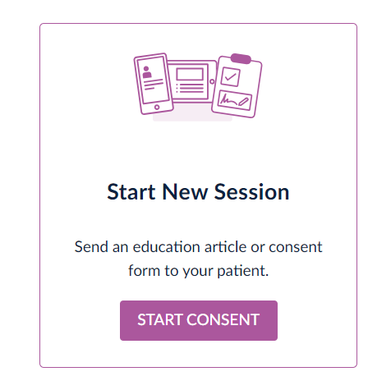
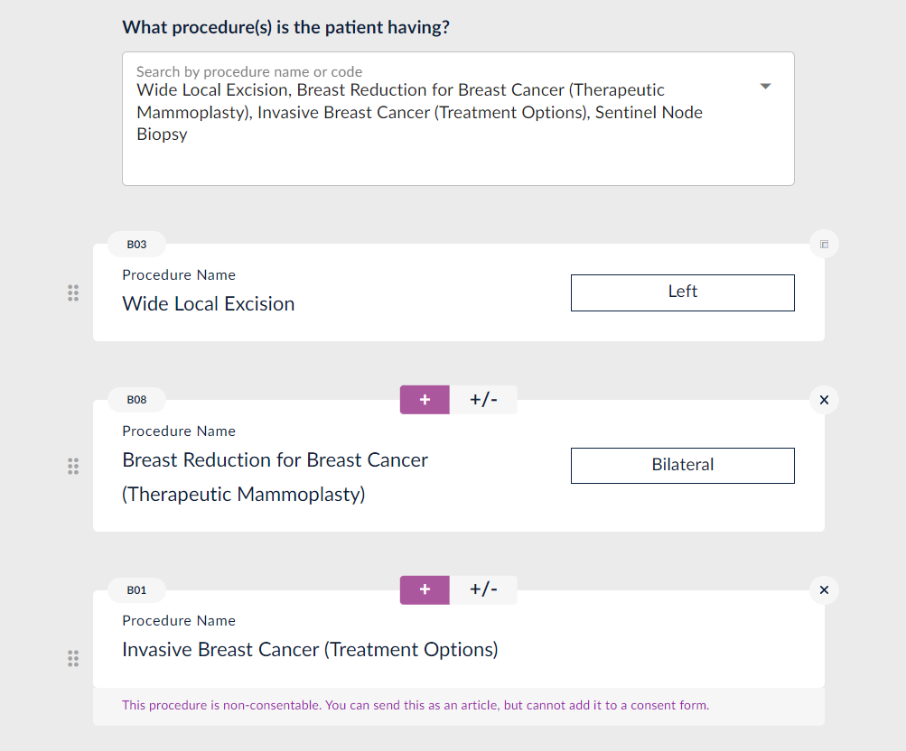
E-consent process
Notes:
Add patient to the system
Add all procedures planned
Add any additional information eg invasive breast cancer options
Confirm laterality of each procedure

Slide 9
E-consent process
Add any patient specific information eg ‘no animal derived products’
Add patient specific risks if appropriate
Complete the clinician consent statement
Either send to patient to complete at home or work through together with staff or support in clinic.
Notes:
Confirm you have explained the procedure risks and benefits

Slide 10
Pilot outcomes
Mar – Nov 24
145 offered e-consent
58 e-consent used in theatre
4 not reached date of surgery yet
4 awaiting surgery date or confirmation of procedure
66

Slide 12
Notes:
½ that patient didn’t complete the digital process
¼ failure on the hospital side (agency staff declined to allow, failed to load to EPR)
¼ unclear

Slide 13
Patient Evaluation
Electronic survey
22 responders
Notes:
sent after completion of e-consent
All who gave feedback thought it was easy

Slide 14
Notes:
Most got information in more than one type ( to be expected as pre-op and post-op information is not integrated for the pilot but will be if adopted across the trust)

Slide 16
Notes:
Time to consider is something a lot of clinicians were concerned about with our traditional process

Slide 19
Do patients feel involved?

Slide 20
Do patients feel empowered?

Slide 21
Would patients ‘go digital’ again?

Slide 22
Comments from patients
Really simple process Didn’t time out. Broke the items to read up Individually so wasn’t overwhelming.
All fine

Slide 23
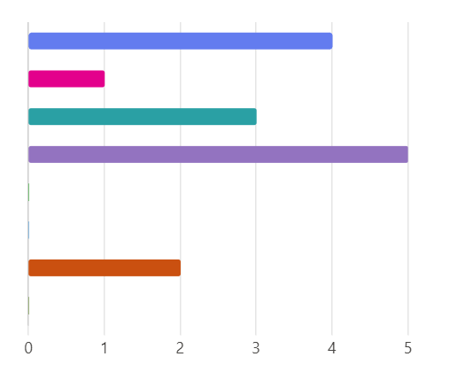
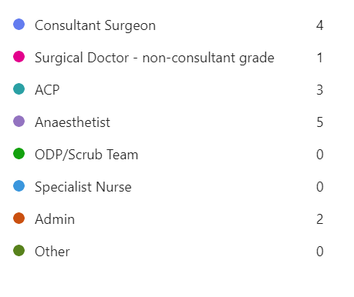
Staff Evaluation – Responses =15
Responses

Slide 24
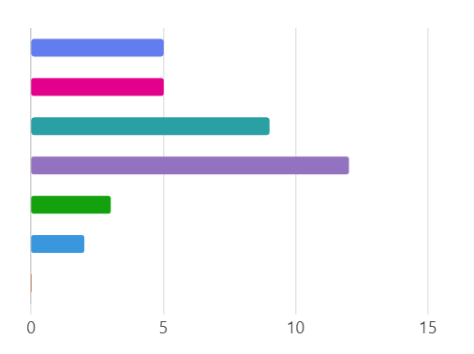
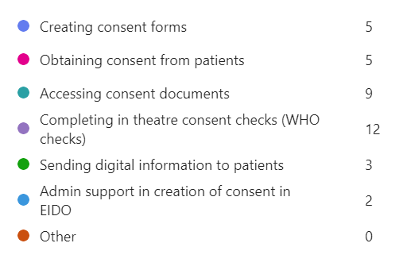
What was your involvement with Digital Informed Consent?

Slide 25
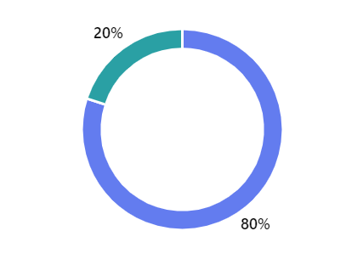
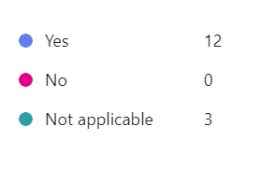
Did you feel your patient received adequate informed consent?
Notes:
Everyone who takes consent thought it was adequate

Slide 26
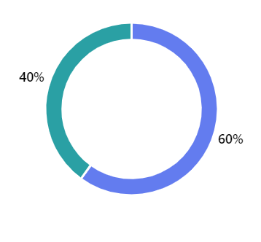
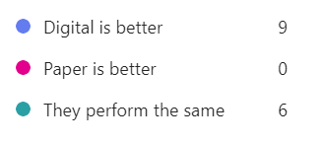
How does digital informed consent compare to paper informed consent?
Notes:
All thought same or better

Slide 27
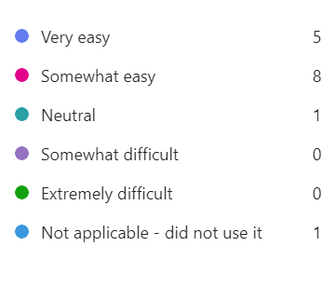
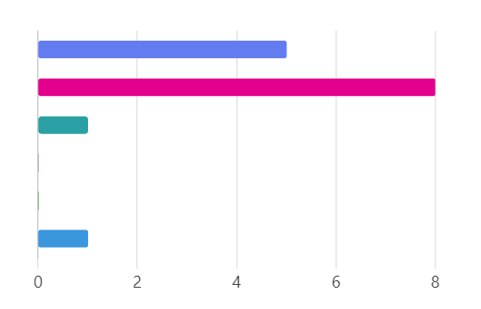
How easy did you find the process?
Notes:
All easy or neutral

Slide 28
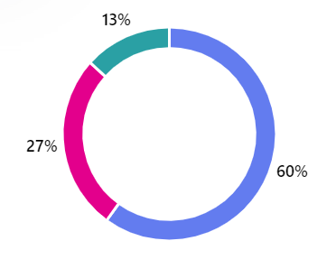
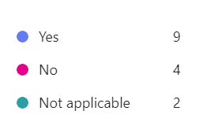
Did you find that using digital consent saved time and improved the process on the morning of surgery?

Slide 29
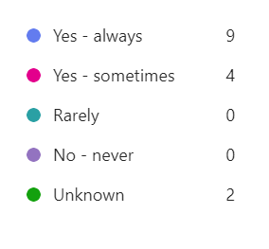
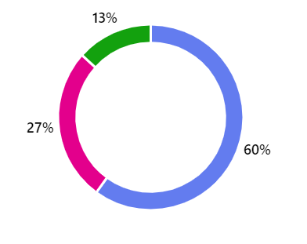
Was the consent form available in digital health record on day of surgery

Slide 30
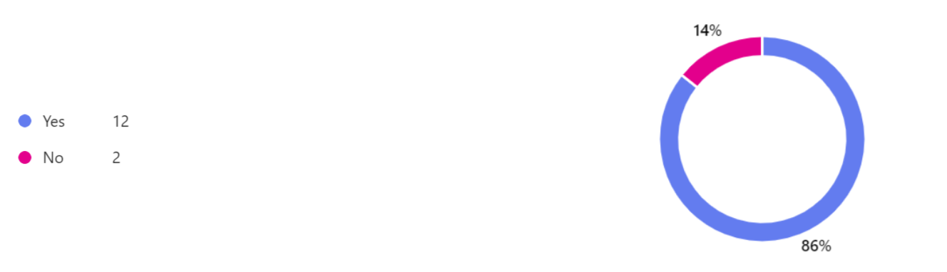
Was the equipment available to you to access digital consent?

Slide 31
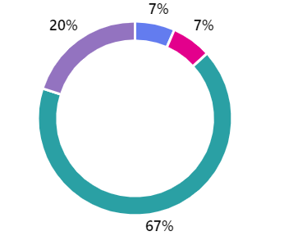
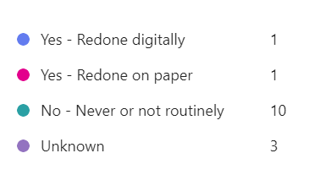
Did the consent have to be redone?

Slide 32
Are any procedures missing from the program?
Revision of breast reconstruction
Nothing that I have noticed
Axillary Node Sampling
Fat grafting
Duct Excision
Notes:
Duct surgery and fat grafting or lipomodelling are written and going through process to be added.

Slide 33
Do you think any changes are needed to the process?
I think digital consent is much easier and saves time on the morning of surgery.
It’s a great tool, I hope it gets used more widely
The biggest issue is ensuring that the patients are sent the link for the consent form prior to the surgery date and this is very dependent on clinician involvement
Texts or email prompts to remind patients to complete
e-consent
Notes:
Reminders are built in.

Slide 34
Do you think any changes are needed to the process?
Electronic consent has performed well in my experience
Consent forms should be logged in DHR in the consent section
Integrating into theatre routine that the patients consent form is accessed by surgical or scrub team to prevent delays
Time consuming adding the patients details in clinic
Notes:
Filing of consent forms to ‘consent section in EPR has been sorted months ago.

Slide 35
Any additional comments
Recent feature added to resend the link really helpful
It is ideal that all patients sign their consents in advance of their procedure date in accordance with NICE guidance
All consents should follow this process
Ideally have ipads in theatre to confirm consent

Slide 36
Challenges
Uptake
Engagement with digital systems that are not integrated
Variability between clinicians / staffing
Common in breast to stack procedures
Technical issues e.g. Filing under consent in EPR
Ensuring mobile numbers and/or email addresses are available
Notes:
Delegated consent means its not always a priority

Slide 37
Take home messages
EIDO system has enabled breast services to move away from consenting patients on the morning of surgery
All patients
remembered receiving procedure information
felt the digital process gave them a good understanding of the benefits of the recommended procedure
Vast majority of patients felt
the digital process gave them adequate time, they were adequately involved, they understood alternatives to the procedure and could ask questions of clinicians
they were empowered to make decisions
Notes:
Vast majority was greater than 90%

Slide 38
Thank you
The patients
The breast team at Nottingham University Hospitals
Adelynn Immaunuel (Med Student) for clinician feedback survey
Kareemah Elahi (Med Student) & Patient Experience Team for patient feedback survey
Becky Bashford – our IT liaision
The team at EIDO

