Slide 1
Informed consent after Montgomery. Implications for surgery and patient safety
November 2024

Slide 2
The first time I took consent……
The person who takes consent should be able to do the procedure…..
Consent on the day……
Patient information leaflets
Sticky labels on written consent forms…..

Slide 3

Implications of the Montgomery ruling

Slide 4
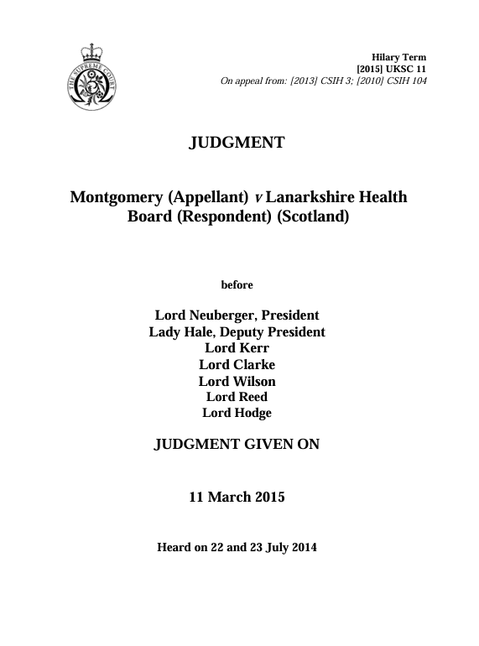

e-Consent
Montgomery 2015Consultation

Slide 5
Montgomery ruling
“The doctor is therefore under a duty to take reasonable care to ensure that the patient is aware of any material risks involved in any recommended treatment, and of any reasonable alternative or variant treatments.”
“The test of materiality is whether, in the circumstances of the particular case, a reasonable person in the patient’s position would be likely to attach significance to the risk, or the doctor is or should reasonably be aware that the particular patient would likely to attach significance to it.”
Lord Kerr and Lord Reed [2015] UKSC 11

Slide 6
Montgomery
Montgomery vs Lanarkshire Health Board (2015)
  The watershed judgment in the Montgomery case shifted the focus of consent towards the specific needs of the patient
  Traditionally clinical practice in the NHS has considered that it is up to doctors to decide what risks to communicate to patients
  Following the Montgomery case judgment doctors must now ensure patients are aware of any and all risks that an individual patient, not a doctor, might consider significant.
  Doctors are no longer the sole arbiter of determining what risks are material to the patient.

Slide 7
Montgomery ruling – Core implications for surgery
Patient specific-consent
Knowing the patient
Onus on the surgeon to ensure the patient is fully informed of the procedure and its consequences
Knowledge of and access to alternative treatments
Consent form vs Decision-making record
Consent vs Supported Decision-making
Communication skills
Time pressures– requiring better information technology

Slide 8
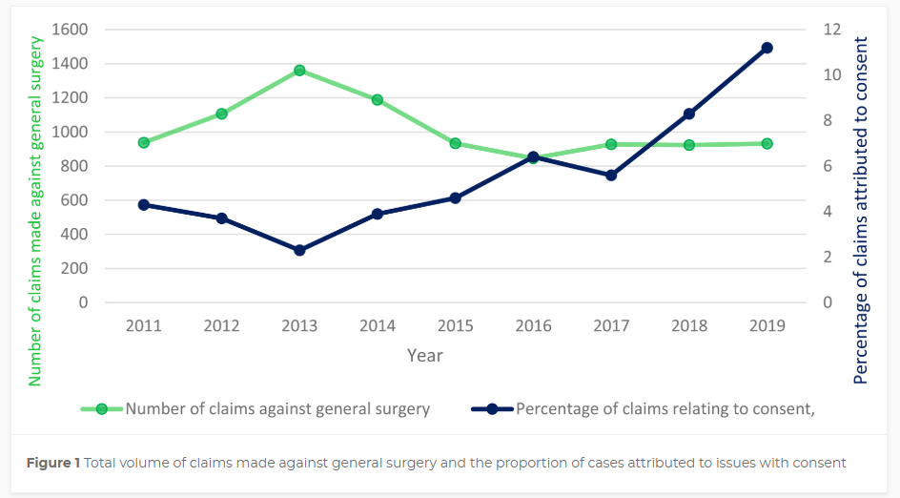
Litigation data – NHS Resolutions
“Variations in consent” Sebastian et al, RCS Annals Vol 106, Number 2
https://doi.org/10.1308/rcsann.2023.0020

Slide 9
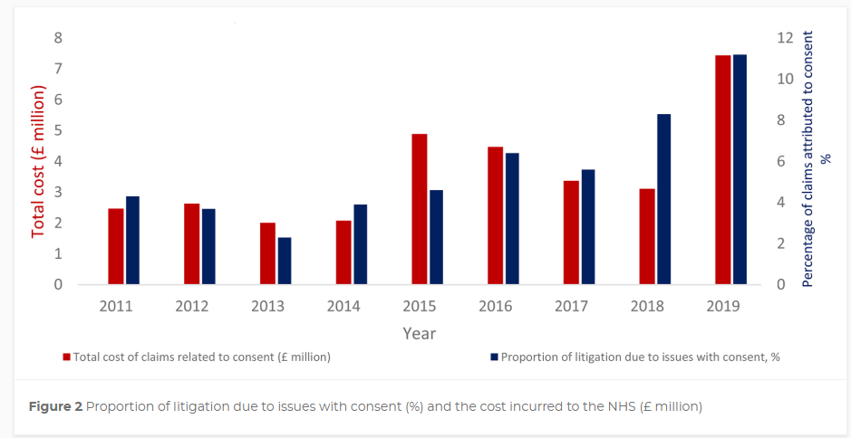
Cost to the NHS
Notes:
Percentage of claims related to informed consent more than double over perif 2011 – 2020
Disproportionate rise in medicolegal cases related to consent in 2015.

Slide 10
Chat GPT
Patient safety benefits of informed consent
Informed consent is a fundamental aspect of patient care that plays a crucial role in promoting patient safety
By ensuring that patients are fully informed about their treatment options, procedures, and associated risks, it helps prevent adverse events, enhances communication, and supports shared decision-making

Slide 11

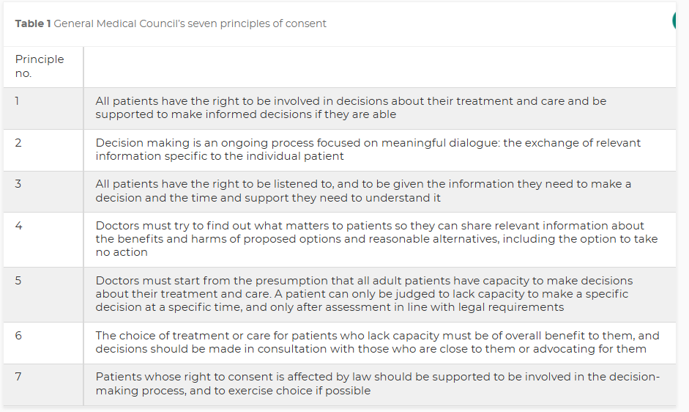
Seven principles of consent
Involve patient
Ongoing process – information exchange
Listen to the patient
What matters to the patient
All adult patients presumed to have capacity
Choice for patients without capacity made in consultation with advocates
Consent affected by law should still involve the patient if possible

Slide 12
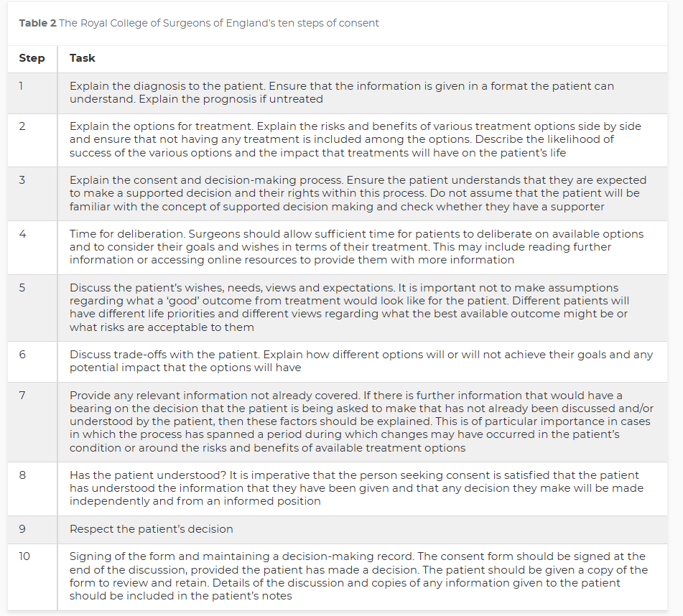
RCS England - 10 Steps to consent
1)Diagnosis
2)Options
3)Explain consent process
4)Time
5) Discuss Wishes
6) Trade offs
7) Relevant information
8) Check understanding
9) Respect the patients decision
10) Sign the consent form
10a)Maintain a decision making record

Slide 13
Enhanced Patient Involvement in Decision-making
Shared Decision Making (SDM) Must be demonstrated
Patients (and their families) are active participants in decision regarding their healthcare
BRAN
Benefits
Risks
Alternatives
(do) Nothing
Decisions that align with their preferences and values
Refuse treatments they are not comfortable with
Avoid unwanted procedures
Ask questions
Voice concerns

Slide 14
Enhanced Communication
Open communication fosters a better understanding of the treatment and encourages trust between patient, their supporters and provider
Clear Expectations
  Potential complications
  Expected outcome
  How to manage (reduce) risk
Shared information
  Medical conditions, anaesthetic difficulties, previous treatment

Slide 15
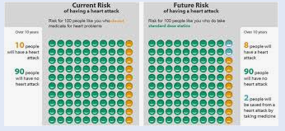
Fully informed?
“Material risk”
Multiple risk quoted as percentages
  1 in 5 (20% ) of the adult population has forgotten how to work out a fraction or percentage
  Use number out of 100
Long list of potential risks does not improve understanding

Slide 16
Empowerment and Trust
Patient Empowerment
  Patients have a voice in their care
  More likely to ask questions
  Engage in their treatment
  Take steps to ensure own personal safety
Building trust
Informed patients feel respected
Better collaboration and adherence to safety protocols

Slide 17
Better post-treatment Outcomes
Preparation for Recovery
  Patients who are informed about potential risks
  Clear expectation of post operative recovery
  More likely to follow post-treatment instructions and avoid complications
Alertness to complications
  Earlier recognition and reporting of complications
  Seek medical help
  Reduce adverse outcomes

Slide 18
Consent does not prevent errors!
Surgeons and patients are human
Complications/Adverse events ( not errors) will happen
Surgeons & AHPs do not set out to cause harm
Consent will enable patient to understand likely risk of errors and complications
Patients may chose not to go ahead

Slide 19
Reduction of Legal and Ethical Risk
Documentation of consent
  Demonstrates consideration of patients right to autonomy
    right to make own health care decisions
  Aligns medical practice with ethical standards
  Records evidence that patient is fully informed before agreeing to treatment
  Creates a record that can be referred to in case of disputes or complications
  Reduces chances of later conflict, misunderstandings or perceived violation of their rights
  Protects healthcare providers from legal risks

Slide 20
How to avoid surgical risk ?
The only way to avoid the complications of surgery is not to have surgery in the first place
  Other complications may ensue
As a surgeon if you have not had any complications then you have not undertaken enough surgery

Slide 21
RCS England perspective

Slide 22
RCS England perspective
Invited review data – 80% of cases involve poor communication, team-working, shared decision-making rather than technical skills
Consultation with membership – Local Workshops, Barts and the London (with the GMC), Guys and St Thomas - highlight issues around lack of time, delegation of consent, and the challenge of materiality
Relevant inquiries and tribunals – e.g. Ian Paterson, Anthony Dixon
NHS Resolution data – See for example, mixed methods study on the variation in consent in general surgery: Ann R Coll Surg Engl 2024; 106: 140–149
doi 10.1308/rcsann.2023.0020
Work with partners – NHS England (development of consent principles), GMC (development of tools to support implementation)

Slide 23
Example – Anthony Dixon tribunal findings - 2024
Used artificial mesh to treat prolapsed bowels at Southmead Hospital, in Bristol, and the Spire Hospital.
Failure to communicate material risks
Failure to offer alternative treatments
Failure to allow adequate reflection period for the patient:
  Para 68 [Colonel Bowley] Whilst all patients undergoing operations should have appropriate consent, it is (in my opinion) particularly important that patients recommended to have planned surgery to correct functional (but not life-threatening) health deficits, such as pelvic floor disorders, should be particularly well informed.”
  Para 420. …The Tribunal considered that…. these risks should have been explained to Patient J and she should have had time to consider and reflect on all the risks involved with her treatment. The Tribunal considered that there was a failure to obtain informed consent as Patient J should not have been advised of these on the day of the procedure given that this was not an emergency but an elective procedure.
  Para 421. The Tribunal determined therefore that Mr Dixon failed to obtain informed consent as he did not advise Patient J of all of the risks associated with her procedure nor was adequate time granted to allow Patient J to properly reflect on the risks.

Slide 24
Issues around implementation
Content of information sharing (material risks)
  Vast volume of information, difficult to balance and individualize information to meet the requirement of “materiality”
Lack of sufficient time to get to know the patient
  Too many patients in outpatient clinics
Delegation of consent
  The consent discussion must be carried out by a surgeon who can perform the procedure who is able to discuss risk and benefits as well as alternative treatments. When delegated to junior doctors, this is not always the case.
Pooled operating lists
  The practice of pooled operating lists in high volume surgical specialties poses unique challenges in the consent process, when the operating surgeons does not know the patient.

Slide 25
Main issues around implementation (cont.)
Reflection period
  Not enough emphasis on a period of reflection / unclear how much time is appropriate but should be procedure- and patient-specific
Over-reliance on the signing of the form
  Not useful as evidence of consent without the accompanying information and conversation. Digital forms do not fully resolve the issue.
Variations in training
  Inconsistent approaches to the consent process and consent training across different hospitals.
Complex consent
  Issues around anaesthetic consent, consent for interventional diagnostic procedures prior to surgery, identifying the high-risk patient

Slide 26
What next?

Slide 27
Emphasis on implementation
Facilitating implementation rather than creating new guidance
Team training on consent – a number of resources available, including College eLearning
Lobby for sufficient time in outpatients to allow for substantial conversation between patient and surgeon
Local policies on addressing adequately issues around delegation of consent and pooled lists
Partnership with EIDO to support information leaflets

Slide 28
College resources
Guidance on Consent: Supported Decision-Making – published in 2015, updated in 2023
  Emphasis on material risks, communication with the patient, delegation on consent, and reflection period
eLearning module on consent – available to individual surgeons and hospitals
Guidance on remote consultations and managing uncertainty in risks
Under development:
  Guidance on pooled operating lists
  Consent checklist (in collaboration with the GMC)
  Consent process map (in collaboration with the GMC)

Slide 29

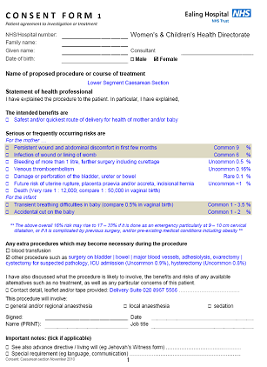








EIDO at MSEFT
DIGITAL
PAPER

Slide 30

The e-Consent system
Procedure library
Digital consent

Slide 31
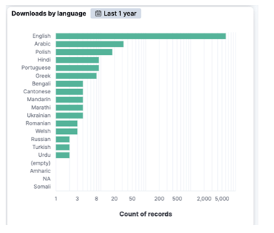
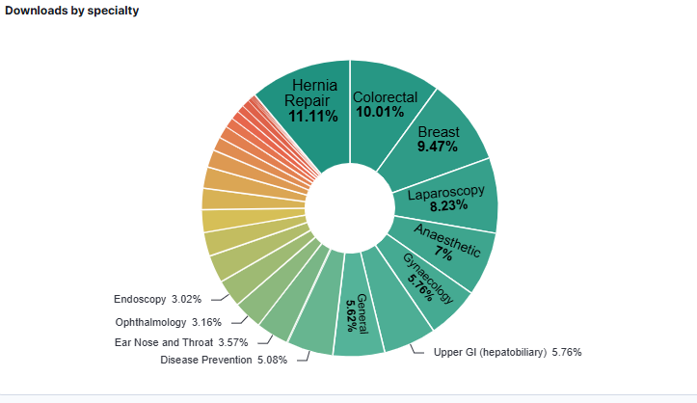
MSE FT EIDO Usage
2024 – 9617 (907 last month)
2023 – 5663
2022 – 3860

Slide 32
Consent Roadmap
- 1. Initial Consultation
Consent Roadmap
- 1. Initial Consultation
1
2
3
4
Identified need for surgery
Discuss pros, cons, risks, benefits & concerns
Provide written information
Agree & confirm initial understanding

Slide 33
Consent Roadmap
- 2. Pre-admission
Consent Roadmap
- 1. Initial Consultation
5
6
7
8
At home review information
Discuss with others
Prior to surgery confirm consent
Patient admitted for surgery

Slide 34
Consent Roadmap
- 3. Surgery day
9
10
11
12
On ward surgeon confirms consent
Transfer to theatre porter & nurse check consent
Anesthetic room- confirm consent
Operating room WHO check

Slide 35
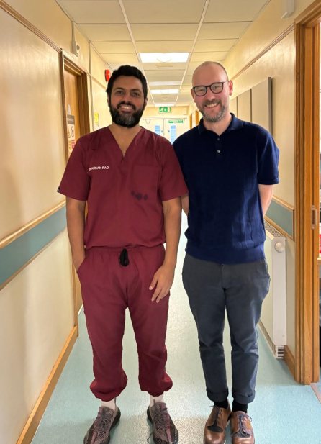
Benefits
Benefits to Patient
Improved information sharing
Flexibility of consent location
A structured process for consent results in fewer errors
    Surgical
    Administrative
Benefits to Hospital
Single source of truth (also reducing errors)
Efficient resource use
Improved Audit
Standardised Consent Process

Slide 36
MSE Existing Transformation Timeline
Until June 2024
Until July 2024
July to August 2024
September 2024 onwards
Increase usage information leaflets, and online surgical procedure video: Patient Information
Complete the Proof of Concept
Integration with Trusts EPR Systems
Clinician Engagement -understand current consent processes
Review and update Trust’s consent policy
Complete governance requirements
Gain approvals
Pilot e-Consent in Breast and ENT at MSE Hospitals
Complete gradual roll-out across MSE Hospitals.

Slide 37
Questions?

