Slide 1

Medical negligence and consent: Identifying common mistakes and preventable harms
Jonathan Fuggle (Partner) and Amelia Newbold (Risk Management Lead)
26 November 2024

Slide 2
Shared decision making and consent
Fundamental principles
Consent must be given voluntarily by a patient who is appropriately informed.
Clinician must explain the procedure/treatment in terms the patient can understand.
Consent can be express or implied.
No requirement for consent to be given in writing but important to have a record for evidential purposes.
Consent is a continuous process – patients are entitled to change their mind.

Slide 3
Medical negligence and consent
Background to the legal test
Bolam v Friern Hospital Management Committee (1957) established that if a doctor acts in accordance with a responsible body of medical opinion, they will not be negligent.
Bolitho – Requirement that the doctor should also have behaved in a way that ‘withstands logical analysis’ regardless of the body of medical opinion.
“I think that English Law must recognise a duty of the doctor to warn his patient of risk inherent in the treatment he is proposing.” (Lord Scarman in Sidaway v Board of Governors of the Bethlem Royal Hospital (1985)).

Slide 4
Montgomery v Lanarkshire Health Board (2015)
A reminder of the facts
Nadine Montgomery has type 1 diabetes - concerned during her pregnancy that the size of her baby might lead to difficulties with a vaginal delivery. She expressed general concerns throughout her antenatal care.
Defendant accepted that women with diabetes have large babies and there was a 9-10% risk of shoulder dystocia in the case of a diabetic mother.
The risk of a serious problem for the baby from shoulder dystocia was small (brachial plexus injury 0.2%; hypoxia 0.1%).
Consultant Obstetrician took the view that if diabetic pregnant women were warned of the possibility of shoulder dystocia, they would ‘invariably choose… delivery by caesarean section’, which she judged not to be in maternal best interests.
The risk of shoulder dystocia was not discussed and a plan was made for vaginal delivery.
As a result of complications of shoulder dystocia Nadine Montgomery’s son was born with serious disabilities.

Slide 5

Montgomery v Lanarkshire Health Board (2015)
The legal test
…a duty to take reasonable care to ensure that the patient is aware of any material risks involved in any recommended treatment, and of any reasonable alternative or variant treatments.

Slide 6

What are ‘material risks’?
The test of materiality is whether, in the circumstances of the particular case, a reasonable person in the patient’s position would be likely to attach a significance to the risk, or the doctor is or should reasonably be aware that the particular patient would be likely to attach significance to it
Two aspects to this test:
what would the reasonable person in the patient’s position consider significant? (objective test)
what would this particular patient consider significant? (subjective test)
There must be genuine dialogue.
It cannot be expected for knowledge of present day risks to be applied retrospectively (Duce v Worcestershire Acute Hospitals NHS Trust [2018])

Slide 7
Applying Montgomery
What are reasonable alternative treatment options?
Bayley v George Eliot Hospitals NHS Trust [2017]
The alternative treatment option must be within the knowledge of the competent clinician (i.e. Bolam standard).
The alternative option should not be a variant of an existing treatment option and there should be evidence of the alternative procedure being performed for the same purpose (i.e. just because stenting is used in heart surgery does not indicate that it is an alternative treatment option for stenting in other parts of the body).
The alternative treatment option must be accepted practice.
The alternative treatment option must be an ‘appropriate option’, not just a ‘possible option’.
NB The alternative treatment option may include doing nothing.

Slide 8
Applying Montgomery
What are reasonable alternative treatment options?
McCulloch v Forth Valley Health Board [2023]
Whether a treatment is a reasonable alternative is to be determined by application of the professional practice test (i.e the Bolam, qualified by Bolitho)
So, provided the clinician’s decision that a potential treatment is not a reasonable alternative is Bolam reasonable, there is no duty to tell the patient of that alternative body of opinion
“…A doctor will first seek to provide a diagnosis (which may initially be a provisional diagnosis) having, for example, examined the patient, conducted tests, and having had discussions with the patient. Let us then say that, in respect of that diagnosis, there are ten possible treatment options and that there is a responsible body of medical opinion that would regard each of the ten as possible treatment options. Let us then say that the doctor, exercising his or her clinical judgment, and supported by a responsible body of medical opinion, decides that only four of them are reasonable. The doctor is not negligent by failing to inform the patient about the other six even though they are possible alternative treatments. As long as the doctor’s view is not illogical!”

Slide 9
Applying Montgomery
Other points to note from recent case-law
Montgomery has been applied to facts which occurred in 1996, prior to the decision in Montgomery (CNZ v Royal United Hospitals of Bath NHS Foundation Trust [2023])
Particular care should be taken when explaining the material risks and benefits of ‘new’ treatments/procedures, making patients aware of the ‘new status’ of any procedure being discussed and providing:
Relevant patient information leaflets.
Any NICE guidance (with a explanation the patient can understand).
Information as to whether NICE has considered the evidence on the safety and efficacy of the procedure.
How may of the ‘new’ procedures the relevant surgeon has performed the procedure and the outcome for the patients involved.
Adequate time for the patient to consider and reflect on the information.
(Snow v Royal United Hospitals Bath NHS Foundation Trust [2023])

Slide 10

Causation
Key considerations
Factual causation
The counter-factual
What would have likely happened?
“If I had been told X I would have done Y”
Diamond v Royal Devon and Exeter NHS Foundation Trust [2019]
Medical Causation
What should the outcome have been medically in the counter-factual?
Expert issue

Slide 11
What does this all mean in practice?
Communication
Work in partnership with your patients.
There must be genuine dialogue – consent is not a ‘tick-box’ exercise.
Consent is a continuous process – patients are entitled to change their mind.
Communicate with your patient in a way to facilitate understanding:
avoid excessively detailed information – keep it simple
so far as possible, avoid technical jargon
tailor the discussion to the individual patient.
check understanding through dialogue
Consider whether there are any barriers to patient understanding e.g. difficulties with literacy, being able to read or hear/understand information provided remotely, English as a second language etc.
“From my experience, care needs to be taken in not assuming that because a person appears to be reasonably fluent in the English language her comprehension will be at the same level”
(Mordel v Royal Berkshire NHS Foundation Trust [2019]).

Slide 12
What does this all mean in practice?
Record keeping and documentation
Patient information leaflets can be useful but remember these are generic in terms of risk.
Statistics/percentages are relevant, but not necessarily decisive.
Document all your discussions:
Avoid general notes e.g. ‘…discussed risks and benefits’ and ‘…explained that transfer to theatre and then reassessment would be best’ (CNZ v Royal United Hospitals of Bath NHS Foundation Trust [2023])
Do include explanations provided as to the nature of the risks, benefits and alternative treatments available to patients (including the possibility of undergoing no treatment at all).
Document whether any patient information leaflets/guidance notes have been provided to the patient in advance of the procedure/treatment – ‘..the clinical notes…record “EIDO” with a tick” (Biggadike v El Farra [2024])
‘When assessing the evidence as to what happened at the consultation, I bear in mind that the consultation was a routine event for Dr Shahrak, whereas for Mrs Winterbotham it was an unusual occasion and therefore more memorable…..’ (Winterbotham v Shahrak [2024])

Slide 13
What does this all mean in practice?
Litigation risk
The law on consent aligns with GMC Guidance on Decision making and consent and recently updated Good Medical Practice (2024) - ‘promoting patient centred care’
Keep up to date with current developments in law, guidance on professional standards and clinical practice
GIRFT – standardised consent forms and decision making and consent principles designed by NHS England, GIRFT, GMC, Patient's association and RCS – anticipated in 2025
Sensitive and frank disclosure in advance of material risks and benefits make it less likely a patient will feel anger and seek legal recourse if complications arise/things do not turn out well, reducing the potential for litigation

Slide 14
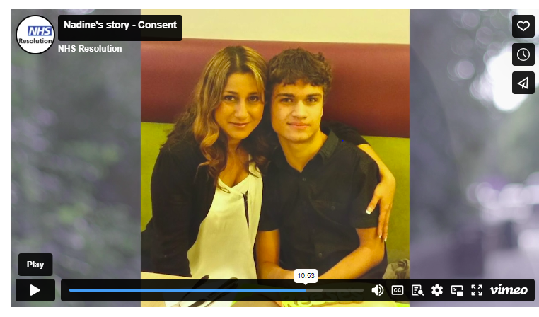
Useful resources
GMC Good Medical Practice on Consent: Patients and doctors making decisions together.
RCS Guidance Consent: Supported Decision Making
RCS Guidance - Tool 5: Consent to treatment, while COVID-19 is present in society — Royal College of Surgeons (rcseng.ac.uk)
Browne Jacobson Shared Insights - consent
NHS Resolution Guidance
The benefits of supported decision making (consent)
Nadines Story Consent

Slide 15


Contact us
Jonathan Fuggle
Amelia Newbold
Partner
Risk Management Lead
+44 (0)121 296 0680 / +44 (0)7743917468
Jonathan.fuggle@brownejacobson.com
+44 (0)115 908 4856 / +44 (0)7917557385
amelia.newbold@brownejacobson.com

Slide 16
Thank you
Notes:
End slide

