Slide 1
Consent Conversations
The view from Downunder
Steve Trumble
MBBS, MD, DipRACOG, FRACGP
Chair, EIDO International Editorial Board
Melbourne, Australia

Slide 2

https://visitgreatoceanroad.org.au/post_location/aireys-inlet/

Slide 3

https://www.australia.com/en/trips-and-itineraries/melbourne-and-surrounds/5-day-road-trip-from-melbourne-to-adelaide.html

Slide 4
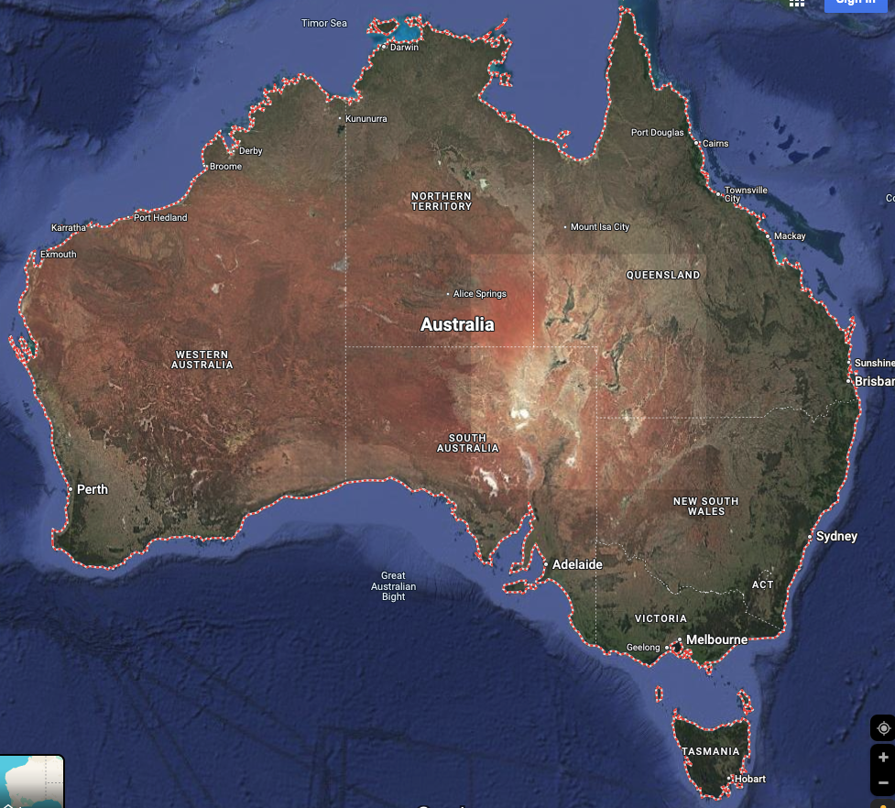

Slide 5


Slide 6
Consent Conversations
The view from Downunder
Steve Trumble
MBBS, MD, DipRACOG, FRACGP
Chair, EIDO International Editorial Board
Melbourne, Australia

Slide 7

Consent Conversations
Medicine is the management of disappointment
Notes:
Accessibility requirements for template users
This PowerPoint template has been created with a number of in-built accessibility options.
When working with this template, there are a few things you will need to do within the file to ensure that it meets Deakin’s accessibility requirements when documents, or exported pdf files, are shared with others or placed online.
Font styles
Only use the provided heading styles and text styles as pre-set in the template
ALT text
All images and graphics, backgrounds, logo and brand shapes need to have ALT text added to describe the image or be indicated as decorative. Elements provided within the template have had this added, but if you make any changes or add your own images/replace any default imagery, you will need to ensure ALT text is added.
If an image is also a hyperlink provide the destination in writing, for example an image of a ‘Hand holding a pen writing in a notebook’ that hyperlinks to Deakin homepage should also explain that the link goes to that page.
ALT text can be added by right clicking on the image/graphic and selecting ‘Edit alt text’ from the window.
Tables
All tables are required to include alt text.
The first row in a Word table can be identified as a header row/table title which can help screen reader users identify what the table content is about and whether they want to read it.
Where tables are already included, a basic form of ALT text will have been added, but you will need to add your own by going into the ‘table properties’ for each table, and clicking on the’ Alt text’ tab, and then completing the fields to provide a suitable description of your content.
Accessibility checker
Word has an inbuilt accessibility checker which can help to flag issues – go to ‘Review > Check accessibility’ in the toolbars.
Saving as a pdf
When saving your file as a pdf, note that using the ‘Print to PDF’ option doesn’t keep any inbuilt accessibility features. Instead use the ‘Save As > PDF’ option, and check that “Document structure tags for accessibility” is selected

Slide 8
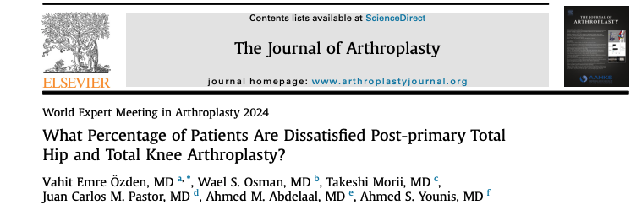
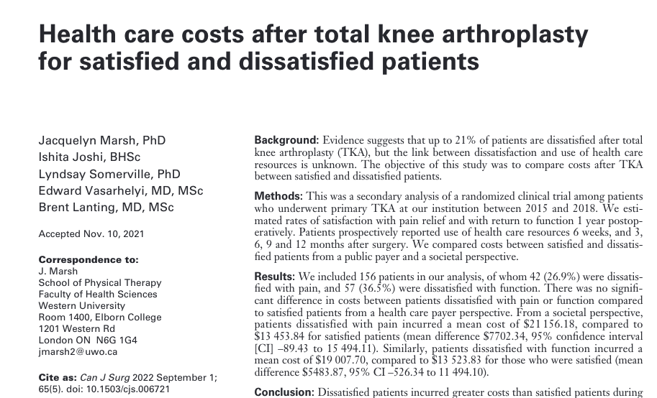
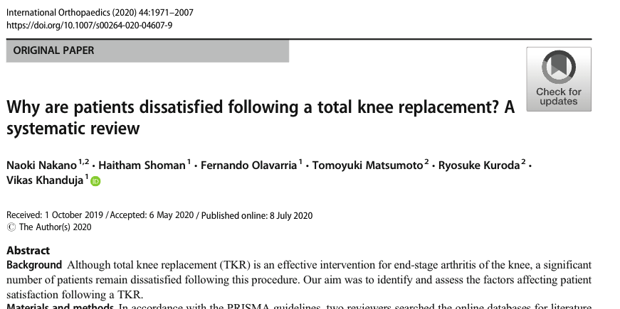
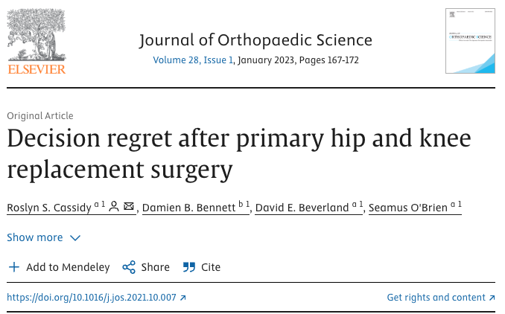
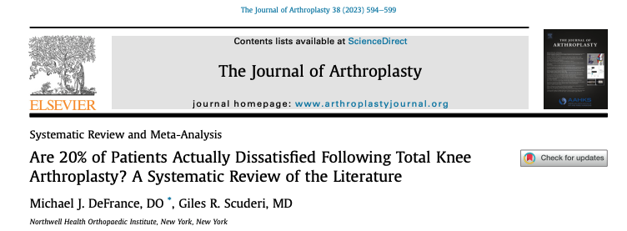
Decision regret

Slide 9
Involving the patient…
https://www.youtube.com/watch?v=oVWjAeAa52o
Doctor in the House 1954

Slide 10
The Consent Conversation
Patient-centred information

Slide 11



Slide 12
The Consent Conversation
Rogers v Whitaker (1992) 175 CLR 47

Slide 13
Rogers v Whitaker
…the doctor’s duty to disclose to the patient any material risk inherent in the proposed treatment, with a risk being considered material if, in the circumstances of a particular case, a reasonable person in the patient’s position, if warned of the risk, would be likely to attach significance to it or if the medical practitioner is or should reasonably be aware that the particular patient if warned would be likely to attach significance to it attach significance to it.

Slide 14
The Consent Conversation
Montgomery v Lanarkshire Health Board (2015) UKSC 11

Slide 15
The two questions
What does any person reasonably need to know about this treatment?
What would this specific person want to know about it?

Slide 16

The consent conversation
Anticipating information needs
Asking patients what else they want to know
Giving patients the information they need.

Slide 17
Thank you.

Slide 18
