Slide 1


All-Wales Peer Review
For Decision Making & Consent
Jonathan Webb, Head of Safety & Learning
Dr Ben Thomas, National Clinical Lead for Decision Making & Consent
Welsh Risk Pool
EIDO Consent Conference
26th November 2024
Delivering Value, Innovation and
Excellence through Partnership

Slide 2
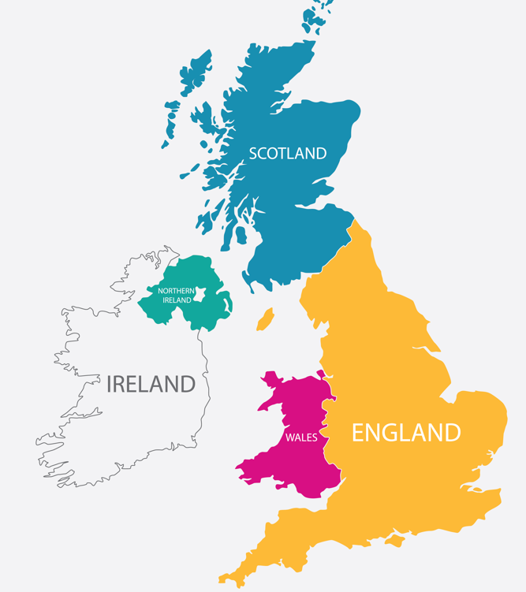
NHS in Wales

Slide 3
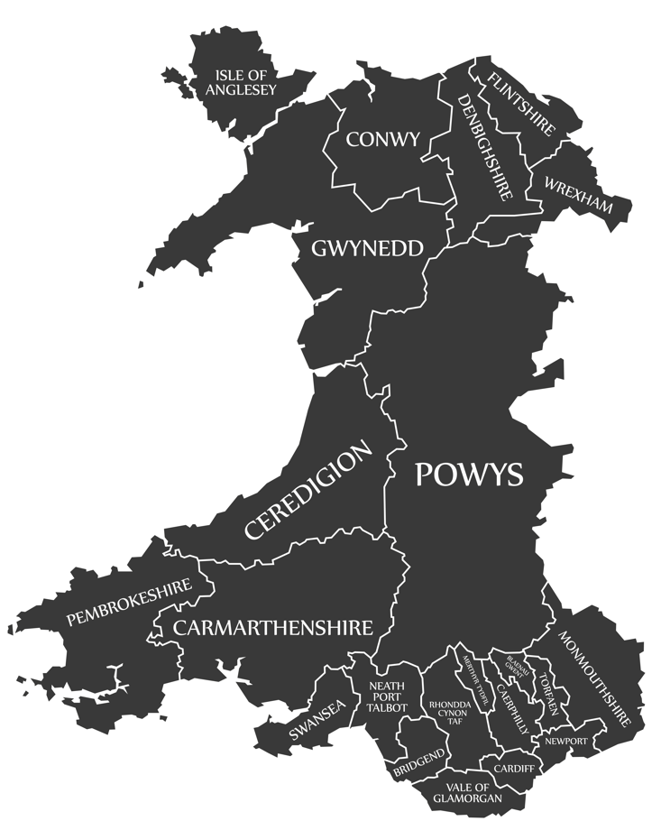
NHS in Wales
7 Health Boards
3 NHS Trusts
Public Health Wales
Velindre University NHS Trust
Welsh Ambulance Services NHS Trust
2 Special Health Authorities
Digital Health & Care Wales
Health Education & Improvement Wales
NHS Wales Executive
Welsh Government
Serving a population of around 3.2m

Slide 4
Welsh Risk Pool
Indemnifier for all Health Bodies in Wales
Challenging Clinical Negligence Claims Profile

Slide 5
Welsh Risk Pool
Indemnifier for all Health Bodies in Wales
Challenging Clinical Negligence Claims Profile
For 2024/25 the expenditure required to settle claims in-year is expected to be
£140m
For the known claims against NHS Wales, reserves are
£1.649bn

Slide 6

Welsh Risk Pool
Indemnifier for all Health Bodies in Wales
Challenging Clinical Negligence Claims Profile
Consent seen as an allegation in approx 20% of clinical negligence matters

Slide 7

Welsh Risk Pool
Indemnifier for all Health Bodies in Wales

Slide 8

Decision Making & Consent Programme

Slide 9

Decision Making & Consent Programme
Collaboration between all health bodies

Slide 10
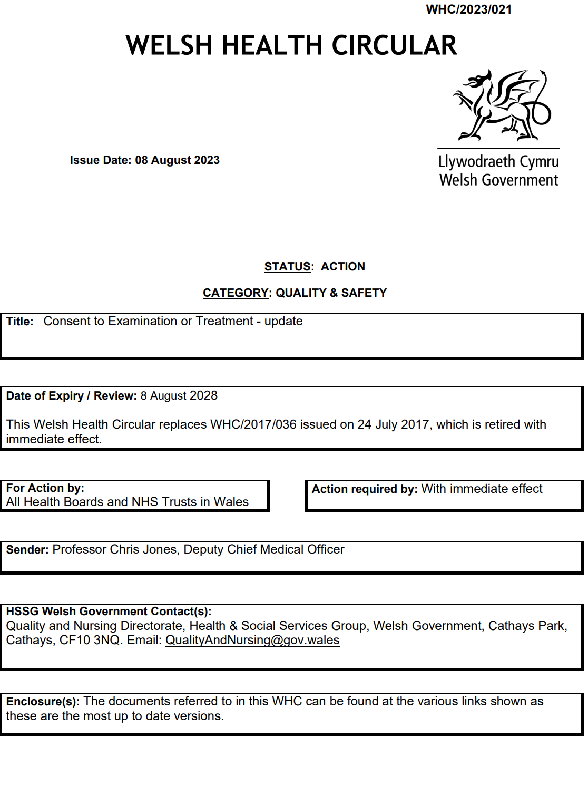
Decision Making & Consent Programme
Collaboration between all health bodies
All-Wales Model Consent Policy

Slide 11
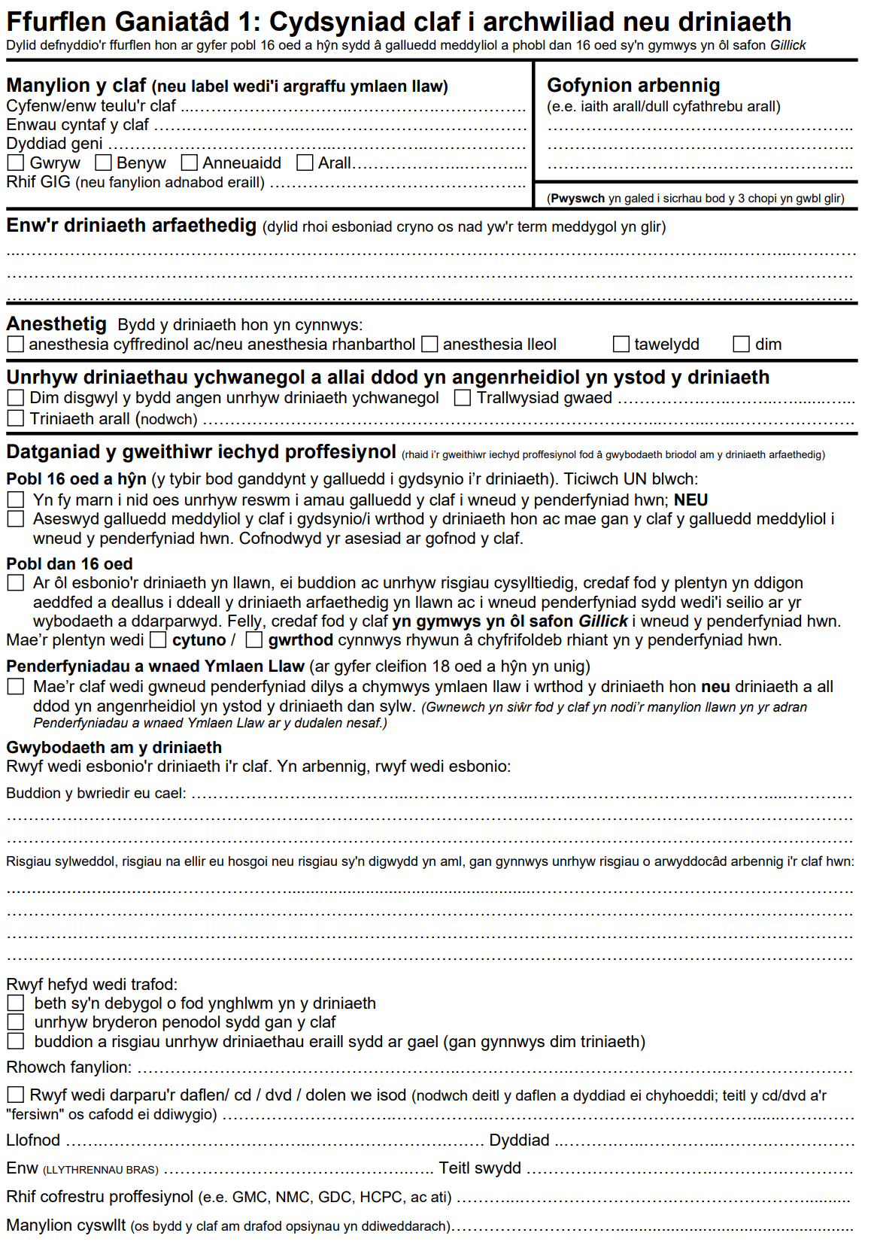
Decision Making & Consent Programme
Collaboration between all health bodies
All-Wales Model Consent Policy
All-Wales Consent Forms

Slide 12

Decision Making & Consent Programme
Collaboration between all health bodies
All-Wales Model Consent Policy
All-Wales Consent Forms
Digital Consent Development

Slide 13
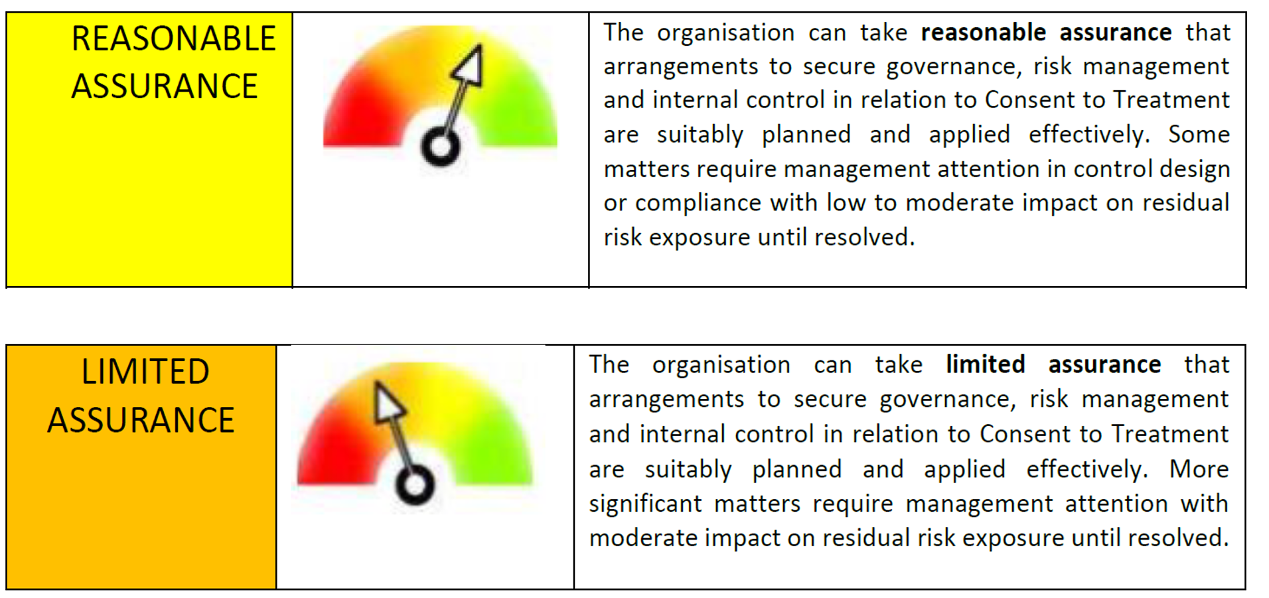
Decision Making & Consent Programme
Collaboration between all health bodies
All-Wales Model Consent Policy
All-Wales Consent Forms
Digital Consent Development
Consent to Examination & Treatment Standards

Slide 14

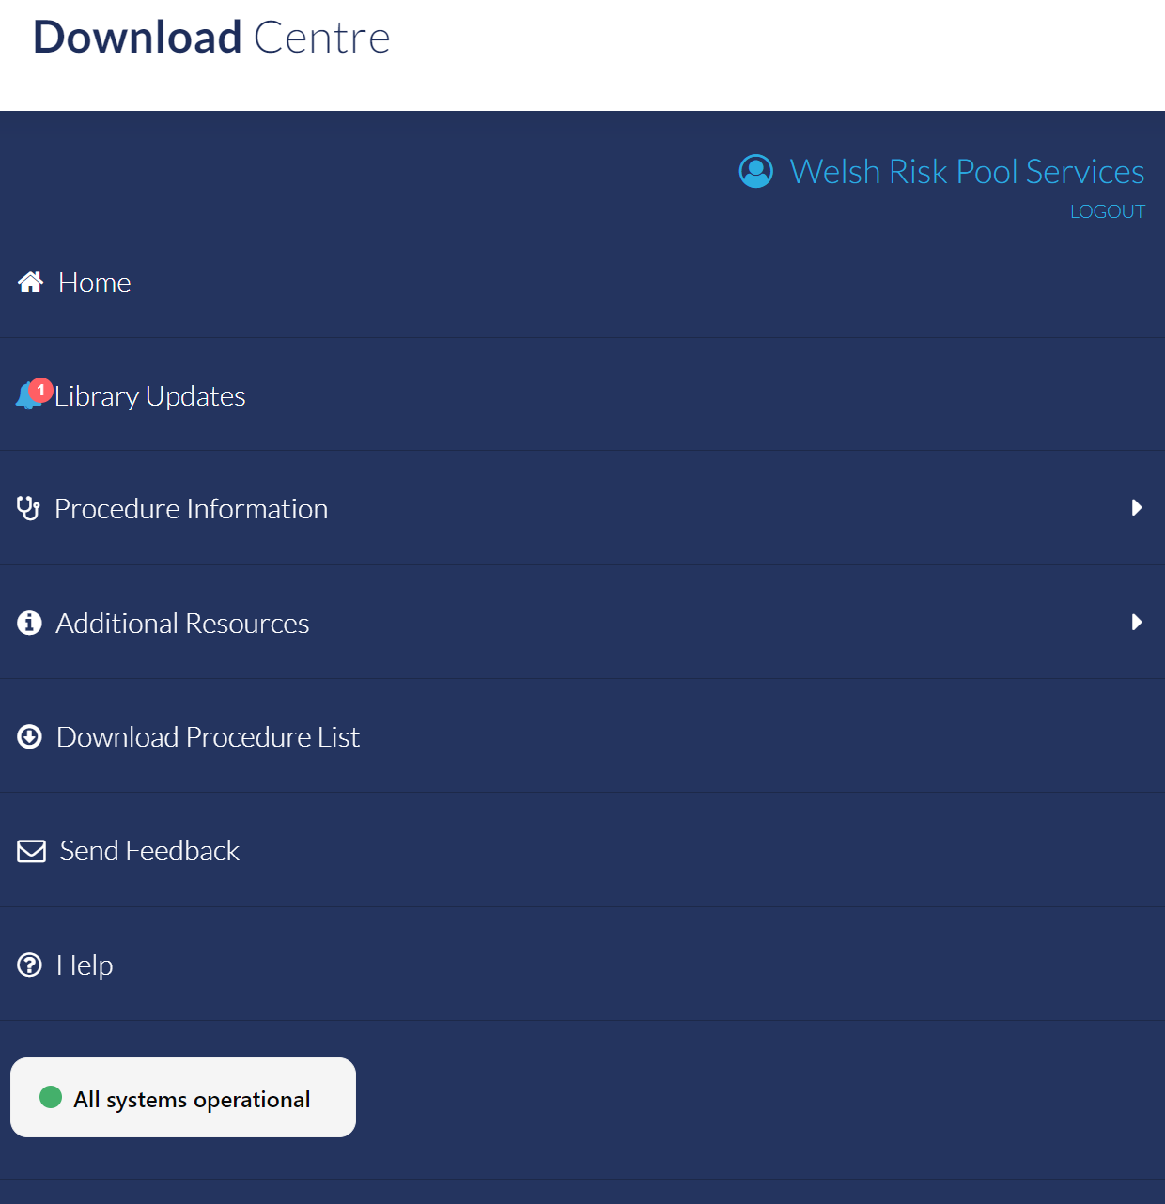
Decision Making & Consent Programme
Collaboration between all health bodies
All-Wales Model Consent Policy
All-Wales Consent Forms
Digital Consent Development
Consent to Examination & Treatment Standards
EIDO Consent Information Leaflets

Slide 15

Decision Making & Consent Programme
Collaboration between all health bodies
All-Wales Model Consent Policy
All-Wales Consent Forms
Digital Consent Development
Consent to Examination & Treatment Standards
EIDO Consent Information Leaflets
Peer-Review Framework

Slide 16


Decision Making & Consent Programme
Collaboration between all health bodies
All-Wales Model Consent Policy
All-Wales Consent Forms
Digital Consent Development
Consent to Examination & Treatment Standards
EIDO Consent Information Leaflets
Peer-Review Framework
Bespoke Wales-specific e-Learning Package

Slide 17


Slide 18
Decision Making & Consent Programme
All Wales Peer Review Framework for
Consent to Examination & Treatment

Slide 19

Every healthcare interaction
Ongoing dialogue
Medical notes provide record of shared decision-making
Valid basis for ongoing treatment
Coherent narrative
Notes:
Decision-making and consent Treatment based on a shared decision-making model involving a fully informed patient
Serious medical treatment Best interests must include wider interests with appropriate consultation with representatives recognising autonomy
Central to every healthcare interaction. Medical notes ongoing record of consent narrative/basis of treatment
Therapeutic anticoagulation for AF/DVT/PE risks and benefits not usually recorded formally in a consent form

Slide 20
Medical decision-making
Complex and nuanced
Subjective assessment of risks and probability of various outcomes
Prospective and dynamic
Difficult to communicate risk and uncertainty

Slide 21
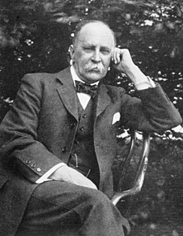

Slide 22
‘Medicine is a science of uncertainty and an art of probability’
William Osler

Slide 23
Constant variation
‘Variability is the law of life, and as no two faces are the same, so no two bodies are alike, and no two individuals react alike and behave alike under the abnormal conditions which we know as disease’.
William Osler

Slide 24
‘Medicine is about making decisions on incomplete evidence, changing them in light of experience, and sometimes living with the consequences of your wrong decisions’
Peter Richards – Dean Medicine St Mary’s Medical School
Susan Spindler. Doctors to Be. London 1992

Slide 25
Legal perspective
Legal
Medical
Retrospective
Certainty/facts
Complete information
Individual
Adversarial
Procedure
Prospective
Uncertainty/probability
Incomplete information
Collective
Collaborative
Outcome

Slide 26
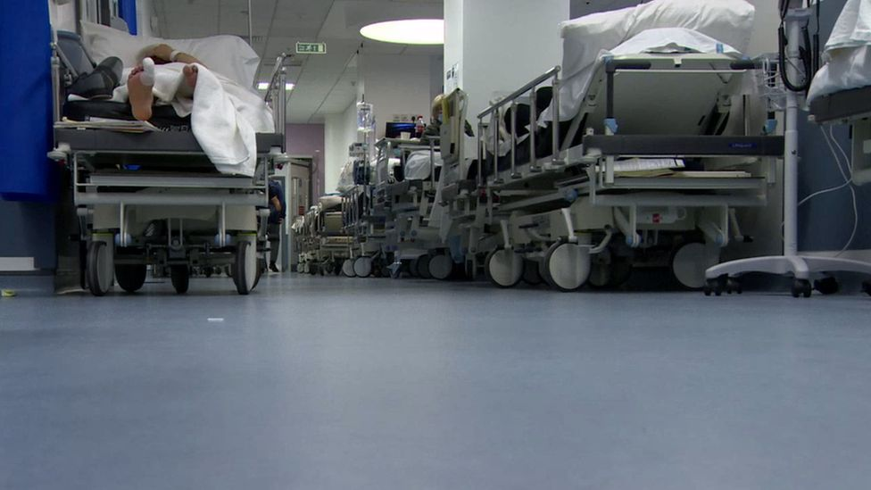
Notes:
Civil servants cannot 'overreach' on NHS, says top offical - BBC News

Slide 28
Respond to training needs on All Wales basis
End of life decision-making/practical challenges treatment escalation planning
  Short training video addressing specific concerns in PHSO and HIW reviews of DNACPR decision-making
  e-learning package – scenario based
Mental Capacity Act – serious medical treatment
  Clinically relevant e-learning focusing on application of MCA framework in clinical practice

Slide 29
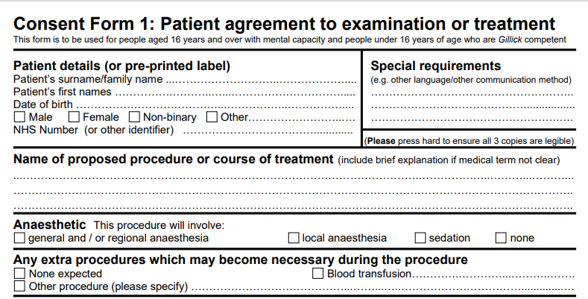
Consent form as a standalone record of consent process?
Summary format
Tick box approach
Further context often required
No evidence of preceding dialogue
Missed opportunities to record dialogue

Slide 30
Assessment of whole process
Process – 2 stage model?
Dialogue – 2 way conversation/shared decision-making?
Specialty based discussion/action
Focuses on Specialty MDT or Clinical Governance Group
Discuss key messages
Facilitate consistent approach:
Pooled lists
Regionalised services
Delegated consent
Why peer review?
Peer review process
Relevant expertise to assess qualitative process
Reflection on own practice
Normalise process of review and reflection
Organisational learning
Greater assurance
Monitor trend
Targeted intervention at a specialty and organisational level
Notes:
Output v Process

Slide 31
Methodology

Slide 32
Methodology
Who | Specialty / Governance Lead to coordinate a peer review of case notes by a panel of clinicians from each department / specialty (reviewing clinician should not review their own patients’ case notes) NOTE - Since clinical judgement will be required when considering what the record tells us about the quality of the consent process, the review process should be undertaken by senior clinicians (consultants, associate specialists, specialty doctors). Junior doctors can participate in a supporting, rather than a lead role.

Slide 33
Methodology
How | Retrospective review using the Peer Review of Consent Processes Tool NOTE - Only include cases where the medical notes are available to the reviewer.

Slide 34
Methodology
What | Peer review of the informed consent process in relation to: elective setting people aged 16 years and over with mental capacity and people under 16 years of age who are Gillick competent agreement of a person with parental responsibility to examination or treatment for a child under 16 years of age who is not Gillick competent (i.e. does not have sufficient maturity or intelligence to consent for themselves) 20 sets of case notes per specialty at each site 3 month window

Slide 35
Methodology
Where | Review of the following specialities: All surgical specialties and sub specialties Obstetrics and Gynaecology Interventional Radiology Interventional Cardiology Dermatology

Slide 36
Methodology
Question number | Guidance
12. Was there evidence of at least a 2 stage consent process? | To answer ‘yes’ there would need to be either: a) Two separate recorded consent conversations with the patient, with a time gap allowing the patient to consider the initial information or… b) The consent form has been completed some time before the surgery (not on the same day as surgery) and the form records a confirmation of the original consent.
15. Was there evidence of shared decision-making with the patient | To answer ‘yes’ there would need to be evidence in the record (consent form, clinical letters, medical notes) of at least one of the following: Explicit recording of the patient’s agreement to the proposed agreement Explicit recording of the patient’s views, concerns or wishes Explicit recording of where a patient has declined a suggested treatment and alternative treatment has been agreed.

Slide 37
Consent standards

Slide 38
Consent standards
No. | Standard
1 | A Consent form was used.
2 | Consent form 1, Form 2 or a Procedure Specific Consent Form was used.
3 | Evidence of at least 2-stage consent process?
4 | The consent dialogue was recorded within the patient’s notes / written communication with the patient?
5 | Evidence that there was shared decision-making/a 2-way conversation with the patient?
6 | Reviewing the consent narrative, the following were discussed with the patient: Significant, unavoidable and frequently occurring risks to all patients Risks of particular significance to this patient (material risks) benefits appropriate alternative treatments including no treatment

Slide 39
Consent standards
7 | An EIDO patient information leaflet is available for the procedure.
8 | A patient information leaflet was offered to patient.
9 | It was clear what type of patient information leaflet was offered to the patient?
10 | It was clear what the title / version of the patient information leaflet offered to the patient?
11 | The leaflet offered to the patient was an EIDO patient information leaflet. (if available)
12 | The patient information leaflet offered to the patient was bilingual.

Slide 40
Compliance and action plan

Slide 41
Compliance and action plan
Hospital where the procedure took place:
Specialty:
Accountable Lead(s):
Responsible Group:
Date of audit:
Date action plan agreed:

Slide 42
No. | Standard | Audit Standard | % Achieved
1 | A Consent form was used. | 90%
2 | Consent form 1, Form 2 or a Procedure Specific Consent Form was used. | 90%
3 | Evidence of at least 2-stage consent process? | 90%
4 | The consent dialogue was recorded within the patient’s notes / written communication with the patient? | 90%
5 | Evidence that there was shared decision-making/a 2-way conversation with the patient? | 90%
6 | Reviewing the consent narrative, the following were discussed with the patient: Significant, unavoidable and frequently occurring risks to all patients Risks of particular significance to this patient (material risks) benefits appropriate alternative treatments including no treatment | 90% 90% 90% 90%

Slide 43
7 | An EIDO patient information leaflet is available for the procedure. | 90%
8 | A patient information leaflet was offered to patient. | 90%
9 | It was clear what type of patient information leaflet was offered to the patient? | 90%
10 | It was clear what the title / version of the patient information leaflet offered to the patient? | 90%
11 | The leaflet offered to the patient was an EIDO patient information leaflet. (if available) | 90%
12 | The patient information leaflet offered to the patient was bilingual. | 90%

Slide 44
Action Plan: Please complete the action plan below that specifying how improvements will be made. Please include an action for each measure where compliance achieved did not meet the audit standard.
Issue identified | Improvement Action | Timescale | Lead | Outcome (if implemented) | Impact (if implemented

Slide 45
Key Messages
Procedure specific information leaflet only provided in 40% cases across all specialties
Version of leaflet provided only recorded 25% cases
Not all appropriate and available treatment options discussed
> 20% cases
Decreased engagement in second cycle of peer review. Lack of clinical capacity cited by clinical leads

Slide 46
Feedback
Well received nationally
Valuable organisational learning tool
Educational value of the exercise
Reflective practice

Slide 47
All-Wales Peer Review
For Decision Making & Consent
Jonathan Webb, Head of Safety & Learning
Dr Ben Thomas, National Clinical Lead for Decision Making & Consent
Welsh Risk Pool
EIDO Consent Conference
26th November 2024
Delivering Value, Innovation and
Excellence through Partnership

