Slide 1

Consent: Broader Perspectives
Professor Vivienne Harpwood

Slide 2
Consent is clearly a central issue in healthcare
Adults with capacity
People who lack capacity
Children and young people
Before and after surgery (sometimes during)
Emergency care
Fertility treatment
Pregnancy and birth
End of life care
In-patient care
Primary care
Public health
Care homes and community care
Mental health
Clinical trials
Organ donation
Resource allocation

Slide 3

Good Communication is vital for consent
The two-way consent process involves listening and explaining
Documenting and recording the patient’s concerns and wishes
Essential for hand-overs and discharge of patients
Crucial for accurate medicines reconciliation

Slide 4

Consent is fundamental throughout the patient journey
Sources of information on how consent is working
Litigation/Law Reports
Annual Reports of NHS Resolution, Welsh Health Legal Services, Defence Organisations etc
Ombudsman reports
NHS Trusts and Health Boards (Wales and Scotland) public papers
Blogs/on-line accounts by counsel and solicitors
GMC and NMC and other regulators
The CQC Annual reports
Parliamentary reports e.g. Maternal Mortality Rates in the Black Community 12th December 2023 (House of Lords Library); and the Parliament Cross Party Report on Birth Trauma

Slide 5
Deeper insights into the consent process
Two key ways of establishing the truth in common law jurisdictions:
Inquests
Public Inquiries – note also lesser investigations
Internal inquiries
External inquiries

Slide 6
Inquests and Public Inquiries
Inquisitorial v Adversarial procedure
Aim is to establish the facts and search for the truth
Unlike the courts, these are not suitable arenas for the concepts of “presumptions” and “burdens of proof” which should not be applied to the deceased person or to interested persons involved in an inquest, for reasons of fairness. That was particularly the case where the person whose conduct was in issue, e.g. a person who might have been suffering from mental illness which led to their suicide and the death of another, was themselves the deceased and a subject of the inquest.
The coroner or Inquiry Chairman can call for witness evidence
Recommendations and “lessons learned” emerge

Slide 7
Inquests
Coroner’s Inquests seek the truth about deaths by investigating deaths in which the circumstances which appear to be due to unknown, violent or unnatural causes.
An Inquest aims to discover who the deceased was, and where, when and how the death occurred.
In certain inquests involving public organisations, the scope of an inquest (how the death occurred) can be widened to include the broader circumstances which led to the death.
The Coroner decides on the scope of the inquest.
Inquest should be completed within a year
Coroner can right a “prevention of future death” letter to CEO asking for information about what lessons have been learned and implemented

Slide 8
What is a Public Inquiry?
A major investigation usually convened under the Inquiries Act 2005 by a government minister into a matter of public concern.
Can be given special powers to compel testimony under oath and the release of other forms of evidence.
Each inquiry is led by a panel with a chairperson, usually a legally qualified
The Public Inquiry begins when its terms of reference are set out. These cover the questions the inquiry will address and the information and feedback that the Government wants.

Slide 9
The good news about Public Inquiries
They –
Raise the profile of large-scale scandals in a coordinated fashion
Investigate thoroughly, leaving few stones unturned
Attract media interest (therefore public attention) to important issues
Draw to serious errors on the part of public bodies
Encourage victims of bad practice to come forward
Save time and money for litigants by unearthing evidence
Make valuable recommendations (not always acted upon) for reform, to prevent similar occurrences

Slide 10
Drawbacks of Public Inquiries
Time-consuming for many reasons
Very expensive
Staff difficulties
Can become adversarial
Recommendations are not always implemented
Government is currently reviewing them.

Slide 11
Some recent and current Public Inquiries
The Ely Hospital Inquiry in the 1970s
The Bristol Inquiry in 2001
The Shipman inquiry in 2005
The COVID Inquiry on-going
The Grenfell Tower Inquiry 2024
The Lucy Letby Inquiry set up in2024

Slide 12
THE INFECTED BLOOD INQUIRY
Sir Brian Langstaff, chairman, presented findings in 2024 after 6 years of Inquiry
More than four thousand statements were received in the course of the Inquiry.
Patients had been treated with blood or blood products and tissue by the NHS since 1948, many of whom (particularly those treated between 1970 and 1998), had died or suffered, not directly as a direct result of their underlying conditions or illnesses, but as a result of the treatment itself. The suffering extended to their relatives and others close to them.
Around 30,000 people were given contaminated blood products and tissue from the 1970s to the 1990s, and 3,000 people have died so far after they contracted HIV and hepatitis.
Among the 6 main findings were 2 that concerned consent. The “profoundly unethical lack of respect for individual patient autonomy”, closely related to which was the concept of clinical freedom - that doctors should be free to do what they believe to be right for each individual patient.
“Clinical freedom” enabled doctors to follow unsafe treatment practices such as administering commercial blood products to young children and giving unnecessary transfusions to women following childbirth.
Reluctance on the part of managers, Chief Medical Officers and health bodies to interfere with clinical freedom led them hesitate from providing advice, guidance or information.

Slide 13
Infected Blood Inquiry
Damage was also caused by lack of candour to the very people whose lives had been destroyed by infections.
There were failings in the processing of blood and blood products, and insufficient research had been conducted into the means by which viruses could be inactivated in donor blood.
Despite the discovery of known risks, many poor treatment decisions had been made. There were also many instances of people not being informed of their diagnosis of infection.
The importing of known risky products from abroad was highly criticised, as was the research conducted on children and young people.

Slide 14
THE INFECTED BLOOD INQUIRY
At a time when Government organisations and regulators were busy drafting policies acknowledging the need to respect patients’ autonomy, emphasising the importance of transparency following the Kennedy (Bristol Inquiry) Report, and when the courts were developing the law on respect for autonomy and consent to treatment along similar lines, hundreds of patients were being treated without being informed about known risks in blood products and without giving proper consent.

Slide 15
Infected Blood Inquiry
Extremely unethical practices were found in the course of clinical trials at Treloar school, from which only around 30 of the 122 of pupils with haemophilia who attended the school between 1970 and 1987 survive. The report points out that what happened at Treloar’s “both illustrates and highlights the nature of, and many of the reasons for, the national treatment disaster which was infected blood.”

Slide 16

THE INFECTED BLOOD INQUIRY
Extremely unethical practices were found in the course of clinical trials at Treloar school, from which only around 30 of the 122 of pupils with haemophilia who attended the school between 1970 and 1987 survive.
The report states that what happened at Treloar’s “both illustrates and highlights the nature of, and many of the reasons for, the national treatment disaster which was infected blood.”

Slide 17
Infected Blood Inquiry
Multiple areas of wrongdoing were identified, including indiscriminate use of commercial concentrates which were known to be likely to transmit infection, lack of informed consent, failure to consult parents and provide sufficient support offered to pupils after diagnosis.
Evidence from the few surviving former pupils among the research subjects in various clinical trials was consistent. There had been no meaningful consultation with parents or with the children themselves before they were entered into trials.

Slide 18
INFECTED BLOOD INQUIRY
It has long been recognised that informed consent is essential before a person can be entered into a clinical trial, and that particular care should be taken when children are being considered as trial subjects. It is also good practice (usually stated clearly in trial protocols in their stopping rules) to stop a trial when it becomes apparent that trial subjects are suffering harm. Obviously the most basic principles of law and ethics were flagrantly flouted in Treloar’s.

Slide 19
Infected Blood Inquiry
The Inquiry found that most of the boys were of an age at which it would have been appropriate to involve them in decisions about their treatment and their future, “but if not, this philosophy infers that their parents at least should have been given the information with which to make their own decisions about their child’s treatment and future”.

Slide 20
Other Inquiries highlighting consent issues
Concerns about maternity services have led to several Inquiries
Ockenden Review Shrewsbury and Telford Maternity Services 2022
East Kent Hospitals University NHS Foundation Trust Maternity Report 2023
Report of the All-Party Parliamentary Group on Birth Trauma

Slide 21
Report of the All-Party Parliamentary Group on Birth Trauma
Listen to Mums: Ending the Postcode Lottery on Perinatal Care
Data gathered from research by the Birth Trauma Inquiry, indicates that around 4-5% of women, (about 30,000) develop post-traumatic stress disorder every year after giving birth in the UK, and about a third of women experience birth as traumatic.
The inquiry received 1,311 personal stories from parents and 92 submissions from maternity-related professional organisations, charities and individuals such as midwives and obstetricians, and it heard accounts from parents and experts, including maternity professionals and academics.
Birth trauma” was defined as covering a woman’s:
“emotionally and psychologically traumatic experience of childbirth-related events and interactions which can also have severe and life-changing negative effects on their health, relationships, work, daily activities and well-being”.

Slide 22
Findings involving consent and poor communication
Failure to listen to women’s concerns or calls for help, dismissing them as over-anxious even when they were in great pain or bleeding internally, suffering incontinence or signs of other serious conditions, or noticing red flag symptoms such as jaundice in their baby.
Lack of informed consent about risks and complications, being mocked when making requests for caesarean section or pain relief denied, being asked at a late stage to give consent for interventions when affected by gas and air, anaesthetic, in severe pain or during labour.
Poor communication was common, and it sometimes involved mixing up patients’ information and test results, as a result of which unwarranted interventions were carried out. In one case the family were given vague advice about their child’s potential dyslexia, cerebral palsy or end-of-life care, and received a congratulatory call from an uninformed health visitor after their baby had died.
Lack of pain relief was common feature, with women being denied medication and chastised or mocked for their distress during labour or postnatal stitching of vaginal tears.

Slide 23
Ockenden Review Shrewsbury and Telford Maternity Services Final Report 2022
Table 1: Time period of family cases included in this review
Pre-2000: 170 families 181 Clinical incidents
2000-2019: 1,305 families 1393 Clinical incidents
Post-2019: 15 families 18 Clinical incidents
TOTALS: 1,486 FAMILIES 1,592 CLINICAL INCIDENTS
Four families had clinical incidents that fell both within the 2000-2019 years and outside these years. Therefore, there are 1,486 unique families in total.

Slide 24
Ockenden: Consent to post-mortems
Post-mortem examinations supporting the determination of cause of death
Obviously a very difficult decision for bereaved parents Immediately after baby dies. It is essential that this is dealt with in a sensitive way by a professional trained to take post-mortem consent. Two examples from 2009 given in Ockenden Report:
A midwife had documented : ‘The went through documents very quickly and with little empathy. Family distressed by this and told me they were not happy with this when he left. Apologies given”.’ (2009)
Also in 2009, a family reported that following the stillbirth of their daughter ‘there wasn’t time or space to make the important and difficult decision about consenting to, or declining, a post-mortem examination’. In this case the post-mortem consent was discussed only 6 hours after an unexpected stillbirth, and the family felt that the consultant obstetrician counselled them against having a post-mortem, and this was their ‘largest concern about the care’ the family received. (2009)

Slide 25
Ockenden recommended “essential action on informed consent”
All Trusts must ensure women have ready access to accurate information to enable their informed choice of intended place of birth and mode of birth, including maternal choice for caesarean delivery
All maternity services must ensure the provision to women of accurate and contemporaneous evidence-based information as per national guidance. This must include all aspects of maternity care throughout the antenatal, intrapartum and postnatal periods of care
Women must be enabled to participate equally in all decision making processes and to make informed choices about their care.
Women’s choices following a shared and informed decision making process must be respected

Slide 26
Ockenden consent- more recommendations
“All maternity services must ensure the provision to women of accurate and contemporaneous evidence-based information as per national guidance. This must include all aspects of maternity care throughout the antenatal, intrapartum and postnatal periods of care
Women must be enabled to participate equally in all decision making processes and to make informed choices about their care.
Women’s choices following a shared and informed decision making process must be respected”.

Slide 27
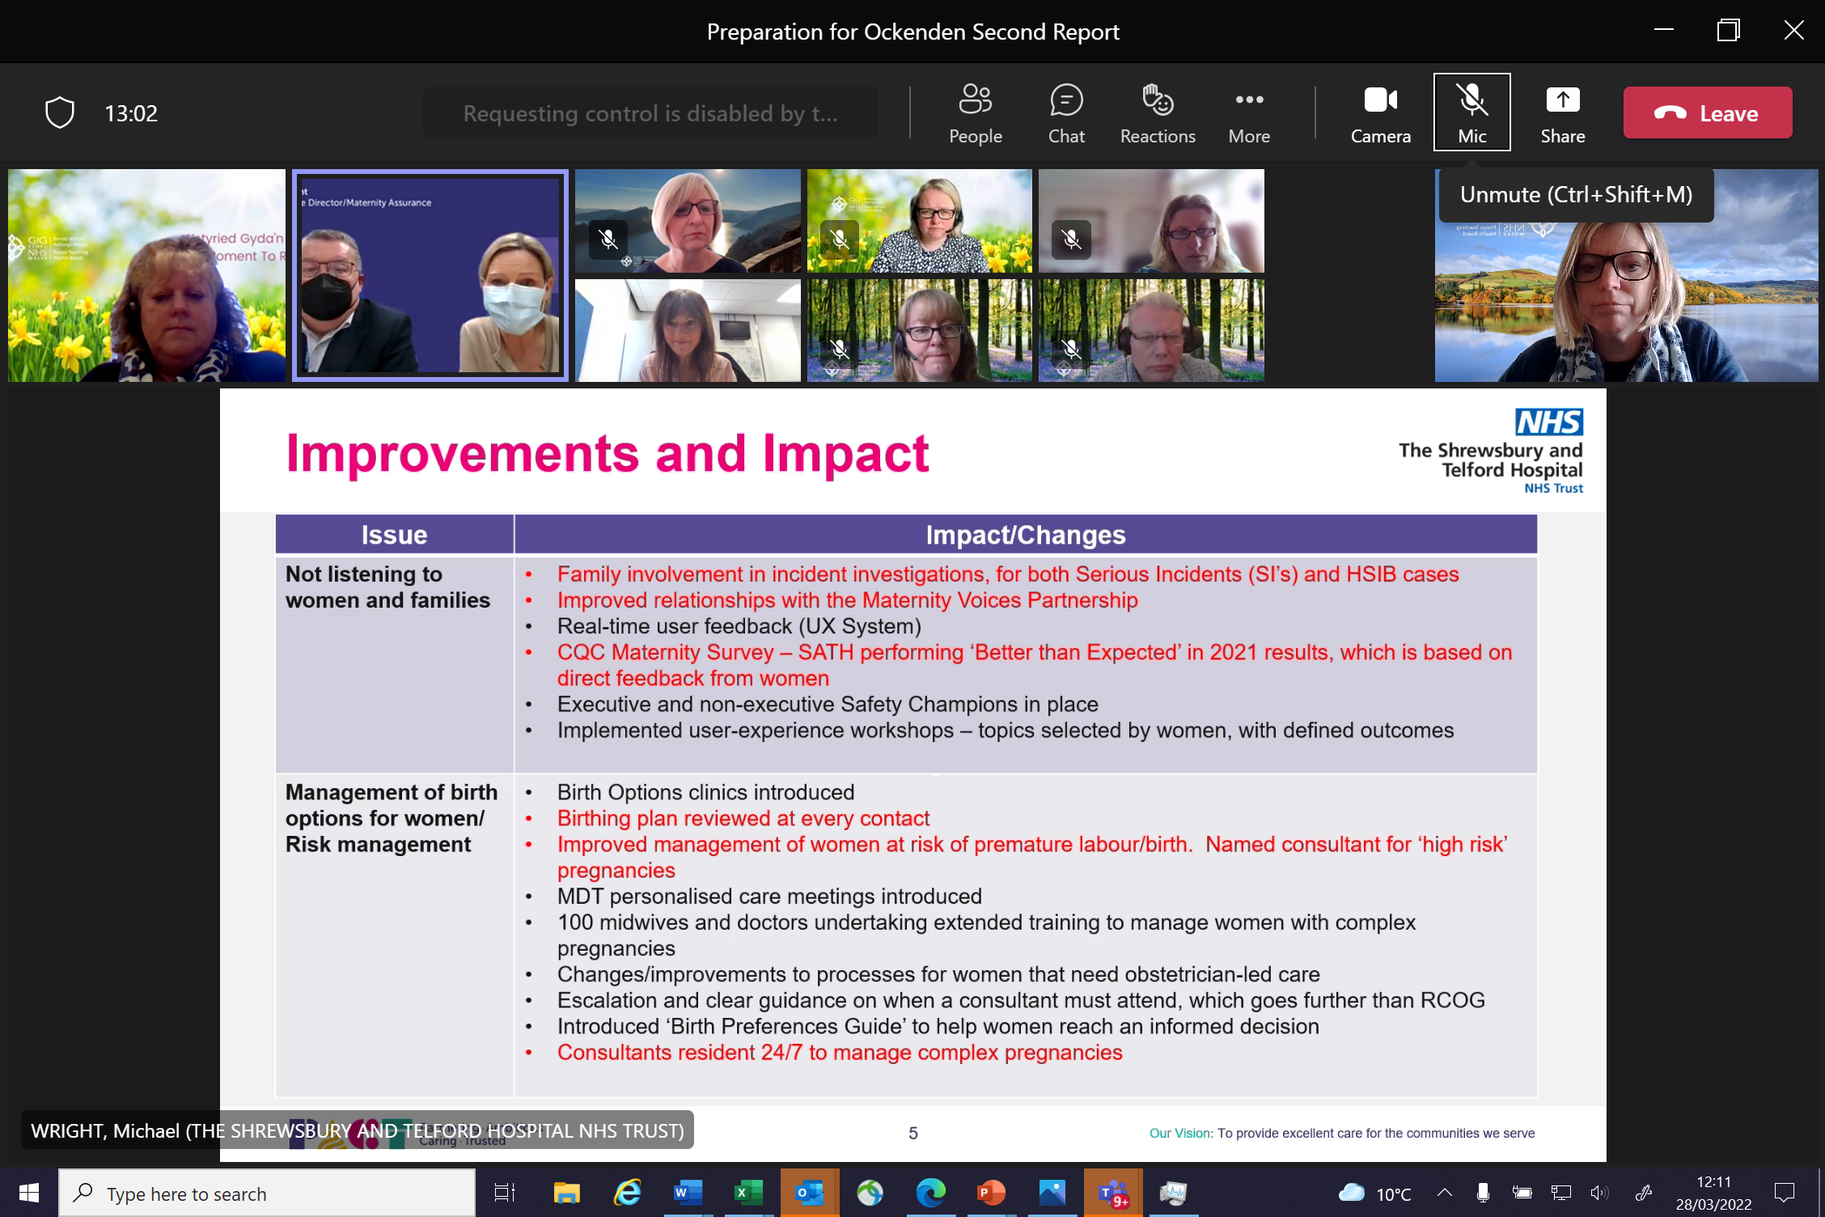
Improvements made following recommendations

Slide 28
Closer to home: Derby Maternity Review
“The NHS Derby and Derbyshire Integrated Care Board was commissioned to conduct a review into seven maternity cases relating to three maternal deaths and four maternal collapses taking place at Royal Derby Hospital between January 2021 and May 2022. Following publications of several reports highlighting the need for openness to learning from incidents, a spotlight has been placed on NHS maternity services across the country to urgently improve provision of care.
The Ockenden and Kirkup Reports into maternity services at the Shrewsbury and Telford Hospital NHS Trust and East Kent Hospitals University NHS Foundation Trust respectively alerted hospitals to the need to enhance patient safety and reduce the tragic loss of, or injuries to, mothers or their babies. On 22 February 2023, in such a commitment to learning and transparency, the University Hospitals of Derby and Burton NHS Foundation Trust (the Trust) published the report findings from an independent maternity learning review.”
One consent finding was “unbelievably poor communication with women on discharge, including an unwillingness to include them in decisions about their own care”.

Slide 29
East Kent Hospitals University NHS Foundation Trust Maternity Report 2023
Bill Kirkup’s Report -
Found failure by doctors and midwives to explain risks and ensure that women were fully informed, including when seeking consent:
“Nobody talked through the risks of a VBAC [vaginal birth after caesarean]. Had I known, I would not have put my baby at risk and would have elected for a C-section … there was no discussion about any risks associated with VBAC induced pregnancies, or the fact that I was an older mum and overweight.”

Slide 30
East Kent findings 2023
Indicative behaviour: Not taking the time to explain to women or their families what was happening or involving them fully in decisions about their care, women being left frightened or uncertain because failed communication: —
“We weren’t really told much but I was told that sepsis is the main killer of babies and as a new mum I was petrified.”
“No-one was telling me what was actually going on, they were just telling me what they were doing. They weren’t explaining things. I was clueless.”
“Although they tell you things, they don’t tell you things how you need to hear them. Every time I tried to sit up, I was physically forced back, to lie back down. I was having flashes in my brain of old films about mental hospitals and things where people are forced to lie down and strapped in, and that’s what it felt like especially with all the wires”.

Slide 31
Women feeling patronised, and not getting answers to their questions
“Because of my age, I was 19, I think that made her feel she could get away with not explaining things to me; it was like she thought I was stupid and she knew better.”
“She didn’t give me any answers, which I think is a massive thing. If she had just explained her thought process, it would have helped so much.”
“Above all, no matter how old you are, you should be listened to. My midwife wasn’t interested in talking to me … she would just say just speak to your doctor or have you had a look on Google; but you want reassurance”.

Slide 32
East Kent: other consent-related findings
A reluctance of staff to discuss women’s birth plans or to try to comply with their wishes.
Women feeling pressured about the mode of delivery.
Women being poorly communicated with and browbeaten to give consent in emergency situations.
Newly bereaved parents feeling under pressure to consent to a post-mortem examination of their infant:

Slide 33
January 18th 2024
Parent led organisation Maternity Alliance called for a Public Inquiry into the performance of maternity services in England available in the House of Lords summarised the findings of earlier important but less authoritative reports.
Survey results showed a five-year downward trend for respondents saying they were ‘always’ given the information and explanations they needed whilst in hospital after the birth. This year, 60% of respondents reported they ‘always’ received the information and explanations they needed, compared to 65% in 2018.
No statistically significant change between 2022 and 2023 in the percentage of people reporting they had the opportunity to ask questions about their labour and birth. (24%) were not given this opportunity.

Slide 34
Systematic Literature Review
Black, Asian, and minority ethnic (BAME) women were found to have significantly higher morbidity and mortality rates in the UK and poorer experiences of care. To date, a systematic literature review has not been undertaken in the UK to explore ethnicity- based health inequalities.

Slide 35
Conclusion
Despite consent being central to good practice and high-quality care, many examples of bad practice on consent have been revealed by Public Inquires
Recommendations of Public Inquiries need to be acted upon as a matter of urgency

