Slide 1
Mr Simon Parsons
Consultant General and Upper GI Surgeon at Nottingham University Hospitals NHS Trust
Honorary Professor (Nottingham University)
Co-founder of EIDO Healthcare Ltd.

Slide 2

Updated 2020 - 7 key principles
All patients have the right to be involved in decisions about their treatment and care and be supported to make informed decisions if they are able.
Principle
ONE
Decision making is an ongoing process focused on meaningful dialogue: the exchange of relevant information specific to the individual patient.
Principle
TWO
All patients have the right to be listened to, and to be given the information they need to make a decision and the time and support they need to understand it.
Principle
THREE
Doctors must try to find out what matters to patients so they can share relevant information about the benefits and harms of proposed options and reasonable alternatives, including the option to take no action.
Principle
FOUR
Note. Principles 5-7 relate to “capacity”

Slide 3
Information you give patients (GMC guidance paragraph 10)
“You must” is an overriding duty or principle
You must give patients the information they want or need to make a decision. This will usually include:
a diagnosis and prognosis
b uncertainties about the diagnosis or prognosis, including options for further investigation 2.c options for treating or managing the condition, including the option to take no action
d the nature of each option, what would be involved, and the desired outcome
4.e the potential benefits, risks of harm, uncertainties about and likelihood of success for each option, including the option to take no action.

Slide 4
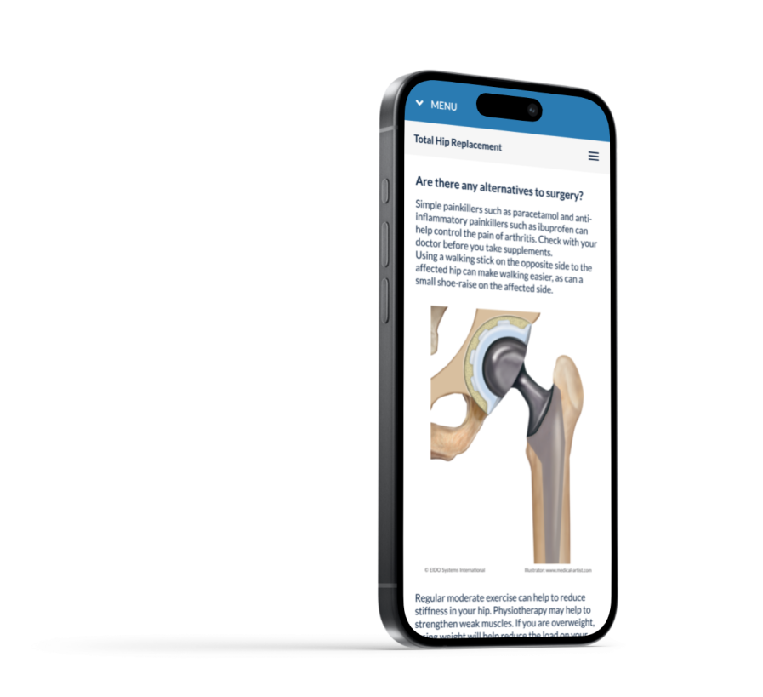
GMC guidance states:
You must give patients clear, accurate and up to date information based on the best available evidence.
The EIDO Inform Library:
Explanation of the problem
Treatment options (alternatives)
What the surgery involves
Risks and complications
Benefits & post op expectations
Lifestyle changes
Notes:
References

Slide 5
Finding out what matters to a patient (GMC guidance paragraph 16-20)
Meaningful dialogue
Listen
Ask questions
Explore:
- patient values
- priorities
- professional and personal activities
- risks they are prepared to take

Slide 6
Supporting patients’ decision making (GMC guidance paragraph 27-30)
Relevant information
Patients need relevant information (see paragraph 10) to be shared in a way they can understand and retain, so they can use it to make a decision.
Share it in a format they prefer - written, audio, translated, pictures or other media or methods
“
Paragraph 30 You must check whether patients have understood the information they have been given, and if they would like more information before making a decision.
”

Slide 7
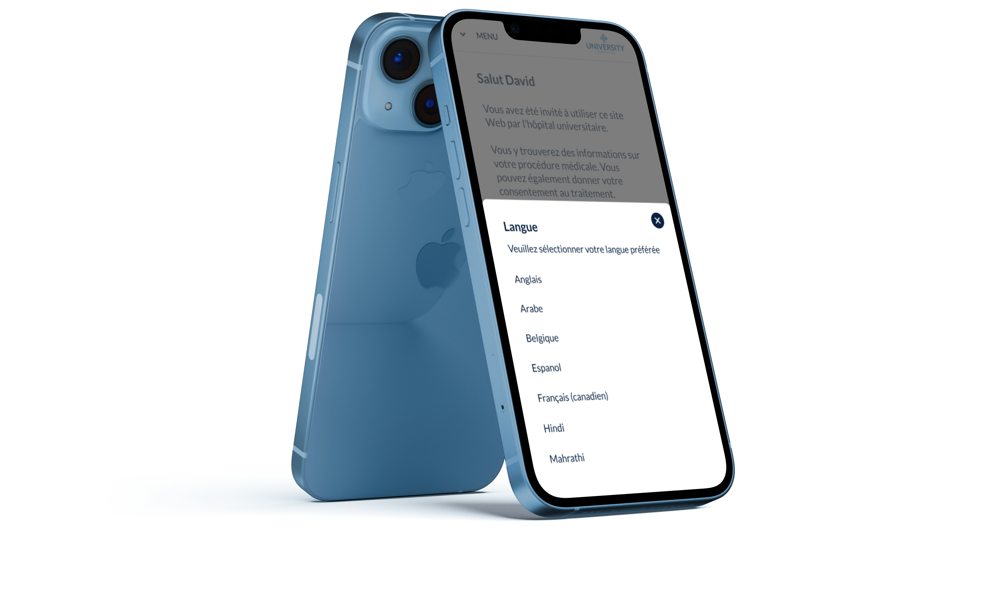
The EIDO Inform Library:
Translated into approx. 30 languages
Accessible Easy-Read versions
Large & Giant Print versions
Screen reader compatible versions
Includes animations for top 50
Notes:
Accessible versions largely a response to the DoH’s Accessible Information Standard (2016). Mandated that patients should be given information in a format which they can understand.
NCIC currently have access to the full English library and the Easy Read module.

Slide 8
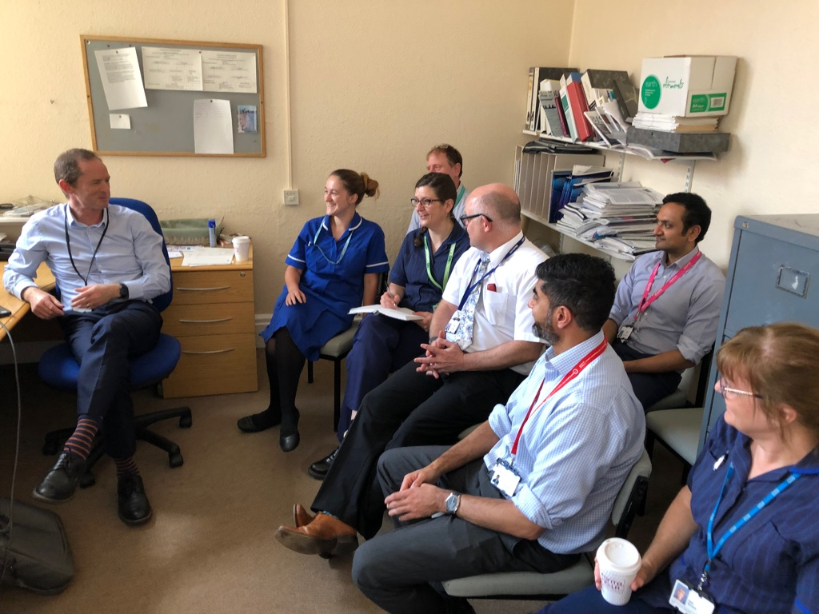
TEAM Consistent information across your team

Slide 9
Delegated consent (GMC guidance paragraph 43-44)
Support from other members of the healthcare team
You must make sure the person you delegate to:
is suitably trained and competent (formal informed consent training package)
has sufficient knowledge of the intervention and its associated benefits and harms, as well as alternative options for treatment and care (written information documents)
has the skills to have a dialogue with the patient that’s in line with this guidance
feels competent to carry out the delegated task and understands and agrees that they will refer to you (or another appropriate colleague) for further information, advice or support if necessary

Slide 10
Don’t be pressurised to act outside your competency (GMC guidance paragraph 46-47)
Act within your competency
46. If a colleague who is sharing information with a patient on your behalf raises concerns about their competence to do this, you should offer support, supervision or training and/or make alternative arrangements.
47. If a colleague asks you to share information with a patient or seek a patient’s consent on their behalf, you must be satisfied you have the necessary knowledge and skills to do so in line with this guidance. If you’re not, you should explain this and seek support. If you believe you’re being asked to practise outside your competence, or you are insufficiently supported you must consider raising a concern.

Slide 11
Medical records (GMC guidance paragraph 50-51)
Patient medical records
50. Keeping patients’ medical records up to date with key information is important for continuity of care. Keeping an accurate record of the exchange of information leading to a decision in a patient’s record will inform their future care and help you to explain and justify your decisions and actions.
51. You should take a proportionate approach to the level of detail you record. Good medical practice states that you must include the decisions made and actions agreed - and who is making the decisions and agreeing the actions - in the patient’s clinical records. This includes decisions to take no action.

Slide 12
Long waiters may have developed new comorbidities while on a waiting list
Reviewing decisions (GMC guidance paragraph 56-58)
58. Reviewing a decision is particularly important:
if you haven’t personally had a discussion with the patient because they were initially seen by a colleague
if significant time has passed since the decision was made
if the patient’s condition has changed
if you have reason to believe the patient might have changed their mind
if any aspect of the chosen treatment or care has changed
if new information has become available about the potential benefits or risks of harm of any of the options that might make the patient choose differently

Slide 13
Time and resource constraints
Your Hospital should support you (GMC guidance paragraph 60-61)
Paragraph 60
Meeting patients' individual needs relies on available time and resources within your organisation.
Under time or resource constraints, leaders at your trust or health board should consider:
Involving other health and care team members.
Referring patients to resources like leaflets, advocacy services, expert programmes, or condition-specific support groups.
Paragraph 61
If external factors prevent patients from receiving adequate time or support to make informed decisions, consider raising a concern.
Make sure it is appropriate to proceed, confirming you have the patient’s consent or valid authority before providing care.

Slide 14

Conclusions
Informed consent is a process which, if performed properly, promotes shared decision making
The Law and the GMC Guidance make it quite clear what is expected of clinicians
Resources are available to help but they can’t replace “meaningful dialogue”
Find GMC guidance for decision making and consent here:

