Slide 1

Induction & Training
Aged Care Services Associated Provider Induction and Training

Slide 2

ABOUT US
History : https://www.focusconnect.org.au/our-history
Webpage https://focusconnect.org.au/
Locations
  MAIN OFFICE
    3 Chamberlain St, Campbelltown NSW 2560
    Phone: (02) 4627 1188 Email: info@focusconnect.org.au
    Hours of Operation: Mon - Fri: 8:30am - 4:30pm (Closed 12:00pm ~ 13:00pm)
  ACTIVITY CENTRES 125 & 127 Dumaresq Street Campbelltown NSW 2560

Slide 3
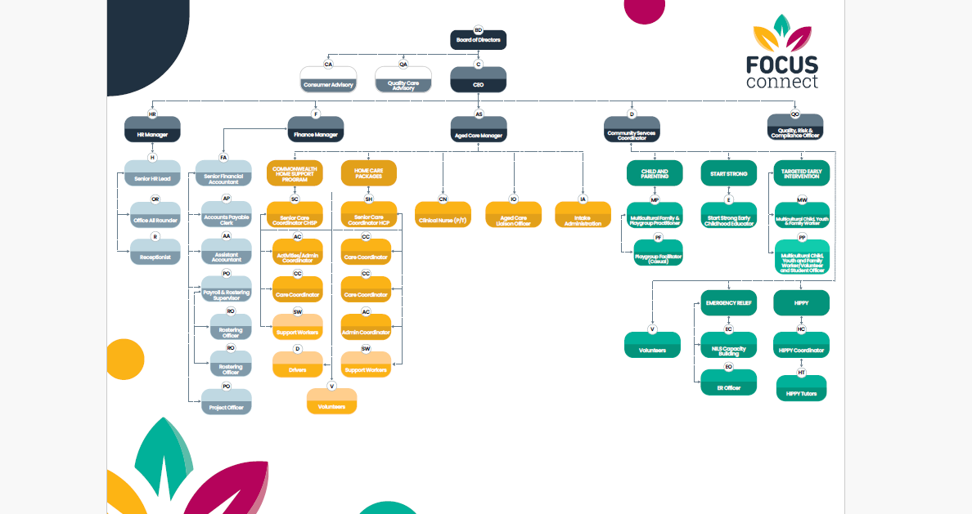

ORGANISATIONAL CHART

Slide 4
Areas We Service
FOCUS Connect provides inclusive support for Multicultural and First Nations communities as a registered My Aged Care provider and through tailored community programs.
We offer aged care services across South West Sydney, including Wollondilly, Wingecarribee, Campbelltown, Bankstown, Camden, Fairfield, and Liverpool, as well as northern Sydney suburbs such as Ryde, Hornsby, and Pymble.
Our holistic community support addresses the cultural and social needs of Multicultural, CALD, and First Nations communities in Macarthur, South West Sydney, and the Illawarra/Shoalhaven. Services include financial support, parenting programs, case management, and referrals to community services to help improve well-being.

Slide 5
Welcome message from leadership: "Thank you for joining our network of trusted partners in delivering aged care services."
Purpose of this induction:
  Align expectations between your organisation and ours
  Clarify roles and legal responsibilities under the new Aged Care Act 2025
  Support safe, high-quality care and services

Slide 6
AGED CARE SERVICES
Commonwealth Home Support Programme – CHSP
  Entry-level care
  Eligibility criteria
  Partially subsidy for
    Domestic Assistance
    Personal Care
    Social Support Individual
    Transport
    Social Support Group
    Flexible Respite
    Meals
    Nursing
    Allied health and therapy services and occupational therapy
    Specialised support
    Home maintenance & Home modifications
    Goods, equipment and assistive technology
Support at Home Program
  Level 1
  Level 2
  Level 3
  Level 4
  Level 5
  Level 6
  Level 7
  Level 8
  Restorative Care Pathway
  End of Life Pathway

Slide 7
Who is an Associated Provider?
Definition: A third-party individual or organisation who delivers services on behalf of a registered aged care provider
Examples:
  Allied health providers (e.g., physiotherapists, podiatrists)
  Contractors (e.g., home maintenance, transportation)
  Support workers engaged under subcontract
Under the Aged Care Act 2025, registered providers remain accountable for care delivered by associated providers
Resources:
Department of Health and Aged Care: Associated Providers Fact Sheet

Slide 8
Our Commitment to Quality and Safety
FOCUS Connect is committed to:
  Delivering person-centred, safe, respectful care
  Upholding the rights, dignity and choices of older people
  Continuous improvement and quality assurance

Slide 9
Your Obligations as an Associate Provider
Comply with the following:
  Strengthened Aged Care Quality Standards
  Aged Care Code of Conduct
  Incident Management and Reporting Procedures
  Privacy and Confidentiality Laws (Australian Privacy Principles)
  WHS Act 2011 and Safe Work Australia
  Aged Care Statement of Rights
Provide services that:
  Are safe, timely and responsive
  Respect diversity and cultural identity

Slide 10
Code of Conduct – Key Principles
You must:
  Act with respect for people’s rights and dignity
  Deliver care and services competently and safely
  Communicate honestly and transparently
  Take action and report if you witness poor care or abuse
Resources:
Aged Care Code of Conduct – Commission Factsheet

Slide 11
Risk and Incident Reporting
Types of incidents:
  Abuse or neglect
  Falls, injury or health deterioration
  Medication errors
  Near misses or system failures
How to report:
  Complete FOCUS Connect Incident report form via this link https://form.jotform.com/252648465875069
  Contact FOCUS Connect designated contact person
Resources : https://www.agedcarequality.gov.au/providers/serious-incident-response-scheme

Slide 12
AGED CARE QUALITY AND SAFETY COMMISSION SERIOUS INCIDENT SCHEME REPORTING
Under the SIRS, providers are also required to notify the Commission of a subset of reportable incidents that occur, including alleged and suspected events, as well as witnessed events. The Commission reviews all incident notifications to identify risk of harm to participants
THE 8 TYPES OF SIRS REPORTABLE INCIDENT
unreasonable use of force
unlawful sexual contact or inappropriate sexual conduct
psychological or emotional abuse
unexpected death
stealing or financial coercion by a staff member
neglect
inappropriate use of restrictive practices
unexplained absence
Resource - Serious Incident Response Scheme - Guidelines for providers of home services

Slide 13
Working with Vulnerable People
Requirements:
  Police check (less than 3 years old)
  Mandatory reporting of abuse or neglect
Guidance:
  Understand signs of elder abuse
  Know when and how to intervene
Resources:
Elder Abuse Prevention Toolkit https://ageingdisabilitycommission.nsw.gov.au/documents/tools-and-resources/for-professionals/NSW-Elder-Abuse-Toolkit.pdf

Slide 14
Communication and Escalation
Communicate clearly and professionally
Use email info@focusconnect.org.au. or phone Call (02) 4627 1188 for enquiries, feedback or complaints
Escalate issues promptly:
  Client safety risks
  Non-compliance by staff
  Reputational or legal concerns

Slide 15
If you feel FOCUS Connect has not addressed your complaint, you are able to lodge the complaint with The Aged Care Quality and Safety Commission.
Complaints can be made:
Online:https://www.agedcarequality.gov.au/making-complaint/lodge-complaint/online-complaints-form.
By phoning 1800 951 822.

Slide 16
Performance Monitoring
What we measure:
  Service timeliness
  Client satisfaction
  Compliance with service agreement
  Record of incidents, complaints, and resolutions
We may conduct audits, surveys, and site visits

Slide 17
Information Security & Record Keeping
All client information must be:
  Stored securely (no public folders or personal devices)
  Accessed only when required for care delivery
  Shared only with authorised parties
  Printed copies should be stored securely and shredded appropriately.

Slide 18
Training and Continuous Improvement
All associated providers must:
  Complete the training modules via these links
  Support at Home provider training | Australian Government Department of Health and Aged Care
  https://www.agedcarequality.gov.au/sites/default/files/media/standards-providers-powerpoint.pptx
  Engage in reviews after incidents or complaints
  Contribute to service improvements

Slide 19
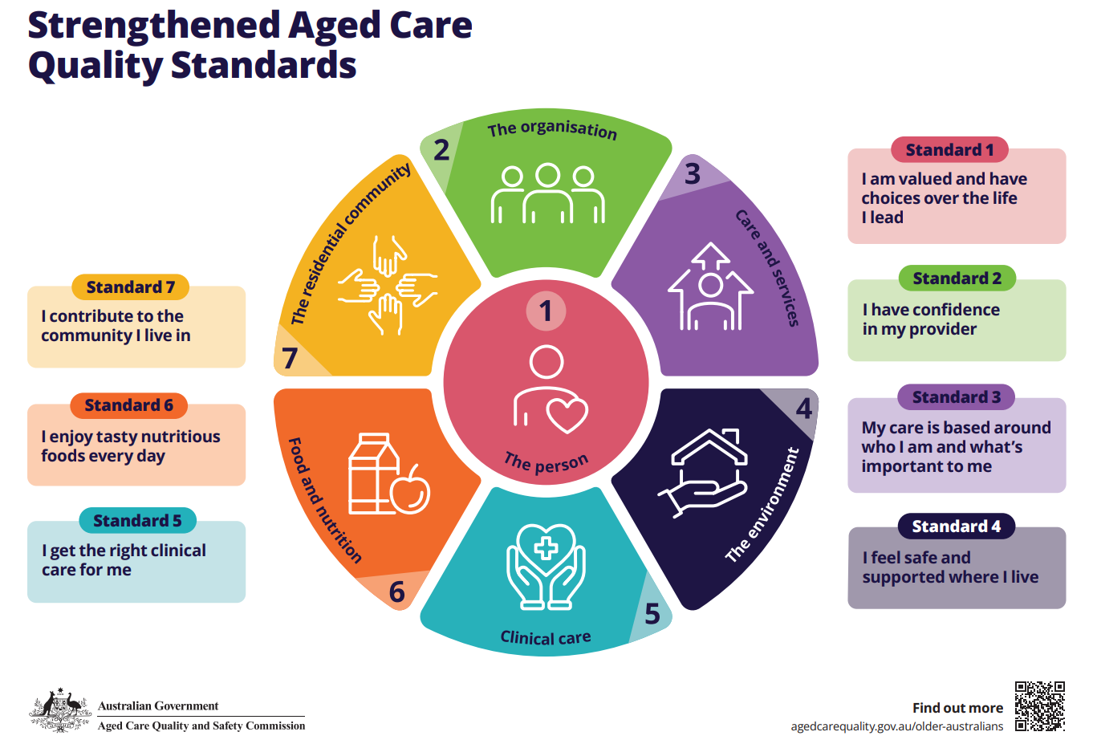

Slide 20
STRENGTHENED AGED CARE QUALITY STANDARDS LEARNING
Click the link below to watch the video
The strengthened Quality Standards in Practice Workshop

Slide 21
POLICIES & PROCEDURES
All Associate Providers must read and comply with FOCUS Connect aged care services policies and procedures manual on the Associated providers page on www.focusconnect.org.au

Slide 22
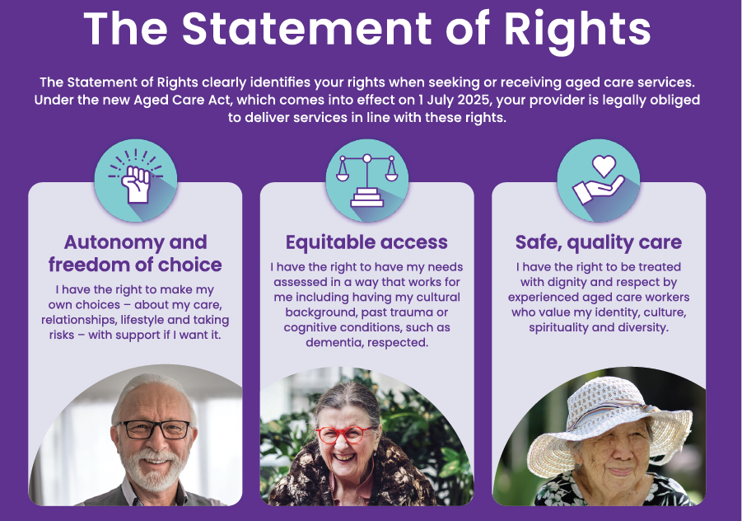
The Statement of Rights information and awareness

Slide 23
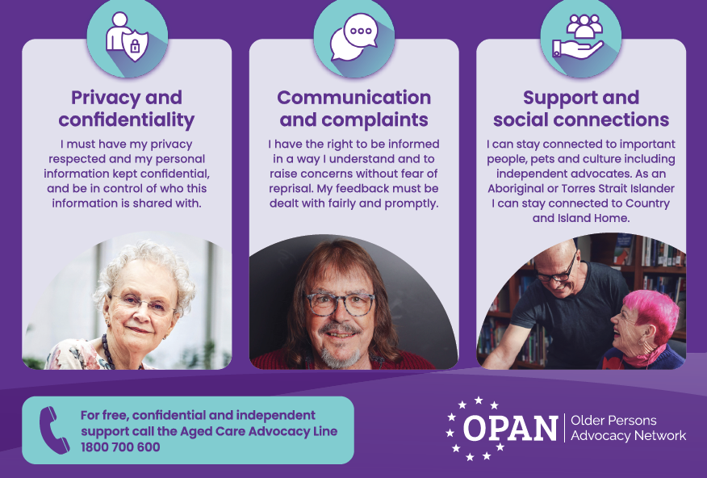

Slide 24
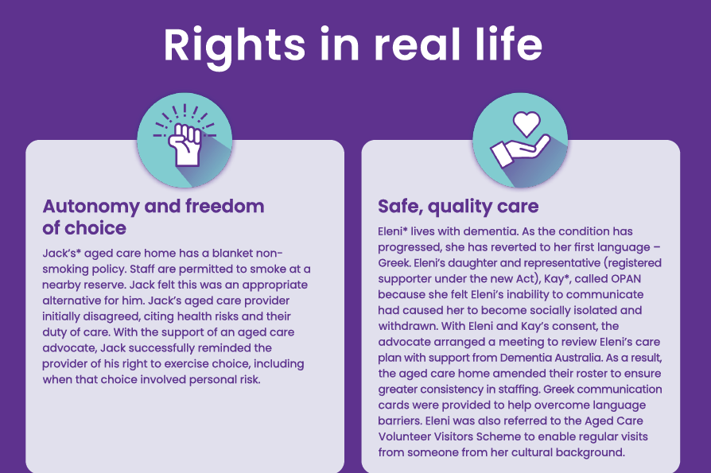

Slide 25
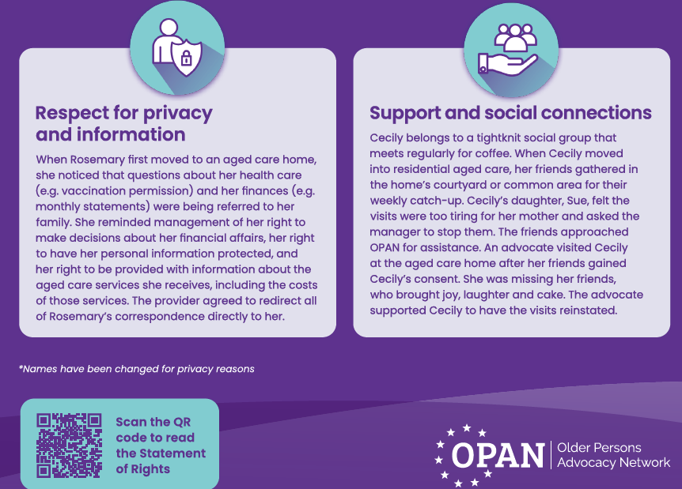

Slide 26

Code of Conduct for Aged Care
– introductory video for providers

Slide 27


Slide 28
RESOURCES
What is dignity of risk? https://youtu.be/uI5jGydMj1A
What is person Centred Care? https://youtu.be/9icUIM-vM3k

Slide 29
FOCUS Connect Key Contacts
Aged Care Manager
Kelly Grasso
Email - kellygrasso@focusconnect.org.au
Mobile - 0491 064 227
Work Phone - +61 2 4627 1188
Administration Support
Sharon Hooper
Email - SharonHooper@focusconnect.org.au
Work phone - +61 2 4627 1188
FOCUS Connect Reception
Email - info@focusconnect.org.au.
phone - +61 2 4627 1188

