Slide 1
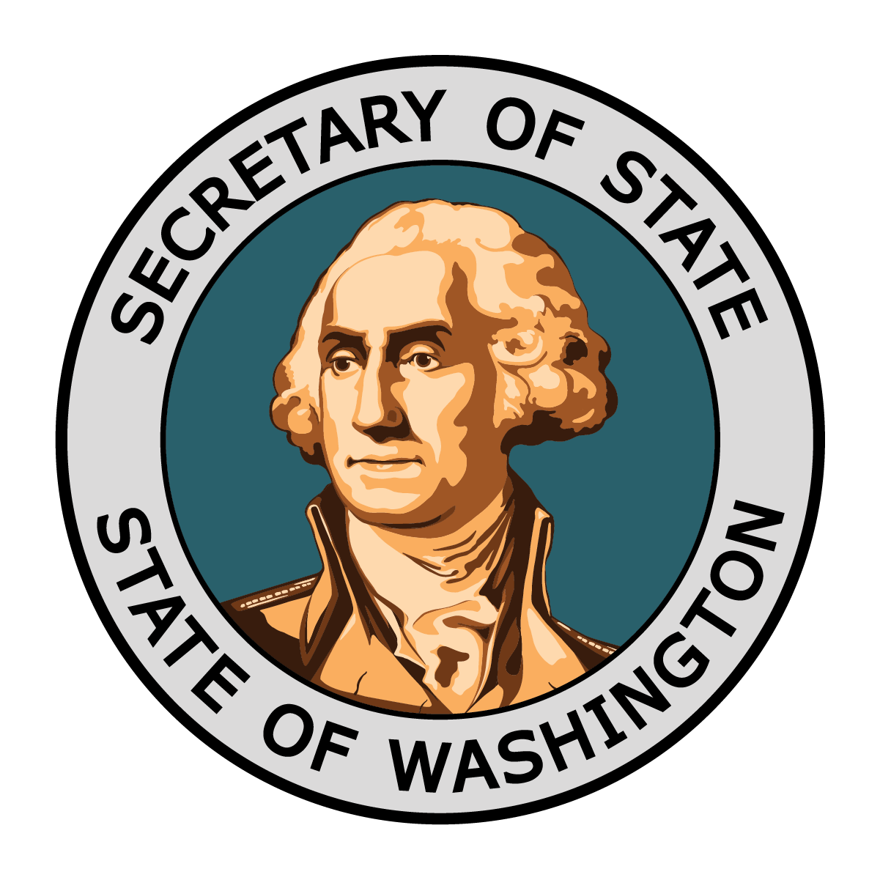
Serving Communities Statewide
Office of the Secretary of State

Slide 2
About the Office

Slide 3
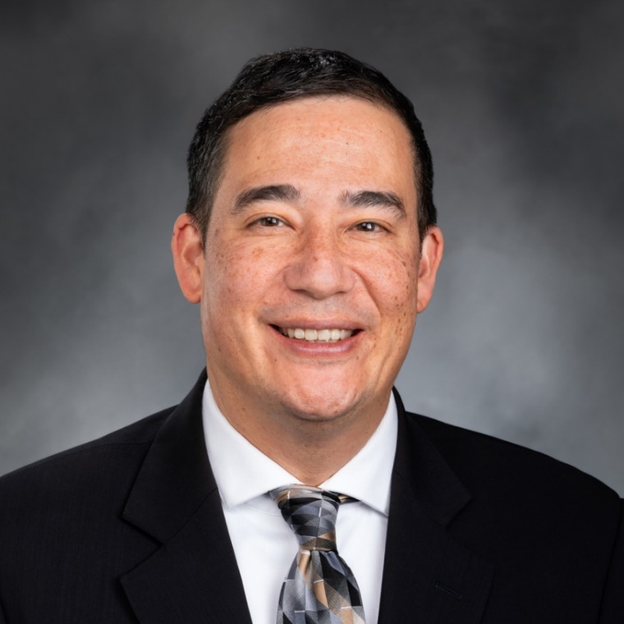
Secretary of State Steve Hobbs
Washington’s 16th Secretary of State.
Began his tenure in 2021 and was elected by the people of Washington in Nov. 2022.
First person of color to head the office, which is one of nine statewide elected positions.
Previously, state senator for Washington’s 44th legislative district, having first been elected in 2006.
Lieutenant colonel in the Washington Army National Guard and proudly served in Kosovo and Iraq.
Holds a master’s degree in public administration, a bachelor’s degree in political science from the University of Washington, and a graduate of the Defense Information School.

Slide 4
Agency Mission
The Office of the Secretary of State promotes public trust by:
Preserving the integrity of elections
Safeguarding vital government records
Providing the business community and public with easy access to information about corporations and charities
Public outreach to improve civic knowledge and participation

Slide 5
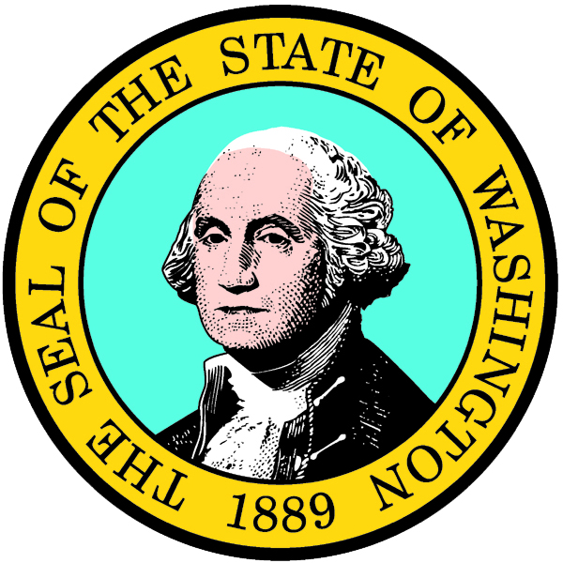
Keeper of the State Seal
Regulating use of the State Seal.
Affixing the State Seal and attesting to commissions, pardons, and other documents which require the governor's signature.
Notes:
The Office of the Secretary of State was established with the adoption of the Washington State Constitution in 1889. Being keeper of the Seal was one of the Office’s original constitutional duties.

Slide 6
Divisions
Notes:
Currently, 296 employees between 8 divisions:
Archives – 51 Corporates & Charities – 53 Elections – 36 External Affairs – 16 Information Security & Response – 15 Information Technology – 31 Library – 59 Operations – 35

Slide 7







Our Divisions
Executive
Archives
Corporations & Charities
Elections
External Affairs
Information Security & Response
Library
Operations

Slide 8
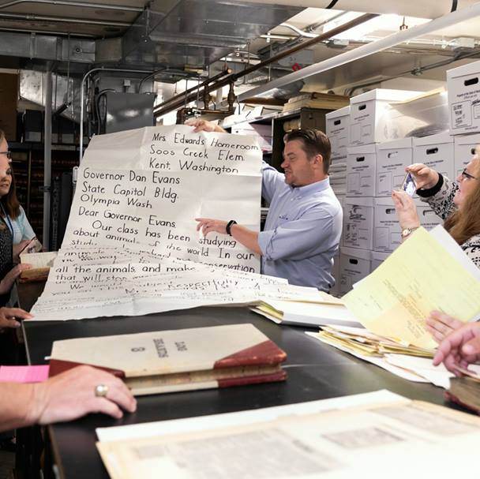
Washington State Archives
Preserving Washington’s rich and diverse history
Collects and preserves the state’s historical records and makes them available for research.
Valuable public resource for all, especially archivists, historians, researchers, educators, students, and journalists.
Legacy Washington documents extraordinary stories in Washington history through State Library, State Archives, original sources, and heritage organizations statewide.
Notes:
Archives branches are located in Eastern, Western, and Central regions of the state. There are also branch locations at Bellevue Community College and the main branch in Olympia across from the Legislative building.
Legacy Washington is a program under the Office of the Secretary of State that documents the stories of the communities across Washington in a variety of ways. Some books published through the program are: “Lightning Boldt” detailing the Boldt decision written by State Archives chief historian John Hughes, “Love Equally,” about the state’s journey to marriage equality, “Daniel J. Evans, An Autobiography,” “Where the Salmon Run” (about Billy Frank Jr.)

Slide 9
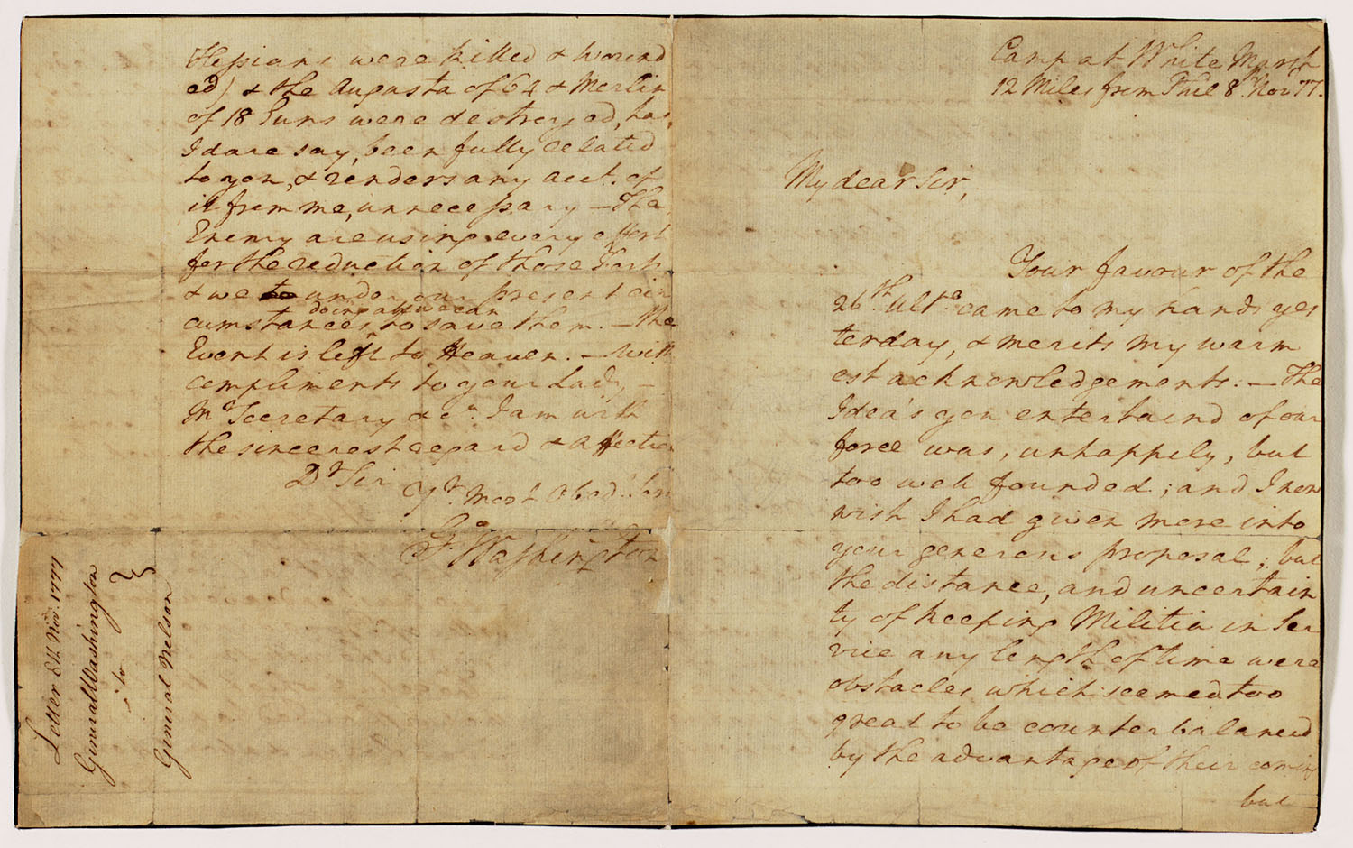
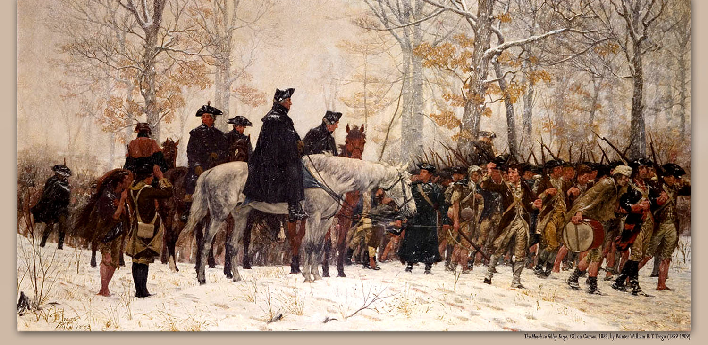
Washington State Archives
Letter from George Washington, dated Nov. 8, 1777
The letter, acquired by the Washington State Archives in 2001 as a permanent loan from The National Society of the Colonial Dames of America in the State of Washington, was conserved by staff in January 2005.
Notes:
Washington State Archives has a letter from George Washington on loan from an outside organization. (There is no Cortez map.)* If the crowd seems like they are open to this information, speak about information related to aliens and UFOs.

Slide 10
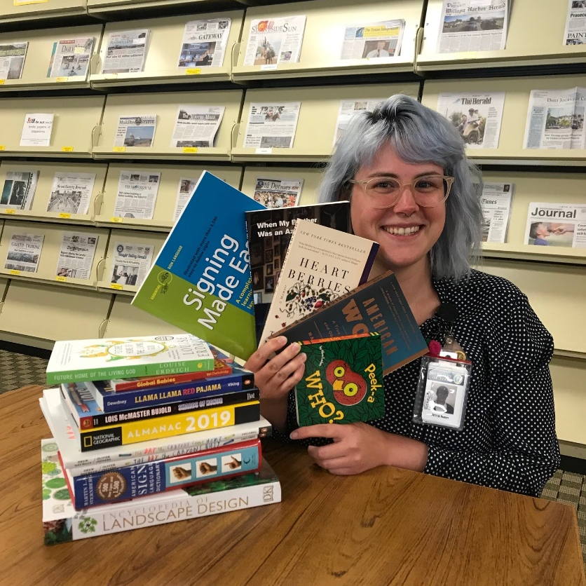
Washington State Library
Our commitment to literacy, reading, and lifelong learning
Connects Washingtonians to their history through the power of libraries.
Digital initiatives and other preservation efforts:
Tell stories of our local communities.
Celebrate our common heritage.
Institutional Library Services for adult correctional facilities and psychiatric hospitals.
Therapeutic tabletop gaming.
Washington Talking Book & Braille Library provides information and reading materials for Washingtonians unable to read standard print.
Notes:
Worked with the Department of Corrections to end the ban on role-playing games in correctional facilities.
Branches of Institutional Library Services, including Youth and DOC: Eastern State Hospital, Western State Hospital, Echo Glen Children's Center, Airway Heights Corrections Center, Clallam Bay Corrections Center, Coyote Ridge Corrections Center, Stafford Creek Corrections Center, Twin Rivers Unit of the Monroe Correctional Complex, Washington Corrections Center, Washington Corrections Center for Women, Washington State Penitentiary, Interlibrary Loan Services for DOC Minimum Security Facilities.

Slide 11
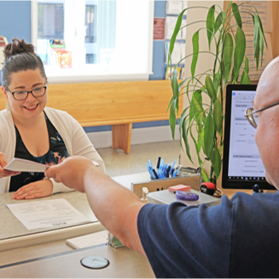
Corporations and Charities
Registers businesses, charities, and nonprofits.
Handles trademark applications, domestic partnership registrations, and apostilles.
Online resource offers 24-hour public access to registrations and annual reports.
Education and training programs and workshops for corporations, charities, and the public.
New branch opening in Cheney in 2024.
Notes:
Future goals include opening office in King County and other branch offices. Spokane

Slide 12
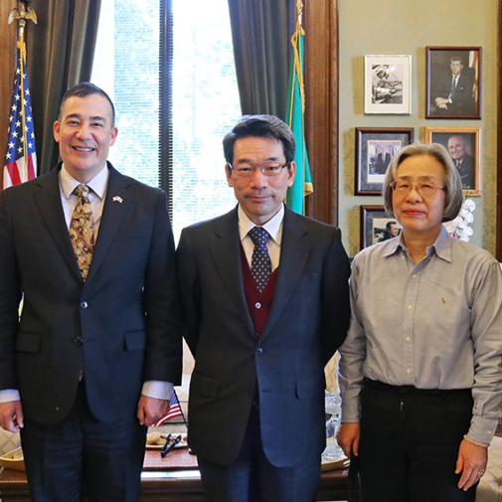
International Relations
Frequently called upon to represent the state in international trade and cultural missions, and to meet with dignitaries and delegations from other countries.

Slide 13
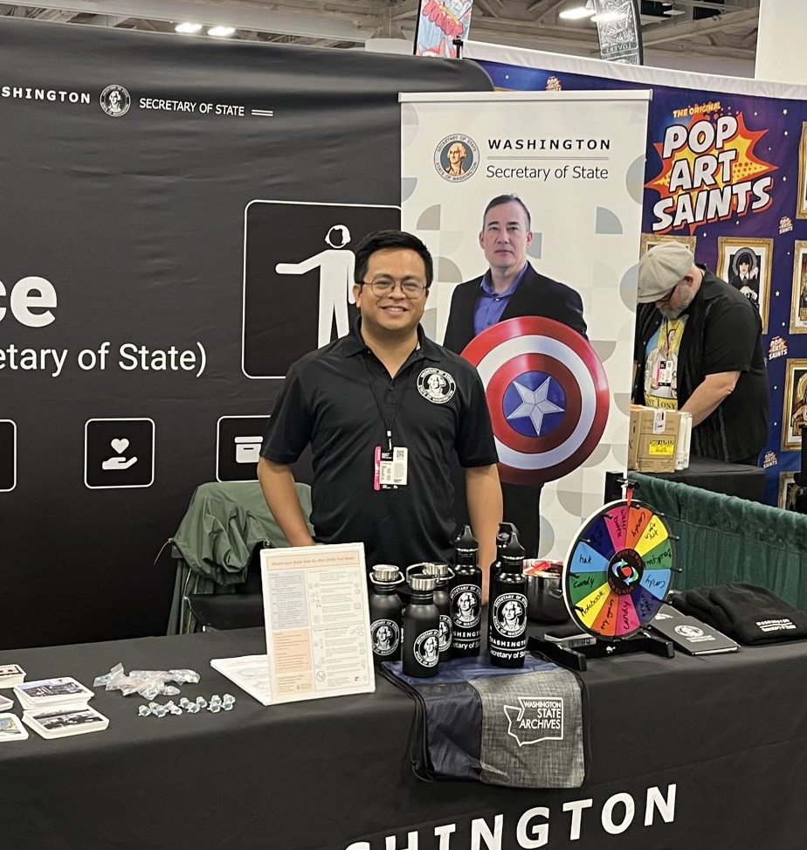
Elections Division
For our right to vote and participate in our democracy
Oversees state and local elections.
Certifies results of state primaries and general elections.
Produces and distributes the statewide voters’ pamphlet.
Filing and verifying initiatives and referenda.
Civic engagement, outreach, and voter education, including Future Voters and Student Mock Election.
Administer statewide official voter information portal VoteWA.gov.
Notes:
Engaging young people where they are, text alerts through VoteWA, moving to the Cloud, Mobile game app, PAX, ECCC, borrowing drop box story, Secretaries of State in United States are invited to classified briefings.

Slide 14
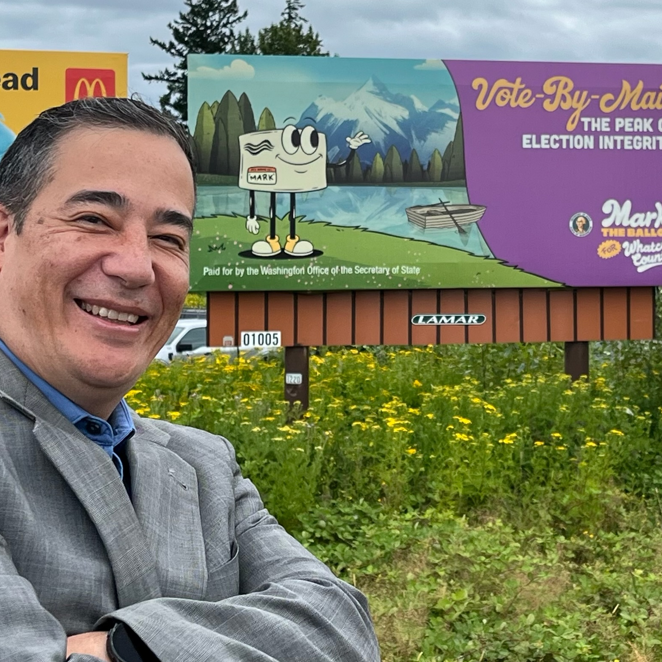
Information Security and Response
Protects against cybersecurity risks to the office.
Works with local, state, and federal agencies, including the Cybersecurity and Infrastructure Security Agency, to protect elections integrity.
Designs strategies to identify and combat election misinformation.
Provides county elections offices with annual grants to improve security.
Recently launched "Mark the Ballot" public awareness campaign to educate voters about vote-by-mail and curb election rumors.
"Mark the Ballot" public awareness campaign
Notes:
County election offices in Adams, Asotin, Benton, Cowlitz, Grays Harbor, Kitsap, Klickitat, Mason, Pend Oreille, Pierce, San Juan, Skagit, Snohomish, Stevens, Thurston, and Walla Walla counties were awarded up to $2 million, with final calculations pending. Must have installed an Albert sensor that monitors the network for cyber threats and attacks. Counties can use the funding to purchase or upgrade their security software and hardware, hire IT security personnel, make structural improvements, and more.
Mark the Ballot public awareness campaign to curb misinformation to promote the integrity of a process that has enabled accessible and secure voting throughout Washington for more than a decade. This campaign’s positive messaging helps all Washington voters understand how vote-by-mail works, celebrate their democratic rights, and encourage participation.

Slide 15
Additional Programs
Address Confidentiality Program provides a substitute address for victims of crime and criminal justice employees.
Combined Fund Drive empowers state and higher-education employees and retirees to support the charities and nonprofits of their choice via payroll contributions and fundraising events.
Productivity Board incentivizes state employees to help state government operate more efficiently by suggesting cost-saving ideas, with the possibility of earning up to $10,000.
Notes:
ACP serves over 6,500 participants each year.
Total supported to date: over 24,984.

Slide 16
Legislative Agenda

Slide 17
Budget Highlights
2023 Election Security: $8 million for cybersecurity, enabling a fresh round of election security grants for counties that have an Albert Sensor. In 2023, we awarded $2 million in grants to 36 counties to strengthen election security.
2024 End of Session Allocation: $3.9 million to stabilize operations of State Library and State Archives operating funds, which are experiencing shortfalls due to historically low transactions producing document recording fees.
Continued support for funding development for much-needed Library Archives Building in Tumwater.

Slide 18
Key Bills
Senate Bill 5152 prohibits use of manipulated visual and audio information (known as "deepfakes") to spread election disinformation. Signed into law 2023.
2024 House Bill 1241: Creates the Class C felony for election worker harassment and allows election workers who have been harassed to join the Address Confidentiality Program. Signed by the Governor March 26.
2024 Senate Bill 5824: Raises the signature threshold to put library dissolution onto the ballot and empowers every voter in areas the library serves to participate in the election. Signed by the Governor March 26.

Slide 19
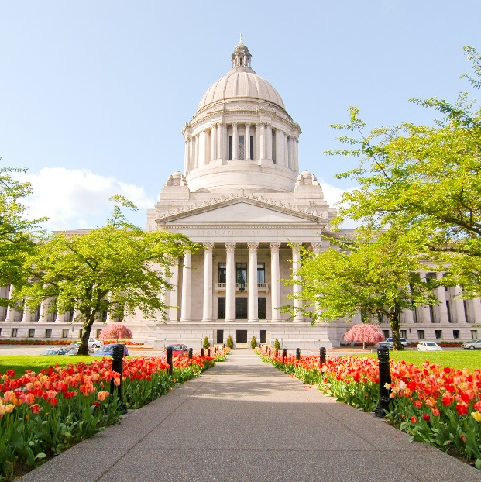
Contact and Social Media
For more information, contact:
www.sos.wa.gov
360-902-4151
secretaryofstate@sos.wa.gov
Follow us:
Facebook: WaSecretaryOfState
Twitter: @secstatewa
Instagram: @secstatewa
YouTube: secstatewa

Slide 20
Thank you

