Slide 1

Opportunity Zones 2.0 What Clallam needs to know Coffee with Colleen Kenan Fikri Senior Fellow kenan@eig.org January 2026

Slide 2
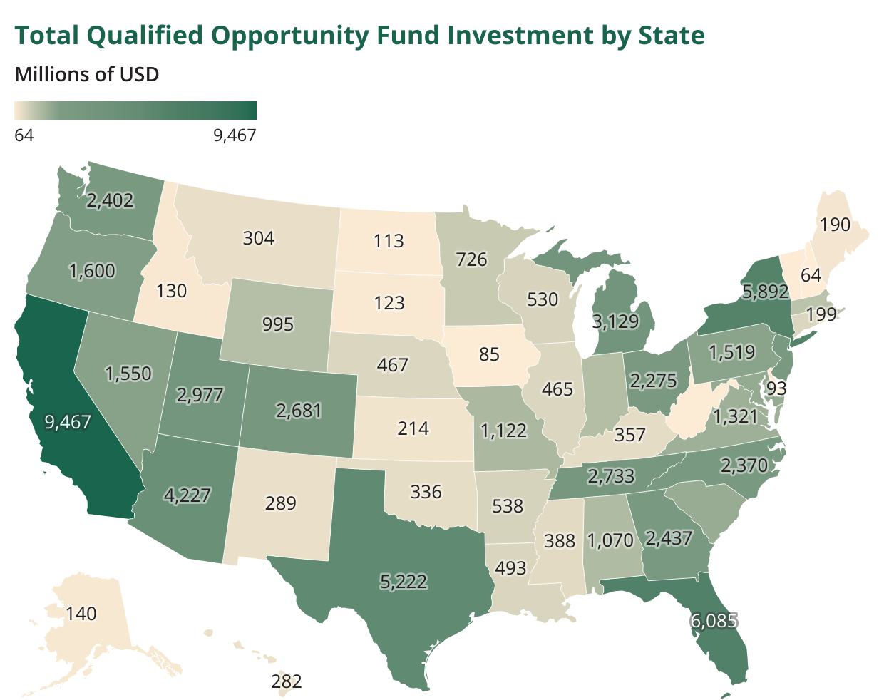
By 2022, 46 states had received more than $100 million in OZ capital.
24 states had received more than $1 billion.
Washington is a leader, with $2.4 billion.
Source: Joint Committee on Taxation, May 2024 | Data through 2022

Slide 3
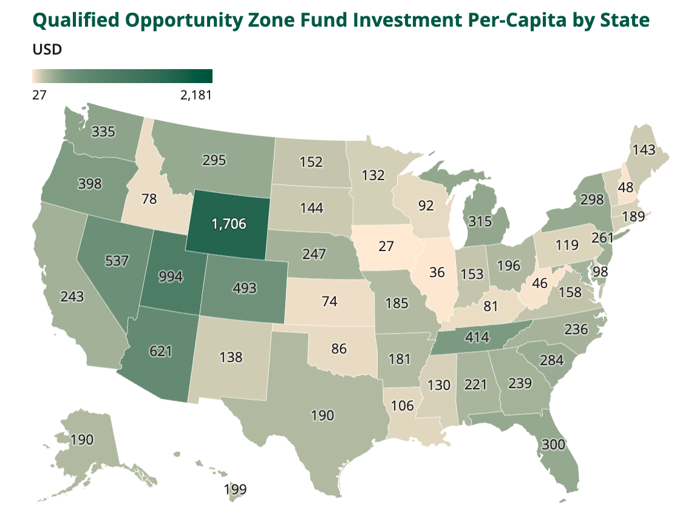
The national per capita baseline was $238 in OZ investment per resident through 2022.
Washington comes in near par for the west on a per capita basis.
Utah and DC stand out as two of the most pro-growth jurisdictions nationally.
2,181
Source: Joint Committee on Taxation, May 2024 | Data through 2022

Slide 4
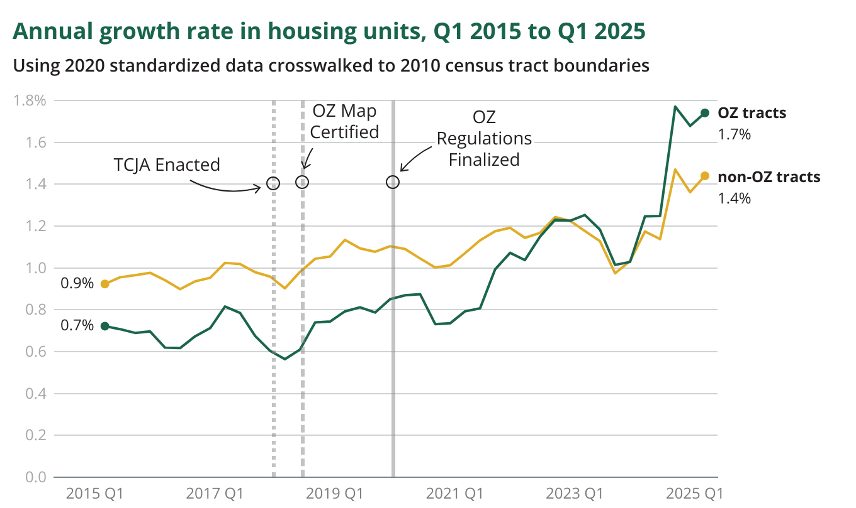
OZ are proving to be one of the most powerful supply-side federal housing incentives in generations
The growth rate in new housing units in Opportunity Zones more than doubled after designation — without taking away from other tracts.
Source: Economic Innovation Group analysis of HUD Aggregated USPS data
Notes:
New JCT analysis with data through the end of 2022

Slide 5
Looking forward: What state and local leaders need to know about OZs 2.0

Slide 6
OZ 2.0: What’s new
Incentive structure. Changes will result in a smoother, more predictable flow of investment.
Rural provisions. Significant added tax benefits for rural investments will influence behavior.
Zone eligibility and designation. Stricter targeting criteria will produce a narrower map.
Reporting and transparency. A robust data collection and publication regime will demystify OZ investment.

Slide 7
Timeline
July 4, 2025: OBBBA signed into law; rural substantial improvement provisions in effect
January 1, 2026: New reporting provisions come into effect for Opportunity Funds and investors
July 1, 2026: Governors’ 90-day window to designate new OZs opens
December 31, 2026: End of OZs 1.0 deferral window
January 1, 2027: OZs 2.0 provisions in effect. OZs 2.0 map activates
December 31, 2028: OZs 1.0 map formally sunsets

Slide 8
Incentive structure
OZs offer three capital gains tax benefits:
Deferral of taxes on any capital gain rolled into a qualified Opportunity Fund
Step-up in basis on those deferred gains once the tax comes due
Exclusion of any gain on investments made in OZs and held for at least 10 years
New changes allow for rolling deferrals and a fixed step-up.
Investors can roll recently realized capital gains into an Opportunity Fund at any point and benefit from a standard 5-year deferral and 10% step-up in basis.
This will smooth investment over time, avoiding the cliffs from OZs 1.0.
New provisions come into effect January 1, 2027.

Slide 9
Rural provisions
Investors into a special class of Qualified Rural Opportunity Funds (QROFs) benefit from
a stronger 30% step-up (compared to the new 10% standard) and
a lower 50% substantial improvement threshold (instead of the standard 100%)
The lower improvement threshold came into effect immediately.
QROFs must hold at least 90% of their assets in qualifying OZ investments in rural areas.
The definition of rural is complex and requires further guidance from Treasury to parse.
The statute reads that rural areas are those outside of cities or towns with more than 50,000 inhabitants or any urbanized area contiguous and adjacent to such places.
EIG’s read: These benefits are likely to increase rural OZ investment significantly.
Special note: Rural areas tend to host a wide mix of OZ use cases, incl. industrial and commercial.

Slide 10
Zone eligibility and designation
Decennial zone selections
New investment maps will be set every 10 years starting January 1, 2027
The 1.0 map will still be in effect for the first two years of the 2.0 map (until December 31, 2028)
Key date: the 90-day window for new zone designations will kick off July 1, 2026.
Eligibility criteria
Poverty rate remains at 20%
However, tracts qualifying on poverty must have a median family income below 125% of the area benchmark.
Median family income falls from 80% of the area benchmark to 70%.
This reduces the number of eligible tracts and future OZs by >20%.
As before, governors nominate 25% of their qualifying tracts as OZs, with a 25 tract minimum.

Slide 11
Community approaches: Zone designations

Slide 12
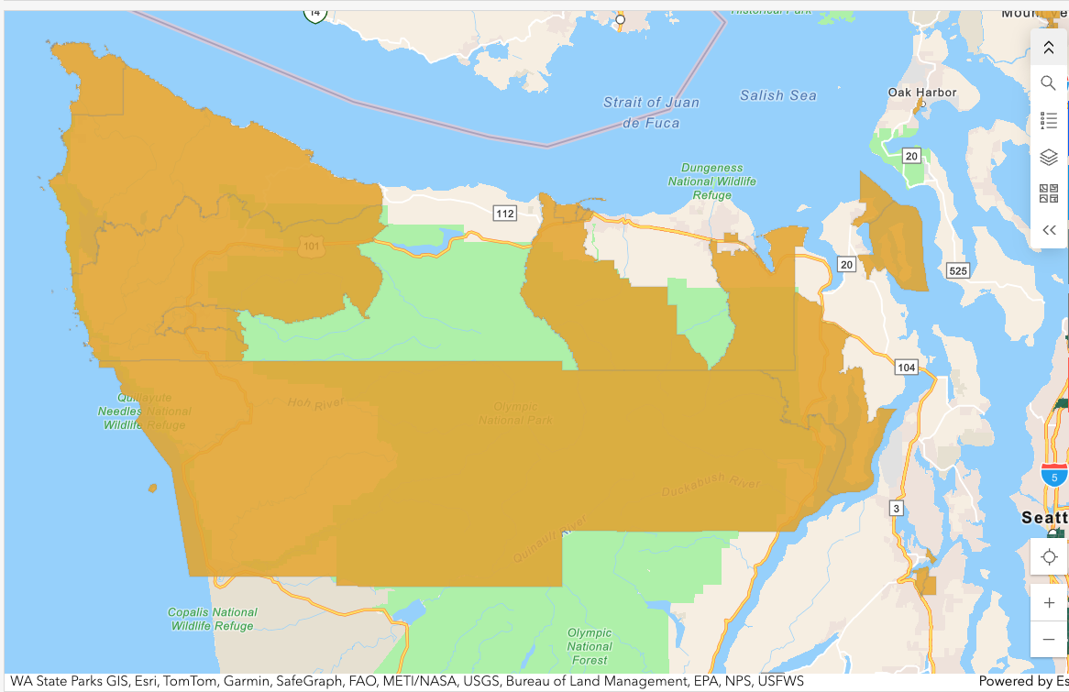
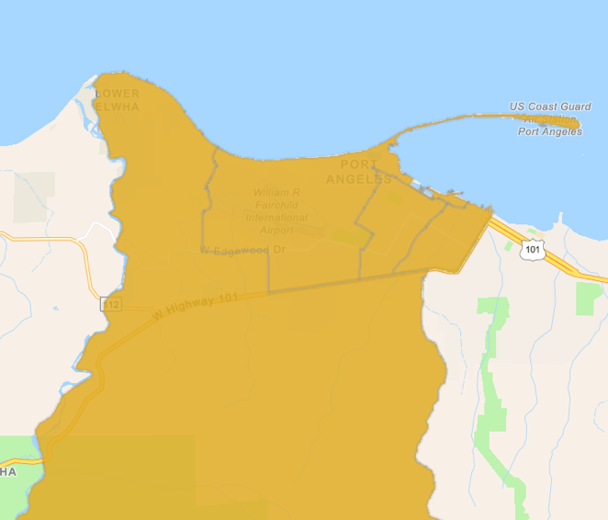
Most of Clallam County is a designated OZ at present

Slide 13
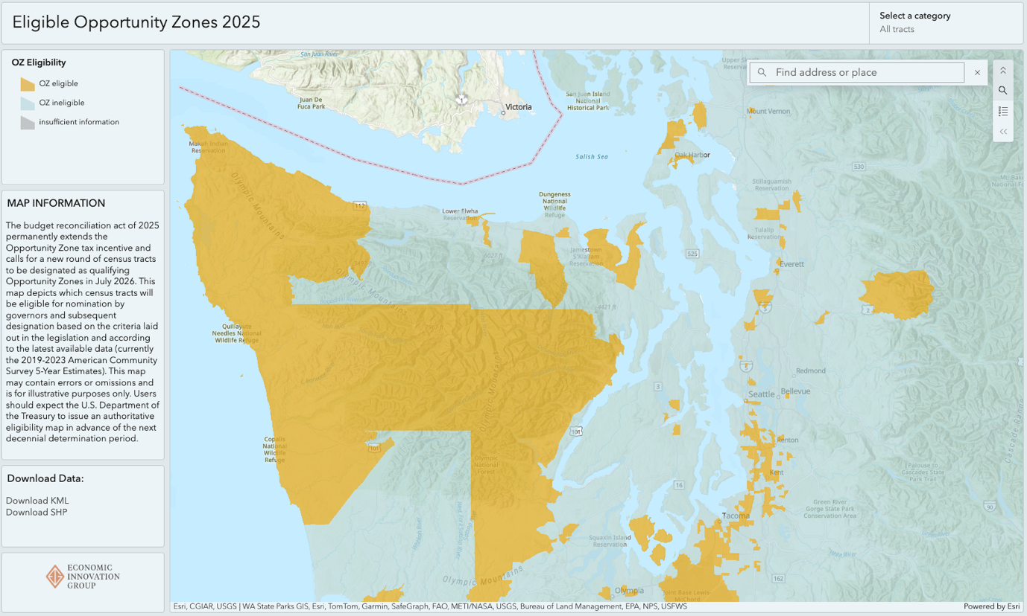
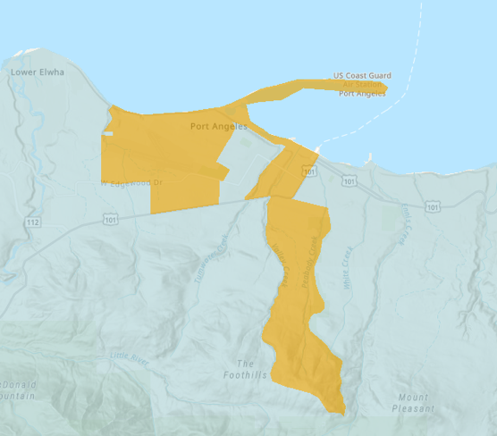
Fewer tracts will be eligible for designation going forward
Preliminary eligibility mapping tools available from EIG as well as Novogradac.
Note! Final eligibility determinations will be made using 2020-2024 ACS data released on January 29, 2026.

Slide 14
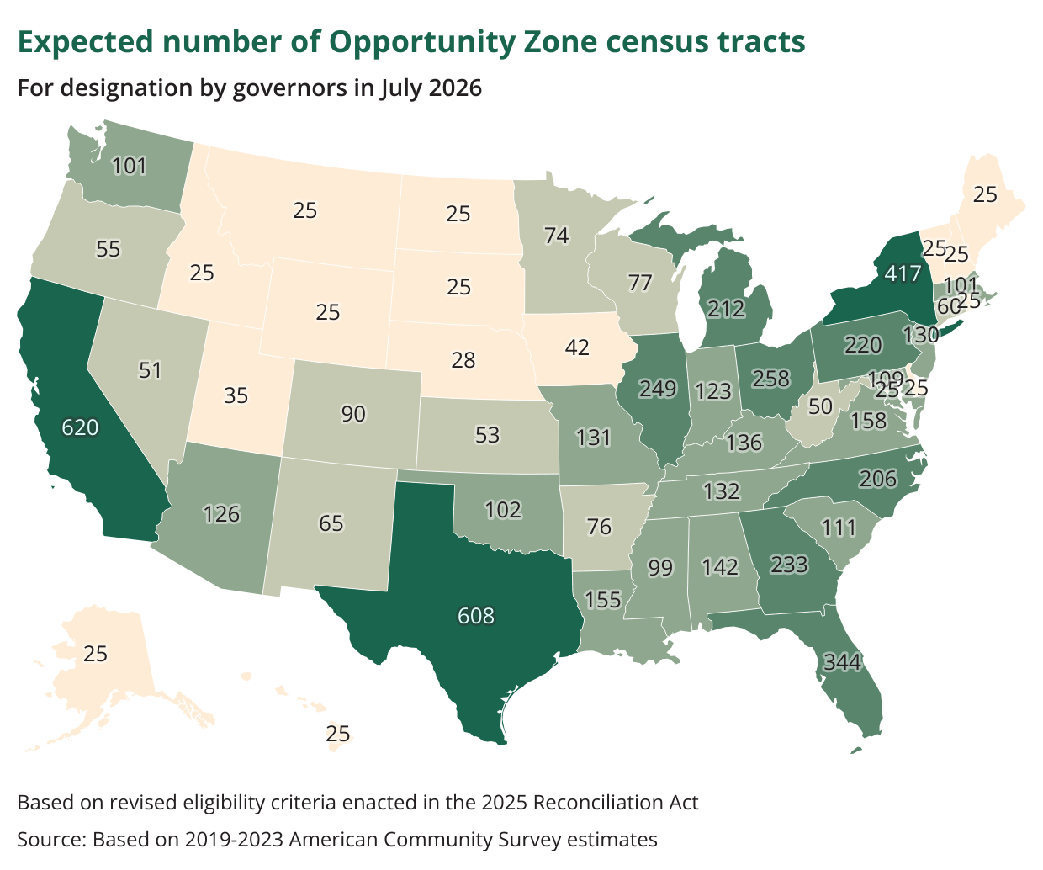
Stricter eligibility criteria mean that most states will have ~20% fewer OZ tracts to nominate in 2026.
Washington will have ~27% fewer.
Nationally, the number of OZs is expected to fall from 8,726 to 6,304.

Slide 15
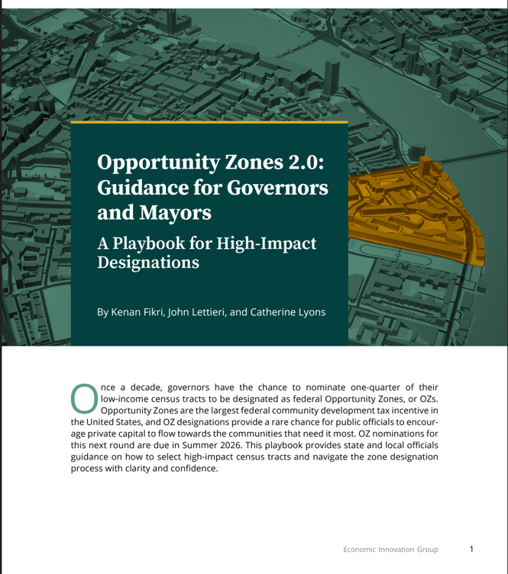
Eight principles for a robust zone designation process
Get a head start preparing data and speaking with trust advisors now
Set a vision for how your state or community aims to harness OZs
Designate a lead coordinating entity within state government
Engage local partners strategically
Balance economic need and investment potential
Combine both quantitative and qualitative insights
Embrace purposeful transparency
Align OZ nominations with supportive policy tools

Slide 16
A three-part test for identifying good OZ tracts
The community test:
Does the area genuinely need new investment to grow and diversify their economies so that residents can prosper?
The market test:
Does the area areas have a reasonable chance to attract private capital and put it to productive use within the policy’s timelines?
The policy test:
Are local policies investment-friendly and conducive to economic development?

Slide 17
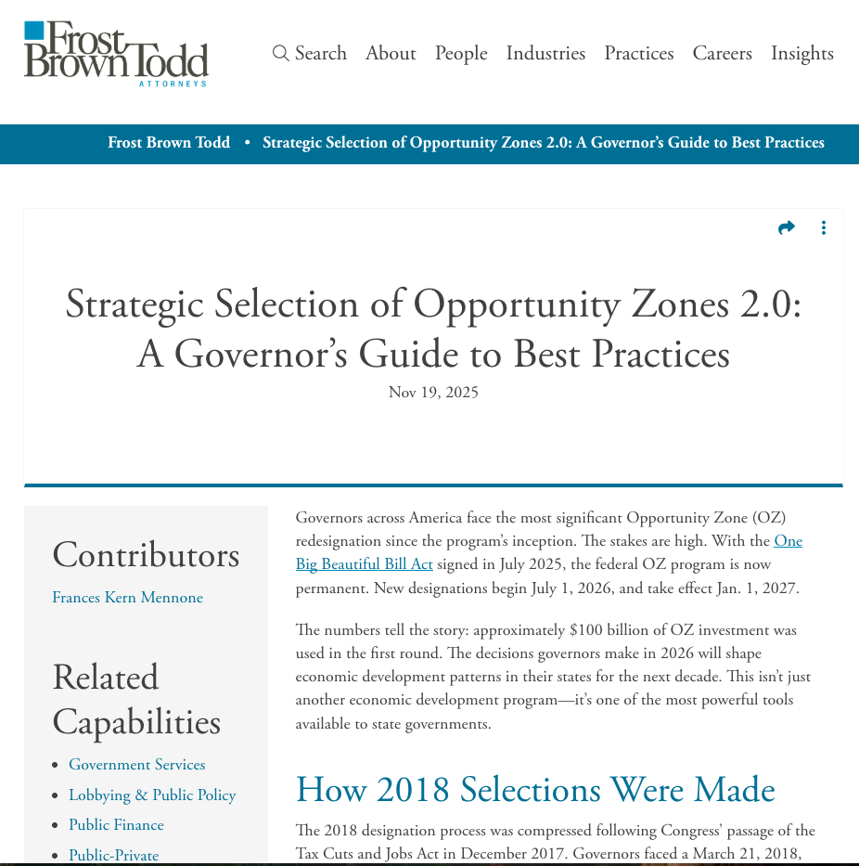
Special considerations for rural areas
States may wish to prioritize rural tracts:
…with an eye towards industrial activity, seeking out areas with:
Major highways
Navigable water and major ports
Rail, air, and intermodal infrastructure
Development-ready sites (or mega-sites)
…Or more of an eye towards placemaking and economic development:
Economic centers such as county seats, historic downtowns, hospital and college districts
In general, governors should deprioritize remote areas without basic infrastructure or anchor institutions.
Source: Forst Brown Todd

Slide 18
Community approaches: Unlocking investment and impact

Slide 19

What tools are at your disposal?
To contribute to projects:
Permitting and approvals!
Publicly-owned land
Ground leases
Occupancy guarantees
To drive investment towards impact:
Inclusionary zoning
Main Street and small business grant programs
Parcel assembly and remediation
Capacity building and ecosystem development grants

Slide 20
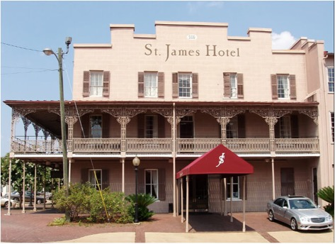
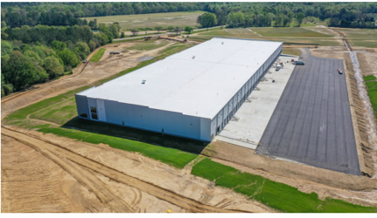
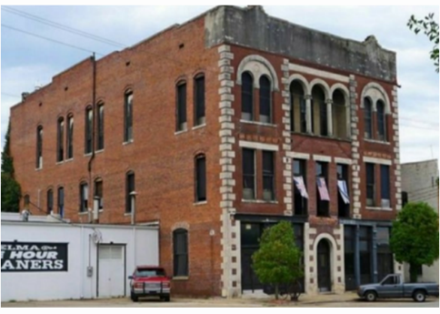
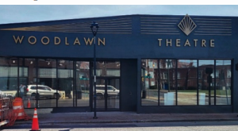
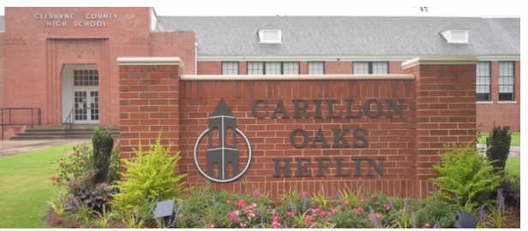
Impact Case Study: Opportunity Alabama “OZs did not come with a playbook. In AL, we decided we needed one.”
How it works:
A non-profit “created to be a catalyst for investments in meaningful projects and underserved places across Alabama”
Civic entrepreneurship and institutional innovation at work
Seeded by local utility, banks, and other anchors
Supported by EDA, philanthropy, others
Certified CDFI with an affiliated investment fund
OPAL builds capacity and solves problems:
Cultivates an investor base and a project pipeline
Engages in predevelopment work
Helps ready distressed rural regions for investment
Connects committed capital to high-impact projects
Coordinates capital and incentives
Read more at Opportunity Alabama, “Investing in Underserved Places”

Slide 21
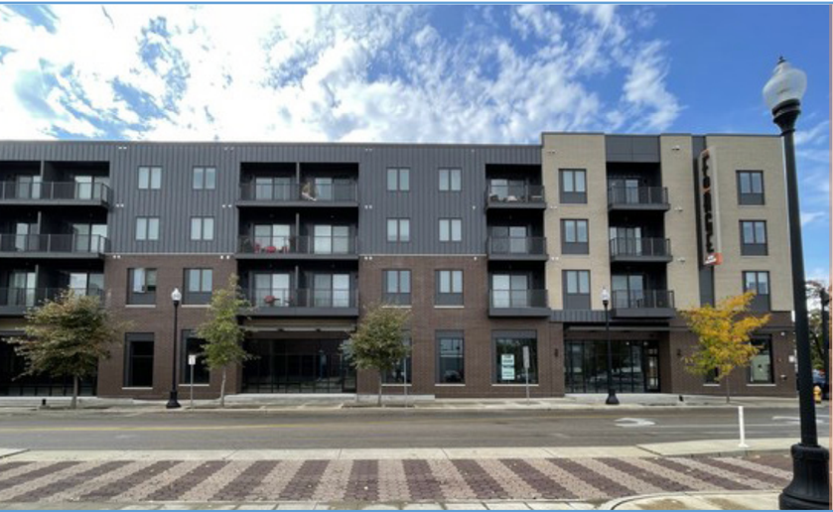
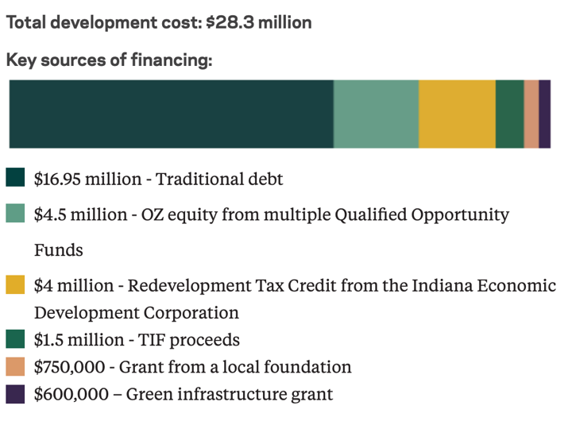
Impact Case Study: Forge on Main Neighborhood revitalization and workforce housing in Evansville, IN
Project creates 180 new residents and commercial space.
Local OZ investors connected with national impact investors through the statewide OZ consortium managed by LISC.
Much-needed new quality housing near downtown.
Remediated a superfund site and alleviated a food desert.
OZ funding raised from six investors combined with state tax credits and city TIFs.

Slide 22
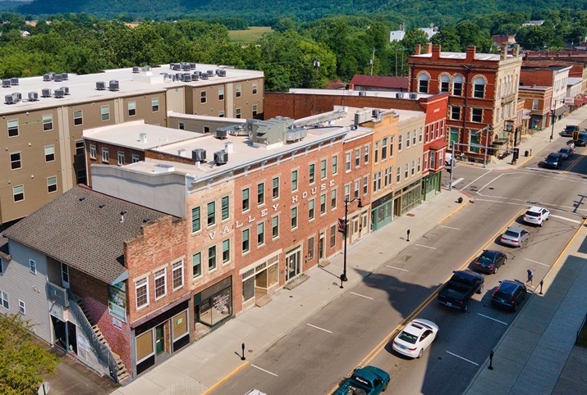
Impact Case Study: Brookville, Indiana Retiring business owners invest in small town transformation
Town had not seen any new development > 20 years when town leaders approached a local developer with a plan to redevelop the historic downtown.
The effort failed to find financing and get off the ground, and the original plan was scaled back and delayed…until Brookville was designated as an OZ.
A local couple that recently sold their business (generating a gain) made an OZ equity investment that allowed developers to move forward with the original concept.
The Valley Flats project offers 27 apartments with assisted living services for seniors, 20 market-rate units, a pharmacy, restaurant, and a movie theater.
The investors behind the project to later used OZ financing to acquire a local newspaper, allowing it to modernize and continue to serve the community, and bring the first hotel to the area.

Slide 23
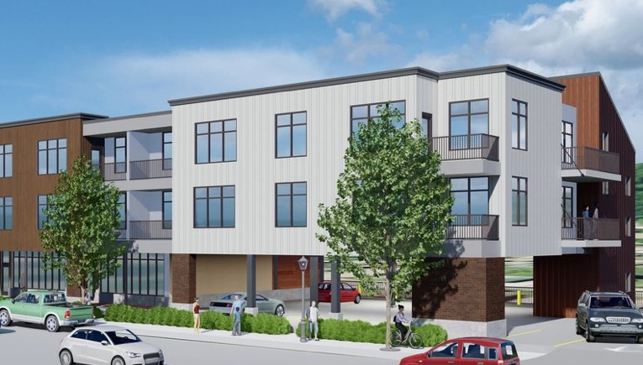
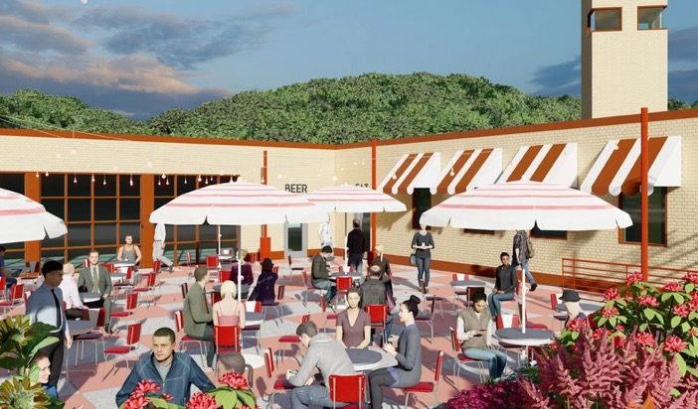
Impact Case Study: Renovare Women-owned developer working statewide and across Michigan’s Upper Peninsula
Renovare builds on its reputation as a developer of high-impact projects in small cities and rural areas.
The firm sources projects statewide.
The firm has developed two projects in Munising, Michigan, (population ~2,000) on the Upper Peninsula:
Utilizing MI’s Transformational Brownfields program, Munising’s Marketplace will bring affordable housing and mixed-use retail to downtown.
All units are reserved for residents at 40% to 80% AMI, and a childcare center and food coop market will occupy the retail space.
Investment in a nearby food hall and beer garden in a historic firehouse, made possible with state historic preservation grants, will help the town capture more tourist spending.

Slide 24
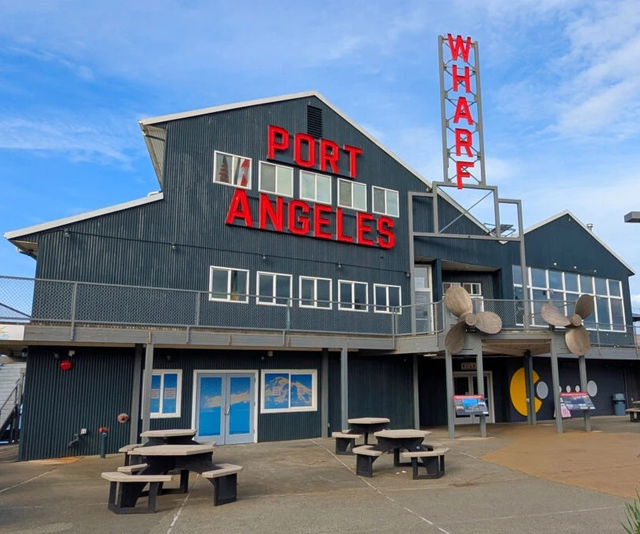
Investment Case Study: Port Angeles Wharf Rehabilitation of an anchor development
2020 OZ investment substantially improved a deteriorating waterfront asset central to the city’s revitalization.
Investment 3x the initial acquisition cost (300% improvement compared to required 100% under OZs 1.0; 50% under OZs 2.0).
Occupancy has risen from 65% to 95% post-OZ investment.
Locus of job creation for 9 new small businesses.
Encountered real pain points around supply and labor constraints, leading to improvisation.
Had to maneuver around state obstacles.
Commitment from local bank was pivotal.

Slide 25
What regional scale unlocks all pieces of a self-sustaining OZ investment ecosystem?
OZ investment ecosystem
Investors
Impact agents
Developers
Viable projects
Some ecosystems might exist within a single city, but others might need to operate regionally, statewide, or beyond.
Cultivating this ecosystem will advance local economic development well beyond OZs, too.

Slide 26
Remember, OZ investment is flexible in:
Who can use it (anyone with a capital gain)
How much they invest (low overhead means large or small)
What it goes towards (as long as it’s new or improved, economically additive and in a zone, it’s likely qualifying.
Wherever there’s a place for equity investment, there’s an opening for OZ capital.

Slide 27
Room for growth Rural and industrial use cases

Slide 28
What do we know about OZ activity in rural places?
Rural areas were well represented in the zone designation process:
23% of OZ tracts are rural/non-metropolitan
⅓ in North Carolina, 40% in Georgia, and 76% in Vermont
$6.1 billion in OZ equity has gone to rural areas* so far.
Rural OZs are home to some of the nation’s most impactful and novel investments.
Rural areas seem to have a particular advantage in business investments.
*Joint Committee on Taxation, rural defined as outside of urbanized areas.

Slide 29
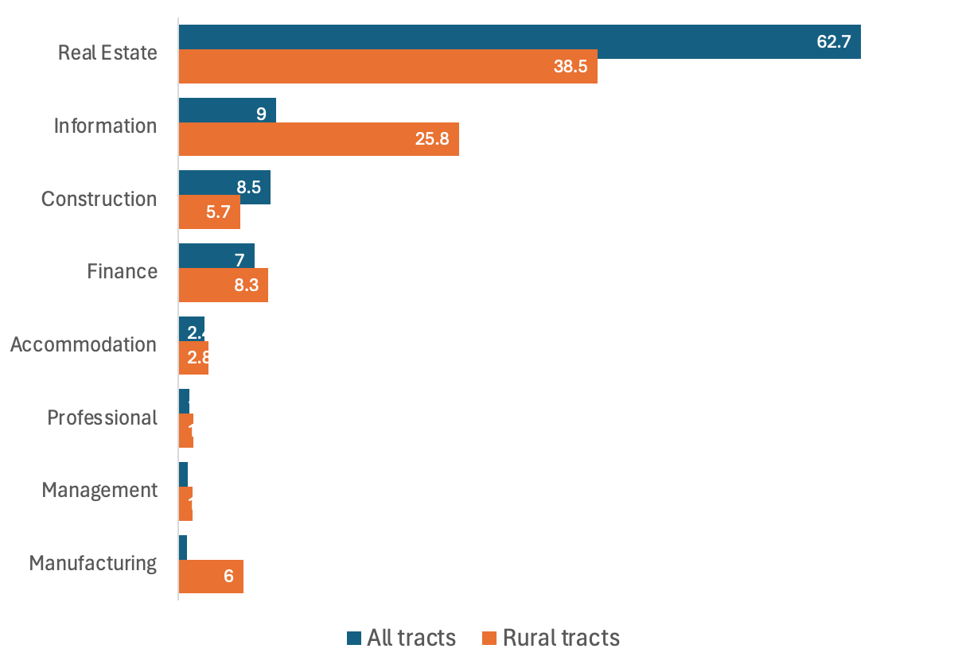
OZ investments in rural areas skews towards information and manufacturing
Source: Joint Committee on Taxation, May 2024

Slide 30
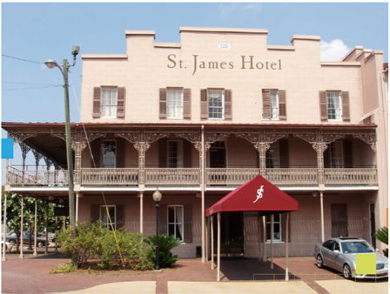
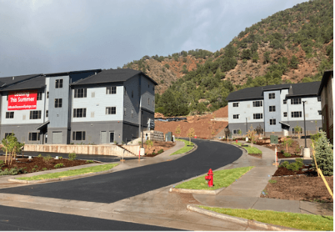
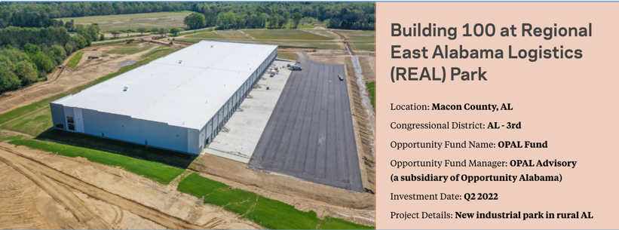
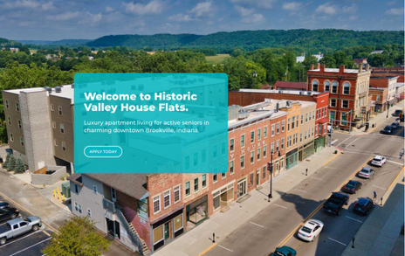
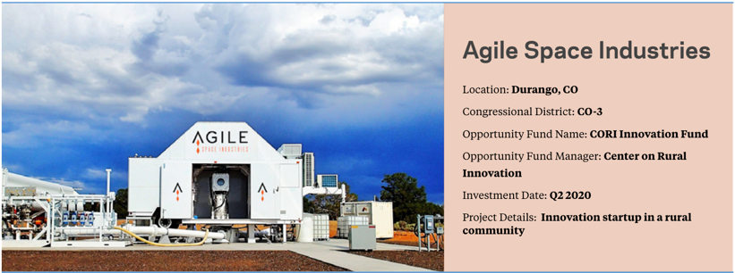

A sample of rural OZ investments (national)
Tourism - Selma, AL
Workforce housing – Glenwood Springs, CO
Industrial development - AL
Downtown revival - Brookville, IN
AI startup - Cape Girardeau, MO
Rural innovation - CO

Slide 31
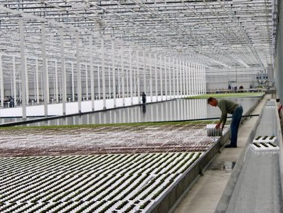
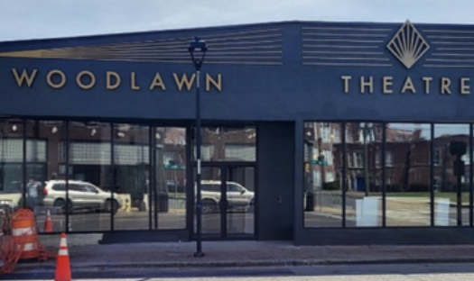

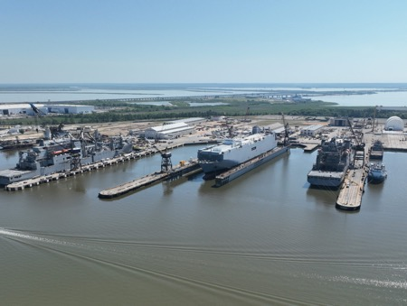
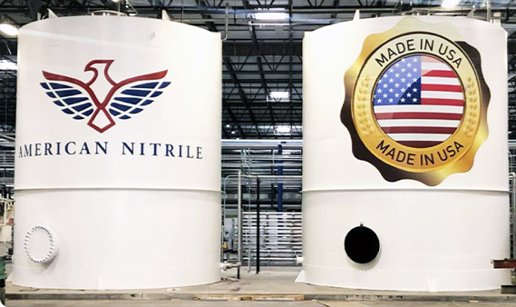
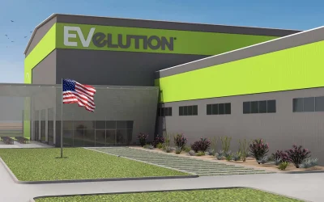
A sample of commercial and industrial OZ investments (national)
Agriculture – Berlin, NH
Culture – Birmingham, AL
Automotive manufacturing – Detroit, MI
Shipbuilding – Mobile, AL
PPE manufacturing – Grove City, OH
Mining – Yuma, AZ

Slide 32




EIG brings together leading entrepreneurs, investors, economists, and policymakers from across the political spectrum to address America’s economic challenges.
EIG.org
facebook.com/EconomicInnovationGroup
linkedin.com/company.economic-innovation-group
twitter.com/InnovateEconomy

