Slide 1

Coffee with colleen
City of Sequim department of community & economic development
12/10/2025

Slide 2
Agenda
01 Introductions
02 Recent Permit Activity
03 Housing and Economic Market Analysis
04 Comprehensive Plan Update
05 Final Thoughts

Slide 3
01 introductions
About Sequim Department of Community Development (DCED):
  Planning/Land Use
    Development Applications
    Environmental Compliance
    Long Range Planning
  Building/Permitting
    Construction Permitting
    Inspections
    Addressing
  Economic Development
    Support Retention and Expansion
    Attract New Businesses
About me:
  30 years of community development experience with small to mid-size cities.
  Dedicated to how thoughtful planning strengthens communities, economic vitality and quality of life for residents.
Joined the team of:
Joel Dressel – Building Official and Fire Marshal
Emily Coler – Permit Coordinator
Travis Simmons – Senior Planner
Scott Radden – Senior Planner

Slide 4
01 introductions
DCED 2025 Focused Efforts
  Enhance Access to DCED
    Online Booking Appointments
    Text Directly to DCED Permit Coordinator
    Online Handouts and Checklists
    Tyler Technologies – online permitting portal
      Permit Portal Assistance
Comprehensive Plan Update
  Working towards a June 30, 2026 adoption.
  Moved effort in-house with specific consultant support.
  More details later in presentation.

Slide 5
02 Recent permit activity

Slide 6
02 Recent permit activity
2020-2025 Housing Building Permit Activity:
  369 total residential building permits issued.
  290 Single Family Residences (SFR).
  10 Multi-Family (MF) Units.
  69 Manufactured Homes (MFH).
Sequim Residential Building Permits Issued 2020-2025
Year | Single Family | Multifamily | MFH | Total
2020 | 50 | 0 | 3 | 53
2021 | 68 | 0 | 5 | 73
2022 | 43 | 2 | 28 | 73
2023 | 19 | 0 | 12 | 31
2024 | 14 | 8 | 10 | 32
2025 | 96 | 0 | 11 | 107
Total | 290 | 10 | 69 | 369

Slide 7
02 Recent permit activity
Final Plats/Final Binding Site Plans Approved 2020-2025
Development | Number of Lots/Units | Issued Permits | Remaining Lots/Units As of 9/24/25 | Unit Type
Lavender Meadows | 217 | 47 | 170 | Manufactured
North Olympic Condos | 8 | 8 | 0 | Condo
Rolling Hills | 215 | 77 | 138 | SFR
Willow Creek Phase C | 27 | 3 | 24 | SFR
McCurdy | 4 | 4 | 0 | SFR
Northwest Ventures | 4 | 0 | 4 | SFR
Van Romer | 2 | 1 | 1 | SFR
Goff | 2 | 1 | 1 | SFR
Talon Court | 4 | 1 | 3 | SFR
Total | 483 | 142 | 341
2020-2025 Land Use Permit Final Activity
  483 lots or units were finalized since 2020.
  Of these, 142 permits have been issued, leaving 341 lots/units available for future construction.
  Lavender Meadows – 170 remaining.
  Rolling Hills – 138 remaining.

Slide 8
02 Recent permit activity
Approved Preliminary Plat/Binding Site Plans 2020-2025
Development | Number of Lots/Units | Type of Units | Known Status | Plat Expiration
Mariners Outlook III | 82 | SFR | Site Construction permit approved; project for sale | 2027
Home Phase B | 33 | SFR | No construction permit submittal to date | 2027
Effie Estates | 15 | SFR | No construction permit submittal to date | 2027
Bell Creek | 104 | SFR | No construction permit submittal to date | 2030
Bella Vista | 24 | SFR | No construction permit submittal to date | 2030
South Olympic Condos | 10 | MFR | Site Construction permit submitted | 2029
Habitat for Humanity | 48 | MFR | No construction permit submittal to date | 2030
Bradley Ridge Apartments | 16 | MFR | Withdrawn | 2027
Maliandra Alteration | 11 | SFR or MFR | No construction permit submittal to date | 2030
Total | 343
2020-2025 Land Use Entitlement Permit Activity
  Since 2020, 9 preliminary plats or preliminary site plans have been approved by the Hearing Examiner.
  These 9 projects represent 343 approved and potential housing units.
Combining 341 units that are ready for building permits and 343 units with land use entitlement results in 684 available units.

Slide 9

03 Housing and economic market analysis
July-November 2025 lead by Leland Consulting Group.
  Report available on the City’s website.
Highlight opportunities & strategies to meet City goals around housing and the economy.​
Describe current employment & housing conditions​.
Identify barriers to construction.

Slide 10
03 Housing and economic Analysis
  Housing – demographic overview, key data, housing policy recommendations.
  Economic Development – workforce and industries data, commuting, and potential opportunity sectors.
  Real Estate Market Trends – market dynamics data, rent and vacancy rates for housing, retail, office, healthcare, hospitality and industrial.
  Zoning Analysis – description and analysis of commercial, employment and residential zones, and identification of potential barriers.
  Non-Zoning Analysis – discussion of other potential barriers, such as permitting processes and market trends.
Following slides are select highlights of the report.

Slide 11
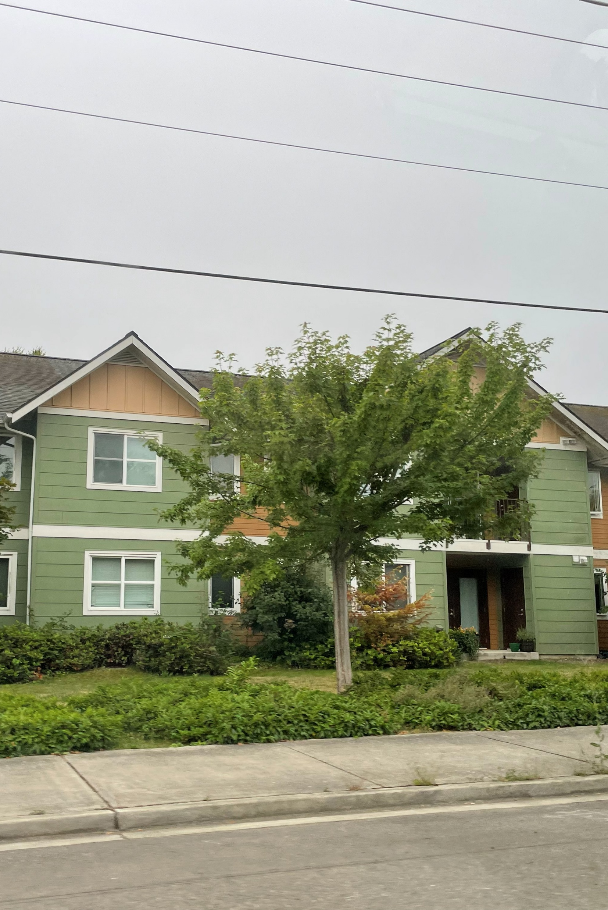
Housing

Slide 12
Housing Inventory
HOUSING
Housing by Type
Sequim’s housing inventory is 31% multifamily, 12% mobile home/special, and 58% remainder of single-family/one unit.
Owner-occupied is 60% of housing unit tenure and 40% renter-occupied.
Share of Occupied Housing Units by Tenure
Source: Washington OFM; US Census Bureau Five-Year ACS (Table S2504)

Slide 13
Tenure by Age
HOUSING
Tenure by Age in Sequim
Households led by someone 65-74 years old have highest rate of homeownership in Sequim.
Half of households headed by someone 45-54 years old own their homes.
Source: US Census Bureau 2023 Five-Year ACS (Table B25007)

Slide 14
Mobile Homes
HOUSING
Sequim has 530 Mobile and Special Dwelling Units, which make up 12% of the City’s housing units.
Special Dwelling Units is defined by OFM as trailers, RVs, boats, boxcars, tents and hotel or motel rooms occupied as permanent living quarters.
Mobile Homes and Special Dwelling Units by City
Source: Washington Office of Financial Management

Slide 15
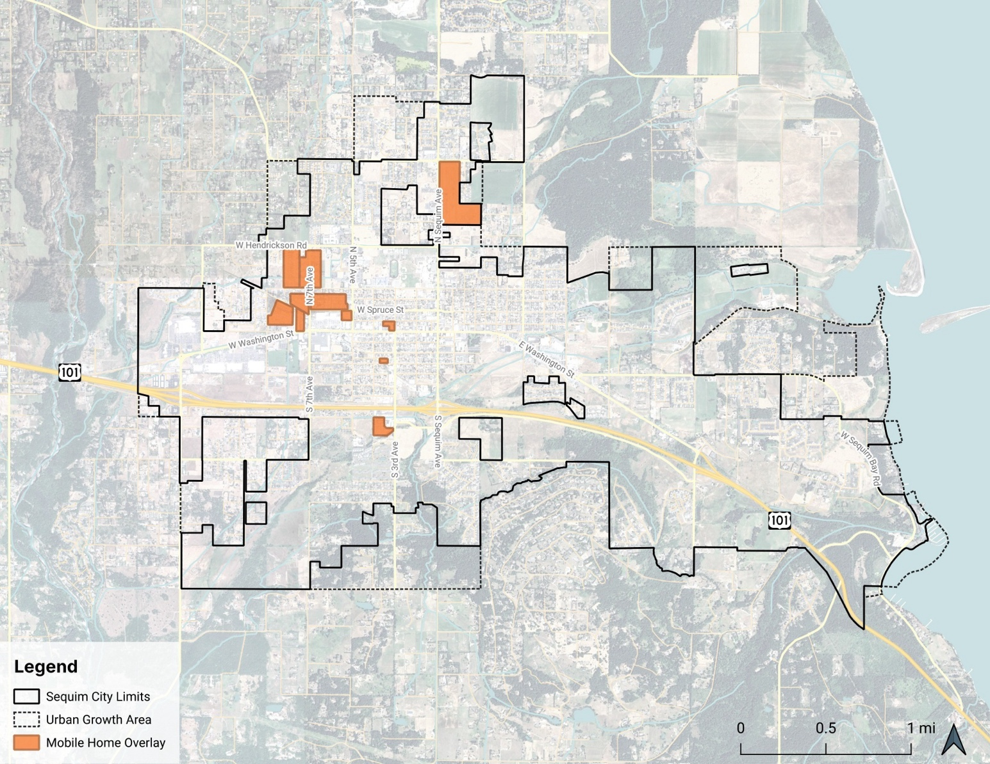
Mobile Homes
HOUSING
In December 2024, City Council approved a new overlay for mobile home parks intended to protect them from being purchased by developers who plan to evict tenants and redevelop the property. Within the MHP Overlay, mobile home parks are the only permitted use.
Source: City of Sequim; Leland Consulting Group

Slide 16
Housing Targets
HOUSING
Housing Units in Sequim, 2015-2025 with 2045 Target
Sequim needs 1,850 new housing units within City limits between 2020 and 2045 – annual growth rate of 1.53 percent.
Source: Clallam County Growth Management Act Steering Committee Resolution 2023-01

Slide 17
Vacant & Seasonal Homes
HOUSING
Total Vacant and Seasonal Use Homes in Sequim
Sequim has a 4.8% residential vacancy rate.
1.4% of homes in Sequim are for seasonal, recreational, or occasional use.
The number of seasonal homes has increased in Sequim over the past few years, but constrained housing inventory is a bigger challenge.
Source: US Census Bureau Five-Year ACS (Table B25004)

Slide 18
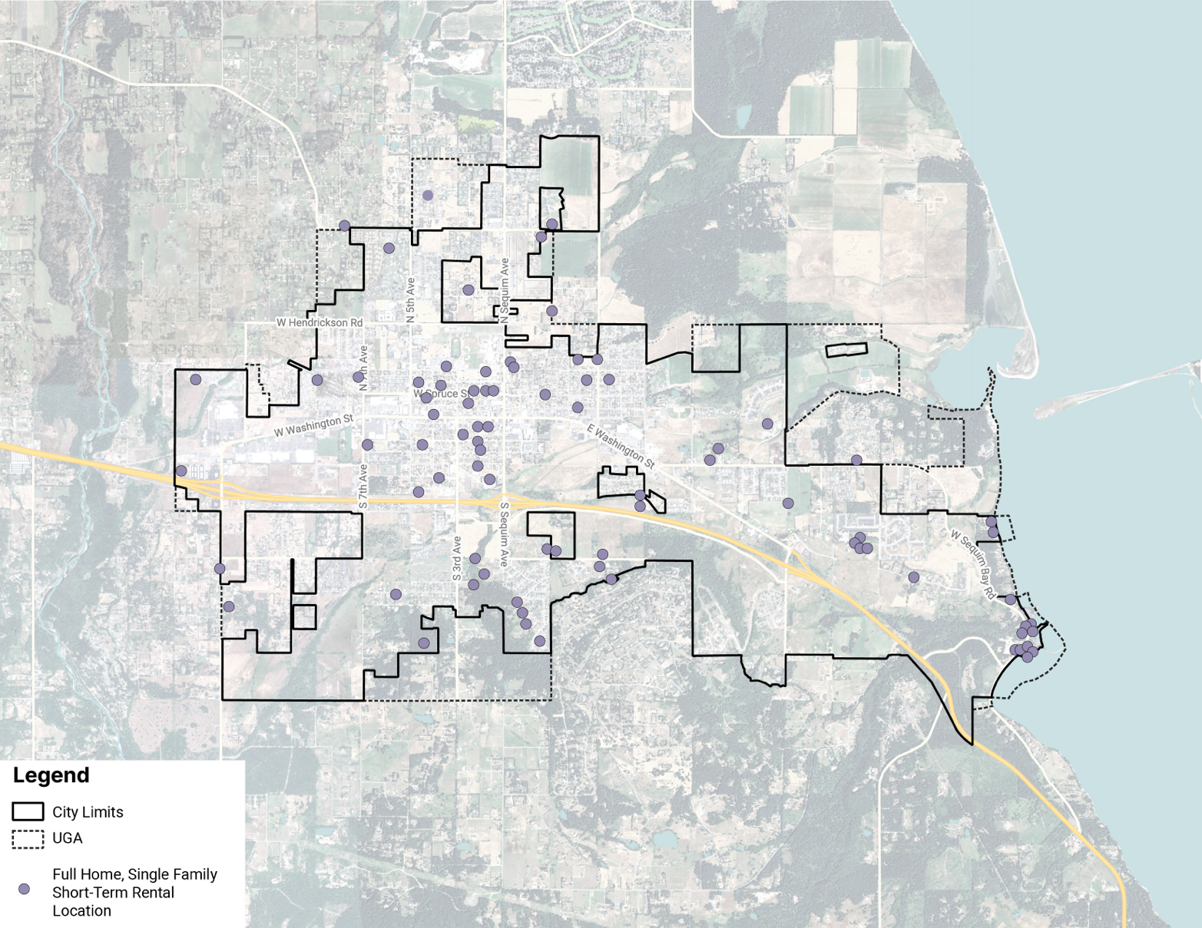
Short-Term Rentals (STR)
HOUSING
Full Home, Single Family Short-Term Rentals in Sequim, July 2025
Full home listings accounted for 2.7% of all single-family homes in City limits.
STRs allow for an increase in rooms during peak seasons.
Source: AirDNA, Leland Consulting Group

Slide 19
Recommendations
HOUSING
Topic | Recommendation
Housing Development | Utilize DCED's existing Developer's Forum to strengthen relationships with local developers.
Housing Development | Partner with local economic development agencies and neighboring communities to educate local developers on middle and multifamily housing development.
Housing Development | Find opportunities to streamline and improve the application review process.
Short Term Rentals | Track the increase in STRs on an annual basis, including the increase in full-home STRs as a share of the total housing supply
Affordable Housing | Offer incentives for below-market-rate affordable housing, including density bonuses, impact fees or other fee waivers, and/or application processing priority.

Slide 20
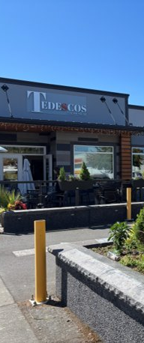
Economic Development

Slide 21
Employment
ECONOMIC DEVELOPMENT
Employment in Sequim, 2012-2022
Health care is biggest sector, jobs have been increasing.
Tourism is key sector supporting retail, accommodation & food services.
Source: US Census Bureau via LEHD OntheMap

Slide 22
Wages
ECONOMIC DEVELOPMENT
Average Annual Wage for Common Jobs in Sequim’s Top Employment Sectors
Health care and education jobs generally pay better than jobs related to tourism & service industries.
Need for housing to support workers at a wide variety of wages.
Source: U.S. Bureau of Labor Statistics (BLS) May 2023 Metropolitan and Non-Metropolitan Area Occupational Employment and Wage Estimates, Western Washington Non-Metropolitan Area.

Slide 23
Employment Projections
ECONOMIC DEVELOPMENT
Employment Projections by Industry in the Olympic Region, 2023-2033
Source: Washington Employment Security Department

Slide 24
Seasonality: Lodging
ECONOMIC DEVELOPMENT
Lodging Tax Revenue by Month Collected, 2021-2025
Overnight visits to Sequim peak in the summer
May to September are the busiest months for tourism
Source: City of Sequim

Slide 25
Seasonality: Downtown Visits
ECONOMIC DEVELOPMENT
Weekly Visits to Downtown Sequim, 2022-2025
Typically peak in mid-July, coinciding with summer events.
December and January are the least busy months in Downtown Sequim.
2022
2023
2024
2025
Lavender
Festival
Source: Placer.ai

Slide 26
Recommendations
ECONOMIC DEVELOPMENT
Topic | Recommendation
Tourism | Work to extend the tourism season through holiday specific programming and content, promoting local tourism, identifying strategies for specific groups such as corporate retreats, weddings, etc., and partnering with the Olympic Peninsula Visitor Bureau and Tourism Commission.
 | Encourage the development of a sufficient supply of housing affordable to workers in the tourism industry through zoning for a wider variety of housing types, creating incentives for affordable housing development, and engaging with employers around housing needs.
Employment Sectors | Target higher-wage jobs in industries in which Sequim has a regional advantage, including wood product manufacturing and beverage manufacturing, through zoning changes, engagement with industry groups, and marketing.
 | Promote Sequim as a location for clean energy research and development with the proximity to the Pacific Northwest National Laboratory (PNNL) and through flexible uses in commercial zones.

Slide 27
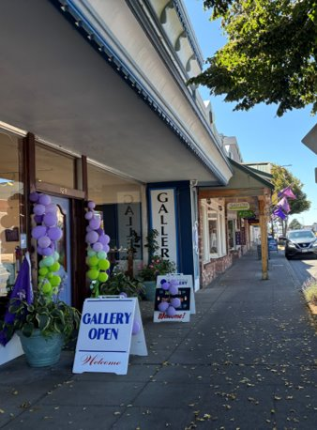
Real estate market trends

Slide 28
Ownership Housing
REAL ESTATE MARKET TRENDS
Typical Home Prices, 2015-2025
Typical price of a home in Sequim is $582,000 as of 2025.
New single-family homes tend to be more expensive than other types of housing.
Average Price of On-Market Homes in Sequim Built Since 2015 (as of August 2025)
Source: Zillow Home Value Index; Redfin

Slide 29
Multifamily Rental Housing
REAL ESTATE MARKET TRENDS
Multifamily Rental Units by Year Built and Location
Most of Sequim’s multifamily rental housing was built between 1980 and 2010.
Sequim’s multifamily vacancy rate is below 1%.
Port Angeles and Port Townsend also have constrained markets.
Multifamily Vacancy Rate
Source: CoStar

Slide 30
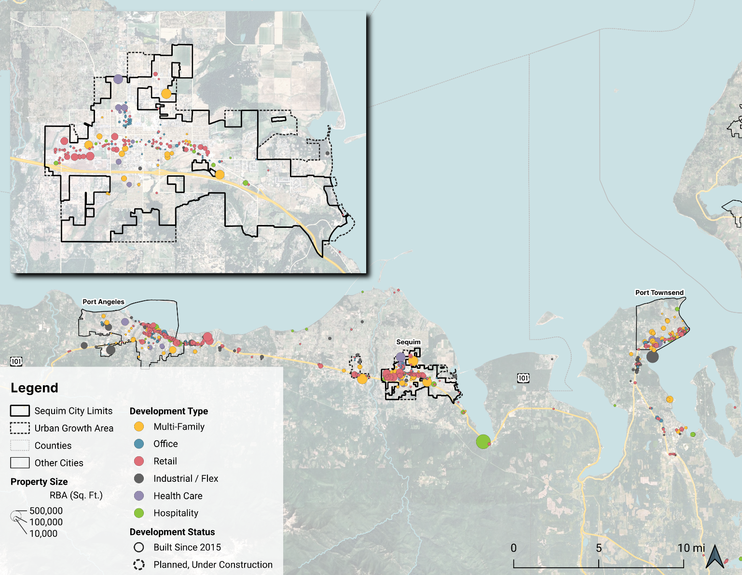
Commercial Inventory
REAL ESTATE MARKET TRENDS
Commercial Space in Sequim & the Olympic Peninsula
Retail concentrated in Port Angeles and Sequim.
Industrial space near Sequim located in Carlsborg area.
Source: CoStar, Leland Consulting Group

Slide 31
Retail: Revenue
REAL ESTATE MARKET TRENDS
Per Capita Quarterly Taxable Retail Sales
The Regional Commercial (RC) zone continues to attract interest from developers and large national retailers.
Q3
Q1
Source: Washington Department of Revenue

Slide 32
Office
REAL ESTATE MARKET TRENDS
Square Feet of Office Space by Year Built in Sequim
No new office space built in Sequim since 2009.
Speculative office space unlikely in the near term.
Opportunities to support remote workers living in Sequim.
Source: CoStar

Slide 33
Health Care
REAL ESTATE MARKET TRENDS
Ratio of Health Care and Social Assistance Jobs to Residents 65 or Older in Neighboring Cities and Other Popular Washington Retirement Destinations
Sequim has a high share of older residents but a limited number of health care jobs to serve them.
Many residents travel to Port Angeles, Bremerton, or Port Orchard for care.
Source: US Census Bureau Five-Year ACS (Table S0101); LEHD OntheMap

Slide 34
Industrial
REAL ESTATE MARKET TRENDS
Industrial Space by City / Area
Port Angeles and Port Townsend are the major industrial hubs on the Peninsula in part because of their ports.
Most of Sequim vicinity industrial space is in Carlsborg.
Transportation issues impact the viability of warehouses.
Source: CoStar

Slide 35
Hospitality
REAL ESTATE MARKET TRENDS
Sequim Hotel Rooms by Year Built
Most of the newer hotel rooms have been built outside of city limits (7 Cedars).
The most recent hotels built in the city are the Quality Inn & Suites and Holiday Inn Express.
Seasonality is a major challenge for hotels.
Source: CoStar

Slide 36
Real Estate & Development Market
REAL ESTATE MARKET TRENDS
Construction Cost Index for Seattle Metro and US
The current market is challenging due to high labor and material costs and interest rates.
Construction costs have more than doubled in the Seattle area since 2009.
Higher rents or incentives are needed to encourage new development.
Source: Mortenson Construction Cost Index

Slide 37
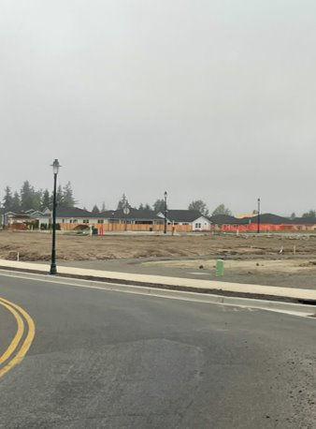
BARRIERS TO DEVELOPMENT

Slide 38
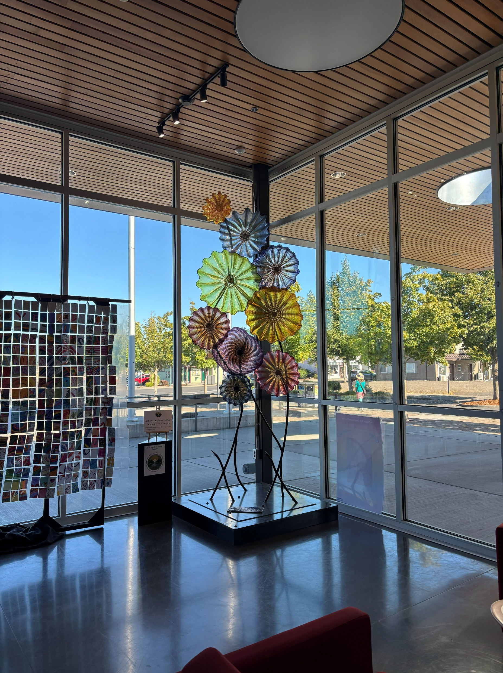
Development Challenges
BARRIERS TO DEVELOPMENT
Staff turnover has impacted relationships between City and developers.
Permitting process can be long and expensive.
Developers & staff aligning on desire to “get to yes.”
Increasing clarity around zoning and processes.
Ongoing relationship building, developer education.
Impact fees are relatively high.

Slide 39
Recommendations
BARRIERS TO DEVELOPMENT
Topic | Recommendation
Processes and Relationships | Work with local and regional partners on educational outreach for developers.
Processes and Relationships | Increase clarity in the zoning code to reduce uncertainty and limit discretionary decision-making.
Processes and Relationships | Create opportunities for open communication between local developers and City staff to improve interpersonal and professional relationships.
Impact Fees | Update impact fees to comply with new state regulations by creating a tiered system based on unit size or number of bedrooms.
Impact Fees | Consider implementing a parks fee waiver for multifamily developments that meet a certain threshold for open space, or developments located within walking distance of an existing park.

Slide 40
04 comprehensive plan update
Enhancing your presentation

Slide 41
04 Comprehensive plan update
A Comprehensive Plan is at its core:
A Policy Document
  Goals and Policies on nine subjects
A Land Use Map
A Capital Facilities Plan
Comprehensive Plan Update
The periodic update must plan to accommodate a portion of the overall growth (population, employment, and housing) that is forecast for the City of Sequim. Growth allocations are determined through a regional process coordinated by Clallam County.
Sequim is to plan for the following 2045 targets:
Population: 2,959 new residents
Employment: 909 new jobs
Housing: 1,850 new housing units

Slide 42
04 Comprehensive plan update
Planning Commission serves in a primary review and advisory role
Reviewing each chapter of the Policy Document.
Considering needed or desired changes to the Land Use Map.
Wrapping up their review of draft Policy Document in 2025.
Comprehensive Plan Update 2026
Next up:
  Capital Facilities Plan underway.
  Turning attention now to revisions and updates to the City’s development regulations – land division, zoning and procedural ordinances.
April 2026 public release of plan.
Public Hearings May and June 2026.

Slide 43
05 Final thoughts
Sequim is poised to grow — permit activity show steady, and potential significant growth could occur in near future.
Housing and Economic Market Analysis and Recommendations reaffirm key community demographics and needs — supporting attainable housing, strengthening local employment, and maintaining quality of life.
The Comprehensive Plan update positions Sequim for the future — aligning policies, land use, and capital facilities/infrastructure planning.
Together, we are shaping Sequim’s path forward — grounded in data, guided by community values, and ensuring Sequim grows gracefully.

Slide 44
THANK YOU
How to Contact Sequim DCED
Phone: 360-683-4908
Text: 360-912-4432
Email: dced@sequimwa.gov
Web: www.sequimwa.gov/1066/Community-Development
Book an Appointment: www.sequimwa.gov/1328/Book-a-meeting-with-DCED-Staff

