Slide 1


2022.2 US
WELCOME TO The best place on the plannet
Notes:
CHANGES
8/27/24: Updated Director Table slide 24 and Conv. Slide 29.
7/26/24: Removed Celebrity Cruises InteleTravel slide.
6/27/24: Added 3 new InteleTravel slides 17-19
6/21/24: Fixed PlanNet spellcheck underline on Slide 4
6/13/24: Removed InteleTravel slides 17 & 18, removed Save More from slide 3
10/30/23: Updated slide 4 to 8 year, updated slide 5 to $3B in travel
09/11/23: Updated Commissions and Andy’s title
08/28/23: Changed slide 29 Conv.
08/21/23: Changed Donald Bradley’s pic on Slide 4
07/31/23: Updated slide 5 added commissions
07/28/23: Updated slide 4 commission $
04/03/23: Updated slide 4 commission $
01/31/23: Slide 4 colors updated.
01/20/23: Updated IDS slide 26
10/24/22: Changed slide 4 to 7-Year-Old Company
10/03/22: Added convention slide 29
01/24/22: Fixed typo on Slide 7
01/14/22: Updated Income Disclosure Statement
11/24/21: Moved PlanNet Pledge slide from 25 to 27
11/9/21 : Slide 4 – 6 Year Company
Slide 5 – Over 30+ Years
2020.2 : SLIDE 12 MILLENIALS SPEND $200 BILLION
2020.5 – SLIDE 4 5 YEAR COMPANY

Slide 2




Slide 3



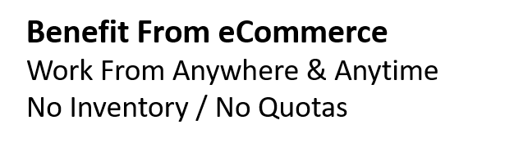


Slide 4


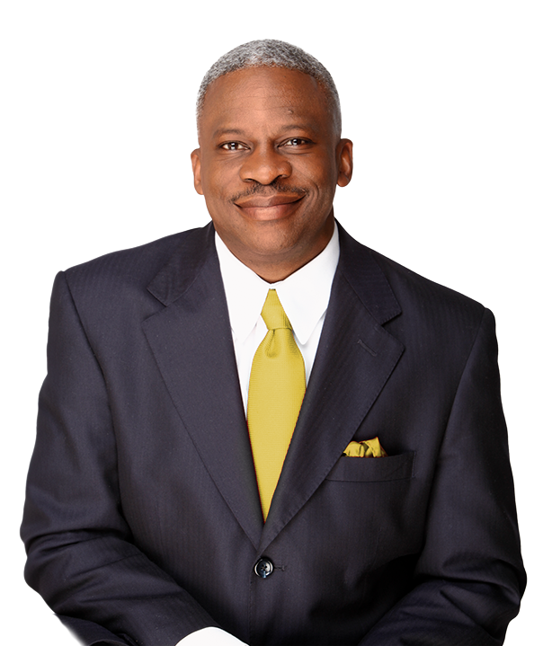





Decades of executive management,
corporate operations, marketing &
sales experience
Manages the PlanNet Support Team

Slide 5







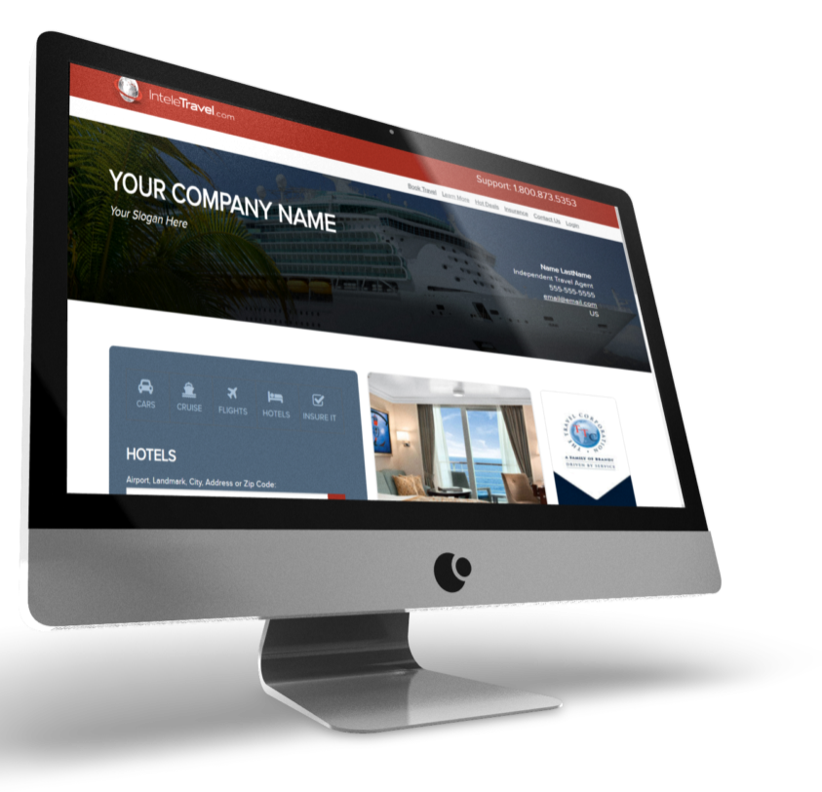







LEADING INNOVATOR IN TRAVEL
OVER 30+ YEARS
The originator of home-based travel
agents
Accredited
Business
Premier CLIA
Member

Slide 6



Slide 7


Slide 8
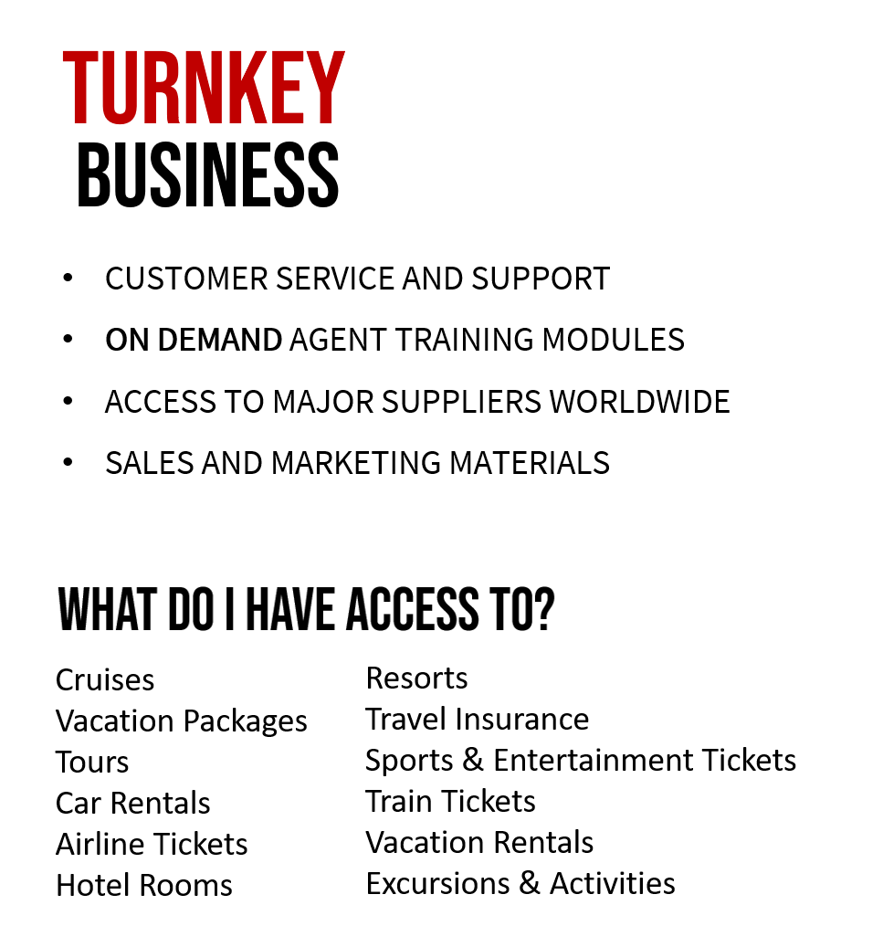


Slide 9






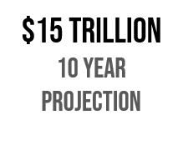





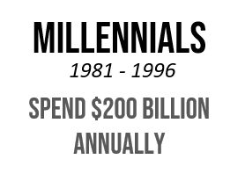


Slide 10





Slide 11






…AND MORE

Slide 12



Commissions represented here are examples and are not a guarantee of income **travel rates are subject to change due to date, availability etc.

Slide 13



Commissions represented here are examples and are not a guarantee of income **travel rates are subject to change due to date, availability etc.

Slide 14



Commissions represented here are examples and are not a guarantee of income **travel rates are subject to change due to date, availability etc.

Slide 15
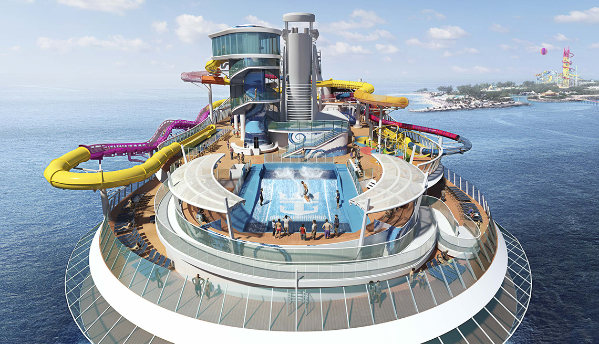


Commissions represented here are examples and are not a guarantee of income **travel rates are subject to change due to date, availability etc.

Slide 16











Slide 17




WELLNESS TRAVEL CERTIFICATION
Wellness travelers are typically more affluent, educated, and well-traveled,
and wellness travel is expected to outpace all other sectors of the overall wellness economy.

Slide 18



LUXURY TRAVEL ADVISOR CERTIFICATION
You will leave INSPIRED and equipped with the knowledge, expertise,
and know-how to set yourself in the luxury travel space.

Slide 19

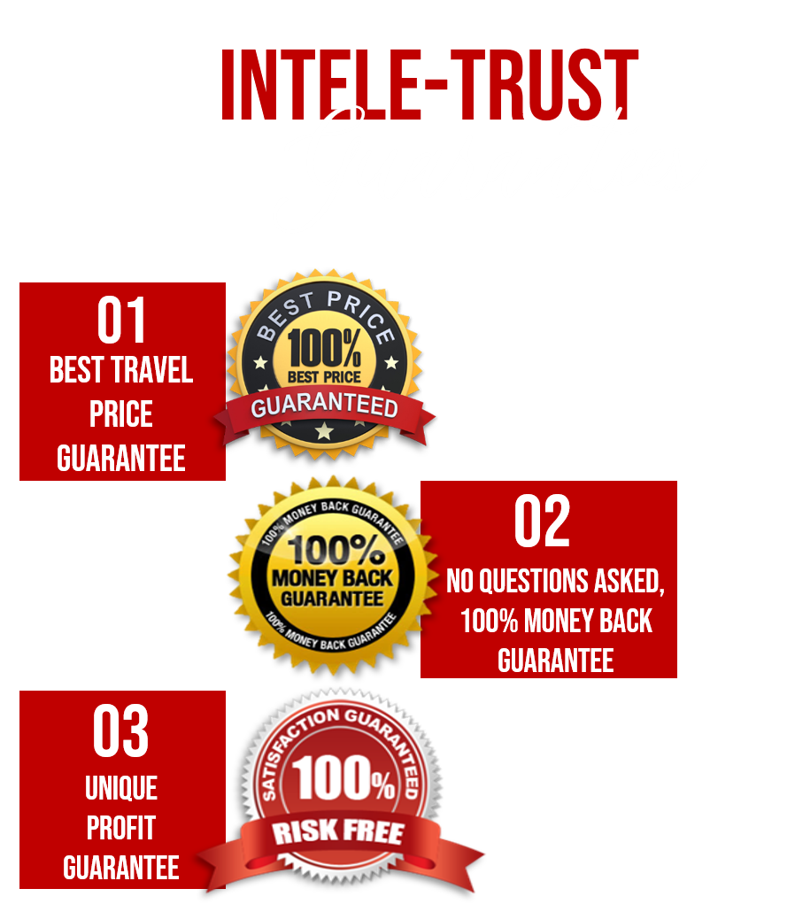

Slide 20



PlanNet Marketing Compensation Plan

Slide 21













$50
$50
$50
$25
$50
$25
No limits on direct sales, matches or team bonuses. Upfront commissions are paid weekly.

Slide 22







Slide 23


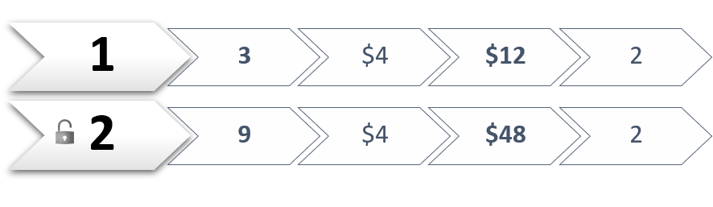
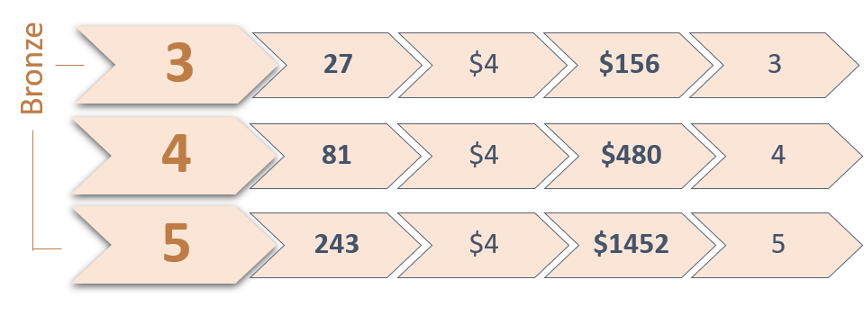
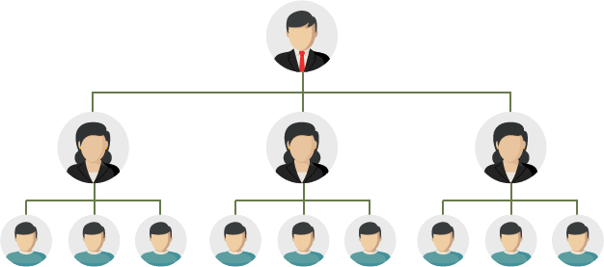
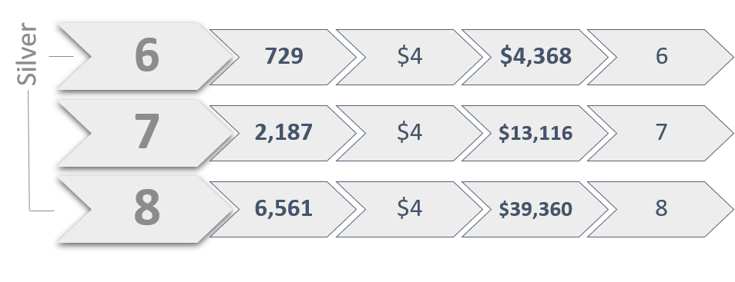
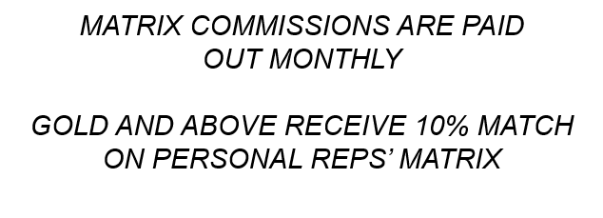


Slide 24
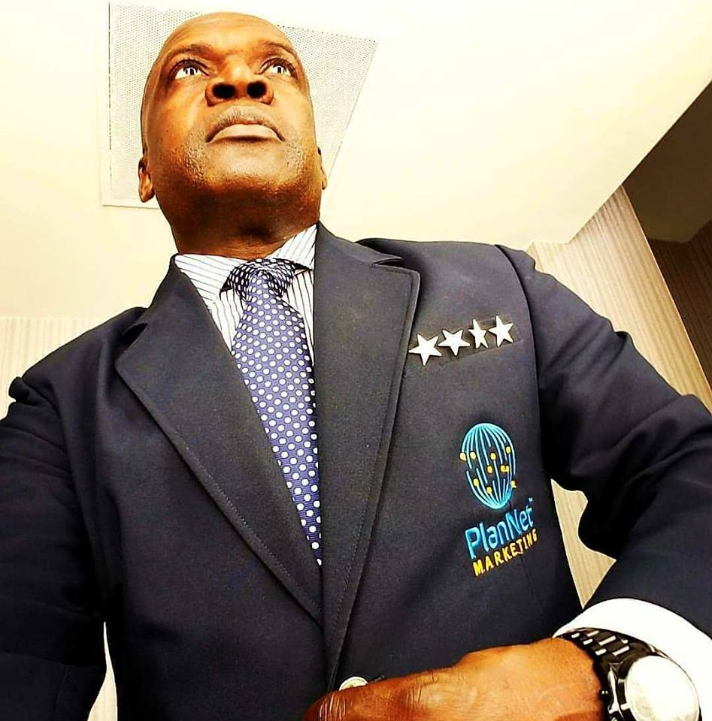

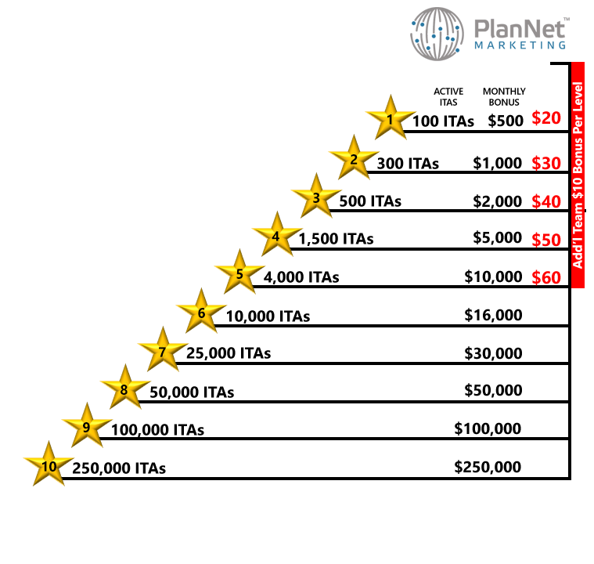

Balanced: No more than 1/3 of the total ITAs coming from any one leg.

Slide 25












ROLEX WATCH
RECEIVED AT
5 STAR DIRECTOR

Slide 26
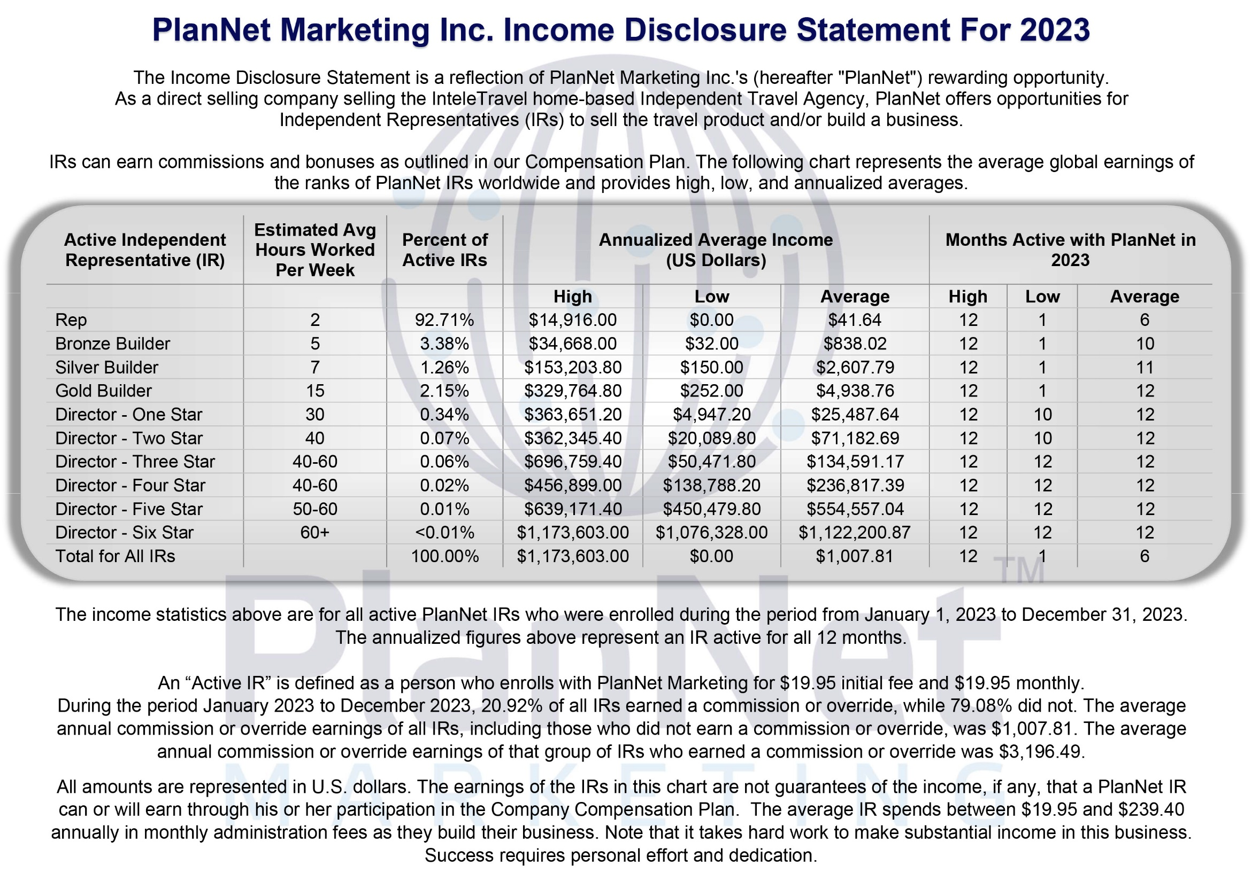

Slide 27



Slide 28
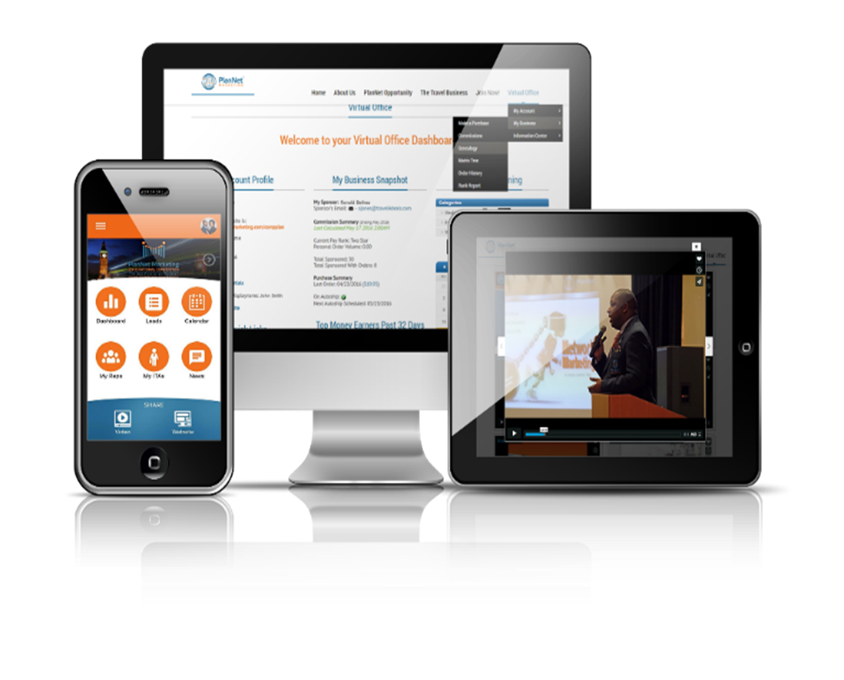

VALUABLE TOOLS, SYSTEMS & SUPPORT!
1
TOOLS
Website to track your business, mobile app to grow your business and more!
2
TRAINING
On demand and live training via web, calls and live!
3
EVENTS
Live events, trainings and conventions!

Slide 29


Slide 30


Slide 31


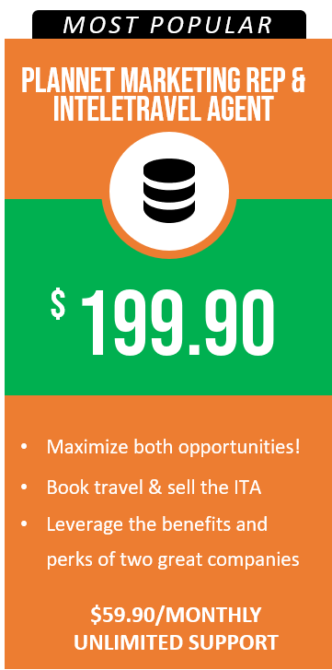
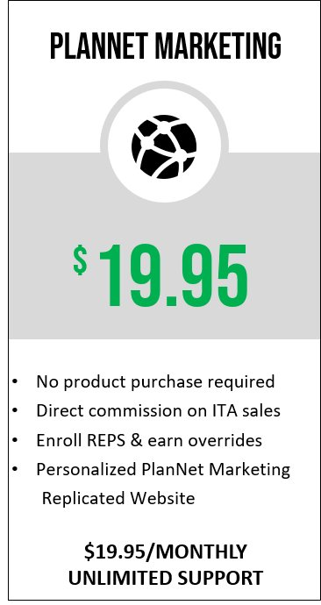


Slide 32


1. READY TO GO
3. NO, THANK YOU
2. HAVE QUESTIONS

Slide 33



Notes:
1/24/2024 – Updated Income Disclosure

