Slide 1

ASL State License Instructions
Kelly Services/Language Line Solutions

Slide 2
Meet the Licensing Team
We are here to help! Meet the team members who will assist you through your licensing process:
Name: Anh Nguyen
Role: Licensing Specialist
Email: asllicensing@kellyservices.com
Phone: (832) 460.3730
Name: Amanda Payne
Role: Licensing Specialist/Coordinator
Email: asllicensing@kellyservices.com
Phone: (248) 686.1892
Name: Shaina Bursey
Role: ASL Team Lead
Email: asllicensing@kellyservices.com
Phone: (312) 273.4553
Feel free to reach out to any of us for assistance at any stage in the process. We’re here to support you!

Slide 3

Table of Contents
Introduction to Required State Licenses
State License Schedule
State Licensing Fees/ Payment Process
Getting Started- What you will need
Submitting Your Time for Payment
Individual State Licensure Processes

Slide 4
Required States Licenses
Although you may already hold an RID National Certification as an ASL interpreter, to interpret for Language Line Solutions, it is required that you obtain additional licensing for this VRI role. There are 11 state licenses to complete.
You will need to complete the application process and submit them for each state. Please complete these in a timely manner. Expected time frame of completion of applications is 10 days after receiving this email.
Listed to the right, are the 11 required state licenses.
Arizona
Arkansas
Connecticut
Idaho
Kentucky
Michigan
Missouri
New Hampshire
Pennsylvania
Rhode Island
Wisconsin

Slide 5
State License Schedule
Missouri- Expiration Date: January 31st (1-Year License)
Arizona- Expiration Date: June 30th (1-Year License)
Michigan- Expiration Date: June 30th ( 1-Year License)
Rhode Island- Expiration Date: June 30th (1-Year License)
Kentucky- Expiration Date: August 30th (1-Year License)
Wisconsin- Expiration Date: August 31st (2-Year License)
New Hampshire- Expiration Date: September 1st (3-Year License)
Connecticut- Expiration Date: September 31st (1-Year License)
Idaho- Expiration Date: October 31st (1-Year License)
Arkansas- Expiration Date: December 31st (1-Year License)
Pennsylvania- Expiration Date: December 31st (1-Year License)

Slide 6
State Licensing Fees / Payment Process
Arizona- $125- Kelly will be invoiced by state (you must require them to invoice Kelly per instructions)
Arkansas- $5 initial ($4 renewal)- Kelly will be invoiced by state (you must require them to invoice Kelly per instructions)
Connecticut- Free (no cost)
Idaho- $75 initial ($25 registration fee and $50 license fee) ($60 renewal)- Interpreter mails payment and then provides receipt to Shaina for reimbursement
Kentucky- $250- Interpreter mails payment and then provides receipt to Shaina for reimbursement
Michigan- $30 (medical endorsement is additional $10), After expiration date $45- Interpreter mails payment and then provides receipt to Shaina for reimbursement
Missouri- $75 initial ($75 renewal)- Interpreter mails payment and then provides receipt to Shaina for reimbursement
New Hampshire- $200- Kelly will be invoiced by state (you must require them to invoice Kelly per instructions)
Pennsylvania- $100- Kelly will be invoiced by state (you must require them to invoice Kelly per instructions)
Rhode Island- $25- Interpreter mails payment and then provides receipt to Shaina for reimbursement
Wisconsin- $60- Interpreter mails payment and then provides receipt to Shaina for reimbursement
**Most states will require you to pay the renewal fee at time of submitting application. We will reimburse you with invoice or copy of payment sent.**

Slide 7
2025-2026 Total Licensing Costs
State | New License Fee | Renewal License Fee | Payment Method
Arizona | $50 | $50 (late fee $100) | State Invoiced
Arkansas | $6 | $4 (late fee $5.50) | State Invoiced
Connecticut | Free | Free | Free
Idaho | $75 | $60 | Kelly to Reimburse
Kentucky | $250 | $150 (late fee $100) | Kelly to Reimburse
Michigan | $40 | $30 (late fee $15) | Kelly to Reimburse
Missouri | $80 | $75 | Kelly to Reimburse
New Hampshire | $200 | $200 ($100 late fee) | State Invoiced
Pennsylvania | $100 | $100 | State Invoiced
Rhode Island | $25 | $25 | Kelly to Reimburse
Wisconsin | $61.35 | $61.35 | Kelly to Reimburse

Slide 8
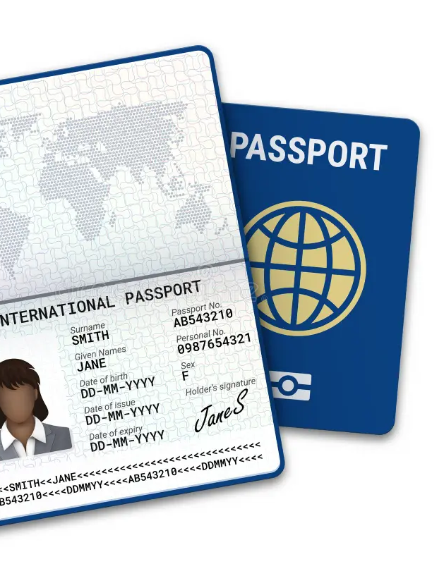
Getting Started
You will need:
Copies of Photo ID
Birth Certificate/ Social Security Card/ Passport Photos
Copy of RID card
School Transcripts
Other Credentials
To be able to open .PDF and Word documents
A printer
Checks and/or Debit or Credit Card
Envelopes and Stamps
Blue or black ink pen

Slide 9
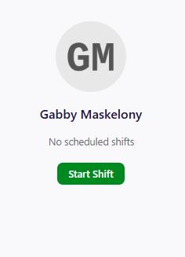
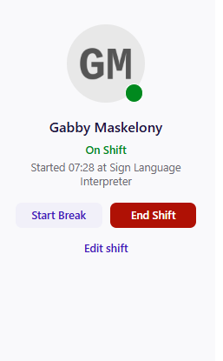
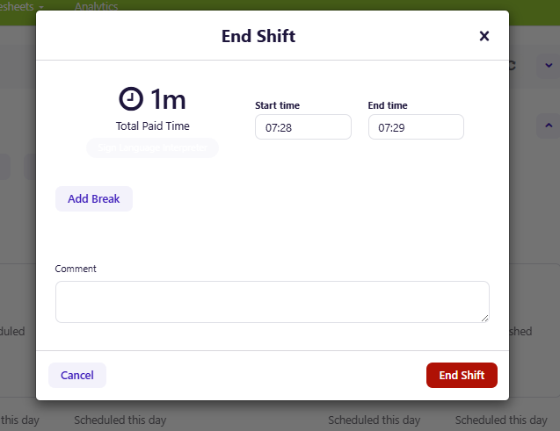
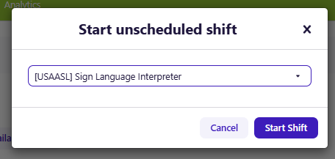
Submitting Your time for Payment
Kelly Services offers compensation for the time you spend applying for and renewing your licenses. Follow the steps below to ensure you’re paid for this time:
4. Adjust the Start and End time to reflect the hours you worked on licensing.
In the comment section, please input which licenses you were working on
1. Start your shift on Deputy
2. Select Sign Language Interpreter & Start Shift
3. Select End Shift
ASL Licensing
To process paid time fairly, we ask that you submit your time within 24 hours of submitting your application. This assures that you are being compensated appropriately. For any issues, please email asllicensing@kellyservices.com

Slide 10
How to Submit Expenses for Reimbursements
Kelly Services will sponsor ALL fees associated with these licenses. Kelly Services will be invoiced directly OR reimburse for all the licensing/registration fees from each state. Please, If you pay for any fees out of your own pocket for any of the additional state licenses, keep all receipts to ensure a simple reimbursement.
Submit any of the following forms of confirmation for licensure:
Paid Receipt/ Invoice
Copy of cashed check once cleared by the bank
Copy of a Cashiers Check (filled out)
Copy of bank statement (your personal info blocked for your protection)
Any additional expenses that you submit can be receipts for things such as:
Mailing Postage (this includes overnight mail)
Finger Printing
Schooling Transcripts
Background Checks (federally & state)
Printer Material (Printer paper & ink)
Printer Copies (made in store or library)
Additional license endorsements (when required by state)
All reimbursement requests (with attached documentation) should be emailed to the Licensing Team at asllicensing@kellyservices.com. Please make sure that you noting which license your email is referring to so that we may properly allocate fees to the correct state.
Once the Licensing Team is in receipt of your reimbursement request and has approved the reimbursement, you should see your reimbursement in 2-3 weeks be deposited and reflected on your that payroll Friday.

Slide 11
State of Arizona Licensure Application
2-Part Application - Online Submission & Email
This application is comprised of 2 parts:
Part One: General Online Application (this is submitted online)
Part Two: Statement of Citizenship: This is in PDF format and will need to be filled out and emailed or mailed
This application will be submitted online.
The application fee will be $125, for a 1-year license. Please note: Kelly Services will be sponsoring the $125 fee for this application via check that will be issued directly to the State of Arizona Therefore, you will need to do the following:
In the section of the General Application "PAYMENT INFORMATION, MAILING ADDRESS & QUESTIONS", please use the email links provided and send an email directly to Ashley Martin at (a.martin@acdhh.az.gov) at the State of Arizona stating your full name, that you've completed your online application, and that invoicing will need to be sent directly to Shaina Bursey Shab968@kellyservices.com to have payment issued for associated fee. Please note: Do NOT attempt to pay out of your pocket for this application fee.
(Part 1): Link to General Online Application for the State of Arizona: https://cdbms.acdhh.az.gov/licenseapplication/Apply?Cat=General-Initial
(Part 2): Link to download PDF for Statement of Citizenship Form: https://www.acdhh.org/media/1229/arizona-statement-of-citizenship.pdf
Link to General Info for the Arizona Commission for the Deaf & Hard of Hearing (ACDHH): https://www.acdhh.org/interpreters
If you have any questions regarding this application, please reach out to State of Arizona: Ashley Martin: a.martin@acdhh.az.gov or 602-542-3659.
After submitting your license application and requested supporting documentation, please send an email notification to the Licensing Team at asllicensing@kellyservices.com. Be sure to also email us your reimbursement request with the required documentation once payment has been submitted/received.

Slide 12
State of Arkansas Licensure Application
This application will be submitted online. The application fee will be $5.00 for an initial license for a 1-year. The Annual Renewal Fee is $4.00.
Professional Letters of Reference:
You will be required to supply three professional letters of recommendation when applying for your Arkansas State License, Kelly Services will provide you with one of the three. The others may come from past employment, fellow colleagues and or other individuals of your choice and should be dated within the last 12 months. They may be emailed directly to the state, or you may gather them and email them yourself. If you choose to have your LORs emailed straight to the state, please have them send their letter (as an attachment) and put “Interpreter Name (your name)-LOR” in the subject line.
Please note: Kelly Services will be sponsoring the $5 fee for this application via check that will be issued directly to the State of Arkansas. Therefore, you will need to do the following:
When you reach the "Initial Licensure Fee Waiver" section, please check the "Not applicable" option.
In the following section for "Application Fees", please check the option "Initial Application and Licensure Fee - $5.00" Enter $5.00 in the "Total Amount Included" section.
In the empty space provided at the bottom of the form "Use this space to explain your reason for consideration of a late fee approval and reinstatement of your license." Please type the following message: "Kelly Services will be fully sponsoring my 1-year application fee of $5.00. Please contact/send invoice to Shaina Bursey asllicensing@kellyservices.com for payment issued directly from Kelly Services on my behalf. - Thank you.“
Link to Online Application: https://healthy.arkansas.gov/boards-commissions/boards/interpreters-for-the-deaf-advisory-board/interpreter-licensure-application-form/
Link to General Online Info: https://healthy.arkansas.gov/boards-commissions/boards/interpreters-for-the-deaf-advisory-board/
Please do not click the "Next" button until after you have submitted your online application for the State of Arkansas.
Upon completing your online application, please send an email to the State of Arkansas at: ADH.InterpreterLicensure@arkansas.gov and CC: asllicensing@kellyservices.com so that they'll invoice Kelly Services. If you are renewing, please do the same when completing your renewal application.

Slide 13
State of Connecticut Licensure Application
This application will be submitted online or via mail. The application is FREE OF CHARGE for an initial license for a 1-year. The Annual Renewal is also FREE.
This application is in PDF format, so you can submit this in two different ways:
Electronic – Please do not fill out the form without first downloading and saving the document to your computer. Email completed registration along with supporting documentation to: DORS.Interpreting@ct.gov
Getting Started:
Access the 2025-2026 application by clicking here: https://portal.ct.gov/ads/-/media/ads-beta/accessibility-files/2025---2026-ct-interpreter-registration-form.pdf?rev=9df9a970eabc4a798109a9a926a41d08&hash=0DA7E85990C1198DC5EAD46E2F04E60D.
Please provide your Credly Badge with “type of certificate you possess” and your expired date on it. If you have RID Credly Badge as the images show below with the expiration on June 30th, 2026. You will need to contact RID/Credly to put a request to send you a Credly Badge through e-mail via ADS.Interpreting@ct.gov. Please e-mail through here with your RID Credly link and your currently updated RID Verification Letter.
Please be sure to complete the 2025-2026 Connecticut Interpreter Registration form and submit in PDF and send it to ADS.Interpreting@ct.gov and CC: asllicensing@kellyservices.com so that we are aware. If you are renewing, please do the same when completing your renewal application.
Here is the link to the website's general info for the state of Connecticut and Deaf & Hard of Hearing Interpreter Registry: https://www.elicense.ct.gov/Default.aspx
Once you've submitted your application, the state of Connecticut will send you an update via email once your registration is complete. This license is typically approved/provided within 48 hours after submission, if it is submitted correctly.

Slide 14
State of Idaho Licensure Application
This application must be submitted via Idaho Licensing Portal. The fees are $75 initial ($25 registration fee and $50 license fee) ($60 renewal) DO NOT CHOOSE $10 license option. This license is only valid through 12/31 of each calendar year and expires shortly after receiving.
Please visit https://dopl.idaho.gov/ (look for the yellow banner and the link for video tutorials) and begin your process to create an Online Profile and apply for your Idaho VRI Out-of-State Registration.
Create an Online Profile in Oasis with demographic information
Select the Board: Speech & Hearing Services and the applicable license-type application: the “Sign Language Interpreter” (A qualified person seeking licensure to practice sign language interpretation services in the State of Idaho) option.
Answer the attestation, questions, and then follow the prompts (*Note the AUTHORIZATION for RELEASE is OPTIONAL and may be by-passed by selecting “NEXT”)
Required: a copy of your RID and a list of all states that you have ever been licensed in.
Upload any documents – if applicable. These may also be emailed to shs@dopl.idaho.gov
Note, you may scroll down the page and use the prompt “NEXT” to bypass a presumed requirement.
Pay the fee online with a check routing information or credit card
If you have questions, please contact: SHS@DOPL.Idaho.gov or call: 208-577-2514.
You must reapply each calendar year with the Out-of-State Registration. Or you may apply for a renewable license (Sign Language Interpreter by ENDORSEMENT). The process is the same with some additional requirements. Note: you cannot practice on an expired license.
After submitting your license application and requested supporting documentation, please send an email notification to the Licensing Team at asllicensing@kellyservices.com. Be sure to also email us your reimbursement request with the required documentation once payment has been submitted/received. This documentation is needed right away after submitting application.

Slide 15
State of Kentucky Licensure Application
This application will be submitted via hardcopy mail. The application fee will be $225 ($75.00 & $150.00), for an initial license for a 1-year. The Annual Renewal Fee are $125.00 (renewal must be paid at time of submitting application).
The application must be submitted as follows: Printed, filled out in black ink only and mailed to the following address:
Regular Mail:
Kentucky Board of Interpreters for the Deaf & Hard of Hearing
PO Box 1360
Frankfort, KY 40602
FedEx/UPS Overnight:
Attn: Tiler Hahn
Public Protection Cabinet Department of Professional Licensing
500 Mero Street – 2SC 32
Frankfort, KY 40601
Once your application has been completed, please send an email to notify the State of Kentucky at: KBI@ky.gov and CC: asllicensing@kellyservices.com. Please indicate that you have mailed your completed application and to generate invoicing to Kelly Services directly for payment of the fees due.
Here is the link to the PDF application: https://kbi.ky.gov/Documents/DPL-KBI-001%20Application%20for%20Full%20Licensure%20REV%20October%202024.pdf
Here is the link for the Renewal Application: https:// kbi.ky.gov/Documents/DPL-KBI-002%20Full%20Lic%20Renewal%20App%20REV%20October%202024.pdf
Link for General Information for the State of Kentucky Board of Interpreters: http://kbi.ky.gov
After submitting your license application and requested supporting documentation, please send an email notification to the Licensing Team at asllicensing@kellyservices.com. Be sure to also email us your reimbursement request with the required documentation once payment has been submitted/received. This documentation is needed right away after submitting application.

Slide 16
State of Michigan Licensure Application
This application will be submitted via mail. The application fee will be $30 for an initial license for a 1-year. The Annual Renewal Fee is $30.00. $45.00 if renewal submitted after expiration date. Additional Endorsement (Medical/Mental Health; Deaf-Blind, Legal) $10.
NOTICE: Payment will need to be summited with application. Just as a few of the other licenses are, you will be reimbursed upon submitting a receipt.
Link to Application: https://www.michigan.gov/documents/lara/Michigan_Certification_Application_12- 20-17_609376_7.pdf
Link to Endorsement Form: https://www.michigan.gov/documents/lara/Endorsement_Form_12- 20-17_609374_7.pdf
Link to Renewal Application: https://www.michigan.gov/documents/lara/MICHIGAN_INTERPRETER_RENEWAL_Se pt_2018_634325_7.pdf
FYI: You will need to complete the application and the required endorsement form. For the endorsement form, you will select the "medical endorsement" on the form and include with your application for submission.
Submitting your application via mail: You can download, print, fill out and mail your application to:
Regular Mail:
Bureau of Community and Health Systems
PO Box 30664
Lansing, MI 48909
If you need any additional information, please access the State of Michigan website here for general information: https://www.michigan.gov/lara/ Telephone: (517) 335-1980.
After submitting your license application and requested supporting documentation, please send an email notification to the Licensing Team at asllicensing@kellyservices.com. Be sure to also email us your reimbursement request with the required documentation once payment has been submitted/received. This documentation is needed right away after submitting application.

Slide 17
State of Missouri Licensure Application
The application fee will be $75 for an initial license for a 1-year and $75 for every renewal year.
Application Submission:
Log into https://mopro.mo.gov/license/s/ to register for your MOPRO Account. (Click on in-depth PDF license instructions from the state)
To register, you need to have an email on record with the board.
If you need help registering for your MOPRO account, the Division of Professional Registration has a call center that can assist you. Please call 833-373-2936, for assistance.
Application for License Instruction Letter.pdf- Guidelines for completing the application
MOPRO will give you access to your information 24/7 including, but not limited to:
Applying for a license.
Renewing your license, whether on time or late.
Submitting payments online for your license, a duplicate license, or licensure verification.
Changing your name, address, or other contact information.
After submitting your license application and requested supporting documentation, please send an email notification to the Licensing Team at asllicensing@kellyservices.com. Be sure to also email us your reimbursement request with the required documentation once payment has been submitted/received. This documentation is needed right away after submitting application.

Slide 18
State of New Hampshire Licensure Application
This application will be submitted via mail. The application fee will be $200 for a 3-year license. Kelly Services pays this fee for you. If you are submitting your renewal after July 1st each year, there will be a reinstatement fee in addition ($100).
The licensure application for the State of New Hampshire must:
Be printed and completed in black ink only.
Include an un-retouched photo no larger than 4” x 6” and no smaller than 1 ½” x 1” which will be printed on the license.
Regular Mail:
Treasurer–State of New Hampshire
21 South Fruit Street, Suite 20
Concord, NH 03301
Notify the state of New Hampshire of your new application:
Send email to the states office to notify them of your new submission at: Beth.A.Keller@doe.nh.gov
Indicate that you are submitting a new application and to send an invoice to Kelly Services to issue payment for associated fees. Also, CC: asllicensing@kellyservices.com.
Use this link to access the PDF application: https://www.education.nh.gov/sites/g/files/ehbemt326/files/inline-documents/sonh/ilb-application-form-revised-october-2023.pdf.
Here is the link to general information for interpreters for the State of New Hampshire Licensure Board: https://www.education.nh.gov/who-we-are/deputy-commissioner/bureau-vocational-rehabilitation/programs-and-services/program-individuals-who-are-deaf-or-hard-hearing/interpreter.

Slide 19
State of Pennsylvania Licensure Application
This application will be submitted via email. The application fee will be $100 for a 1-year license and Kelly will be invoiced for this payment after you submit your license request. ​
NOTE: There is no application form to be completed for this state. You will need to submit your request by generating an email. The process is initiated by doing the following:
Send an email to Dee Dee Keiser at dkeiser@pa.gov and type in the subject line: "(Your Full Name) - Kelly Services Sponsored ASL Registration" and include the following information in the body of the email:
Full Name
Address
Phone number
Email address
Do you want to be published in the Pennsylvania Data Base? Yes/ or No
Your email must include the following documents:
Copy of current RID Card (Must have one of the following approved certs on RID Card)
CI – Certification of Interpreter
CT – Certification of Transliterator
CDI – Certified Deaf Interpreter
CSC – Comprehension Skills Certification
MCSC – Master Comprehension Skills Certification
NIC – National Interpreter Certification
NIC Advanced – National Interpreter Certification Advanced
NIC Master – National Interpreter Certification Master
NAD IV Advanced – National Association of Deaf Advanced
NAD V Master – National Association of Deaf Master
Copy of Transcript (CEU credits)

Slide 20
State of Pennsylvania Licensure Application (continued)
Also, CC: asllicensing@kellyservices.com. Also indicate that Kelly Services will be sponsoring your fee and to generate an invoice for payment to Kelly Services.
Your registration should be processed after they've received payment from Kelly Services.
General Website for Info: https://www.dli.pa.gov/Individuals/DisabilityServices/odhh/interpreters/Pages/Sign-Language-Interpreter-Registration.aspx
Licensure Contact:
Dee Dee Keiser
Phone: 717-783-4912
Email address: dkeiser@pa.gov

Slide 21
State of Rhode Island Licensure Application
This application will be submitted online or via mail. Online payments (credit/debit) excepted. The application fee will be $25 for a 1-year license. Application fees are due at time of submittal.
As an initial first-time applicant, you will need to print, fill out and mail your completed application to:
Regular Mail:
Rhode Island Board of Interpreters for the Deaf
Room 104 3
Capitol Hill
Providence, RI 02908-5097
Link to download application: https://health.ri.gov/licenses/detail.php?id=227
Link to State of Rhode Island website for general info for interpreters: http://www.cdhh.ri.gov/interpreter-and-cart-services/for-interpreters/
On this application, on the first page, you will need to check the box for "RID Certification" if you hold an RID card.
On the left-hand side of the page where it reads "License # & Name", you will leave it blank. This portion is for the state of Rhode Island to fill out when your license has been issued.
On the page for "Licensure Requirements", check the box for "Original BCI check from the RI Attorney General’s Office with stamp and seal; A background check is mandatory. Directions on next page. (You may go to your local police department to complete this process). You will also need a state level background check completed in your local state to be completed and submitted with application.
On the "Interstate Verification Form", you only need to fill the top portion in (name, SSN, DOB and signature). The rest is to be left blank.
NOTE: Please include the following when applying:
A Verification Letter from RID: A letter from the Registry of Interpreters for the Deaf (RID). Please obtain and submit this letter with your application directly to Rhode Island.
Verification Letters from each state that you have held or hold an ASL License. Please obtain and submit these with your application (Pg. 6 of application).

Slide 22
State of Rhode Island Licensure Application (continued)
Obtaining a Background Check (BCI):
To get a background check by mail from our Rhode Island Office, you will need to mail the following:
A signed and notarized release form: Rhode Island- (BCI) Background Check Release of information Form.pdf (request from Licensing Team)
A copy of a valid form of photo identification
Valid state issued driver’s license (Front and Back)
Valid state issued identification card (Front and Back)
Valid United States passport
Check or money order for $5.00, payable to “BCI.” Credit cards and cash not accepted by mail.
Self-addressed, stamped return envelope. Include this inside the envelope sent to our office, for your request to be sent back
Mail all documents above to the following address:
Regular Mail:
Rhode Island Office of The Attorney General 4 Howard Ave Cranston RI 02920
Please allow 14 days for mailing and BCI processing.
For urgent requests, please include an envelope with pre-paid overnight shipping & mail tracking.
For questions or issues on State BCI's, please email BCIstate@riag.ri.gov.
NOTE: If you are missing any of these items, the state will not reach out and make you aware. Please make sure you follow the instructions.
After submitting your license application and requested supporting documentation, please send an email notification to the Licensing Team at asllicensing@kellyservices.com. Be sure to also email us your reimbursement request with the required documentation once payment has been submitted/received. This documentation is needed right away after submitting application.

Slide 23
State of Wisconsin Licensure Application
This application will be submitted online. The application fee will be $60 for a 1-year license. This must be paid upfront with your application and will be reimbursed after submitting the proper receipt.
Applicants will need to create an account and submit payment upon applying for your license, any card or checking account can be used at that time. You can create your account at: license.wi.gov. If you already have an account, please log in and renew your license if you previously held a WI license.
If you are wondering about the application process: https://dsps.wi.gov/pages/Home.aspx. Wisconsin will also comment with what is still required once the application is reviewed by their team.
Completing the application:
On this application, you will opt for the "Sign Language Interpreter – Advanced Hearing" using "Method 2“.
Go to the RID website and request a verification letter be sent to the state: https://rid.org/cert-verification-form/.
Under the "Application Fees" portion of the form, you will check the option for "Initial Credential Fee" and then, check the box "Advanced Hearing" and check the box "Method 2". This should be a total of $60.00.
On the bottom of the application, there is a box that contains 2 options: One is for BEI & and the other is for RID. You will need to click the link of whichever certification you hold (BEI or RID) and complete that form. This form will need to be included with your Wisconsin application when you submit it. If it's not completed, the state of Wisconsin will contact you asking for it.
After submitting your application, please send an email notification to the state of Wisconsin at E-Mail: dspscredsignlanguageinterpreters@wi.gov and cc: asllicensing@kellyservices.com. Please indicate that you have submitted your application, so we are aware it has been completed.
License Renewal Instructions: https://dsps.wi.gov/Documents/LicensE/LicensE_Renewal_Instructions.pdf
After submitting your license application and requested supporting documentation, please send an email notification to the Licensing Team at asllicensing@kellyservices.com. Be sure to also email us your reimbursement request with the required documentation once payment has been submitted/received. This documentation is needed right away after submitting application.

