Slide 1


Working with immigrant survivors of sexual violence in the workplace: Holistic responses
National Webinar, Part II
Presented by: Lauren Bonds, Jennifer Cooley, Giselle Hass, Sonia Parras Konrad & Debbie Smith.
This document was supported by a grant from Raliance, a collaborative initiative to end sexual violence in one generation, made possible through a commitment from the National Football League (NFL). Its contents are solely the responsibility of the authors and do not necessarily represent the official views of the NFL.

Slide 2
Overall project goal
Forge partnerships between labor and anti-violence advocates that create models to challenge and eradicate workplace sexual violence against immigrant women.
Debbie Smith

Slide 3
Today
Introduction to basic interviewing techniques
Safety considerations when working with survivors impacted by trauma
Documenting your case (EEOC)
Building strong models

Slide 4
Effective interviewing skills
Sonia Parras

Slide 5
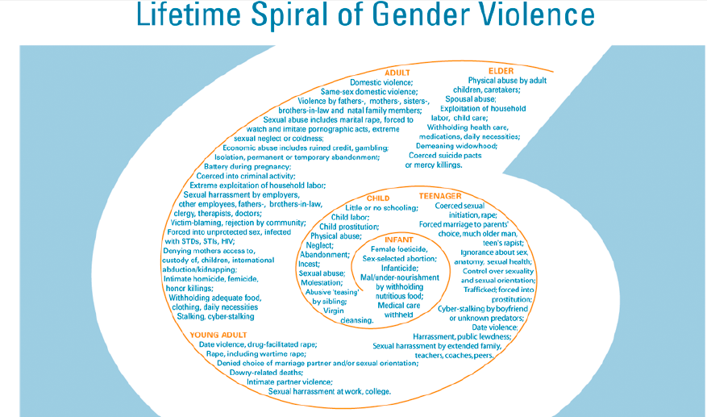
Asian Pacific islander Institute

Slide 6
POLL
Did she consent?

Slide 7
She “consented”…?
  Control is influencing someone to do something they would not otherwise do.
  Coercion is the act of getting someone to act or think in a particular way by using or threatening with negative consequences for noncompliance.
        * Better pay-raise
        * Improve working conditions
        * Scheduling
        * Getting/keeping a job for a family member
        * Not getting “punished”
        * Chisme
        * Avoid physical harm to self or others

Slide 8
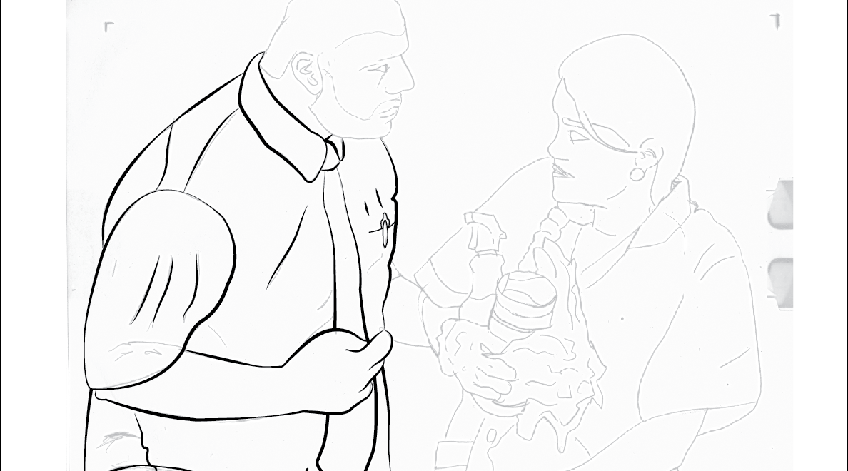
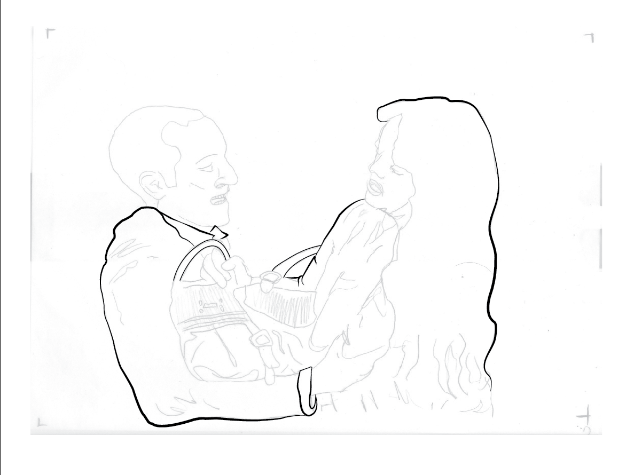
Dynamics
Consent-giving in-consent-continuum of violence-consent-coercion-consent-force-consent-intimidation-consent-threats

Slide 9
Strengthening your interviewing skills
What
When
How
  Repeat
  Conversation starters
    How are things at work?
    Do you like your job?
    What do you do there?
    How many hours do you work?

Slide 10
Strengthening your interviewing skills
A step removed
Money
  Are they paying you all your hours, overtime?
  How are they treating your co-workers? Any complaints?
  What do you see?
Supervisors or anyone with perceived power
  How does your supervisor/co-workers treat you?
  Has anyone mistreated or disrespected your peers? How?
  Did any of it ever happen to you?
  Has your supervisor/Co-worker ever made you feel uncomfortable? If so, how?
Did you complain about it or talked about it to
  a trusted person in the office/company or a peer? Human resources representative? Union leader? Nurse? Anyone else?
Did any of your supervisors/co-workers ever ask you out or offer you to go to lunch, call you outside of work, invite you to give you a ride home before or after work?
  What happened if you said no? (potential punishment/retaliation)
  Did your supervisor/co-worker ever touch you in an offensive way or in any manner?
    How many times did it happen? Did anyone see it?
    Did this happen to you ever?
    Did you tell anyone about it?
    Did anyone see it?
On sexual violence

Slide 11
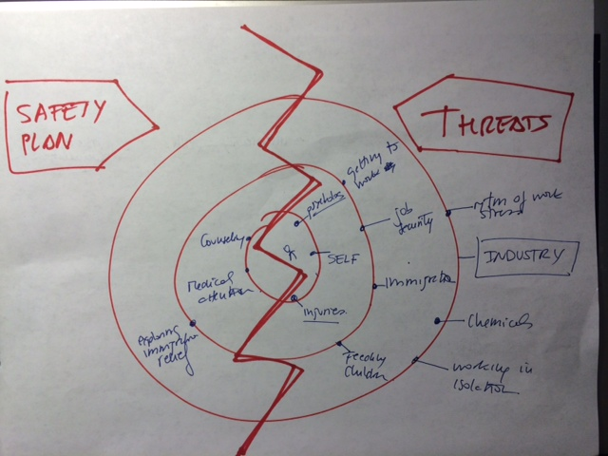
What does safety look like?
EEOC
DOL
OSHA
?
Perceived
threats
vs.
Completed threats
Lawyer & advocate &SANE
Police?
Religious leaders
Lawyers
Co-worker?
Union/promotorass
Family

Slide 12
Strategies for creating safer environments with labor organizers & union leadership
Educate
Advocate
Refer
Secure

Slide 13
Safety First
Giselle Hass
Consideration for union
leaders

Slide 14
Interviewing techniques: Remember that the interview
Can be immense, unforgettable, inspiring
Can have consequences for the traumatized survivor
Can have consequences for the interviewer
Can cause her to re-live the trauma

Slide 15

Invite the survivor to write/tell her story
You have to provide a safe environment, without judgment
Bear witness to her experiences
Provide support and validation

Slide 16
Eliciting the trauma story
Allow adequate time and breaks
Watch for SUBTLE CLUES reflecting internal experiences
Facial expressions, eye movements, body language
Your attitude will be CRITICAL
Follow survivor’s lead
Watch for flashbacks
The more understanding you show, the better the results
Use open-ended questions if possible
Watch for dissociation

Slide 17
Interviewing techniques
Give
Offer
Let
Allow
  Give survivor as much CONTROL as possible
  Offer to change anything in setting that triggers bad memories
  Let survivor tell story at OWN pace as much as possible
  Allow survivor to STOP talking about trauma

Slide 18
Interviewing techniques
Use general explorative questions to help survivor expand the story
Use gentle questions
“I wonder if you could tell me ….”
“Would you be comfortable telling me what happened to you during ……?”

Slide 19
Interviewing techniques
Symptoms that affect the interview:
  Reliving the trauma
  Having intense distress at reminders
  Avoiding trauma memories at all costs
  Feel too ashamed to speak of what was done to them
  Have sleep or eating disturbances
  Being depressed but not showing emotions
  Having difficulty concentrating
  Having memory problems
  Being afraid of reprisals or revenge

Slide 20
Address openly survivor’s fears to speak about it
May be quite realistic
Ask survivor for his/her suggestions for getting the info you need
Find alternative ways to get the affidavit in way that the survivor feels is safer
Find an alternative source of info
Find solutions to their fear or threat to themselves and their family

Slide 21
Most of all: Avoid replicating the traumatic situation
Acknowledge how difficult it might be to discuss the trauma
Image of “shattered glass.” Be careful not to crush any pieces
Be respectful, compassionate
Show it in your eyes, facial expressions, body language
Exercise caring & nonjudgmental listening
Social amenities can help (i.e., coffee)

Slide 22
Interviewing Techniques
When directly asked about abuse, a survivor may show:
Extreme stress,
Anxiety,
Fear
Anger
Engaging:
What can trigger you or make you feel upset?
What are some ways I would know if something were making you upset?
What helps when you start to feel upset? How can I help you calm down and feel better?
What does not help you when you are upset?

Slide 23
POLL
What is “wrong” with her!

Slide 24
Identifying trauma
The impact of trauma varies
Depression and memory disturbances
Re-experiencing symptoms
Anxiety and Hyperarousal symptoms
Avoidance symptoms
Post Traumatic Stress Disorder
Physiological problems

Slide 25

Do not forget to assess coercion
Perpetrators of coercion intimidate victims by creating fears, credible to the victim, of disastrous consequences if they do not obey or acquiesce to the abuse. This creates a great deal of anxiety and fear.

Slide 26
Documenting trauma
It is normal for a survivor of severe trauma to:
  Be unable to provide linear account
  Avoid memories
  Have difficulty remembering dates, details
  Changing the trauma account
  Increase level of details with trust, good questions, increased stabilization

Slide 27
Sometimes symptoms are not reported but show up in their behavior
Client does not answer telephone
Afraid of talking about past; no energy for social conversations
Client does not show up on time
Afraid of interview; depleted emotional & physical energy
Client does not show up at all!
Forgetful because of trauma; can’t face interview
Client reluctant to reveal info
Talking means re-living it for days; difficulty trusting

Slide 28


Ask about functioning before and after the traumatic experience

Slide 29
Ending the interview
Acknowledge
Acknowledge person’s courage
Help
If possible, help person identify ways s/he can feel safe after the interview
Observe
Observe how you feel after hearing about the trauma and what do you need.

Slide 30

Resources https://www.youtube.com/watch?v=05Z95q1bkG4

Slide 31
Pre-viewing questions
What red flags would lead you to suspect workplace violence, gender violence, sexual violence. (This scene will help you understand how there can be a synergy of destabilizing factors in play at the workplace.)
What are some of the potential challenges a worker in housekeeping or janitorial professions might face? Are there risks specific to female workers in janitorial/housekeeping positions?
What potential workplace problems can arise if partners (such as husband and wife) work for the same employer?
Do workers with children face special challenges? What issues might a worker with small children think about during her workday?

Slide 32
Follow-up questions
Signs of violence
Dynamics
Special Vulnerabilities

Slide 33
“Beatriz”
https://www.youtube.com/watch?v=n7tqnJCmpIc&list=PLTifzqDcaHT3XFuM9XxjEOmGSFh3wZtI6&index=3
Jennifer Cooley

Slide 34
Documenting cases
Lauren Bonds

Slide 35
Documenting cases of sexual violence
Strength of the Legal Claim Depends on Strength of the Evidence
When assisting workers w/ potential claims, think about what they need to show to make out a case:
  Severe or Pervasive:
    Severe: Documents from hospital visit?
    Pervasive: Notebook to write down every comment, or tell the worker to text you every time they are touched, are told an offensive statement

Slide 36
Documenting cases of sexual violence (Contd.)
Employer Knew or Should Have Known:
  Record meetings w/ supervisor where complaints are made (if allowed in your state), take pictures of documents/complaints you file with HR
Help collect anything that Supports Your Case:
  Witnesses?
  Cameras at the worksite that could have captured incident?
  Inappropriate text messages?

Slide 37
VIOLENCE IS VIOLENCE
Sexual violence and assault in the workplace is a form of sexual harassment
Title VII of the Civil Rights Act of 1964 prohibits race, color, sex, national origin and religion discrimination; Equal Employment Opportunity Commission investigates and litigates
Sexual Assault criminal action: target abusers, criminal justice
Sexual Harassment civil lawsuit: target is company for $$ and changes in company practices

Slide 38

Vulnerable workers: Priority for EEOC
Immigrant, Migrant, and Vulnerable Workers priority under the National Strategic Enforcement Plan-since 2012
Agriculture, service industry, restaurant, janitors
Need to collaborate with public interest groups, advocates; sexual assault program staff may be the “first line” to identify harassment

Slide 39
Remedies
Monetary ($)
  Remedy is $ for victims of harassment (backpay, reinstatement, compensatory damages (emotional distress, pain and suffering), punitive damages, $300k CAP)
  Remedy may also include $ for those who were retaliated against as witnesses
Non-monetary
  EG. New company policies to encourage complaints without fear of retaliation (as part of court order); bar rehiring of harasser; discipline, termination of harasser

Slide 40
Selected cases
EEOC v. Tanimura & Antle: rapes, $1.855 million settlement (California Rural Legal Assistance)
EEOC v. DeCoster Farms, rapes, retaliation, $1.525 million (Iowa Coalition Against Domestic Violence)
EEOC v. Rivera Farms, harassment of 20 women and one rape $1.0 million
EEOC v. Harris Farms, multiple rapes of farm workers, nearly $1.0 million verdict (Lideres Campesinas, rape crisis center)

Slide 41
Selected cases
EEOC v. ABM, sexual harassment of 20 female janitors, one raped, $5.8 million settlement
EEOC v. National Food Corp., forced oral sex of poultry worker, $650,000 (Columbia Legal Services)
EEOC v. Monterey Gourmet Foods, same-sex harassment, retaliation $535,000 (California Rural Legal Assistance)
www.eeoc.gov for more cases

Slide 42
POLL
Filing charges

Slide 43
Filing the charge
Charge notifies EEOC to investigate; www.eeoc.gov; mail, walk-in, letter from advocacy group
Third Party Charge (advocacy group, church, union, etc.)
Commissioner’s charge
Class members: EEOC can gather information regarding named and unidentified class members if CP alleges that there’s a class of workers similarly situated
Charge must be filed within 180/300 days of last act of harassment

Slide 44
Filing the charge, investigation
Information from claimant (and her counsel) to investigator is not covered by confidentiality privilege
Lawyer for Employer shares no privilege with EEOC investigator
All factual information given to EEOC during investigation can be discovered in litigation
(BUT in EEOC lawsuit, Trial Attorneys share quasi-attorney-client privilege with Charging Party)

Slide 45
Key issues in EEOC investigation
Did harassment occur?
Did Charging Party (CP) complain to a supervisor? HR?
Did the employer fail to protect the employee from harassment? Why?
Is harasser the top official? Nowhere for CP to go?
Did employer or its agents threaten CP if and/or after she complained???

Slide 46
Proving harassment
Charging Party: is she credible? (Do not assume that CP is lying.)
Emotionally upset? Crying? (Caveat: no one way for rape victims to react)
Describes details? Physical touching, grabbing? Frequency?
Verbal harassment? What was said?
Any threats by harasser? Manager? Co-workers? Human Resources? Discouraged from complaining?

Slide 47
Proving harassment
Post-Traumatic Stress??
Any physical injuries? What? Medical treatment?
Need ongoing medical or psychological treatment??
Evidence bolsters credibility to establish liability and damages
This evidence could also support claim for compensatory damages (emotional distress, pain and suffering) (sexual assault program staff could be key witnesses)
See EEOC v. Willamette Tree Wholesale; examination by and testimony of psychologist Dr. Fabiana Wallis and therapist documented trauma caused by multiple rapes and threats to kill farm worker and her family

Slide 48
Proving harassment
Harasser: is he credible? Who supports his story? Any prior complaints of harassment?
What did company do?? Was harasser previously disciplined or not? Position in company – supervisor, manager, co-worker, owner? Company officials ill-trained to handle issue? Did they retaliate?
Note: during EEOC investigation agency will obtain personnel file and records of previous complaints

Slide 49
POLL
Documenting the case

Slide 50
Proving harassment
Corroboration through Witnesses: co-workers, supervisors, actual eyewitnesses? Note: Most egregious harassment happens “behind closed doors”.
Counselors, doctors: what was observed? What did claimant say? Injuries? Treatment?
Parents, spouse, other relatives,
Other harassed individuals? Did CP complain to anyone about the harassment? What was said? Evidence could support victim’s credibility.

Slide 51
Proving harassment
Cops: Was police report filed? (non-conclusive); Note: less than 10% of sexual assault crimes are reported
Compare: “beyond a reasonable doubt” v. “by a preponderance of the evidence, i.e. 51%”
EEOC v. Harris Farms: 3 Rapes by supervisor; Deputy sheriff: “victim is lying”; Jury: “we believe her and here’s $1 million”

Slide 52
Building partnerships

Slide 53

Lideres Campesinas’ approach

Slide 54
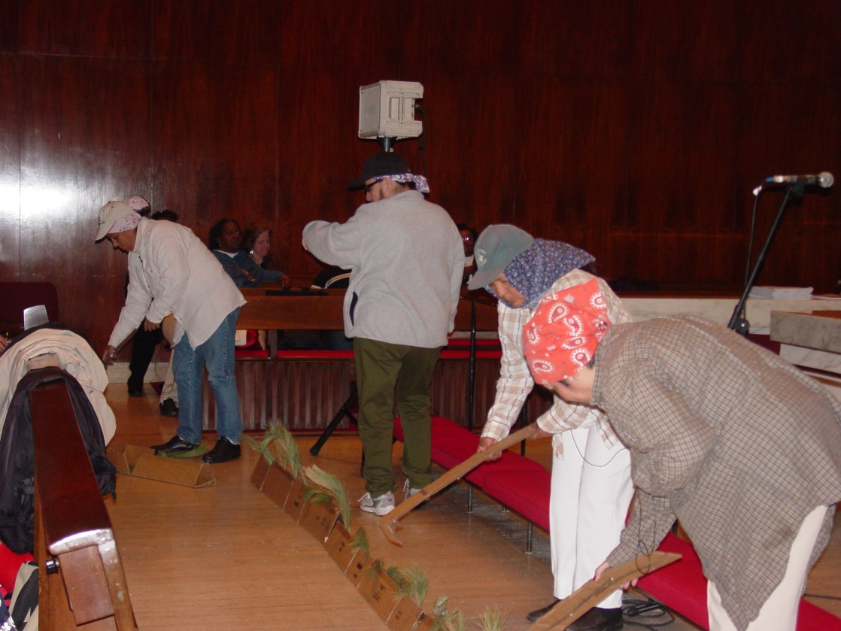
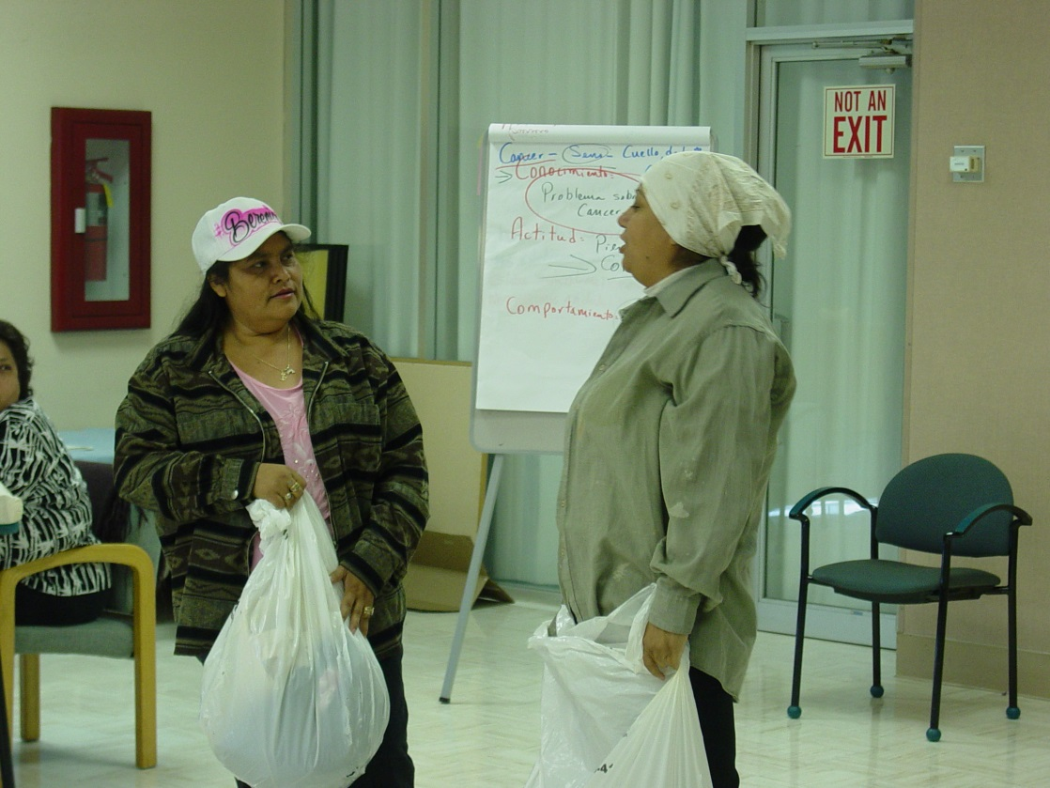
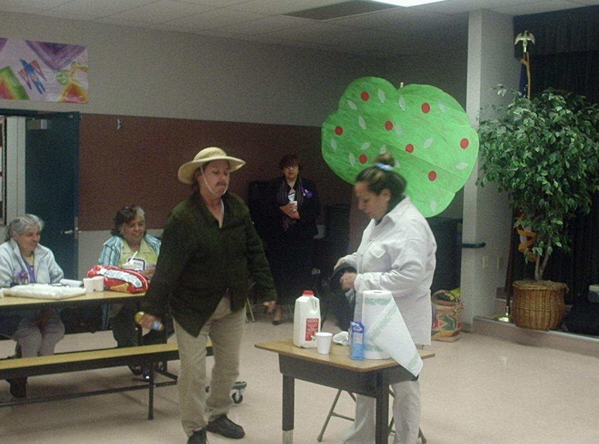
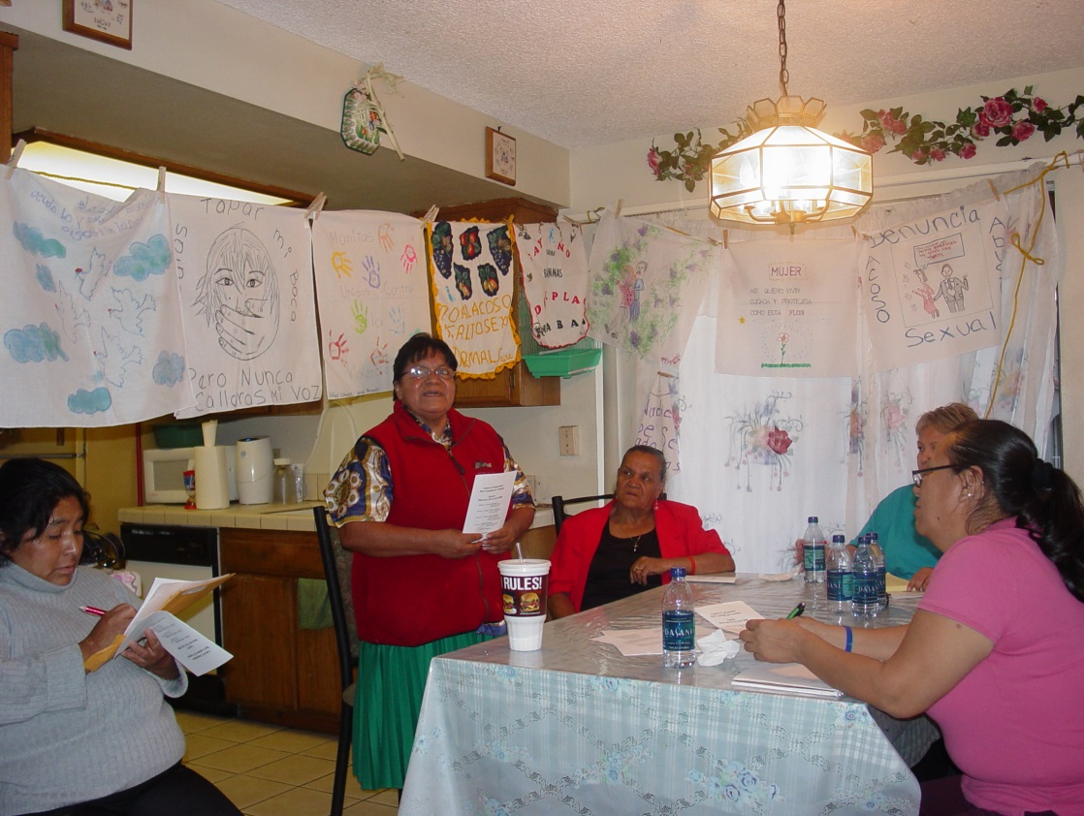

Slide 55
Key questions to consider in outreach and prevention with immigrant communities
What are the priorities in the community? What can you do to support the community in addressing these priorities?
Who are the natural leaders in the community?
How can you partner with these leaders to support their efforts? Who in your community is currently engaging immigrant survivors?
What do your outreach efforts currently look like? Who are you reaching? Who are you missing? How can you strengthen your current efforts to reach communities that may be under-served?

Slide 56
An unusual team
CHURCHES/FAITH BASED ORGANIZATIONS
CRIMINAL DIVISION INVESTIGATIONS & AG’S OFFICE
DV/SA ADVOCATES & IMMIGRATION & LABOR RIGHTS ORGANIZATIONS
SURVIVORS
WORKFORCE DEVELOPMENT/DOL/EEOC/ CIVIL RIGHTS
PSYCHOLOGISTS/THERAPISTS/COUNSELORS
LAWYERS/ NATIONAL LAW FIRMS

Slide 57
Changing workplace culture
Information is the best tool
Support/assistance for victims
Accountability/consequences for perpetrators
Role of co-workers as “upstanders”

Slide 58
Resource List
Advocates can use the following resources when working with employers to improve workplace prevention and response to sexual violence. Many of the resources listed are tailored to the response and prevention of domestic violence. However, they include aspects of sexual violence and can be adapted and applied to sexual violence prevention and advocacy within the workplace. Advocates can share many of these resources with employers to help inform their policies and violence prevention plans.
Websites
https://www.nsvrc.org/sites/default/files/publications_nsvrc_resource-list_sexual-violence-workplace.pdf
American Bar Association Commission on Domestic and Sexual Violence
ASISTA
California Rural Legal Assistance, Inc., Farmworker Sexual Violence Technical Assistance Project
Centers for Disease Control and Prevention (CDC)
Corporate Alliance to End Partner Violence
Domestic Violence and Sexual Assault Project SURVIVE
Centers for Disease Control and Prevention, Injury Prevention & Control: Data & Statistics (WISQARSTM)
Futures Without Violence
Legal Momentum-The Women’s Legal Defense and Education Fund
Lideres Campesinas
Centers for Disease Control and Prevention, National Institute for Occupational Safety and Health (NIOSH)
National Sexual Violence Resource Center (NSVRC)

Slide 59
What is ahead?
Thursday, March 8, 2018 - 1:00pm - 2:30pm EDT: “Assessing possible legal remedies for immigrant survivors”
In this webinar, speakers with discuss the array of possible legal options for immigrant survivors of sexual violence in the workplace, including challenging labor violations, gaining immigration status, and other civil and criminal system options. We will look at options in the context of a union organizing campaign and in a workplace covered by a bargaining agreement.
Registration link: https://register.gotowebinar.com/register/8650692893347243267

Slide 60
Thank you for your participation!
Link to ASISTA national webinars: https://youtu.be/GZqFsw8XWTs

