Slide 1


Challenging Sexual Violence in the Workplace Webinar I
Presented by: Lauren Bonds, Jennifer Cooley, Giselle Hass, Sonia Parras Konrad & Debbie Smith.
This document was supported by a grant from Raliance, a collaborative initiative to end sexual violence in one generation, made possible through a commitment from the National Football League (NFL). Its contents are solely the responsibility of the authors and do not necessarily represent the official views of the NFL.
ASISTA@2017 All Rights Reserved

Slide 2
Overall project goal:
Forge partnerships between labor and anti-violence advocates that create models to challenge and eradicate workplace sexual violence against immigrant women.
Debbie Smith

Slide 3
About the project
Introduction of partners
Why?
A collaborative effort among advocates and labor organizers provides a trauma-centered approach to empowering survivors.
With this partnership, advocates and organizers can work together in advocating for better workplace policies.
The road ahead
Sexual Violence as Gender Violence Against Immigrant Women
Working with immigrant survivors of sexual violence in the workplace; holistic responses
Assessing possible legal remedies for immigrant survivors

Slide 4
Today
Explore the basic protections against sexual violence in the workplace in general
Explore how sexual violence manifests itself in the lives of immigrant women
Review considerations when working with survivors of traumatic experiences

Slide 5
Sexual Harassment Legal 101
Lauren Bonds
ACLU, Kansas

Slide 6
What is sexual harassment?
Unwelcome sexual advances and requests for sexual favors that interfere with a worker’s performance or create an intimidating, hostile, or offensive work environment

Slide 7
Sexual harassment basics
Claim you bring against company, not an individual
Prohibited by federal law “Title VII”
Physical, verbal, or visual
Men can harass men, women can harass women, women can harass men, etc.

Slide 8

Sexual orientation & gender identity discrimination
An ongoing pattern of comments and rumors about sexual orientation constitutes sexual harassment
Harassment has also been found when the employer intentionally and persistently misgenders or deadnames a transgender worker
EEOC will pursue cases, federal courts is still split
Some states have passed laws protecting LGBTQI workers

Slide 9
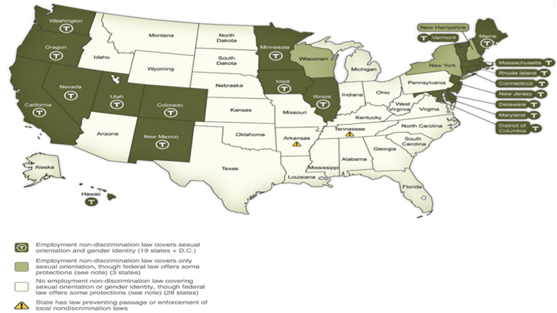

Slide 10
Quid Pro Quo harassment
Only supervisors
Offering of a benefit in exchange for a sexual favor
Withholding a benefit for rejecting his advances

Slide 11
Hostile work environment
Can come from a supervisor, co-worker, or a customer
Must show:
Unwelcome
Severe OR Pervasive
For co-workers and customers: Management knew or should have known
The less severe the conduct, the more times it needs to happen
Groping, assault by a manager only needs to happen one time
Request for a date or sexual rumor generally need to happen on multiple occasions

Slide 12
Hypothetical
Sexual Harassment or
Just Really Gross?

Slide 13

Reporting harassment to the employer
Faragher/Ellerth Defense--Employer is not liable if:
They took reasonable steps to prevent and correct sexual harassment in the workplace (i.e. have a system for reporting and investigating)
The employee unreasonably failed to take advantage of employer’s system for reporting
Workers should report harassment when possible
Workers do not need to report harassment when:
The company lacks a anti-harassment policy
Worker can only report the harassment to their harasser
Workers should report in method prescribed by policy
Eg. Policy says submit form to HR, worker should submit form to HR

Slide 14
Retaliation
An independent violation of Title VII, can have a claim for retaliation even if you don’t have one for sexual harassment
Common for an employer to retaliate against workers that report harassment in an attempt to silence them
Beware: Retaliation can be camouflaged as a remedy
Forms
Reduction of hours
Moved to a less desirable shift
Demotion
Termination
Closer scrutiny of work
Rumors, accusations, or interrogations

Slide 15
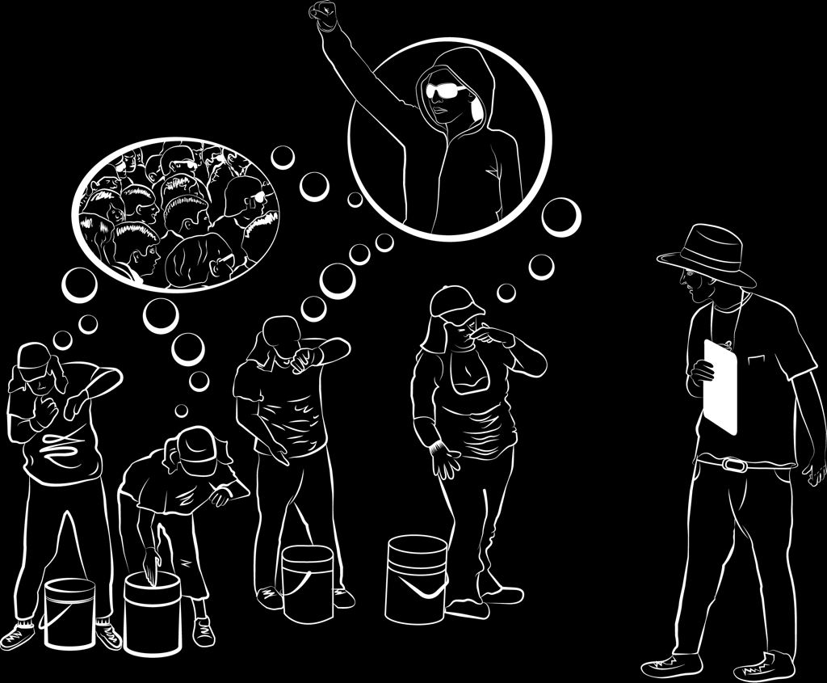
Introduction to the dynamics of SVWP
Sonia Parras Konrad

Slide 16
Introduction to the dynamics of SVWP
Identify survivors
Risks of “talking”
Dynamics
Next webinar
Strategies for working
with survivors
Selfcare
Collaboration

Slide 17
Sexual harassment preceding sexual assault
In DeCoster, Swift and Postville all women endured sexual harassment in silence for weeks and months before they were sexually assaulted
The few that complained suffered retaliation and punishment through harder jobs, less hours of paid work, public humiliation etc
Sexual harassment is a red flag for further victimization

Slide 18
What are we talking about?
Sexual harassment is a form of sexual violence and gender violence
Sexual harassment must be addressed immediately and seriously because it is often a precursor to sexual violence in the form of rape
Immigrant survivors report that supervisors or co-workers perpetrators had harassed and abused them multiple times before completing a rape during a period of time

Slide 19
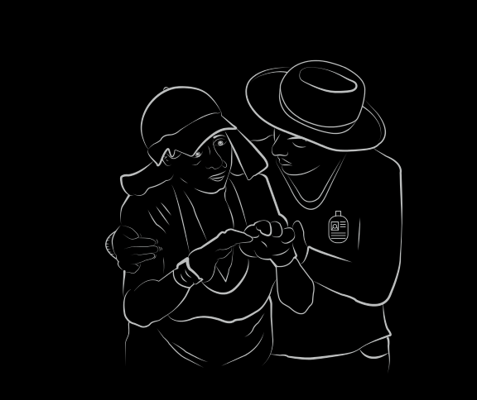
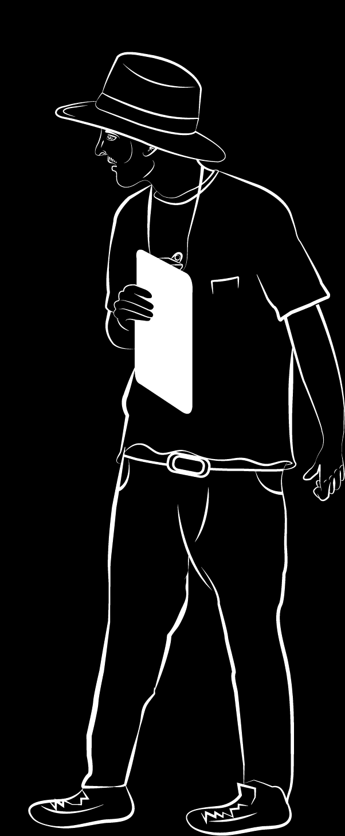
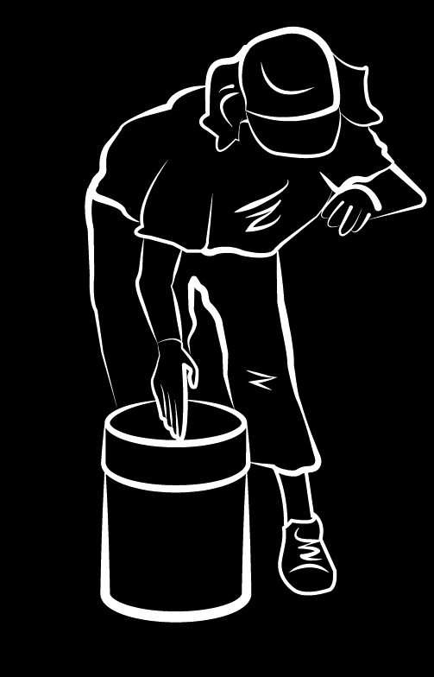
Why?
Sexual violence in the workplace is fostered by an imbalance of power between employers, supervisors and their low wage immigrant workers. (See Human Rights Watch “Cultivating Fear.”)
Power: to hire or fire, retaliate and/or confer certain “benefits”
Immigrant women are extremely vulnerable
Immigrant women often face systemic barriers exacerbated by their status as blue collar workers, often unauthorized to work will NOT report these abuses nor bring perpetrators to justice

Slide 20
Parties
• Perpetrator may be
man or woman
of same sex
supervisor, agent of
employer, co-worker, third party
• Victim can be affected by the hostile work
environment

Slide 21
Manifestations of SV in the workplace
My friend told me that…

Slide 22
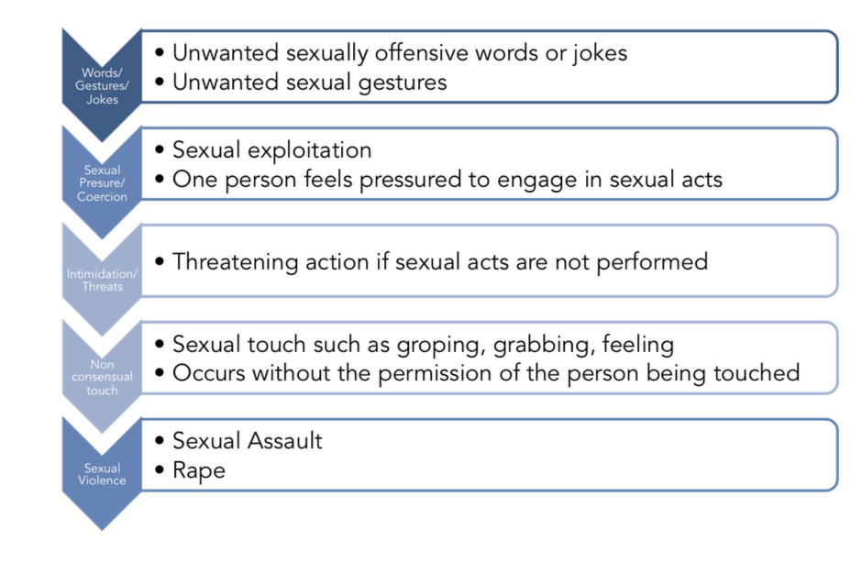
Sexual violence in the context of gender violence

Slide 23
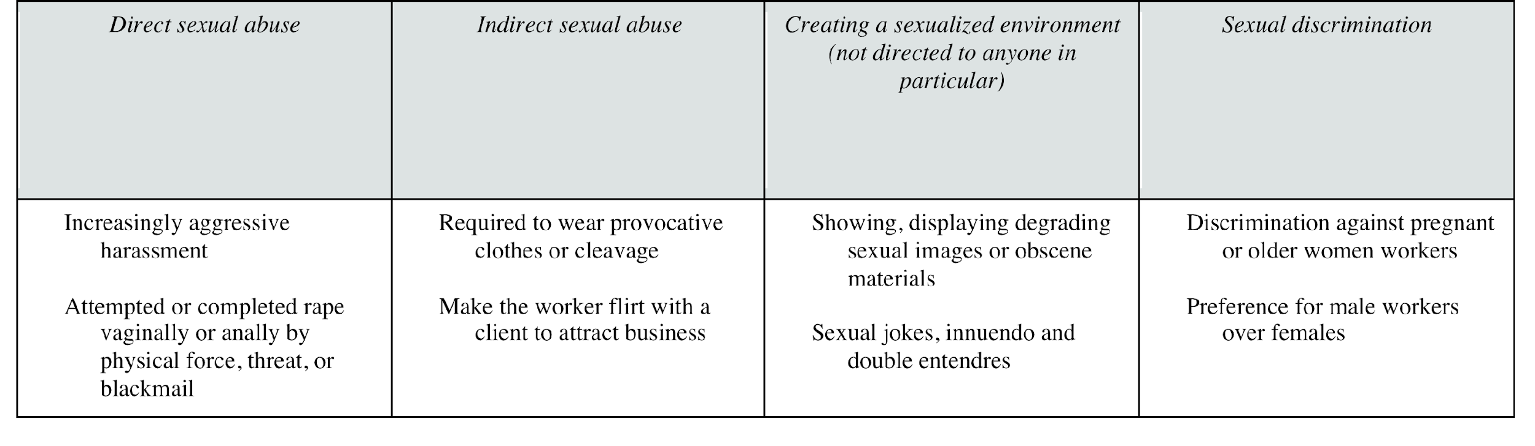
Test your Knowledge…

Slide 24
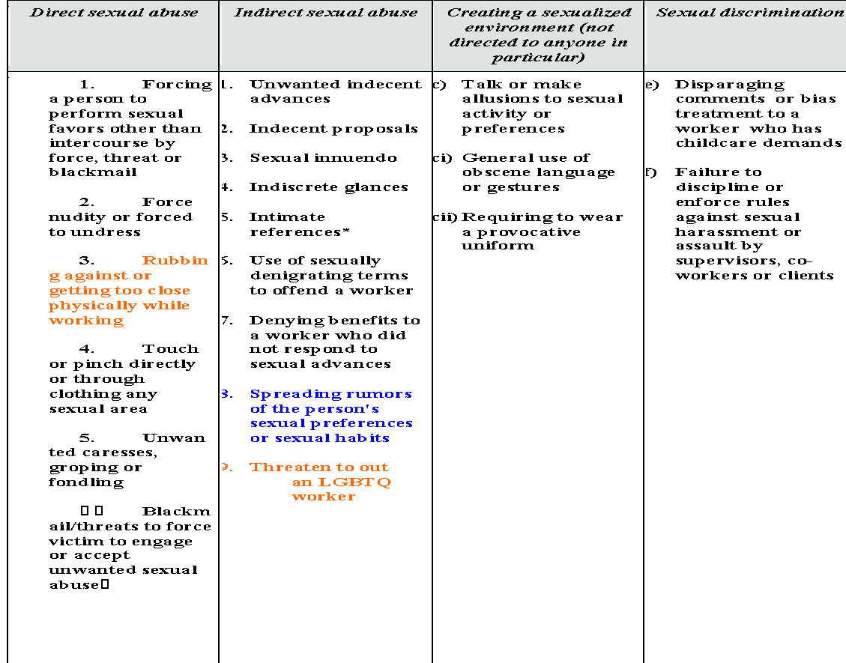

Slide 25
She “consented”…?
Control is influencing someone to do something they would not otherwise do.
Coercion is the act of getting someone to act or think in a particular way by using or threatening with negative consequences for noncompliance.
* Better pay-raise
* Improve working conditions
* Scheduling
* Getting/keeping a job for a family member
* Not getting “punished”
* Chisme
* Avoid physical harm to self or others

Slide 26
Type of abuse/exploitation:
PHYSICAL
OTHER
Rape
Sexual assault
Sexual Harassment
Retaliation
Sex Trafficking
Stalking
Domestic Violence
Pregnancies/ Ownership
Pornography
Threats with physical harm
Voyeurism
Hostility
Intimidation, Verbal abuse
Black listing
Family Members as targets
Recruitment under false pretenses-Fraud Recruitment
Heterosexual, Homosexual sex
Secondary trauma by other workers who are not target
Use of legal systems to control

Slide 27

Identifying the risks

Slide 28
Exercise Identifying the risks
Think about these particular industries and looking at the next table identify what kind of risks immigrant women may be more prompt to experience in that particular industry.
a. Housekeeping
b. Food processing
c. Farm work
d. Restaurant

Slide 29
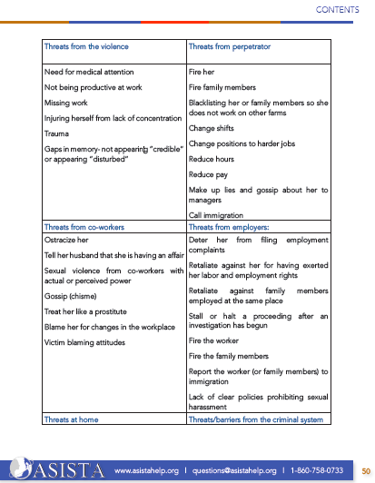
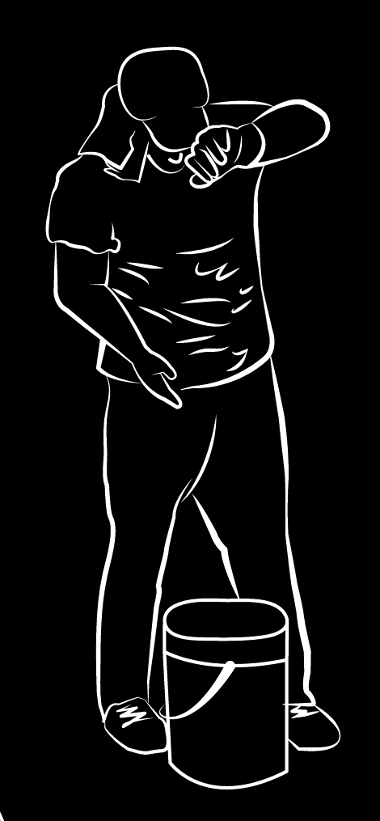
Safety first!

Slide 30
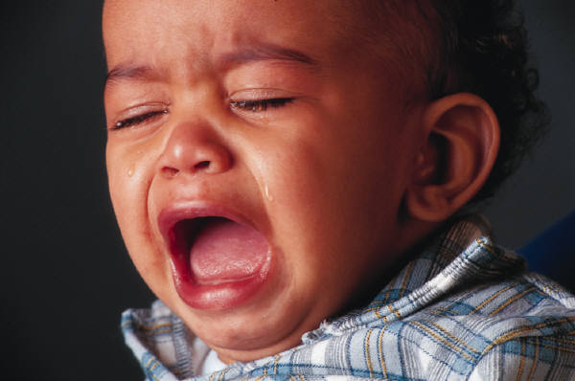






Risks of reporting

Slide 31
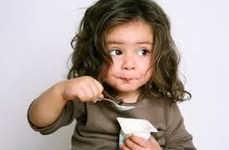

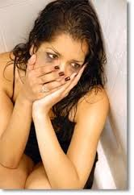
“INTERVIEWING TECHNIQUES”
Talking about it!

Slide 32
Dealing with workplace challenges
Does the survivor want to disclose?
What does the survivor need/want?
What are the relevant laws/policies that can help?
Who in the workplace will be an ally? An obstacle?
What is possible within the context of the particular workplace?

Slide 33
The beginning of “talking about it,” What do I need to know? Giselle Hass
.

Slide 34
Invite the survivor to write/tell her story
You have to provide a safe environment, without judgment
Bear witness to her experiences
Provide support and validation

Slide 35
Coercion
Perpetrators of coercion intimidate victims by creating fears --credible to the victim-- of disastrous consequences if they do not obey or acquiesce to the abuse. This creates a great deal of anxiety and fear.

Slide 36

Key principles
Being victimized or exposed to victimization is stressful for everyone.
Undergoing a stressful situation
leaves consequences:
positive and/or negative.

Slide 37
Distress from abuse accumulates
Frequency
Intensity
Nature

Slide 38

Pre-trauma vulnerability:
- previous trauma,
- mental health,
- personality traits,
- age,
- gender,
culture,
physical health and impairments

Slide 39
Preparedness for the event
Sequential stressors
Quality of the immediate and short term responses:
- social support
Institutional response
Post-event recovery factors

Slide 40

What is trauma?
Symptoms that reflect a person’s inability to come to terms with real experiences that have overwhelmed their capacity to cope
Stress of extreme proportions
“The critical element that makes an event traumatic is the subjective assessment by the victim” (of how threatened and helpless they felt).

Slide 41
Emotional consequences
Anxiety symptoms: panic, dissociation, fragmentation of bodily experience
Flashbacks, memories, acting as if threat was still occurring
Hypervigilance and heightened arousal
Increased risk of alcohol/drug use
Poor impulse control-problems with irritability or anger
Depression likely to follow

Slide 42

Long-term consequences
Low self-esteem
Impaired self-perception
Tendency for somatization
Difficulties with decision-making
Difficulties to manage emotions
Irrational thoughts
Difficulties to trust others
Behavioral problems

Slide 43
Complications that may impact the traumatic response for immigrant women
Low economic status or extreme financial demands
Language
Immigration Status
Cultural values and norms
Lack of information
Isolation
Trauma

Slide 44

Women cope with interpersonal violence by using:
Denial
Minimization
Avoidance
Freezing
Ambivalence
Embarrassment/ Shame
Dependence/ Attachment
Self-defense
Substance Abuse

Slide 45
Direct and indirect ways of coping with the abuse
Direct
Indirect
Tell someone in authority
Quit the job
Made a report
Refused to do what employer asked
Confronted the abuser
Fought back
Ask for a transfer
Sought help
Call the police
Call in sick to avoid going to work
Dress dowdy
Get a boyfriend or flirt with someone in the place of employment
Go along up to certain point
Tell someone
Try to distract supervisor
Try to make the work environment safer

Slide 46
What is next?
Webinar II
FEB. 12, 2018. 1:00- 2:30 EASTERN TIME
Working with immigrant survivors of sexual violence in the workplace: holistic responses
Webinar III
March 8, 2018. 1:00- 2:30 Eastern time
Assessing possible legal remedies for immigrant survivors

