Slide 1


Expanding Your Bag of Tricks III Webinar Series
Presented by: Carly Beusch, Jennifer Cooley, Abbie Kretz & Sonia Parras Konrad.
This document was supported by a grant from Raliance, a collaborative initiative to end sexual violence in one generation, made possible through a commitment from the National Football League (NFL). Its contents are solely the responsibility of the authors and do not necessarily represent the official views of the NFL.

Slide 2
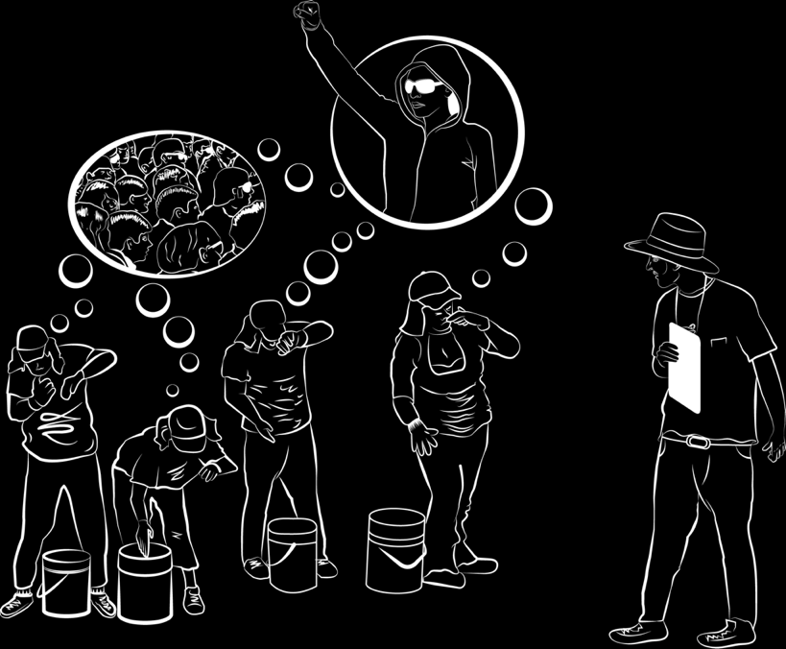
GOAL
To identify legal protections for survivors of sexual violence in the workplace and responses through collaboration
Labor
Civil/Criminal
Immigration
Reaching out to survivors
Strategies for collaborating

Slide 3
Estela
Estela works at the poultry processing plant of “Niceruraltown” from 6am to 8pm Monday through Friday and then at the local Mexican restaurant cooking during the weekend. She got her jobs from a nice supervisor who invited her to come from her village in Guatemala.
Her partner assaulted her during the weekend and the neighbors called the police. Estela tells you that she deserves what she got because her partner found out about the sex at the plant.
When you ask her about whether she is being mistreated at work, she tells you that she has become increasingly uncomfortable because the owner of the restaurant often makes crude jokes about her and other employees. He has also started following her around the restaurant and has started making unwanted sexual advances at her. When she complaint just once, the owner threatened with firing her and did not pay her hours that night. She is scared and confused.
She comes to your agency because she really needs the money to pay the supervisor that invited her to come.

Slide 4
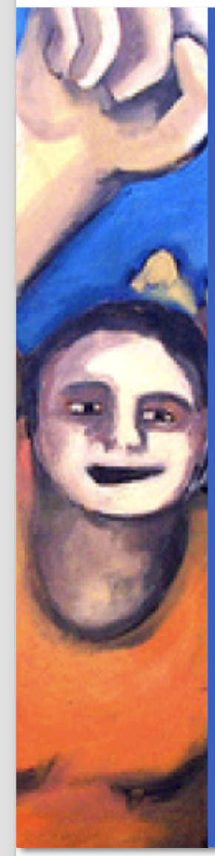
Questions
What do you think is going on with Estela in general?
Identify “red flags”
Identify potential violations of labor rights
Identify potential non-legal responses
What can you do/offer?
Who do you need?
Do you want to know anything else?
Identify potential labor rights responses
Who do you need to contact if she consents?
What can they do for her?
Identify potential immigration/civil relief
Does she qualify for anything?
What can you do for her?
Who else do you need?

Slide 5
An introduction to the labor agencies and protections for immigrant survivors

Slide 6

Federal Agencies Department of Labor (DOL)
Occupational Safety and Health Administration
Save Lives
Prevent injuries
Protect the health of America’s workers

Slide 7

Federal Agencies Department of Labor (DOL)
Wage and Hour Division (WHD)
Enforce the Fair Labor Standards Act (FLSA)
Minimum Wage
Overtime Pay
Child Labor
Recordkeeping

Slide 8
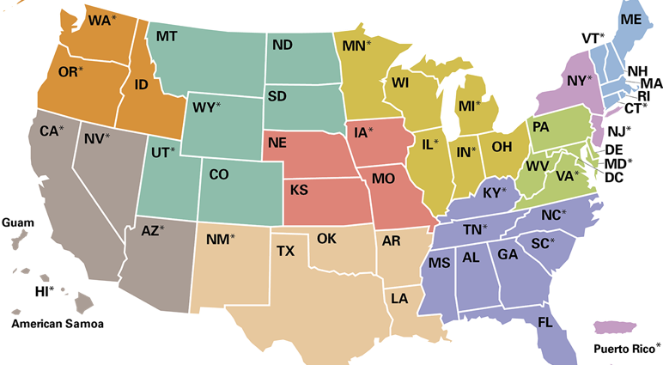
Where are they Located? IOWA Des Moines, IA 50309 210 Walnut Street Room 643-TEL: (515) 284-4625

Slide 9
Civil Remedies: Wage and Hour Violations
Federal law provides standards which all employers must obey in order to protect employees under the Fair Labor Standards Act (FLSA)
Undocumented immigrant workers are also protected
FLSA does not equally apply to domestic or agricultural workers
Some states have laws which provide additional protections to works.
All wage and hour claims must be brought within certain time periods of the violation(s).

Slide 10
Civil Remedies: Wage and Hour Violations (Continued)
Violations can include:
Failing to pay minimum wage and/or overtime
Lack of meal and/or rest breaks
Failure to maintain accurate records
Unlawful deductions from wages
Child labor
Agencies include:
U.S. Department of Labor
State or local Departments of Labor
Federal courts
Claims must be brought within 2 years for most violations, or in the case of willful violations, within 3 years.

Slide 11
Elisabeth
Her main complaint- not getting paid
How can you help Elisabeth?

Slide 12
W&H division- How can you help?
To file a complaint,
You may either contact your local Wage & Hour Division office or call (866)487-9243 to be directed to the nearest office.
When contacting the Division:
Be prepared to provide the following information:
• Name, address, and phone number of complaining worker
• Name, address, and phone number of the company
• Name of the owner and manager
• Small description of the type of work done
• Description of how and when one was paid (i.e. cash or check, weekly)
Evidence a worker should provide includes copies of pay stubs or checks, individually
Advise your client to kept records such as a journal or calendar with hours worked, photographs, and written testimony from co-workers if safe from the moment she contacts you.

Slide 13

Federal Agencies Department of Labor (DOL)
Equal Employment Opportunity Commission (EEOC)
Protect workers to be free from discrimination in the workplace
Age - Race/Color
Disability - Religion
Equal Pay/Compensation - Retaliation
Genetic Information - Sex
Harassment - Sexual Harassment
National Origin
Pregnancy

Slide 14
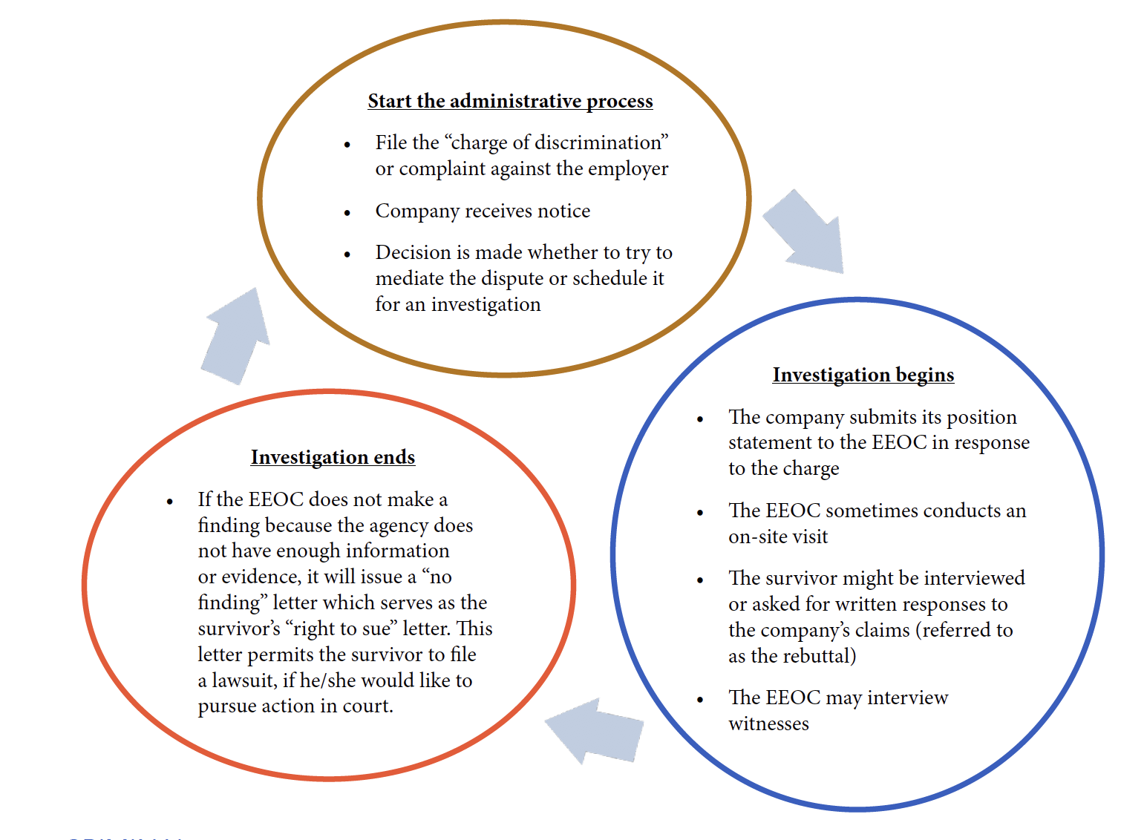

Slide 15
Anti-Discrimination Violations
Federal law defines sexual harassment as a form of sex discrimination under Title VII.
State law may provide additional protections.
Title VII protects:
Employees who have been subjected to hostile or intimidating behavior that created an abusive work environment
Employees who have refused a supervisor’s request for sexual favors
Employees who have to tolerate a sexually charged work environment and are retaliated against by the employer

Slide 16
Anti-Discrimination Violations (Continued)
Agencies involved:
Equal Employment Opportunity Commission
State or local agencies which enforce state or local anti-discrimination laws
Possibly state or federal courts
Anti-discrimination claims with the EEOC must be brought within 300 days of the violation(s).
Claims in state or federal courts must be made within a certain amount of time after the violation(s).

Slide 17
Teresa
Her main complaint- paying her bills
- Her victimization
- How can you help?

Slide 18
How can you help?
To file a complaint, you may either contact your local EEOC office or call the National Contact Center at (800) 669-4000.
When contacting the EEOC, be prepared to provide the following information:
-The name, address, and telephone number of the person filing the charge
-The name, address, and telephone number of the company and number of employees
-A short description of the event with any supporting documents
-The dates the event took place
- The names, addresses, and telephone numbers of any witnesses
- Information on whether a state or local charge was also filed
- The name, address, and telephone number of a person who can contact the person
filing the charges

Slide 19
She must be ready!
Credibility is the key many of these cases since the case relies primarily on the testimony of the survivor.
As a result, it will be important to provide any evidence to support the survivor’s charges and testimony.
Evidence may include a diary or log of events, photographs, letters from witnesses, or records of previously filed complaints.
You are not alone!
Work with your partners and allies to strengthen her credibility and the journey ahead

Slide 20

Federal Agencies Department of Labor (DOL)
National Labor Relations Board (NLRB)
Protect workers’ right to organize
With a union
Without a union

Slide 21
State Agencies in Nebraska
Nebraska Department of Labor (NEDOL)
Wage Payment and Collection Act
Minimum Wage
Contractor Registration Act

Slide 22
State Agencies in Nebraska
Nebraska Equal Opportunity Commission (NEOC)
Be free of discrimination in:
Workplace
Housing
Public Services

Slide 23
Local Agencies in Nebraska
Omaha Human Rights and Relations
Investigate, eliminate, and prevent all types of socioeconomic disparities and prohibited discrimination:
Housing
Employment
Public Accommodations
Contracting

Slide 24
An introduction to civil, criminal and immigration main protections for immigrant survivors

Slide 25
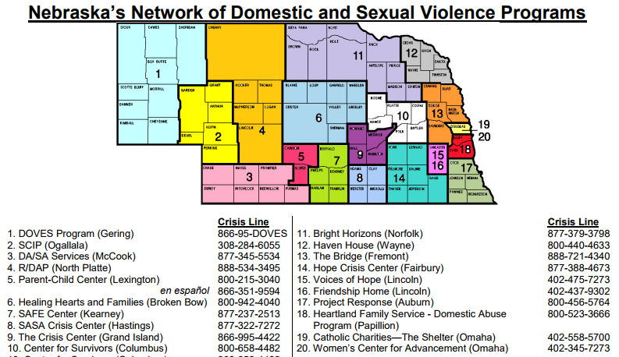
www.nebraskacoalition.org
Nebraska Spanish Crisis Line 1-877-215-0167

Slide 26
The Role of Advocates with Sexual Violence Survivors
Providing information regarding options (and referrals if needed)
Criminal justice process
Civil legal matters (such as protection orders, divorce, custody, etc.)
Medical
Accessibility to public benefits and/or other community support services
Shelter
Transportation
Safety planning
Many more
Empower survivors through supporting their own decision making

Slide 27
Different Types of Sexual Assault Advocates… and Why it Matters
Advocates can work in a variety of places:
Law enforcement agency **
Prosecutor’s office **
Domestic violence/sexual assault crisis
center
** Advocates do not have advocate/client privilege and the survivor’s information is not confidential.

Slide 28
Other remedies
Survivors can seek to have criminal action taken against the perpetrator for his/her actions.
Immigrant survivors often fear involvement with law enforcement.
It is important to talk to victim advocates within the law enforcement offices to better understand the process that the survivor will navigate should he/she choose to take action under the criminal legal system.
Criminal
Certain state laws might allow the survivors to sue the perpetrator for damages or other relief
Survivors should consult with lawyers in their state about the available protections and filing deadlines
Civil action against the perpetrator
In addition to Title VII, other laws might also allow survivors to pursue a legal action against the employer.
These might be based on state anti-discrimination laws or other laws that protect individuals.
Survivors should consult with lawyers in their state about available protections and filing deadlines
Civil action against the company

Slide 29
Civil Remedies: Protection Orders
This is a type of court order which can be issued to help protect a victim of various types of crimes, including sexual violence
Different types in Nebraska:
Domestic Abuse Protection Order
Sexual Assault Protection Order
Harassment Protection Order
Restraining order (only issued when there is a pre-existing case filed, as it is not a stand alone order)
Agencies involved:
County or District Court judge
County or District Court staff
Sheriff (for service of order on respondent)

Slide 30
Advocate’s Role: Assisting in the Filing of Protection Orders
Typically, advocates cannot directly assist with legal matters because they are not attorneys
Nebraska allows domestic violence/sexual assault advocates to help survivors:
Select the type of protection order which is best for them
Assist the completion of the protection order affidavit
Accompany the survivor to court

Slide 31
Tort Claims
A “tort” is a wrongful act or the infringement of a right that allows the wronged person to sue the bad actor for damages. They can include:
Intentional or negligent infliction of emotional distress
False imprisonment
Assault
Battery
Negligence
Violation of contract terms
Agencies involved:
State Courts
The injured person must file their lawsuit within a certain amount of time.
This amount of time varies by state.

Slide 32
The Advocate’s Role: Labor Violations, Discrimination, or Tort Claims
An advocate does not need to know details of each type of remedy
An advocate’s role in these situations is to potentially “issue spot” and provide referrals to other agencies

Slide 33
Immigration Remedies
There are several different types of remedies which may be options for survivors. The most common affirmative remedies include:
U Visas
T Visas
VAWA Self-Petitions
Primary Agency Involved:
United States Citizenship and Immigration Services (USCIS)

Slide 34
U Visa Eligibility
Must be a victim of a qualifying criminal activity
Suffered substantial physical or mental abuse as a result of the crime
Possess information about the crime
Has been, is being, or is likely to be helpful to the investigation and/or prosecution of the crime
Crime must have occurred in the U.S. or violated a U.S. law
**Must have a signed certification from law enforcement, prosecutor, or judge.**

Slide 35
U Visa Crimes
Rape
Torture
Trafficking
Incest
Domestic violence
Sexual assault
Abusive sexual contact
Prostitution
Sexual exploitation
FGM
Being held hostage
Peonage
Involuntary servitude
Fraud in foreign labor contracting
Slave trade
Kidnapping
Abduction
Unlawful criminal restraint
False imprisonment
Blackmail
Extortion
Manslaughter
Murder
Felonious assault
Witness tampering
Obstruction of justice
Perjury
Stalking

Slide 36
U Visa Certification
Agencies which can sign U Visa Certifications include:
Law enforcement
Prosecutors
Judges
Federal Bureau of Investigation (FBI)
Department of Homeland Security (DHS)
U.S. Department of Labor
Some state Departments of Labor
Equal Employment Opportunity Commission (EEOC)
National Labor Relations Board (NLRB)

Slide 37
U Visa Benefits
Do not need a sponsor to apply
Broad waivers of inadmissibility
Can apply for certain family members
Eligible to work in the U.S.
4 year duration of status
Can adjust status to that of lawful permanent resident after 3 years

Slide 38
Immigration Status and U Visa
Investigator will not ask about immigration status; don’t volunteer it
Discovery: EEOC will seek protective order in litigation
U-Visa: EEOC can certify if “serious criminal activity” is involved, e.g. rapes, threats to harm, extortion, slave-like conditions
U-Visa: contact Regional Attorney (may share attorney-client privilege)

Slide 39
T Visa Eligibility
Be a victim of a severe form of trafficking in persons
Be physically present in the U.S. as a result of the trafficking
Comply with any reasonable requests for assistance in the investigation and/or prosecution of the human trafficker
Suffer extreme hardship involving unusual and severe harm upon removal from the U.S.

Slide 40
T Visa Benefits
Applicant does not need a sponsor
Applicant does not need a law enforcement certification
Can apply for certain qualifying family members
Eligibility to work in the U.S.
4 year status duration
Potential ability to adjust status to that of lawful permanent resident
May be eligible for federal refugee benefits

Slide 41
VAWA Self-Petition
Provides immigration relief to victims of domestic violence or extreme cruelty
Many victims of domestic violence remain in an abusive marriage or relationship because immigration status is often tied to their abuser
Allows victim to petition without the requirement of a sponsor (as in family based immigration)

Slide 42
VAWA Self-Petition Relationship Requirements
Requires specific relationship between perpetrator and victim
Spouse or child of USC or LPR
Non-abused parent of a child abused by USC or LPR
Abuse child of a USC or LPR
Abused parent battered or subjected to extreme cruelty by an adult USC child

Slide 43
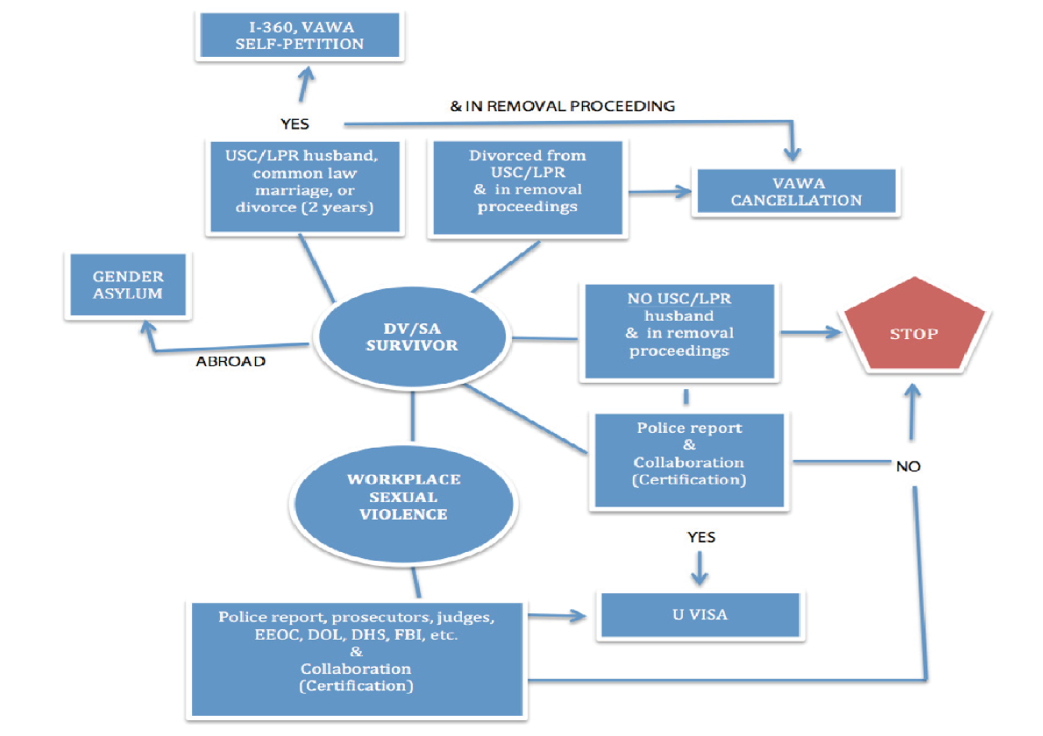
A Flowchart for Advocates

Slide 44
Advocate’s Role: Immigration
Again, an advocate do not need to know details of each type of remedy
An advocate’s role in these situations is to potentially “issue spot” and provide referrals to other agencies

Slide 45
Remember Estela?

Slide 46
Estela
What do you think is going on with Estela in general? | Identify “red flags
Identify potential violations of labor rights Identify potential immigration/civil relief Does she qualify for anything? What can you do for her? Who else do you need? | Identify potential labor rights responses Who do you need to contact if she consents? What can they do for her? Identify potential non-legal responses What can you do/offer? Who do you need? Do you want to know anything else?

Slide 47
Questions
What do you think is going on with Estela in general?
Identify “red flags”
Identify potential violations of labor rights
Identify potential non-legal responses
What can you do/offer?
Who do you need?
Do you want to know anything else?
Identify potential labor rights responses
Who do you need to contact if she consents?
What can they do for her?
Identify potential immigration/civil relief
Does she qualify for anything?
What can you do for her?
Who else do you need?

Slide 48
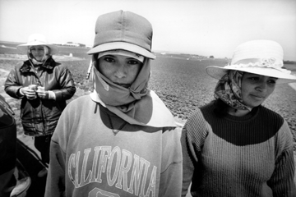
We must join efforts!

Slide 49
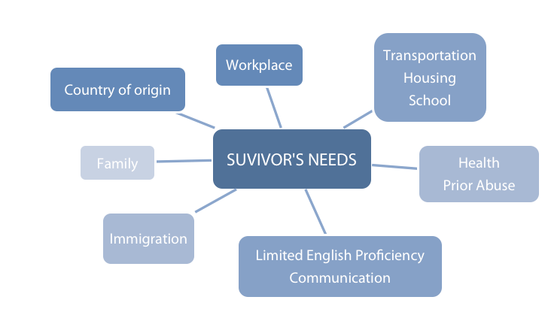
Strategies for Working with Survivors

Slide 50
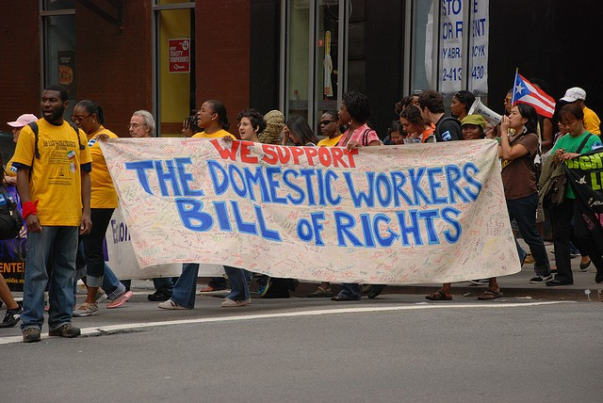
Finding Common Ground; Advocacy at the Crossroads

Slide 51
Working at the crossroads…
Race class gender age ethnicity language country of origin immigration status level of education religion health status | Employers unions immigration advocates consumers law enforcement hospitals clinics schools churches counseling agencies | Neighbors pastors priests friends attorneys politicians teachers co-workers partners children

Slide 52

Advocacy at the crossroads: Integration or confusion? Cohesion or gaps in service? Complimentary or contradictory?

Slide 53
Step 1: Your own agency, its mission and role
Take a moment to consult with members of your agency (or to think individually) about the core mission and roles your agency plays as an advocate for workers and/or survivors.
List the name of your agency and a few of these roles in the discussion box.

Slide 54
Step 2: Estela’s case: My role
Thinking now about the specifics of Estela’s situation, what services or assistance could your agency provide?
State these services to people around you or list them in the dialogue box.

Slide 55
Step 3: The commonalities of our capabilities
As you look at the ways individual agencies can contribute, where is there overlap in services? (Note these in the dialogue box.)
Is this overlap beneficial to survivors? Can it create confusion?

Slide 56
Step 4: Facing our limits
Where can we identify gaps in the services we provide? Are there issues that we cannot address? Note these verbally with those around you or in the dialogue box.
Thinking of survivor’s needs (those of their families, significant others, etc.), who do we, as an agency, need to work with? Note these.

Slide 57
Debriefing: What have I added to my toolbox?
Thinking about how our work overlaps, intersects and where there are potential gaps in the services we can provide, what do I know now that I didn’t know before today?
What would I still like to learn more about as I look toward the future?

Slide 58
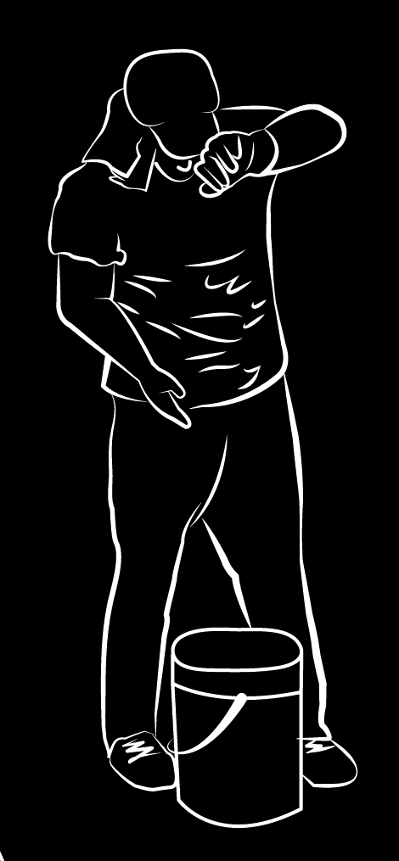
Preparing for an ICE encounter; Things to know

Slide 59
What do I need to Know?
Prior encounters with ICE
Prior orders of removal
Severe prior immigration violations
Encounters with the criminal system
Arrests
Charges
Convictions of certain crimes (aggravated felonies)
Encounters with DOT or Gov’ Agencies
Using false papers to obtain license
Attempting to use false papers to obtain drivers license
Renewing license with REAL identity after obtaining immigration relief
I-9!!!!! Employer verification

Slide 60
INFORMAL HELP SEEKING BEHAVIOR
MUST INVOLVE THE COMMUNITY
SA ADVOCATES
EMPLOYERS
UNIONS
DIRECT SERVICES, COUNSELING, ADVOCACY
CAN PREVENT, MODIFY CONDITIONS, REMOVE –FIRE HARASSER ETC
LAW ENFORCEMENT, HOSPITALS,
EEOC, EMPLOYMENT LAWYERS, IMMIGRATION CRIMINAL OR CIVIL REMDIES
SYSTEMIC RESPONSE
LEGAL RESPONSE

Slide 61
QUESTIONS?

Slide 62
Coming up!

Slide 63

ROUND TABLE IN PERSON MEETING

Slide 64
NEXT STEPS
Selection Process by
Region
Discipline
Deadline November 7th
Commitment
Pre-meeting work
Meet partners (phone, skype, in person)
Environmental scanning of your region
Identify gaps, needs
Bullet point steps to respond to gaps & needs
One day meeting
December 1, 2017
8:30-4:30
Progress Report back February 28th

