Slide 1


Responding to the needs of survivors of SVWP; safety and collaboration
II Webinar Series
Presented by: Carly Beusch, Jennifer Cooley, Giselle Hass, Abbie Kretz & Sonia Parras Konrad.
This document was supported by a grant from Raliance, a collaborative initiative to end sexual violence in one generation, made possible through a commitment from the National Football League (NFL). Its contents are solely the responsibility of the authors and do not necessarily represent the official views of the NFL.

Slide 2
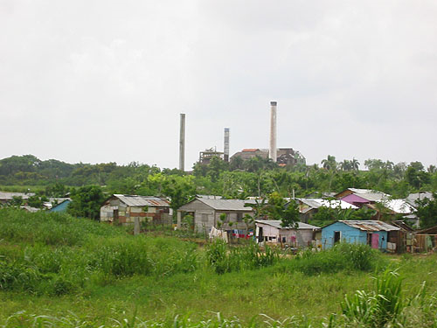
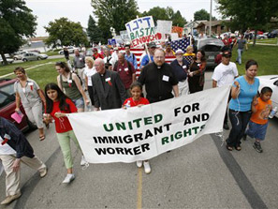
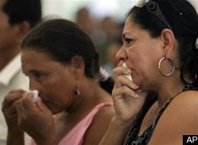

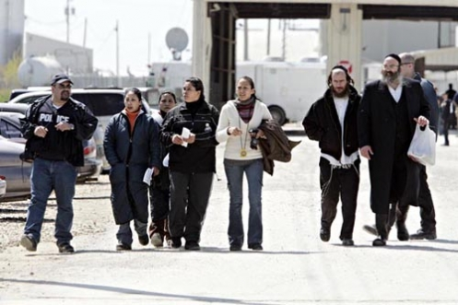
IMMIGRANT WOMEN WORKERS

Slide 3
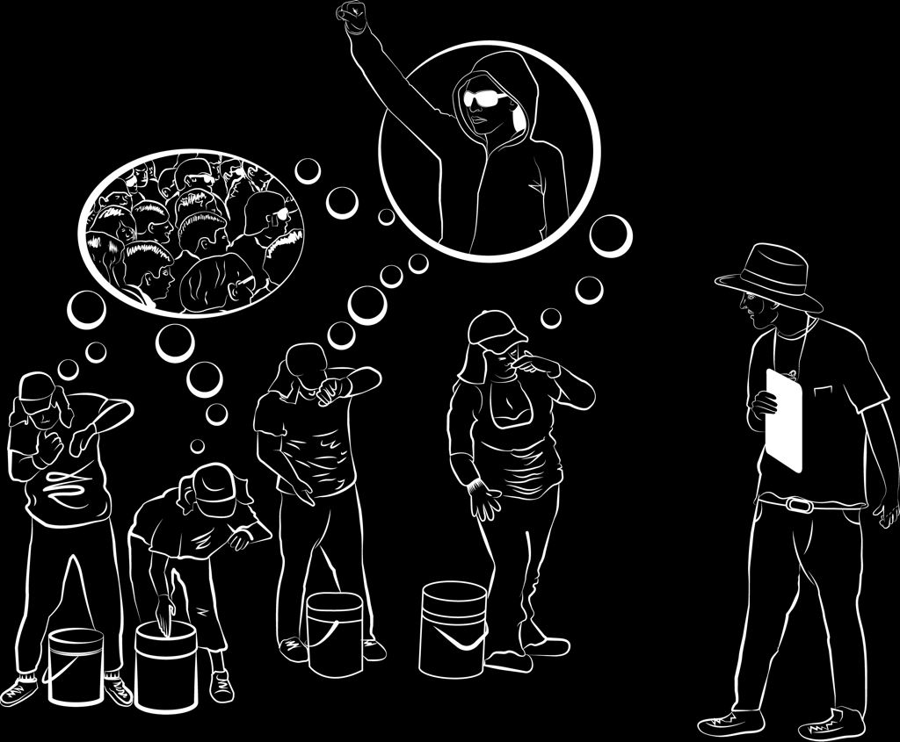
GOAL
To introduce participants to the dynamics of sexual violence in the workplace
  Identify risks
  Strategies for working
  with survivors
  Self- care
  Collaboration

Slide 4
Sexual Harassment preceding
Sexual Assault
In DeCoster, Swift and Postville all women endured sexual harassment in silence for weeks and months before they were sexually assaulted
The few that complained suffered retaliation and punishment through harder jobs, less hours of paid work, public humiliation, etc.
Sexual harassment is a red flag for further victimization

Slide 5
What are we talking about?
Sexual harassment is a form of sexual violence and gender violence
Sexual harassment must be addressed immediately and seriously because it is often a precursor to sexual violence in the form of rape
  Immigrant survivors report that supervisors or co-workers perpetrators had harassed and abused them multiple times before completing a rape during a period of time

Slide 6
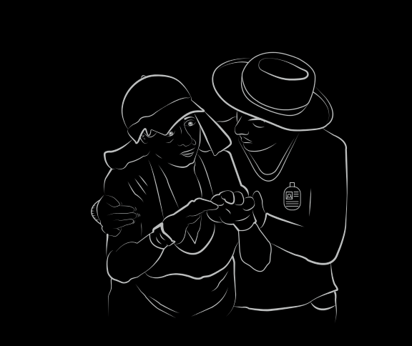
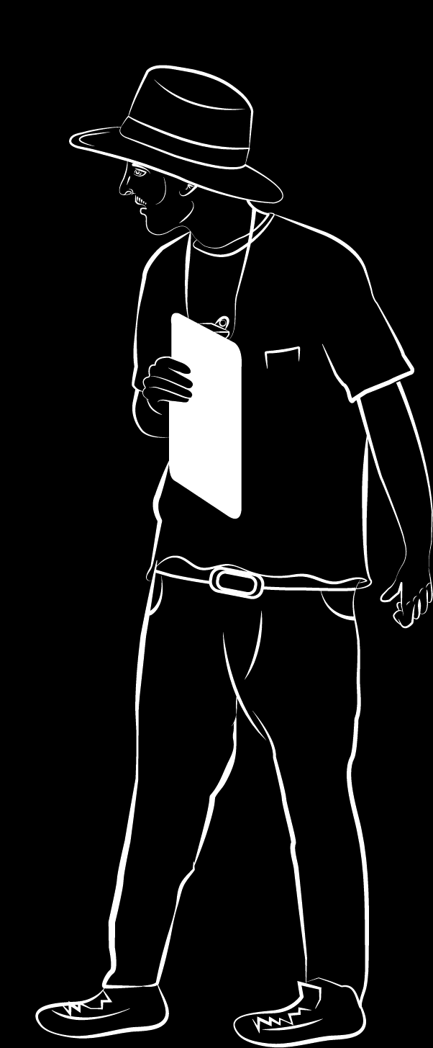
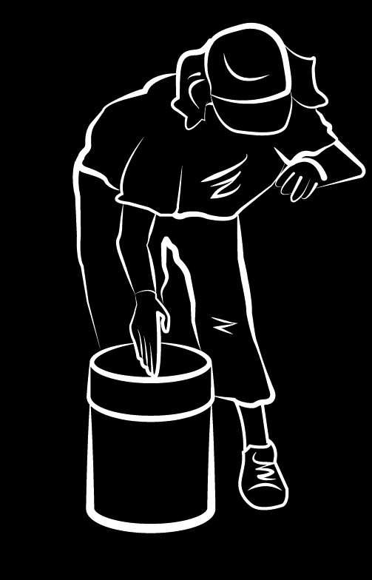
Why?
  Sexual violence in the workplace is fostered by an imbalance of power between employers, supervisors and their low wage immigrant workers- Human Rights watch- cultivating fear-
  Power: to hire or fire, retaliate and/or confer certain “benefits”
  Immigrant women are extremely vulnerable
  Immigrant women often face systemic barriers exacerbated by their status as blue collar workers, often unauthorized to work will NOT report these abuses nor bring perpetrators to justice

Slide 7
Parties
• Perpetrator may be
  man or woman
  of same sex
  supervisor, agent of
  employer, co-worker, third party
• Victim can be affected by the hostile work environment

Slide 8
Manifestations of SV in the Workplace
My friend told me that…

Slide 9
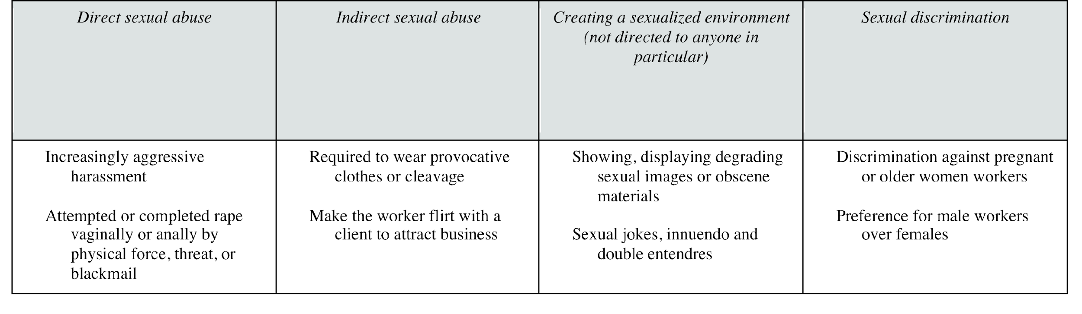
Test your Knowledge…

Slide 10
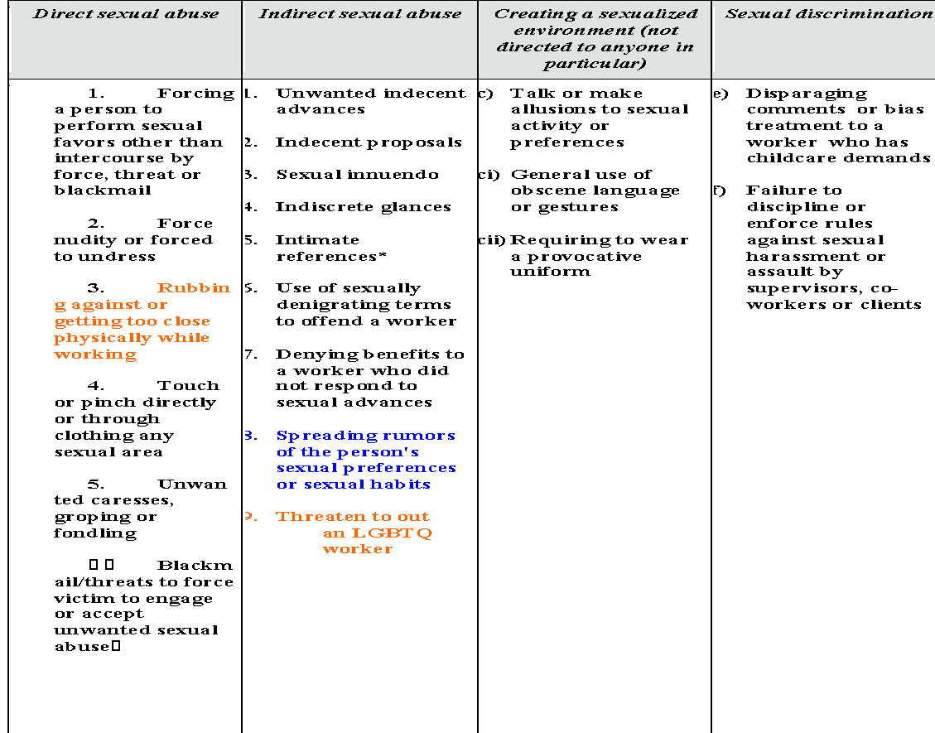

Slide 11
She “consented”…?
  Control is influencing someone to do something they would not otherwise do.
  Coercion is the act of getting someone to act or think in a particular way by using or threatening with negative consequences for noncompliance.
      * Better pay-raise
      * Improve working conditions
      * Scheduling
      * Getting/keeping a job for a family member
      * Not getting “punished”
      * Chisme
      * Avoid physical harm to self or others

Slide 12
Type of abuse/exploitation:
PHYSICAL
OTHER
Rape
Sexual assault
Sexual harassment
Retaliation
Sex trafficking
Stalking
Domestic violence
Pregnancies/Ownership
Pornography
Threats with physical harm
Voyeurism
Hostility
Intimidation, Verbal abuse
Black listing
Family members as targets
Recruitment under false pretenses-Fraud Recruitment
Heterosexual, Homosexual sex
Secondary trauma by other workers who are not target
Use of legal systems to control

Slide 13
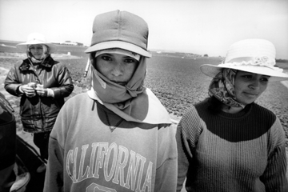
Identifying
the Risks

Slide 14
EXERCISE
IDENTIFYING THE RISKS
GOAL
Help participants identify the diverse range of risks or threats survivors are experiencing depending on the industry and to see where commonalities may arise regardless of the industry.
1. Think about a particular industry and looking at the table above
identify what kind of risks immigrant women may be more prompt to experience in that particular industry.
2. The following four industries may be suggested for this activity:
  a. Housekeeping
  b. Food processing
  c. Farm work
  d. Restaurant

Slide 15
BEATRIZ
BEATRIZ- HOUSE KEEPING

Slide 16
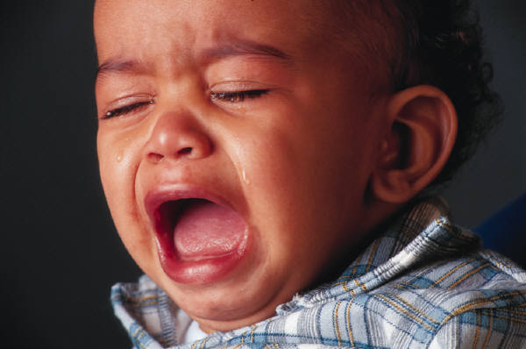






Risks of Reporting

Slide 17
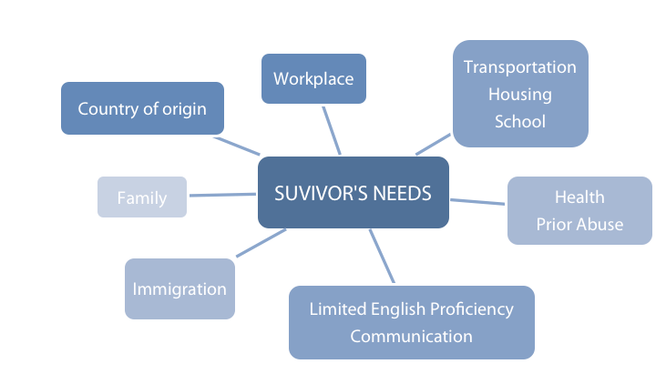
Strategies for Working with Survivors

Slide 18
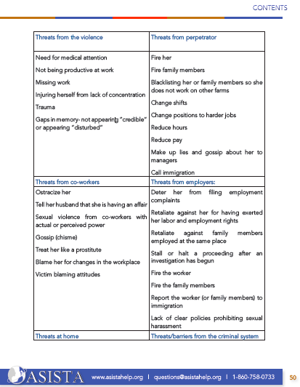
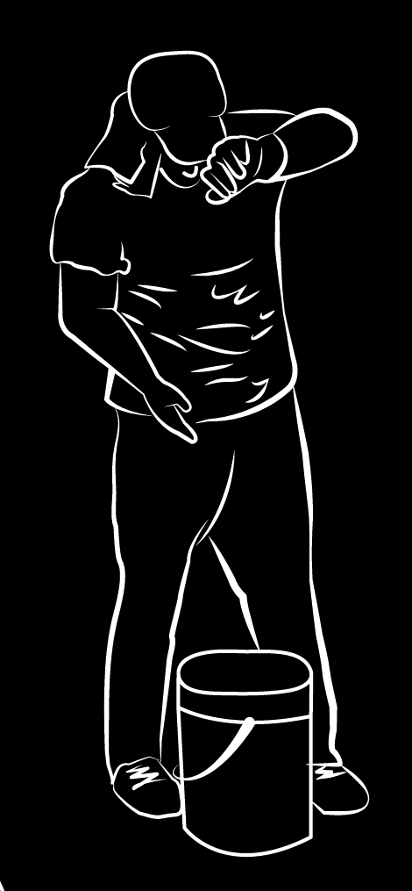
Safety first!

Slide 19
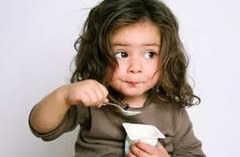
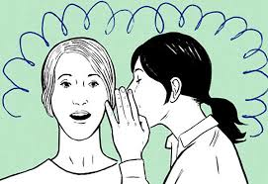
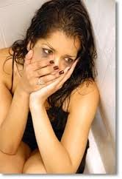
TALKING ABOUT IT
“INTERVIEWING TECHNIQUES”

Slide 20
Dealing With the Workplace
Does the survivor want to disclose?
What does the survivor need/want?
What are the relevant laws/policies that can help?
Who in the workplace will be an ally? Obstacle?
What is possible within the context of the particular workplace?

Slide 21
Interviewing immigrant women victims of workplace sexual violence
Exercise
Turn to the person seating next to you
The oldest will be the survivor, the youngest the advocate
In the next 5 minutes, share with the advocate your last consensual sex experience in detail

Slide 22

Strengthening your interviewing skills
A step removed
On sexual violence
Money
  Are they paying you all your hours, overtime?
  How are they treating your co-workers? Any complaints?
  What do you see?
Supervisors or anyone with perceived power
  How does your supervisor/co-workers treat you?
  Has anyone mistreated or disrespected your peers? How?
  Did any of it ever happen to you?
  Has your supervisor/Co-worker ever made you feel uncomfortable? If so, how?
Did you complain about it or talked about it to
  a trusted person in the office/company or a peer? Human resources representative? Union leader? Nurse? Anyone else?
Did any of your supervisors/co-workers ever ask you out or offer you to go to lunch, call you outside of work, invite you to give you a ride home before or after work?
  What happened if you said no? (potential punishment/retaliation)
  Did your supervisor/co-worker ever touch you in an offensive way or in any manner?
    How many times did it happen?
    Did anyone see it?
    Did this happen to you ever?
    Did you tell anyone about it?
    Did anyone see it?

Slide 23
When speaking about the instant incident
Ask in-depth questions
Provide prompts to get episodic memories
Provide choices
Probe with behavioral markers for issues that the client may fail to mention for any reason
Validate but do not collude with denial or minimization
Do not be judgmental
Normalize, educate, provide structure
Guide her to move forward, support small steps, support the vision for the future
Provide reality checks and clarity in judgment
Expand her options and alternatives

Slide 24
If abuse was ongoing
Ask about first, worst and last incident
Get information on the exact nature of the abuse
Find out about grooming
Find out about what she did, think, feel, and experience around the issue
Open the door for ambivalence
Ask about functioning before and after the instant incident or the first time
Ask not only about psychological symptoms but also interpersonal, social and health-related

Slide 25

Re-empower the victim
  Help her clarify what her bottom line is
  Help her make her own decisions
  Do not engage in a power struggle but be directive
  Focus on a violence-free life

Slide 26
  Self-Care for Advocates
  Adapted from “Understanding Vicarious Traumatization –
  Strategies for Social Workers” By Shantih E. Clemans, DSW Social Work Today,

Slide 27
The Importance of Self Care
What is Vicarious Trauma?
Cumulative effects of working with survivors of traumatic life events, such as rape, incest, child abuse, or domestic violence.
Three important things to know about VT are:
  VT manifests differently in each individual.
  VT is cumulative. The effect on helpers intensifies over time and with multiple clients.
  VT is pervasive. It affects all areas of helpers’ lives, including emotions, relationships, and their views of the world.

Slide 28
What are the signs of VT?
Feelings of vulnerability
  Hearing traumatic stories can cause a helper to question their own safety and feel that they and their loved ones are vulnerable.
Difficulty trusting
  After hearing accounts of abuse within intimate relationships—through battering, acquaintance rape, and child sexual abuse—trusting someone can be difficult.
A changed view of the world
  Interactions with traumatized people can change a helper’s ability and willingness to see the world as a good and safe place for themselves and those they love
    These feelings can lead to diminished empathy and resentment towards victims and isolation.

Slide 29
What can be done to minimize VT?
Know your A-B-C’s
  Awareness
  Balance
  Connection

Slide 30
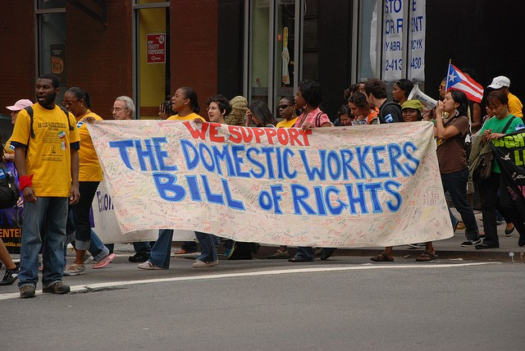
Integrating the labor movement and building new collaborations
WHY?

Slide 31
Whose Business is it Anyway?
SA programs:
Fewer resources
Lack of access to workplaces
“That is not part of my grant…”
  No direct connection or partnership with EEOC, Fair Agencies, Workforce development, employment attorneys, unions, etc.
Survivors:
  Lack knowledge about the services
  Concerned about losing their jobs if reporting
  Concerned about being deported if brought to law enforcement’s attention
Labor Advocates
  We do not do that stuff
  We help if she wants to file complaints
  I do not find these cases

Slide 32
Safety from the Labor Field
Unions
  Civil rights, women’s, and safety & health committees
  Union educators/trainers
  Labor mediators
  Engaging men as allies
  Manual
Businesses
  HR and EAP professionals
  Comprehensive programs, not just policies
  Pilot site project

Slide 33
Outreach/Training/TA Strategy
Advocates
  Assisting survivors to maintain employment
  Working with workplaces as a partner
  Trainings
Federal government
  Policies and training/TA
  EEOC fact sheet and trainings for advocates

Slide 34
Approach
Encourage workplaces to recognize, respond and refer, and implement preventative measures for future
Proactive framework that is survivor-centered and ensures accountability for perpetrators
Multi-stakeholder

Slide 35
In Nebraska
Who do you need to know?

Slide 36
QUESTIONS?

Slide 37
Coming up!

Slide 38
Responding to the Needs of Immigrant Workforces Victims of Sexual Harassment and/or Assault
Meaningful alliances

