Slide 1

Forging Futures Without Violence Challenging sexual violence against immigrant women in the workplace
Presented by: Carly Beusch, Jennifer Cooley, Giselle Hass, Abbie Kretz & Sonia Parras Konrad.
This document was supported by a grant from Raliance, a collaborative initiative to end sexual violence in one generation, made possible through a commitment from the National Football League (NFL). Its contents are solely the responsibility of the authors and do not necessarily represent the official views of the NFL.

Slide 2
OVERALL GOAL OF THE PROJECT
To forge a partnerships between labor and anti-violence advocates that create models to challenge and eradicate sexual violence in the workplace against immigrant women

Slide 3
TODAY
Explore how sexual violence manifests in the lives of immigrant women
Evaluate survivor’s history of victimization
Introduction on considerations when working with survivors of traumatic experiences

Slide 4
ABOUT THE PROJECT
Introduction of partners
Why?
The road ahead
Sexual Violence as Gender Violence Against Immigrant Women

Slide 5
Heartland Workers Center

Slide 6

Mission
To improve the quality of life of Latino/a immigrant workers.
Vision
To build a community that works for all.

Slide 7
How
Community Organizing
Leadership Development
Civic Engagement
Workers Rights

Slide 8

The Nebraska Coalition to End Sexual and Domestic Violence is a statewide advocacy organization committed to the prevention and elimination of sexual and domestic violence.
We work to enhance safety and justice for victims of domestic violence and sexual assault by supporting and building upon the services provided by our network of local programs.

Slide 9
The Role of the Nebraska Coalition
The Nebraska Coalition was established in 1976 to support the Network of Programs in Nebraska through:
Training
Technical Assistance
Direct legal services to survivors
Pass through funding
Legislation and policy
Establishment of program standards

Slide 10
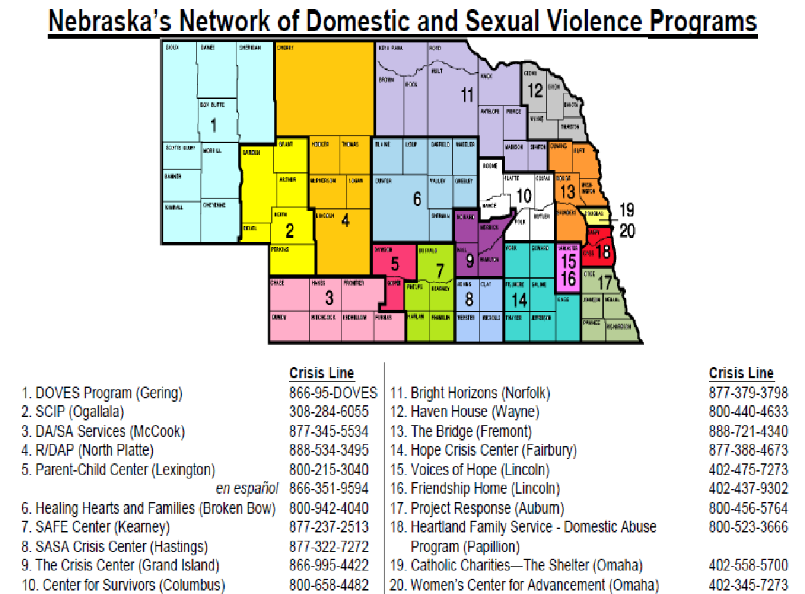

Slide 11
Nebraska DV/SA Program Services
24 hour crisis line
Legal referrals and assistance with Protection Orders
Emergency shelter
Ongoing support and information
Transportation
Education and prevention programs
Medical advocacy and referrals
Additional services may be available depending on size of program

Slide 12
Consulado de Mexico
Ventanilla de la Mujer

Slide 13
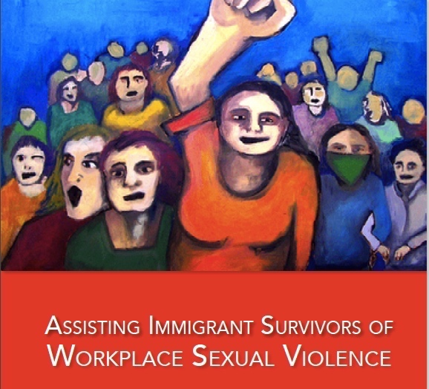
Stop Workplace Sexual Violence!
A guide for advocates, organizers and leaders
to advance immigrant women’s gender equality rights in the workplace

Slide 14
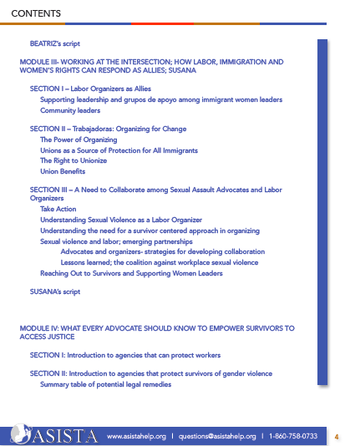
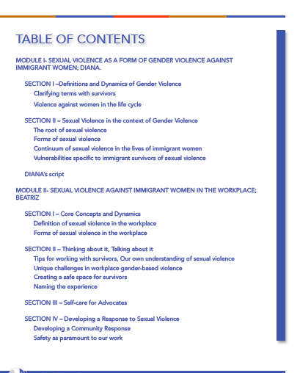

Slide 15
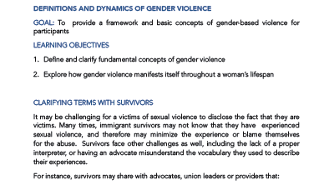
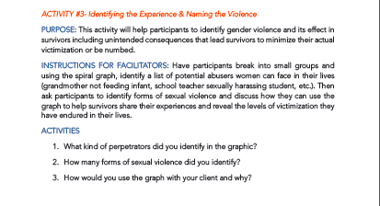
The Method

Slide 16
Integrating the labor movement and building new collaborations
WHY?

Slide 17
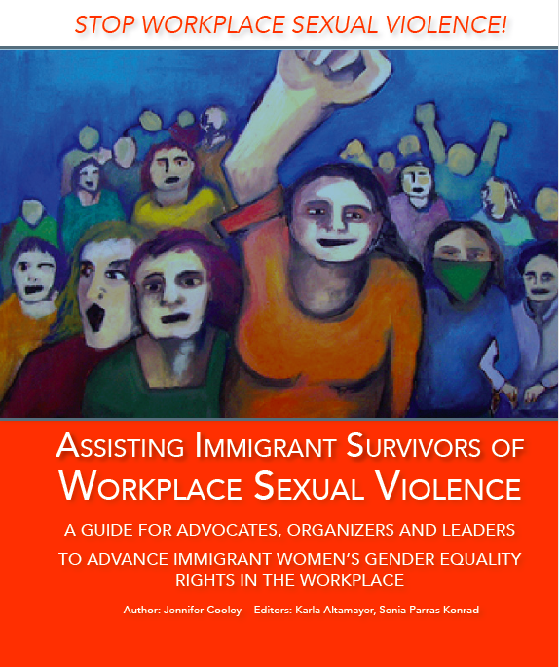
What’s new and different about these tools?
Why are they better?
`

Slide 18
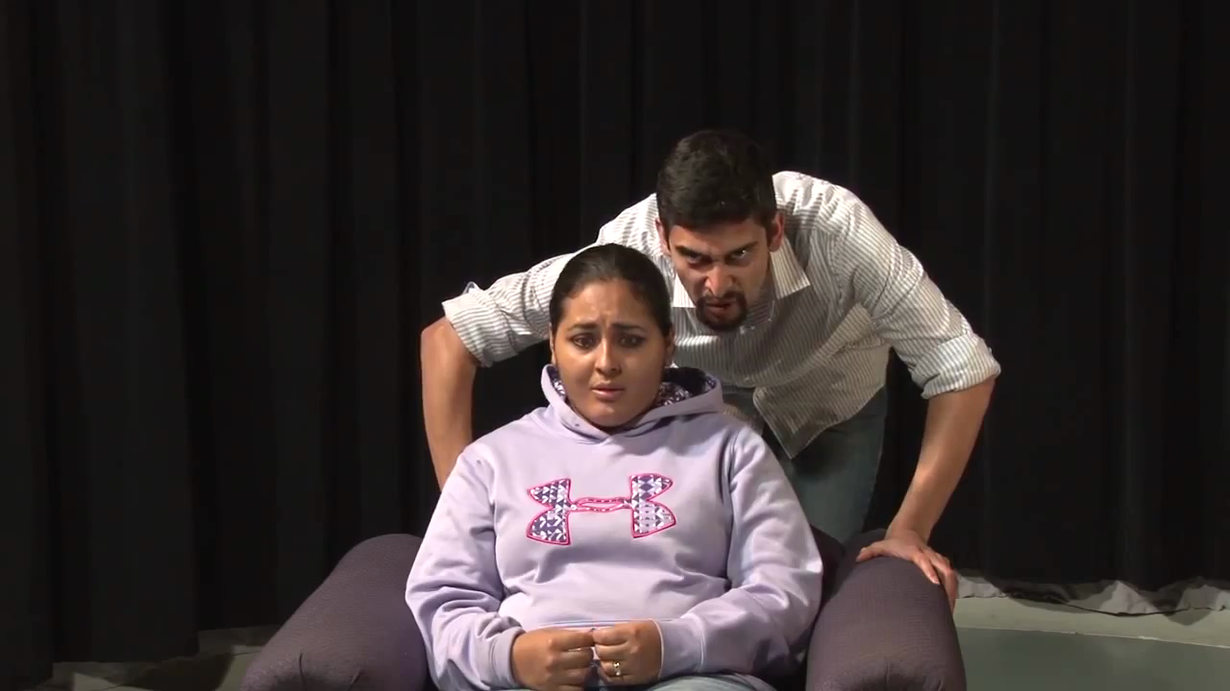
IF WE CAN PLAY VIDEO
VIDEO CLIP HERE

Slide 19
The “Theatre of the Oppressed” model (Augusto Boal)
Interactive responses to short performances based on real-life stories.
Methods designed by Brazilian director and activist, Augusto Boal.
Theater is an ideal way express how oppression impacts us and to seek creative, collaborative solutions to social injustices.

Slide 20
Forum Theatre
Our specific methods reflect Boal’s “Forum Theatre” practices.
Break down the barrier between actors and spectators, engage as “spect-actors” in initiating responses to oppression.
Strategies and solutions, means to advocate and collaborate emerge through group interaction.

Slide 21
Applications for SV Training & Education
Factual content, yet low-impact on survivors
Our performances are based on ethnographic research conducted with migrant women who faced sexual violence in the workplace.
By reenacting these scenes with actors and offering them in a digital format, no survivor is forced to recount her experiences multiple times. https://www.youtube.com/watch?v=mojfJVd-lAQ&list=PLTifzqDcaHT3XFuM9XxjEOmGSFh3wZtI6&index=4 - Survivor-actor same sex perpetrator

Slide 22

Sexual Violence as Gender Violence Against Immigrant Women

Slide 23
Violence Against Women
Our work focuses on restoring agency to women
Understanding the contextual nature of violence against women during her life cycle is crucial to resolving trauma and restoring agency.
Violence against women is a world wide phenomenon occurring in all communities and groups.

Slide 24
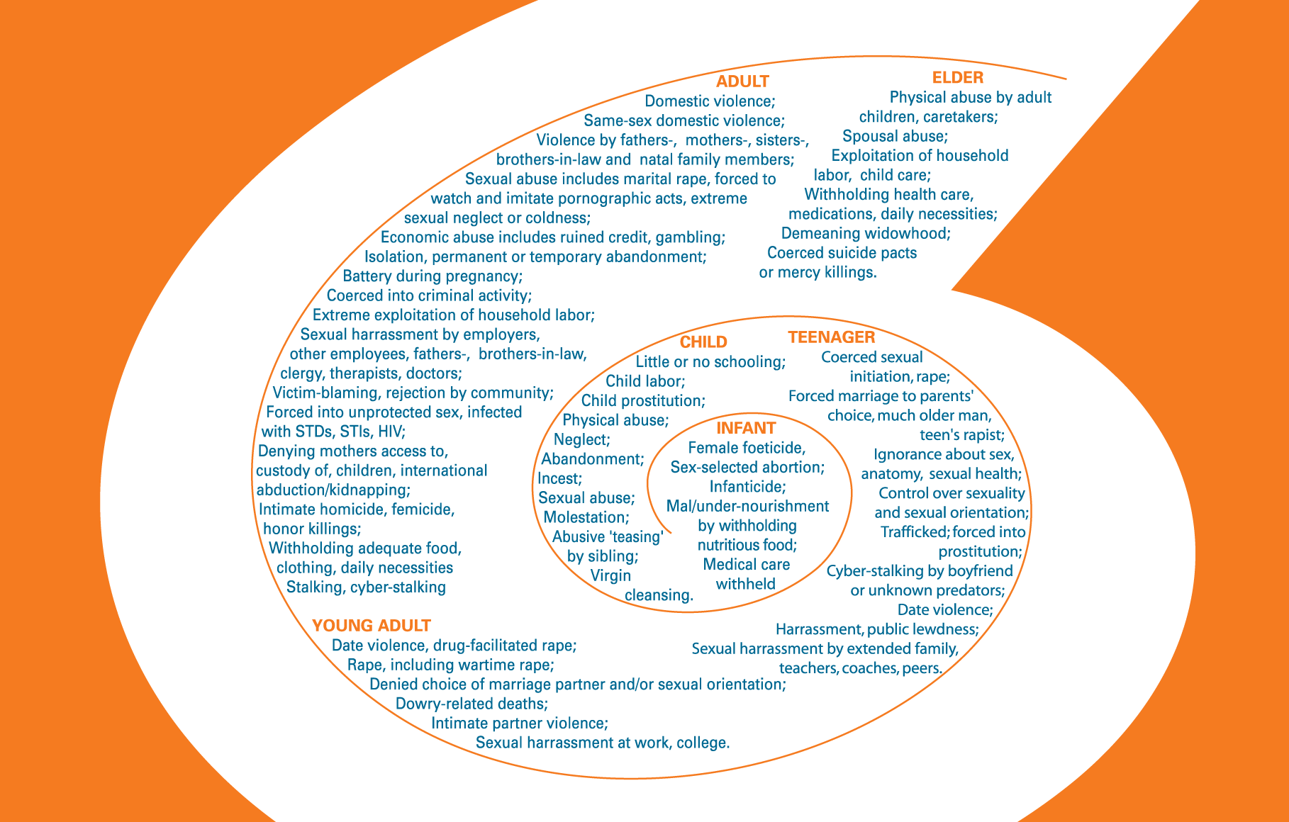
Asian Pacific Islander Institute “The Spiral of Violence”

Slide 25
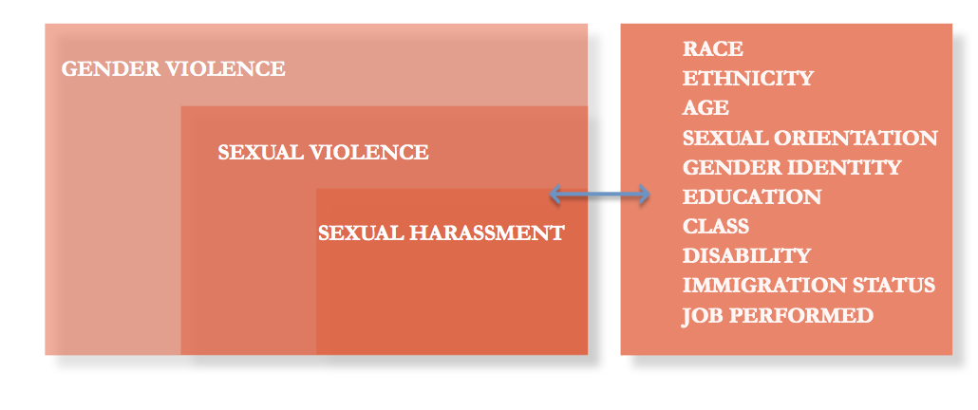
Sexual Violence in the Context of Gender Violence

Slide 26
Consent
EXERCISE:
WHAT DO YOU MEAN BY CONSENT?

Slide 27
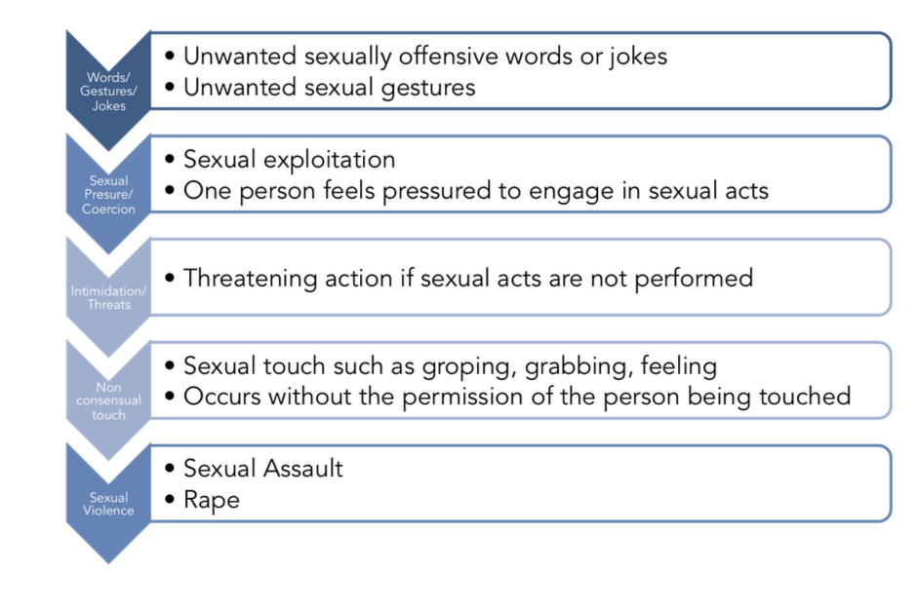
Sexual Violence in the Context of Gender Violence

Slide 28
Immigrants Face Vulnerabilities in all Phases of immigration
Immigrants, especially women, are vulnerable to violence during all phases of migration:
At home
When being recruited for migrant work
While in transit
At home by partners or family members
And, once in the destination country – at work

Slide 29
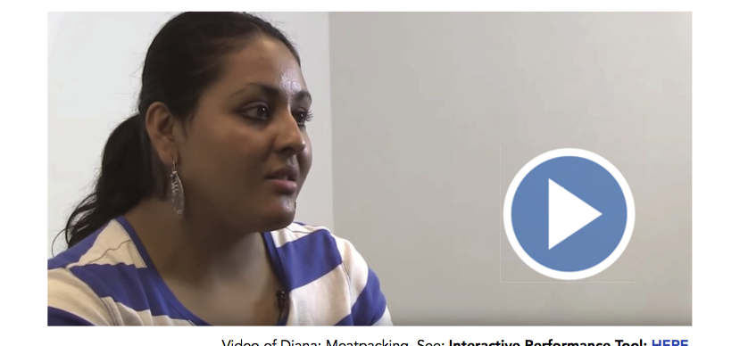
Diana’s Vulnerabilities

Slide 30
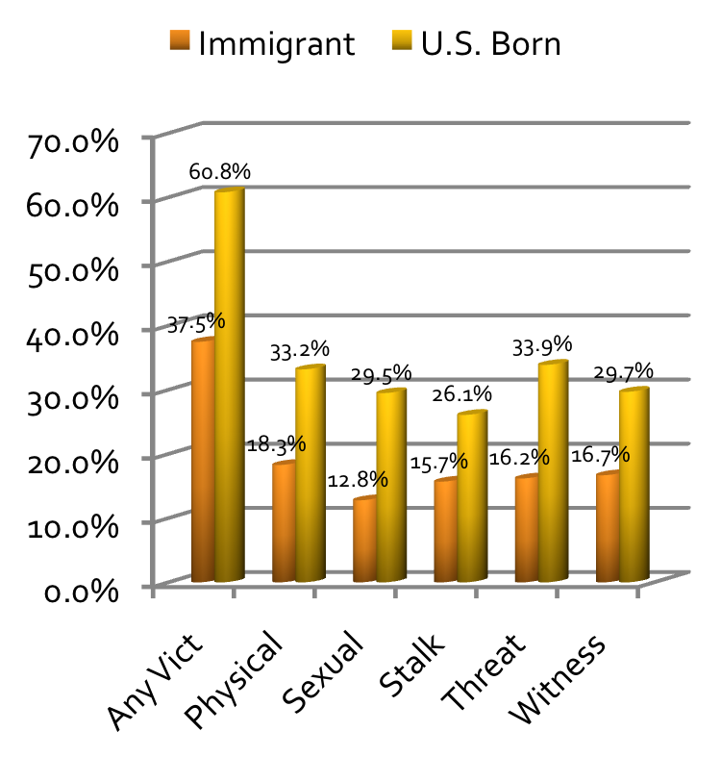
Cultural Factors and Victimization
Any Vict
Physical
Sexual
Anglo
Acculturation
Stalk
Threat
Witness

Slide 31
Help Seeking
77% of victimized women sought some type of help, either formal or informal, or both
More Common
Informal help-seeking more common than formal help-seeking.

Slide 32
Impact of Sexual Crime in the Lives of Immigrant Women
.

Slide 33
Invite the Survivor to Write/Tell Her Story
You have to provide a safe environment, without judgment
Bear witness to her experiences
Provide support and validation

Slide 34
Coercion
Perpetrators of coercion intimidate victims by creating fears, credible to the victim, of disastrous consequences if they do not obey or acquiesce to the abuse. This creates a great deal of anxiety and fear.

Slide 35

Key Principles
Being victimized or exposed to victimization is stressful for everyone.
Undergoing a stressful situation
leaves consequences:
positive and/or negative.

Slide 36
Distress from Abuse Accumulates
Frequency
Intensity
Nature

Slide 37

Pre-trauma vulnerability:
- previous trauma,
- mental health,
- personality traits,
- age,
- gender,
- culture,
physical health and impairments

Slide 38
Preparedness for the event
Sequential stressors
Quality of the immediate and short term responses:
- social support
Institutional response
Post event recovery factors

Slide 39

What is Trauma?
Symptoms that reflect a person’s inability to come to terms with real experiences that have overwhelmed their capacity to cope
Stress of extreme proportions
“The critical element that makes an event traumatic is the subjective assessment by the victim” (of how threatened and helpless they felt).”

Slide 40
Emotional consequences
Anxiety symptoms: panic, dissociation, fragmentation of bodily experience
Flashbacks, memories, acting as if threat was still occurring
Hypervigilance and heightened arousal
Increased risk of alcohol/drug use
Poor impulse control-problems with irritability or anger
Depression likely to follow

Slide 41

Long Term Consequences
Low self-esteem
Impaired self-perception
Tendency for somatization
Difficulties with decision-making
Difficulties to manage emotions
Irrational thoughts
Difficulties to trust others
Behavioral problems

Slide 42
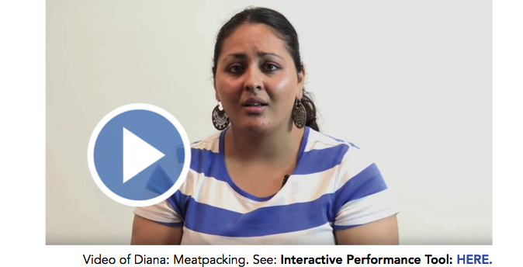
Diana’s Challenges

Slide 43

NEED TECHNICAL ASSISTANCE?
www.asistahelp.org
questions@asistahelp.org
sonia@asistahelp.org
manager@asistahelp.org
Other Resources:
Heartland Worker’s Center: abbie@heartlandworkerscenter.org
Nebraska Coalition to End Sexual and Domestic Violence: carlyb@nebraskacoalition.org
ASISTA@2017. All Rights Reserved
Copyright © 2015 ASISTA – All Rights Reserved

