Slide 1
Evaluating chw work

Slide 2
Quick start
Why have CHW-specific evaluation practices?
Documents for evaluating CHW performance
Evaluations with client input

Slide 3
Why chw-specific evaluation?
Conventional mechanisms for monitoring worker productivity (e.g. clocking in/out, time tracking) do not always capture complexities of CHW work
Community-engaged work tends to show dividends more slowly

Slide 4
Go slow to go fast
Community-engaged research often requires extended timelines, particularly at project onset
  Establishing communication and trust is key, with one researcher calling this phase “go slow, to go fast”¹
Likewise, CHW work can require considerable time for outreach and trust-building
1, Pinsoneault LT, Connors ER, Jacobs EA, Broeckling J. Go Slow to Go Fast: Successful Engagement Strategies for Patient-Centered, Multi-Site Research, Involving Academic and Community-Based Organizations. J Gen Intern Med. Jan 2019;34(1):125-131. doi:10.1007/s11606-018-4701-6

Slide 5
How not to evaluate chws
Avoid requiring or depending upon
  Early evidence of impact in terms of cost savings or numbers of people helped
  Hours spent in any particular setting
  Encounter or intake forms alone

Slide 6
Understand chw work
CHWs in the field often encounter employer concerns about wasting time and engaging in leisure activities during their workday
Outside understandings of work may miss how a CHW is building trust and relationships

Slide 7
evaluation principles
Research suggests that evaluation of CHW work should acknowledge that
  CHWs must be adequately supported in their work to succeed
  CHW work can be measured with a number of different metrics
  Community transformation can result from CHW work but may not be immediately visible

Slide 8
Chw evaluation framework
CHW-level outputs
e.g. service delivery and quality, data reporting
Community-level outcomes
Program processes
e.g.
supervisory support, recruitment, training
Community-level outcomes e.g. service use, referrals, care experiences
CHW-level outputs
Community-centered care & improved health outcomes
Inputs
Figure modified from Agarwal S, Sripad P, Johnson C, et al. A conceptual framework for measuring community health workforce performance within primary health care systems. Human Resources for Health. 2019/11/20 2019;17(1):86. doi:10.1186/s12960-019-0422-0

Slide 9
Questions to ask chws
Process: How did you identify client needs and find resources? How did the organization support (or not) your outreach and activities?
Impact: Were there actions taken or situations resolved? What were they?
Outcomes: Was there improvement in the client or client’s situation?

Slide 10
Documents for evaluation

Slide 11
When to consider
When there are not pre-established documentation procedures (e.g. when billing Medicaid for CHW services)

Slide 12
Time logs
Many advocate for time logs to periodically or consistently track CHW activities, which might seem to allow for flexibility and nod to the wide number of services CHWs can provide
DATE | START TIME | STOP TIME | TOTAL TIME | TASKS COMPLETED

Slide 13
Question
What potential problems do you see with this type of time log? Could you fill out one of these logs for your job? What information would it give—or not give—you?

Slide 14
Problems with standard time logs
Such documentation is arduous
  CHW must note time, record patient name, and describe activities and further actions
Standard logs provide very little information beyond proving that a CHW was working during a certain amount of time, and may not include things like:
  Performance assessment, understanding of client status, and potential follow-up activities

Slide 15
Improved time log
This example does not ask for start and stop times, merely total time spent on an activity.
Includes potential activities pre-populated in form
Does not provide client-specific information or performance assessment information
 | DATE | DATE | DATE | DATE | DATE | DATE | DATE | Total hours per activity
ACTIVITIES
Phone or email outreach
Face-to-face outreach
Medical visit
Teaching skills
Providing information
Providing personal assistance
The purpose of this time log is essentially to determine 1) the amount of time spent on tasks and 2) to ensure that CHWs are working

Slide 16
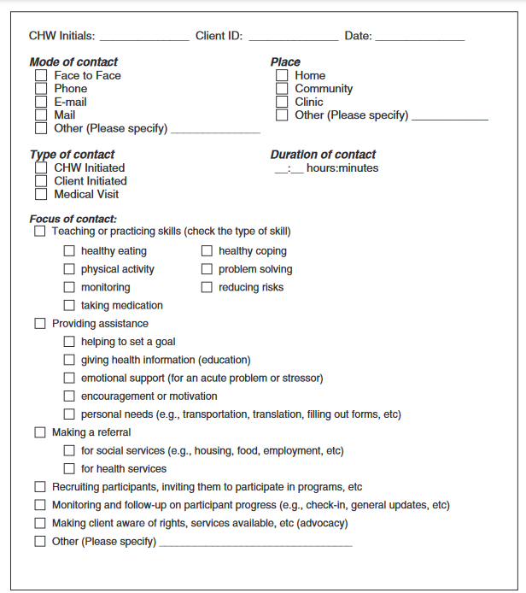
Another work log
One study by Davis et al. 2007 recognized these issues and built an alternative work log¹ that
  Reduced burden on CHWs by including pre-populated areas
  Provided client-specific information
  Primarily focused on CHW deliverables rather than time spent
Davis KL, O'Toole ML, Brownson CA, Llanos P, Fisher EB. Teaching How, Not What. The Diabetes Educator. 2007/06/01 2007;33(S6):208S-215S. doi:10.1177/0145721707304133

Slide 17
However
Another researcher noted that these logs “were not designed to monitor daily activities, provide information for ongoing supervision, or guide interactions between CHWs and their patients.”²
Lemay CA, Ferguson WJ, Hargraves JL. Community Health Worker Encounter Forms: A Tool to Guide and Document Patient Visits and Worker Performance. Am J Public Health. 2012;102(7):e70-e75. doi:10.2105/ajph.2011.300416

Slide 18
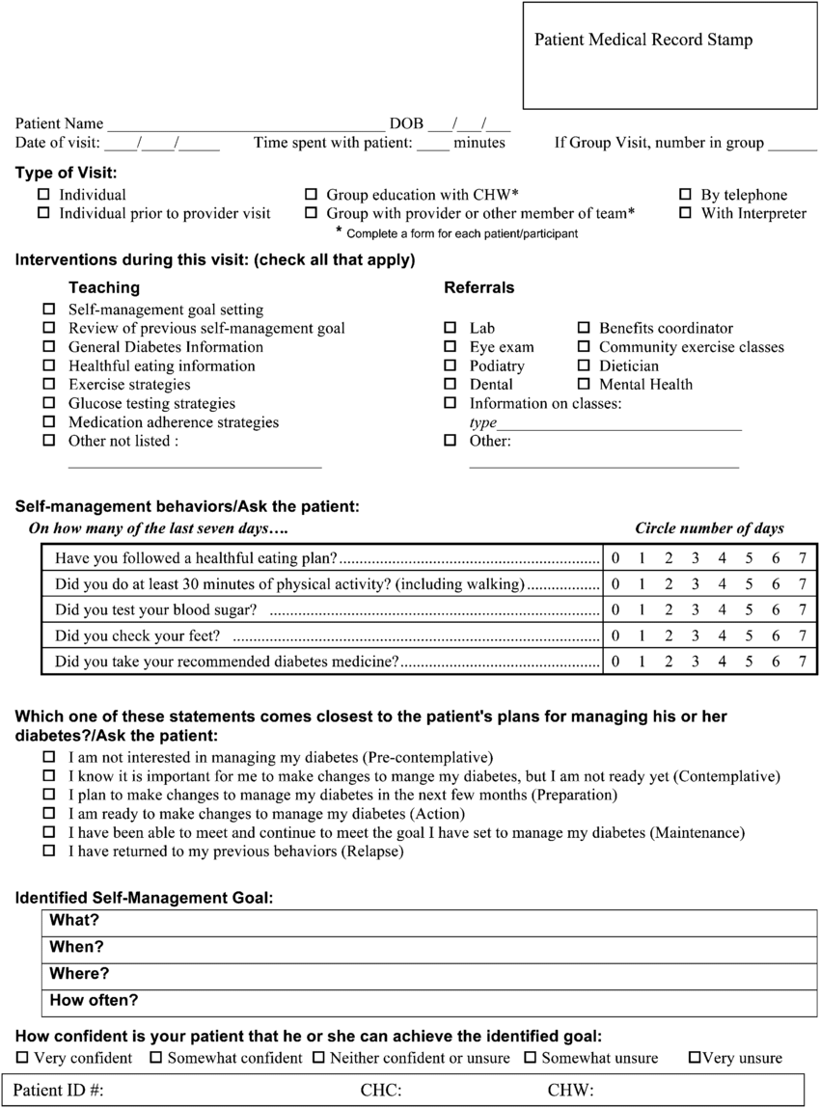
encounter forms
That same study observed CHWs across 6 community health centers for 13 months. The CHWs used encounter forms to record types of encounters, CHW activities, and indicate where clients felt in terms of improving their self-management²
Lemay CA, Ferguson WJ, Hargraves JL. Community Health Worker Encounter Forms: A Tool to Guide and Document Patient Visits and Worker Performance. Am J Public Health. 2012;102(7):e70-e75. doi:10.2105/ajph.2011.300416

Slide 19
Benefits of encounter forms
Were co-developed by researchers and CHW supervisors and refined based on CHW input
Allowed supervisors to identify areas where CHWs could use additional training
CHWs were able to use these forms as a guide for client encounters
Standardized documentation makes reimbursement easier

Slide 20
Developing an encounter form
Encounter forms should be tailored to a specific project
Authors of original encounter form encourage modifications of their encounter forms to fit other CHW programs

Slide 21
alternatives
Work logs pre-populated with activities not included in direct client contact (e.g. meetings, calls to services, etc.)
Provide CHWs with a project-specific cell phone that allows them to track client calls, time spent, and add information / reimbursement requests to Google forms or similar

Slide 22
resources
Encounter forms described in this presentation (LeMay et al., 2012)
Additional sample encounter forms from Boston University School of Social Work
Patient Activation Measure® (PAM®) is a paid service that tracks patient engagement with their health. This tool provides quantified data (levels/scores) for user-designated metrics
The Rural Health Information Hub (RHIhub) suggests other data tracking mechanisms potentially of use, including group education session documentation, surveys, and interviews

Slide 23
Evaluations with client input

Slide 24
Asking clients
After establishing a CHW program, consider surveying your client base to gather quantitative data on CHW performance. We suggest that you link performance to CHW competencies used in your state. Some potential survey questions include:
  Did you feel that your CHW cared about your health or circumstances?
  Did the CHW help motivate you to make changes in your health or circumstances?
  Did the CHW share information about your situation with you?
  Did the CHW follow up with you after initial visits?
  Did the CHW refer you to other services and resources?

Slide 25
Questions to ask clients
Another method to consider is qualitative data gathering (e.g. interviews, focus groups). This can offer richer detail and capture nuance in a way that cannot be done with a survey. Potential sample questions include:
  What is the CHW helping you with?
  Are you being helped?
  What do you feel has changed in your situation?
  Do you feel differently about your situation than when you begun working with the CHW?

Slide 26
references
Bell M, Lewis N. Universities claim to value community-engaged scholarship: So why do they discourage it? Public Understanding of Science. 2023;32(3):304-321. doi:10.1177/09636625221118779
Pinsoneault LT, Connors ER, Jacobs EA, Broeckling J. Go Slow to Go Fast: Successful Engagement Strategies for Patient-Centered, Multi-Site Research, Involving Academic and Community-Based Organizations. J Gen Intern Med. Jan 2019;34(1):125-131. doi:10.1007/s11606-018-4701-6
Agarwal S, Sripad P, Johnson C, et al. A conceptual framework for measuring community health workforce performance within primary health care systems. Human Resources for Health. 2019/11/20 2019;17(1):86. doi:10.1186/s12960-019-0422-0
Lemay CA, Ferguson WJ, Hargraves JL. Community Health Worker Encounter Forms: A Tool to Guide and Document Patient Visits and Worker Performance. Am J Public Health. 2012;102(7):e70-e75. doi:10.2105/ajph.2011.300416
Davis KL, O'Toole ML, Brownson CA, Llanos P, Fisher EB. Teaching How, Not What. The Diabetes Educator. 2007/06/01 2007;33(S6):208S-215S. doi:10.1177/0145721707304133

