Slide 1
Chws and client data

Slide 2
About this section
This section discusses data specifically collected about clients (e.g. for intake, summative project evaluation, grant proposals). A few slides overlap with “Evaluating CHWs,” which discusses documentation that allows employers to track and evaluate CHW performance.

Slide 3
Best practices for client data

Slide 4
Why collect this data?
Before embarking on data collection, consider why your organization needs to collect data
  For grant requirements
  To ensure that things are going well
  To count and capture return on investment
  To get additional funds to support clients

Slide 5
Data purpose
Understanding the why of data collection is vital to
  Ensure that you only collect data that will be needed
  Identify what types of data will be needed and how it will be best to collect them

Slide 6
data type
What type of data should be collected? Is all the data to be collected quantifiable (i.e. numerical), or is there room to collect qualitative data to allow for richer detail and nuance that is often inherent in community-engaged work?

Slide 7
How to collect data
How should the data be collected? In clinical settings, time for charting is generally considered as part of patient load and therefore built into employee workload
However, in other settings like community-based organizations (CBOs) or non-governmental organizations (NGOs), the time required can be overlooked

Slide 8
Client confidentiality
Client confidentiality is always forefront, but particular care should be taken among populations whose safety and status is more tenuous, e.g. undocumented immigrants
If information such as immigration status must be collected (e.g. to address housing, employment), best ethical practices suggest limiting the recording of this information to verbal discussion and/or indirect phrasing such as “ineligible for insurance” in the written record

Slide 9
Intake forms

Slide 10
Why an intake form?
Intake forms are screening tools that help establish client baselines and provide key insight into their needs. Organizations may wish to consider including a brief section to collect demographics on these forms to capture data on an organizational level
Featured intake forms are described and linked in this section. Please note that these have not been reviewed by the authors of this toolkit and are provided for information only

Slide 11
Intake form examples
Protocol for Responding to and Assessing Patients’ Assets, Risks, and Experiences (PRAPARE): This two-page screening tool was specifically developed to address the social determinants of health and can be used to develop care plans. An implementation and action toolkit is also available to provide best practices and resources regarding the tool’s implementation.
Social Needs Screening Tool: This simple screening tool was developed by the American Academy of Family Physicians through the EveryONE project to screen for five core health-related needs.

Slide 12
Other intake forms
Social Needs Screening Toolkit by Health Leads: A screening toolkit that is editable for different interventions and areas of concerns. A graphical version of the tool is available here, while another version that includes reading level comprehension and validation information for the questions is available here.
A Review of Tools to Screen for Social Determinants of Health in the United States: This practice brief from the Institute of Medicine surveyed nine screening tools to identify common domains and provide recommendations for use.

Slide 13
Encounter forms: Data focused on ongoing care

Slide 14
What are encounter forms?
Pre-populated documents that can be used to
  Record CHW activities (type and place of encounter, interventions performed during visit)
  Help guide CHWs during encounters through pre-determined questions

Slide 15
Why are they useful?
Encounter forms help organizations
  Track CHW activities and interventions
  Inform future outreach
  Standardize documentation for reimbursement / funding applications
  Identify CHW training needs
  Track client progress towards self-management and self-care

Slide 16
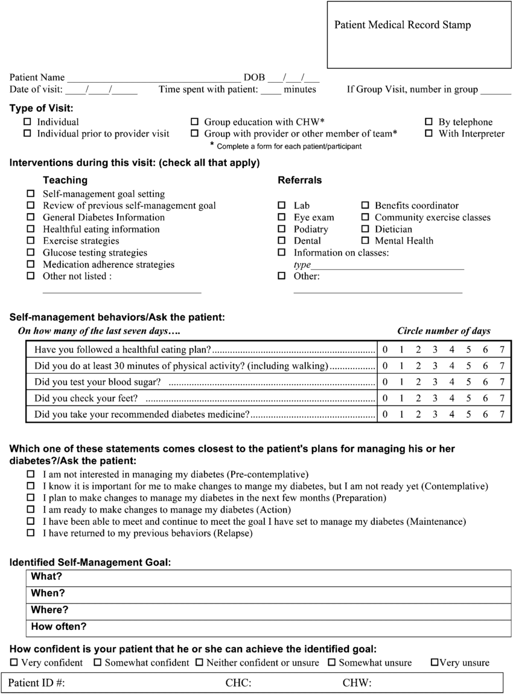
encounter forms
Sample encounter form to the right was co-developed by researchers and CHW supervisors and refined based on CHW input
Lemay CA, Ferguson WJ, Hargraves JL. Community Health Worker Encounter Forms: A Tool to Guide and Document Patient Visits and Worker Performance. Am J Public Health. 2012;102(7):e70-e75. doi:10.2105/ajph.2011.300416

Slide 17
creating an encounter form
Encounter forms should be tailored to specific projects
Authors of the previous encounter form encourage modifications of their encounter forms to fit other CHW programs

Slide 18
resources
Encounter forms described in this toolkit (LeMay et al., 2012)
Additional sample encounter forms from Boston University School of Social Work
Patient Activation Measure® (PAM®) is a paid service that tracks patient engagement with their health. This tool provides quantified data (levels/scores) for user-designated metrics
The Rural Health Information Hub (RHIhub) suggests other data tracking mechanisms potentially of use, including group education session documentation, surveys, and interviews

Slide 19
Chw notes
CHWs often keep informal notes (notebooks or tablets, phone notes, voice memos) for their own use
Such notes are typically for CHW use only and should not replace encounter forms
If organizations wish to retrospectively collect a certain kind of data, CHW notes may be useful, however . . .

Slide 20
Client confidentiality
CHWs, especially those who work with populations at-risk of deportation, may be concerned that wholesale note sharing could compromise client safety
For that and other client confidentiality reasons, only request pseudonymized or generalized notes with identifying details removed

Slide 21
references
McCarthy M, Barry K, Estrada C, et al. Recruitment, Training, and Roles of the Bilingual, Bicultural Navegantes: Developing a Specialized Workforce of Community Health Workers to Serve a Low-Income, Spanish-Speaking Population in Rhode Island. Community Case Study. Frontiers in Public Health. 2021-June-04 2021;9doi:10.3389/fpubh.2021.666566
Wennerstrom A, Haywood CG, Smith DO, Jindal D, Rush C, Wilkinson GW. Community health worker team integration in Medicaid managed care: Insights from a national study. Front Public Health. 2022;10:1042750. doi:10.3389/fpubh.2022.1042750
Ballard M, Odera M, Bhatt S, Geoffrey B, Westgate C, Johnson A. Payment of community health workers. The Lancet Global health. Sep 2022;10(9):e1242. doi:10.1016/s2214-109x(22)00311-4
Cherrington A, Ayala GX, Elder JP, Arredondo EM, Fouad M, Scarinci I. Recognizing the diverse roles of community health workers in the elimination of health disparities: from paid staff to volunteers. Ethn Dis. Spring 2010;20(2):189-94.
Community Health Worker (CHW) Toolkit: A Guide for Employers. 2016. https://www.health.state.mn.us/facilities/ruralhealth/emerging/chw/docs/2016chwtool.pdf
Community Health Workers in Vermont: Professional Identity Snapshot. 2020. https://www.chcf.org/wp-content/uploads/2021/02/CHWsVermontProfessionalIdentitySnapshot.pdf

