Slide 1

Governance Slides

Slide 2
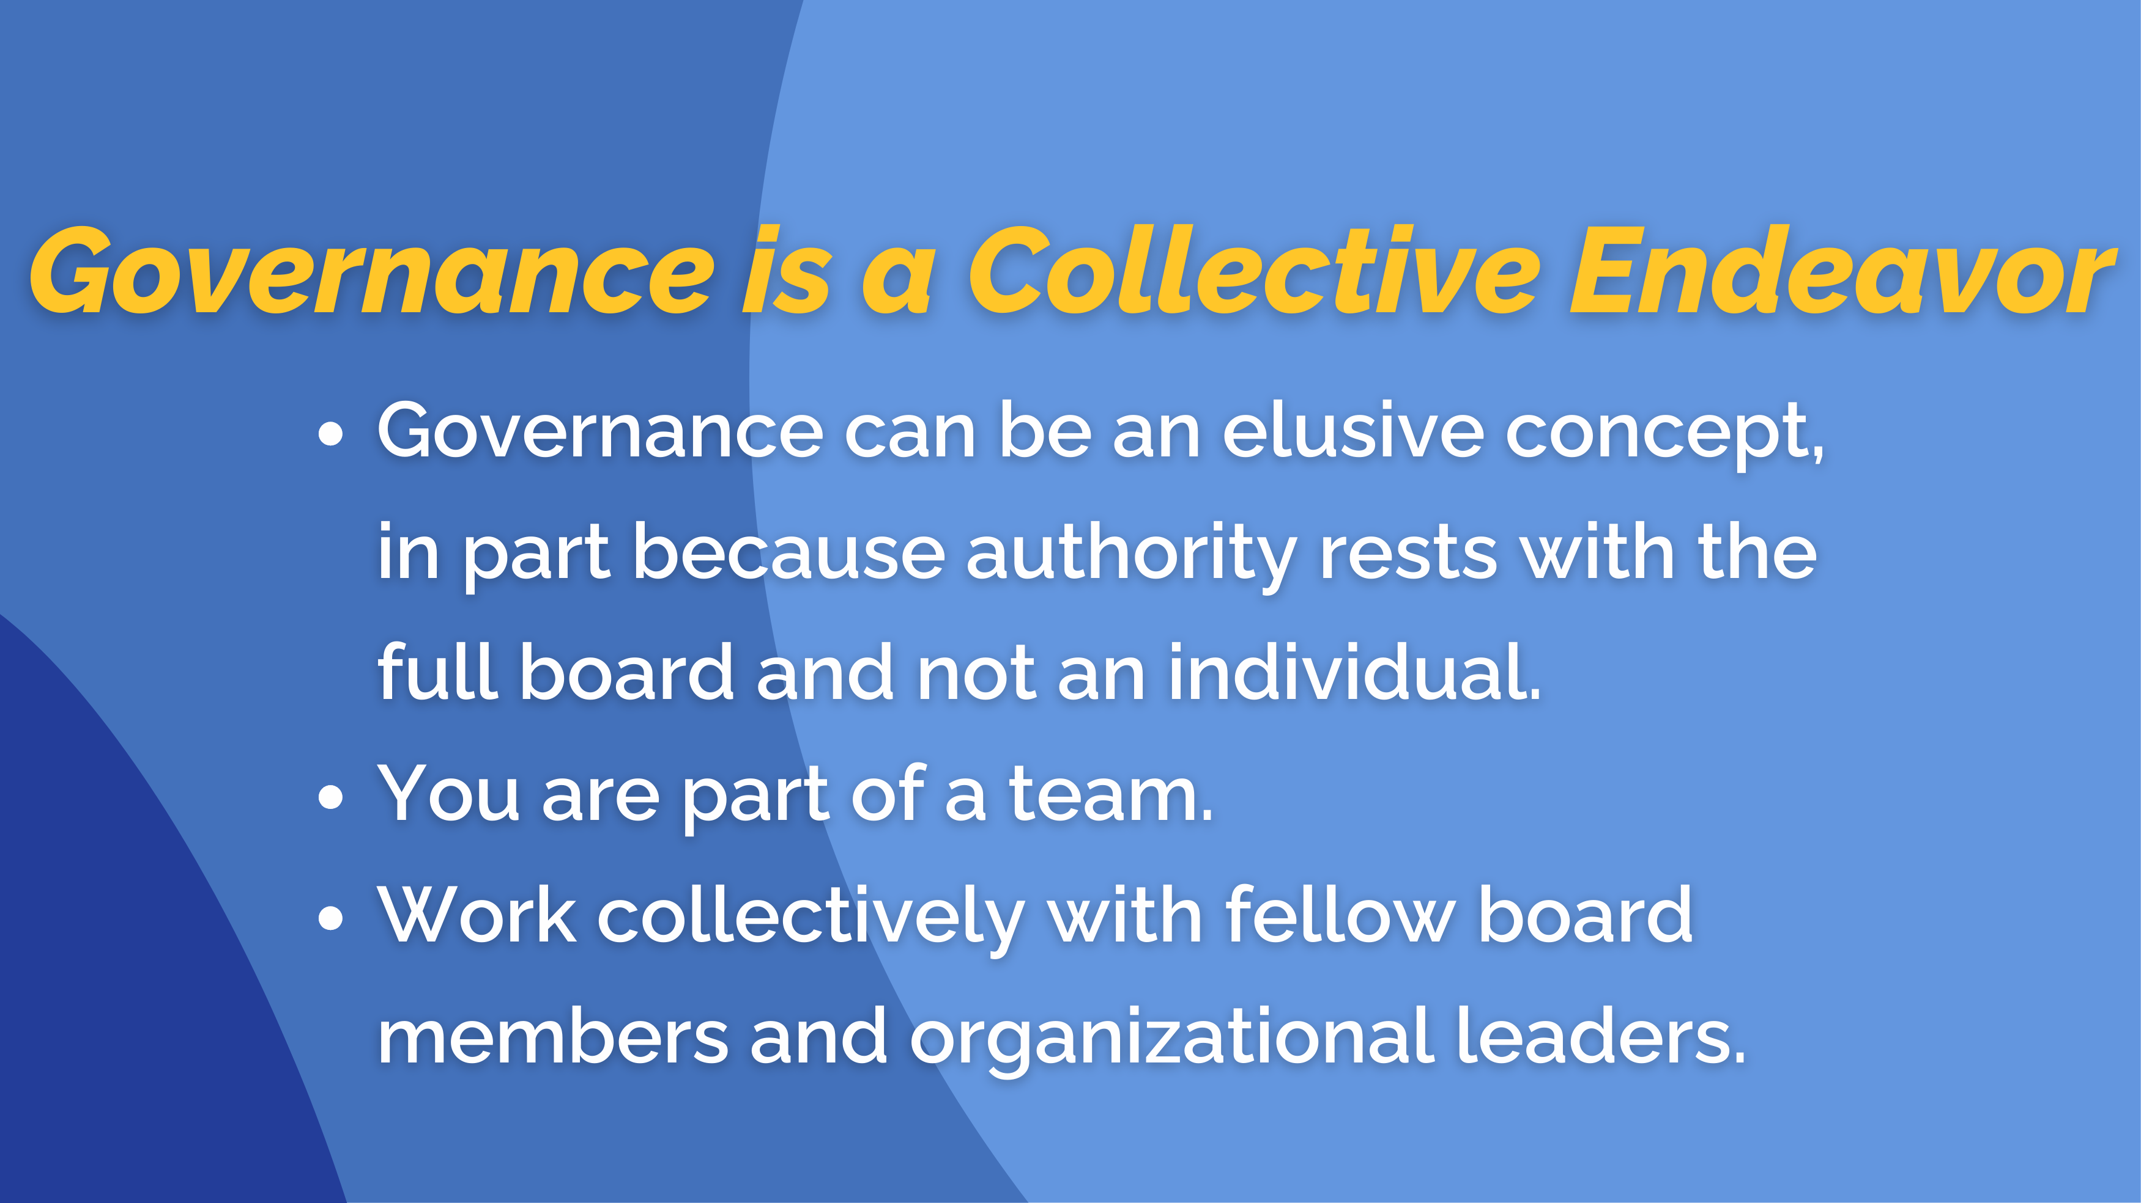

Slide 3


Slide 4
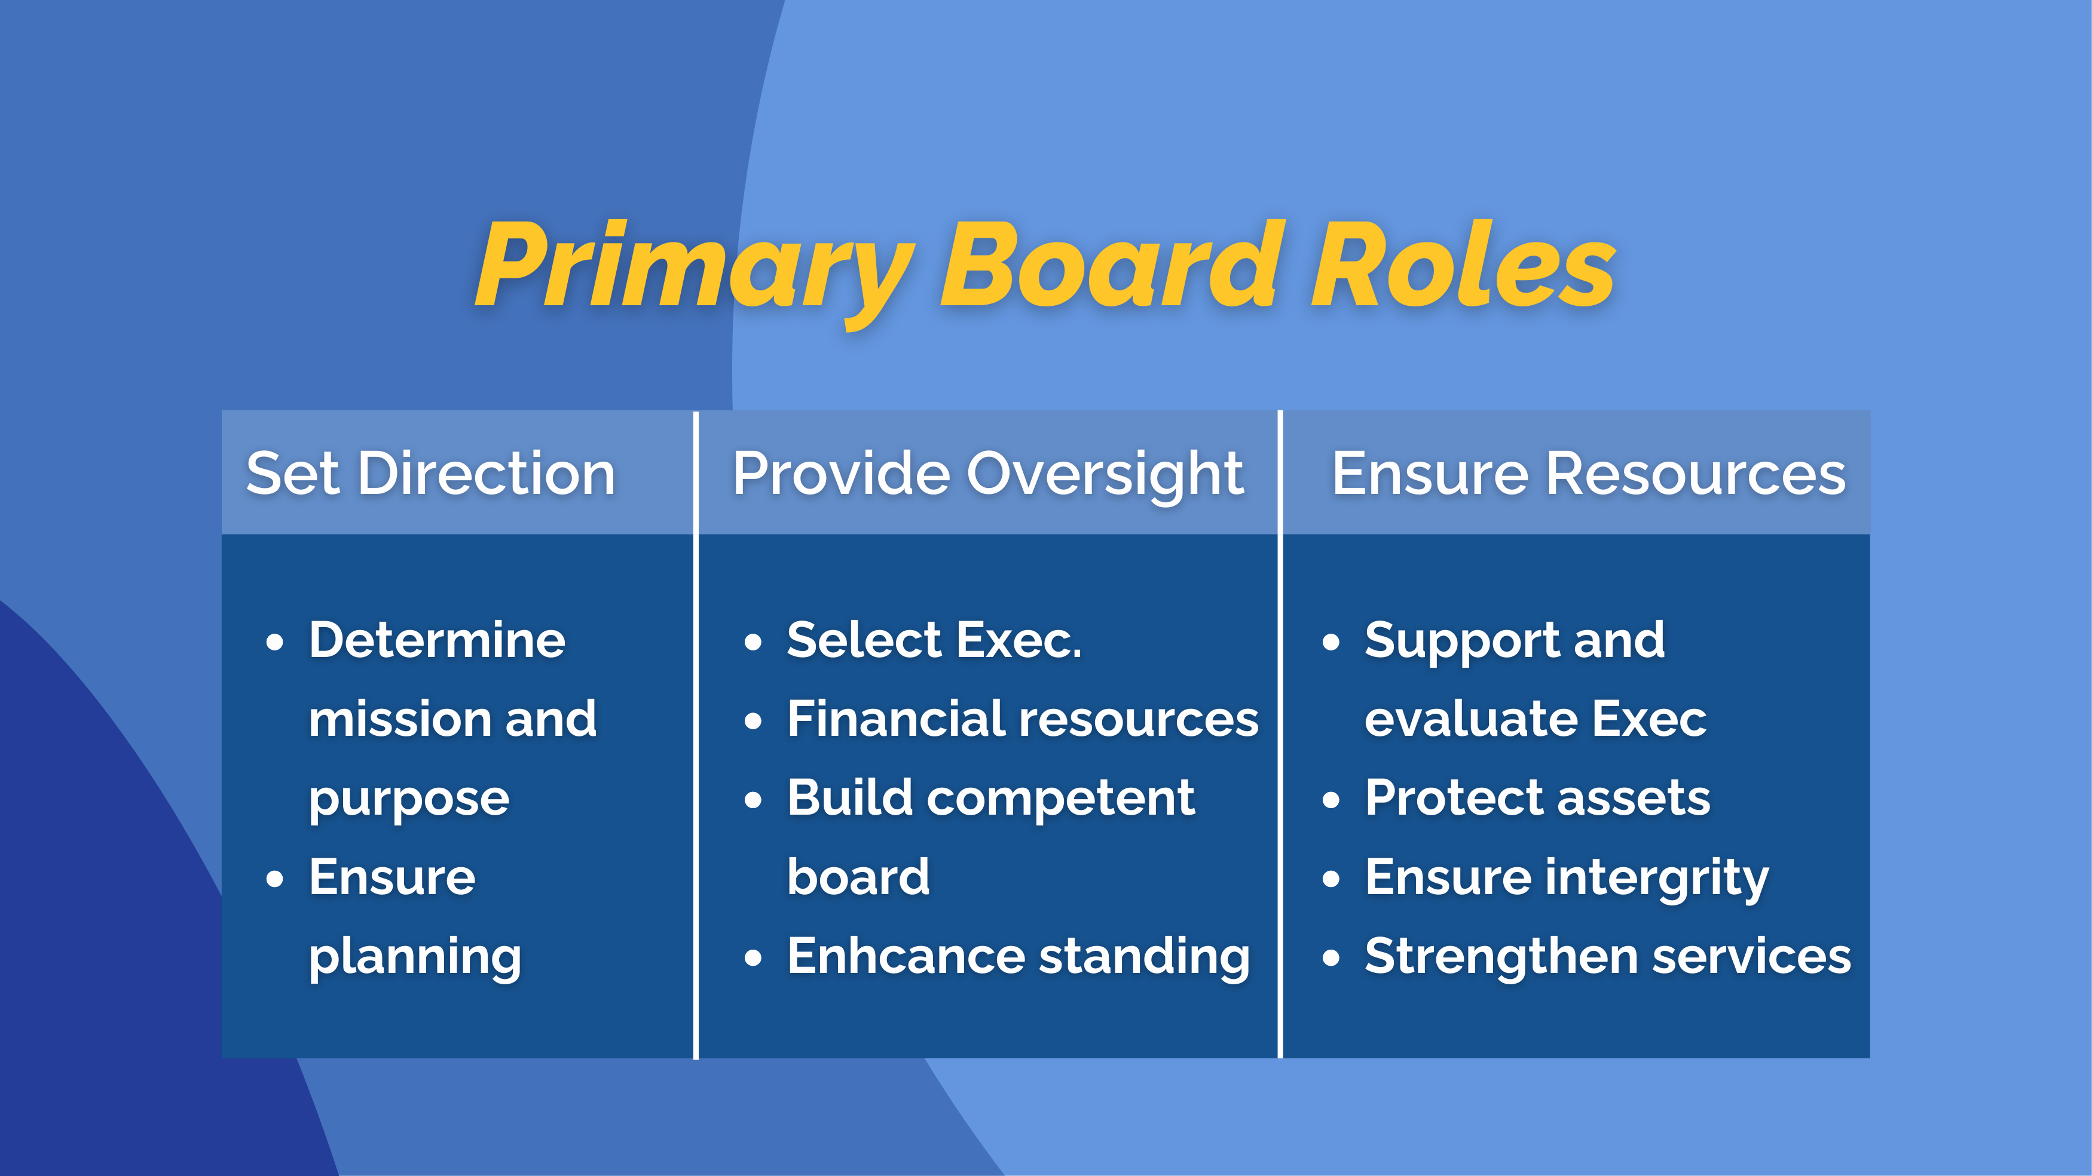

Slide 5
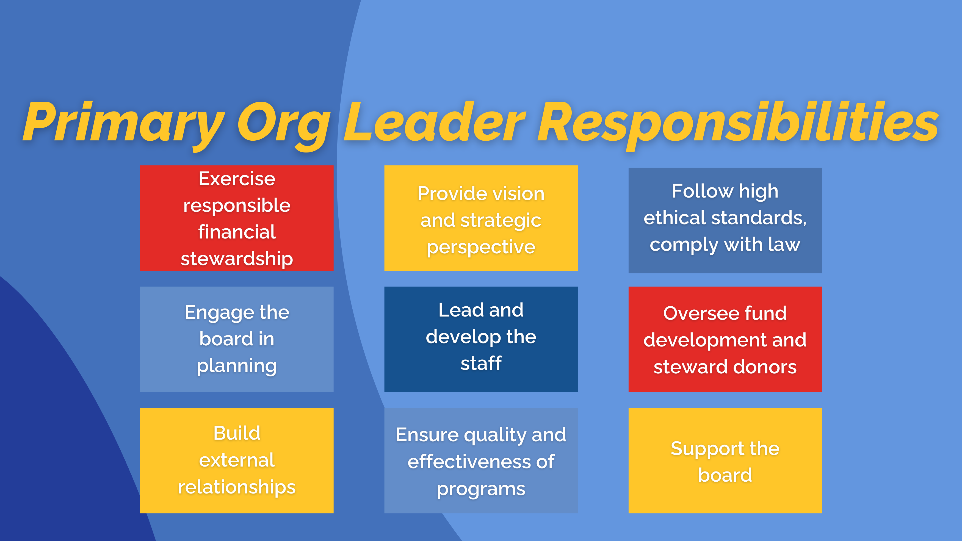

Slide 6
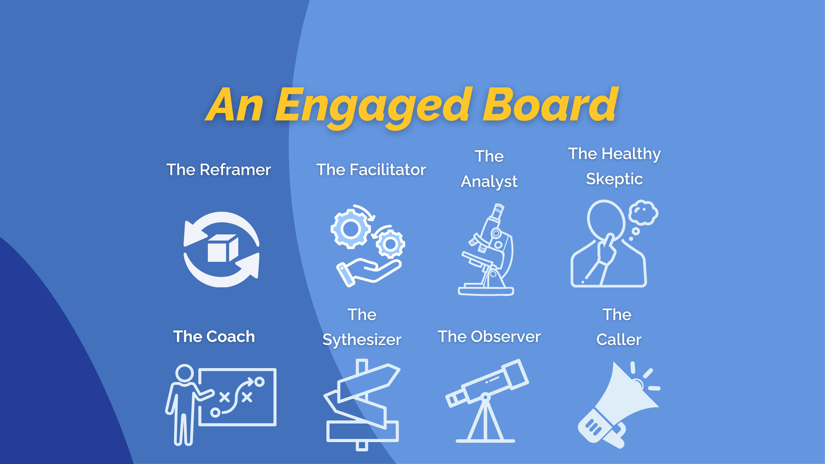

Slide 7





Slide 8


Slide 9


