Slide 1
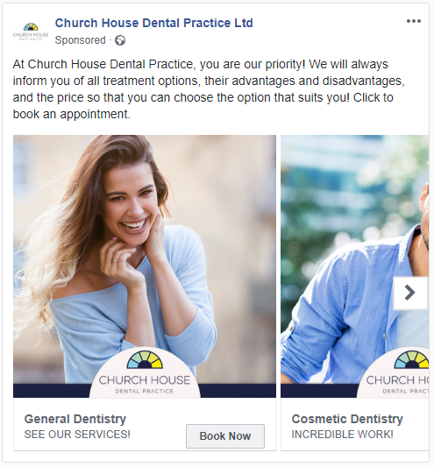
DENTIST
Campaign was created to promote the dentist surgery and to encourage users to book an appointment. The main aim of the ad was to showcase the range of services that the dental surgery offers and to highlight the quality customer services offered.
Main text on the ad highlights quality customer service and the dentist’s dedication to providing the best treatment for each individual. Also encourages users to book.
Imagery chosen for the ad was taken from stock and shows a range of individuals and couples smiling, representing the quality services provided and the satisfaction of customers.
Clear and direct CTA ‘BOOK NOW’ added to each slide makes clear that users are encouraged to book an appointment with the surgery in order to select a treatment for them.
1,953 Total Clicks
(Dec ‘18 – Aug ’19)
8.65% Engagement Rate
(Dec ‘18 – Aug ’19)
22,589 Reach
(Dec ‘18 – Aug ’19)
Engagement rate beats the average by more than 4x!

