Slide 1


Peer Review Best Practices
&
VPQHC’s Peer Review Program
John Wallace, Attorney at Law
Shareholder & Vice President, Primmer, Piper, Eggelston & Cramer
Hillary Wolfley, Executive Director VPQHC
Randall Messier, QI Specialist and Peer Review Coordinator, VPQHC

Slide 2
Agenda
Introductions- Randy Messier
Peer Review- John Wallace
Outline of VPQHC Peer Review Support Process- Randy Messier
Next steps- Randy Messier

Slide 3
This webinar and slides are intended to provide general information for educational purposes only. They do not constitute legal advice, nor do they necessarily reflect the views of Primmer, Piper, Eggleston & Cramer PC or the Vermont Program for Quality in Health Care, Inc. The presentation does not create an attorney-client relationship and does not suggest or promise any potential outcome or results. If you have specific questions as to the application of law to your activities, you should seek the advice of your legal counsel.

Slide 4

Peer Review/Quality Review Privilege
Privilege applies:
Committee of a health care organization or VPQHC
Evaluates health care services to
improve the quality of care; or
determine if the standard of care was met
Information used by the committee is confidential and privileged and cannot be used in a civil action against the provider organization or individual practitioners
original source records such as medical records and other business records are not protected by the privilege.
POLL

Slide 5
How To Ensure That Information Is Privileged
Focus: Things a provider organization can do so that a judge, regulator, peer review participant, administrator, staff know how the process:
protects the candid contributions of participants; and
Identifies the information that is and isn’t protected
Key: Policies and procedures must describe the review process in detail and clearly identify:
roles,
records, and
process

Slide 6
Board of Directors
Fiduciary Duty of Due Care
Board members have a duty to act with the care of an ordinarily prudent person in a like position would under similar circumstances.
must ensure that the medical staff is accountable to the governing body for the quality of care provided to patients. 42 CFR § 482.12(a)(5)
governing body has exclusive authority to grant, deny, continue, revise, discontinue, limit, or revoke clinical privileges. 42 CFR § 482.12(a)(2)
Establish criteria for external peer review:
Insufficient internal expertise, including new procedure or technology
Conflict or duality of interest
Confirmation of standard of care
Need for objective expertise
Complex adverse event or issue of competency

Slide 7
Confidential and Privileged
Peer Review and Quality Review
Confidentiality creates the foundation for effective review processes to foster candid, compelling evaluation of the provision of care to reduce errors and improve quality and safety
All 50 states have peer review laws that protect peer review/quality review information
No general federal peer review protections
Federal Patient Safety and Quality Improvement Act (PSQIA) provides immunity for peer review participants, but Patient Safety Work Product (PSWP) only protects information gathered to report to a federal Patient Safety Organization
Federal Nursing Home Reform Act (FNHRA) – federal quality assurance privilege (FQAP) that protects records created by or for a quality assurance committee that meets specific criteria of a skilled nursing facility. 42 CFR 483.75(o)
Federal courts apply state evidentiary privileges to state law claims egg negligence

Slide 8
Vermont Peer/Quality Review Privilege
Peer review Committee: 26 VSA §1441
The Vermont Program for Quality in Health Care, Inc., or its subsidiaries; or
A committee
of a state or local professional association, or
of a hospital, or other health care provider
Formed
to evaluate and improve the quality of health care rendered by providers of health services; or
to determine that health services rendered were professionally indicated; or
were performed in compliance with the applicable standard of care

Slide 9
Vermont Peer/Quality Review Immunity
Peer review immunity: 26 VSA §1442
No monetary liability or no cause of action for damages
For any member, staff, contractor, or other person who participates in or assists a peer review committee
For any act or proceeding related to peer review activities
Undertaken or performed within the scope of the functions of a peer review committee
Provided the person acted without malice, has made a reasonable effort to obtain the facts, and the action taken was with the reasonable belief that the action was warranted by the facts

Slide 10
Vermont Peer/Quality Review Privilege How the Privilege Protects Information
Records immune from discovery: 26 VSA §1443
Proceedings, reports, and records of a committee
Including information and evidence required to be reported the Board of Medical Practice or the Patient Safety Surveillance and Improvement System
Shall be confidential and privileged
Shall not be subject to discovery
Shall not be subject to testimony from any committee member, staff, contractor, or other person who participates in or assists a committee
cannot be required or permitted to testify in any civil action in relation to findings, recommendations, evaluations, opinions, or other actions of a committee
Except original source documents
i.e. medical records or other business records are not immune from discovery merely because they were presented to a committee

Slide 11
Need To Understand Difference Between
1. Privileged Information Related To Peer/Quality Review
2. Routine Business Operations
Statute only protects information when the formalities of peer review process, (ideally as described in a policy), are “clearly apparent”
Who: specific roles defined in the review process
What: records created as part of a formal review process (records are explicitly labeled)
When: circumstance/criteria identified when review process applies
Why: action is an identified part of the review process
Robinson v. Springfield Hospital, No. 109-VS-75, (D. Vt. Feb. 5, 2010)
Prouty v. Southwestern Vermont Medical Center, No. 89-2-13 Bncv. Vt. Super. Ct. Bennington, Civ. Div. (Oct. 30, 2013)

Slide 12
Routine Business Operations
Statute does not protect conversations, communications, or documentation related to ordinary business operations
Records such as routine email or notes of a conversation that are part of the normal course of operations and not part of a formal review process should not be labeled as privileged.
Individual conducting review and interviewing witnesses should have a role identified in the policy
Conversation without identified roles and without required formalities regardless of purpose or importance is not privileged
Policy and the formalities that it describes provide a road map for a judge reviewing a document or witness – privileged or routine operations

Slide 13
The Privilege That Protects A Record Is Durable And May Not Be Waivable
Vermont law does not recognize that the peer review protection can be waived
Disclosures to external third parties or deviation from process does not waive peer review protection
Section 1443 looks more like a prohibition against disclosure as opposed to a privilege that can be waived
Shall be confidential and privileged
Shall not be subject to discovery
Peer review participant cannot be required or permitted to testify
Wheeler v. Central Vermont Medical Center, 155 Vt. 85, 94 n.3. (1990)(privilege may not be waivable since 26 V.S.A § 1443 does more than provide a privilege, but arguably announces a mandatory policy against disclosure

Slide 14
How the Privilege Protects Information
New CMS guidance on protecting privileged information, QSO-25-24-Hosptals (Sept. 5, 2025)
CMS Surveyors are required to avoid using Quality Assurance and Performance Improvement (QAPI) information as evidence of violations of CoPs unless there is evidence of current non-compliance with regulatory requirements. Tag A-0263
Surveyors should be aware of the sensitivity of QAPI information that relates to peer review and adverse events. Surveyors should avoid making notes that could identify particular events.
If a surveyor requests privileged information, the hospital may provide alternative evidence of compliance that is not protected.
Surveyor has sole discretion to determine if alternative evidence is sufficient to evaluate compliance.
A deficiency must be cited if there is no alternative evidence or alternative evidence is insufficient.

Slide 15
How the Privilege Protects Information
Consider using a quality/peer review summary sheet to:
separate sensitive facts regarding an adverse event e.g. individual witness statements, from description of the process and outcome to allow a surveyor, or judge evaluate the process and consider the applicability of the privilege without reviewing sensitive facts
Summary sheet
Type of review – quality review, peer review – adverse event related
Review process – root cause analysis, failure mode analysis, peer review Internal/external
Corrective actions
Always separate description of an adverse event (facts), which do not need to be widely communicated from corrective actions that often need broad communication

Slide 16
Protecting factual statements is different than
the fact that an adverse event occurred that led to
corrective actions
The fact that an adverse event occured only relevant to the question of whether something undesirable occurred.
Fact of an adverse event does not establish that the organization or individual caused the adverse event, negligently or otherwise
Rule of Evidence 407 – evidence of subsequent remedial measures after an injury or harm is not admissible to prove negligence, culpable conduct, or need for a warning
Mayotte v. Brattleboro Memorial Hospital, No. 416-12-16 Vt. Super. Ct., Windham, Civil Div. (Apr. 11, 2022)

Slide 17
Value of Well Developed Review Process
Broad recognition that candid and confidential review process supports patient safety and quality
Fosters an environment where participants feel comfortable contributing to patient safety and quality
Supports risk management by protecting information that should not be used as evidence against providers
Protects organizations and individuals because the failure to protect information often determines the outcome of litigation with potentially severe consequences for provider organizations and practitioners.

Slide 18
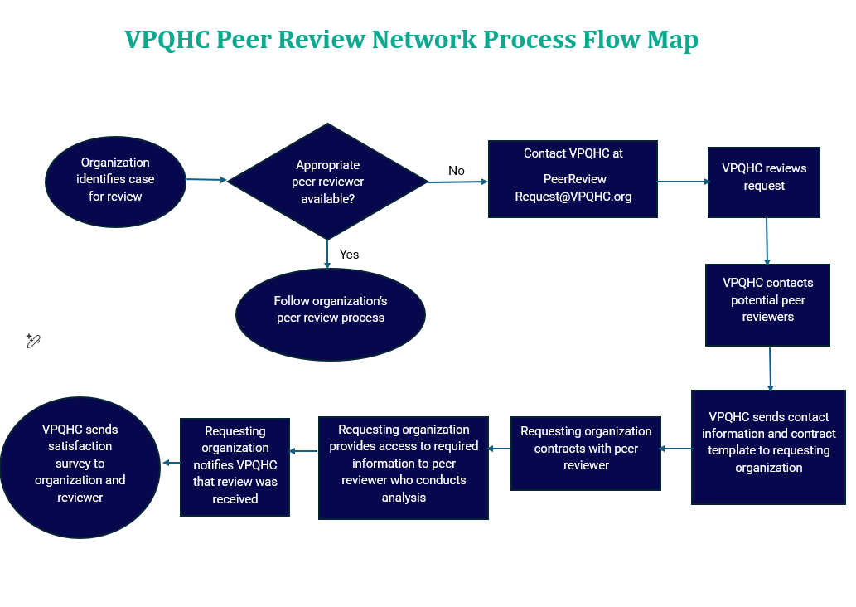


Slide 19
Next Steps
The slides from this session will be posted on the VPQHC website.
VPQHC will be contacting each participating organizations Peer Review Coordinator to confirm the participating Specialties and Physicians.
When Peer Review services are needed, please contact VPQHC by emailing PeerReviewRequest@VPQHC.org. The Peer Review Coordinator will respond and obtain the necessary information to start the process as outlined in the process flow.
Satisfaction Survey- https://www.surveymonkey.com/r/NDTHRXK

