Slide 1

PROGRESSIVE 15

Slide 2
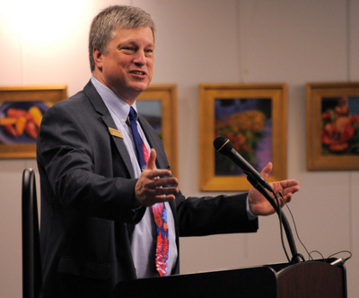
Wayne Williams
Colorado’s 38th Secretary of State
Attended First Caucus—1981 (age 18)

Slide 3
The Colorado Secretary of State
Business and Licensing
Record number of business entities – 660,894 (more than ever)
Online so you never have to go to Denver
Lowest business renewal fees in the nation -- $10
Nonprofit filings (48,210) / Charitable solicitation reports
Bingo and raffle – filings can now be made online
Notary publics – training added online
Elections
Work with Colorado’s 64 county clerks – visited every office
Election security – no voting or tabulation machines connected to the internet
2017 Coordinated Election in 58 counties – specific support
Voter registration easy at www.govotecolorado.com or text “CO” to “2vote”

Slide 4
3,761,426 citizens
2,644,717 voters
74.5%
registered to vote. Highest Percentage in America! +25K to highest ever!
voted by mail.
Turnout for registered voters. Fourth Highest in America in 2016.

Slide 5
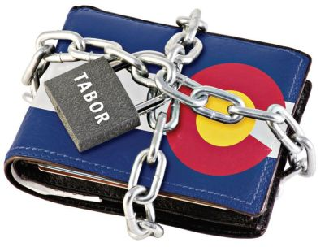
We like to Vote: TABOR
Gives Coloradans the right to vote on debt and tax questions and
requires vote of citizens to exceed spending limits.

Slide 6
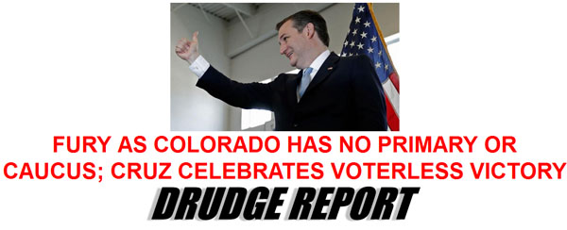
The GOP executive committee voted to cancel the non-binding presidential preference poll after the national party changed its rules to require a state’s delegates to support the candidate that wins the caucus vote.
Colorado forfeited a role in the early nomination process.

Slide 7
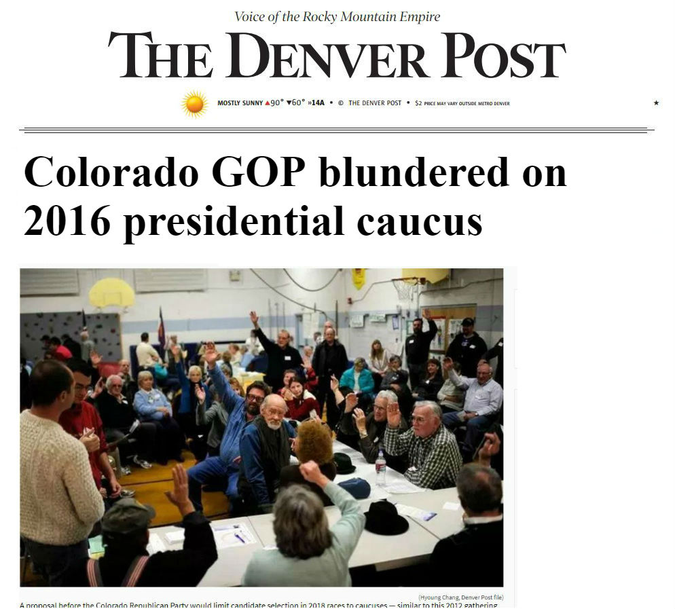

Slide 8
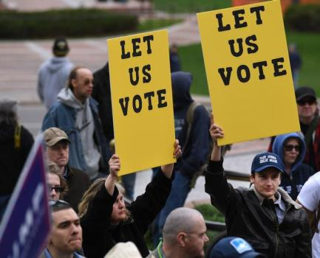
Legislative Efforts to Restore Presidential Primary Fail
2015 and 2016 General Assemblies considered two bills that would have restored presidential primary.
Both bills would have required party affiliation to participate.
Colorado Secretary of State warned that the failure to pass a presidential primary bill would result in the adoption of initiatives 107 and 108.
Both bills died.
“Sen. Kevin Lundberg, a Republican from Berthoud who sponsored the Senate bill, said there was deep concern about both bills and the role that unaffiliated voters might play. If a proposed ballot initiative fails, he will try again next year, he said.
“’We tried, but in the end there just wasn’t enough consensus to pass it,’ he said of his bill.”
--Denver Post, May 9, 2016

Slide 9
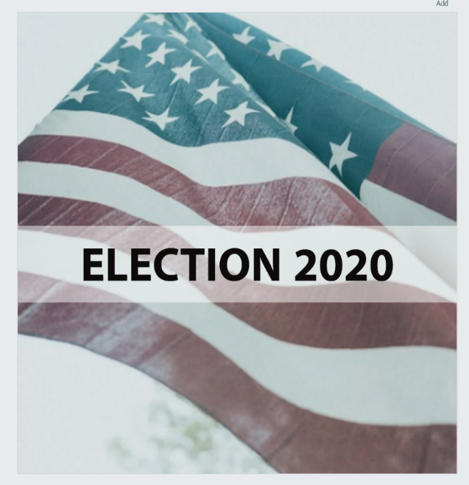
PROPOSITION 107
107
Presidential Primary Election

Slide 10
PROPOSITION 107: PRESIDENTIAL PRIMARY
107
Restores a presidential primary to be held before the end of March in presidential election years.
Unlike proposed bills, allows unaffliated voters to participate without joining a political party.
Delegates still chosen through caucus system, but they are bound by the primary election results.

Slide 11
PROPOSITION 107 – SB 17-305
107
.
Clarified Requirements of 107 and 108
Unaffiliated voters will receive all major parties’ ballots
Based on push from Secretary of State, counties fully reimbursed for reasonable costs of presidential primary.

Slide 12
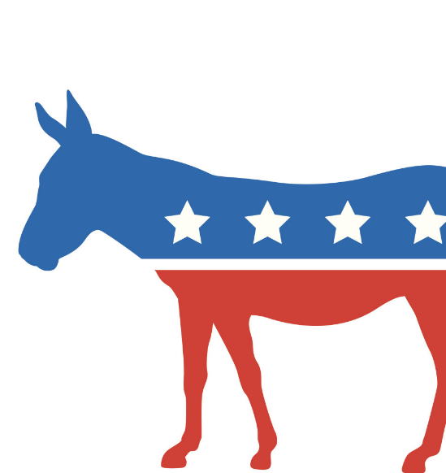
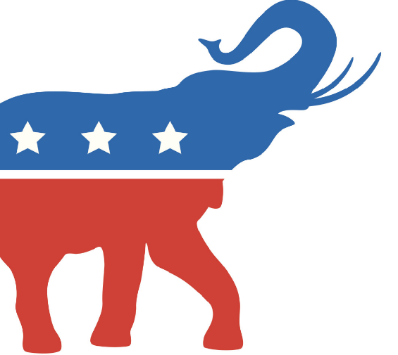
PROPOSITION 108
108
Primary Elections

Slide 13

PROPOSTION 108: PRIMARY ELECTIONS
108
Pre-existing law permitted unaffiliated voters to affiliate and vote at any point.
New initiated law allows unaffiliated voters to participate in primary elections without affiliating.

Slide 14
PROPOSTION 108
108
Proponents’ Arguments
Gives unaffiliated voters, who make up more than one third of the Colorado registered voters, the opportunity to vote in publicly financed primary elections.
May increase likelihood of more moderate candidates prevailing – if primary is not cancelled.
Con
Dramatically increases cost of campaigns without increase in limits.
Increases influence of unaccountable advocacy groups.
Creates voter confusion and causes ballots to be disqualified if a voter votes in both parties’ contests.
Increases administrative and financial burden for counties.

Slide 15
PROPOSTION 108: PRIMARY ELECTIONS
108
Affiliated voters will receive the ballot for the party with which they are affiliated.
Unaffiliated voters may select in advance a party’s primary ballot they wish to receive.
If no selection is made, unaffiliated voter will receive both parties’ ballots but may only vote in one party’s primary.
All voters still may vote for whomever they wish in November.

Slide 16
PRIMARY ELECTION RULES
7.2.10 The mail ballot return envelope for each unaffiliated voter in a primary election may provide a means for the county to determine, before opening the envelope, which party’s primary election ballot the elector returned. If the mail ballot return envelope does not provide such a means, or the county cannot determine which party’s ballot the elector returned before opening the envelope, the county must follow the process outlined in Rule 7.5.13. The county’s determination under this Rule may not rely solely on a voter’s self-reported selection (for example, a checkbox).
7.2.11 Each mail ballot return envelope and mail ballot instruction for an unaffiliated voter in a primary election must include a statement instructing the voter to return only one ballot.

Slide 17
PRIMARY ELECTION RULES
7.5.8 After election judges verify the elector’s eligibility and signature, the county clerk must dissociate and segregate the mail ballot return envelope from the secrecy sleeve and a voted ballot in a manner that ensures no person is able to determine how an individual voted.

Slide 18
PRIMARY ELECTION RULES
7.5.13 Unaffiliated voters in a primary election. If an election judge is unable to determine, before opening the envelope, which party’s ballot the elector returned as outlined in Rule 7.2.10, the county must separate the elector’s ballot from the envelope in the following manner: (a) An election judge must remove the ballot, enclosed in its secrecy sleeve, from the mail ballot return envelope and pass it to a bipartisan team of judges without allowing the team of judges to determine the identity of the elector. (b) The bipartisan team of election judges must remove the ballot from its secrecy sleeve, review the ballot, and audibly report to the first election judge which political party’s election the elector voted in. (c) The first election judge must record in SCORE which political party’s election the elector voted in, or document the proper party information for later recording in SCORE.

Slide 19
PROPOSTION 108: PRIMARY CANDIDATES
108
Candidates still make ballot either by obtaining 30% of vote at assembly or by submitting petitions.
Over 90% of all candidates obtain place on primary ballot via the caucus/assembly process.
New SOS supported law requires signature verification of candidate petitions beginning in 2018.

Slide 20
PROPOSTION 108: PRIMARY ELECTIONS
108
Propositions 108 allows party’s to completely cancel the primary for every race if 75% of party’s state central committee votes to do so.
Eliminating primary would:
Bar unaffiliated voters and nearly 1 million affiliated voters in each party from voting.
Bar candidates obtaining ballot by petition (Beauprez, Coffman, Lamborn, Tancredo).

Slide 21
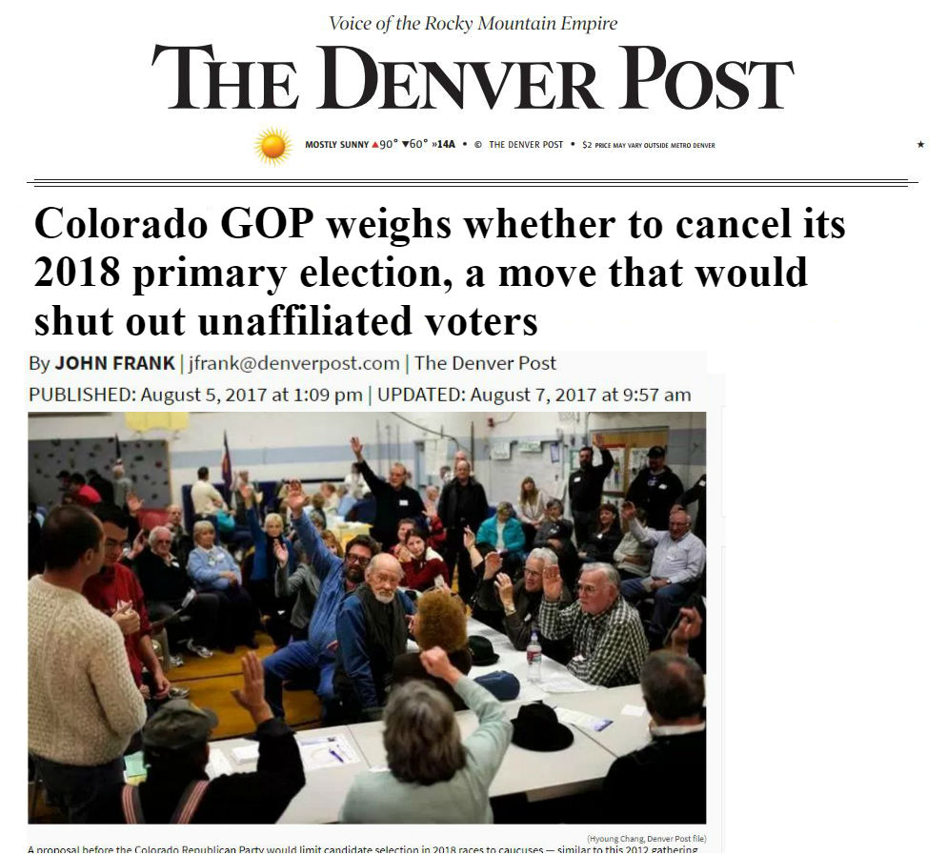
“Ben Nicholas, a central committee member from Adams County, argues that the caucus system is the only way to “select a candidate who will adhere to the party platform and our conservative principles.”
“Jake Viano, the Denver GOP chairman, said ‘it would be political suicide for the Republican Party to opt out’ given that the Democrats are not.”

Slide 22
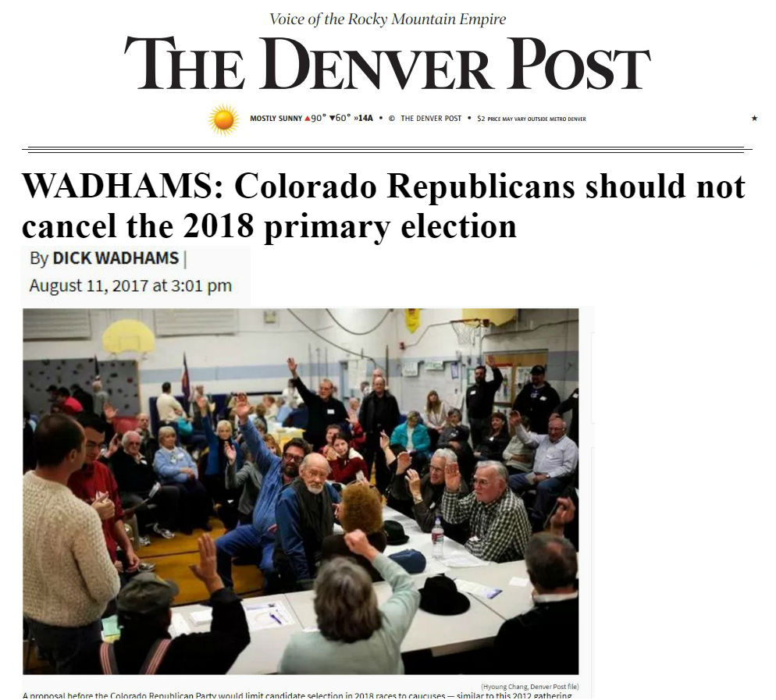
“Republican candidates should embrace 108 as an opportunity to craft their campaign messages to not only reflect Republican principles but to attract unaffiliated voters as well.”

Slide 23
Should Colorado Parties Limit Participation?
Coloradans cherish the right to vote.
Military and many others have difficulties attending caucus.
Coloradans get angry if they can’t vote – even in a straw poll for president that doesn’t count.
Colorado law doesn’t allow party to require party affiliation to participate in primary, so it’s either allow participation or no primary.
65-85% of participants in a party’s primary will be affiliated.
Both major parties are participating in the primary

Slide 24
Questions? CONTACT ME
Office: (303) 860-6970
Cell: (719) 439-1870
E-mail: Wayne.Williams@SOS.State.CO.US

