Slide 1
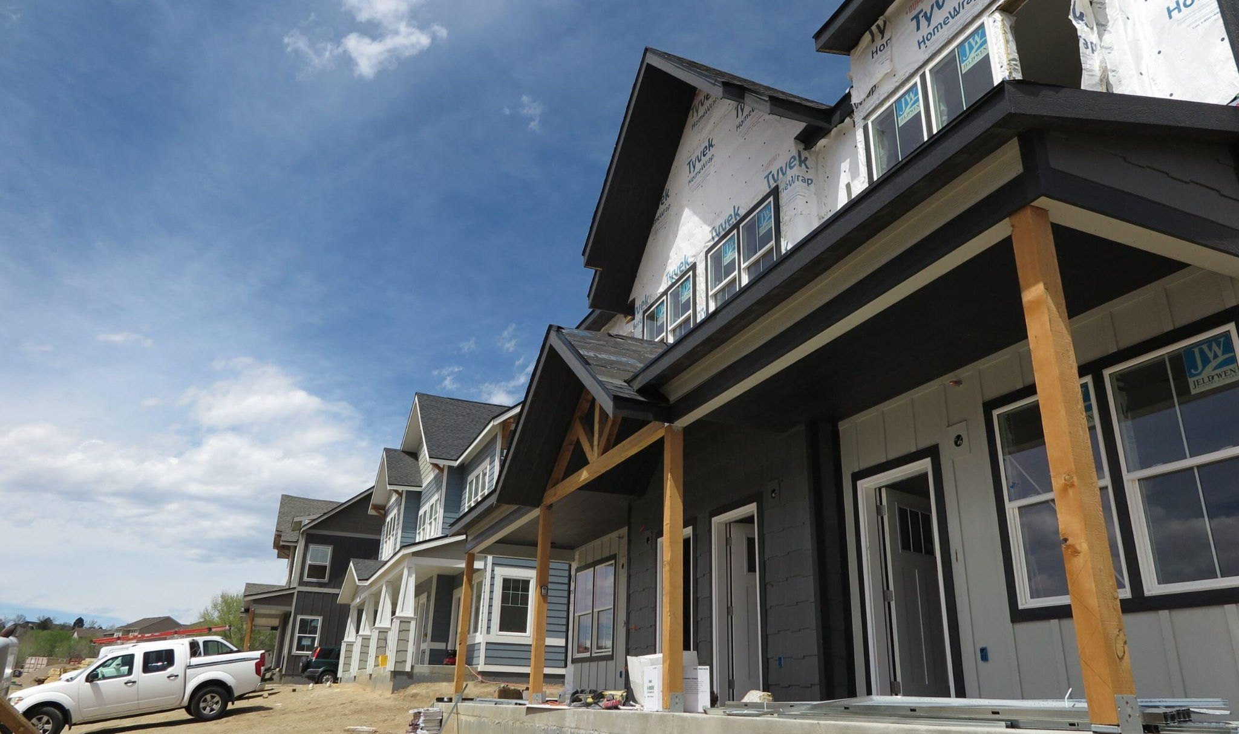

DOLA is in the House!
An Overview of the Department’s Grant Programs, Technical Assistance Offerings and New Initiatives
Eric Bergman
Director, Division of Local Government

Slide 2
Agenda
Understanding DOLA and its structure
Division of Local Government and its programs/opportunities
Screening new documentary “Bureaucrat: The Eric Bergman Story”
2024 legislation and affordable housing funding opportunities
Q & A

Slide 3

Warning:
Alphabet Soup Ahead
Questions?

Slide 4





About DOLA
Division of Housing
Division of Local Government
Division of Property Taxation
Board of Assessment Appeals
State Demography Office
Administer gap financing
Technical assistance
Provide individual support
Provide funding opportunities
Technical assistance
Build community resilience
Provide reporting
Technical assistance
Offers professional education
Administer exemptions
Docket appeals
Hold evidentiary hearings
Issue written decisions
Production of estimates & forecasts
Data dissemination
Technical assistance and outreach

Slide 5
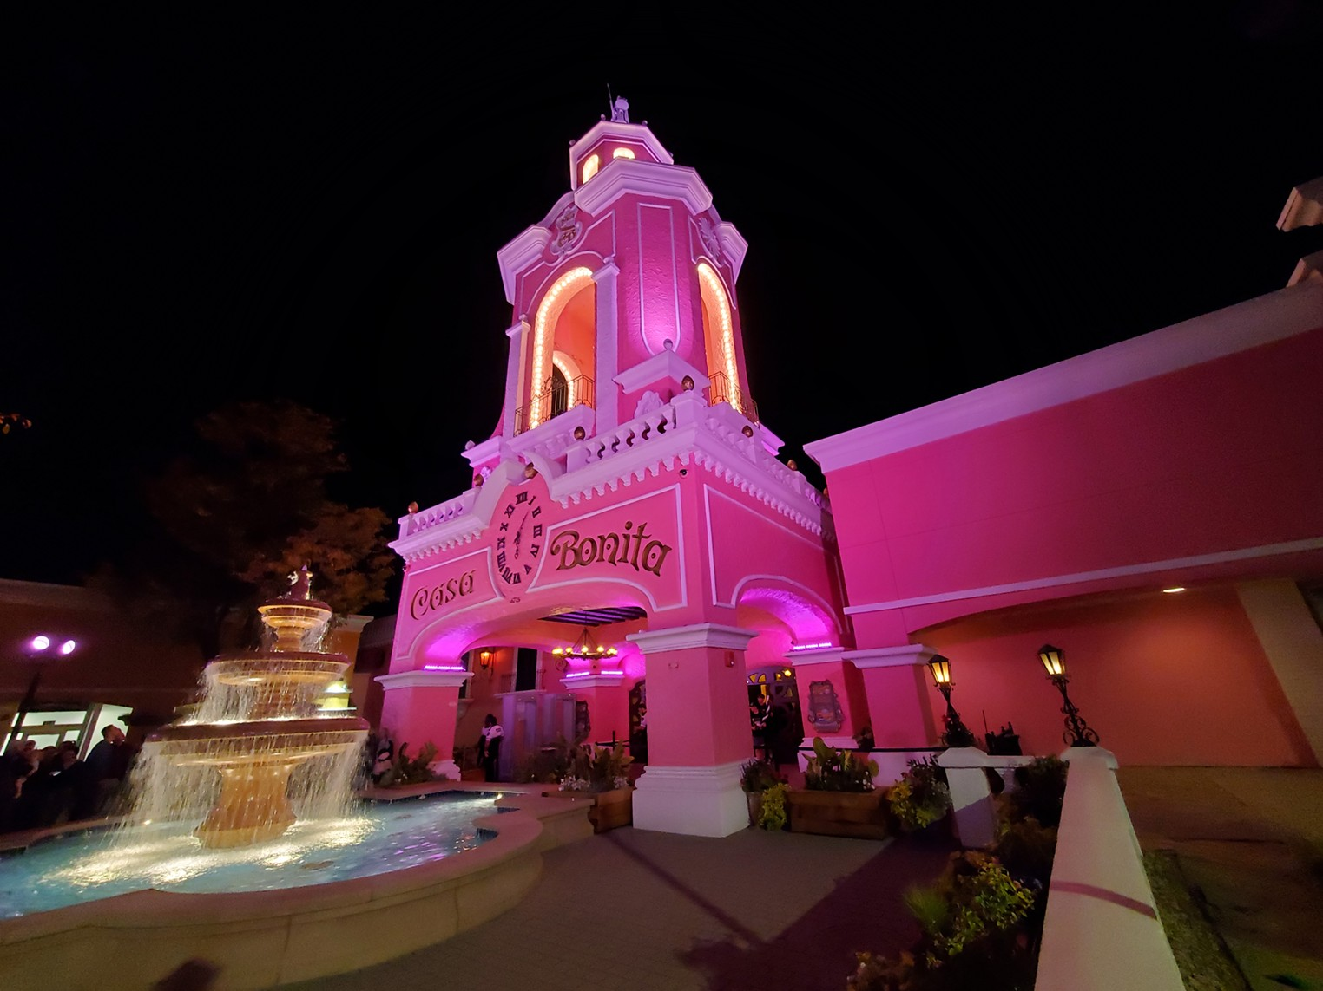
Questions?

Slide 6
About DOLA
Division of Housing
Division of Local Government
Division of Property Taxation
Board of Assessment Appeals
State Demography Office
Administer gap financing
Technical assistance
Provide individual support
Provide funding opportunities
Technical assistance
Build community resilience
Provide reporting
Technical assistance
Offers professional education
Administer exemptions
Docket appeals
Hold evidentiary hearings
Issue written decisions
Production of estimates & forecasts
Data dissemination
Technical assistance and outreach

Slide 7




Our Leadership Focus for 2025
Lean Machine
Transparency and impact focus
Educate and elevate
Proactive leadership on housing
Notes:
Staff hiring and training
Improving contracting
Process improvement
Policy Innovations

Slide 8

Questions?
Division of Local Government

Slide 9
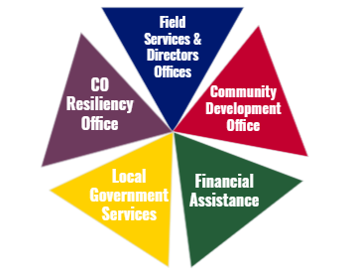
Division of Local Government
The Division of Local Government (DLG) provides strategic expertise, advocacy, and funding to strengthen Colorado communities. The division promotes local problem solving, informs decision making and invests in communities.
Notes:
We are the states experts on Local gov, statutory framework, operations, management and infrastructure, face of the state for ULG’s - they know they can call us and we will get them to the right place, and we are your resource - we can help communicate, enter and work with communities, we can be ombudsman between ULGs and State Departments; Our focus is local strength and getting information, training, money to them so they can succeed. We respond and can pivot to their needs, often being the first Department tackling a growing issue. (BB example)
FAS - program administration - over $1b going out the door this past year - usually $300m to local govs thru 25 community development programs
LGS - the team of experts on statutory requirements, local elections, spedical districts providing TA lcoally
Then go thru the 3 sections slides

Slide 10
Local Government Services
Colorado’s inventory of local governments and public files https://dola.colorado.gov/lgis/
  New E-filing portal - October/November 2024
  More information coming soon
Local Government Budget Law & Annual Levy Law (“5.5%”)
Special District Elections and Administration
Research and Financial Analysis
  Water and Sewer Financing
Notes:
lgs team - lots of interactions with special districts
Maintain inventory of state’s local governments, plus public files
Administer statutes intended to promote local government transparency/accountability
but not a local government compliance/”oversight” role!
new e-filing portal coming soon
The Division’s Local Government Services Section administers multiple statutory transparency and compliance programs intended to improve public access to local government information and to promote and assure accountability of local governing boards.
Each of the Section’s programs also provide assistance and training to local officials and staff to help achieve statutorily directed transparency and compliance and to assist them with effectively meeting the needs of Colorado citizens. The Section’s assistance is most often provided to smaller and primarily rural governments with limited resources.
In addition, the Section conducts studies of local government, intergovernmental relations, the structure and powers of local government units and their relationships to each other, local government finance, services, management, and other research necessary to carry out the functions of the Division. The Section has 11 staff.

Slide 11
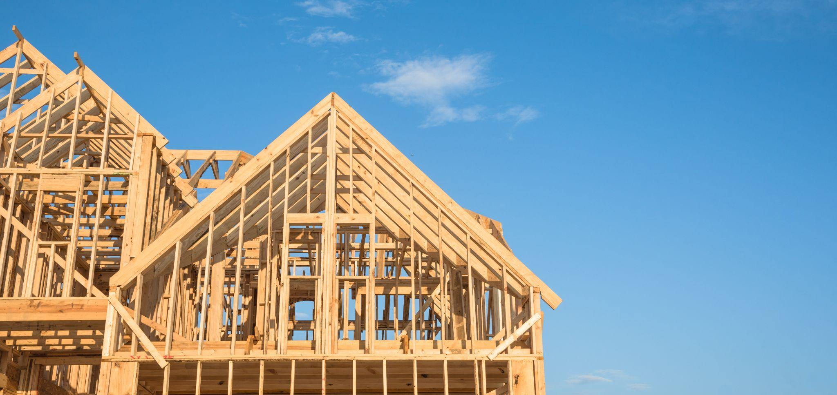
Special Session: Property Taxes
HB24B-1001
Webinar recording available on DOLA website
HB24-1303
Additional mill levy transparency / reporting
Division of Property Tax
Additional resources

Slide 12
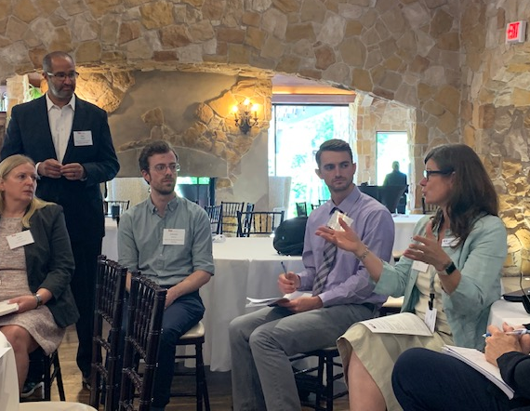
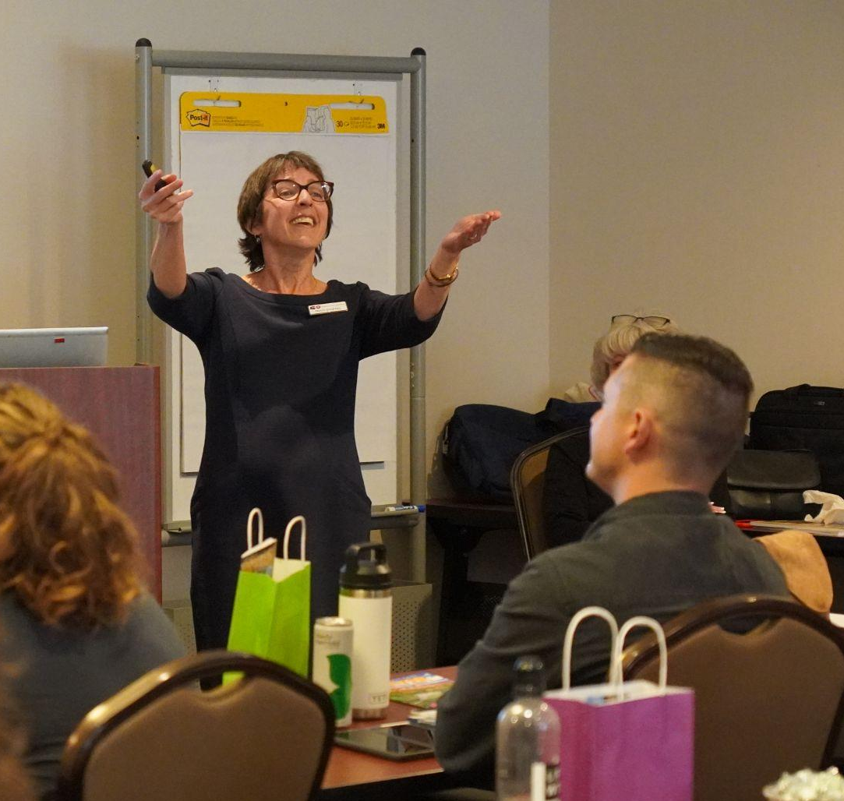
2) Community Development Office (CDO)
Land Use Planning and Assistance
Provide information, funding, and technical advising on best practices
Ensure grantee compliance and success; find creative solutions
Guide communities in attracting and retaining small businesses and preserving cultural heritage/place-making
Notes:
Really only kept this slide because the photos might be useful

Slide 13
CDO’s Primary Programs and Functions
Community Economic Development / Downtown Revitalization
  Colorado Main Street Program
  Architectural and preservation support
Land Use Planning / Community Development
  Land use education, training, and assistance (state & local govts)
  Land Use & Housing Incentive Programs (Stimulus - 1271 & Strong Comms)
  Local Planning Capacity Grant Program (Prop 123)
  New 2024 land use and housing legislation implementation
Notes:
Eric- You could easily cut Arch and pres support bullet under MS and the HPCP bullet under LU to reduce the text
EIAF: referring to DLG’s Energy and Mineral Impact Assistance grant program
SLFRF: Coronavirus State and Local Fiscal Recovery Funds
HPCP: State law - High Performance Certification Program, which CDO administers for DLG and reports to Ofc State Architect/DPA; ensures third party verification of energy efficiency required by state law of certain state owned or funded projects

Slide 14
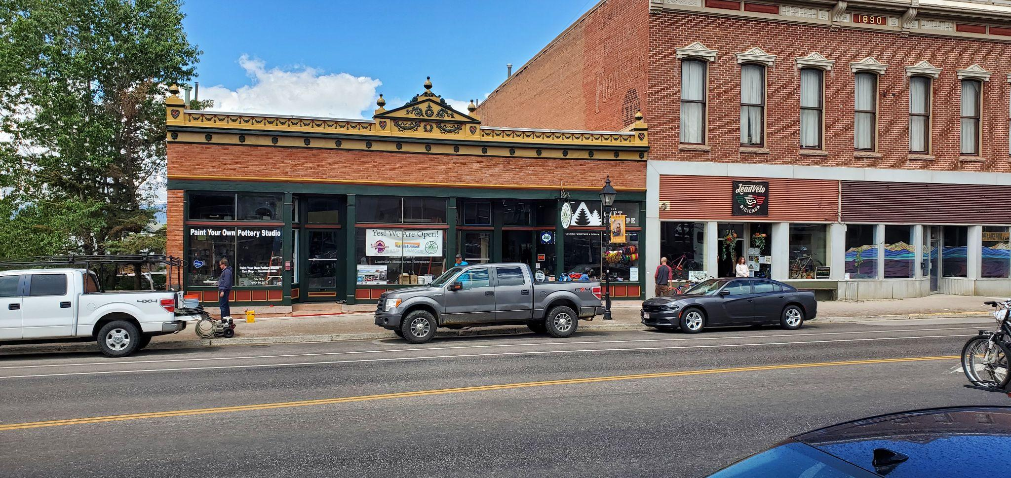
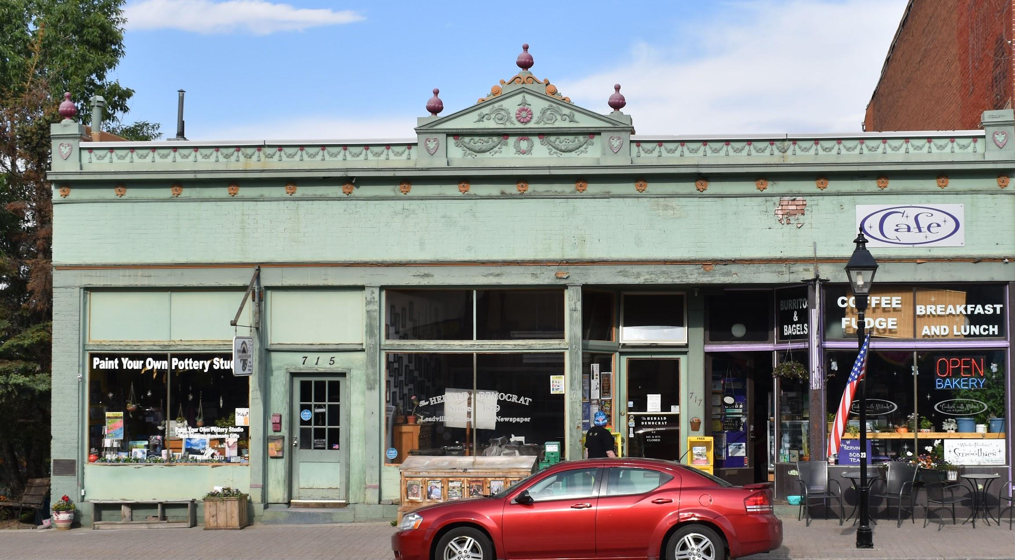
Main Street Open for Business
Leadville - Herald Democrat (Heritage Energy)

Slide 15
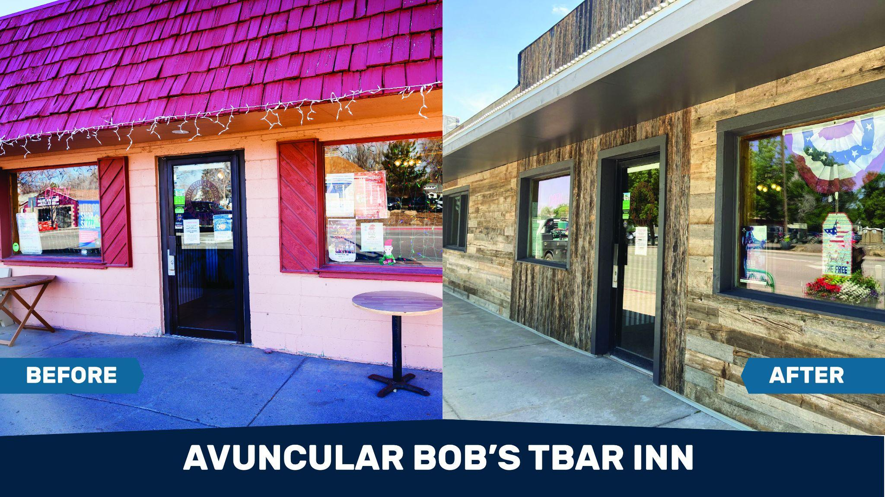
Main Street Open for Business
Wellington - Avuncular Bob’s T-bar Inn

Slide 16
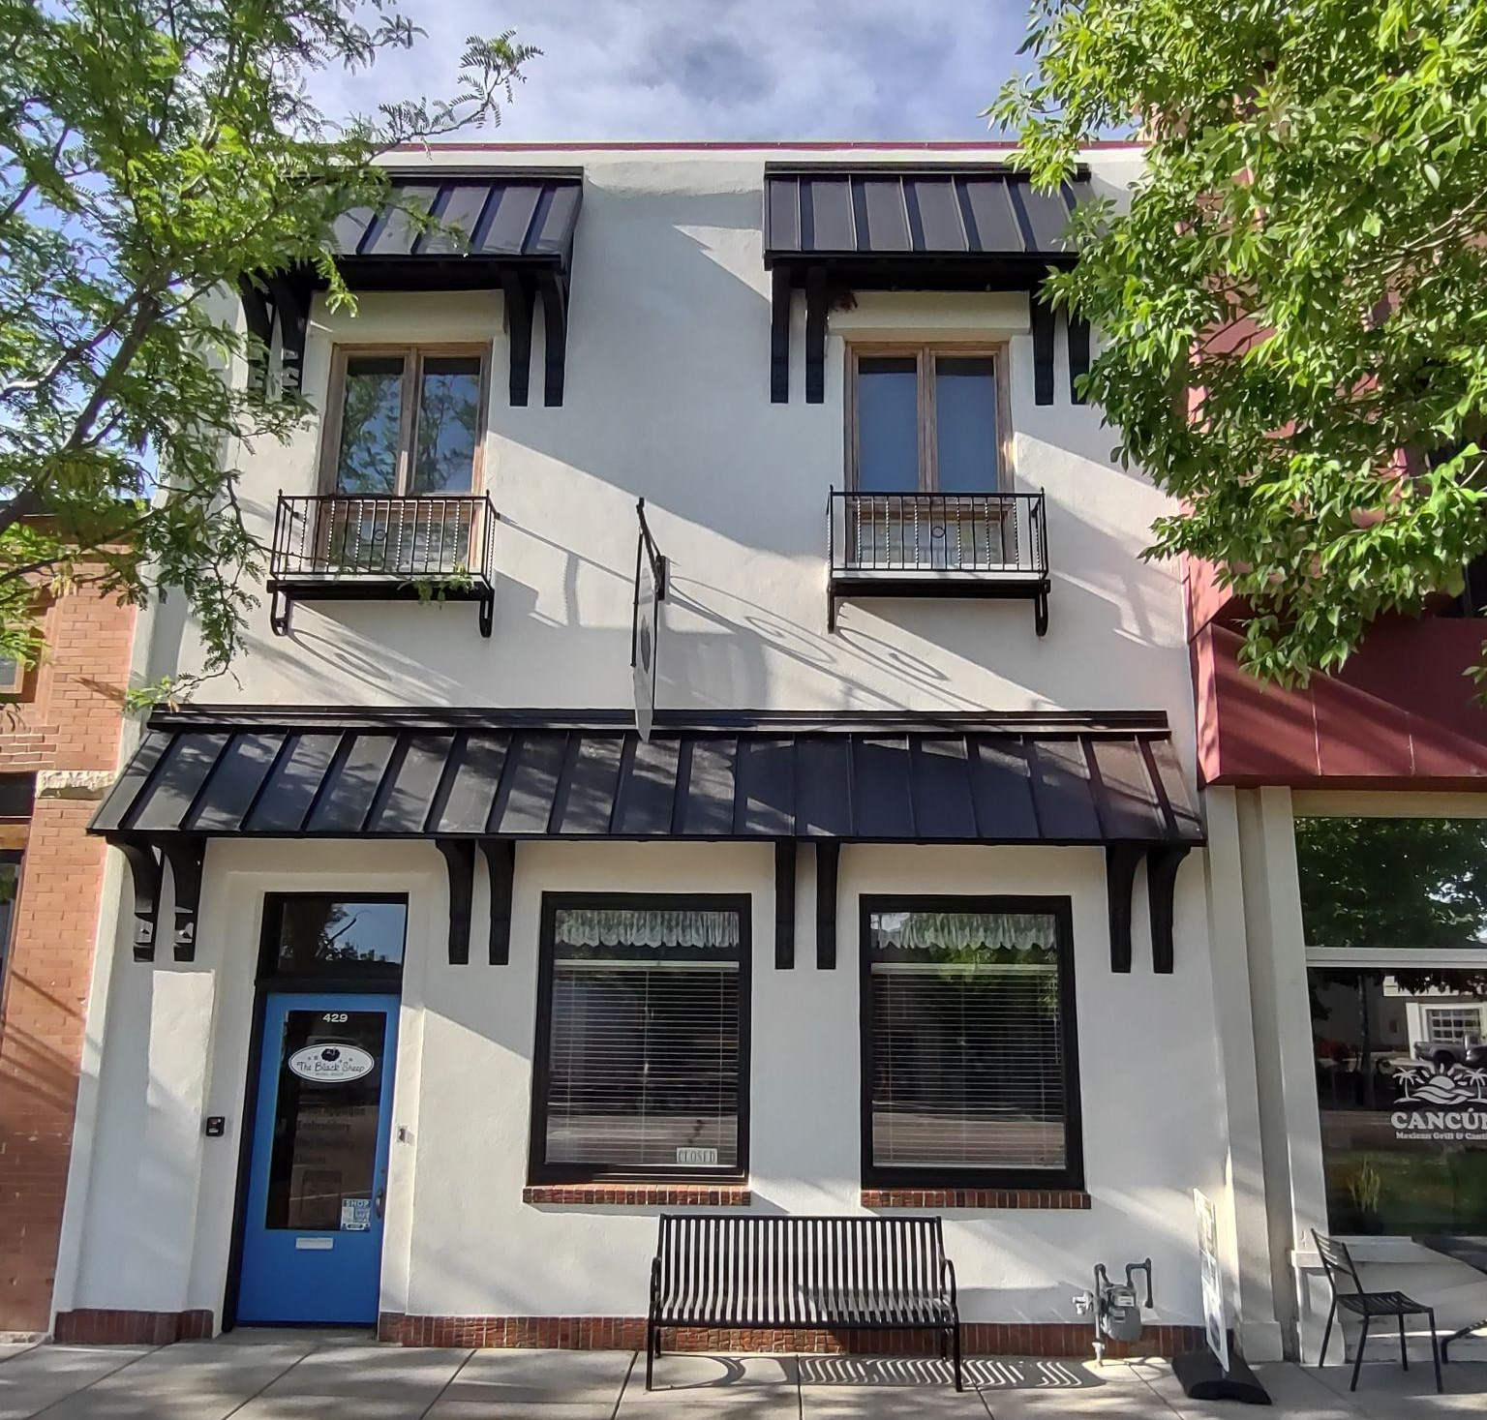
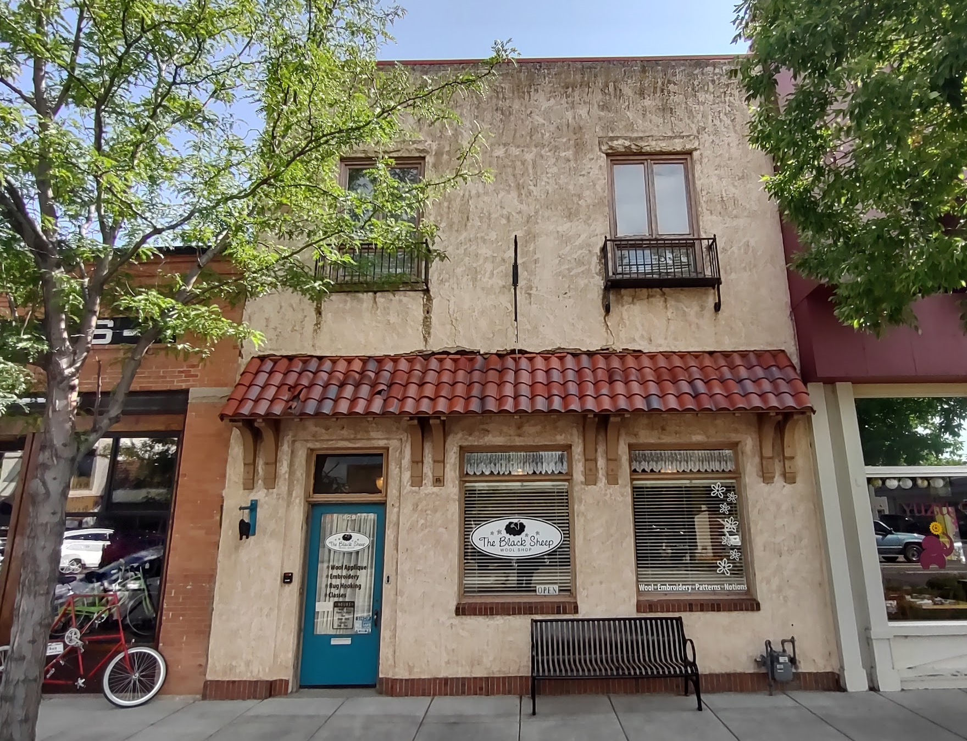
Main Street Open for Business
Windsor - Wool Shop

Slide 17
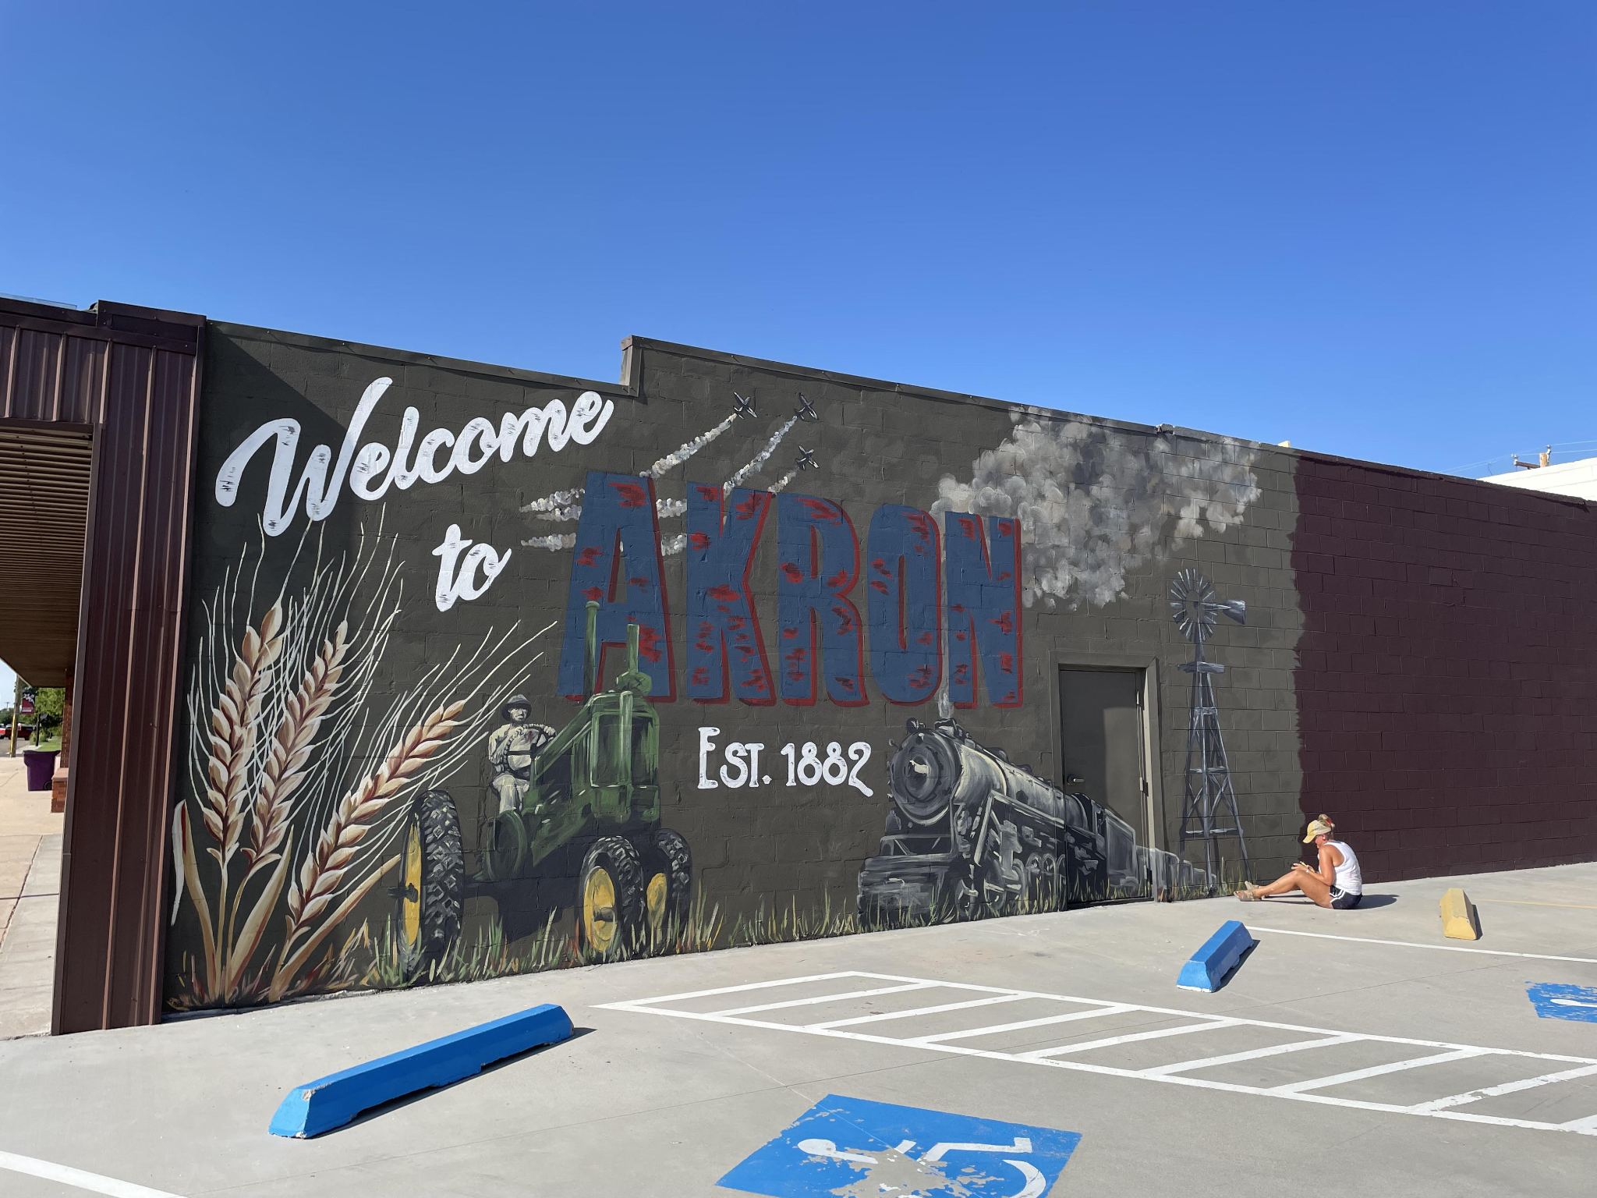
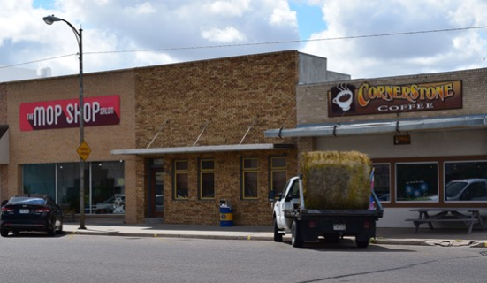
DOLA’s Newest Main Street Community
Town of Akron

Slide 18


The Division of Local Government
Colorado Resiliency Office
3) Colorado Resiliency Office

Slide 19




About the Colorado Resiliency Office
Established in 2013
In response to massive wildfires and flooding in 2012 and 2013 in the state.
Created by Statute
Colorado Revised Statute 24-32-122 lays out how we serve local communities.
Mission
Help communities build stronger, safer, and more resilient systems.
Vision
A long-term adaptable and vibrant future for all Coloradans.
Notes:
Established in statute in 2018 and placed in DLG via HB18-1394.

Slide 20
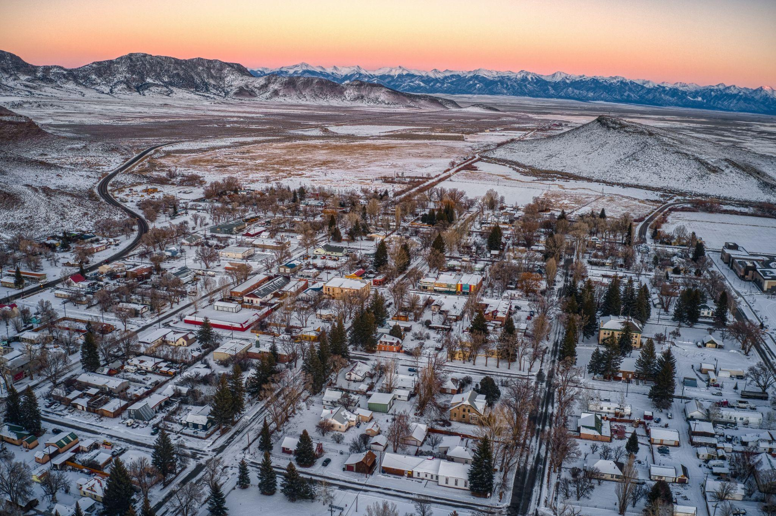
Resilient Colorado Communities
Program Tracks
Climate Change & Local Resilience
Recovery (pre- and post-disaster)
Rural Prosperity

Slide 21

Climate Change & Local Resilience
Resilience workshops, planning, and implementation
Webinar series for local governments and nonprofits
Technical assistance and peer exchange facilitation on specific climate-related impacts (e.g., extreme heat)
Funding and resource navigation support
DOLA/CRO funding
  Microgrids for Community Resilience (MCR)
  Climate Resilience Challenge (EIAF set-aside)
Grid reliability & resilience planning

Slide 22

Recovery
Disaster recovery coordination
Support interagency coordination, unmet needs assessment, and resource navigation for local governments
Local technical assistance and training
Facilitate local and regional training and workshops to develop pre- and post-disaster expertise among local governments
Best practices and tools for disaster preparedness, resilient recovery, and building back better

Slide 23
Rural Prosperity
Resilience planning workshops for communities
Rural Economic Development Initiative (REDI)
Technical assistance for integrating resilience into projects (EIAF/REDI, etc.)
Transitioning communities TA (partner to Just Transitions Office)
State agency coordination during economic disruptions

Slide 24

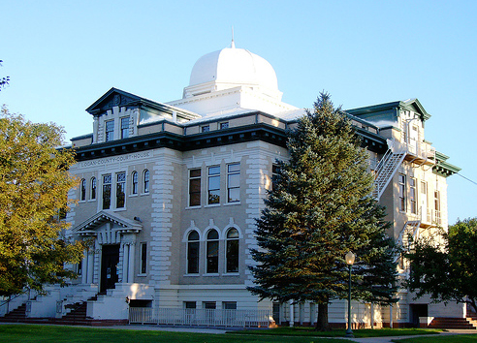
4) Financial Assistance Services
Mobilize and steward financial resources to strengthen Colorado communities
Grants
Loans
Technical assistance
Data
Reporting
Compliance
Notes:
Akron has taken advantage of many DOLA resources.

Slide 25
Questions?
PARTIAL List of DLG Grant Programs
EIAF - Energy/Mineral Impact Assistance Fund Grant
Civil Asset Forfeiture Reporting
CTF - Conservation Trust Fund
Defence Counsel First Appearance Grant Program
Severance Tax Direct Distribution
Local Government Limited Gaming Impact Grant
Gray & Black Market Marijuana Enforcement Grant
Law Enforcement Community Services Grant
Mobile Veterans Support Unit Grant
Non-Profit Infrastructure Grant
Local Planning Capacity Grant Program
Strong Communities Grant Program
REDI - Rural Economic Development Initiative

Slide 26
Questions?
PARTIAL List of DLG Grant Programs (cont’d)
Peace Officer Behavioral Health Support & Community Partnership Grant Program
Community Crime Prevention Initiative
CDBG - Community Development Block Grant
  ED - Economic Development
  PF - Public Facilities
  PS - Public Services
  Disaster Recovery
CSBG - Community Services Block Grant
LOMA - Local Match for IIJA
Volunteer Firefighter Pension
Main Street Open for Business Program
Innovative Affordable Planning Grant Program
Microgrids for Community Resilience

Slide 27

DLG Awarded 250 MILLION DOLLARS in FY2024 alone!

Slide 28
Questions?
DLG Funding Directory
https://dlg.colorado.gov/funding-directory

Slide 29

Questions?
Confused on Which Grant Program Suits You?

Slide 30
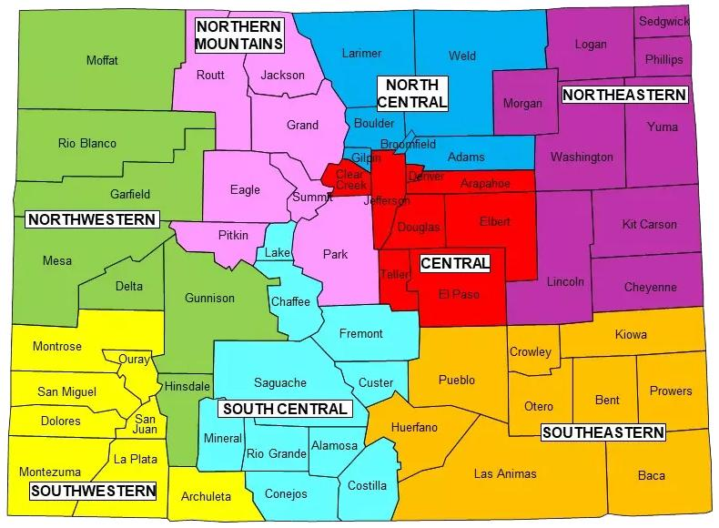
5) Field Services
Regional Managers
Expert Project Development
Extensive Experience
Comprehensive Support
Regional Assistance
Contract Management
Training and Resources
Assistance with Required Documentation
Notes:
https://pixabay.com/en/ipad-map-tablet-internet-screen-632394/

Slide 31
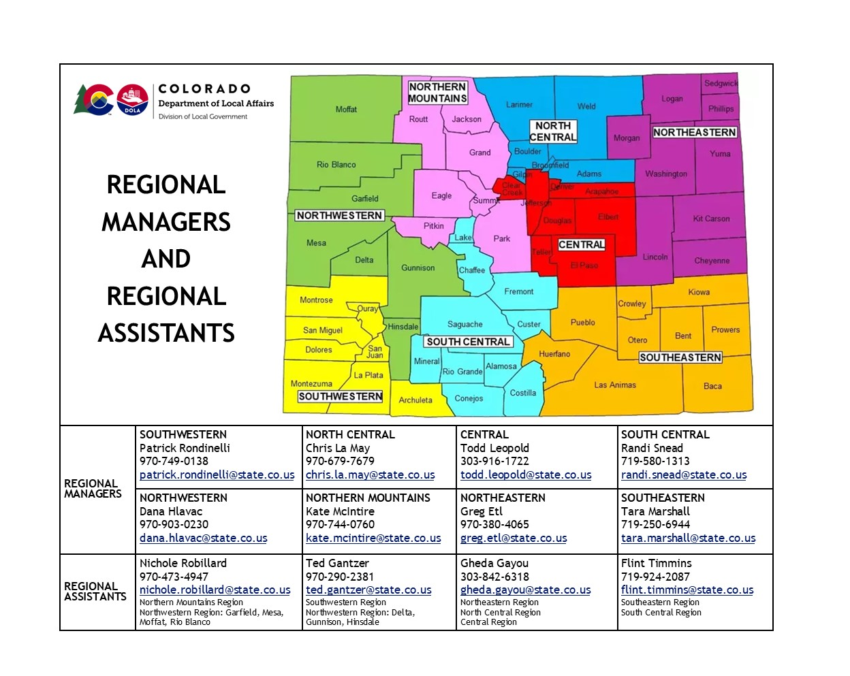
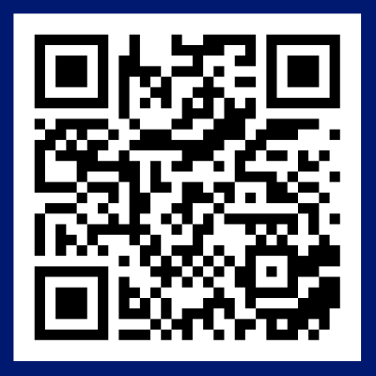
Find your Regional Manager Team
Notes:
https://pixabay.com/en/ipad-map-tablet-internet-screen-632394/

Slide 32
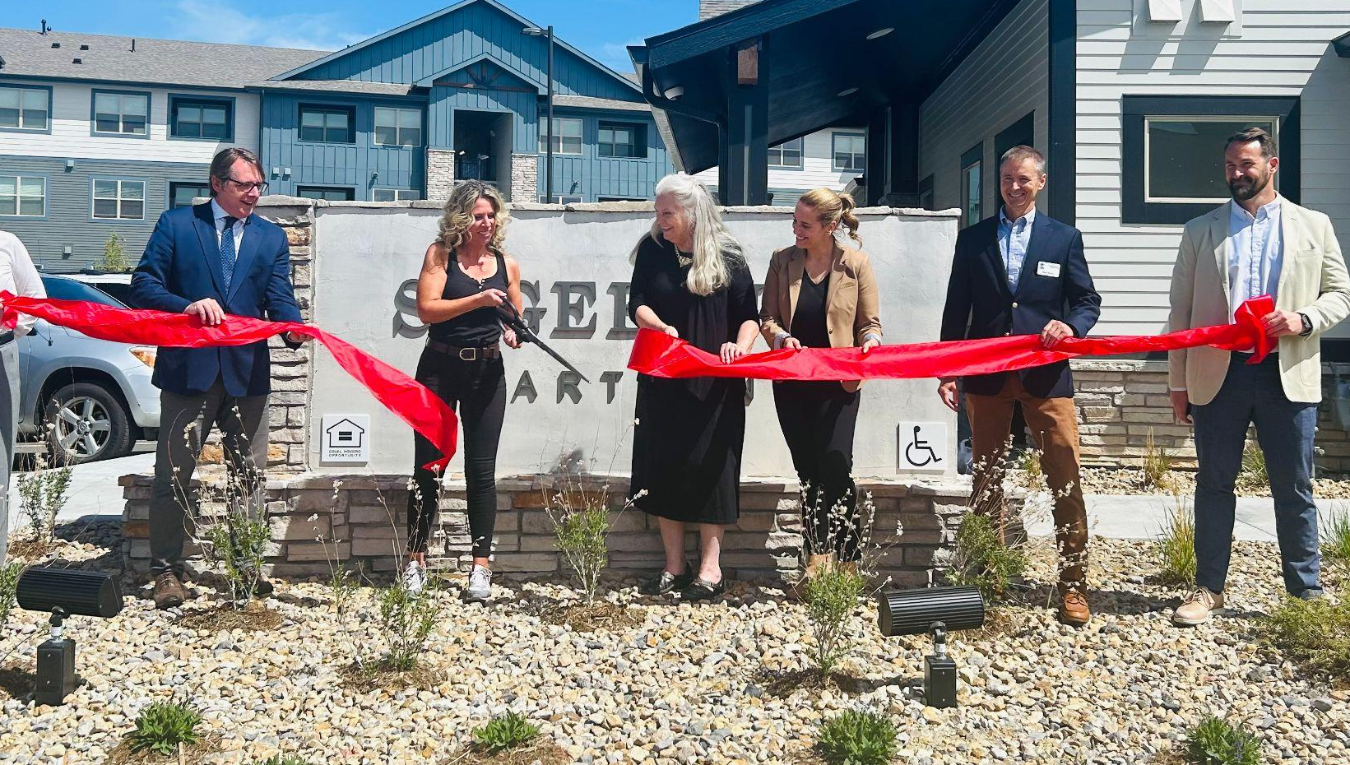
Working in the Affordable Housing Space

Slide 33




DOLA’s Impact on Affordable Housing Since 2020
Over 225,000 Coloradans have received housing support.
More than 110 Local Governments supported in developing Affordable Housing Strategies.
Over 29,000 affordable housing units built.
Over $725 million awarded for affordable housing in Colorado.
Notes:
Numbers from the last three years

Slide 34

Basing Our Strategy on Feedback
Implementation of Proposition 123
Emerging Themes
Feedback collection avenues:
Web surveys, polls, questions
Stakeholder discussions
Summer statewide outreach events
Provide expanded, flexible funding
Help reduce red tape for nonprofits
Provide technical assistance for small entities
Help with more types of homes
Meet owners and buyers where they are

Slide 35



Colorado’s Affordable Housing Realities
Demand for affordable housing is rising
One time funding is ending
Keeping up with demand

Slide 36
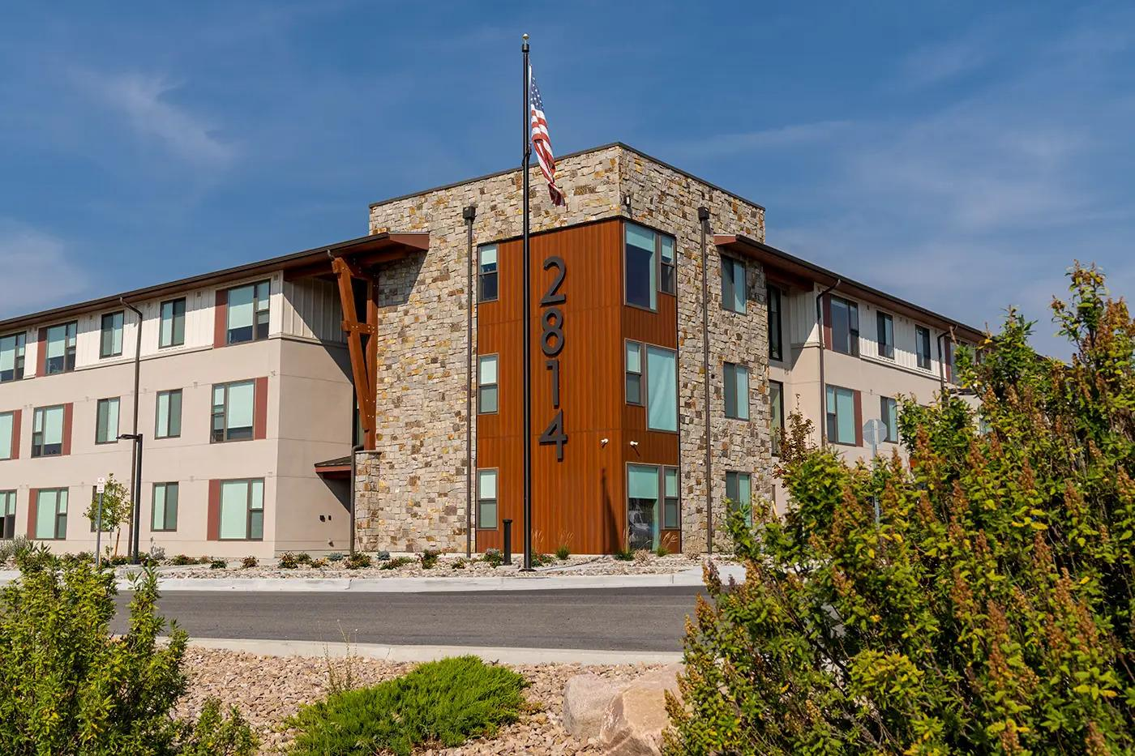
New Approaches for Affordable Housing
Bold and Fresh Ideas at DOLA
Innovative affordable housing strategies
Strong communities planning & infrastructure grants
EIAF/More Housing Now - planning and infrastructure grants
Statewide supportive housing expansion pilot program
Medicaid waiver for billable services

Slide 37




Addressing the New Realities
Hiring and training staff
Improving contracting processing times
Identifying process improvements
Policy innovation
Notes:
Staff hiring and training
Improving contracting
Process improvement
Policy Innovations

Slide 38




Managing the New Realities
Increased staff from 62 FTEs to 180 FTEs (190% Increase)
The average program size has grown by 156% from $1.8 million in 2019 to $4.7 million in 2024, on average.
The housing development and preservation budget has grown 500%
Increased Division programs from 13 to 22 (70% Increase)
Notes:
We’ve grown really quickly. 517%

Slide 39
New Approaches for Affordable Housing
Implementation of Proposition 123
DOLA
Year one
Increase funding opportunities for existing programs.
Year two
Support innovation and capacity building in homelessness programs
Provide support for land acquisition, pre-development
Bolster options for modulars, mobile homes, and accessory dwelling units
OEDIT
Year one
Developed and launched the Land Banking, Concessionary Debt and Equity Programs
Prioritized projects that were shovel ready
Year two
Preparing to launch Land Banking and Concessionary Debt this summer, followed by Equity in the fall.
Coordinating with DOLA to prioritize projects with childcare facilities
Prioritizing modular and other innovative building technology

Slide 40
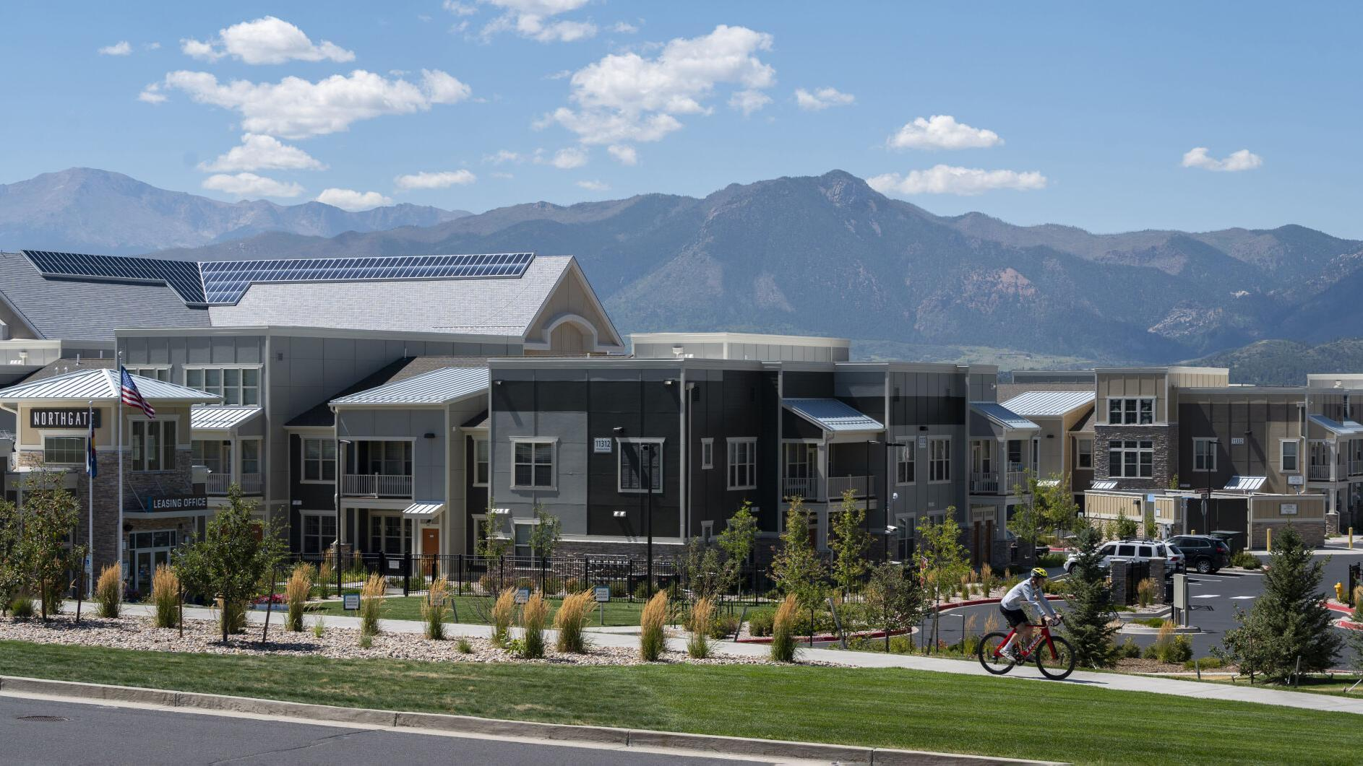
2024 Land Use & Housing Legislation Overview

Slide 41

Land Use & Housing Laws
DLG’s Implementation Priorities
HB 24-1007 Residential Occupancy Limits
HB 24-1304 Minimum Parking Requirements
HB 24-1152 Accessory Dwelling Units
HB 24-1313 Transit-Oriented Communities
SB 24-174 Affordable Housing Planning
Notes:
https://pixabay.com/en/ipad-map-tablet-internet-screen-632394/

Slide 42
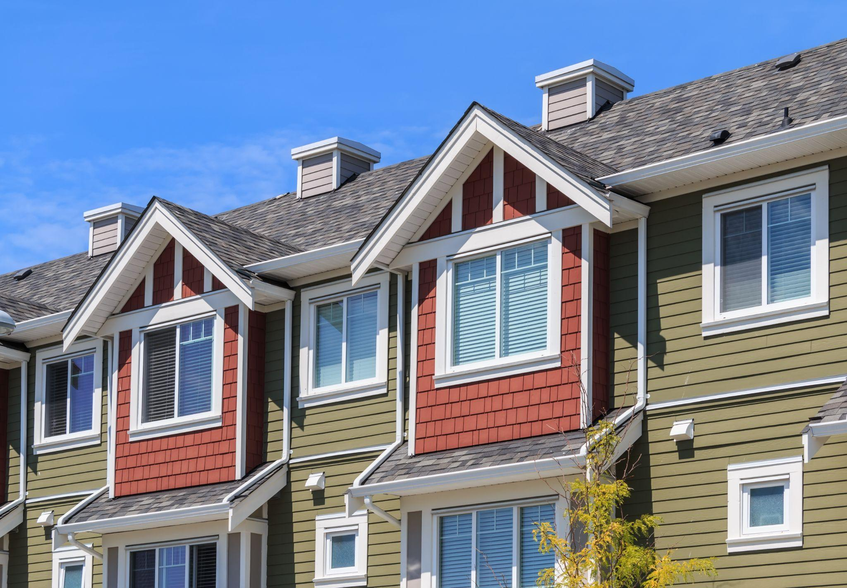
House Bill 24-1007
Prohibit Residential Occupancy Limits

Slide 43
HB 24-1007 Residential Occupancy: Components
Local governments must not limit residential occupancy based on familial relationship.
Local governments may limit residential occupancy based on “demonstrated health and safety standards” (i.e., IBC, fire code, CDPHE wastewater/water quality standards or affordable housing program guidelines).
Compliance guidance now posted on our website.
Notes:
https://pixabay.com/en/ipad-map-tablet-internet-screen-632394/

Slide 44

House Bill 24-1304 - Minimum Parking Requirements

Slide 45
HB 24-1304 Parking Minimums: Components
Local requirement
By 6/30/25, for areas in MPOs and at least partially within applicable transit service areas, local governments must not enact/enforce local laws requiring minimum parking for multifamily residential, adaptive reuse for residential, or adaptive reuse for mixed use that includes 50% of use for residential.
Applicability map
DOLA publishes transit service areas map (by 9/30/24).
Required support
DOLA publishes best practices and technical assistance materials (by 12/31/24).
Notes:
https://pixabay.com/en/ipad-map-tablet-internet-screen-632394/

Slide 46
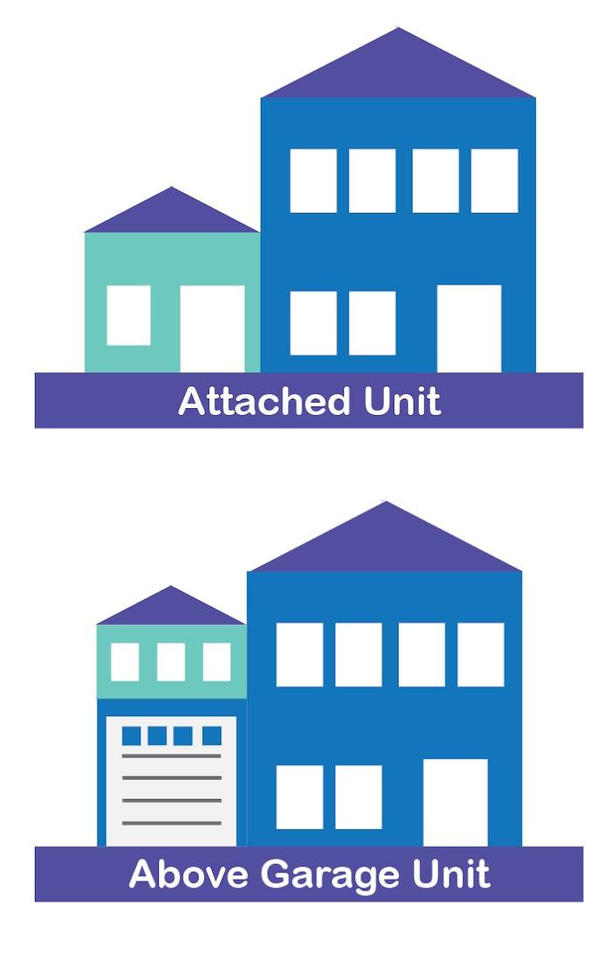
House Bill 24-1152
Accessory Dwelling Units (ADUs)

Slide 47
HB 24-1152 Accessory Dwelling Units: Components
Local ADU requirements
1 ADU allowed in single-family zones.
Applies to:
Local governments within MPOs
Municipalities with 1k+ population
CDPs with 40k+ population
Administrative approval only (no public hearing).
Restrictions: No parking or owner occupancy requirements (limited exceptions); minimal design standards.
Notes:
https://pixabay.com/en/ipad-map-tablet-internet-screen-632394/

Slide 48
HB 24-1152 Accessory Dwelling Units : Components
Certification Process
Submit a compliance report.
Implement at least one strategy to encourage ADU construction/conversion.
Opt-in available for non-subject jurisdictions.
Grant Program
Fee reduction/encouragement program for pre-approved ADU plans.
Local technical assistance or fee reduction support.
Additional financing options via CHFA.
Notes:
https://pixabay.com/en/ipad-map-tablet-internet-screen-632394/

Slide 49
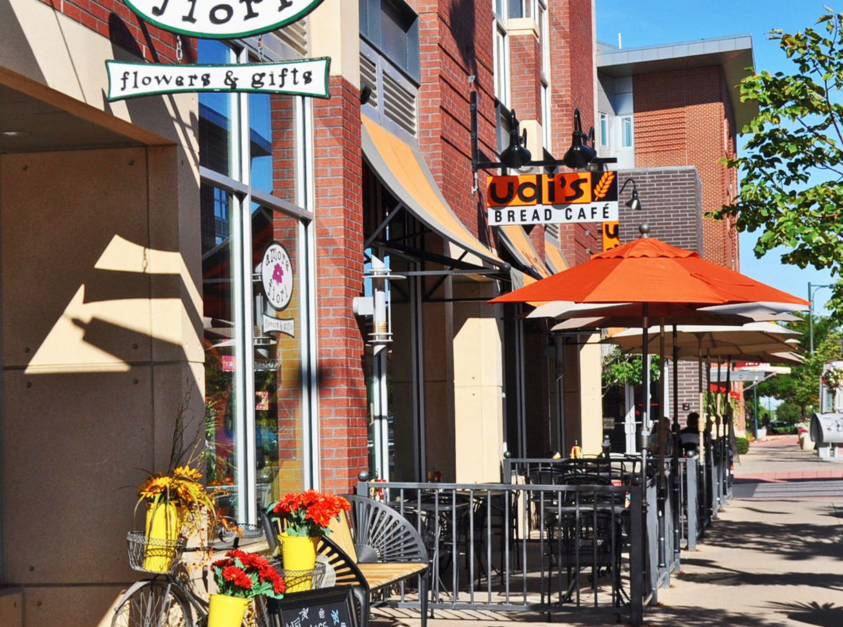
House Bill 24-1313
Housing in Transit-Oriented Communities (TOC)

Slide 50
HB 24-1313 Transit-Oriented Communities: Applicability
Jurisdictions that are required to meet their Housing Opportunity Goal through "Transit Centers"
Municipalities: in MPOs, with a population of 4,000 or more, with 75 acres or more of Transit Areas (areas near frequent transit service).
Counties: in MPOs and near light or commuter rail stations, or, have unincorporated areas that are completely surrounded by municipalities.
Adams County
Arapahoe County
Arvada
Aurora
Boulder
Broomfield
Centennial
Cherry Hills Village
Colorado Springs
Commerce City
Denver
Douglas County
Edgewater
Englewood
Fort Collins
Glendale
Golden
Greenwood Village
Jefferson County
Lafayette
Lakewood
Littleton
Lone Tree
Longmont
Louisville
Northglenn
Sheridan
Superior
Thornton
Westminster
Wheat Ridge
Local jurisdictions statewide may opt-in with "Neighborhood Centers."
Notes:
https://pixabay.com/en/ipad-map-tablet-internet-screen-632394/

Slide 51
HB 24-1313 Transit-Oriented Communities: Components
Housing Opportunity Goal (HOG) Calculation
Step 1: use DOLA map of Transit Areas and calculate jurisdiction-wide HOG
Step 2: identify any gap between existing zoned capacity and HOG
Step 3: designate Transit Centers as needed to meet HOG
Step 4: evaluate existing affordability and displacement mitigation strategies and create an implementation plan
HOG Reporting
Preliminary Report (June 2025)
Final Report (Dec 2026) with additional time to complete zoning and strategies (until Dec 2027)
Ongoing 3-year Status Reports
Notes:
https://pixabay.com/en/ipad-map-tablet-internet-screen-632394/

Slide 52
HB 24-1313 Transit-Oriented Communities: Resources
Key Dates
All local governments statewide that have designated Transit Centers and have been certified, or opt-in Neighborhood Centers are eligible for the TOC Infrastructure Grant Program.
Affordable Housing Tax Credits (via CHFA)
Available to affordable housing developers for projects in Transit Centers and Neighborhood Centers.
Technical Assistance
DOLA must provide TA to complement the grant program. DOLA must also publish a calculation model to support local governments with designating Transit Centers.
Notes:
https://pixabay.com/en/ipad-map-tablet-internet-screen-632394/

Slide 53
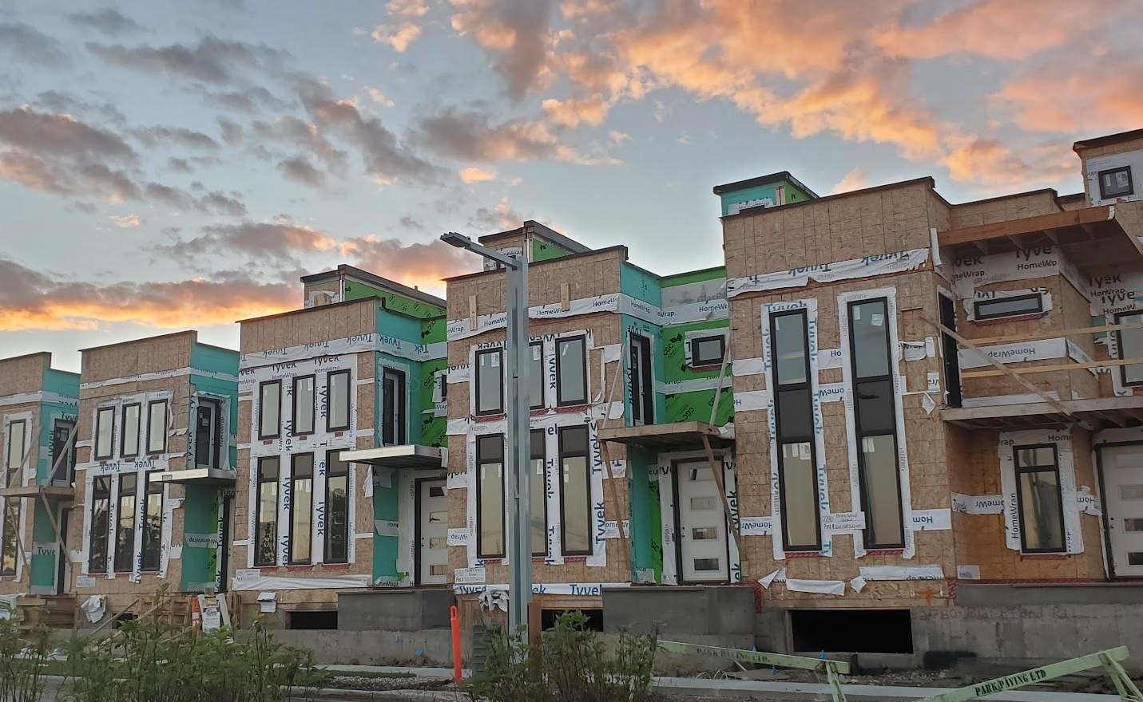
Senate Bill 24-174
Sustainable Affordable Housing Assistance
Housing Planning

Slide 54
SB 24-174 Sustainable Affordable Housing Assistance: Components
Housing Needs Assessments (HNAs)
All local governments of 1,000 or more in population (unless negative pop change 1%+ in last decennial census or participated in Regional HNA).
HNA must conform to DOLA’s methodology and requirements in statute.
Housing Action Plans
Local governments of 5,000 or more in population or 1,000 or more in population and participated in a RHNA or rural resort community as of 1/1/24.
Grant program
Housing Needs Planning TA Fund for HNAs.
Technical Assistance
Materials, training, tools, templates, and function as a clearing house.

Slide 55
SB 24-174 Sustainable Affordable Housing Assistance: Components
Directory
Affordability strategies, displacement mitigation strategies.
State Reports
DOLA leads, facilitates engagement for, and publishes (1) a statewide strategic growth report and (2) a natural/agricultural interjurisdictional opportunities report.
State Grants Criteria
Update to prioritize projects in/supporting neighborhood centers and compliant LGs (re HNAs/HAPs and comprehensive plans).
Comp Plans
Must include a strategic growth element and a water supply element by 12/31/26.

Slide 56
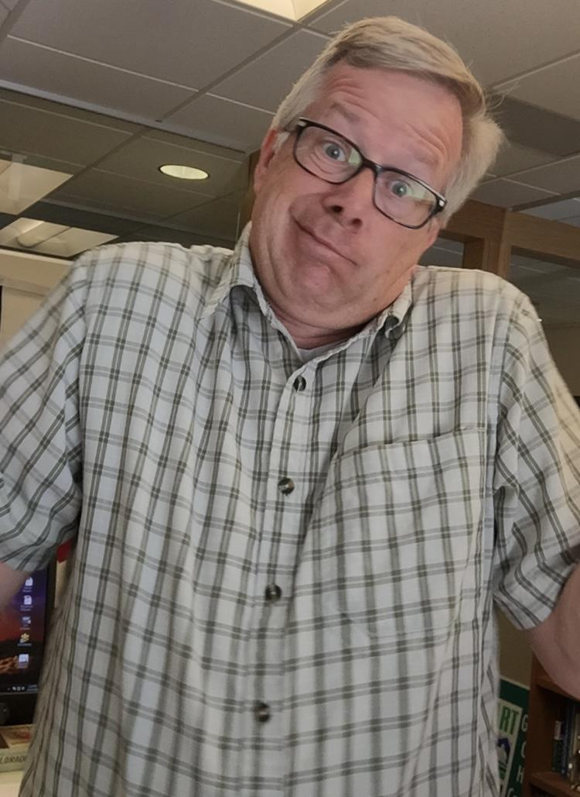
Questions?

Slide 57
Thank You !

