Slide 1

Colorado’s Budget Made Easy
Christopher Stiffler
Senior Economist

Slide 2
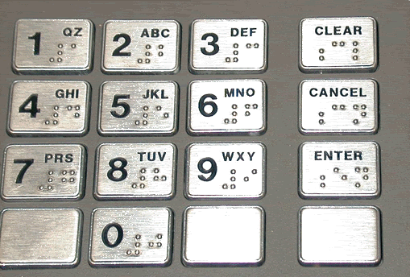
Why is there Braille on drive-thru ATMs?

Slide 3

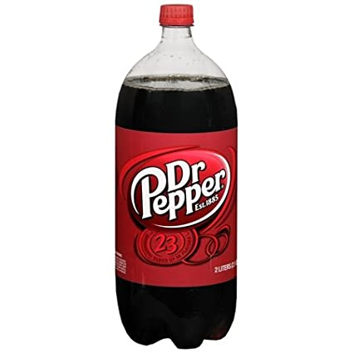
Why is milk sold in rectangular containers while soda and beer are sold in round?

Slide 4
Wasted shelf space

Slide 5
Graduated Tax Example:
$0-$10 is taxed at 2%
$11-$20 is taxed at 3%
$21-$30 is taxed at 4%
$31+ is taxed at 5%
What are taxes if Person A earns $25?
=$10(.02) + $10(.03) +$5(.04)
= $.20 + $.30 + $.20
=$0.70 in taxes

Slide 6
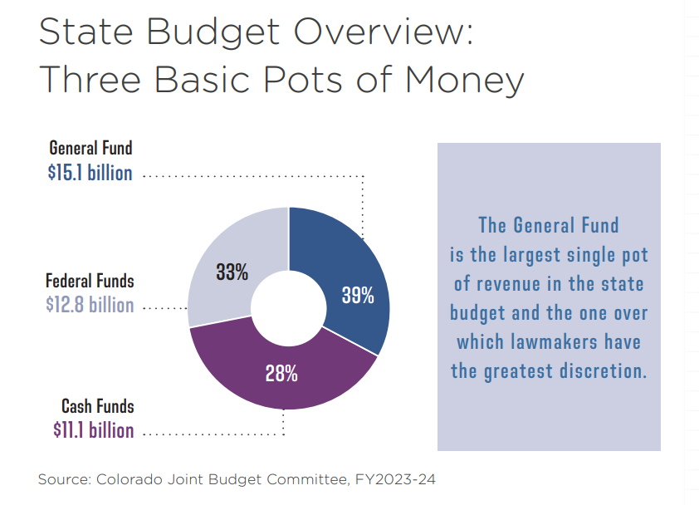

Notes:
3 basic pots of money in the entire state budget: federal $$$, cash funds, and taxes
Cash Funds: are the specific fees raised for specific purposes---think motor vehicle fees when you register your car every year.
Can’t raise a fee on a farmer and use it for “general purposes” that’s what the General Fund is for.
General Fund is the pot of money that our elected officials have the most discretion over.

Slide 7
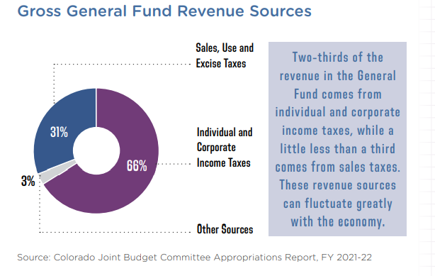

Notes:
About 30 percent comes from the state sales tax (that’s the 2.9% states sales tax you pay on items subject to sales tax in CO).
Most of the General Fund comes from individual and corporate income taxes.
Think of the GF as the collective pot of money that Coloradans throw their tax dollars into.

Slide 8
Sales Taxes Across Colorado
Sales Tax Rates In Selected Cities across Colorado
 | State | County | City | Regional Transportation | Cultural District | Mass Transit | Total
Aspen | 2.9% | 3.1% | 2.4% | 0.4% |  | 0.5% | 9.30%
Boulder | 2.9% | 0.985% | 3.86% | 1.0% | 0.1% |  | 8.85%
Colorado Springs | 2.9% | 1.23% | 3.12% | 1.0% |  |  | 8.25%
Denver | 2.9% | * | 4.81% | 1.0% | 0.1% |  | 8.81%
Durango | 2.9% | 2.0% | 3.0% |  |  |  | 7.90%
Evergreen | 2.9% | 0.5% |  | 1.0% | 0.1% |  | 4.50%
Fort Collins | 2.9% | 0.65% | 3.85% |  |  |  | 7.40%
Pueblo | 2.9% | 1 | 3.5% |  |  |  | 7.40%
Gunnison | 2.9% | 1% | 4% | 1.0% |  |  | 8.90%
Winter Park | 2.9% | 1.3% | 7.0% |  |  |  | 11.20%
COLORADO Ave. | 2.9% |  |  |  |  |  | 7.72%
Notes:
45 states collect a state sales tax and 38 states collect local sales tax. Delaware, New Hampshire, Alaska, Oregon, and Montana have no state sales tax.
The state sales tax rate is 2.9 percent, the lowest in the country among states collecting sales tax.
Local sales tax rates in Colorado averaged an additional 4.6 percent on a population-weighted basis, the nation’s third-highest local sales tax rate after Alabama and Louisiana.
When combining both the state and local sales taxes together, Colorado ranks 16th at a combined rate of 7.5 percent. Louisiana ranks highest with a combined weighted rate of 9.98 percent.
https://taxfoundation.org/state-and-local-sales-tax-rates-in-2017/

Slide 9
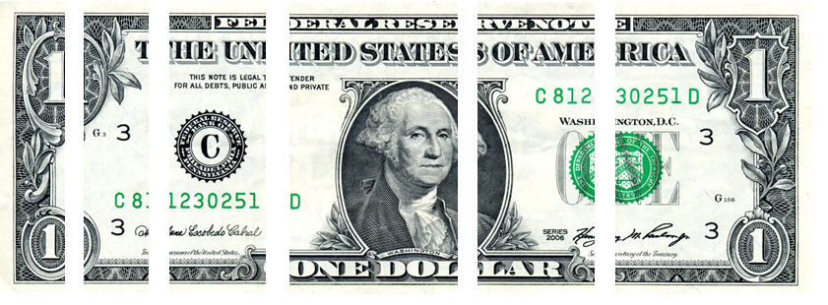
What do you think?
How do you think Colorado spends your tax dollar?
Higher Education, K-12, Roads, Courts, Prisons,
Human Services, Healthcare, Other?
Notes:
EXERCISE-------Should be between 30 and 35 minutes in.
EXPLAIN exercise
Ask them to work individually first – about 5 minures
then work in a group.. About 10 minures
Ask them to turn in their work and take a break 10 minute break

Slide 10
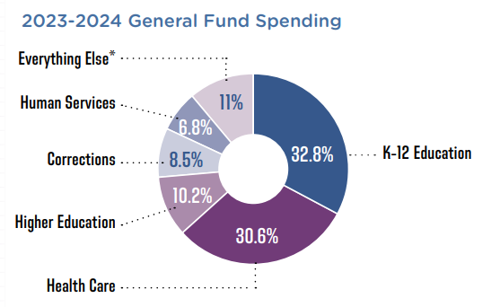
Notes:
Here is what those collective tax dollars buy: K-12 is the biggest piece, followed by healthcare (most of that spending is for Medicaid).

Slide 11
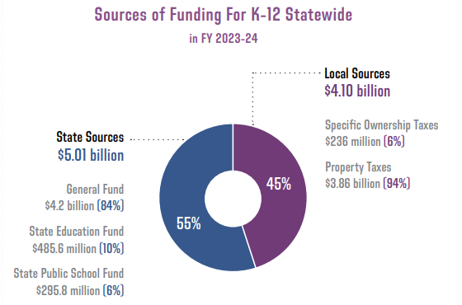
Notes:
Here is what those collective tax dollars buy: K-12 is the biggest piece, followed by healthcare (most of that spending is for Medicaid).

Slide 12
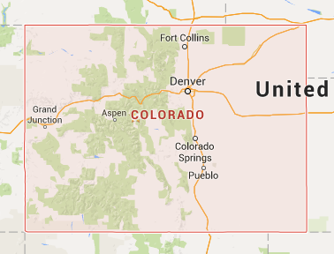
Shares Vary Depending on Property Taxes
Notes:
As I talked about earlier, schools are funded in part by property taxes. How much a district can shell out for schools depends hugely on the value of the property in that district. The state tends to pay much more to school districts with low property values, whereas wealthier districts can pay for a lot more of their share.
Wealthier districts end up spending more per pupil for this and other reasons that I’ll go into soon.

Slide 13
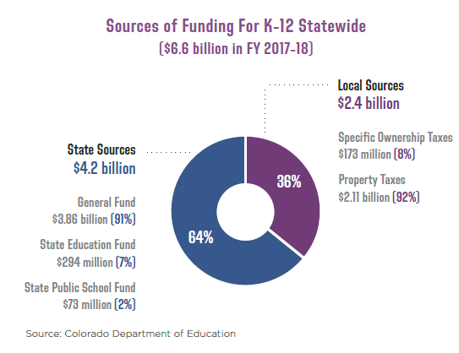
2018
2024
Notes:
Here is what those collective tax dollars buy: K-12 is the biggest piece, followed by healthcare (most of that spending is for Medicaid).

Slide 14
The timeline to understand the fiscal discussion today
School Finance Act
Mill Stabilization
Gallagher
Amendment 23
Negative
Factor
TABOR
Ref. C
1982
1992
1994
2000
2005
2007
2009
Notes:
Firstly, as we learned last time, the Gallagher Amendment in 1982 began to drive down how much property taxes go to schools. It did so by locking in our residential property assessment rate at 7.15%. Even though that was repealed in 2020, we still can’t raise that assessment rate without a vote of the people because of… TABOR! TABOR limits how much we can grow revenue-wise, and limits the pot of money from which we take school funding dollars out.
The School Finance Act dictates how the school finance formula is calculated and hasn’t been updated in a long time, so there are perhaps more ways we could adjust the base funding to include more factors that could increase what the base is.
There was a span of ten years or so where it looked like we were getting back on track:
Amendment 23 required per-pupil funding for schools to increase every year, to try and reach a spending goal that would put us back on track with the national average. Since Gallagher, our per pupil funding had been dropping – and TABOR made it worse.
Ref C, as I went over earlier, allowed the state to keep up a little better with costs, but not quite enough.
Mill stablisation law said that school districts no longer had to cut property tax rates to avoid exceeding the TABOR cap.
Then, the great recession happens. This takes all the progress we had been making working around TABOR and gallgher, and kind of throws it out the window. the negative fctor, which I’m about to discuss, created a tool to cut funding for school idstricts to help balance the state budget in the midst of the financial crisis.

Slide 15
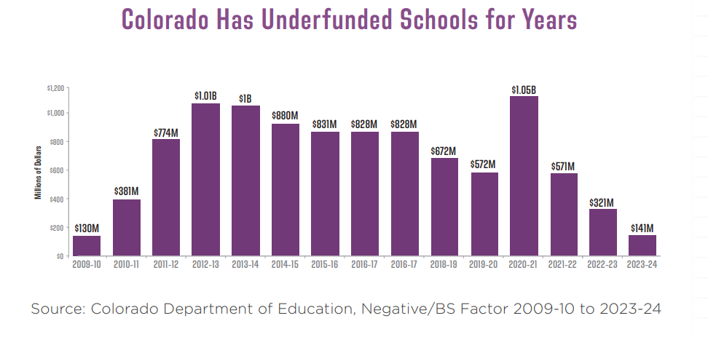

Slide 16
Explanation: TABOR Major Provisions
Limits The Legislature’s Ability to Raise Revenue
Limits Revenue Collections
Limits Tax Options
Sets Election Provisions
Notes:
TABOR elections can occur in both odd and even years whereas non-TABOR-related elections can only occur in even years.
A TABOR ballot measure must begin with “shall taxes/debt be increased by $_____ annually”
Blue Book Requirements

Slide 17
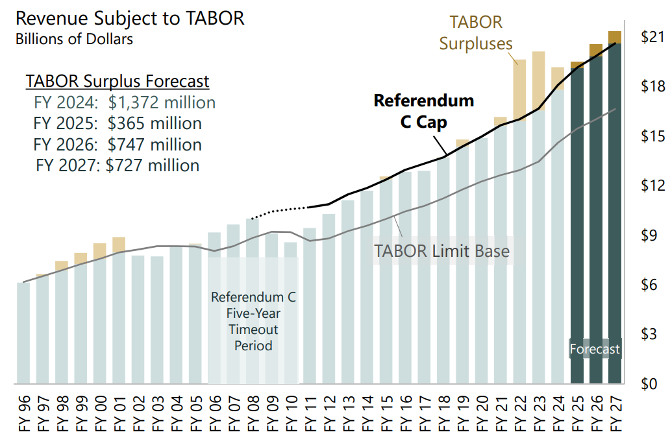

Slide 18
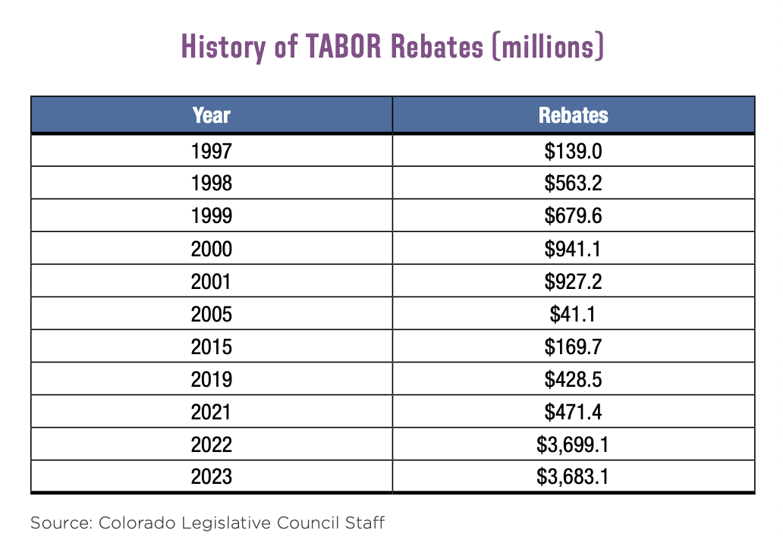
Historically Large TABOR Rebates

Slide 19
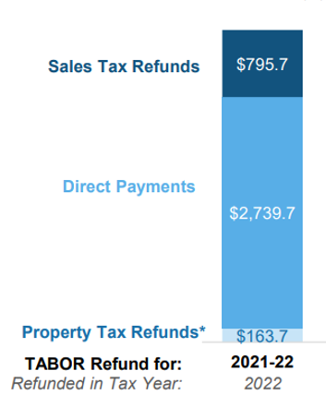
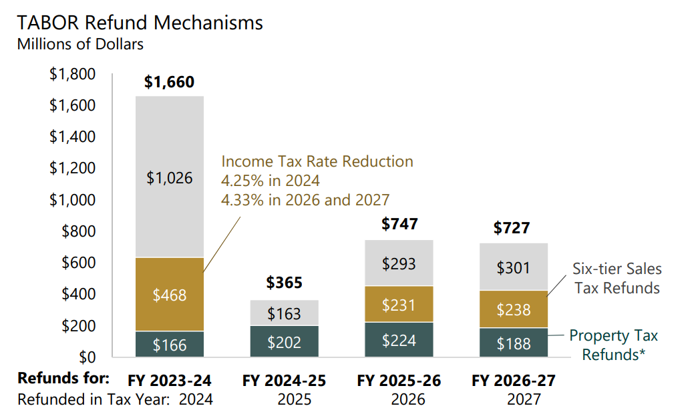
How the TABOR Rebates are Distributed

Slide 20

Property Tax Explained….
Property Tax = Property Value X Assessment Rate X Mill Levy
determined locally
by market value
set by the state
by property category
—e.g. residential, commercial
established at
local district level
X 6.7%
X 90 mills = $3,316
= $36,850
$550,000

Slide 21
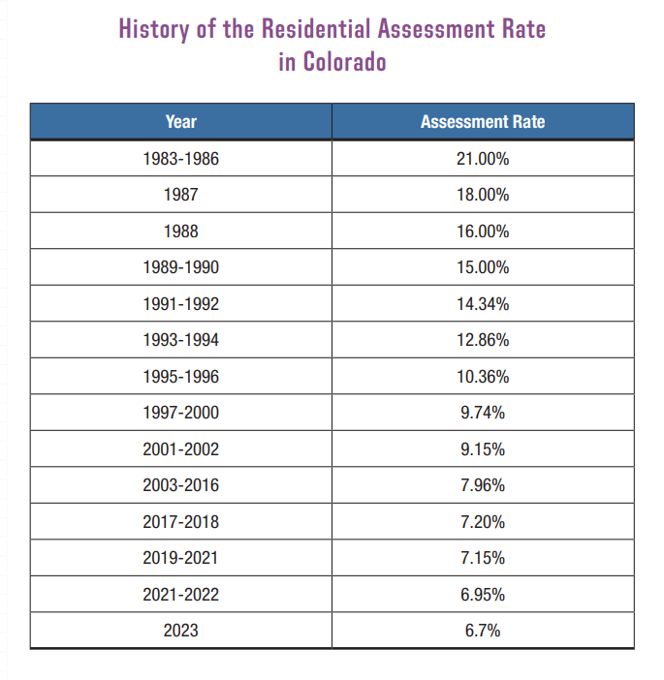

Slide 22
Property Taxes are all Local
Schools: 51.1 percent
Counties: 19.5 percent
Special Districts: 18.8 percent
City and County of Denver: 4.9 percent
Municipal governments: 4.6 percent
Local district colleges: 1.2 percent

Slide 23
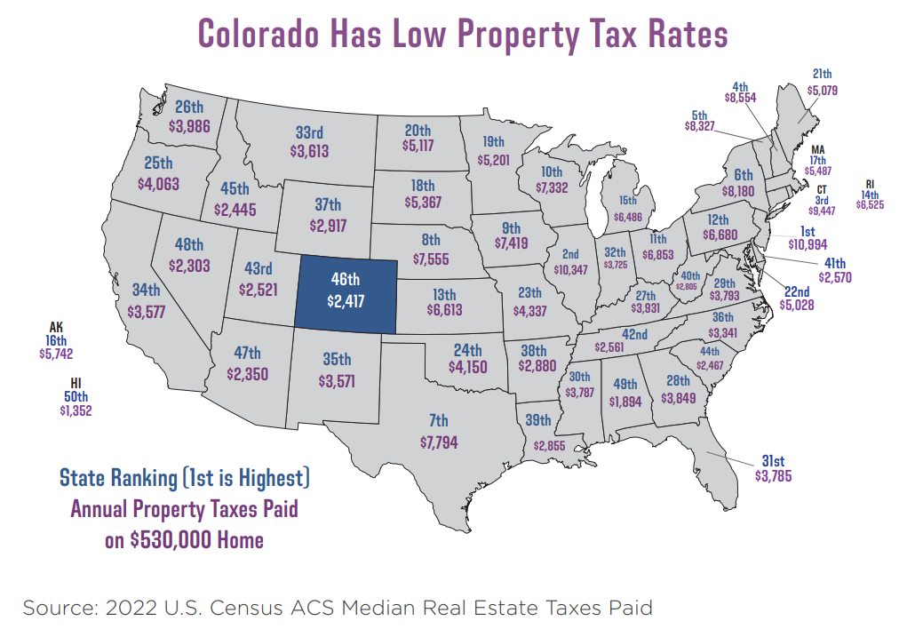

Slide 24
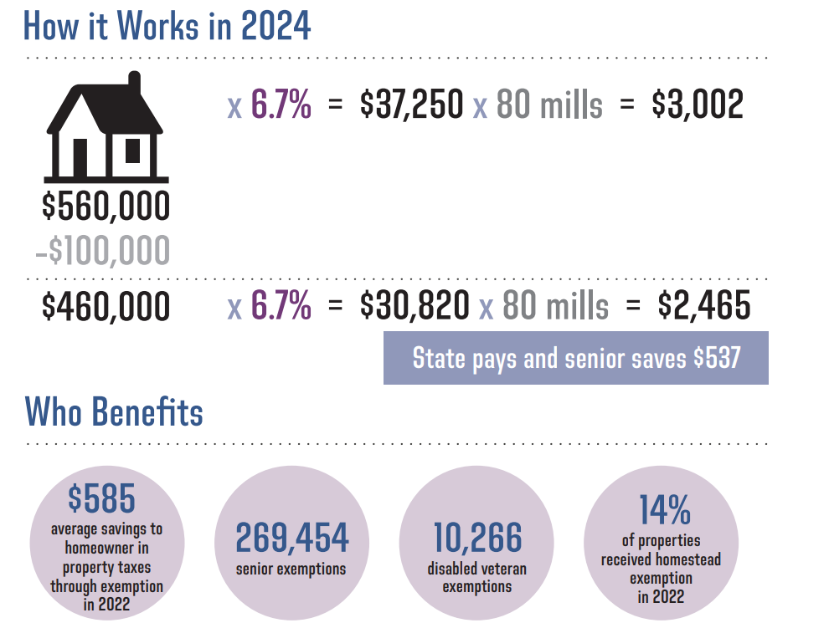

Slide 25
Retail Marijuana Revenue is about 1.6% of Gross General Fund
$285 million
$17.2 billion
March 2023 Legislative Council Forecast for FY2021-22

Slide 26
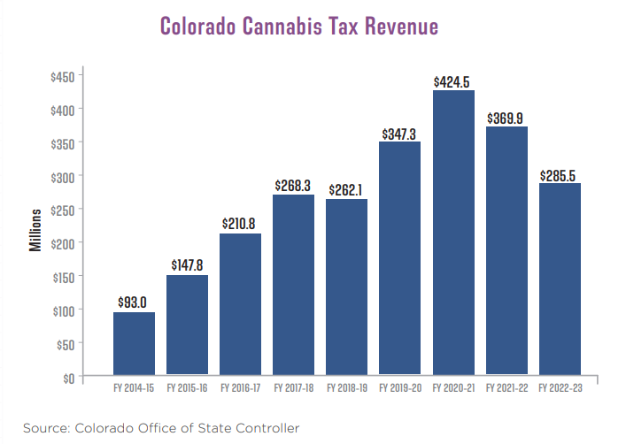

Slide 27
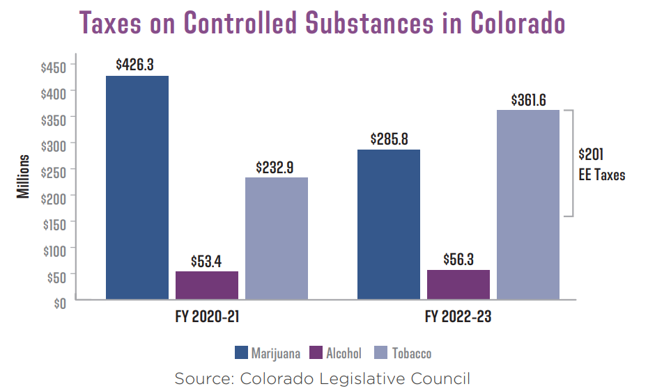

Slide 28
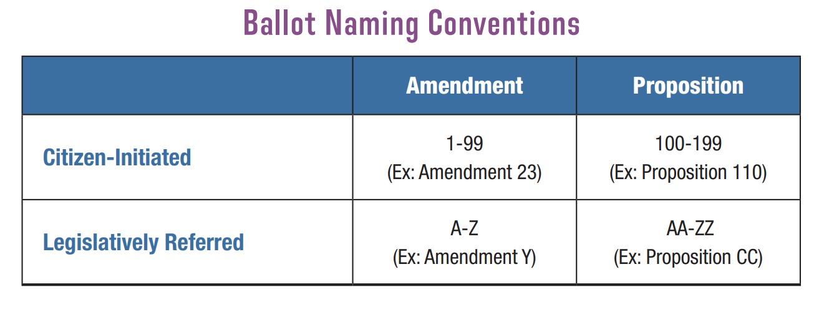
What about the 2024 Ballot?

Slide 29
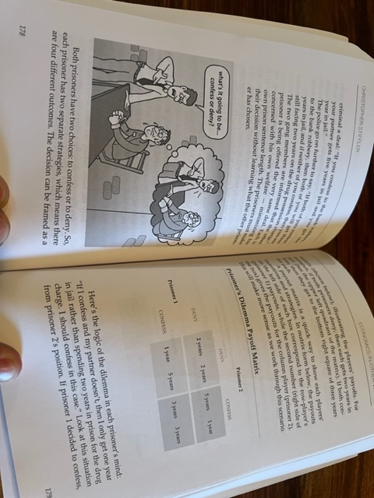
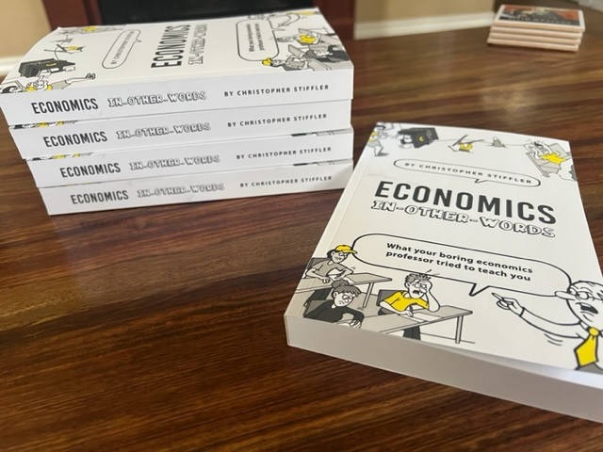
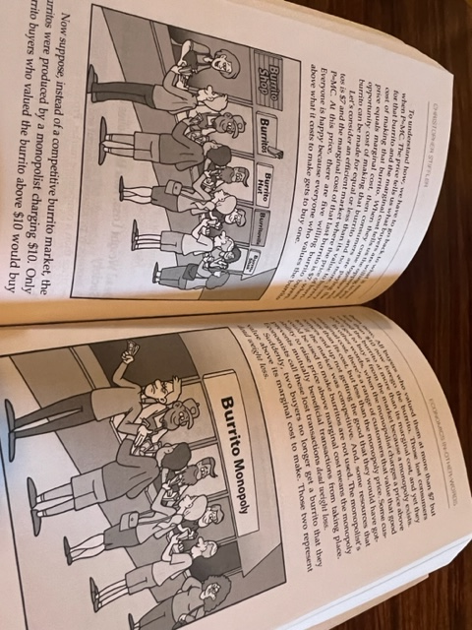

Slide 30
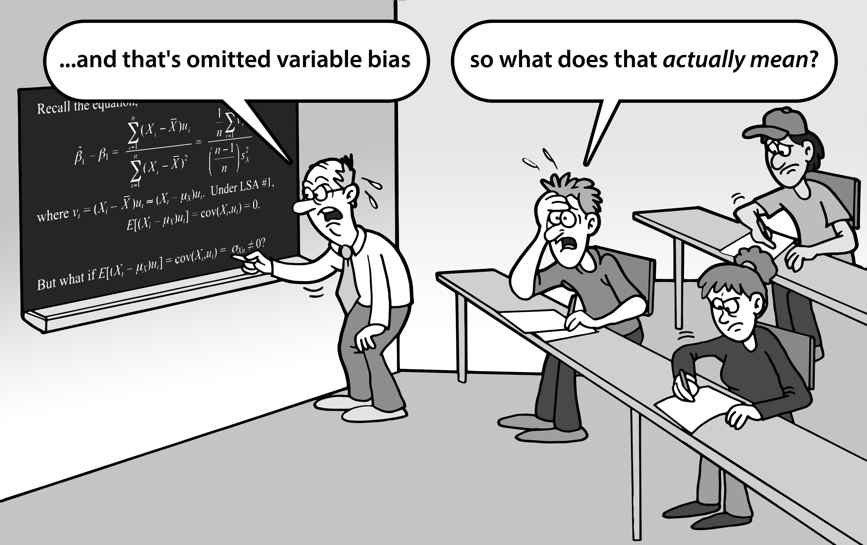

Slide 31
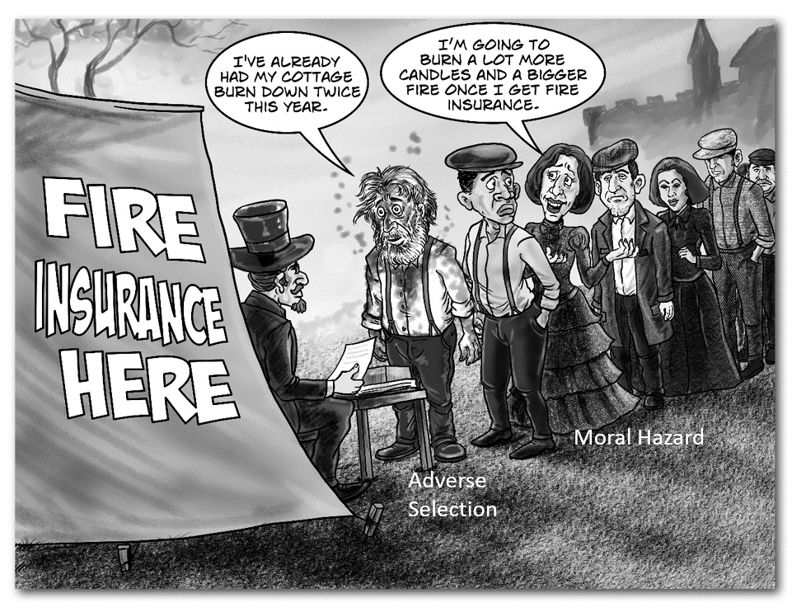
The Book’s Goal: Lead with the In-Other-Words Words
moral hazard: used to describe a correlation between the incidence of the insured event and the possession of insurance for that event.
In other words, people with fire insurance are more likely to burn down their house.

Slide 32
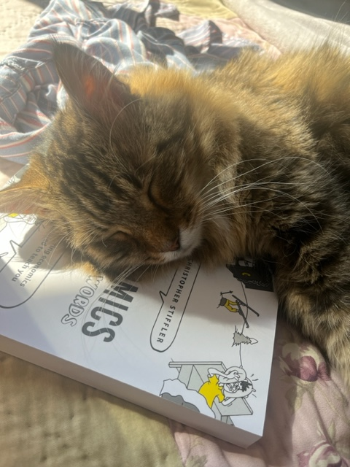
“Economics by Os-meow-sis”
“Talk about
Purr-fect Competition”
“I thought you said ‘lazy-faire’”

Slide 33
Questions?
Christopher Stiffler
Stiffler@coloradofiscal.org

Slide 34
May 2022

Slide 35
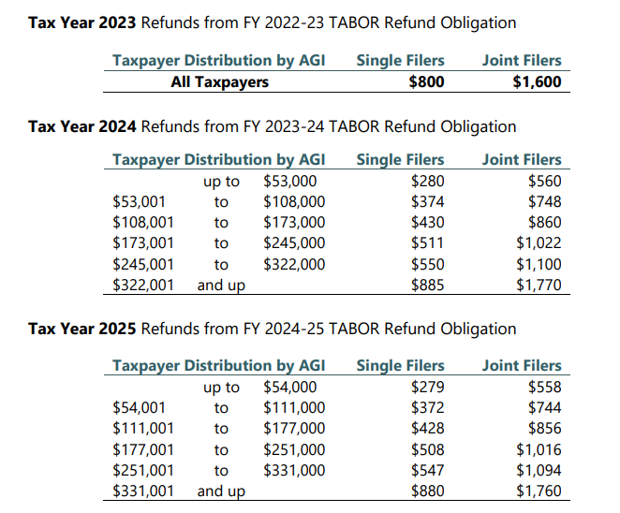

Slide 36
Prop HH (Chris Notes)
Provides Property Tax relief (by lowering assessment rates and exempting some market value)
Changes the revenue cap (allows cap to grow by an extra 1%)
Reimburses some local governments
More money dedicated to schools
More money for affordable housing
Creates limit on local property tax collection
Creates Property Tax Break for those who lost Homestead Exemption
Notes:
Backfills local governments based on a growth formula to avoid having to cut critical local government services
Homestead notes: allows 65-year-old to get it without having the 10-year residence requirement

Slide 37
Prop HH (CFI Notes)
Gives Property Tax Cut by lowering assessment rates
Backfills some local governments
Allows state to keep more TABOR revenue by allowing revenue cap to growth by an extra 1%

Slide 38
Prop HH (1% extra Growth on Revenue Cap Compounds)
$1 billion extra by FY26-27

Slide 39


Formula Doesn’t Measure What Government Buys
Notes:
The broad-based measure of the CPI calculates the prices of a bunch of items. This doesn’t accurately reflect what government needs to buy. In fact the stuff government buys tends to have its prices grow faster than the broad-based measure that TABOR dictates in the formula.
The a grocery cart of goods that contains phone bills, shirts, toothpaste, hair cuts, medical services, plane tickets, food. The CPI measures the prices of all of them.
But the grocery cart that government buys is roads, teachers, healthcare. They all grow faster.
Using a consumer based price index to calculate how much the government can spend on its own collection of goods and services is not an accurate or precise way of determining how much money it will need.

Slide 40
Prop HH (Details)
 | 2023 | 2024 | 2025-2032
Residential Assessment Rate (Current Law) | 6.765% | 6.98% | 7.15%
Residential Assessment Rate (Prop HH) | 6.700% | 6.700% | 6.700%
Exempted Market Value (Current Law) | 15,000 | 0 | 0
Exempted Market Value (Prop HH) | 40,000 | 40,000 | 40,000
$550,000
Denver
2023 2024 2025
Savings if HH Passes: $171 $357 $436
 | 2024-2026 | 2017-2028 | 2029-2030 | 2031-2032
Non-Res Assessment Rate (Current Law) | 27.90% | 29.00% | 29.00% | 29.00%
Non-Res Assessment Rate (Prop HH) | 27.85% | 27.65% | 26.90% | 26.90%

