Slide 1

Securing an Accurate 2020 Census
Pro15 Board of Directors
Rural Healthcare Discussion
Melanie Worley
Deputy Director - Colorado

Slide 2
Council for a Strong America ReadyNation
National bipartisan nonprofit promoting solutions that prepare children to succeed in education, work, and life.
ReadyNation - Business membership group building a skilled workforce and strong economy by helping to put kids on the right path to productive lives.
Notes:
CSA is a national, bipartisan nonprofit that unites five membership groups made up of law enforcement officials, business leaders, retired admirals & generals, faith based leaders, & coaches & athletes, promoting solutions that prepare kids to succeed in school, work & life.

Slide 3
What Does the Census Do
Determines apportionment in Congress.
Provides data for distribution of more than $1.5 Trillion in Federal Funds (FY 2017).
Provides data essential for redistricting in 2021. This includes congressional and state legislative districts, school districts, and more.
Informs government, nonprofit and business decision making. Especially important when it comes to planning for growth and development.
Provides population benchmark for nearly every other U.S. based survey.

Slide 4
Confidentiality
Federal Law – Title 13 of the US Code protects the confidentiality of all information.
Employee Oath – Protect confidentiality for life. Penalties if violated can be 5 years in prison and/or $250,000 fine.
Statistical Safeguards – Ensure that statistics released do not identify individuals.
Records are confidential for 72 years by law (Title 44, U.S. Code).

Slide 5
How You Will Be Counted
95% of households will receive their census invitation in the mail.
Almost 5% of households will receive their census invitation when a census taker drops it off. In these areas, the majority of households may not receive mail at their home’s physical location (like households that use PO boxes or areas recently affected by natural disasters).
Less than 1% of households will be counted in person by a census taker, instead of being invited to respond on their own (very remote areas).
Notes:
Every household will have the option of responding online, by mail, or by phone. Nearly every household will receive an invitation to participate in the 2020 Census from either a postal worker or a census worker.

Slide 6
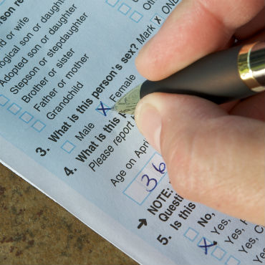

4 Ways to Respond
Internet & Phone | Paper Mailer | In-Person Interview
Arabic Chinese English French Haitian Creole Japanese Korean Polish Portuguese Russian Spanish Tagalog Vietnamese | English & Spanish | Numerous community individuals hired to interview others in their own community and language
Encouraging Self Response Yields Best Data ~ More Accuracy
Notes:
Internet and phone options offered in 13 languages – Paper form in English and Spanish only

Slide 7
Questions Asked
2020 Census will ASK:
  How many people are living/staying at your home on April 1, 2020
  Whether the home is owned or rented
  For each person in your home, you will be asked to report the:
    Sex
    Age
    Race (including whether of Hispanic, Latino, or Spanish origin
    Relationship to other household members
2020 Census will NEVER ask for:
  Your social security number
  Money/donations
  Anything on behalf of a political party
  Bank/credit card account info

Slide 8
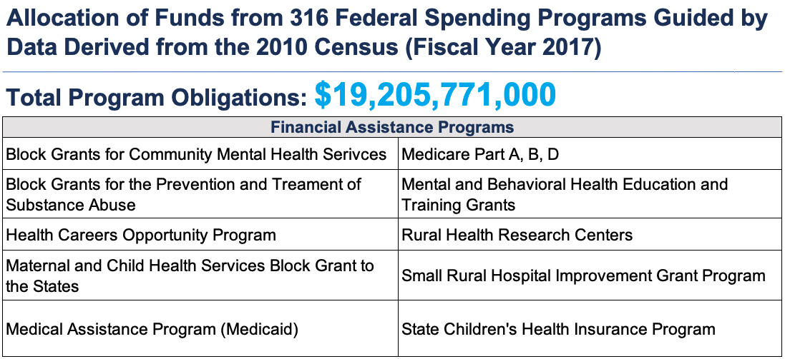
Colorado Has a Lot to Lose
= $3,300 per person, per year x10 years

Slide 9
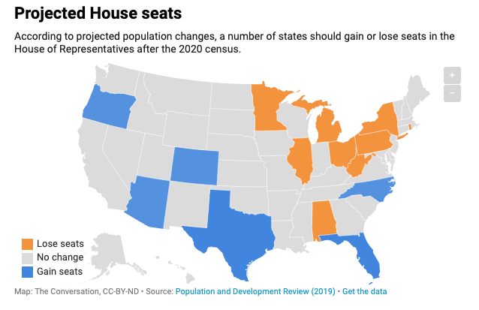
Political Gain for Colorado
Notes:
According to projected population, blue states, including Colorado should gain a Congressional seat. The orange states are projected to lose at least one seat (NY likely two), and the grays are even, with the exception of California, which may lose a seat. An small undercount could cost us that seat.
States are fighting (with significant dollars) for their Congressional seats and we know it’s a zero sum game.
Bottom line – a small undercount will have a huge impact on Colorado from a fiscal and a representation standpoint and it is important that we understand how few we need to miss in order to be negatively impacted.

Slide 10
Hard-to-Count Population
Low Income
Homeless
Renters
Older Adults
538,533 Estimated HTC population in Pro-15 Counties
Immigrants
Refugees
Rural
Young Children
Notes:
It is believed that there are at least 1.5 million people in HTC populations in Colorado with over 538k in the Pro 15 area.

Slide 11
Hard-to-Count by Pro-15 County

Slide 12


2020 Census Timeline
Census Day - April 1st
March 12-20
March 16-24
Mar 26- Apr 3
April 8-16
April
20-27
First mailer sent to households
Second mailer sent
to households
Postcard reminder
Mailer with paper questionnaire
"It’s Not Too Late” postcard
Notes:
Four cohorts - Update Leave in areas with post office box or county road addresses - some get questionnaires (lack of broadband)

Slide 13



Census Timeline
July 31
December 2020
May 13
Door-to-door enumeration begins
Door-to-Door Enumeration ends
Census numbers delivered to President
Notes:
May starts the door-to-door campaign for those that have not responded and that process ends in July.
Census Bureau predicts that the self-response rate – or the rate of those who respond without direct outreach – will be in the 50-60% range, so very low
We have our work cut out for us.

Slide 14
Ways to Engage
Externally
Community Members
Local Businesses
Internally
Employees
Contractors

Slide 15

External Engagement
Paid Advertising
Census message on mailers, fliers, newsletters, billings
2020 Census information on website - link to DOLA website
Social media messaging
Tie Census message to business priorities (construction, housing, healthcare)
Place Census response kiosks in public areas of facilities for customers

Slide 16
Internal Engagement
  Educate/train employees on the importance of the 2020 Census
  Census information in break rooms
  Employee bulletins
  Employee Intranet
  Messaging with paychecks
  Provide time, space, and equipment (tablets, computers) for employees to complete the form

Slide 17

Utilizing Existing Census Resources
Existing Designs - Logo
Department of Local Affairs Census 2020 Website
Complete Count Committees – Printing Resource
  ReadyNation Business Toolkit – TPs, Social Media Graphics, Draft Communication, Customizable Flier
Notes:
DOLA has a designer that is willing to adapt this logo to individual cities and towns so if interested they will help and has set aside funds for Printing resources and suggest working through CCCs to coordinate printing needs
CLOSING: In addition to the fiscal and political loss potential, Cities and Towns need accurate data to make decisions about growth and development, including economic development. You need it to plan for new and improved infrastructure.
Bottom line is that this is not about how the Government will spend for the next 10 years, but where, and we need to do all we can to preserve what belongs to Colorado.
Message = It’s Important, Easy, Safe & Required

