Slide 1

Visit WWW.NORTHERNCOLORADO.COM
Northern Colorado Economic Alliance

Slide 2
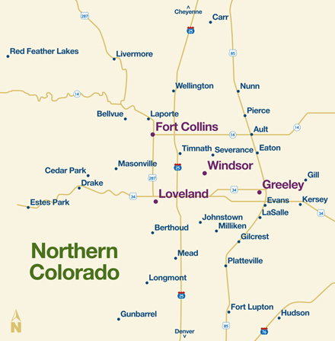
NORTHERN COLORADO ECONOMIC ALLIANCE
WHO?
WHY?
HOW?
1 hour drive from Denver
Less than 1 hour drive from DIA

Slide 3

NCEA Mission
NCEA MISSION
Our primary goal is to market Northern Colorado as a region and to attract and facilitate the relocation of primary employers to the region.

Slide 4








6 Reasons Why Economic Development!
Economic Growth and Sustainability
Maintaining a vibrant economy and economic growth requires ongoing intentional effort. Economic development organizations play a vital role in supporting the needs and well being of existing business and attracting new business and industry that will drive jobs and opportunity in the future.
Advocacy and Leadership
Maintaining a positive business climate is critical to maintaining and growing a healthy economy. NCEA continually advocates for sensible regulation and taxation policies and helps to create a synergistic business environment to capitalize on economic opportunity.
LEAD
GROW
CREATE
Infrastructure Investment
Attracting new business and industry to the region often is accompanied by infrastructure investment that can create additional economic opportunity for business in the region and result in long term resources.
New Business Creation
New business formation is a key differentiator in the economic output of a region. Fostering an environment that encourages entrepreneurship is a vital part of sustaining that culture. Often, new primary employers that locate to the region will create opportunity for both existing and new small business.
INVEST
MAINTAIN
Workforce Utilization
Having and growing job opportunities that fully utilize the skills of the talent in the region is necessary to achieving future economic growth. With robust educational resources and a highly educated workforce, it is important to continue to attract primary employers and better paying jobs to Northern Colorado.
Quality of Life Maintenance
Maintaining the outstanding quality of life we enjoy in Northern Colorado. Is reliant on vibrant economic drivers. As the economy and business is never static, and as business is critical to supporting infrastructure needs, it is essential to always be gardening for future economic opportunity.
UTILIZE

Slide 5































MIGRATION OF THE TOP 10 S&P COMPONENTS
1983
1993
2003
2013
2017

Slide 6










We only just begun the age of disruption!

Slide 8
Every 10% Growth in Utilization Rate is Worth and Estimated $40 to $50 Million in Increased Wages for MSA

Slide 9


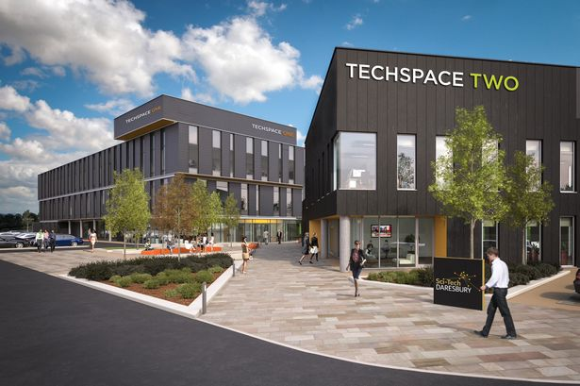


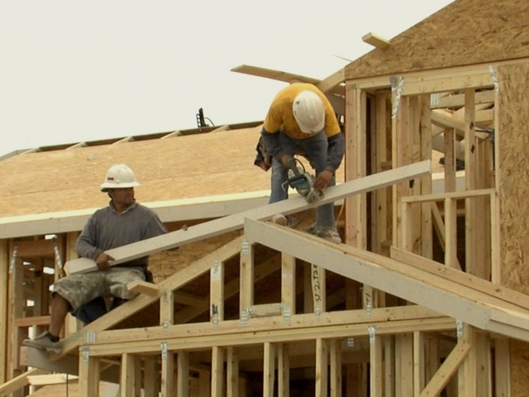
Primary employers provide multiplier in additional jobs

Slide 10



2016 In Review
NEW CEO/MOVE INTO OFFICE
SITE SECTORS GUILD NASHVILLE
OIL AND GAS SEMINAR
IAMC CONFERENCE NEW ORLEANS
ROLL OUT OF WEB SITE AND MARKETING PLAN
ONGOING:
Larimer County Econ Dev Meeting
Denver Econ Dev Meeting
Larimer BR&E
Larimer Workforce
Affordable Housing Committee
NCLA
No Co Manufacturing Association
WINTER
INVESTOR EVENT ROCKIES
MAYORS /CITY MANAGERS BREAKFAST
BROADBAND DINNER
PROSPECT FAMILIARIZATION TOUR
KALAMAZOO TRIP
SPRING
YEAR ONE
LAND AND DEVELOPMENT CONFERENCE
OUTDOOR INDUSTRY CONFERENCE/LEADERSHIP
NOCO CEO VISITS
AEROSPACE CONFERENCE
ADVANCED ENERGY CONFERENCE
DENVER SITE SELECTORS FAMILIARIZATION TOUR
SUMMER
SITE SELCTORS GUILD LITTLE ROCK
IAMC INDIANAPOLIS
CORENET PHILADELPHIA
PROSPECT NO CO TOUR
MINNEAPOLIS TRADE MISSION
SOUTHERN CALIFORNIA SITE SELECTOR VISITS
FALL

Slide 11
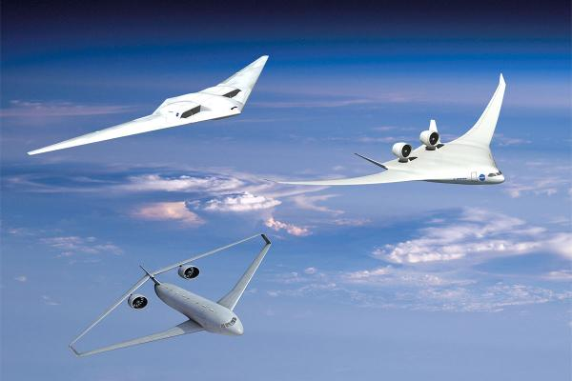



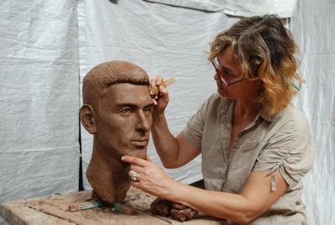


DIVERSITY OF INDUSTRY CLUSTERS IN REGION
AEROSPACE
INFORMATION TECHNOLOGY
ADVANCED MANUFACTURING
BIOSCIENCES
CREATIVE INDUSTRIES
HEALTH AND WELLNESS
ENERGY
FOOD AND AGRICULTURE

Slide 12
Barriers To Primary Industry Growth
Low Unemployment
Housing Costs
Costs of Doing Business
Relocation Decision
WE NEED TO BE ABLE TO TELL THE WHOLE STORY!

Slide 13
NCEA BOARD OF DIRECTORS
Weld County
Larimer County
Scott Ehrlich, Ehrlich Motors (Chairman)
Charlie Monfort, Colorado Rockies
Roger Knoph, Envirotech Services, Inc.
Ed Holloway, Petroleum Management
Royal Lovell, Flood and Peterson
Margo Karsten, Banner Health
Dan Sanders, Front Range Energy
Tom Gendron, Woodward, Inc. (Vice Chairman)
John Pawlikowski, In-Situ, Inc. (Treasurer)
Mark Driscoll, First National Bank
Alison Larsen, Phase 2 Company
Troy McWhinney, McWhinney
Kevin Unger, U.C. Health
Dave Yowell, MM Solutions
Evan Hyatt, Kaiser Permanente

