Slide 1


My Colorado Journey
Career Pathways
Pro15
March 12th, 2020
Thomas Hartman, Ph.D.
Notes:
Thomas Hartman, Ph.D., Colorado Workforce Development Council, Denver, CO
As an undergraduate I studied psychology, as a graduate student I studied counseling and education. I had many behavioral health jobs throughout my academic pursuits, including peer counselor, served children with disabilities, agency counselor, facilitated parents groups, served clients with domestic violence issues, career counseling, college support programs, and now as a Talent Development Consultant.

Slide 2
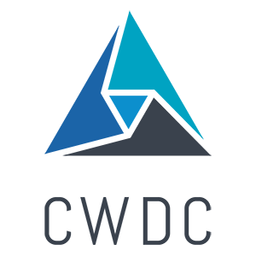
Colorado Workforce Development Council
The vision of the Colorado Workforce Development Council is that every Colorado employer has access to a skilled workforce and every Coloradan has the opportunity for meaningful employment, resulting in individual and statewide economic prosperity.
The CWDC’s mission is to enhance and sustain a skills-based talent development network that meets the needs of employers, workers, job seekers, and learners for today and tomorrow.

Slide 3
Resources
Sector Partnerships
Healthcare and Behavioral Health Career Pathway Development: Regional Forums
My Colorado Journey-Careers in Colorado
CO Helps Grant: Healthcare Apprenticeships
Lives Empowered: Retail Upskilling
Talent Pipeline Report

Slide 4
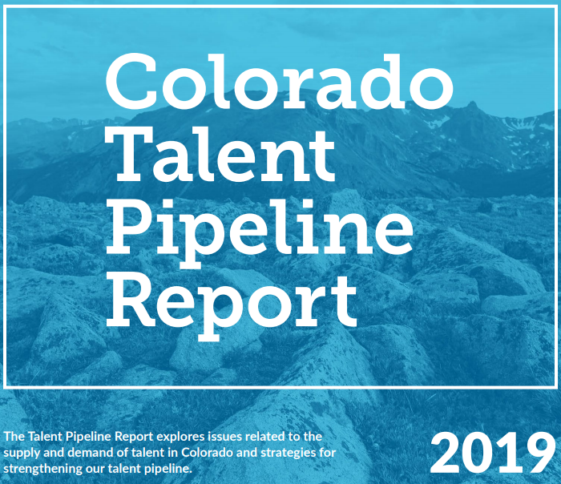
Talent Pipeline Report
Through the analysis of economic demands and
current top jobs, Colorado’s talent supply, and the success of strategies to impact all components of the talent pipeline, this report assesses where Colorado stands in forging a workforce to meet the demands of today and tomorrow.
Notes:
To start to identify critical occupations, we identify key growth industries and the top jobs in those industries utilizing our annual Talent Pipeline Report.

Slide 5
Colorado’s High Growth Industries
Health Care and Social Assistance- 27%
Mining, Quarrying, and Oil and Gas Extraction- 21%
Professional, Scientific, and Technical Services- 19%
Educational Services- 18%
Management of Companies and Enterprises- 16%
Construction- 15%
Accommodations and Food Service- 15%
Top Jobs meet three criteria:
High Annual Openings
Above Average Growth Rates
Provides a Good Wage
Notes:
The Talent Pipeline Report uses labor-market projections from the Colorado Department of Labor and Employment (CDLE) Office of Labor Market Information to identify top jobs in key industries.
Top Jobs are those that meet three criteria: 1. Projected high annual openings (>40) 2. Above-average growth rates (>2.05% per year) 3. A good wage

Slide 6
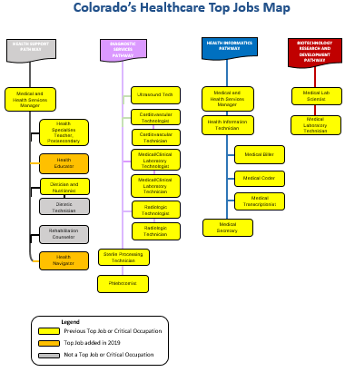
A Career Pathway Map is:
an actual picture or map that tells job seekers what skills they need to attain jobs within the industry and where they can build those skills and credentials.
Notes:
A Career Pathway Map is an actual picture or map that tells job seekers what skills they need to attain jobs within the industry and where they can build those skills and credentials. (Here is an example of a map we used to build the career pathway maps in Careers in Colorado).
The purpose of your career pathway map is:
‣ To serve as a career advisory tool for educators, guidance counselors, workforce development organizations, frontline staff in multiple programs, parents, and students. The map helps students and job seekers identify industries of interest and map out a path that includes the relevant training and work experience to be successful in their chosen career.
‣ To support ongoing collaboration throughout your career pathway system, or the network of education, training, and workforce development organizations that prepare people for jobs in the targeted industry. Your career pathway map acts as a connecting framework across the multitude of private and public education and training institutions responsible for guiding individuals onto a career path, ensuring that partners are playing complementary roles and aligning around industry demand.

Slide 7
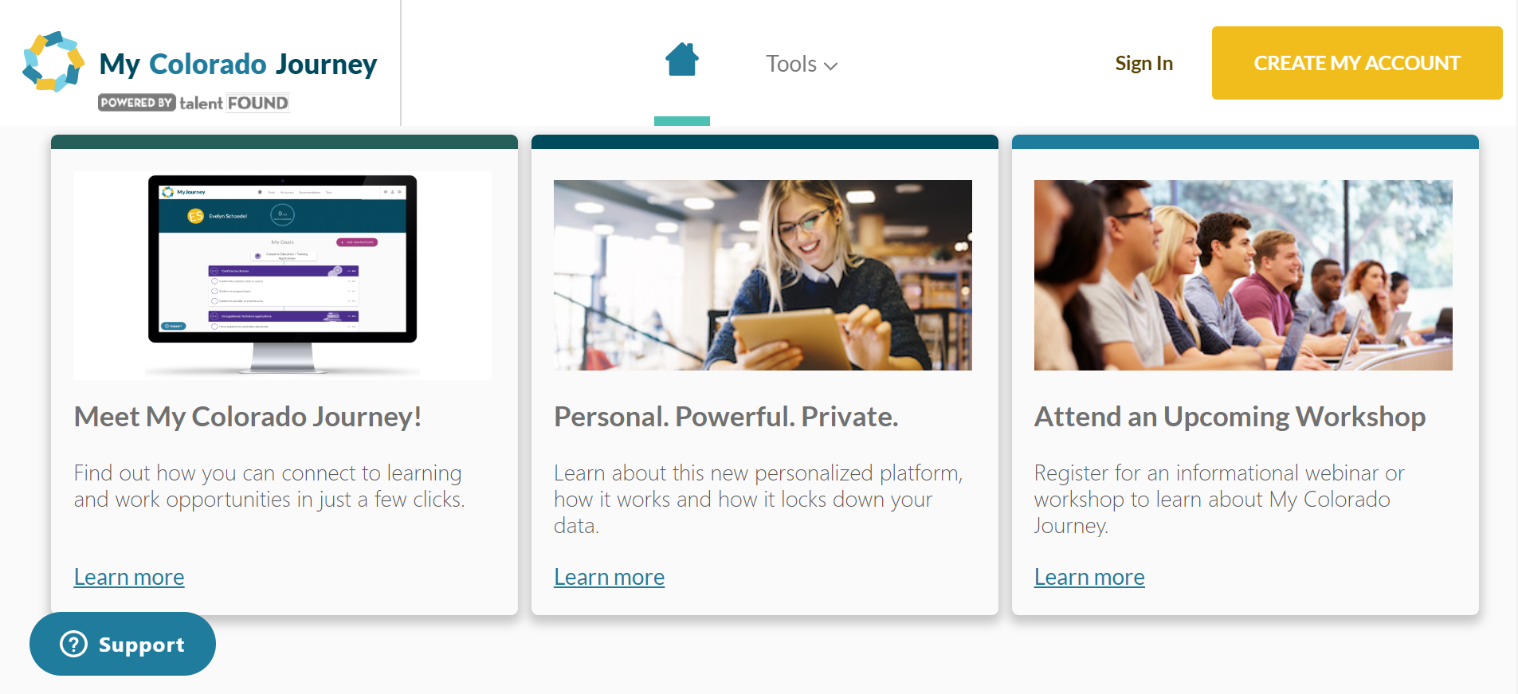
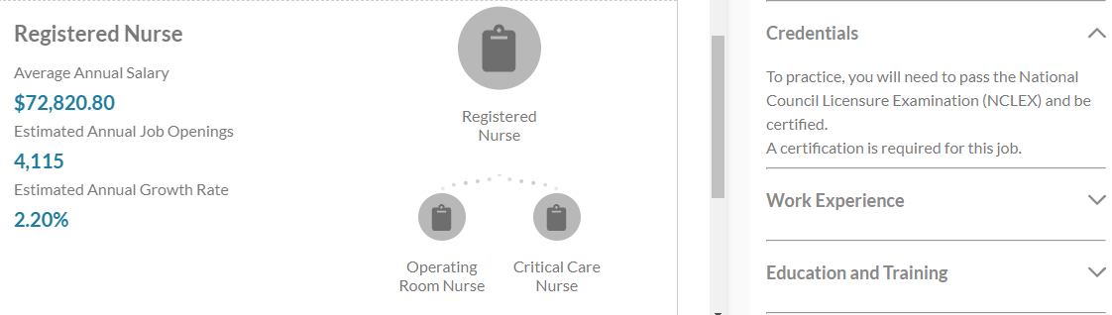
My Colorado Journey & Careers in Colorado
Notes:
The My Colorado Journey platform is a powerful, personal and private platform that provides step-by-step guidance for accomplishing career and education goals, whether it's finding the right job or applying to college. A free resource, My Colorado Journey will soon integrate collaborative case management tools and revamped versions of legacy tools, such as the College Admissions Tool and Money 101.
Careers in Colorado has been reimagined as a tool within the My Colorado Journey suite of tools and resources.
We have career pathways built for Construction, Information Technology, Cybersecurity, Healthcare, Business Operations, and just added this year Education. (Advanced Manufacturing links are included to a seperate platform.)
Careers in Colorado provides:
Introductory overviews and facts about key Colorado industries and regional top jobs
Career pathway maps highlighting individual occupations and career progression options
Information on the knowledge, skills, and abilities required for each occupation
Regionally specific occupational demand and salary data

Slide 8
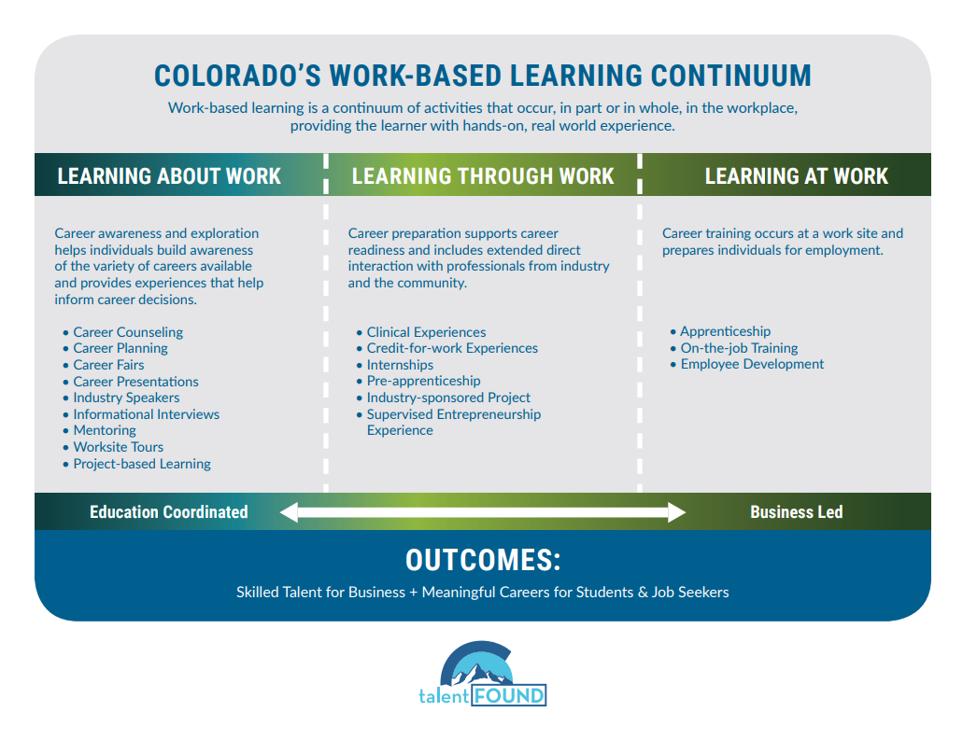
Notes:
Stackable credential and degree programs are communicated to career seekers through career pathway tools.
Work-based learning is another important component of career pathway programs. Work-based learning is a continuum of activities that occur, in part or in whole in the workplace, providing the learner with hands-on, real world experiences. While not a new strategy, work-based learning is one way education and training systems are partnering with business to ensure that students have the skills and career exposure needed to build pathways to meaningful careers.

Slide 9

Thank you & connect with me.
Thomas Hartman, Ph.D., Talent Development Consultant
Colorado Workforce Development Council
633 17th Street
Denver, Colorado 80202
P: (303) 318-8083
Thomas.Hartman@State.CO.US

